Slide 1
ETL Project: Cleaning messy data with MySQL
Demonstrating Extract, Transform, and Load with SQL
Presented by: Ankan Das

Slide 2
Project Overview
Goal: Clean and transform raw e-commerce order data using SQL
Key Steps:
- Extract: Simulate raw data insertion
- Transform: Clean and standardize data
- Load: Store clean data into final structured table
Tools Used: MySQL

Slide 3
Dataset Description
Contains issues such as:
- Inconsistent date formats
- Text values in numeric fields
- Missing and duplicate records
- Negative or null quantities
Final cleaned dataset: clean_data

Slide 4
Extract Phase
Data inserted directly into messy_data table
Simulates importing from a CSV or external source
Sample inserted data included:
- price = 'abc'
- order_date = '23/11/2023', '2023-13-01'
- NULLs and negative numbers in quantity

Slide 5
Transform Phase Part 1
Fixing Price Column:
- Replaced non-numeric values with 0
- Converted price from VARCHAR to DECIMAL
Handling Quantity:
- Converted nulls to 0
- Applied ABS() to remove negatives
- Enforced CHECK constraint for non-negative values

Slide 6
Transform PhasePart 2
Standardizing Order Dates:
- Replaced '/' with '-' for uniformity
- Converted formats using STR_TO_DATE()
- Manually corrected invalid dates
- Cast column to proper DATE type

Slide 7
Transform PhasePart 3
Customer Name Cleaning:
- Replaced NULLs with 'Not found'
- Detected and removed duplicate entries using GROUP BY and DELETE
Other Schema Fixes:
- Set order_id to auto-increment

Slide 8
Load Phase
Created new table clean_data
Proper column types and constraints applied
Inserted clean records from messy_data

Slide 9
Final Result
Cleaned and normalized dataset
Suitable for reporting, analytics, and dashboards
Demonstrates full SQL-based ETL pipeline

Slide 10
Key Takeaways
SQL can be effectively used for ETL.
Data quality issues can be tackled with simple transformations
Automation and integrity constraints are crucial in production

Slide 11
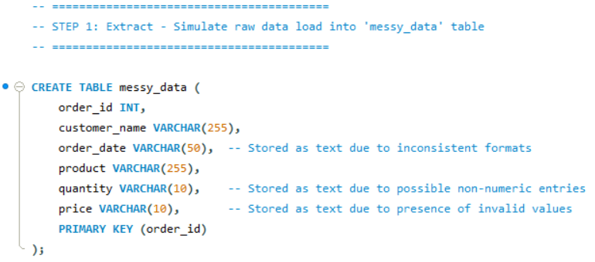
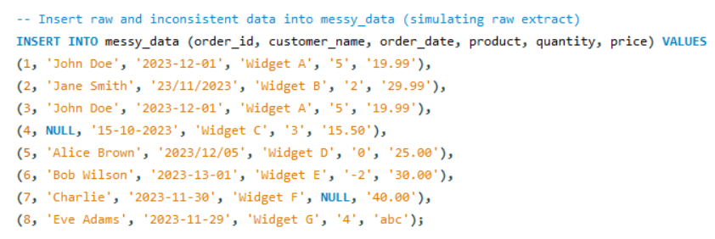

Slide 12
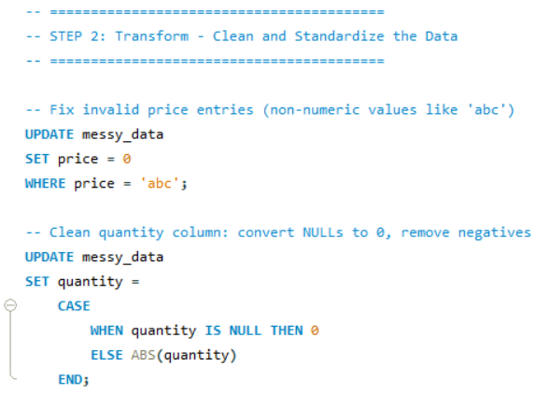

Slide 13
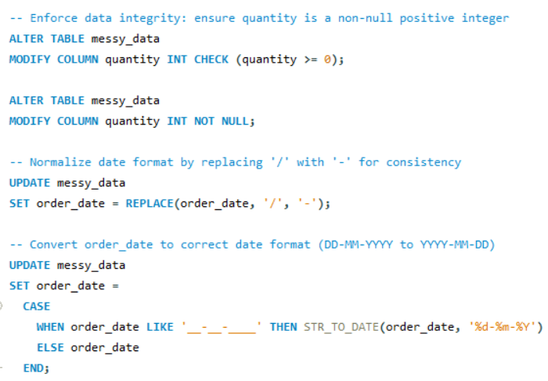

Slide 14
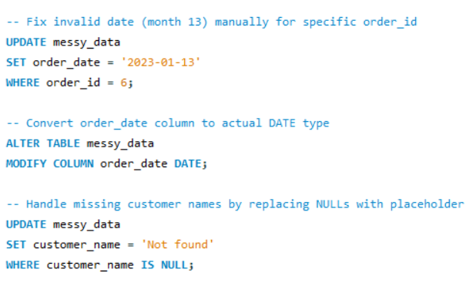

Slide 15
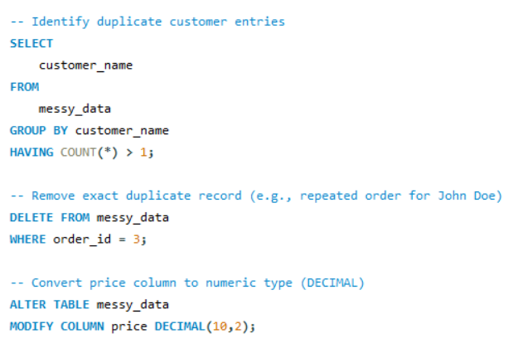

Slide 16
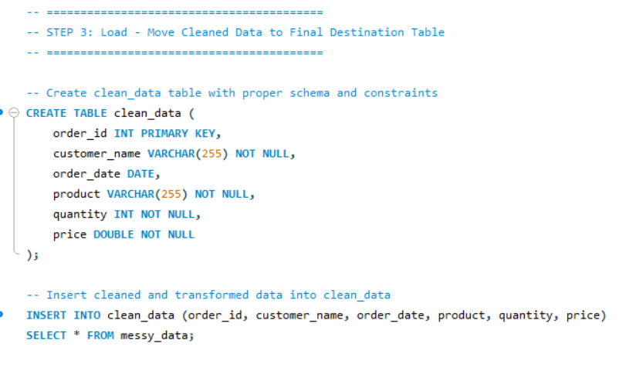

Slide 17
Thank You
Contact: LinkedIn
GitHub : Repository | Profile Link
Email : 21ankandas@gmail.com

