Slide 1






CI Pipeline
Calling pipeline
Application code
Workflow- pipeline
Build
Unit Test
SonarQube Scan
SynK Scan
GHAS Scan
Success
Publish
Publish Docker Image
Publish Helm Chart
Build Artifact
DLL
Sonar report
CD Pipeline
Overwrite chart
Harnes Pipeline
Env variable
Deploy
Dev
Test
Production

Slide 2


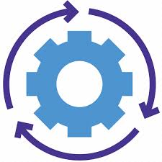
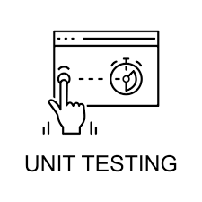

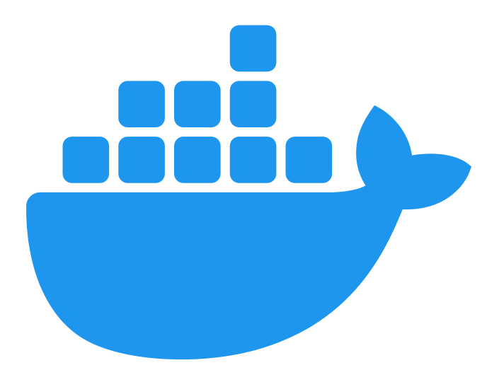


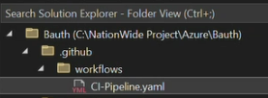

Deployment Flow Diagram
GitHub CI Pipeline and Harness CD Pipeline for Cloud
Dev Cluster
build
unit test
Sonar
Build
Docker Image
Publish Image
Harness CD
Test Cluster
Publish Helm
Package Helm Chart
Prod Cluster
Overwrite Env Helm
GHAS Scan
Scan Report
Code Push to GitHub
Synk Scan
Publish Build
GitHub CI and CD for On-Prem
build
unit test
sonar
Dev Server
Publish Build
Github Action CD
Test Server
GHAS Scan
Synk Scan
Scan Report
Prod Server

