Slide 1
The BCM theory of synaptic plasticity.

Slide 2
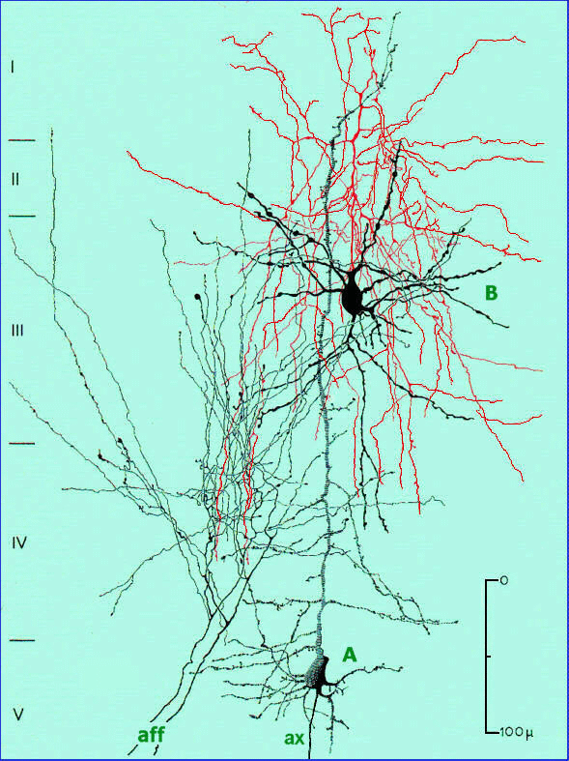
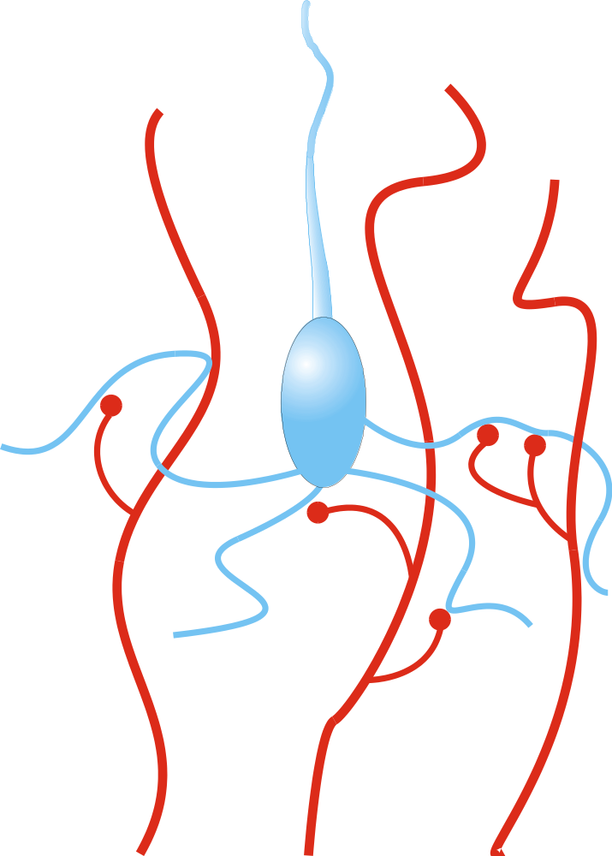
Simple Model of a Neuron
Output
c
Synaptic weights
m
1
m
3
m
2
Inputs
d
d
d
1
2
3

Slide 3
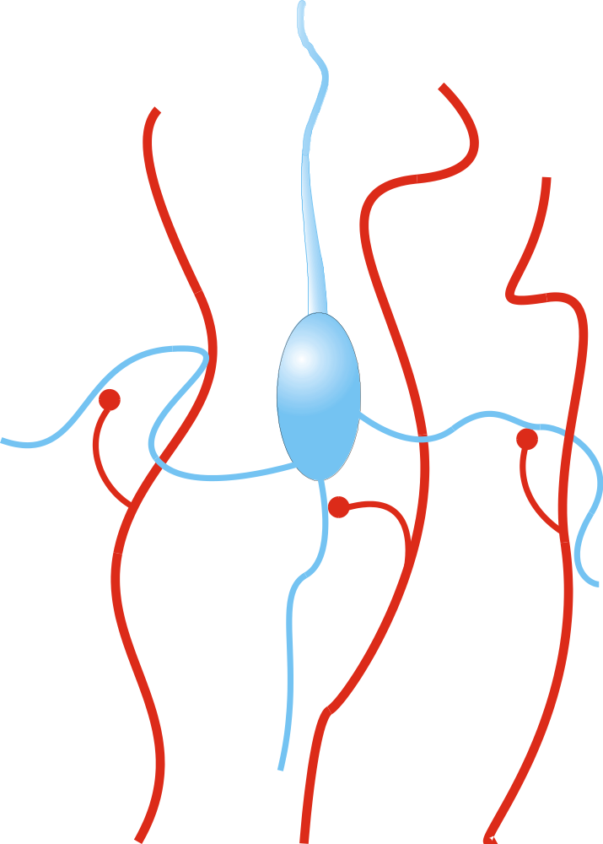
Neuron Activation
Output
c
æ
n
ö
c
=
s
ç
å
m
×
d
÷
è
i
i
ø
(
i
=
1
)
Synaptic weights
=
s
m
×
d
m
»
m
×
d
1
m
3
m
2
s
(
×
)
m
d
m
×
d
Inputs
d
d
d
1
2
3

Slide 4



Synaptic Modification
Output signal
Output increase
Output decrease
c
≈
m
⋅
d
c
c
Synaptic weight
m
m
m
Weight increase
Weight decrease
Input signal
d
d
d

Slide 5
Hebbian Learning
“When an axon in cell A is near enough to excite cell B and repeatedly and persistently takes part in firing it, some growth process or metabolic change takes place in one or both cells such that A’s efficiency in firing B is increased.” - Hebb, 1949
“Those that fire together wire together”
Mathematically:
dm
i
=
cd
dt
i

Slide 6
Stability and Behavior of Hebbian Learning
dm
i
=
cd
dt
i
Unstable as written: requires synaptic decrease
Finds correlations in environment
dm
i
=
cd
dt
i
environmen
t
environmen
t
=
∑
m
d
d
j
j
i
j
environmen
t
=
∑
m
d
d
j
j
i
environmen
t
j
=
∑
C
m
ij
j
j

Slide 7


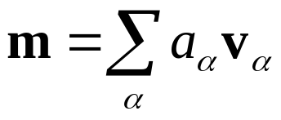
Hebbian Learning and
Principal Components
Matrix equivalent of Hebbian Learning
dm
∑
d
m
i
=
C
m
=
Cm
dt
ij
j
dt
j
Eigenvectors of C, the principle components:
Expand in terms of eigenvectors, :
dm
∑
da
i
=
α
v
dt
dt
α
α
=
∑
a
Cv
=
∑
a
λ
v
α
α
α
α
α
da
α
α
α
=
a
λ
a
(
t
)
=
a
(
0
)
e
λ
α
t
dt
α
α
α
α
Component with largest eigenvalue wins

Slide 8

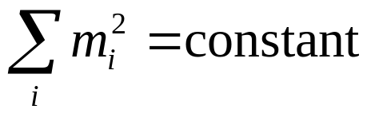



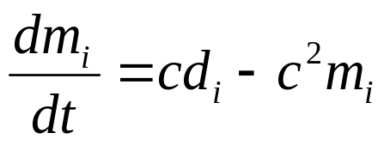
Synaptic Stabilization
Mathematical method implies Biological mechanism
Synaptic weights
Saturation limits
Normalization
Decay terms
Moving threshold
(Linsker 1986;Miller 1994)
(Oja 1982, Blais et. al. 1998)
(BCM 1982, IC 1992; Blais et. al. 1999)

Slide 9
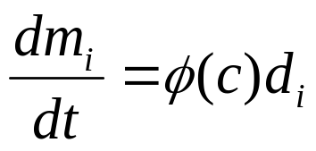







Combining Hebbian and
Anti-Hebbian Learning
A more general Hebbian-like rule
Includes a decrease of weights in
For response increases
For response decreases
Yields selectivity…
… but not stable

Slide 10
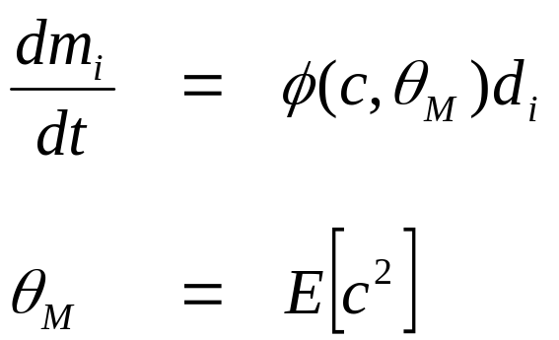

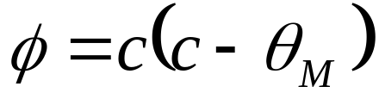
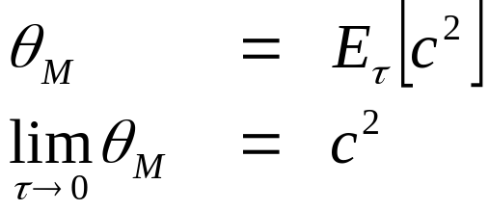
BCM Theory
(Bienenstock, Cooper, Munro 1982;
Intrator, Cooper 1992)
Selectivity learning rule with moving threshold
Time average of the square of the neuron activity
Notes:
Animation of the phi function

Slide 11
BCM Theory
(Bienenstock, Cooper, Munro 1982;
Intrator, Cooper 1992)
dm
j
=
η
d
φ
(
c
,
θ
)
dt
j
M
θ
∝
[
]
=
E
c
2
M
1
t
∫
2
′
−
(
t
−
′
τ
′
€
c
(
t
)
e
t
)
/
d
t
τ
−∞
€
Requires
Bidirectional synaptic modification LTP/LTD
Sliding modification threshold
The fixed points depend on the environment, and in a patterned environment only selective fixed points are stable.
€
LTD
LTP

Slide 12
Is equivalent to this differential form:
The integral form of the average:
1
t
θ
=
∫
c
2
(
t
′
)
e
−
(
t
−
t
′
)
/
τ
d
t
′
M
τ
−
∞
d
θ
1
m
=
(
c
2
−
θ
)
dt
τ
m

Slide 13

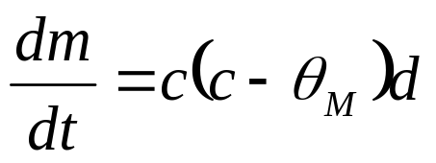

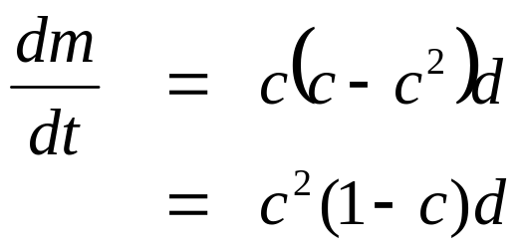


BCM Theory
Stability
One dimension
Quadratic form
Instantaneous limit

Slide 14
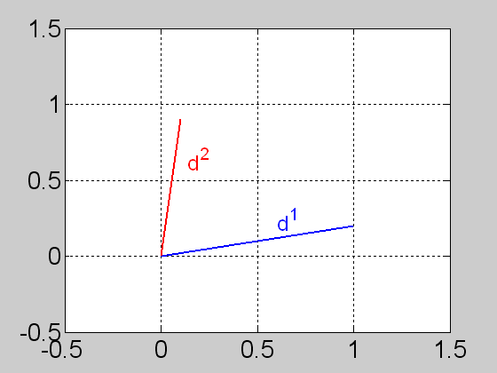
What is the outcome of the BCM theory?
Assume a neuron with N inputs (N synapses), and an environment composed of N different input vectors.
A N=2 example:
What are the stable fixed points of m in this case?
⎛
1
.
0
⎞
⎛
0
.
1
⎞
d
1
=
⎜
⎟
d
2
=
⎜
⎟
⎜
⎟
⎜
⎟
⎝
0
.
2
⎠
⎝
0
.
9
⎠

Slide 15
(Notation: )
c
i
=
m
×
d
i
Note:
Every time a new input is presented, m changes, and so does θm
What are the fixed points? What are the stable fixed points?

Slide 16
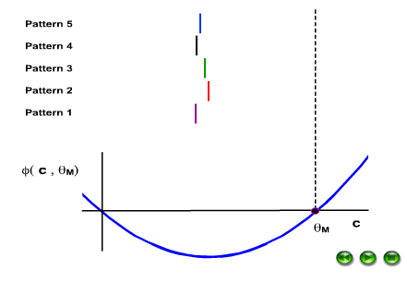
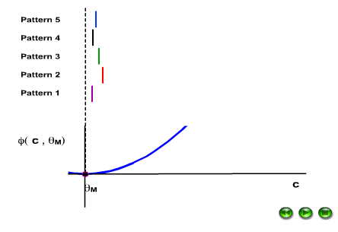
Two examples with N= 5
Note: The stable FP is such that for one pattern c^{i}=md^{i}=θm while for the others
C^{(i≠j)}=0.

Slide 17
BCM Theory
Stability
One dimension
Quadratic form
Instantaneous limit

Slide 18



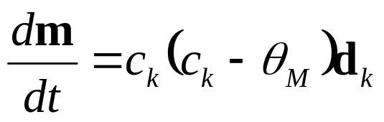
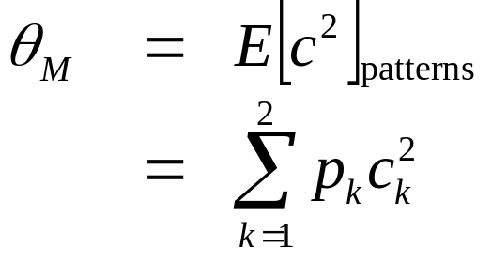


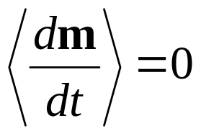
BCM Theory
Selectivity
Two dimensions
Two patterns
Quadratic form
Averaged threshold
,
Fixed points

Slide 19
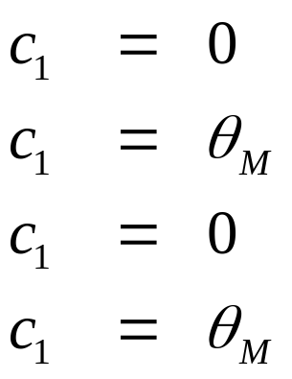
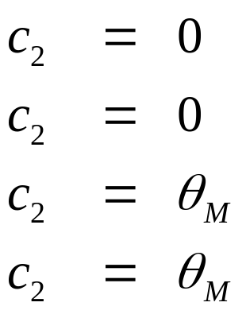




BCM Theory: Selectivity
Learning Equation
Four possible fixed points
(unselective)
,
(Selective)
,
(Selective)
,
(unselective)
,
Threshold

Slide 20
BCM Theory: Stability
Learning Equation
Four possible fixed points
(unstable)
,
(stable)
,
(stable)
,
(unstable)
,
only selective fixed points are stable
Threshold

Slide 21
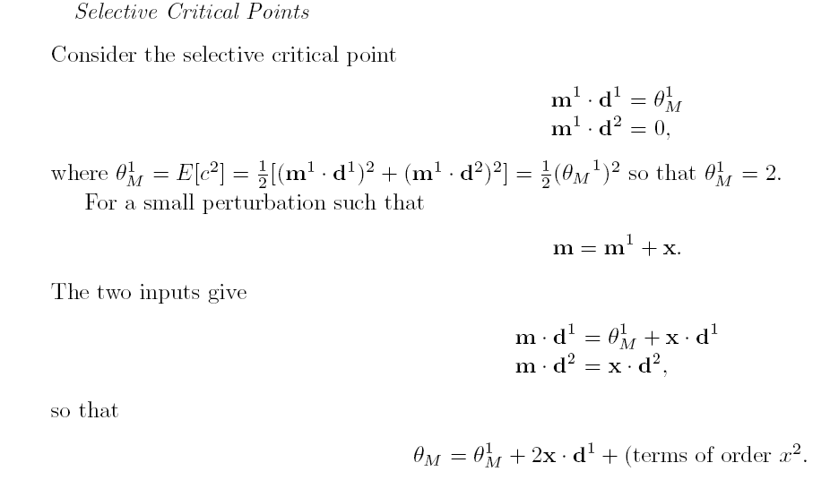

Slide 22
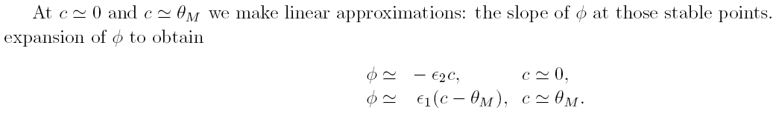
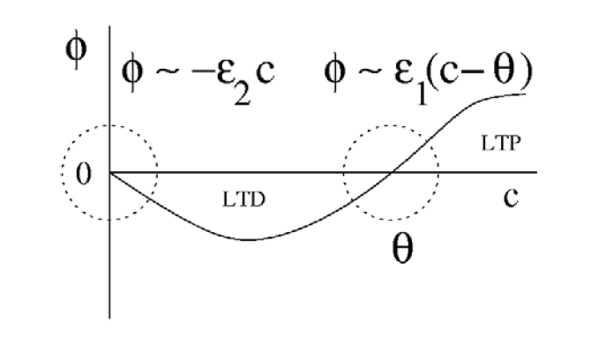
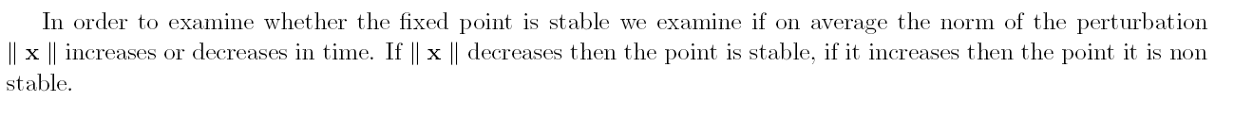

Slide 23
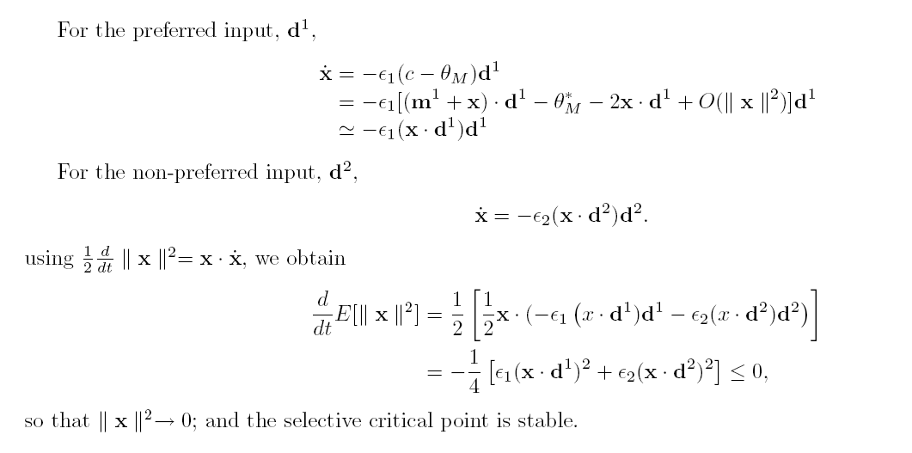

Slide 24
Ex1 - Final Task
Create a BCM learning rule which can go into the Fast ICA algorithm of Hyvarinen.
  Run it on multi modal distributions as well as other distributions.
  Running should be as the regular fast ICA but with a new option for the BCM rule.
  Demonstrate how down in Fisher score can you go to still get separation

Slide 25
Experimental vs. Theoretical Evidence

Slide 26

Left
Right
Left
Right
Tuning curves
Response (spikes/sec)
0
90
180
270
360

Slide 27
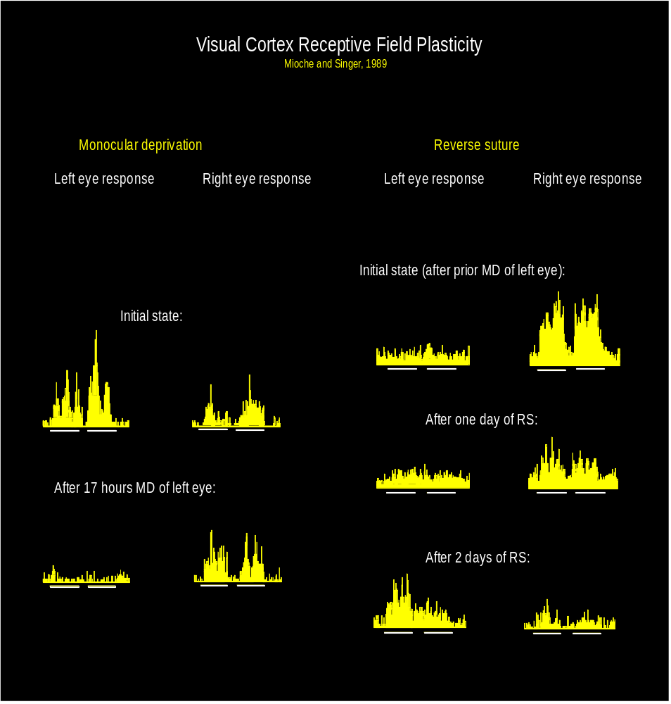
Receptive field Plasticity
Ocular Dominance Plasticity (Mioche and Singer, 89)
Synaptic plasticity in Visual Cortex (Kirkwood and Bear, 94 )
Left Eye Right Eye
S
t
i
m
u
l
a
t
e
R
e
c
o
r
d
1
5
0
LTD
1
2
5
% of baseline
1
0
0
7
5
1
H
z
5
0
-
3
0
-
1
5
0
1
5
3
0
4
5
T
i
m
e
f
r
o
m
o
n
s
e
t
o
f
L
F
S
(
m
i
n
)
2
0
0
LTP
% of baseline
1
5
0
1
0
0
HFS
5
0
-
1
5
0
1
5
3
0
Time (min)
Notes:
The fundamental question is how experience shapes the brain. This broad category includes learning memory and experience dependent development. A mechanism widely believed to form the basis for such changes is synaptic plasticity. We describe a combined theoretical/experimental approach which attempts to bridge these two levels of description.
On the left: an example of how cell in the visual cortex alter their response properties as a result of changing their inputs. This example carried out by Mioche and singer of a well know experimental paradigm pioneered in the early 60’s by Hubel and Weisel. At the top left we see responses from a binocular cell in visual cortex, this cell is dominated by the left eye. This eye is the sutured and after a 17 hours we see that the response of the cell is now dominated by the right eye.
How do such changes come about? It is generally believed that such changes arise from plasticity at the synaptic level. On the right: results that display some plasticity paradigms carried out in the visual cortex. We see here two examples: on the top how synaptic strengths are weakened as a result of low frequency stimulus and on the bottom how they are strengthened as a result of a high frequency stimulus.
These are two different levels of description, how can they be linked?
How do we know if the phenomena we observe at the cellular can indeed account for those observed on the system level?
One such way is theoretical analysis in which we make postulates, based on observation, to describe results on the cellular level and then use theoretical analysis or neuronal modeling to figure out what the consequences of these assumptions are. We can then compare these results to experiments and see if they indeed agree with the experimental results.

Slide 28
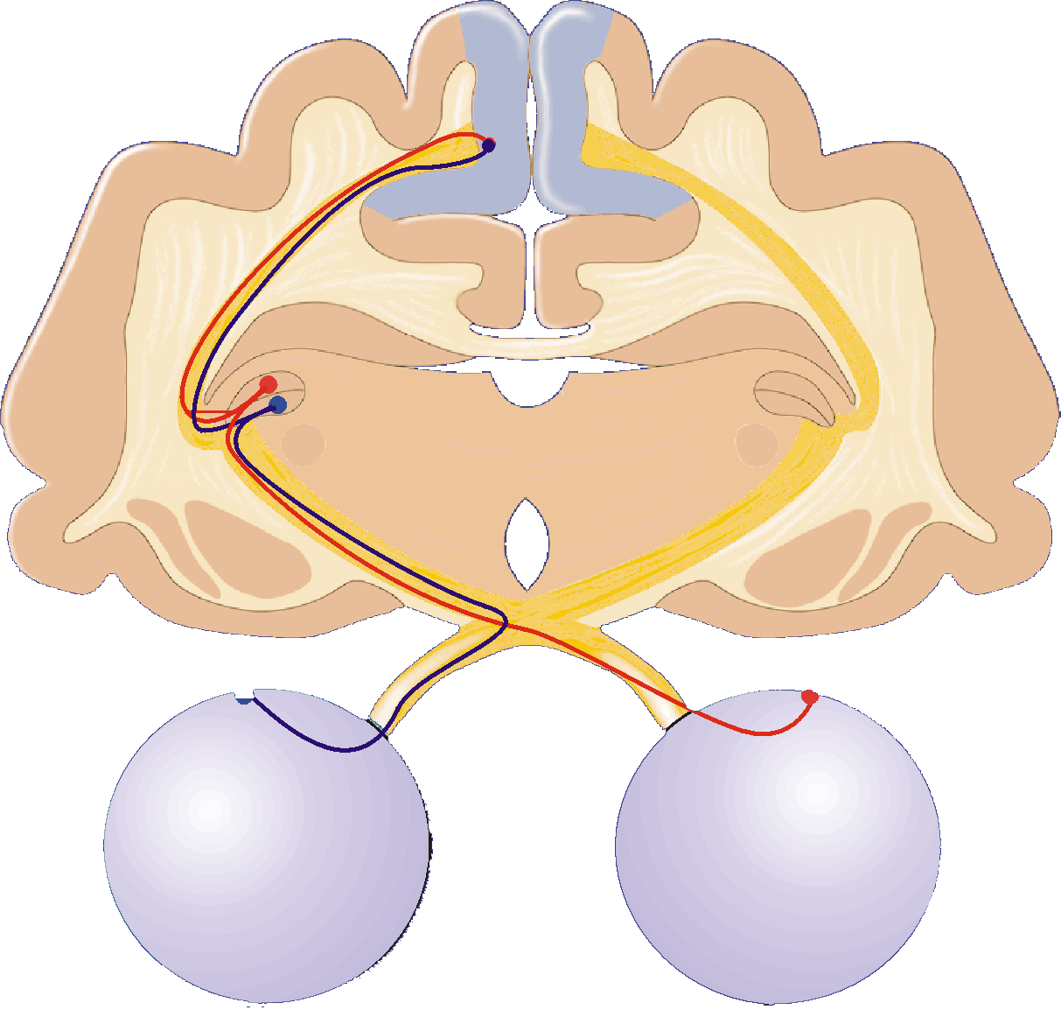
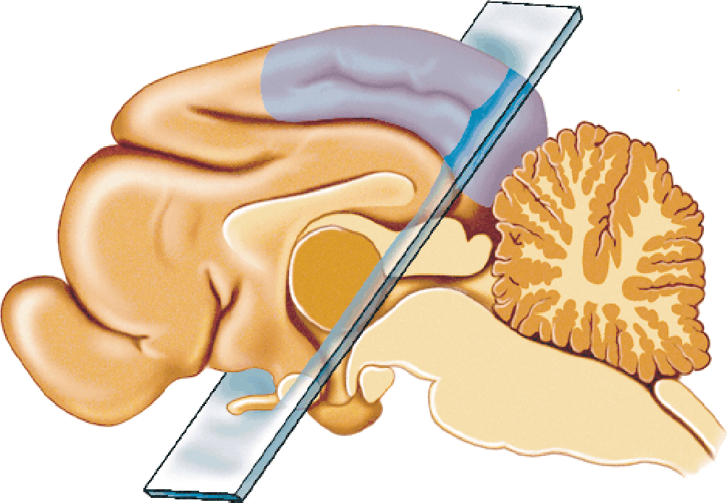
Visual Pathway
Visual Cortex
Receptive fields are:
Binocular
Orientation Selective
Area
17
LGN
Receptive fields are:
Monocular
Radially Symmetric
Retina
light electrical signals
Notes:
I have chosen to use the visual cortex as a model system. It is a good system since there is a lot of experimental data about the VC plasticity and because it is easy to directly control the inputs to the visual cortex.
Now Describe visual pathway
Stress monocular LGN with no orientation selectivity + radially symmetric.

Slide 29
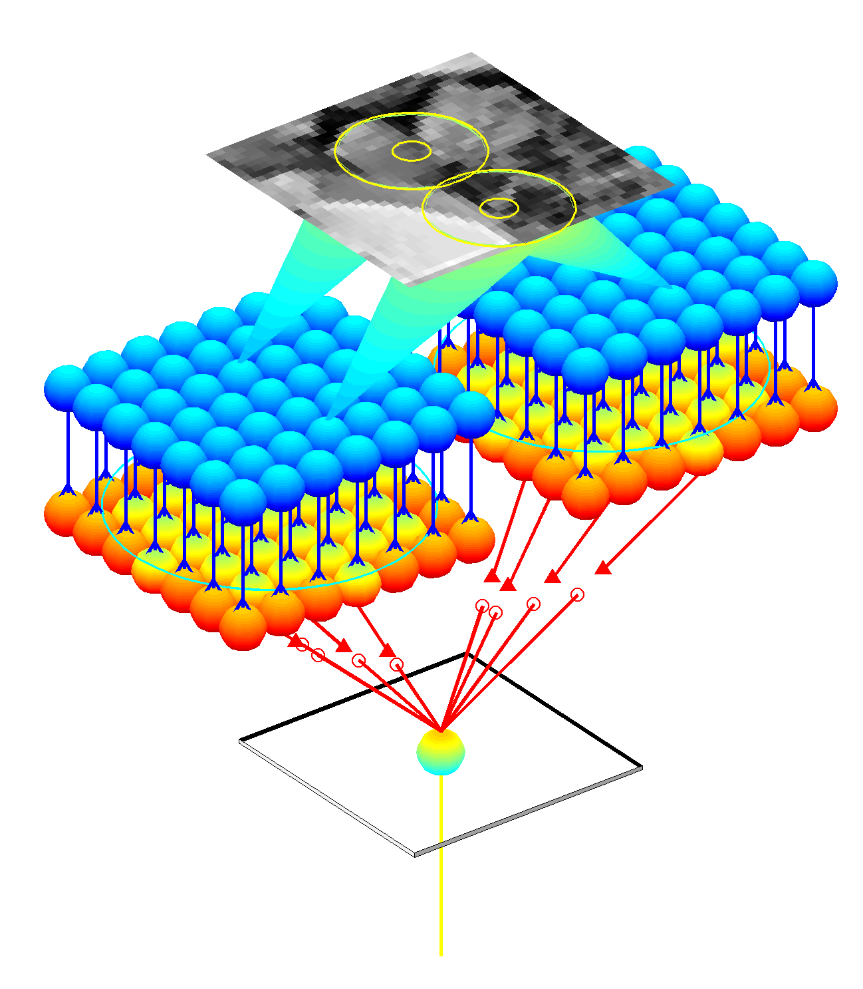
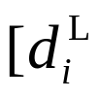
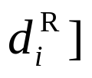

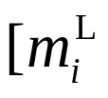
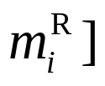

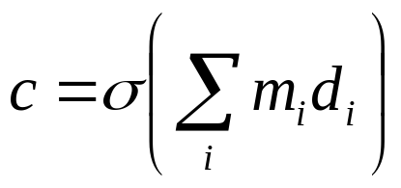
Model Architecture
Image plane
Right Retina
Left Retina
LGN
Inputs
LGN
Right Synapses
Synaptic weights
Left Synapses
Cortex
Output
(single cell)

Slide 30
Orientation Selectivity
Normal
Binocular Deprivation
Adult
Response (spikes/sec)
Response (spikes/sec)
Adult
angle
angle
Eye-opening
Eye-opening
Notes:
It has been established that the maturation of orientation selectivity is experience dependent.
In cats at birth some cells show broadly tuned orientation selectivity. As the animal matures in a
Natural environment it’s cells become more orientation selective (Show images). If an animal is deprived of
A patterned environment it will not develop orientation selectivity and even loose whatever orientation selectivity
It had at eye opening.

Slide 31
Normal
Monocular Deprivation
Left
Right
Right
Response (spikes/sec)
Left
angle
angle
20
30
% of cells
15
10
1 2 3 4 5 6 7
1 2 3 4 5 6 7
group
Rittenhouse et. al.
group
Notes:
Cells in visual cortex show varying degrees of ocular dominance. Cells can be classified by their degree of ocular dominance.
Point to OD and explain. If an animal is monocularly deprived by lid suture it alters the OD histogram – as seen in first slide etc.
Show OD histogram.

Slide 32
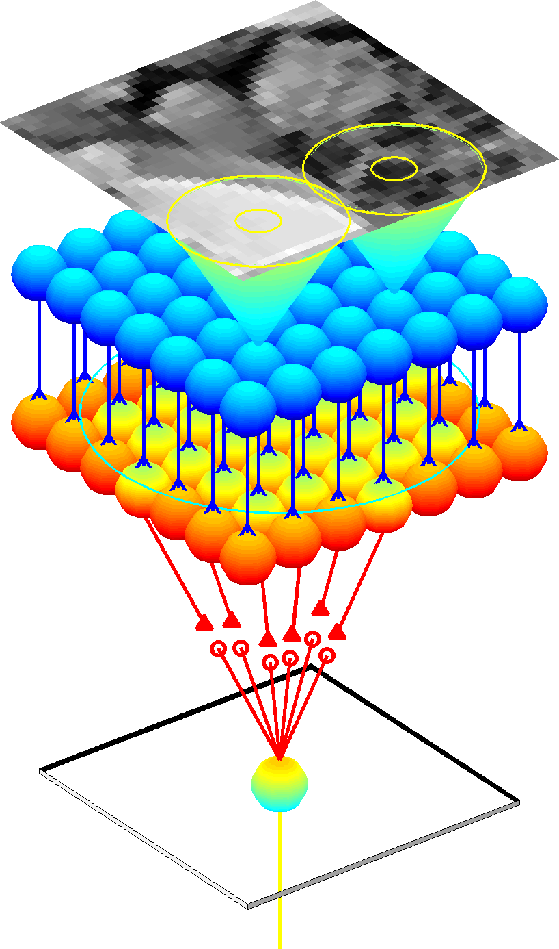
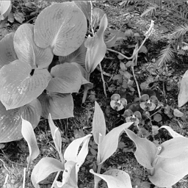
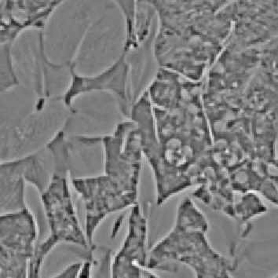
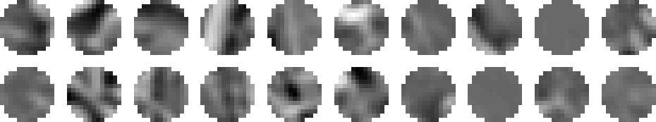
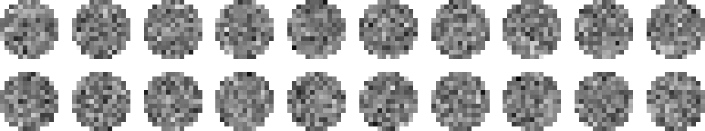
Natural Images, Noise, and Learning
image
retinal activity
present patches
update weights
Patches from retinal activity image
Patches from noise

Slide 33

Cortical Properties and Synapses
Synaptic weights output properties
Orientation selectivity
  responds to bars of light at a particular orientation
  elongated regions of strong synapses
(Mioche, Singer 1989)
Binocularity
  responds to both eyes
  similar synapse configuration from each eye
20
15
N=33
Number of cells
10
5
0
Left
Both
Right

Slide 34

Hebbian Learning and Orientation Selectivity
Orientation selectivity
  responds to bars of light at a particular orientation
  elongated regions of strong synapses
experiment
simulation

Slide 35
BCM Learning and Orientation Selectivity
Orientation selectivity
  responds to bars of light at a particular orientation
  elongated regions of strong synapses
experiment
simulation

Slide 36


Binocularity
Hebbian Learning
Right Eye
Left
Right
Left Eye
BCM Learning
Right Synapses
Left Synapses
Left
Right

Slide 37






Orientation selectivity and
Ocular Dominance
PCA
Right Eye
Left Eye
Left
Right
100
50
0
Right Synapses
100
50
Left Synapses
0
No. of Cells
100
50
0
100
50
0
1
2
3
Bin
Notes:
Can PCA neurons exhibit both Orientation selectivity and varying degrees of OD?
Explain model on left then results on the right – observation RF’s are always binocular
And have certain symmetry to them.
Can prove it must be so by symmetry arguments.

Slide 38








BCM neurons can develop both orientation selectivity and varying degrees of Ocular Dominance
100
Right Eye
50
0
Left Eye
100
50
0
No. of Cells
Right Synapses
40
Left Synapses
20
0
100
50
0
1
2
3
4
5
Bin
Shouval et. al., Neural Computation, 1996
Notes:
Can BCM neurons attain both ocular dominance and orientation selectivity -> YES show results!
Have also shown direction selectivity.
We can show there are several other varients of these rules that can attain similar results. Some are stabilized by a sliding threshold and others by a heterosynaptic LTD -> How can we distinguish between these families. Let us go back to the experimental paradigm of MD and explain how each of these two families of rules can account for MD.

Slide 39
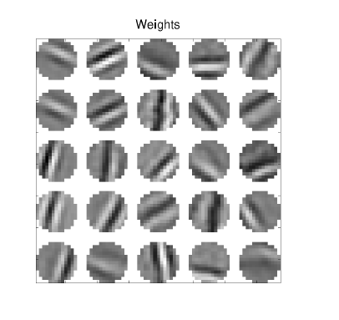
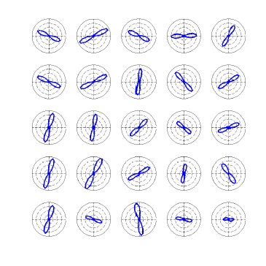
Resulting receptive fields Corresponding tuning curves

Slide 40
Cortical Properties and Synapses
(Mioche, Singer 1989)
Monocular deprivation (MD)
  in 12 hours, responds more strongly to open eye
  synapses from closed eye weaken
Binocular deprivation (BD)
  in 3-4 days, responses are smaller from both eyes
  all synapses are weakened, but more slowly than MD
20
N=33
15
Number of cells
10
5
0
Both
Right
Left
(adapted from Freeman et. Al. 1981)
N=42
Selectivity
0
1
2
3
4
5
6
Days

Slide 41
Observation
Loss of response during Monocular Deprivation is much more rapid than during Binocular Deprivation. (Hubel and Wiesel, 1963, 1965)
Therefore the two eyes compete for limited resources.
Mechanism: Synaptic competition.
Notes:
A single observation that the rate of disconnection of the deprived eye during MD
Is much faster than the rate of loss of orientation during BD has lead to a very influential
Set of theories about mechanism of leading to MD.
Synaptic competition!

Slide 42

Synaptic Competition and Monocular Deprivation
Normalization implies competition
  for weights to increase, others decrease
Monocular deprivation (MD)
    open eye weights are driven up
  closed eye weights are driven down
  more activity in closed eye reduces driving force
No competition in binocular deprivation
open eye
response
closed eye
time
(Mioche, Singer 1989)
20
N=33
15
Number of cells
10
5
0
Both
Right
Left

Slide 43
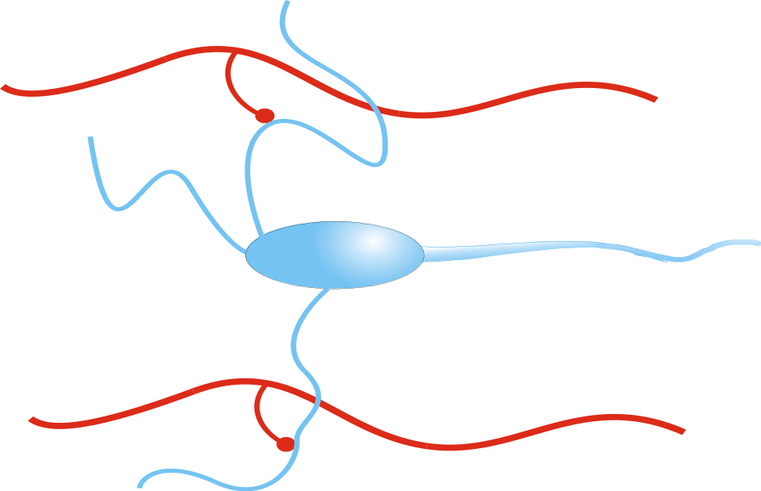




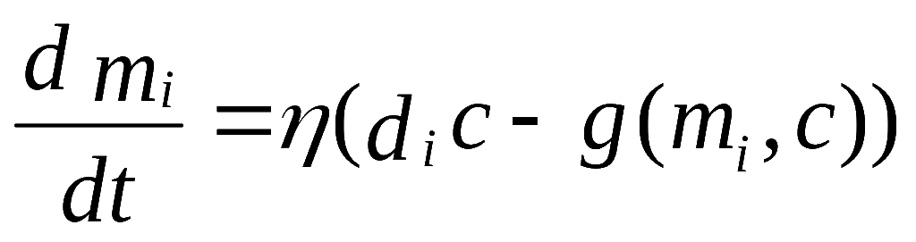
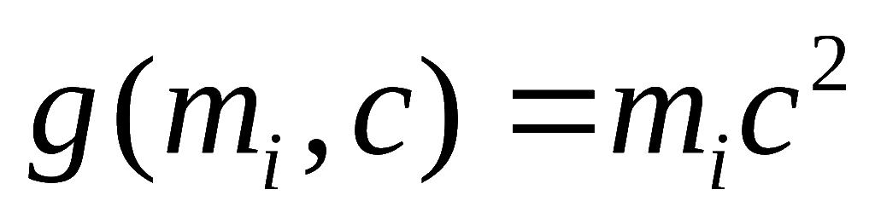
| || | || |
| | || | |
| | |
A stabilized Hebb rule:
{
Heterosynaptic LTD
If
Oja rule (PCA)
Many variants: Stent (73), von der Malsburg (73), Miller (89) ...
Notes:
Here we see a schematic diagram of a neuron- m –weights, d inputs c firing rate/ postsynaptic depolarization.
Many theories of synaptic plasticity stem from the Hebb rule: It is well known that the Hebb rule is unstable ->
An appropriate decay term can stabilize them. This term also contributes to the disconnection of the close eye in MD.
Explain why this is heterosynaptic.

Slide 44

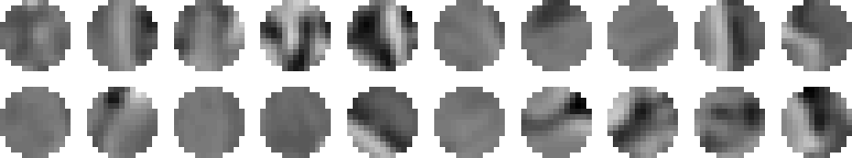
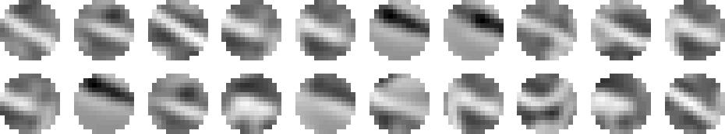


BCM Theory and Monocular Deprivation
Temporal competition between incoming patterns
For a selective neuron, most responses are…
open eye
response
closed eye
~ 0 for non-optimum patterns
~ for optimum patterns
time
θ
M
Linear approximation of
φ
(
c
)
φ
(
0
)
≈
−
ε
c
2
φ
(
θ
)
≈
+
ε
(
c
−
θ
)
M
1
M

Slide 45

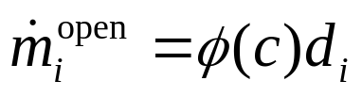

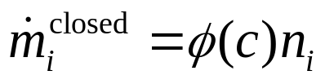
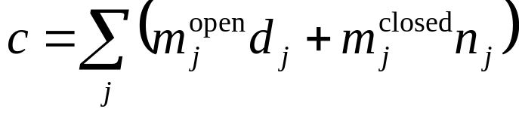
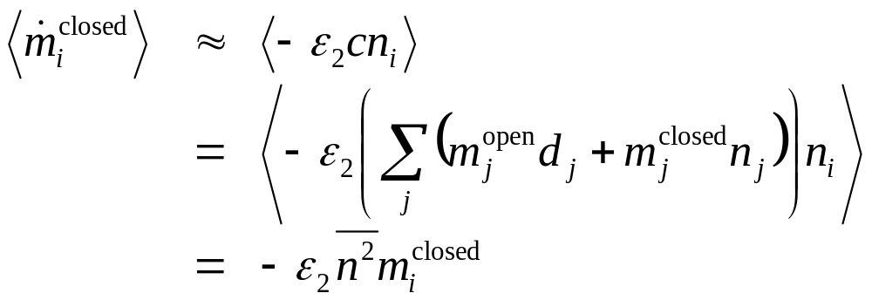

BCM Theory and Monocular Deprivation
Pattern into open eye,
Noise into closed eye,
Output depends on pattern and noise
Two cases of patterns into the open eye
  non-optimum patterns
  optimum patterns

Slide 46



BCM Theory and Monocular Deprivation
Two cases of patterns into the open eye
  non-optimum patterns
  optimum patterns
For a selective neuron,
closed eye weights decrease
more activity in the closed eye increases the effect

Slide 47
Summary of Theory
weak activity
strong activity
Synaptic competition
  more activity into closed eye decreases shift in responses toward open eye
BCM Theory
  more activity into closed eye increases shift in responses toward open eye
Number of cells
Right
Both
Left
Right
Both
Left
Number of cells
Right
Both
Left
Right
Both
Left

Slide 48
Experiment and Theory
weak activity
strong activity
160
160
Rittenhouse et. al. 1999
  TTX in retina
  consistent with BCM
120
N=238
120
N=273
Number of cells
80
80
40
40
0
Right
Both
Left
0
Right
Both
Left
Synaptic competition
Number of cells
Right
Both
Left
Right
Both
Left
BCM Theory
Number of cells
Right
Both
Left
Right
Both
Left

Slide 49


Monocular Deprivation
Homosynaptic model (BCM)
Low noise
High noise
Notes:
Lets now see an example of a simulation of an MD experiment. Here we show how the rate of disconnection of a BCM neuron depends on the level of the noise in the deprived channel. Starting from a perfectly binocular state – as show by both the tuning curves and the receptive fields above. MD results in a disconnection of the deprived eye – here.
If the degree of noise is larger as seen below, the disconnection is faster.

Slide 50


Monocular Deprivation
Heterosynaptic model (K2)
Low noise
High noise
Notes:
In this heterosynaptic model – K2 based on a substractive measure of Kurtosis – a statistical measure of deviation from a normal distribution, the situation is reversed.

Slide 51
Summary
Theoretical predictions
Heterosynaptic mechanisms: Loss of response in Monocular Inactivation is faster than in Monocular lid Suture
Homosynaptic mechanisms: Loss of response in Monocular lid Suture is faster than in Monocular Inactivation
Experimental results
MS faster than MI
Homosynaptic
Notes:
Read out

Slide 52


Networks of BCM Neurons
BCM Synaptic Plasticity.
Binocular natural image inputs.
Radially symmetric lateral connectivity.
strength
distance
Shouval et. al., Vision Research, 1997
Notes:
People for whom this talk is the first neuroscience talk they heard might be under the impression that there is but one neuron in the cortex.
There is a little more than that. Here I show results of some simulations we carried out several years ago of networks of interacting BCM neurons that interact via radially symmetric center surround interaction – short range excitatory long range inhibitory.
The resulting network is shown on the right. Each box represents a single neuron, the bar codes for it’s preferred orientation and the color of the background for it’s OD –black right eye, white left eye. It shows some of the properties of cortical maps relatively smooth transitions in preferred orientation and similar OD classes are grouped together. However it does not agree with the details of cortical maps.

Slide 53



Two identical networks with different initial conditions
Notes:
Here is another way of encoding orientation maps by color. This panel is the key to the color code for example a horizontal orientation is coded by red. Here we display two orientation maps that were extracted by identical networks that differed only in their initial conditions. This is what physicists call a spontaneous symmetry breaking. Keeping this result in mind you will understand why I was very surprised by the following experimental results.

Slide 54
Summary
Both stabilized Hebb rules and BCM can account for orientation selectivity.
BCM neurons show varying degrees of Ocular Dominance.
Theoretical analysis and Experimental evidence indicate that Homosynaptic LTD is the mechanism of ocular dominance plasticity.
Structured long range connections, as observed in cortex, can account for the stability of orientation maps.
Notes:
Read out summary.
Importance of theory!! And a close collaboration between theory and experiment.

Slide 55
Conclusions
Models of Synaptic Modification
  differ by methods of synaptic stabilization
  synaptic competition
  BCM theory: moving threshold
Reproduce deprivation experiments
Dynamics of monocular deprivation
  experiment to distinguish learning rules
  Rittenhouse et. al. 1999 consistent with BCM

Slide 56



Different levels of description
Molecular
Synaptic
Cellular
System/Maps
1
5
0
LTD
1
2
5
1
0
0
Theoretical
Framework
% of baseline
7
5
1
H
z
5
0
-
3
0
-
1
5
0
1
5
3
0
4
5
T
i
m
e
f
r
o
m
o
n
s
e
t
o
f
L
F
S
(
m
i
n
)
Notes:
IN the previous slide I described some of the specific conclusions of my research. I would like to conclude with more general comments.
Neurobiology is a complex filed spanning many levels of description; molecular, synaptic, cellular and system. How can these different levels be linked? How can we know if results we observe on the molecular level can account for results observed on the synaptic level? I hope the examples I described helped convince you that one way of doing this is using a theoretical framework. Although many biologists do have an implicit theoretical framework it is usually not formulated mathematically and can lead to ambiguous results. The complex field of neurobiology requires well formulated mathematical theories. However it is essential that these theories be be based on assumptions that are sufficiently detailed and realistic so they can be experimentally tested, to do that a strong and intimate knowledge of experimental neurobiology is required.

Slide 57




Orientation Selectivity of Stabilized Hebb Neurons
Using the Oja rule (PCA)
Power Spectrum:
Size and shape of retinal filter
Size of receptive field
Theory
Simulations
Shouval and Liu. Network., 1996
Notes:
The case of Oja neurons – which extract the principal components is quite appealing the a theorist because
It amounts to solving an eigenvalue equation II) because we know what the power spectrum of the correlation function is.
This work is based on an expansion of the power spectrum and the receptive fields in a fourier-bessel basis.
Have orientation selectivity but RF’s are broadly tuned.

Slide 58










PCA Neurons: Two-eye Parity
r
l
S
r
r
PCA Neurons are always binocular!
Notes:
Receptive fields are perfectly binocular because the correlation matrix Q is symmetric under a 2 eye parity transform.
The standard parity transform send point r to point –r . Here se also exchange the two eyes I.e send s-> -s. The correlation function is invariant under this and this implies a certain form to the eigenvectors.

Slide 59












Monocular Deprivation
| | | | | ||
Open Eye
(pattern vision)
| || | || |
| | || | |
| | | |
Deprived Eye
(noise)
| | |
BCM:
MD
Notes:
I will now give an account of how heterosynaptic and homosynaptic models account for MD.
In a heterosynaptic model as the synapses from the more active/non-deprived eye are potentiated by the
Hebbain term, other synapses are depressed in order to keeo the norm of the weights approxiamtly constant.
In the absence of any presynaptic activity in the deprived channel these weights would still depress due to the heterosynaptic LTD term.
In a homosynaptic model such as BCM on the other hand, activity in the open channel would sometimes result in LTP and other times in LTD. Activity in the deprived channel however is uncorrelated and is unrelated to the structure of the RF. It is therefroe unlikely to reach the LTP threshold – resulting in a net depression of that channel. The larger the level of the noise in this model, as long as it is not strong enough to elicity LTP, the faster the disconnection.

