Slide 1
FairyTED: A Fair Rating Predictor for TED Talk Data
Rupam Acharyya, Shouman Das, Ankani Chattoraj, Md. Iftekhar Tanveer
Notes:
Good morning/afternoon/evening everyone. My name is Rupam and today I will tell you about a fair rating predictor for TED talk data. This is joint work with …...

Slide 2
Outline
Importance of fairness in ML/AI and why choose TED talk dataset
Race and gender bias in TED talk ratings
Counterfactual Fairness
Use counterfactual fairness to mitigate unfair rating in TED talk
Influence and impact of fair prediction in TED talk and alike datasets
Notes:
First I will ... followed by that I will.. then I will.....and finally I will.. so lets start with the first point

Slide 3
Outline
Importance of fairness in ML and why choose TED talk dataset
Race and gender bias in TED talk ratings
Counterfactual Fairness
Use counterfactual fairness to mitigate unfair rating in TED talk
Influence and impact of fair prediction in TED talk and alike datasets
Notes:
First let us talk about …...

Slide 4
Why care about Fairness?
Increase in awareness about fairness in various domains:
criminal justice system, job applications, evaluate human’s social skill
Our goal: fair rating prediction in the TED talk
cover a wide variety of topics
influence audience by educating and inspiring them
consists of speakers from a diverse community (age, gender and ethnic attributes)
ratings are provided by spontaneous visitors to the TED talk website
Our technique:
identify the sensitive attributes causing bias
mitigate the bias using counterfactual fairness
Notes:
Over the past years ML/AI researchers have acknowledged the need to build algorithms and architectures that ensure fairness in prediction besides improvement of accuracy
We here choose the TED talk dataset to develop a fair prediction system. Diversity of speakers and raters make it a plausible ground for existence of bias and because of its wide outreach such bias mitigation is important.
To the best of our knowledge not much work has been done on fairness in public speech ratings
So there are two main steps towards achieving our goal, first, identifying..... and second, devising a setup using counterfactual fairness to mitigate bias

Slide 5
Outline
Importance of fairness in ML and why choose TED talk dataset
Race and gender bias in TED talk ratings
Counterfactual Fairness
Use counterfactual fairness to mitigate unfair rating in TED talk
Influence and impact of fair prediction in TED talk and alike datasets
Notes:
So lets first talk about what types of bias we found in TED talk ratings

Slide 6
Dataset
We crawled the website to obtain data from 2400 videos
Sensitive attributes S: race and gender, annotated using M-turk
Data attributes X include:
transcript T for each talk using word2vec embedding
view count V for each talk by normalizing with total views
14 rating labels Y = (y₁ ,…, y₁₄) binarized w.r.t median

Slide 7
Quantify unfair bias in TED talk dataset
Bias or unfairness w.r.t. S (race and gender of the speaker) for 14 binarized rating labels using
statistical parity difference (SPD)
SPD = P(y_{i} = 1|S ∈ Grp 1) − P(y_{i} = 1|S ∈ Grp 2)
disparate impact (DI)
DI = P(y_{i} = 1|S ∈ Grp 1) / P(y_{i} = 1|S ∈ Grp 2)
Greater SPD and DI indicates bias in favor of Grp1 compared to Grp2
source tool-kit AIF360 (Bellamy et al.2018),(Biddle 2006) ​
Notes:
Bias or unfairness in our preprocessed dataset w.r.t. S(race and gender of the speaker) for each of the 14 binarized rating labels using two known metrics.
The statistical parity difference metric and the disparate impact metric.
Both these metrices compute how likely it is for group1 to obtain a particular rating label more or less than group2.
Note that greater the value SPD and DI, greater is the bias in rating label in favor of group1 as compared to group 2.

Slide 8
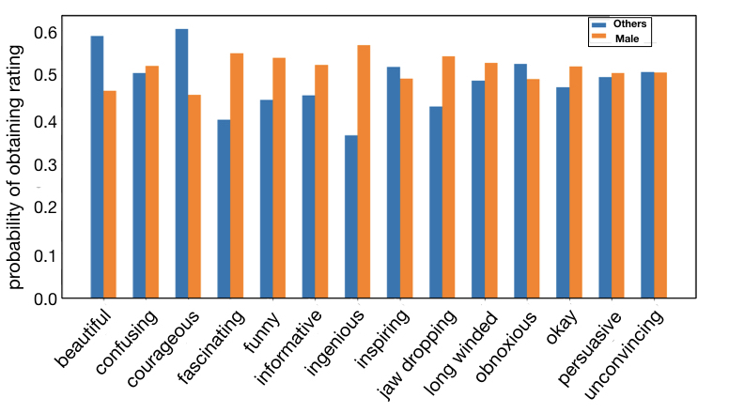
Unfair rating bias w.r.t race and gender
Notes:
Here we compare male speakers with speakers of other gender.

Slide 9
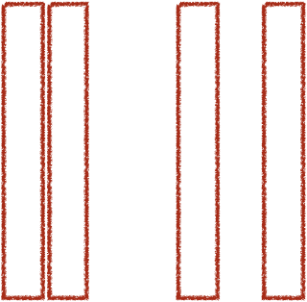
Unfair rating bias w.r.t race and gender
Notes:
We observe that talks from male speakers are rated ingenious, fascinating and jaw dropping with greater probability. This identifies some classic instances of bias in data arising from social norms and structures.

Slide 10
Unfair rating bias w.r.t race and gender
Notes:
.
However, not all bias observed in data are against the presumed unprivileged community, for example, speakers from other genders get higher probability for courageous label as compared to male speakers.
Our goal is to remove all types of bias from data, both expected and unexpected.. So how do we remove any such bias prevailing in the data?

Slide 11
Outline
Importance of fairness in ML and why choose TED talk dataset
Race and gender bias in TED talk ratings
Counterfactual Fairness
Use counterfactual fairness to mitigate unfair rating in TED talk
Influence and impact of fair prediction in TED talk and alike datasets
Notes:
This brings us to the thrid part of the talk, the idea of counterfactual fairness

Slide 12
Why Counterfactual fairness?
The counterfactual fairness is agnostic to the type of bias.
Counterfactual fairness implies group fairness.
Goal of counterfactual fairness with example:
if we observe that talks given by white male speakers are rated to be fascinating with a probability of 0.6 then counterfactually assigning the same talk content and other attributes to white females, say, should not change the probability from 0.6 significantly
Counterfactual fairness is applied on a causal model.
Kusner et al. (2017)
Notes:
Well there are many ways in which such a system can be made fair, so why choose counterfactual fairness:
First because counterfactual fairness is agnostic to the type of bias and aims to remove all possible unfairness in rating across all possible combinations of sensitive attributes.
And second it can be shown that under suitable assumptions, counterfactual fairness implies group fairness.
Let me try to explain the goal of counterfactual fairness with an example.......
In order to apply the notion of counterfactual fairness we need to define a causal model for TED talk ratings

Slide 13
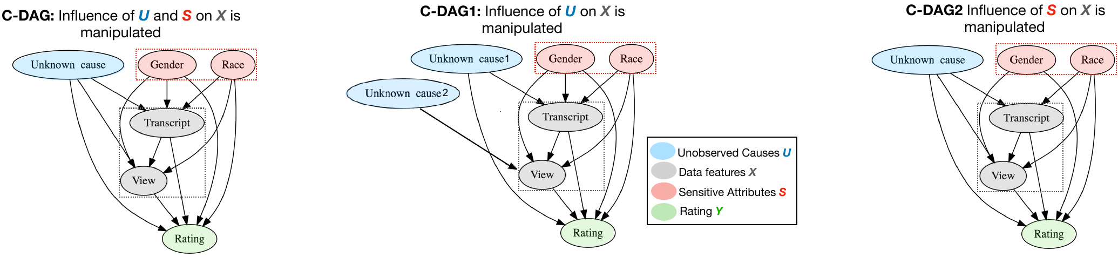
Causal models for counterfactual fairness
Causal model is a DAG that consists of dependencies between:
unobserved attributes U (skill set, background), sensitive attributes S (race, gender), data attribute V (view) and T (transcript) and rating prediction Y
Pearl and others (2009)
Notes:
Here we consider three causal models. In C-DAG1 we manipulate the influence of U on V and in C-DAG2 we manipulate the influence of S on V. This setup allows averaging across possible causal models when the true model is unknown.

Slide 14
Causal models
We consider three causal models by manipulating :
the influence of U (unobserved) on V (views and T (transcript)
the influence of S (race, gender) on V (views and T (transcript)
Notes:
Here we consider three causal models. In C-DAG1 we manipulate the influence of U on V and T and in C-DAG2 we manipulate the influence of S on V and T. This setup allows averaging across possible causal models when the true model is unknown.
So now that we have causal models defined for our dataset how do we use it to implement counterfactual fairness..

Slide 15
Outline
Importance of fairness in ML and why choose TED talk dataset
Race and gender bias in TED talk ratings
Counterfactual Fairness
Use counterfactual fairness to mitigate unfair rating in TED talk
Influence and impact of fair prediction in TED talk and alike datasets
Notes:
This brings us to the thrid part of the talk, the idea of counterfactual fairness to mitigate unfair rating in TED talk

Slide 16
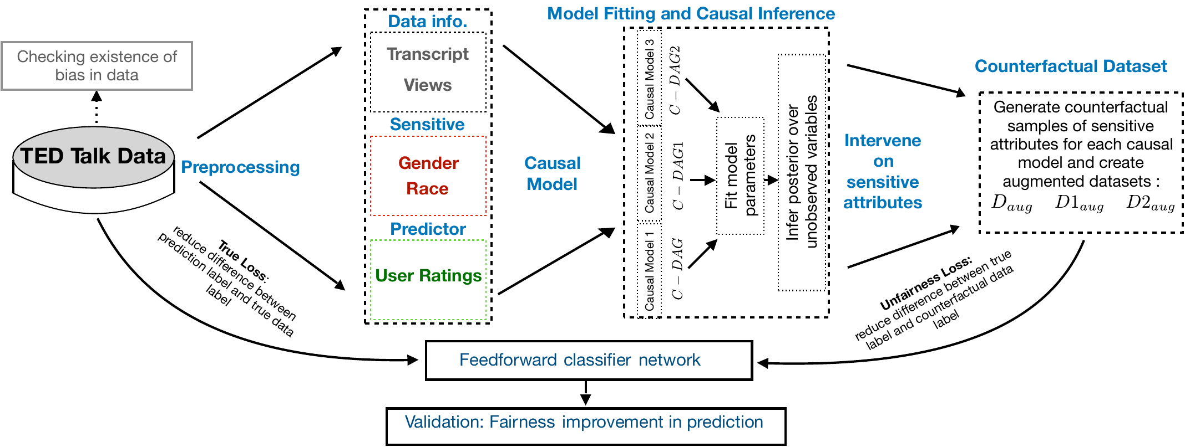
FairyTED pipeline
Notes:
First step we confirm presence of bias in data.
Next we preprocess the data to obtain relevant attributes: transcript, views, rating, race, and gender of speaker.
Following that we build possible causal models for the preprocessed data and generate augmented datasets with counterfactual samples, that is, maintaining the content and quality of talk we assign different instances of sensitive attributes that did not occur but are possible.

Slide 17

FairyTED pipeline
Notes:
We then train a classifier on the augmented datasets with a loss function incorporating a fairness measure.
The loss function used to train the network has two parts: 1) the first part minimizes prediction error when compared to true data labels and 2) the second part reduces disparity between the labels of observed values of S and their corresponding counterfactuals. This ensures that simply changing a male speaker to female with fixed skill set and background does not influence the rating. The prediction accuracy of the fair classifier is obtained by averaging performance across all three models.
As a final step we validate that our system learns to generate fair prediction of ratings for the TED talk dataset

Slide 18
FairyTED pipeline
Notes:
The loss function used to train the network has two parts: 1) the first part minimizes prediction error when compared to true data labels and 2) the second part reduces disparity between the labels of observed values of S and their corresponding counterfactuals. This ensures that simply changing a male speaker to female with fixed skill set and background does not influence the rating. The prediction accuracy of the fair classifier is obtained by averaging performance across all three models.
As a final step we validate that our system learns to generate fair prediction of ratings for the TED talk dataset

Slide 19
Improvement of fairness shown by CV_{prob}
CV_{prob} compares variability of ratings across possible instances of S before and after introduction of fairness measure.
hypothetically if male and female speakers were rated funny with probability 0.75 and 0.45 just due to difference in S and after fairness was introduced in prediction this variability should drop, say, becoming 0.75 and 0.70 solely based on same content, skill set and background.
Lesser the CV_{prob} greater is the fairness in prediction.

Slide 20
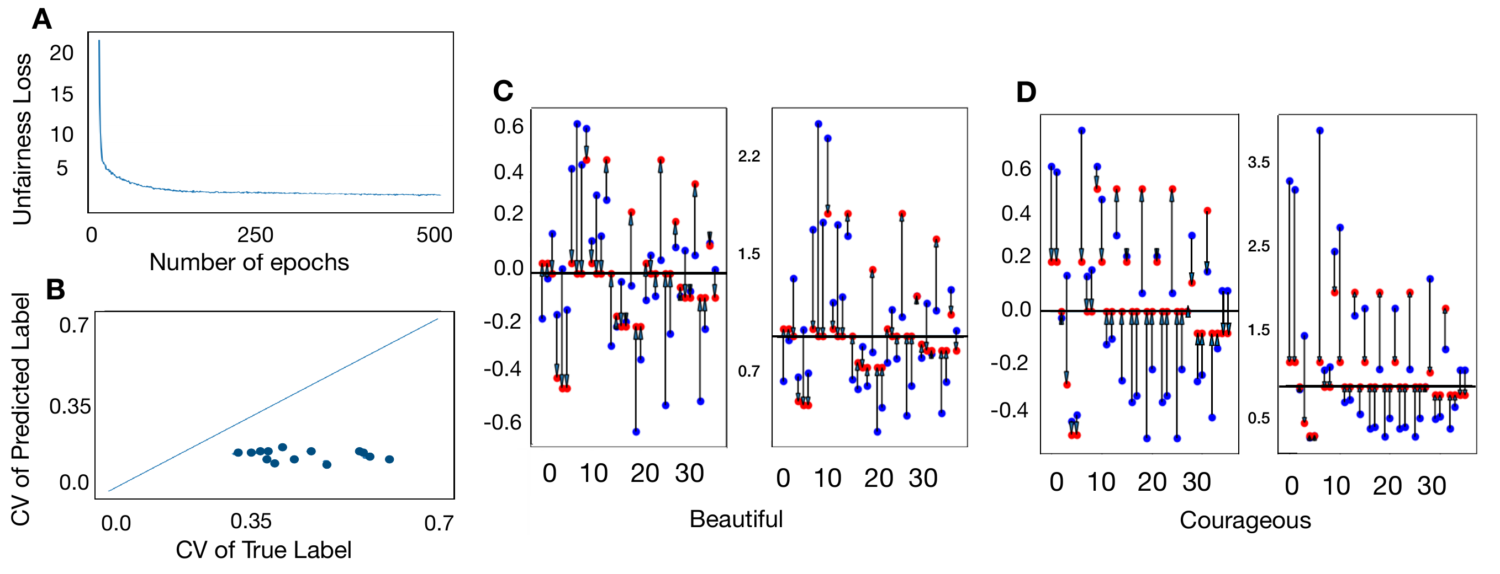
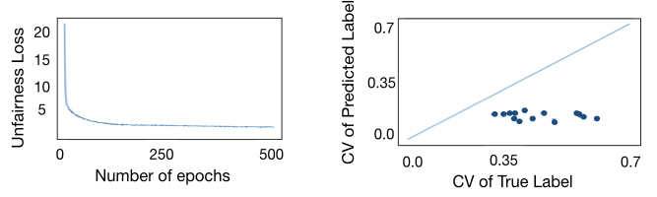
Result CV prob
Remember greater fairness in prediction means:
Lesser the CV_{prob}
SPD closer to 0
DI closer to 1
Notes:
The unfairness measure of the classifier decreases with the increase in training iterations and CVprob values of true vs predicted labels fall under the y=x diagonal line, implying CVprob is reduced by the fair classifier.
Further, in these plots the blue dots denote the fairness measures for the true labels and red dots denote the fairness measures for the predicted labels.
Here you can see SPD moves towards 0 and DI moves towards 1 for most of all possible pairs of groups across race and gender after the prediction.
All these indicate improvement in fairness in rating prediction using FairyTED pipeline.

Slide 21
Outline
Importance of fairness in ML and why choose TED talk dataset
Race and gender bias in TED talk ratings
Counterfactual Fairness
Use counterfactual fairness to mitigate unfair rating in TED talk
Influence and impact of fair prediction in TED talk and alike datasets
Notes:
This brings us to the thrid part of the talk, the idea of counterfactual fairness to mitigate unfair rating in TED talk

Slide 22
Summary and future work
We apply counterfactual fairness on influential database of TED talk videos
Counterfactual fairness allows to consider expensive test conditions.
Accomodates possibility of not knowing true causal model.
Allows incorporating unobserved causes, here U.
Any dataset with a simple embedding scheme can use FairyTED setup.
We propose an intuitive novel metric that quantifies degree of fairness
FairyTED setup has three important social impacts:
it ensures that speakers get fair feedback
organizers can employ diverse speakers without worrying about degradation in rating when skill, ability, influence and content are matched
new viewers will not be biased by prevalent unwanted biased ratings from previous users and prevents propagation of unfairness over time

Slide 23
Thank you!

