Slide 1
Inference by binary sampling as a model for V1 spiking responses
Ankani Chattoraj
BCS, 3rd Year Lunch Talk, University of Rochester
Notes:
Thank you Shaorang.
So today I will talk about Inference by binary sampling as a model for V1 spiking responses

Slide 2


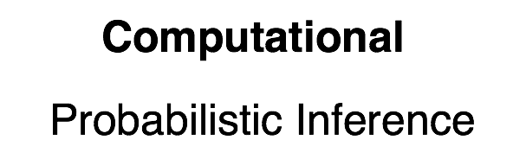
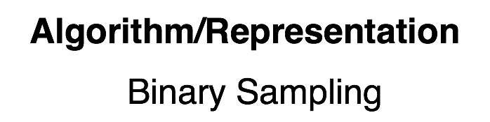
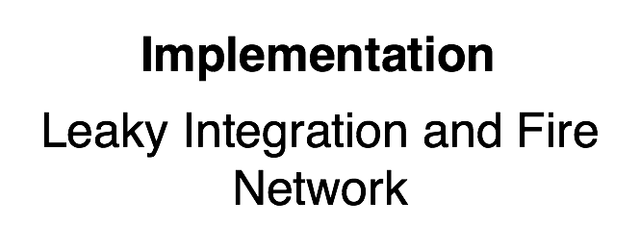
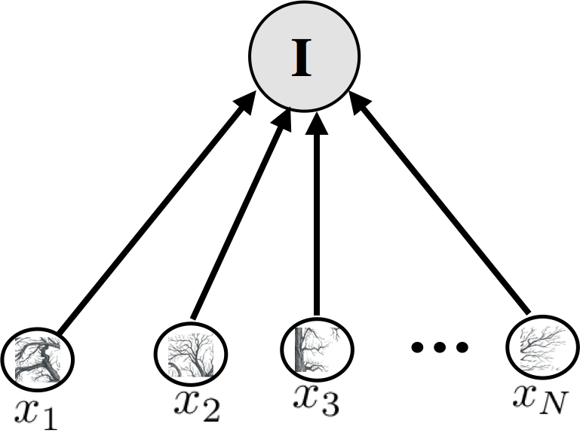
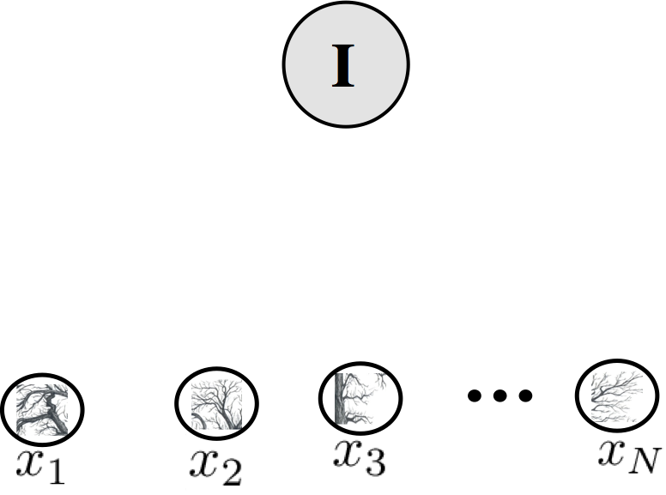
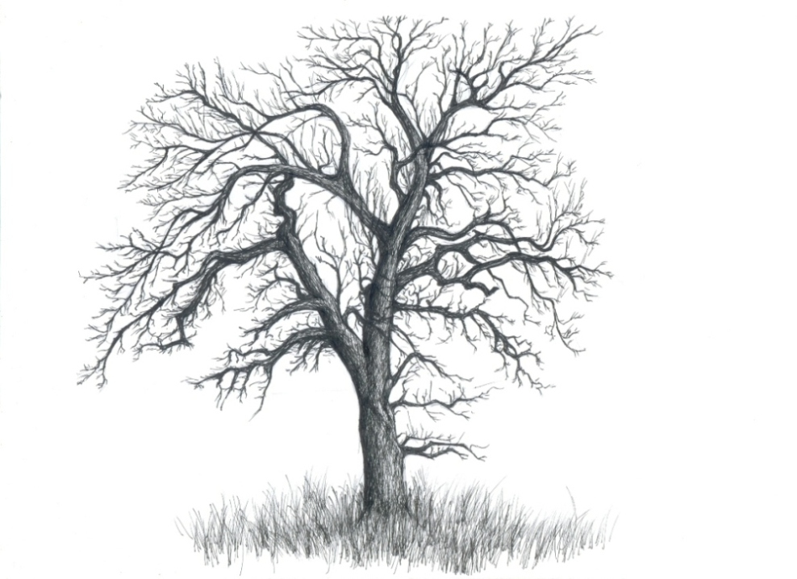
Visual processing as probabilistic inference
Marr’s Level 1
Marr’s Level 2
Marr’s Level 3
Probabilistic Inference
Image (I)
Linear Image Model
Inference
We hypothesize that the brain uses Sampling based algorithm
GOAL: Use this framework of sampling based probabilistic inference to model what neurons in primary visual area V1 are doing
Computing probability of feature present in I
But it is hard and often intractable
Samples generated are continuous values if x represents continuous variable or, 0/1 if x is binary variable
Olshausen and Field, Nature 1996
Notes:
David Mar, a famous neuroscientist and physiologist in the 1980s proposed the idea that one must understand visual processing at three distinct levels of analysis.
First is to understand what is the computational goal of the brain; second is to understand what algorithm or representation the brain is using to achieve the goal and finally third is to understand is it possible for a biophysically realistic model of neurons to implement the algorithm in order to fulfill the goal.
Going back to level 1; Visual processing is often characterized as implementing probabilistic inference: networks of neurons compute posterior beliefs over unobserved causes given the sensory inputs.
Suppose I now show you a natural image, you look out of the window and see a tree denoted as I. The tree has different features, it has branches in different locations and spreading in different directions, different texture, and other such features. Researchers have worked towards learning these features that can be then combined to generate natural images that we see in the outside world.
If I now denote these features of the image in the outside world as x’s ; then under the framework of probabilistic inference what I am trying to compute is the probability of each of these features being present in the outside world.
However, computing these probabilities is hard; even in such simple model and intractable in general.
So we hypothesize that the brain uses Sampling based algorithm to compute these probabilities approximately in order to do inference.
Sampling in general is an algorithm from statistics in which one does not compute the probability directly but comes up with a rule using which one can generate samples from the distribution; and over many samples it is guaranteed to converge to the correct distribution.
Note that, the the x’s can be continuous variables indicating the intensity of the feature in the image or binary indicating the presence or absence of the feature in the image
In our case, we consider them to be binary and I will explain that a little bit more in the next slide.
But before that I want to bring the goal of this project into your attention; that what we are trying to do here is use the sampling based probabilistic framework; we are trying to model what neurons in cortical area V1 might be doing.

Slide 3
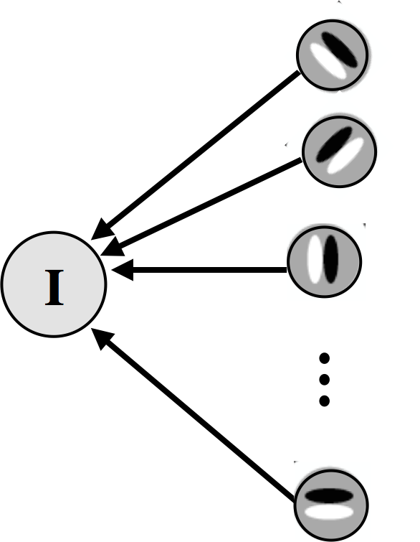
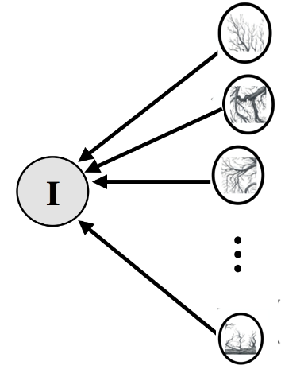








Binary sampling in linear image model
Marr’s Level 1
Marr’s Level 2
Marr’s Level 3
Sampling
Image(I)
Linear Image Model
Binary Samples
Spikes
0
0
1
1
0
1
1
…
1
. . .
Are spiking responses of cortical neurons such binary samples?
1
0
0
0
0
0
1
…
0
. . .
Gibbs Sampling Algorithm to generate samples
1
1
1
1
0
0
1
…
0
. . .
0
0
1
1
1
0
0
…
1
. . .
Notes:
So again going back to the framework, suppose I show you an image, now say a simple oriented grating.
Now we can again think of the same model; but since we are trying to model V1, we now replace these complex features with say, oriented edge type patterns, called Gabors because V1 neurons are known to respond to such features.
So now each x is a V1 neuron and each of them represent features that have structures of different orientation, spatial frequency, positions and so on.
Then we generate binary samples of x’s using the Gibbs Sampling equation. I will talk more about the sampling algorithm later but now let us first try to understand what sampling in this context gives us.
Sampling here means nothing but drawing values 0 or 1 for these neurons at any point in time. I can keep on doing this and end up with a series of 0s and 1s for each neuron.
So then the question is if the spiking responses of cortical neurons nothing but such binary samples that the brain is generating to perform probabilistic inference?

Slide 4
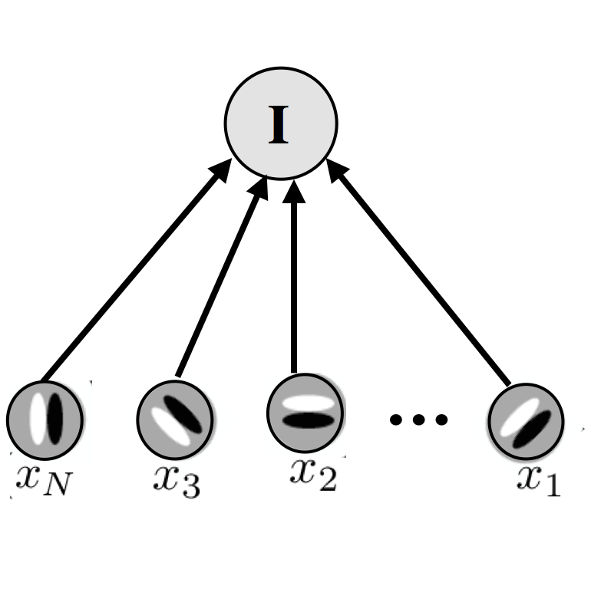
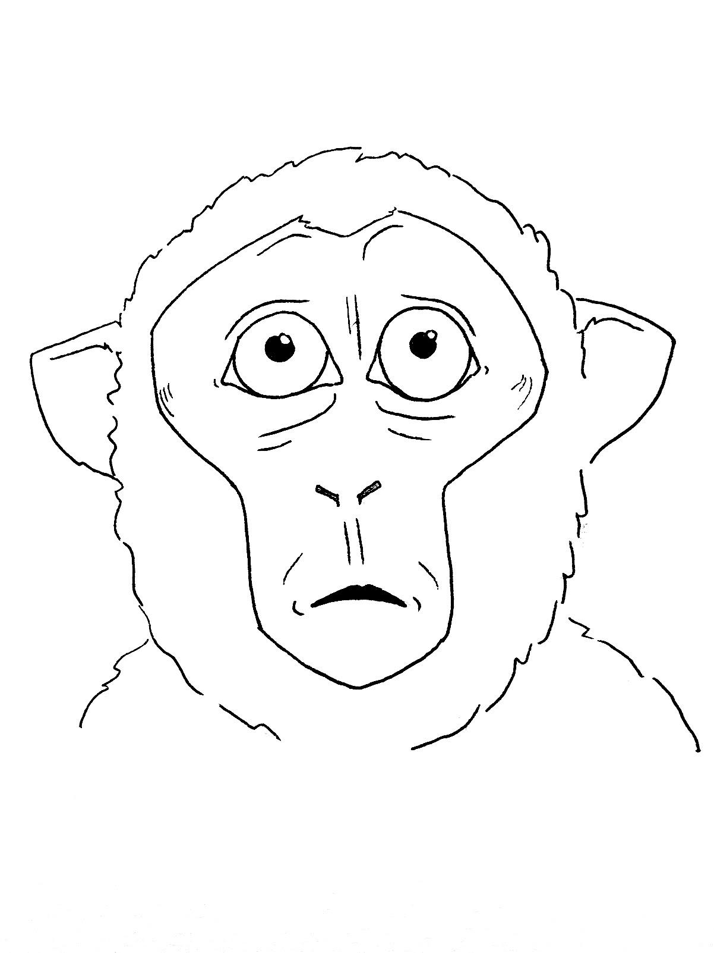
Simulated experiments
Now we can measure anything that an experimentalist would measure.. Say tuning curves, spiking statistics and so on..
Image(I)
Model
Spikes
1
0
1
1
1
0
0
0
1
0
1
0
0
1
0
Notes:
So to answer the last question; we can try to see if our computational framework can explain activity of real neurons. And how can we test that here?
Well, under the assumption that a monkey is doing probabilistic inference using sampling in our simple model; I can then show it a bunch of images and get out spikes in the form of binary samples.
So given these spike-trains generated through sampling in our model we can now ask questions that an experimentalist can ask when recording spikes from neurons in the brain.
I can show an image for 1 sec say and obtain samples and compute the firing rate of each neuron and look at tuning curves; or I can look at the spiking statistics from the series of spikes generated by the model and compare it to empirical observations made in the brain.

Slide 5
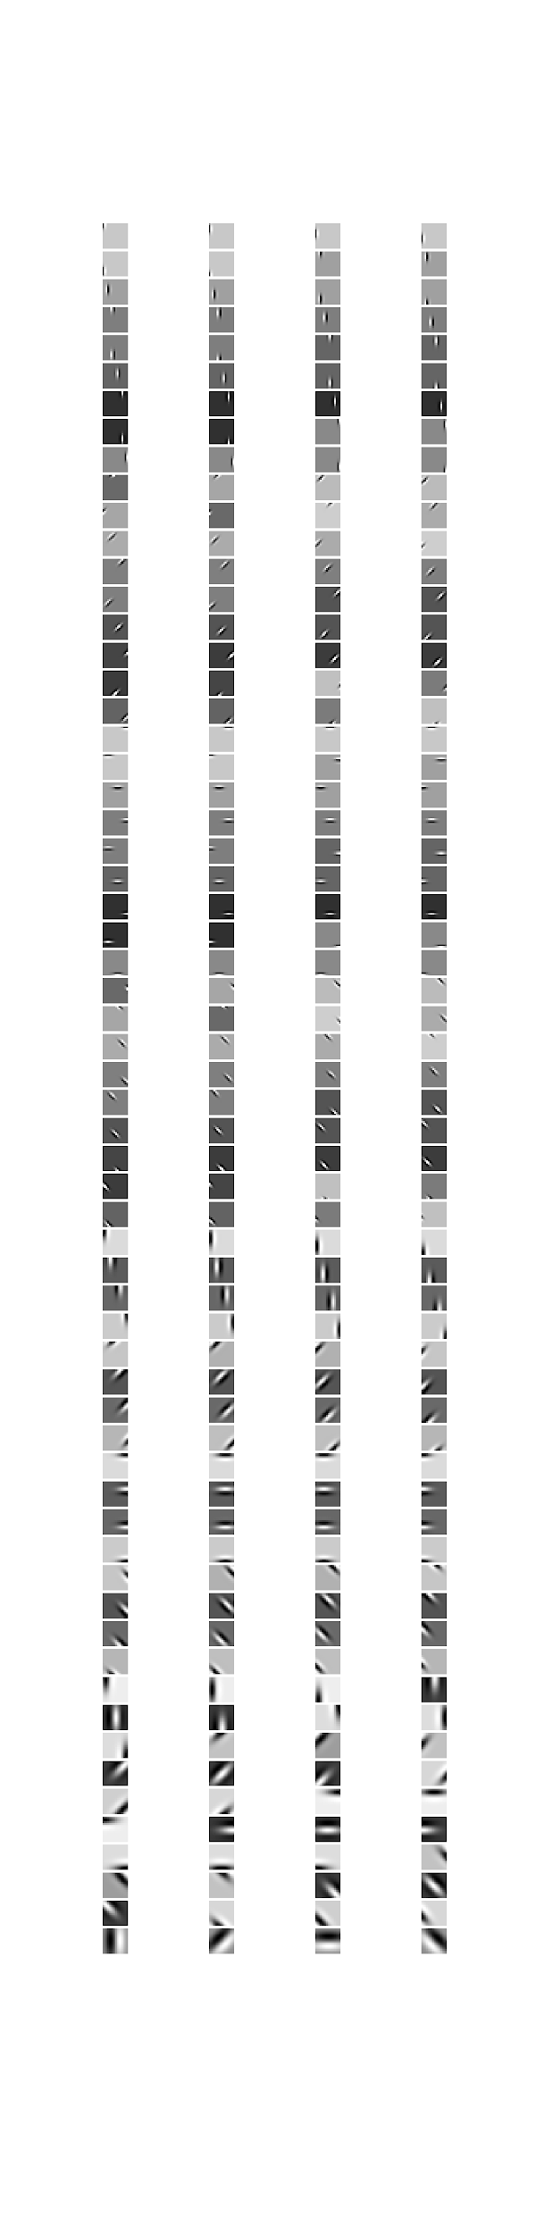
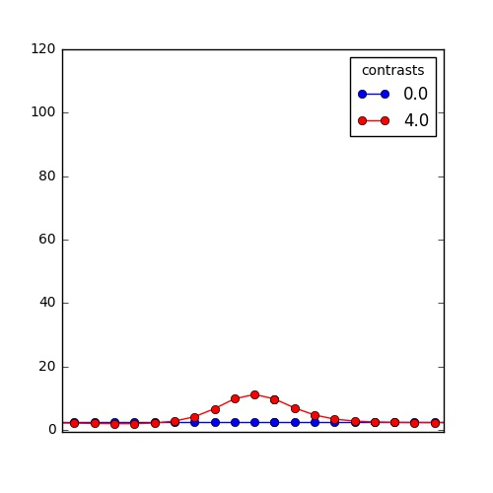
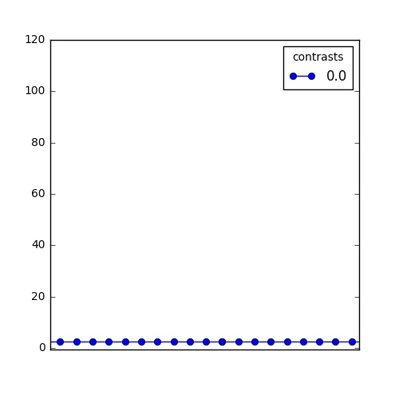
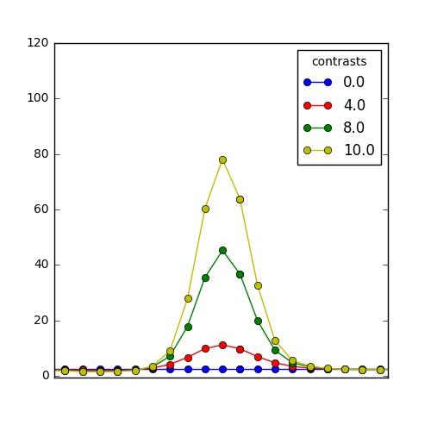
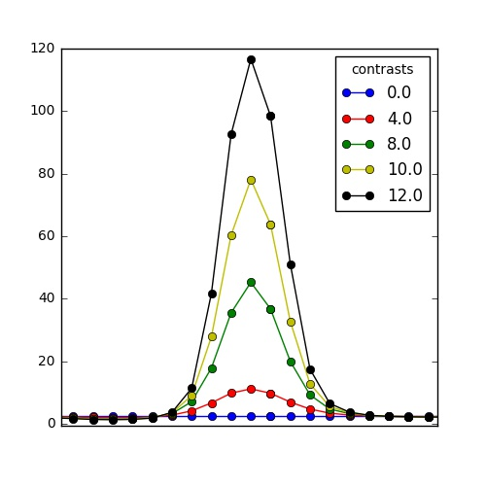
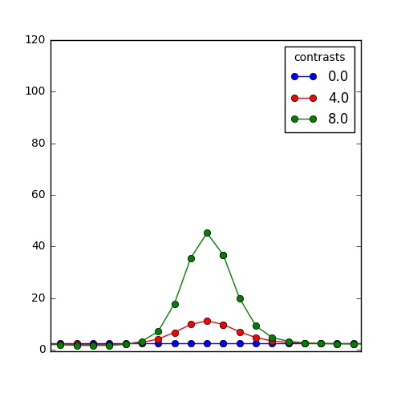
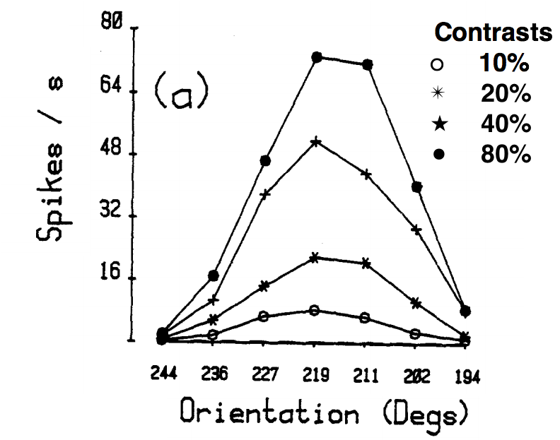
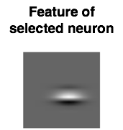
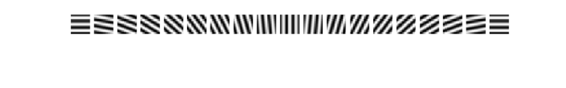
Contrast invariant tuning curves
248 neuron model with PF(features) covering a range of orientations, spatial frequencies and positions
Feature of the selected neuron
Feature of the selected neuron
Oriented gratings shown as images, one at a time!
Images
Firing rate of selected neuron
Orientation Selectivity in the Cat's Striate Cortex is Invariant with Stimulus Contrast
G. Sclar and R.D. Freeman
-π/2 0.0 π/2
Orientation of grating image shown
Orban et al Neuron 2016
Notes:
First we will look at the contrast invariant tuning property of neurons for their preferred orientation.
I want to emphasize this is a property that people have proposed long back and no simple linear model could explain it and finally models with normalization properties could explain this phenomenon. Now can Sampling based probabilistic inference in our simple model also do the same?
To test that I took a population of 248 neurons each of which represent oriented features in different positions in space and of different spatial frequencies.
And to this population of neurons I show a bunch of oriented gratings; one at a time. Suppose then for a fixed neuron, say this one I now look at the tuning curve.
When I show the gratings at zero contrast the neuron only fires with a baseline firing rate.
But as I increase the contrast of the gratings, the firing rates grow and peaks around the orientation preferred by the neuron, here 0 degrees.
And then as I keep on increasing contrast the width of the tuning curve remains fixed but the height changes as has been observed empirically in real neurons.

Slide 6
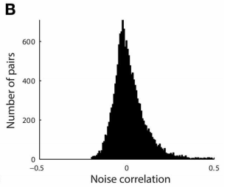
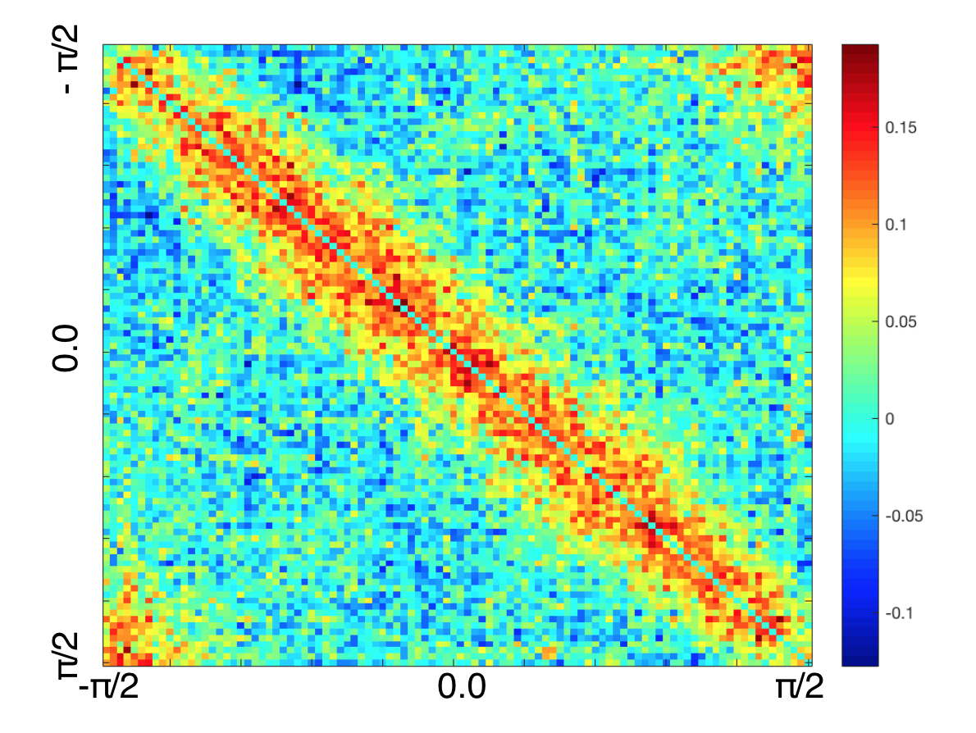
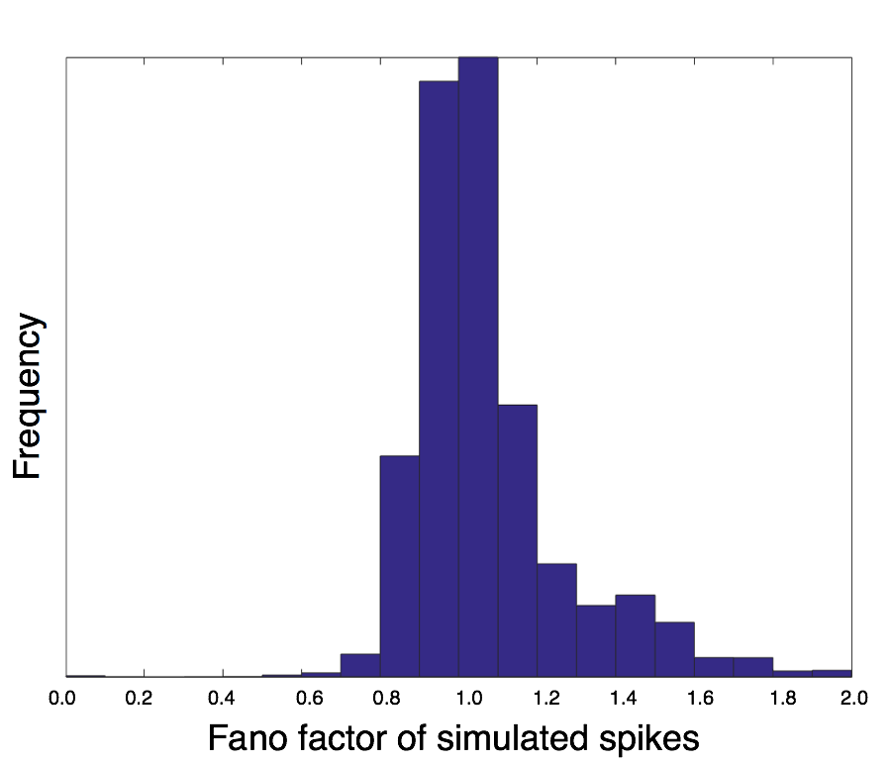
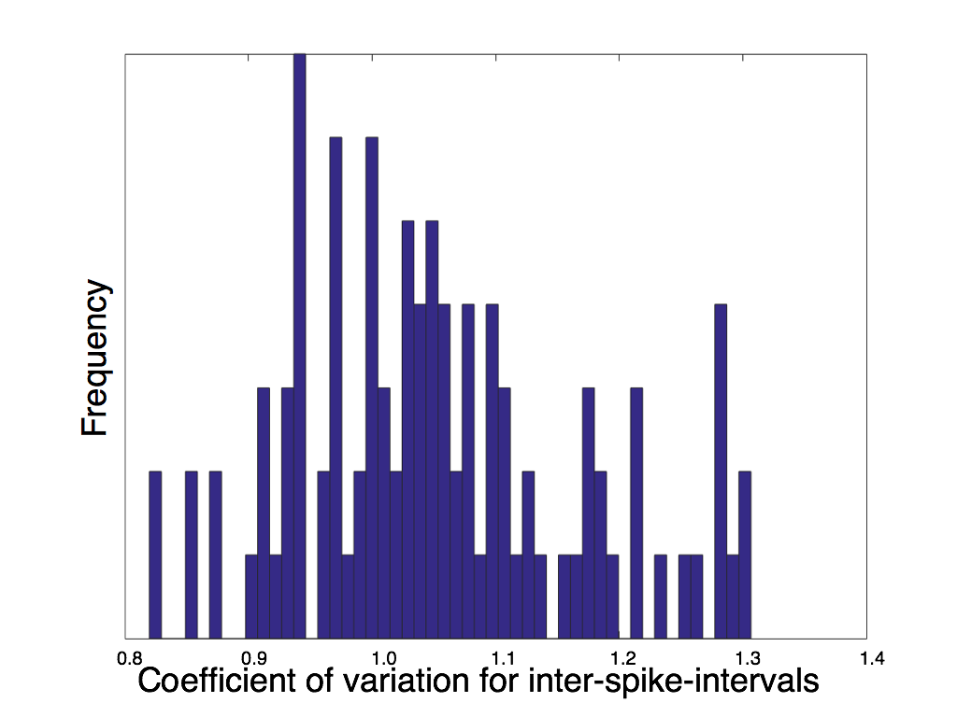
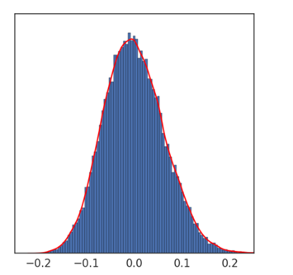
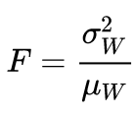

Are simulated responses variable?
Pairwise Correlations sorted as per orientations preferred by neurons
Histogram of fano factor for spike counts in 100 ms bins
Histogram of coefficient of variation for interspike intervals
Distribution of pairwise correlation coefficients matches empirical observation (Ecker et al 2010)
Variability of spikes emerges naturally from the sampling based algorithm that we assume the brain uses to do probabilistic inference
Normalized frequency
Three-dimensional mapping of microcircuit correlation structure; R. James Cotton, Emmanouil Froudarakis, Patrick Storer, Peter Saggau and Andreas S. Tolias
Pairwise correlation of sampled spikes
Notes:
We can then also look at the spiking statistics.
There are two statistical factors widely used to quantify variability in spikes.
One of it is the fanofactor given by the ratio of variance of spikes in a fixed window to the mean of spikes in that window. ad that is typically reported to be close to 1 for real neurons.
Another statistic is looking at the coefficient of variation for the interspike interval and for a Poisson like neuron this measure should be close to 1 and that is what we find from our simulations as well.
At this point I want you note that our model just like real neurons in the brain show Poisson statistics. However, this variability is often considered to be noise intrinsic to the neuron or network.
However, in our case it merges naturally from the sampling based algorithm that we assume the brain uses to probabilistic inference.
Finally we also looked at pairwise correlation of spikes of neurons and the distribution shows that correlation tend to be small
It has been reported in various studies that correlation in cortex has mean very close to zero which we see in our simulations too.

Slide 7
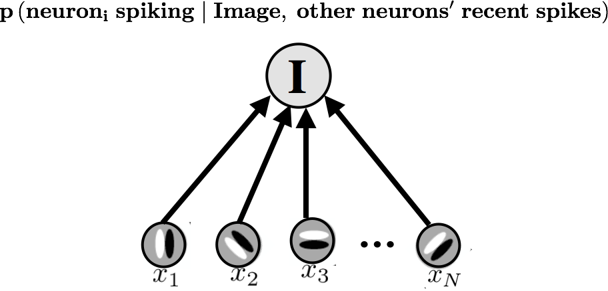
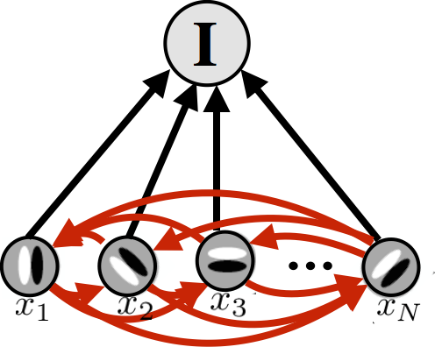
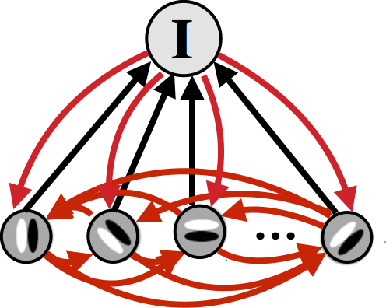
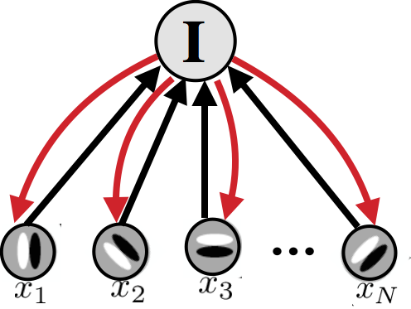
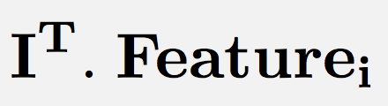
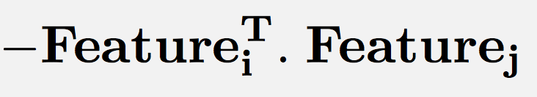
Intuition behind Gibbs Sampling
In Gibbs Sampling we compute:
Recurrent Connections with other neurons
Feedforward drive from the Image
The feedforward and recurrent drive together determine whether neuron ‘i’ should spike or not.
Notes:
Okay we see that sampling based inference in the simple model show properties that real neurons in the brain show.
But lets now take a step back and understand the equation that we use for generating these binary samples.
The sampling algorithm that we use in particular is called the Gibbs Sampling. It is a simple sampling algorithm that allows distributed and localized computation of posterior probabilities over hidden states.
In our case specifically, at any point in time the rule is to compute the probability a neuron i should spike given the image that is shown on the screen and what other neurons that it is connected to doing.
So whether or not neuron i fires depends on two things;
first the feedforward drive from the image; this depends on how well your feature matches the Image shown.
Second are the recurrent drives from other neurons being active or not. This depends on how much the feature of the two neurons match.
So the feedforward and recurrent drives together determine whether a neuron should fire or not. This important and I will come back to it in a later slide.

Slide 8
Connecting sampling and biologically realistic implementation
Can a network of Leaky Integrate and Fire (LIF) neurons implement binary sampling?
Marr’s Level 1
Marr’s Level 2
Marr’s Level 3
Sampling
Leaky Integrate and Fire
Notes:
Okay, With that now lets try to move to the third level of Marr.
That is to understand if a system of biologically realistic neurons generate spikes that look like samples being drawn from the correct distribution.
To investigate that we take the simple and popular Leaky Integrate and Fire neuron model.
Next then lets try to understand the LIF model.

Slide 9
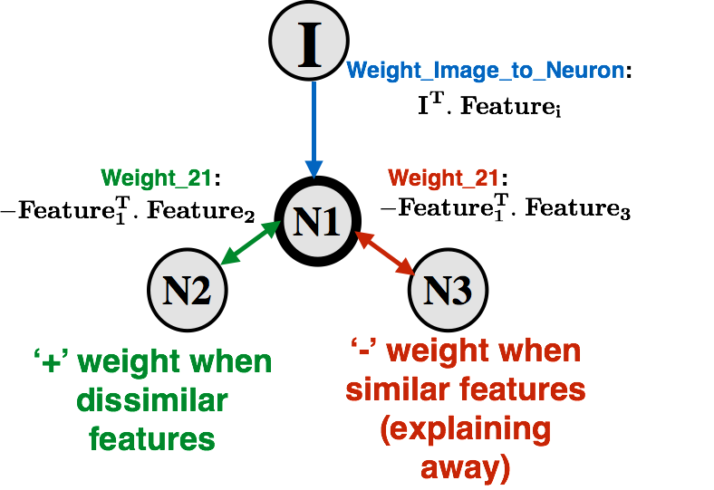
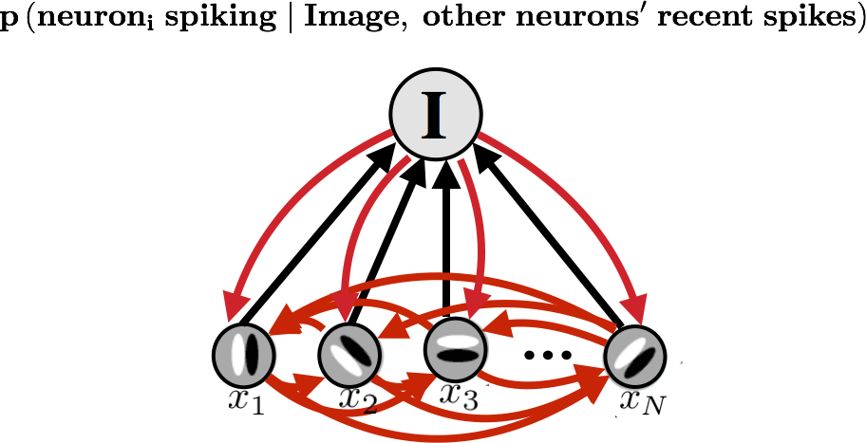
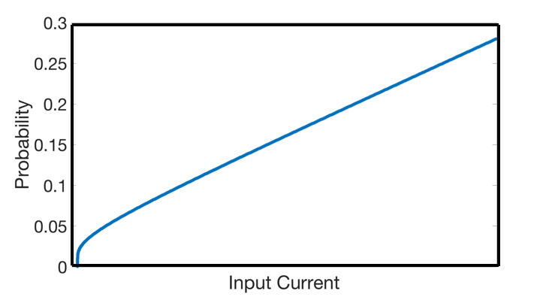
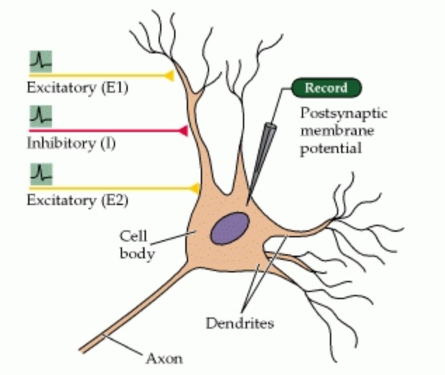
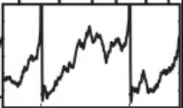

Connecting sampling to LIF neuron spikes
Neurons in General
Input Current to make neuron fire with a probability
Leaky Integrate and Fire neuron (LIF) is one such neuron model
Gibbs Sampling from posterior distribution
Output spikes
Threshold
Membrane Potential
Time in ms
Probabilistic inference through sampling requires the connection weights to be such that they agree with observation in cortex. Not hardcoded into the model!!
Recurrent and Feedforward terms set up the weights for the network of neurons .
Input Current depends on the strength of recurrent connections from neighbouring neurons and feedforward input from the image, as in Gibbs Sampling!
Input Current needed to make LIF neuron fire with the desired posterior probability
Hierarchical Bayesian inference in the visual cortex Tai Sing Lee David Mumford
Notes:
In general a neuron gets excitatory and inhibitory inputs from external source and from other neurons.
These inputs cause a change in the neuron’s membrane potential over time and whenever the membrane potential hits a threshold a spike if generated and the membrane resets itself to a baseline value.
Leaky Integrate and Fire neurons are also based on this idea.
So how often the membrane potential of a neuron reaches the threshold depends on how the net input that goes into the neuron. The net input is the combination of all excitatory and inhibitory inputs at any point in time.
Specifically for the Leaky integrate and fire neuron the input current to probability of spiking of a neuron can be worked out mathematically and the plot shows the relationship. As input current increases, probability of spiking grows but in a non linear fashion.
Now if you remember, in Gibbs sampling at any point we compute the probability of spiking of the neuron given the feedforward drive from the image and the recurrent drive from current state of other neurons.
We can then plug in this probability to obtain the input current needed for the LIF neuron to spike with the desired probability.
Note that this input current becomes a function of feedforward drive and recurrent drive.
This then sets up the weights of the network. The weight between neurons is determined by how similar are the features they represent. If they represent similar features they inhibit each other but if they have dissimilar features they have positive weights between them. The external input drive comes from how well the neuron’s represented feature matches the image, as I mentioned before.
The interesting thing to note is, these connection weights seem consistent with biology but they arise not from any external use of parameters but as a natural consequence of sampling equations used to do probabilistic inference.

Slide 10
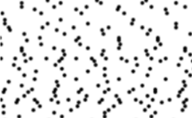
Simulated spikes from LIF network
Now we can re do all the analyses we did with samples on spikes generated by the LIF network
Image(I)
Model
Spikes
Notes:
Then again under the assumption that a monkey is doing probabilistic inference using sampling on a network of Leaky integrate and Fire neurons;
We can again show it some images and now look at spikes generated by the network LIF neurons and re do all the analysis that we did before.

Slide 11
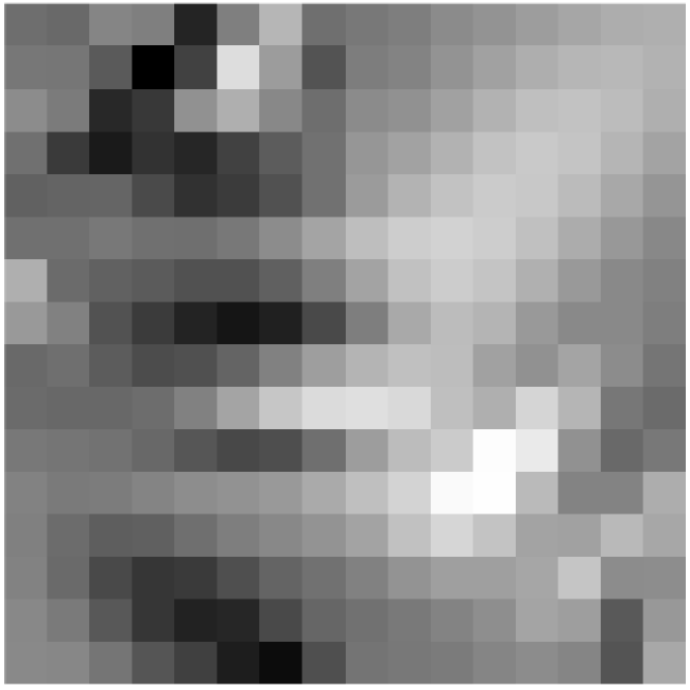
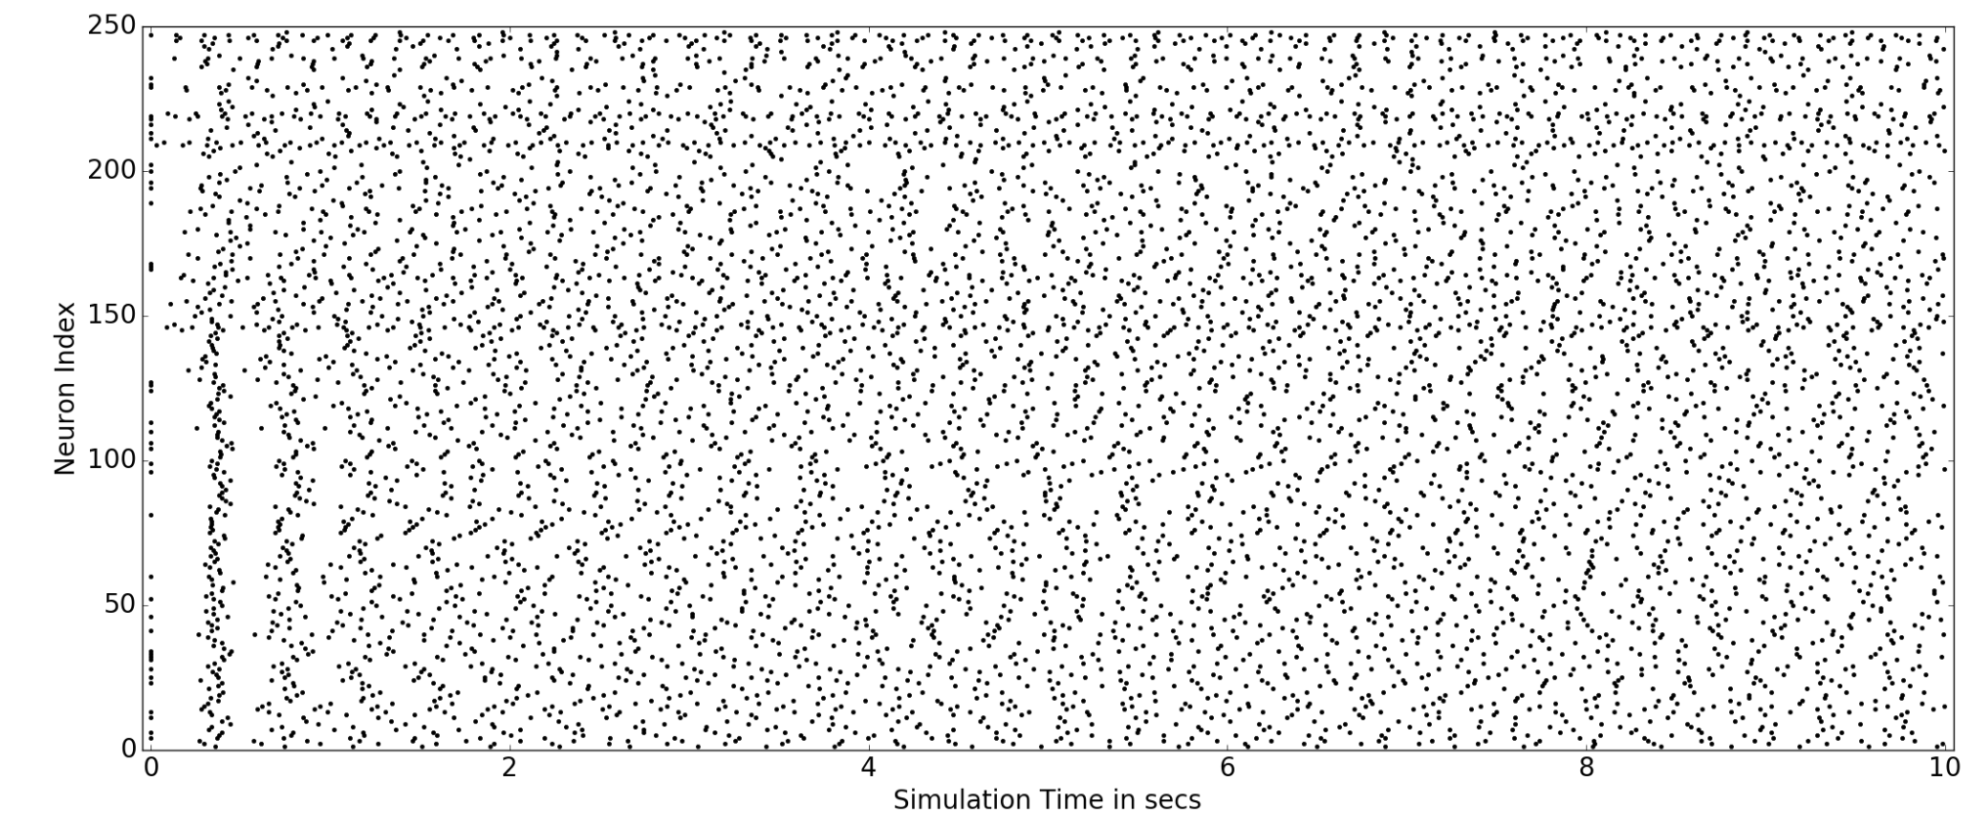
Simulated spikes from LIF network
Random Image shown to network of 248 LIF neurons as before
Is the LIF network able to generate spikes from the correct posterior distribution?
Notes:
Slide 11:
I take the same population of 248 neurons and show it some random image and obtain spike trains, that will look like this.
This is a raster plot, where x axis is time in ms, duration which the image was presented to the network and y-axis is each neuron.
But before we redo any of the analyses we did with our samples; the first question is whether the LIF network is able to generate spikes from the correct posterior distribution.

Slide 12
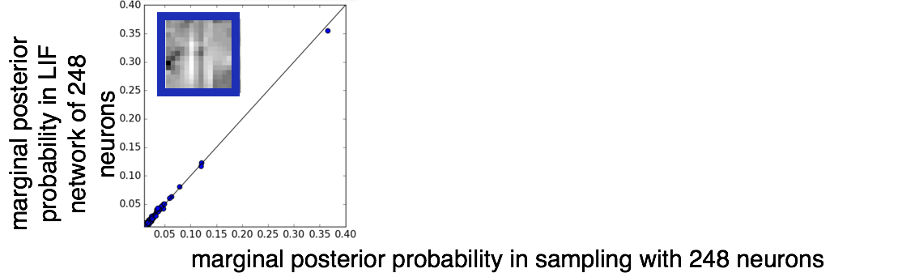
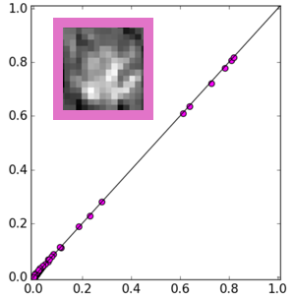
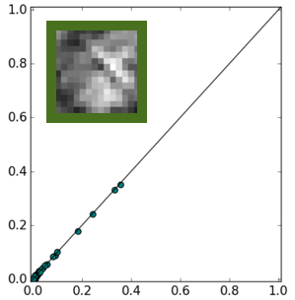

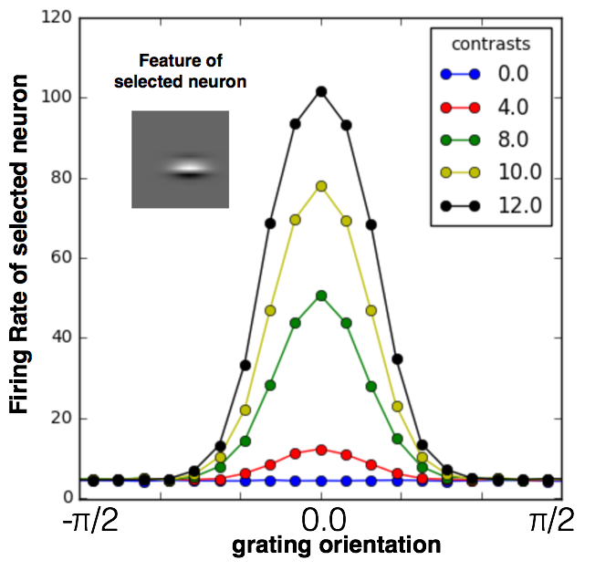
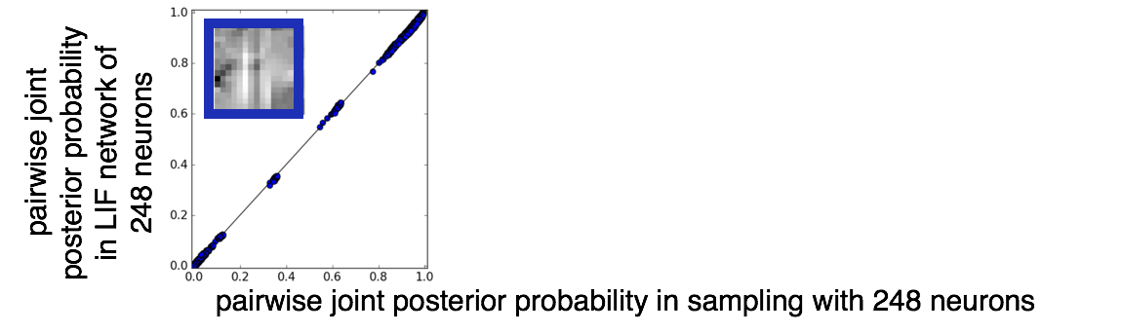
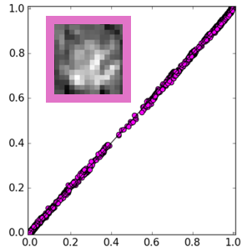
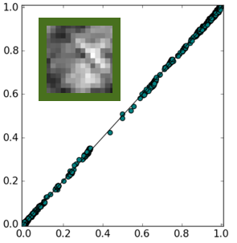
Agreement between LIF simulations and sampling
Notes:
To test the last question, what we did was for any random image
plotted the true marginal probability of spiking of neurons shown on x-axis against in the implied probability of the LIF network shown on the y axis . As you see it lies on the identity line indicating LIF network could generate spikes from the correct posterior distribution.
Similarly we also looked at the true pairwise joint probability against the pairwise joint implied by LIF network and they too match well.
Repeating this for other random images also show a good match.
And since the marginal probabilities match a direct observation from there is that the LIF network can reproduce the contrast invariant tuning plot, we saw for samples before.

Slide 13
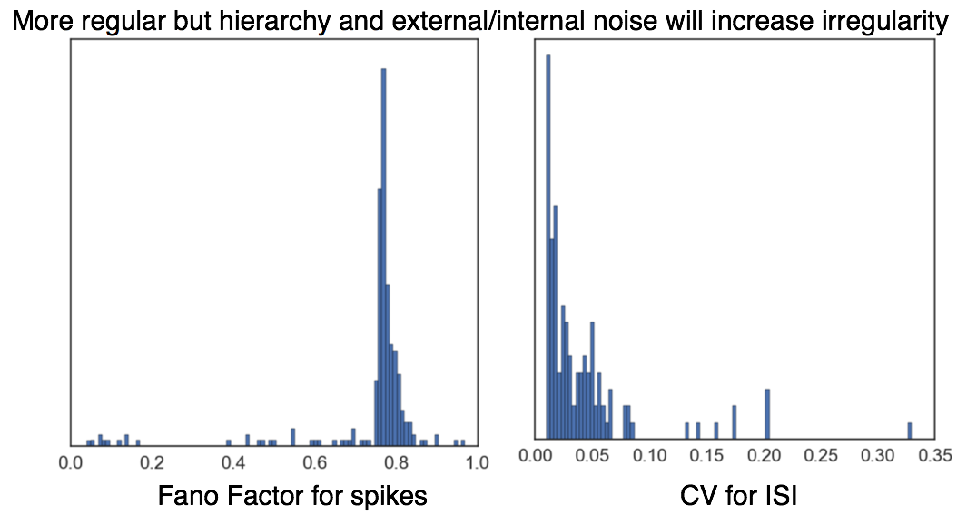
Less variable spikes
Histogram of fano factors of LIF network spikes
Histogram of coefficients of variation of inter-spike-interval
Histogram of fano factors of LIF network spikes
Histogram of coefficients of variation of inter-spike-interval
Various factors can help increase the irregularity of spiking in this model:
Larger network with more neurons
Adding Hierarchy
Stochastic input
Stochastic synapses
Notes:
Then we can again look at the spiking statistics of the neurons.
What we see is that the fanofactor is distributed close to 1, around 0.8
but the coefficient of variation of interspike interval is very low suggesting that the spikes are way more regular than observed in the cortex.
However a lot of factors can help increase the irregularity of spikes. Like adding more neurons and hierarchy will only increase the chaotic nature of the spikes.
Currently the image is fixed throughout the duration of presentation however we know that the feedforward input os stochastic and noisy, so adding that will add to irregularity of spikes.
Also synapses have been considered to be perfect but we know that is also not reliable always, so adding stochasticity there will also increase irregularity of spikes.

Slide 14
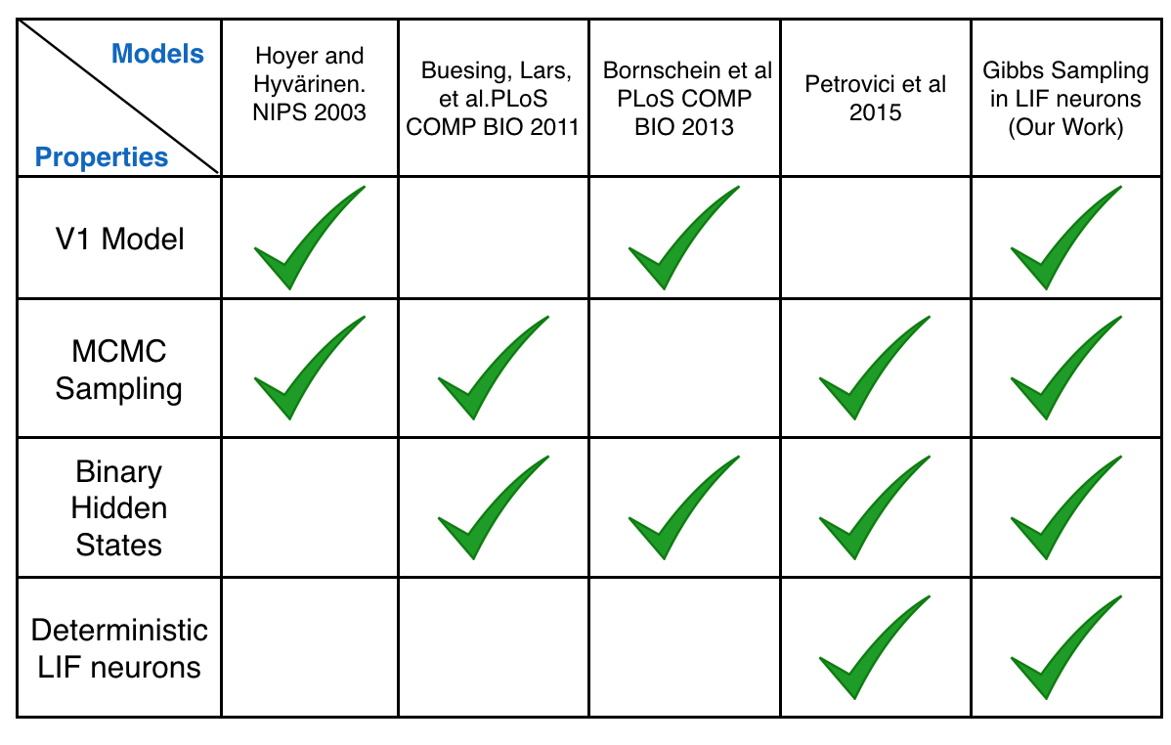
Connecting to previous work
Notes:
Now taking a step back we can try to see what other researchers have done before and what we have added in this context.
Different studies have addressed different levels of Marr’s in their research.
However our work is the first to make an attempt to bridge these three levels and bring together all the concepts that people have proposed under one concrete framework.

Slide 15
Summary
Samples generated by Gibbs Sampling algorithm on a binary linear Gaussian model show empirically observed properties
Contrast invariant tuning
Low correlation coefficients for pairs of neurons
Fano Factor of spikes distributed around 1.
Coefficients of variation for inter-spike-intervals distributed around 1.
LIF network can implement sampling in binary linear-Gaussian image model
However, they are more regular than empirically observed spikes
Larger network with more neurons and hierarchy, stochastic input, stochastic synapses can add irregularity
Notes:
So to summarize what I told you today, in the first part I showed
Samples generated by Gibbs Sampling algorithm on a binary linear Gaussian model show empirically observed properties
Contrast invariant tuning
Low correlation coefficients for pairs of neurons
Fano Factor of spikes distributed around 1.
Coefficients of variation for inter-spike-intervals distributed around 1.
In the second part of the talk I discussed,
LIF network can implement sampling in binary linear-Gaussian image model
However, they are more regular than empirically observed spikes
Larger network with more neurons and hierarchy, stochastic input, stochastic synapses can add irregularity

Slide 16
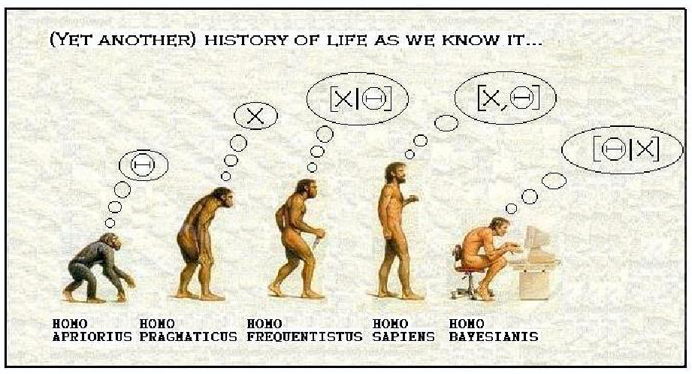



Acknowledgement
Thank you all for listening. :)
Haefner Lab
And also the Mitchell lab for valuable feedback!!
Notes:
With that I would like to thank Ralf, Richard and Sabya for their endless support and many helpful suggestions, contributions and discussions.
The Mitchell Lab for feedback on this talk. and you all for listening.
And I will now take questions. Thank you.

