Slide 1
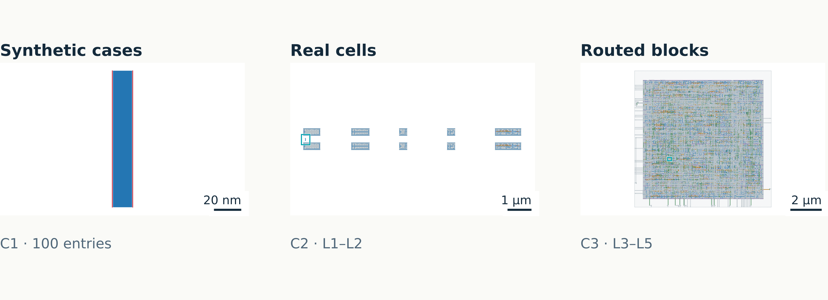
PROJECT OVERVIEW
DRC datasets and repair experiments
Synthetic geometry, real cells, and routed blocks
M1 blue · M2 amber · V1 purple · V2 rose · M3 green | Red: saved markers
Sources: C1 and C2/C3 accepted manifests · exact paths in notes
01
Notes:
This deck explains the retained datasets and the exact tested repair pipeline. C1 is a deterministic synthetic catalog. C2/C3 adds real ASAP7 standard-cell hierarchy and complete routed GCD/UART blocks. Figures use retained GDS inputs; none is a generated repair. Results cover C1 OpenAI and Bedrock, and C2/C3 Bedrock plus local baselines. Electrical correctness is outside the measured scope.
Exact source references:
/home/ankdesh/explore/build-with-terminator/eda/gdsii/klayout-4-drc/test_data/benchmark_v1/manifest.json
/home/ankdesh/explore/build-with-terminator/eda/gdsii/klayout-4-drc/test_data/benchmark_c2c3/manifest.json
Layer colors in native geometry: M1 blue(19/0), M2 amber(20/0), V1 purple(21/0), V2 rose(25/0), M3 green(30/0). Red overlays are saved scored markers, teal outlines are spatial permission masks, cyan outlines locate top inspection windows. Colors have no net identity meaning.
Figure description: Synthetic geometry, real cells, and routed blocks
Units: nm and µm
Encoding: Blue M1, amber M2, purple V1. Scale bars are per view.

Slide 2
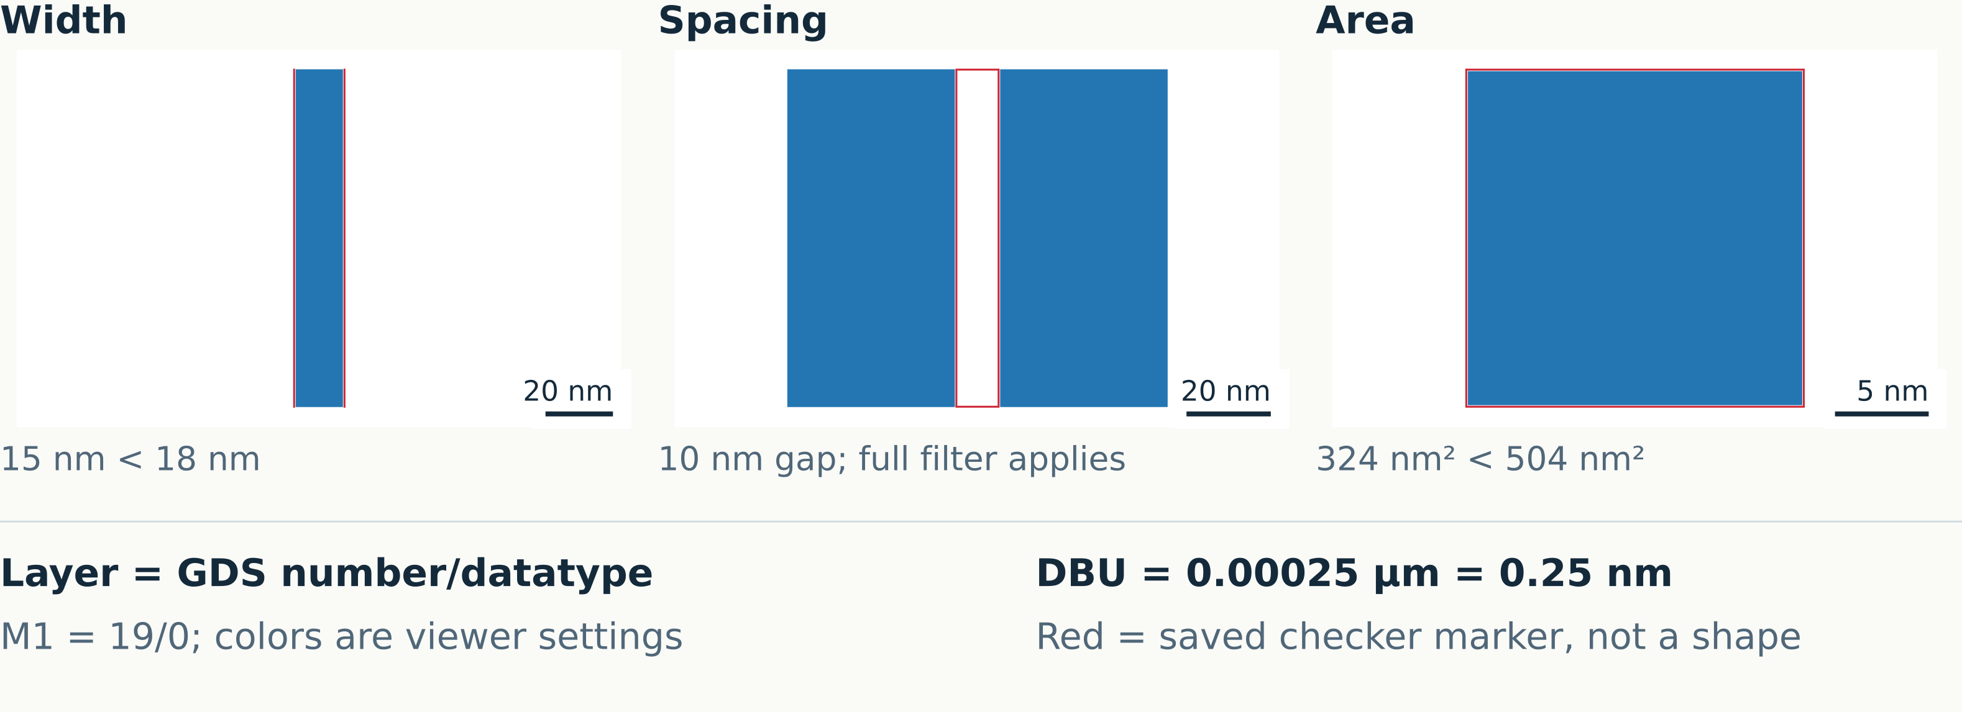
FOUNDATIONS
GDS geometry and DRC markers
A marker identifies a rule condition; it is not a circuit diagnosis
M1 blue · M2 amber · V1 purple · V2 rose · M3 green | Red: saved markers
Sources: C1 input GDS + saved checker reports · exact paths in notes
02
Notes:
GDS stores layout geometry and cell instances. DRC means design rule checking. A GDS layer is identified by layer number and datatype. The layouts use integer database coordinates, with one DBU equal to 0.25 nm. Multiply length in DBU by layout.dbu to obtain micrometers, and area in DBU squared by layout.dbu squared. Red overlays are read from saved checker reports. Width and spacing can be represented by edge pairs; area markers can outline polygons. One shape may produce more than one marker. M1 spacing uses the complete decoded deck expression, including edge filters. A gap below 18 nm alone does not define every possible spacing violation.
Exact source references:
/home/ankdesh/explore/build-with-terminator/eda/gdsii/klayout-4-drc/test_data/benchmark_v1/manifest.json
/home/ankdesh/explore/build-with-terminator/eda/gdsii/klayout-4-drc/knowledge/klayout_api_patterns.md
Layer colors in native geometry: M1 blue(19/0), M2 amber(20/0), V1 purple(21/0), V2 rose(25/0), M3 green(30/0). Red overlays are saved scored markers, teal outlines are spatial permission masks, cyan outlines locate top inspection windows. Colors have no net identity meaning.
Figure description: A marker identifies a rule condition; it is not a circuit diagnosis
Units: nm, nm², DBU
Encoding: Actual input GDS with saved marker edges. Independent labeled scales.

Slide 3
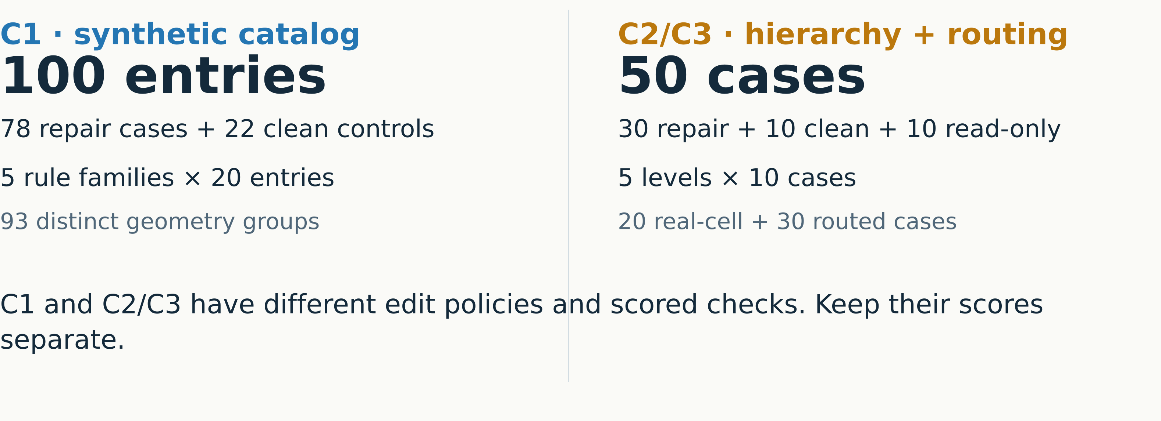
DATASET CREATION
Dataset structure
Each benchmark has its own scope and denominator
Sources: C1 and C2/C3 accepted manifests · exact paths in notes
03
Notes:
C1 has 100 entries but 93 distinct geometry groups. Some boundary entries are clean, so the 22 clean controls exceed the 15 explicitly negative entries. C2/C3 contains five levels, each with two source groups. Each group supplies three repair cases, one clean control, and one read-only challenge. Levels L1 and L2 use real cell masters; L3–L5 use retained routed designs. These are separate benchmark scopes, not a single 150-case repair score.
Exact source references:
/home/ankdesh/explore/build-with-terminator/eda/gdsii/klayout-4-drc/test_data/benchmark_v1/manifest.json
/home/ankdesh/explore/build-with-terminator/eda/gdsii/klayout-4-drc/test_data/benchmark_c2c3/manifest.json
Layer colors in native geometry: M1 blue(19/0), M2 amber(20/0), V1 purple(21/0), V2 rose(25/0), M3 green(30/0). Red overlays are saved scored markers, teal outlines are spatial permission masks, cyan outlines locate top inspection windows. Colors have no net identity meaning.
Figure description: Each benchmark has its own scope and denominator
Units: case counts
Encoding: Parallel scope summaries; no combined success rate.

Slide 4
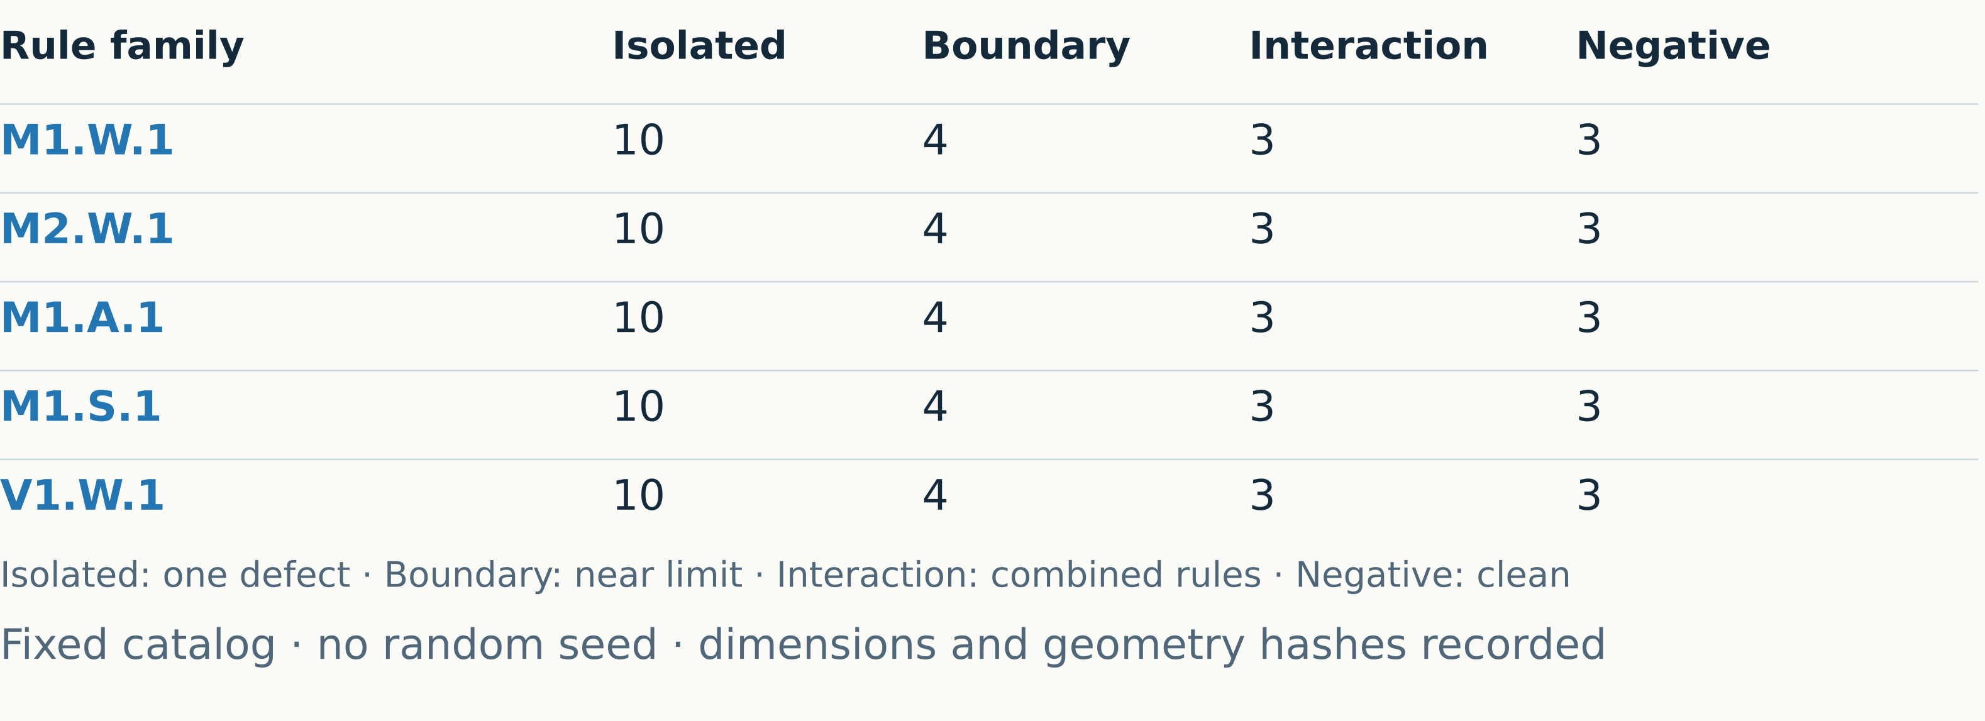
DATASET CREATION
C1 case catalog
Each rule family has the same four coverage tiers
Sources: C1 manifest + deterministic generator · exact paths in notes
04
Notes:
Isolated entries expose one rule condition. Boundary entries test dimensions around the threshold. Interaction entries combine geometry conditions or rule families. Negative entries should have no scoped marker. The deterministic catalog has 20 entries per rule family: ten isolated, four boundary, three interaction, and three negative cases. Across five families this gives 50 isolated, 20 boundary, 15 interaction, and 15 negative entries. Boundary and interaction cases are part of the same fixed catalog. Acceptance stores the constructor geometry, expected counts, observed marker evidence, source hashes and duplicate geometry groups. V1.W.1 checks width, not via enclosure.
Exact source references:
/home/ankdesh/explore/build-with-terminator/eda/gdsii/klayout-4-drc/test_data/benchmark_v1/manifest.json
/home/ankdesh/explore/build-with-terminator/eda/gdsii/klayout-4-drc/src/klayout_drc/benchmark/generator.py
Layer colors in native geometry: M1 blue(19/0), M2 amber(20/0), V1 purple(21/0), V2 rose(25/0), M3 green(30/0). Red overlays are saved scored markers, teal outlines are spatial permission masks, cyan outlines locate top inspection windows. Colors have no net identity meaning.
Figure description: Each rule family has the same four coverage tiers
Units: entry counts
Encoding: Five rows with exact per-tier counts.

Slide 5
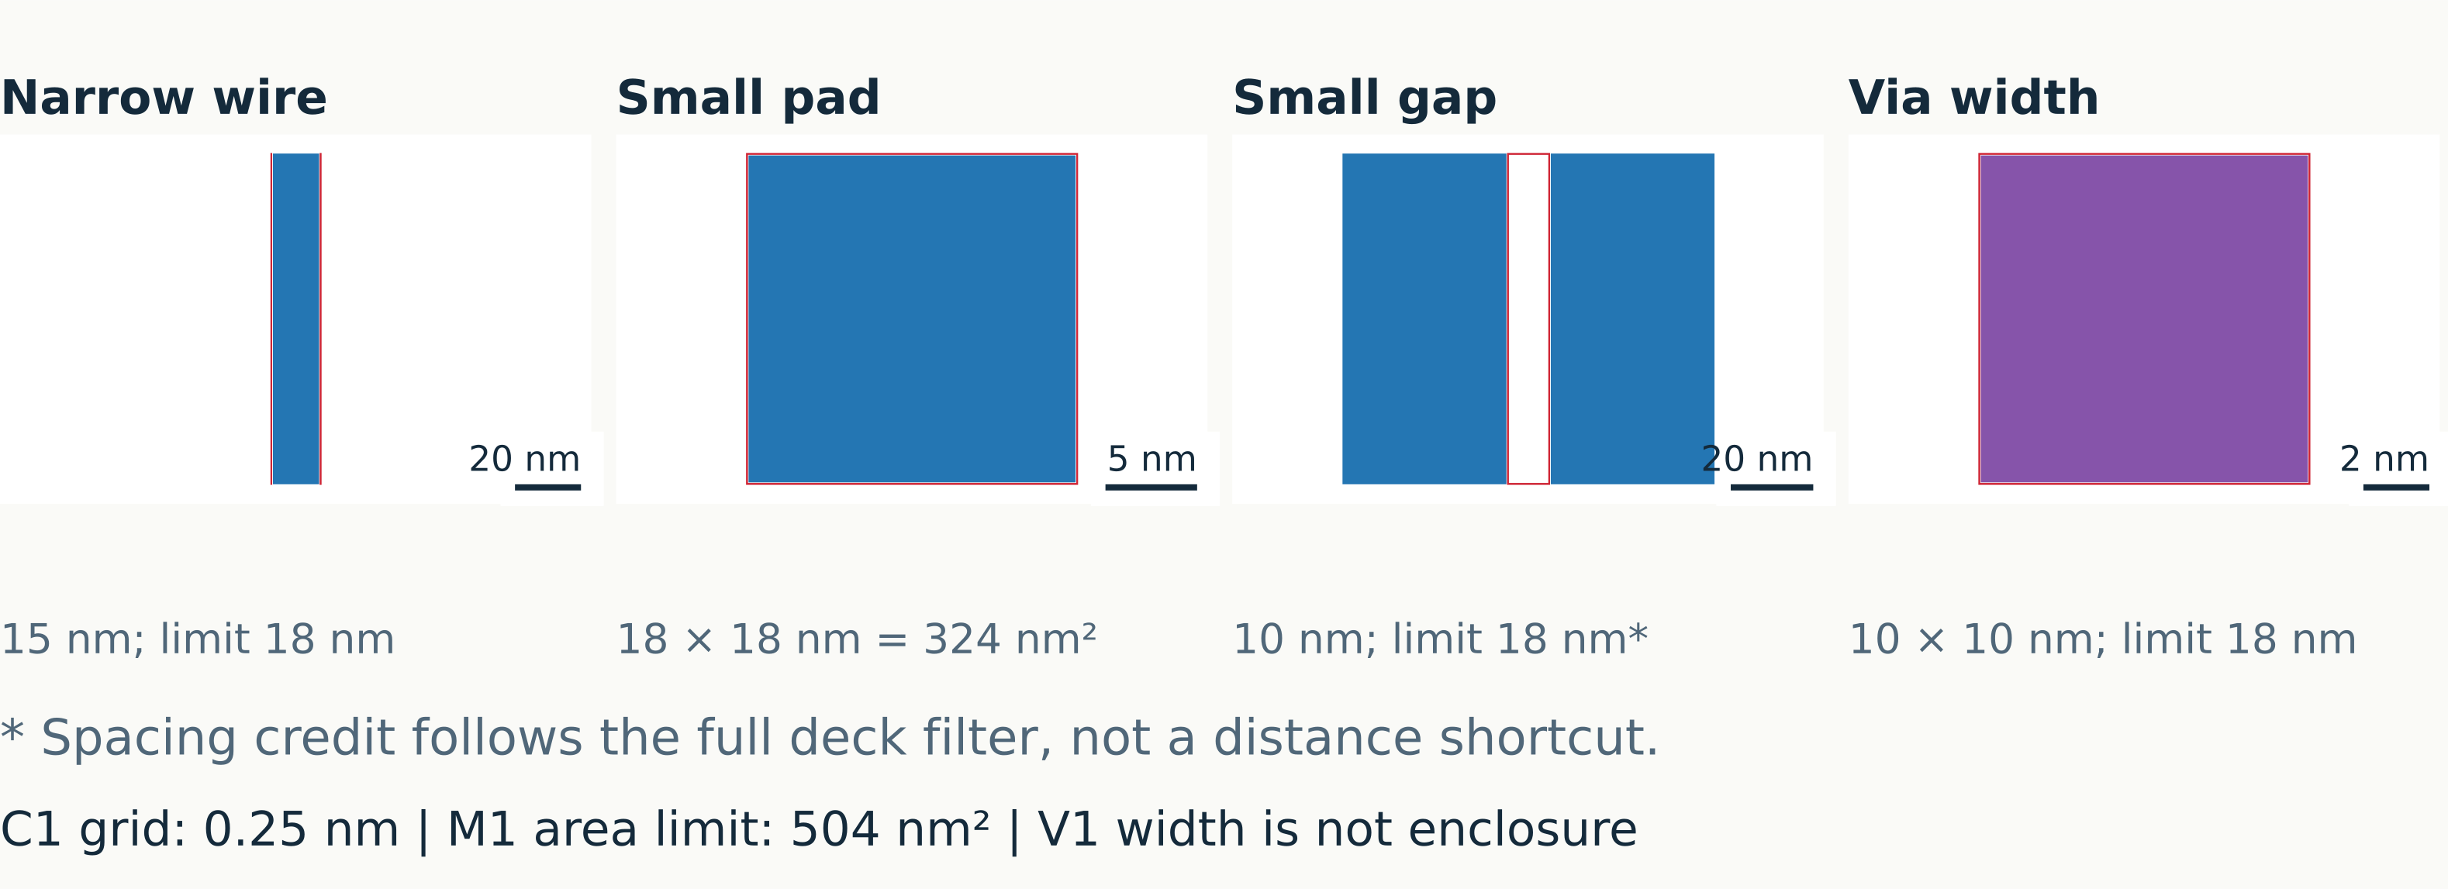
DATASET CREATION
C1 geometry construction
Dimensions are stored as exact integer geometry
M1 blue · M2 amber · V1 purple · V2 rose · M3 green | Red: saved markers
Sources: C1 input GDS + saved checker reports · exact paths in notes
05
Notes:
The four examples are actual published inputs, not concept artwork: m1_w1_iso_04 is 15 nm by 100 nm; m1_a1_iso_01 is 18 nm square; m1_s1_iso_01 has two 40 nm by 80 nm wires separated by 10 nm; v1_w1_iso_01 is a 10 nm square. Each view has its own physical scale. The C1 manufacturing/coordinate grid is 0.25 nm. An area test is applied per component and uses square units. Via width produces markers in both dimensions for a small square. The spacing rule includes edge-length filtering; preserve separate components when net ownership is unknown.
Exact source references:
/home/ankdesh/explore/build-with-terminator/eda/gdsii/klayout-4-drc/test_data/benchmark_v1/manifest.json
/home/ankdesh/explore/build-with-terminator/eda/gdsii/klayout-4-drc/src/klayout_drc/benchmark/generator.py
Layer colors in native geometry: M1 blue(19/0), M2 amber(20/0), V1 purple(21/0), V2 rose(25/0), M3 green(30/0). Red overlays are saved scored markers, teal outlines are spatial permission masks, cyan outlines locate top inspection windows. Colors have no net identity meaning.
Figure description: Dimensions are stored as exact integer geometry
Units: nm and nm²
Encoding: Four independent actual GDS insets with saved marker overlays.

Slide 6
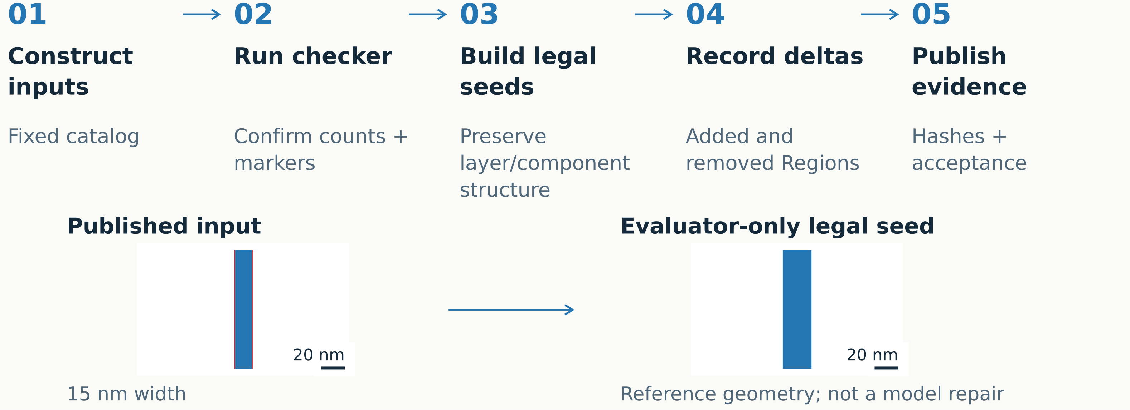
DATASET CREATION
C1 acceptance and legal references
C1 legal seeds are constructed after the test inputs
M1 blue · M2 amber · V1 purple · V2 rose · M3 green | Red: saved markers
Sources: C1 generator + acceptance records · exact paths in notes
06
Notes:
The actual order is important. The generator first constructs deterministic test inputs. Acceptance runs the checker on those inputs, then constructs synthetic legal component seeds. These are not recovered pristine source designs and are not generated repairs. Seeds retain layers and component counts. Exact Region additions and removals map the seed to the input; round-trip reconstruction is checked. Reference reports, input reports, canonical markers, preservation data and hashes are then recorded. The seed is private evaluator evidence and never sent to the model.
Exact source references:
/home/ankdesh/explore/build-with-terminator/eda/gdsii/klayout-4-drc/src/klayout_drc/benchmark/generator.py
/home/ankdesh/explore/build-with-terminator/eda/gdsii/klayout-4-drc/src/klayout_drc/benchmark/acceptance.py
/home/ankdesh/explore/build-with-terminator/eda/gdsii/klayout-4-drc/test_data/benchmark_v1/manifest.json
Layer colors in native geometry: M1 blue(19/0), M2 amber(20/0), V1 purple(21/0), V2 rose(25/0), M3 green(30/0). Red overlays are saved scored markers, teal outlines are spatial permission masks, cyan outlines locate top inspection windows. Colors have no net identity meaning.
Figure description: C1 legal seeds are constructed after the test inputs
Units: nm in layout insets
Encoding: Numbered chronological process and explicitly labeled private reference.

Slide 7
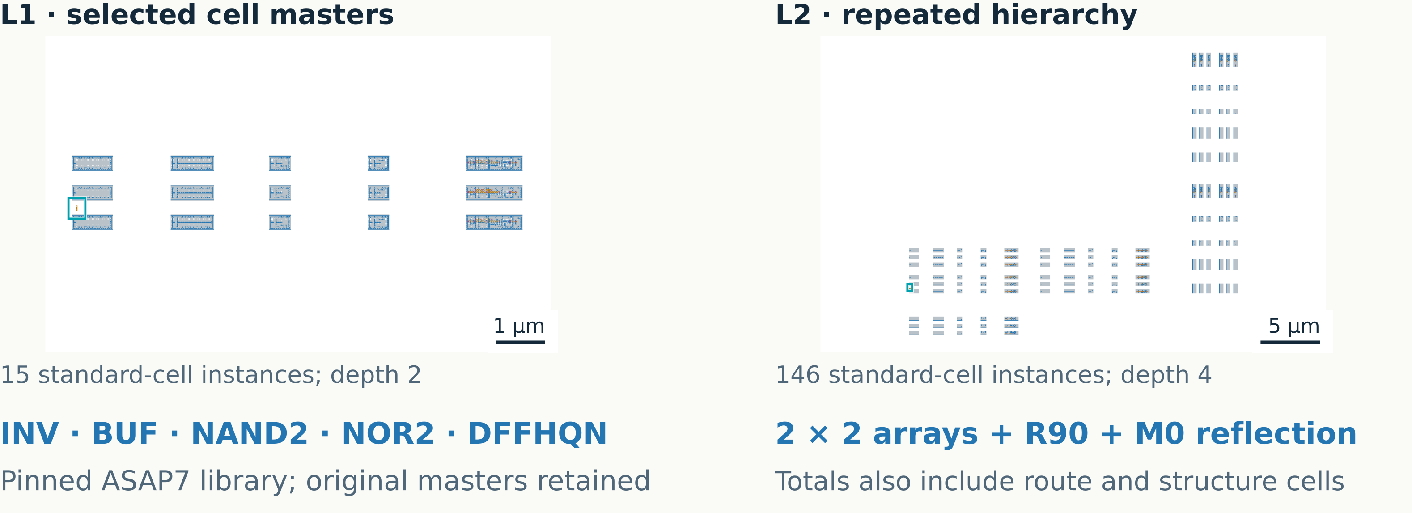
DATASET CREATION
Real-cell dataset construction
Repeated instances retain their source masters and transformations
M1 blue · M2 amber · V1 purple · V2 rose · M3 green | Red: saved markers
Sources: Pinned ASAP7 library + real-cell generator · exact paths in notes
07
Notes:
The pinned library is asap7sc7p5t_28_R_220121a.gds, SHA-256 f43d5b33df635cf9e66cbca66b6bdd05364f824d8040cd21528b9e12808b9263. Masters are chosen deterministically from sorted INV, BUF, NAND2, NOR2 and DFFHQN families, using group index zero or one. L1 places 10 or 15 real instances. L2 builds a REPEATED_BLOCK, places it in a 2 by 2 CLUSTER array, then places a base cluster, an R90 cluster, and an M0 reflected block. L2 contains 101 or 146 real cell instances. Including route and structure gives 103 or 148. The two actual full-layout exports have independent scales.
Exact source references:
/home/ankdesh/explore/build-with-terminator/eda/gdsii/klayout-4-drc/src/klayout_drc/benchmark/c2c3/generator.py
/home/ankdesh/explore/build-with-terminator/eda/gdsii/klayout-4-drc/test_data/benchmark_c2c3/manifest.json
/home/ankdesh/explore/build-with-terminator/eda/gdsii/klayout-4-drc/test_data/benchmark_c2c3/provenance/toolchain.json
/home/ankdesh/explore/build-with-terminator/eda/gdsii/klayout-4-drc/reports/runs/c2c3_v1_agent/frozen_source.json
Layer colors in native geometry: M1 blue(19/0), M2 amber(20/0), V1 purple(21/0), V2 rose(25/0), M3 green(30/0). Red overlays are saved scored markers, teal outlines are spatial permission masks, cyan outlines locate top inspection windows. Colors have no net identity meaning.
Figure description: Repeated instances retain their source masters and transformations
Units: µm
Encoding: Native all-layer GDS views; independent scale bars.

Slide 8
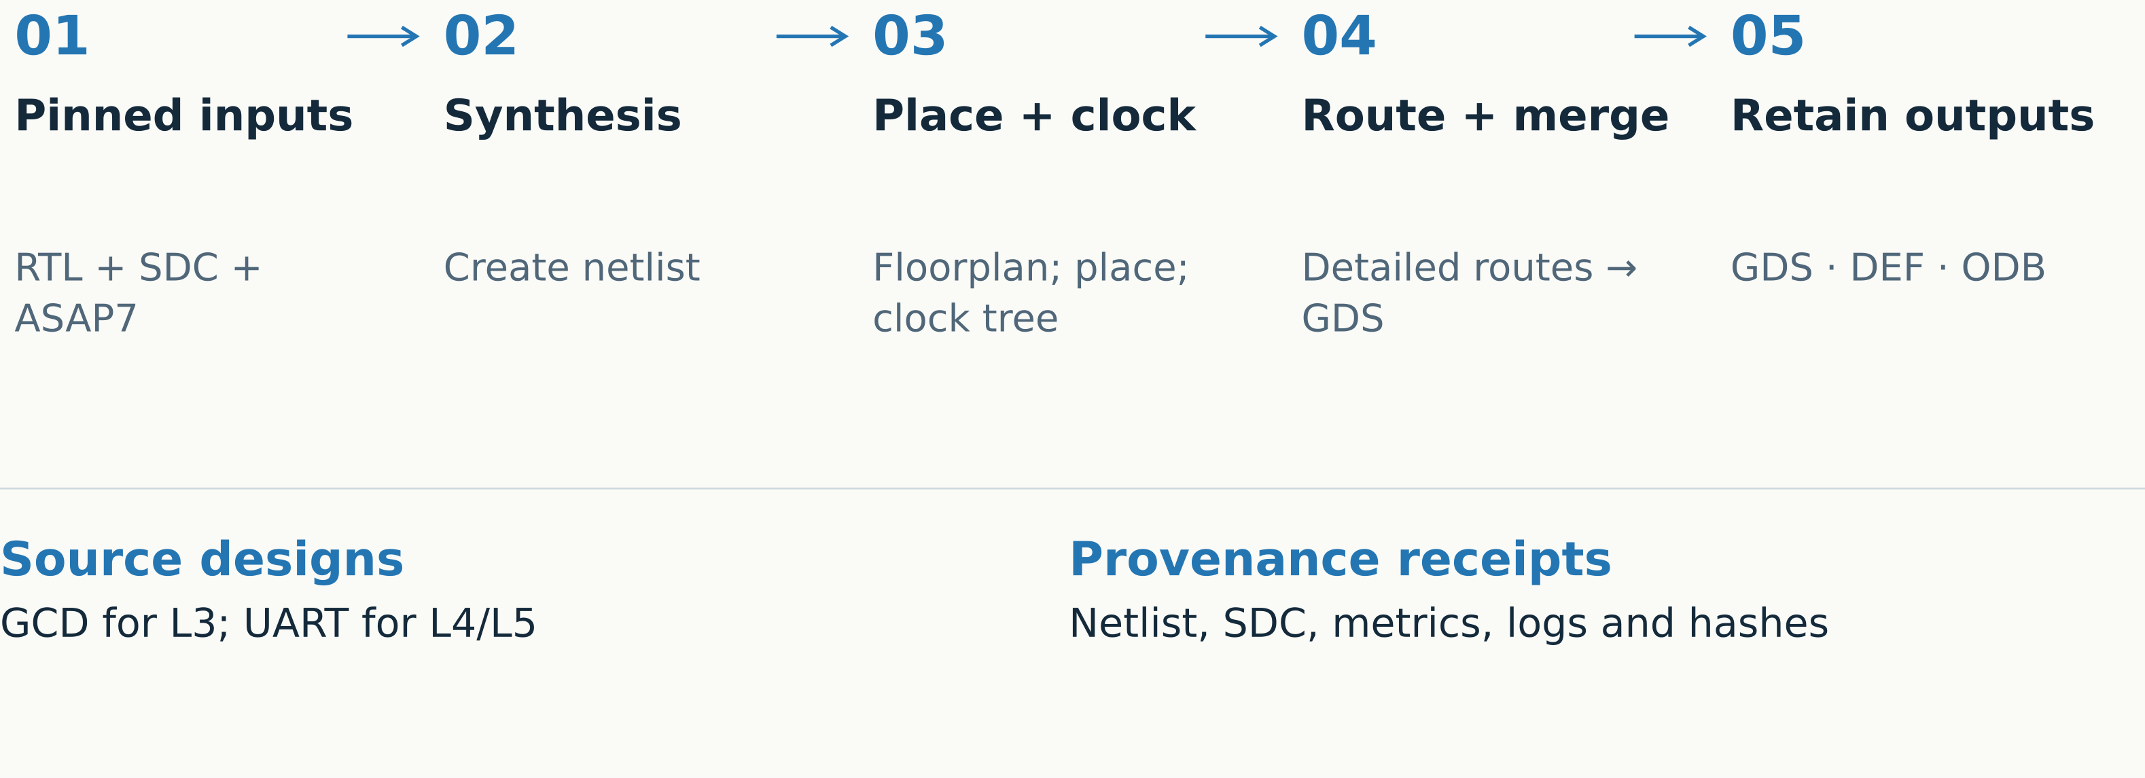
DATASET CREATION
Routed source construction
The retained source bundle links final geometry to the build inputs
Sources: ORFS toolchain + provenance receipts · exact paths in notes
08
Notes:
RTL is the hardware description. SDC supplies timing constraints. DEF records physical placement and routing; ODB is the OpenROAD database. Routed sources use the pinned OpenROAD Flow Scripts revision 64939f3717ad7c694199ba04cb98924b98022868. Official container: openroad/orfs@sha256:6810dbf0e03dddbc89ed8c0a1e13cad09ce4c98d40c4ac0ab99fdc04b0676347. Flow inputs include RTL, timing constraints and ASAP7 technology collateral. Completed builds retain merged GDS, DEF, ODB, netlist, SDC, configuration, metrics, logs and per-artifact hashes. OpenROAD reports an unknown version string; actual binary hash and image digest identify it. Builds ran serially with two threads, no container network and a 60-minute limit. This deck reads retained bundles and does not repeat source builds.
Exact source references:
/home/ankdesh/explore/build-with-terminator/eda/gdsii/klayout-4-drc/docs/C2_C3_BENCHMARK.md
/home/ankdesh/explore/build-with-terminator/eda/gdsii/klayout-4-drc/test_data/benchmark_c2c3/provenance/README.md
/home/ankdesh/explore/build-with-terminator/eda/gdsii/klayout-4-drc/src/klayout_drc/benchmark/c2c3/toolchain.py
/home/ankdesh/explore/build-with-terminator/eda/gdsii/klayout-4-drc/test_data/benchmark_c2c3/provenance/toolchain.json
/home/ankdesh/explore/build-with-terminator/eda/gdsii/klayout-4-drc/reports/runs/c2c3_v1_agent/frozen_source.json
Layer colors in native geometry: M1 blue(19/0), M2 amber(20/0), V1 purple(21/0), V2 rose(25/0), M3 green(30/0). Red overlays are saved scored markers, teal outlines are spatial permission masks, cyan outlines locate top inspection windows. Colors have no net identity meaning.
Figure description: The retained source bundle links final geometry to the build inputs
Units: process order, no geometric scale
Encoding: Source inputs → retained artifact bundle.

Slide 9
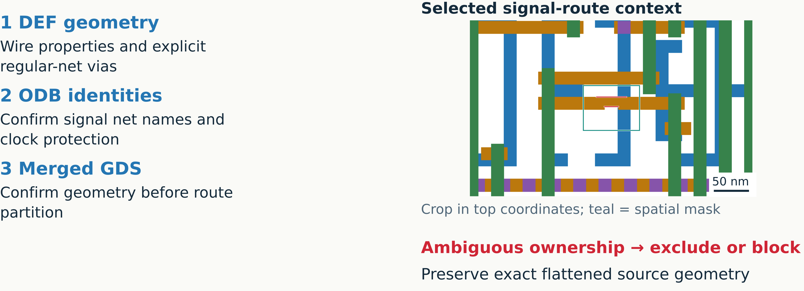
DATASET CREATION
Route ownership and extraction
Only unambiguous signal routes become editable
M1 blue · M2 amber · V1 purple · V2 rose · M3 green | Red: saved markers
Sources: DEF/ODB/GDS ownership checks + route extractor · exact paths in notes
09
Notes:
KLayout imports DEF wires with net properties. Explicit regular-NETS via statements supply ownership when properties are omitted; only supported unrotated via statements qualify. ODB net identities are exported with Tcl and checked against the DEF ownership. Geometry is matched against merged GDS. Power and clock routes stay protected; conservative clock classification uses signal types, terminals, CTS connections and names. Ambiguous ownership, geometry or clock classification is excluded or blocks preparation. Only routing via cells are expanded. Real standard-cell masters and placements remain hierarchical. Route partitioning must preserve exact flattened geometry. The inset shows the actual l3_g0_c0 top-coordinate inspection window.
Exact source references:
/home/ankdesh/explore/build-with-terminator/eda/gdsii/klayout-4-drc/src/klayout_drc/benchmark/c2c3/routes.py
/home/ankdesh/explore/build-with-terminator/eda/gdsii/klayout-4-drc/src/klayout_drc/benchmark/c2c3/routed_generator.py
/home/ankdesh/explore/build-with-terminator/eda/gdsii/klayout-4-drc/docs/C2_C3_BENCHMARK.md
/home/ankdesh/explore/build-with-terminator/eda/gdsii/klayout-4-drc/reports/runs/c2c3_v1_agent/frozen_source.json
Layer colors in native geometry: M1 blue(19/0), M2 amber(20/0), V1 purple(21/0), V2 rose(25/0), M3 green(30/0). Red overlays are saved scored markers, teal outlines are spatial permission masks, cyan outlines locate top inspection windows. Colors have no net identity meaning.
Figure description: Only unambiguous signal routes become editable
Units: µm in inspection crop
Encoding: Three evidence sources plus actual context inset.

Slide 10
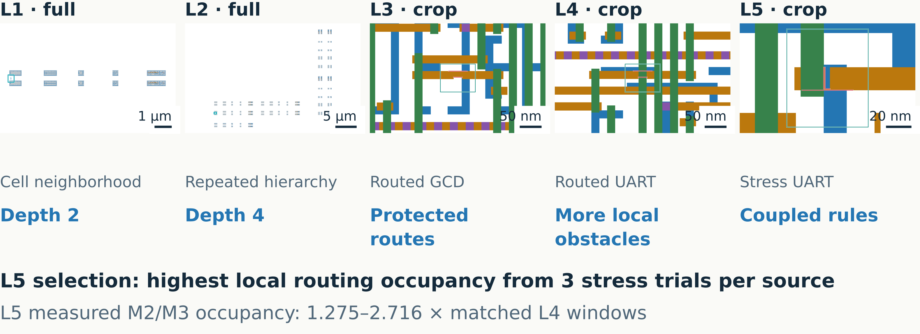
DATASET CREATION
Five complexity levels
Each level adds hierarchy, routing context, or coupled constraints
M1 blue · M2 amber · V1 purple · V2 rose · M3 green | Red: saved markers
Sources: C2/C3 manifest + stress selection + obstacle audit · exact paths in notes
10
Notes:
L1/L2 use real cells and preserve their hierarchy. L3 retains full routed GCD blocks from two utilization settings, with 721/976 total structural and cell instances. L4 uses UART with 8-bit/12-bit data widths and 1909/1978 total instances. Measured protected polygon intersections in repair windows rise from median 28.5 in L3 to 50 in L4. L5 chooses the highest local M2/M3 routing occupancy among three stress trials per source. Accepted L5 repair windows must exceed matched L4 occupancy by at least 25%; observed ratios are 1.275–2.716. The six L5 repair cases couple M2 width and V2 enclosure by M2 on the same landing. These images have independent scales; L1/L2 are full views and L3–L5 are labeled inspection crops.
Exact source references:
/home/ankdesh/explore/build-with-terminator/eda/gdsii/klayout-4-drc/test_data/benchmark_c2c3/manifest.json
/home/ankdesh/explore/build-with-terminator/eda/gdsii/klayout-4-drc/test_data/benchmark_c2c3/provenance/stress_selection.json
/home/ankdesh/explore/build-with-terminator/eda/gdsii/klayout-4-drc/test_data/benchmark_c2c3/provenance/obstacle_audit.json
Layer colors in native geometry: M1 blue(19/0), M2 amber(20/0), V1 purple(21/0), V2 rose(25/0), M3 green(30/0). Red overlays are saved scored markers, teal outlines are spatial permission masks, cyan outlines locate top inspection windows. Colors have no net identity meaning.
Figure description: Each level adds hierarchy, routing context, or coupled constraints
Units: µm, occupancy ratios
Encoding: Five independent scales. Local metal occupancy, not global placement density.

Slide 11
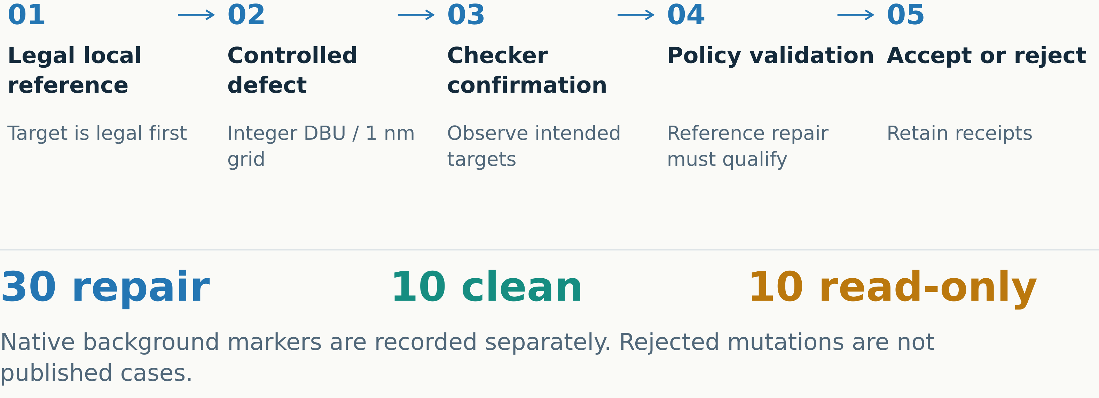
DATASET CREATION
C2/C3 mutation and qualification
C2/C3 starts with a legal local target before injecting the defect
Sources: C2/C3 generators + checker qualification · exact paths in notes
11
Notes:
Unlike C1 synthetic seeds, C2/C3 constructs a legal local reference before a controlled mutation. Inputs and references are written and reread, then checked under asap7_c2c3_v1. Intended target markers must be observed. The hidden reference repair must pass edit policy and scored checks for repair cases. Read-only cases deliberately disallow the hidden reference change, so the expected action is unchanged geometry. Clean controls have zero native scored markers; public deck background can differ. Rejected mutation candidates stay in rejection logs. There are 30 repair, ten clean and ten read-only cases, with six/two/two per level. Grid is 1 nm, or four 0.25 nm DBUs.
Exact source references:
/home/ankdesh/explore/build-with-terminator/eda/gdsii/klayout-4-drc/src/klayout_drc/benchmark/c2c3/generator.py
/home/ankdesh/explore/build-with-terminator/eda/gdsii/klayout-4-drc/src/klayout_drc/benchmark/c2c3/routed_generator.py
/home/ankdesh/explore/build-with-terminator/eda/gdsii/klayout-4-drc/test_data/benchmark_c2c3/manifest.json
/home/ankdesh/explore/build-with-terminator/eda/gdsii/klayout-4-drc/docs/C2_C3_BENCHMARK.md
/home/ankdesh/explore/build-with-terminator/eda/gdsii/klayout-4-drc/reports/runs/c2c3_v1_agent/frozen_source.json
Layer colors in native geometry: M1 blue(19/0), M2 amber(20/0), V1 purple(21/0), V2 rose(25/0), M3 green(30/0). Red overlays are saved scored markers, teal outlines are spatial permission masks, cyan outlines locate top inspection windows. Colors have no net identity meaning.
Figure description: C2/C3 starts with a legal local target before injecting the defect
Units: case counts; DBU and nm
Encoding: Qualification flow with separate kind denominators.

Slide 12
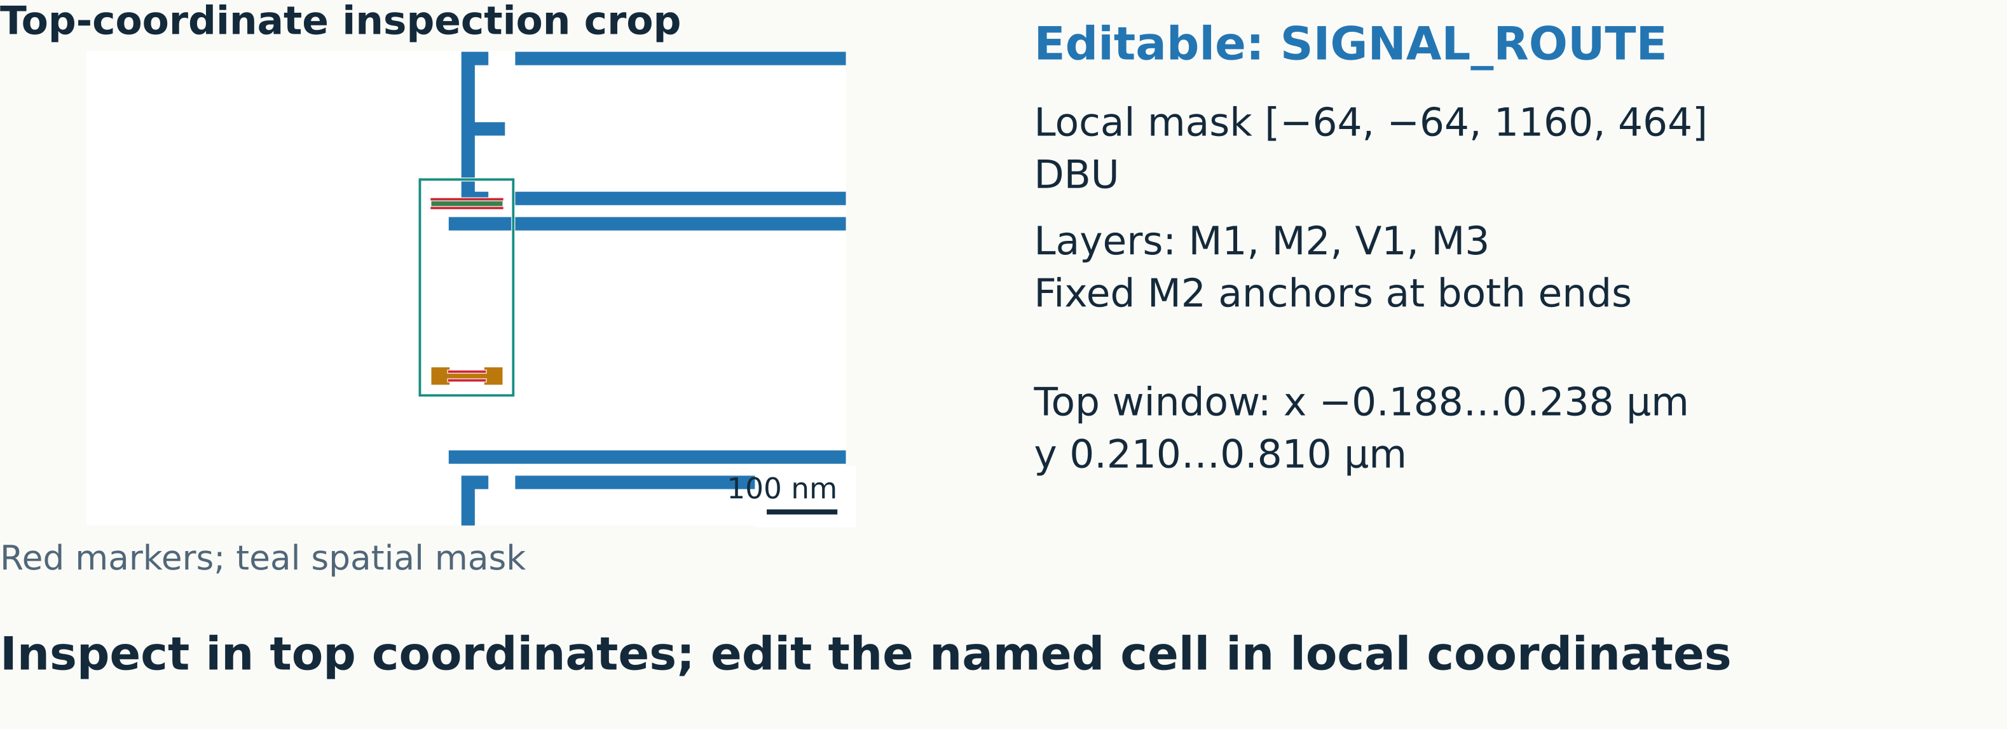
REPAIR WORKFLOW
Edit permissions and coordinate frames
A spatial mask alone does not grant permission to edit every shape inside it
M1 blue · M2 amber · V1 purple · V2 rose · M3 green | Red: saved markers
Sources: Public edit policy + retained input GDS · exact paths in notes
12
Notes:
Concrete example l2_g1_c0: editable cell SIGNAL_ROUTE has local mask [-64,-64,1160,464] DBU and editable layers 19/0,20/0,21/0,30/0. Two fixed M2 anchor boxes are [0,0,96,24] and [0,376,96,400] DBU. The top inspection window is [-0.188,0.210,0.238,0.810] micrometers. A recursive iterator applies accumulated hierarchy transforms to inspect top coordinates. Candidate edits must target the named local route cell; flattening into protected masters is forbidden. All other contents, properties and instance definitions are immutable. New same-layer protected overlaps and route deletion are rejected. An empty editable-cell map requires an unchanged output.
Exact source references:
/home/ankdesh/explore/build-with-terminator/eda/gdsii/klayout-4-drc/test_data/benchmark_c2c3/manifest.json
/home/ankdesh/explore/build-with-terminator/eda/gdsii/klayout-4-drc/src/klayout_drc/edit_policy.py
/home/ankdesh/explore/build-with-terminator/eda/gdsii/klayout-4-drc/src/klayout_drc/benchmark/c2c3/generator.py
/home/ankdesh/explore/build-with-terminator/eda/gdsii/klayout-4-drc/reports/runs/c2c3_v1_agent/frozen_source.json
Layer colors in native geometry: M1 blue(19/0), M2 amber(20/0), V1 purple(21/0), V2 rose(25/0), M3 green(30/0). Red overlays are saved scored markers, teal outlines are spatial permission masks, cyan outlines locate top inspection windows. Colors have no net identity meaning.
Figure description: A spatial mask alone does not grant permission to edit every shape inside it
Units: local DBU; top µm
Encoding: Actual top crop; public local policy values. Teal is spatial permission only.

Slide 13
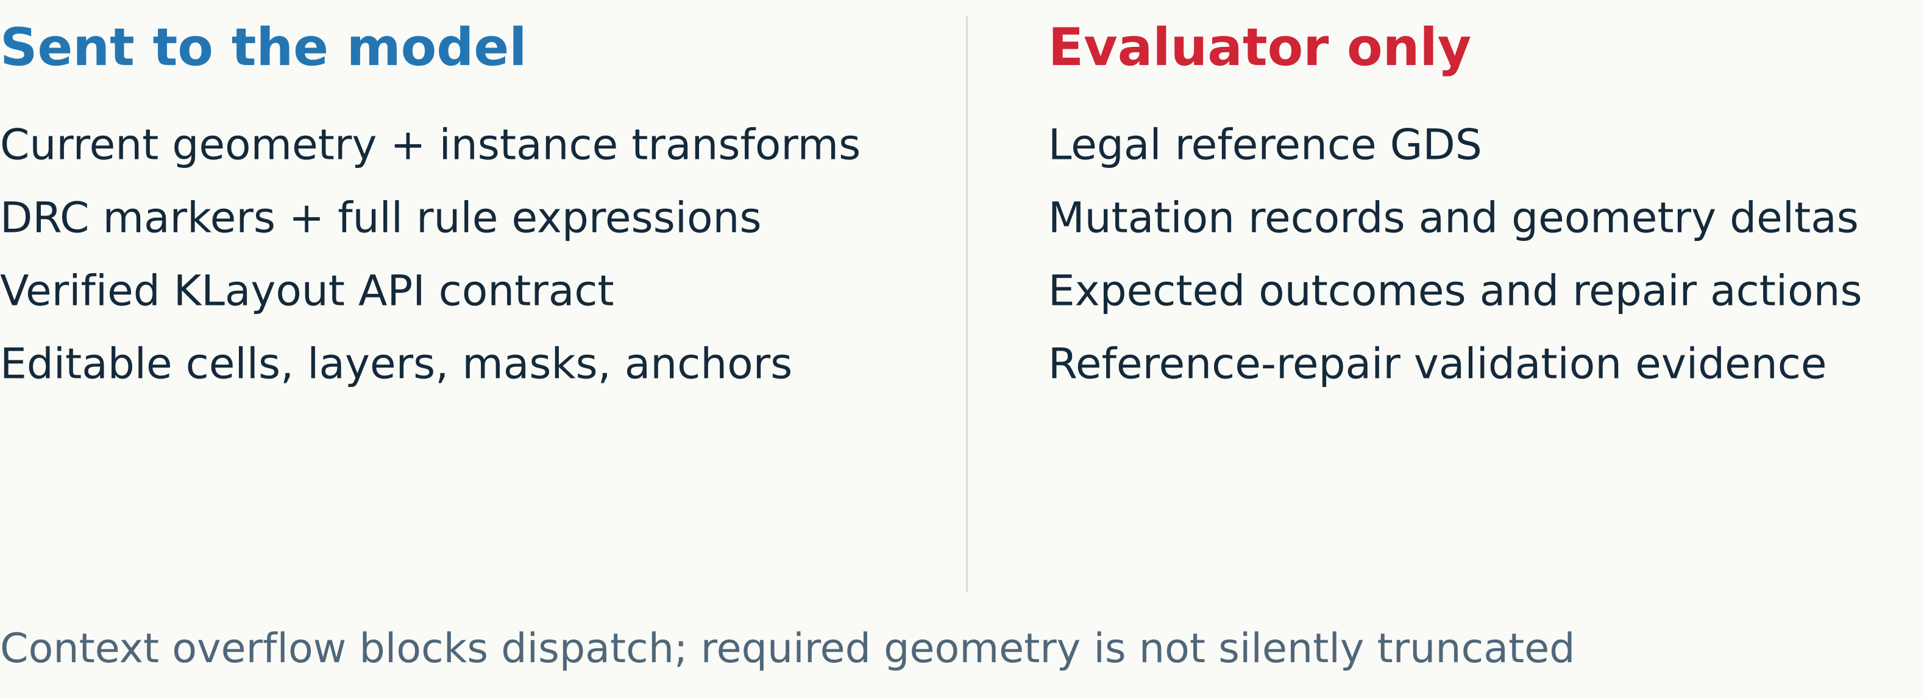
REPAIR WORKFLOW
Information supplied to the model
Public task context is separate from private evaluator evidence
Sources: Frozen synthesis sources + public policy contract · exact paths in notes
13
Notes:
The public request contains repair instructions, active technology/layer facts, the complete verified API reference, current layout geometry, markers, deck expressions and case edit policy. C2/C3 adds local and top coordinates, instance paths and transforms. The oracle directory is not provided to either the model or candidate worker. This keeps hidden references, mutation recipes and expected actions evaluator-only. If required geometry exceeds 1024 shapes or 120000 context characters, the case is blocked instead of truncated. This deck uses private evidence to explain dataset qualification, not as model input. C1 request identity was verified for all 100 cases after excluding the model field.
Exact source references:
/home/ankdesh/explore/build-with-terminator/eda/gdsii/klayout-4-drc/src/klayout_drc/edit_policy.py
/home/ankdesh/explore/build-with-terminator/eda/gdsii/klayout-4-drc/docs/C2_C3_BENCHMARK.md
/home/ankdesh/explore/build-with-terminator/eda/gdsii/klayout-4-drc/knowledge/klayout_api_patterns.md
/home/ankdesh/explore/build-with-terminator/eda/gdsii/klayout-4-drc/reports/runs/c2c3_v1_agent/frozen_source.json
Layer colors in native geometry: M1 blue(19/0), M2 amber(20/0), V1 purple(21/0), V2 rose(25/0), M3 green(30/0). Red overlays are saved scored markers, teal outlines are spatial permission masks, cyan outlines locate top inspection windows. Colors have no net identity meaning.
Figure description: Public task context is separate from private evaluator evidence
Units: information boundary
Encoding: Two columns separated by explicit public/private boundary.

Slide 14
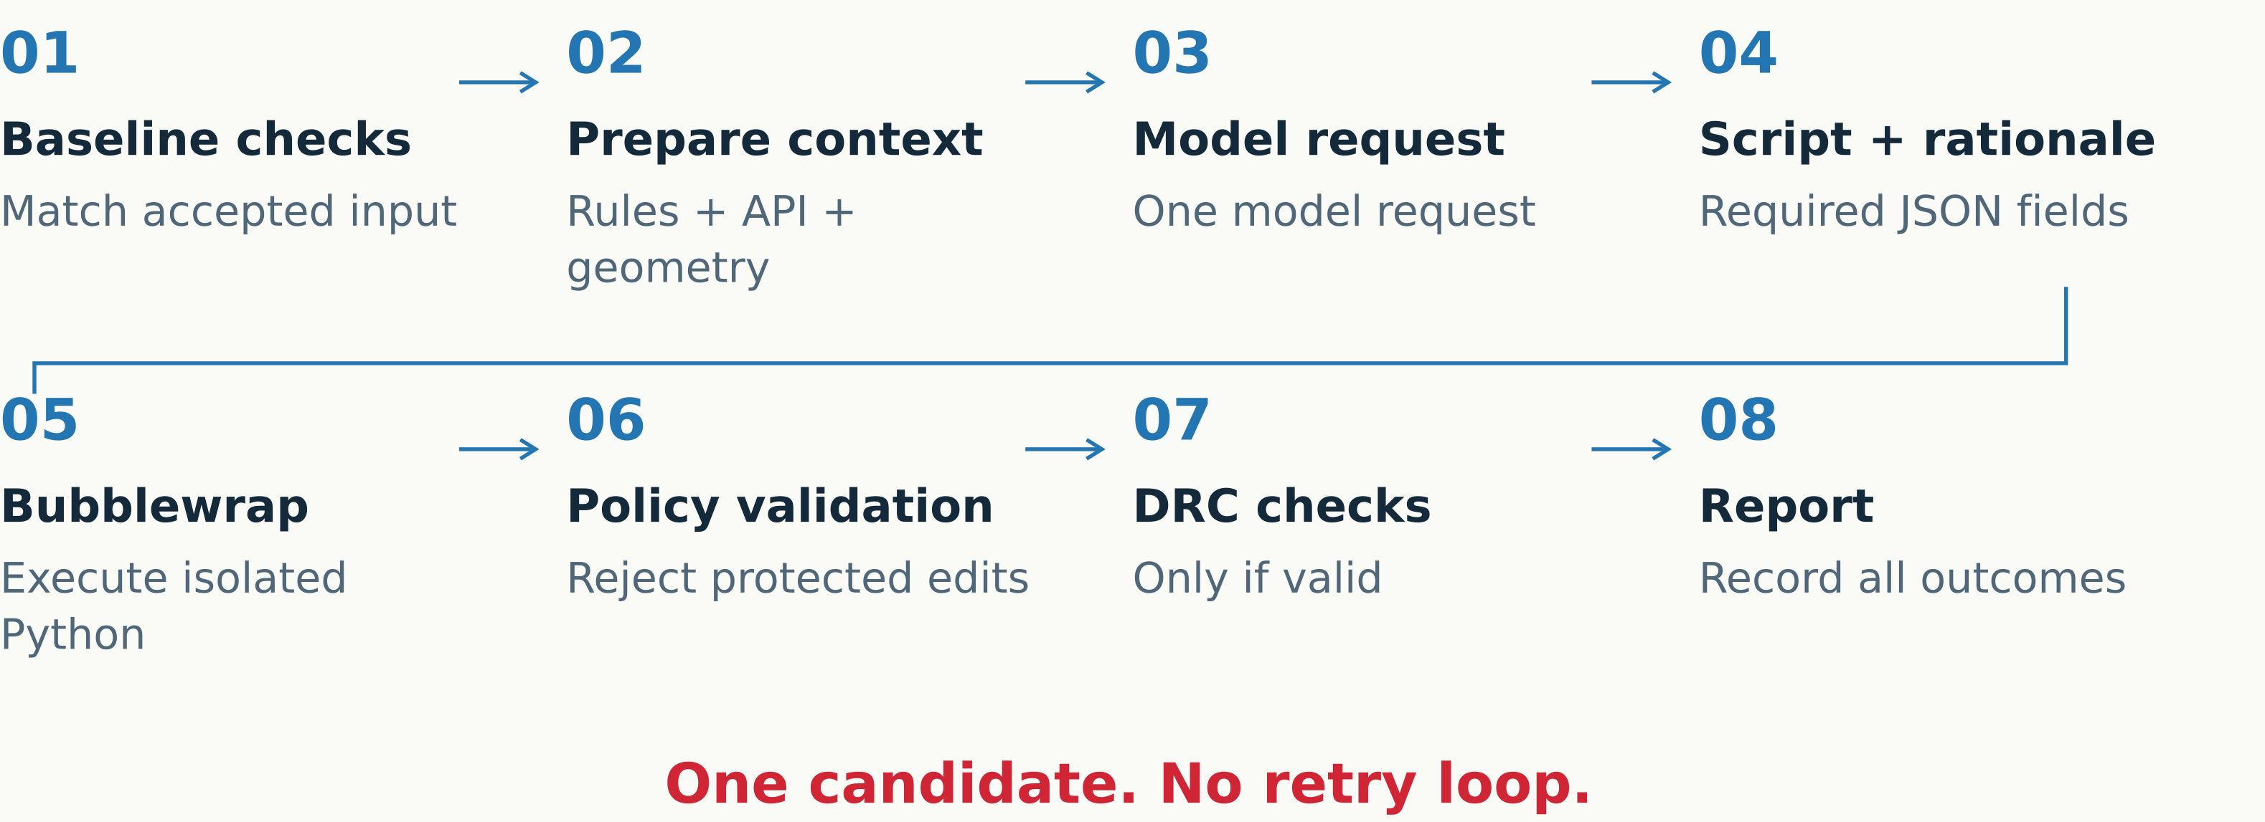
REPAIR WORKFLOW
One repair attempt
Validation runs before after-DRC; failures remain recorded
Sources: Frozen evaluator + synthesis + sandbox sources · exact paths in notes
14
Notes:
Before dispatch, the pipeline verifies the input and runs trusted API reference checks in the candidate Python environment. Fresh baseline DRC must match accepted evidence. The model gets one request and must return python_script and rationale. The script executes in Bubblewrap, then layout and preservation/edit-policy validation run. Only valid candidates proceed to after-DRC and marker comparison. The report keeps failures and missing stages explicit. There is no repair retry loop or automatic model correction. The C1 comparison used the same frozen Bedrock source for OpenAI rather than resetting live development files. C2/C3 campaign continuation sent only ten previously unrequested L5 cases; it did not retry earlier failures.
Exact source references:
/home/ankdesh/explore/build-with-terminator/eda/gdsii/klayout-4-drc/reports/runs/c1_bedrock_all100_strict_api_20261027/frozen_source.json
/home/ankdesh/explore/build-with-terminator/eda/gdsii/klayout-4-drc/src/klayout_drc/benchmark/c2c3/evaluator.py
/home/ankdesh/explore/build-with-terminator/eda/gdsii/klayout-4-drc/reports/runs/c2c3_v1_agent/frozen_source.json
Layer colors in native geometry: M1 blue(19/0), M2 amber(20/0), V1 purple(21/0), V2 rose(25/0), M3 green(30/0). Red overlays are saved scored markers, teal outlines are spatial permission masks, cyan outlines locate top inspection windows. Colors have no net identity meaning.
Figure description: Validation runs before after-DRC; failures remain recorded
Units: process order
Encoding: Numbered single attempt, no return arrows.

Slide 15
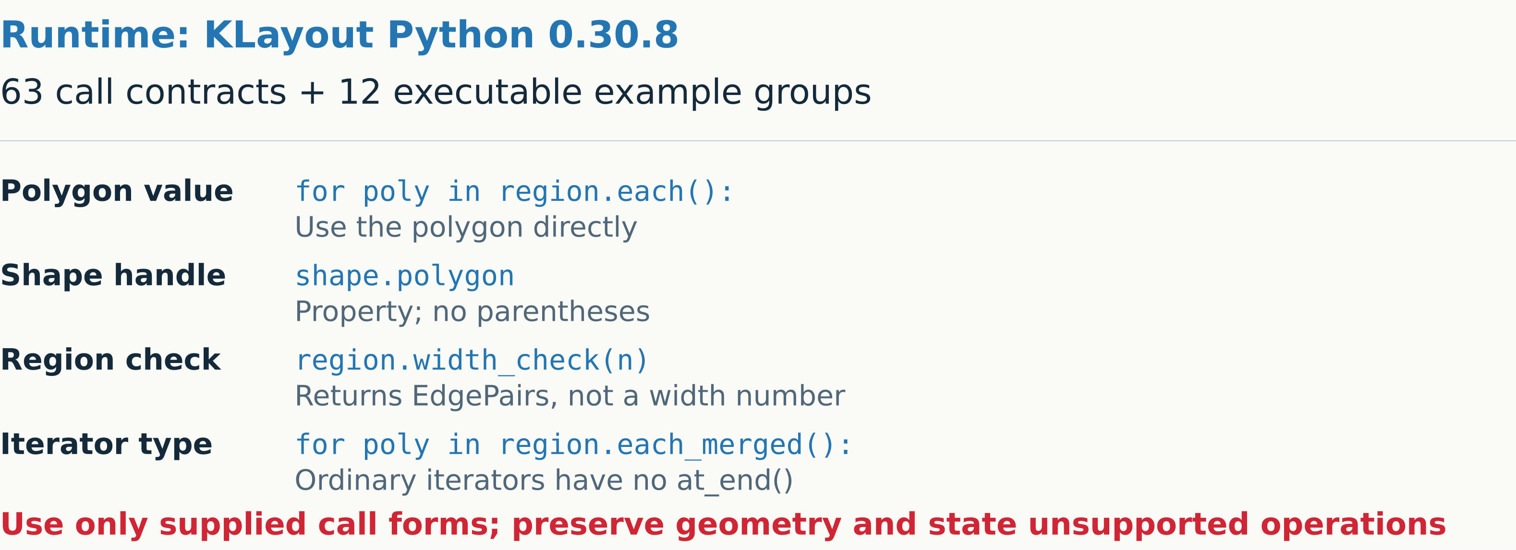
REPAIR WORKFLOW
Verified KLayout API guidance
Reference checks can block dispatch, but model scripts still need execution
Sources: Saved runtime preflight + complete API reference · exact paths in notes
15
Notes:
The tested reference targets klayout.db 0.30.8. Preflight checks execute 63 supported call contracts and 12 example groups on synthetic geometry, asserting values and returned geometry rather than member existence alone. The complete rendered reference is included once. It covers DBU, areas, grid rounding, properties, overloads, transformations, hierarchy, safe editing and known failure replacements. Digest: ad5b7aab61cfeb241a0bbf8188485f49a2629056f325a56e4a2f6593ea8dbac5. The tested reference contains 16169 characters. Region.each()/each_merged() yields polygon values; Shape.polygon is a property on a handle; width_check belongs to Region. Ordinary Python iterators lack at_end(), while a RecursiveShapeIterator supports it. Trusted reference failure stops model dispatch. Guidance cannot guarantee that a model follows it.
Exact source references:
/home/ankdesh/explore/build-with-terminator/eda/gdsii/klayout-4-drc/knowledge/klayout_api_patterns.md
/home/ankdesh/explore/build-with-terminator/eda/gdsii/klayout-4-drc/reports/runs/c1_bedrock_all100_strict_api_20261027/frozen_source.json
/home/ankdesh/explore/build-with-terminator/eda/gdsii/klayout-4-drc/reports/runs/c1_openai_all100_strict_api_20261028/runs/m1_w1_iso_04_20261028_065749_9351fb/api_reference_check.json
/home/ankdesh/explore/build-with-terminator/eda/gdsii/klayout-4-drc/reports/runs/c2c3_v1_agent/frozen_source.json
Layer colors in native geometry: M1 blue(19/0), M2 amber(20/0), V1 purple(21/0), V2 rose(25/0), M3 green(30/0). Red overlays are saved scored markers, teal outlines are spatial permission masks, cyan outlines locate top inspection windows. Colors have no net identity meaning.
Figure description: Reference checks can block dispatch, but model scripts still need execution
Units: DBU thresholds for Region checks
Encoding: Short exact code forms; properties distinguished from method calls.

Slide 16
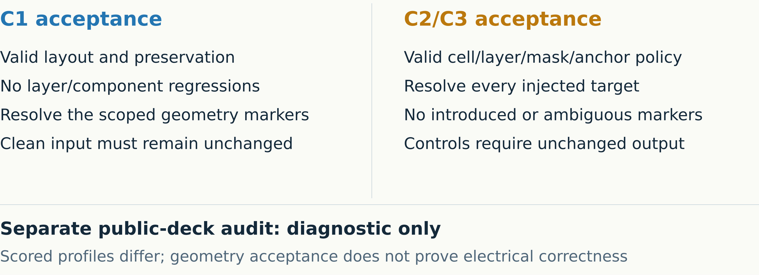
REPAIR WORKFLOW
Acceptance gates
Missing after-DRC is unknown; it never counts as zero markers
Sources: Frozen evaluators + preservation and edit policy · exact paths in notes
16
Notes:
C1 applies its five-family curated profile and preservation checks, including layer and component structure. C2/C3 uses eleven qualified checks; nine occur as injected target families, with M2 spacing and V2/M3 enclosure as additional guards. A repair must complete, pass policy, remove all targets and introduce no new or ambiguous scored markers relative to baseline. Clean and read-only controls require a successfully written unchanged layout; a script error earns no restraint credit. Read-only controls retain intentional defects. Public full-deck audit is separate, diagnostic only, and has a 600-second limit; scoped scoring uses 120 seconds. Native public markers must not be confused with injected targets. Research checker qualification is not foundry signoff.
Exact source references:
/home/ankdesh/explore/build-with-terminator/eda/gdsii/klayout-4-drc/src/klayout_drc/benchmark/c2c3/evaluator.py
/home/ankdesh/explore/build-with-terminator/eda/gdsii/klayout-4-drc/src/klayout_drc/edit_policy.py
/home/ankdesh/explore/build-with-terminator/eda/gdsii/klayout-4-drc/docs/C2_C3_BENCHMARK.md
/home/ankdesh/explore/build-with-terminator/eda/gdsii/klayout-4-drc/reports/runs/c1_bedrock_all100_strict_api_20261027/frozen_source.json
/home/ankdesh/explore/build-with-terminator/eda/gdsii/klayout-4-drc/reports/runs/c2c3_v1_agent/frozen_source.json
Layer colors in native geometry: M1 blue(19/0), M2 amber(20/0), V1 purple(21/0), V2 rose(25/0), M3 green(30/0). Red overlays are saved scored markers, teal outlines are spatial permission masks, cyan outlines locate top inspection windows. Colors have no net identity meaning.
Figure description: Missing after-DRC is unknown; it never counts as zero markers
Units: scored markers; acceptance rules
Encoding: Parallel benchmark gates with separate audit lane.

Slide 17
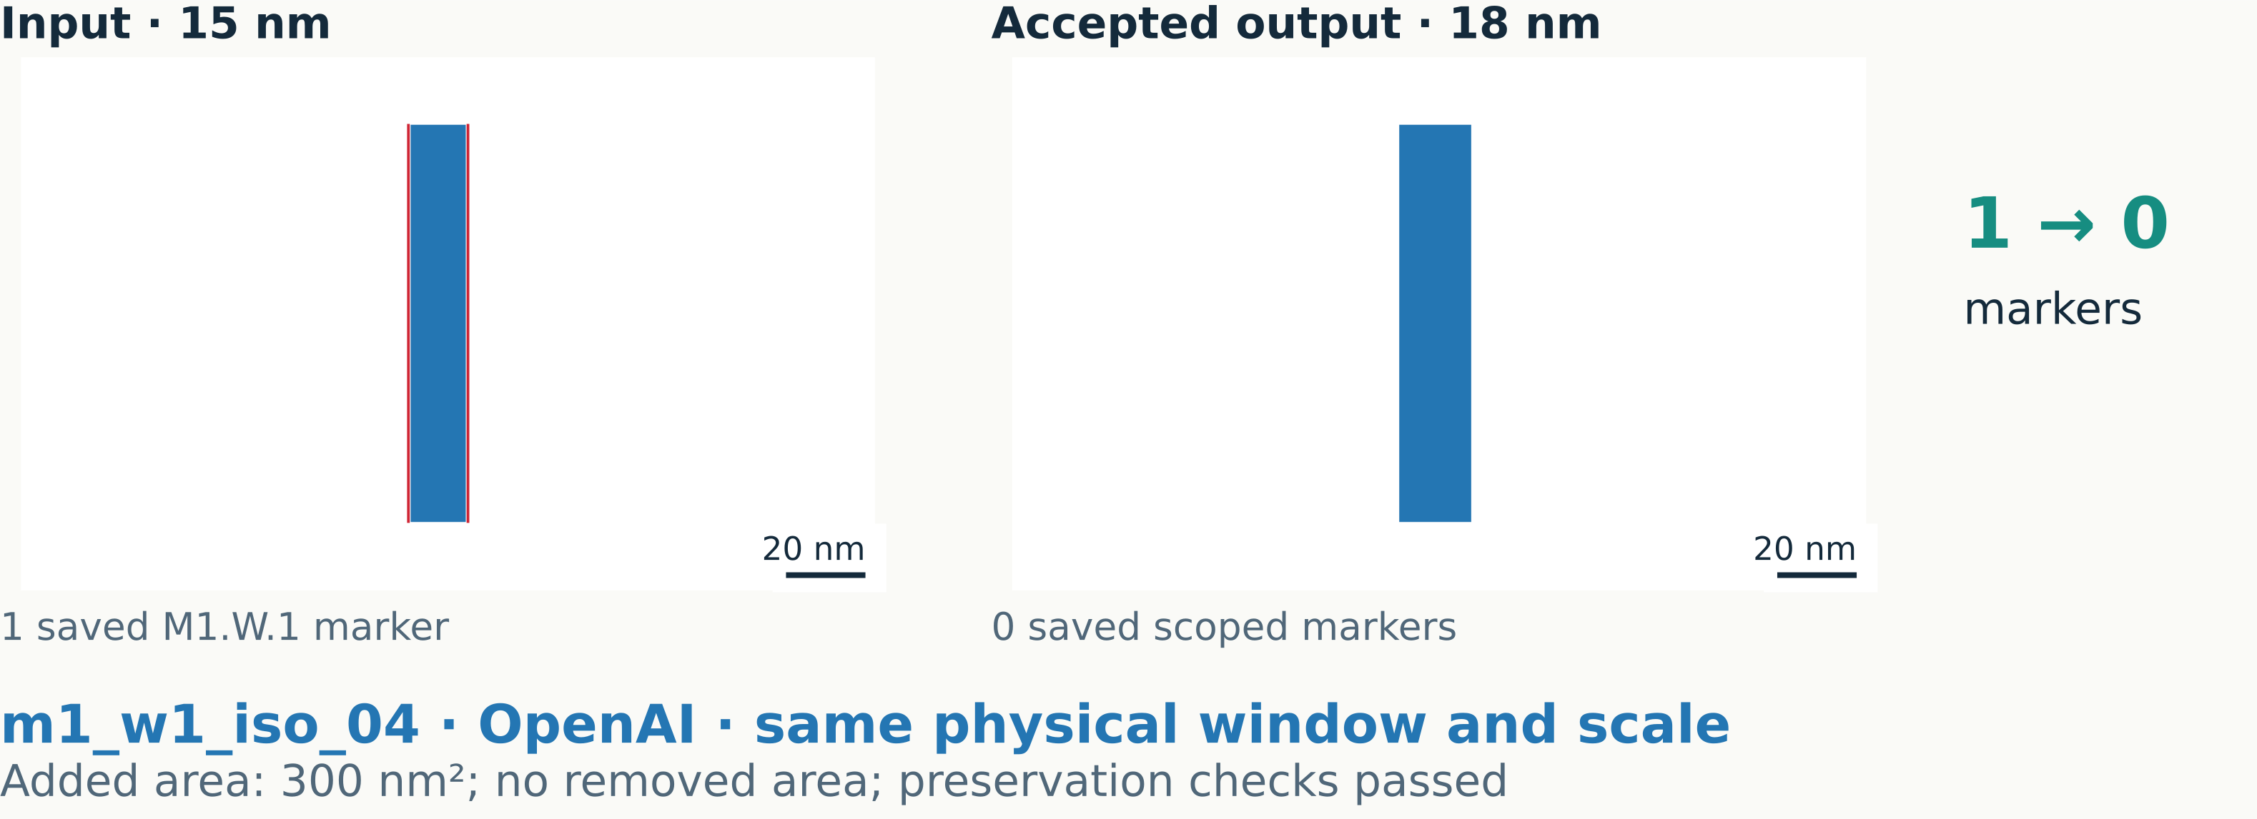
CASE STUDY
A successful C1 repair
The generated script widened the wire from 15 nm to 18 nm
M1 blue · M2 amber · V1 purple · V2 rose · M3 green | Red: saved markers
Sources: OpenAI m1_w1_iso_04 saved run bundle · exact paths in notes
17
Notes:
OpenAI case m1_w1_iso_04 is the generated candidate, not the hidden legal reference. The saved input is one rectangular M1 polygon 15 nm wide and 100 nm long; the saved output is 18 nm by 100 nm. Rectangle checks precede bounding-box width measurement. Input and output use exactly the same physical camera, preserving scale. Saved before/after reports have one and zero scoped markers. Added area is 0.0003 square micrometers, equal to 300 square nanometers; removed area is zero. Validation is geometry-only and preserved the one component. Outcome clean_success; marker matching records one resolved, zero introduced and zero ambiguous. This does not prove net connectivity or timing.
Exact source references:
/home/ankdesh/explore/build-with-terminator/eda/gdsii/klayout-4-drc/reports/runs/c1_openai_all100_strict_api_20261028/runs/m1_w1_iso_04_20261028_065749_9351fb/input.gds
/home/ankdesh/explore/build-with-terminator/eda/gdsii/klayout-4-drc/reports/runs/c1_openai_all100_strict_api_20261028/runs/m1_w1_iso_04_20261028_065749_9351fb/patched.gds
/home/ankdesh/explore/build-with-terminator/eda/gdsii/klayout-4-drc/reports/runs/c1_openai_all100_strict_api_20261028/runs/m1_w1_iso_04_20261028_065749_9351fb/before.lyrdb
/home/ankdesh/explore/build-with-terminator/eda/gdsii/klayout-4-drc/reports/runs/c1_openai_all100_strict_api_20261028/runs/m1_w1_iso_04_20261028_065749_9351fb/after.lyrdb
/home/ankdesh/explore/build-with-terminator/eda/gdsii/klayout-4-drc/reports/runs/c1_openai_all100_strict_api_20261028/runs/m1_w1_iso_04_20261028_065749_9351fb/benchmark_result.json
/home/ankdesh/explore/build-with-terminator/eda/gdsii/klayout-4-drc/reports/runs/c1_openai_all100_strict_api_20261028/runs/m1_w1_iso_04_20261028_065749_9351fb/candidate_fix.py
Layer colors in native geometry: M1 blue(19/0), M2 amber(20/0), V1 purple(21/0), V2 rose(25/0), M3 green(30/0). Red overlays are saved scored markers, teal outlines are spatial permission masks, cyan outlines locate top inspection windows. Colors have no net identity meaning.
Figure description: Actual C1 input15nm wire and accepted18nm output, one marker resolved.
Units: nm, nm²
Encoding: Matched camera GDS input/output with actual saved checker edges.

Slide 18
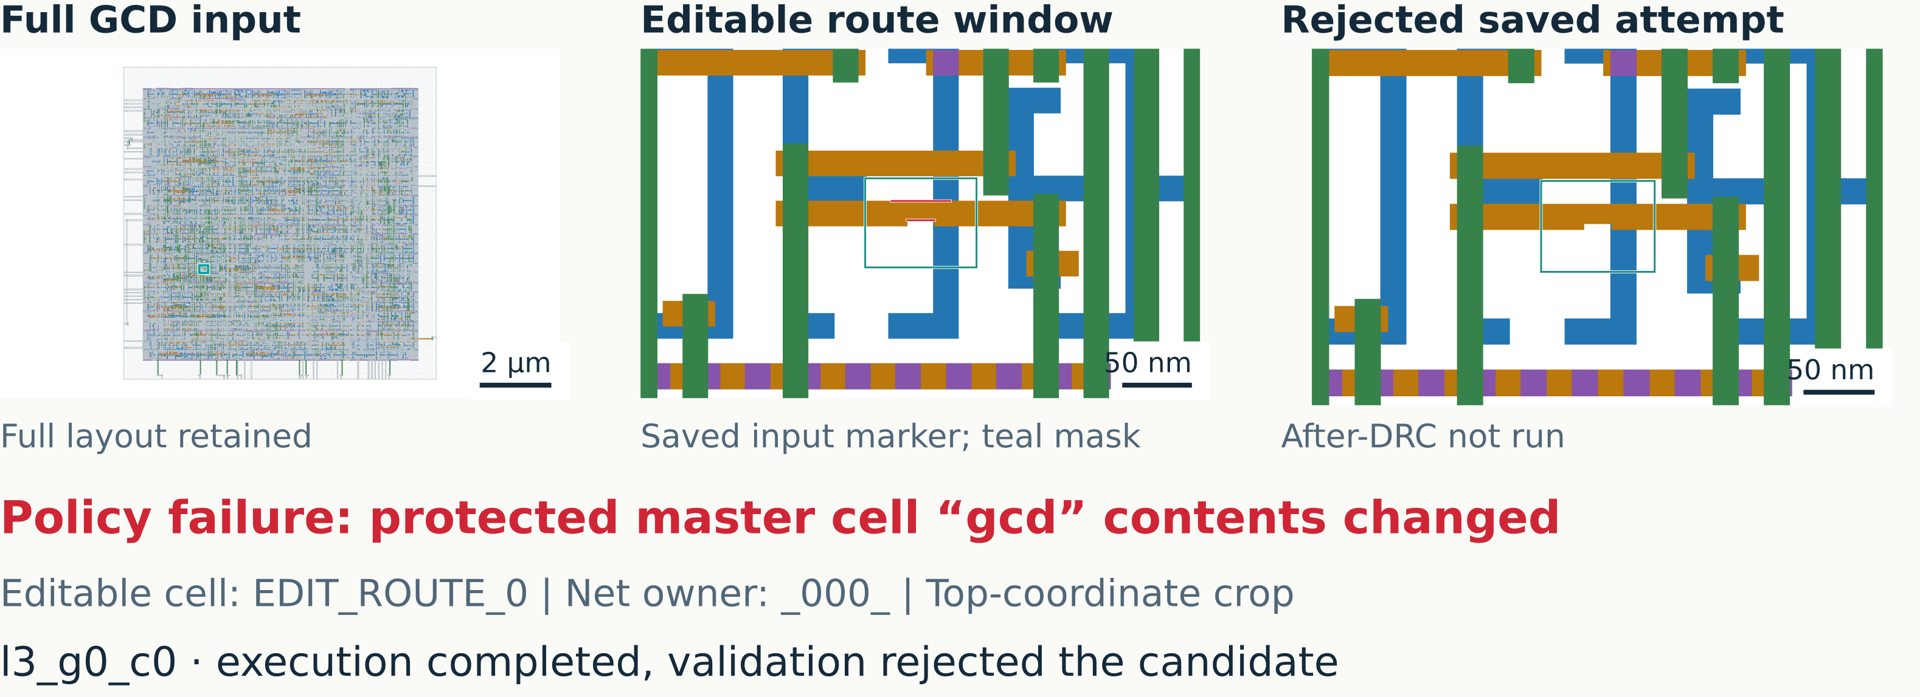
CASE STUDY
A rejected routed repair
Changing a protected master stops evaluation before after-DRC
M1 blue · M2 amber · V1 purple · V2 rose · M3 green | Red: saved markers
Sources: Bedrock l3_g0_c0 saved run bundle · exact paths in notes
18
Notes:
The Bedrock agent produced a saved patched.gds for l3_g0_c0. Its Python execution completed with exit code zero, but validation rejected it: Protected master cell gcd contents changed. Only EDIT_ROUTE_0 and its declared layers, local spatial mask and fixed anchor are editable. Net owner is _000_. One input M2.W.1 marker exists. No after.lyrdb was produced, total_after is null and marker comparison is null. Therefore this is an invalid patch with unknown after-DRC, not a checker-clean repair or zero-marker output. The full-layout overview and context are retained source views. Input crop and rejected candidate crop share the exact same camera.
Exact source references:
/home/ankdesh/explore/build-with-terminator/eda/gdsii/klayout-4-drc/reports/runs/c2c3_v1_agent/runs/l3_g0_c0_20261028_065423_ed44ed/input.gds
/home/ankdesh/explore/build-with-terminator/eda/gdsii/klayout-4-drc/reports/runs/c2c3_v1_agent/runs/l3_g0_c0_20261028_065423_ed44ed/patched.gds
/home/ankdesh/explore/build-with-terminator/eda/gdsii/klayout-4-drc/reports/runs/c2c3_v1_agent/runs/l3_g0_c0_20261028_065423_ed44ed/before.lyrdb
/home/ankdesh/explore/build-with-terminator/eda/gdsii/klayout-4-drc/reports/runs/c2c3_v1_agent/runs/l3_g0_c0_20261028_065423_ed44ed/results.json
/home/ankdesh/explore/build-with-terminator/eda/gdsii/klayout-4-drc/reports/runs/c2c3_v1_agent/runs/l3_g0_c0_20261028_065423_ed44ed/edit_policy.json
/home/ankdesh/explore/build-with-terminator/eda/gdsii/klayout-4-drc/reports/runs/c2c3_v1_agent/runs/l3_g0_c0_20261028_065423_ed44ed/candidate_fix.py
Layer colors in native geometry: M1 blue(19/0), M2 amber(20/0), V1 purple(21/0), V2 rose(25/0), M3 green(30/0). Red overlays are saved scored markers, teal outlines are spatial permission masks, cyan outlines locate top inspection windows. Colors have no net identity meaning.
Figure description: Routed GCD context and rejected output, protected gcd cell changed, afterDRC unavailable.
Units: µm; local DBU policy
Encoding: Full source plus matched input/attempt inspection crops; explicit unavailable after-DRC.

Slide 19
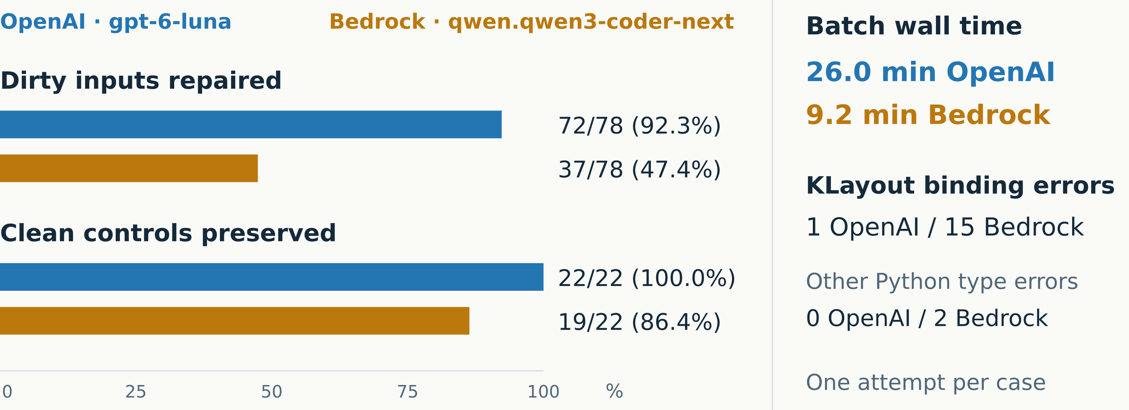
RESULTS / C1
C1 model comparison
Same 100 cases and request contents; model and provider changed together
Sources: C1 campaign comparison + verification JSON · exact paths in notes
19
Notes:
OpenAI gpt-6-luna repaired 72 of78 dirty inputs, 92.3%, versus Bedrock qwen.qwen3-coder-next 37 of78, 47.4%. Clean controls passed unchanged:22/22 versus19/22. Counts and percentages are calculated from comparison.json. C1 batches took1558.872711553 and550.744367333 seconds, respectively, including model generation and local checks. Reviewed KLayout binding failures are1 and15; Bedrock also has2 other Python value-type failures, which must stay separate. Both ran the same frozen pipeline and100 saved request payloads match after excluding model. Explicit temperature, case order, dataset and deck match, but model-specific reasoning and sampling defaults can differ. The result does not isolate endpoint effects. No retries or corrected substitutions were used.
Exact source references:
/home/ankdesh/explore/build-with-terminator/eda/gdsii/klayout-4-drc/reports/runs/c1_openai_all100_strict_api_20261028/comparison.json
/home/ankdesh/explore/build-with-terminator/eda/gdsii/klayout-4-drc/reports/runs/c1_openai_all100_strict_api_20261028/verification.json
Layer colors in native geometry: M1 blue(19/0), M2 amber(20/0), V1 purple(21/0), V2 rose(25/0), M3 green(30/0). Red overlays are saved scored markers, teal outlines are spatial permission masks, cyan outlines locate top inspection windows. Colors have no net identity meaning.
Figure description: C1 OpenAI repairs72/78, controls22/22; Bedrock37/78,19/22; runtime26.0versus9.2minutes.
Units: cases, %, minutes
Encoding: Linear0–100% bars, separate78/22 denominators, direct labels.

Slide 20
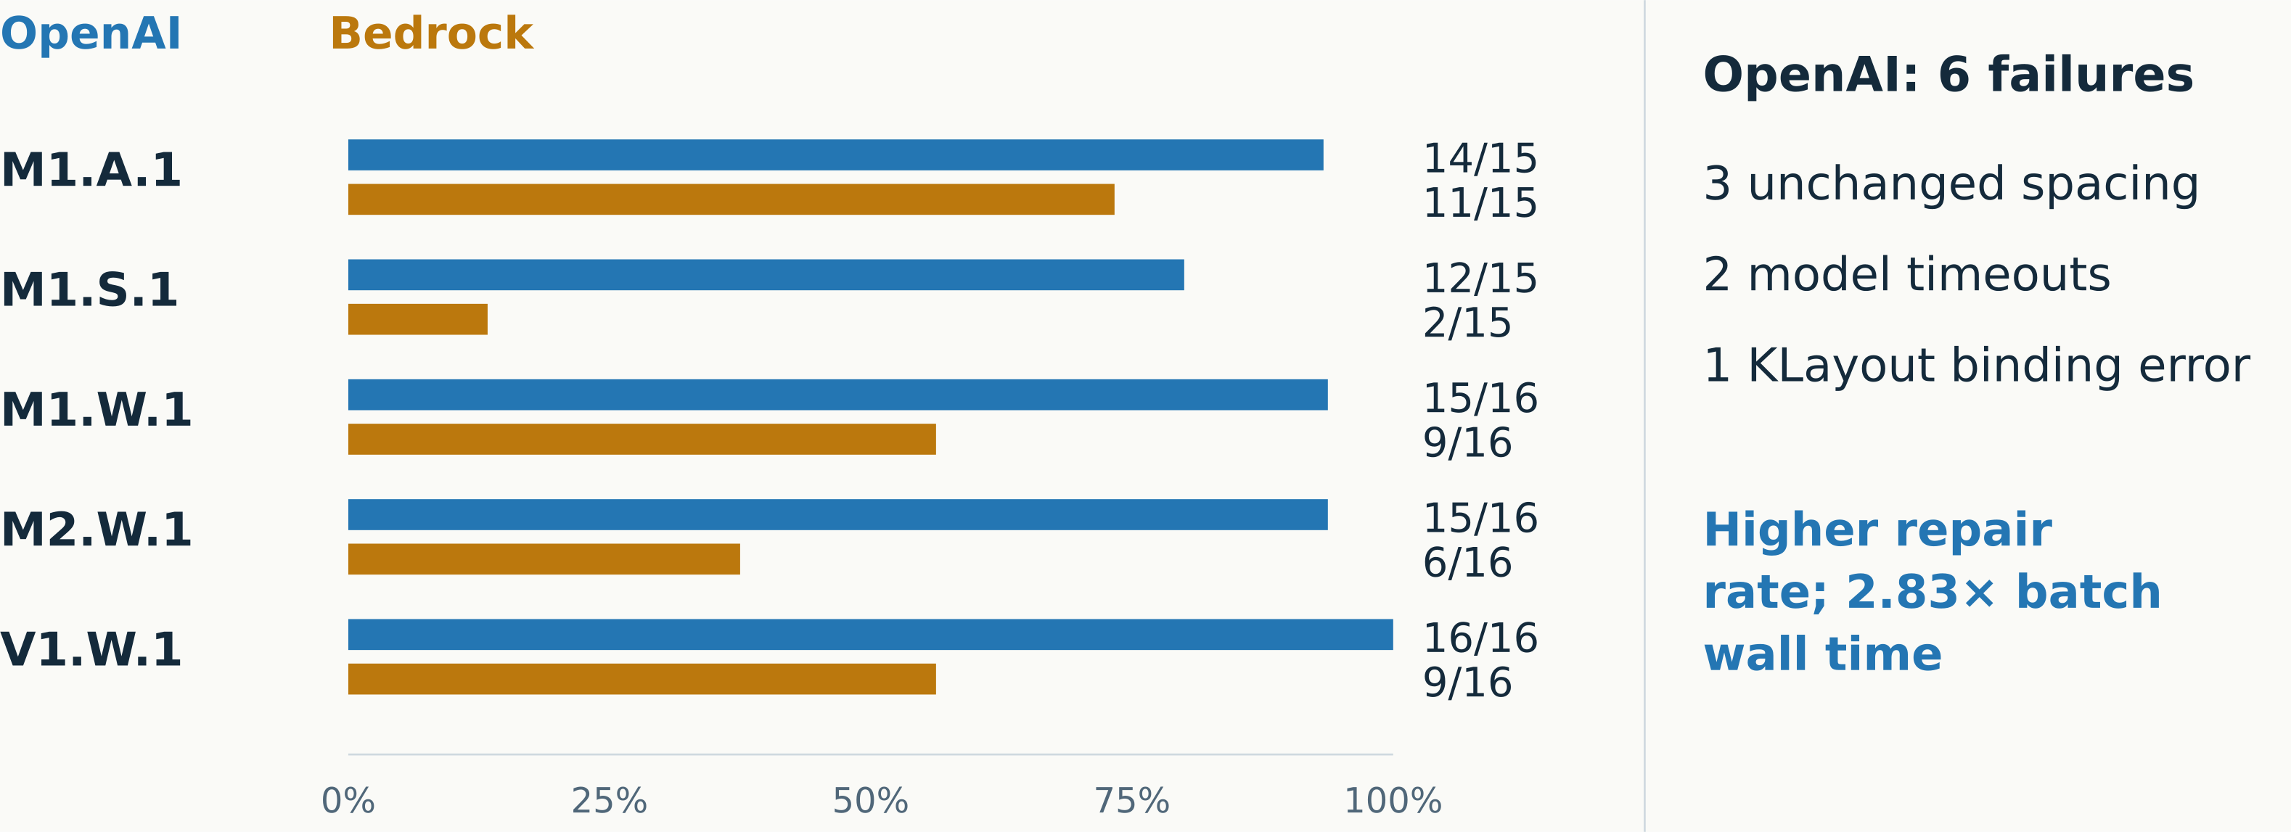
RESULTS / C1
C1 results by rule
OpenAI improved repair counts in every family; spacing still left three cases
Sources: C1 campaign comparison JSON · exact paths in notes
20
Notes:
The five rows use dirty-case denominators only: M1.A.1 is14/15 OpenAI versus11/15 Bedrock; M1.S.1 is12/15 versus2/15; M1.W.1 is15/16 versus9/16; M2.W.1 is15/16 versus6/16; V1.W.1 is16/16 versus9/16. Per-rule percentages use these denominators, not20 total entries. Remaining OpenAI failures: m1_s1_iso_02,m1_s1_iso_05,m1_s1_int_03 left spacing defects unchanged; m1_w1_int_03 and m1_a1_iso_04 timed out; m2_w1_iso_03 called at_end on an ordinary iterator. Runtime ratio1558.872711553/550.744367333 is2.83048, displayed2.83. Single attempts provide no consistency estimate. These are development results, not held-out generalization evidence.
Exact source references:
/home/ankdesh/explore/build-with-terminator/eda/gdsii/klayout-4-drc/reports/runs/c1_openai_all100_strict_api_20261028/comparison.json
Layer colors in native geometry: M1 blue(19/0), M2 amber(20/0), V1 purple(21/0), V2 rose(25/0), M3 green(30/0). Red overlays are saved scored markers, teal outlines are spatial permission masks, cyan outlines locate top inspection windows. Colors have no net identity meaning.
Figure description: OpenAI improved repair counts in every family; spacing still left three cases
Units: repair cases / dirty cases, %
Encoding: Paired bars from0to100 with exact counts. Runtime separately annotated.

Slide 21
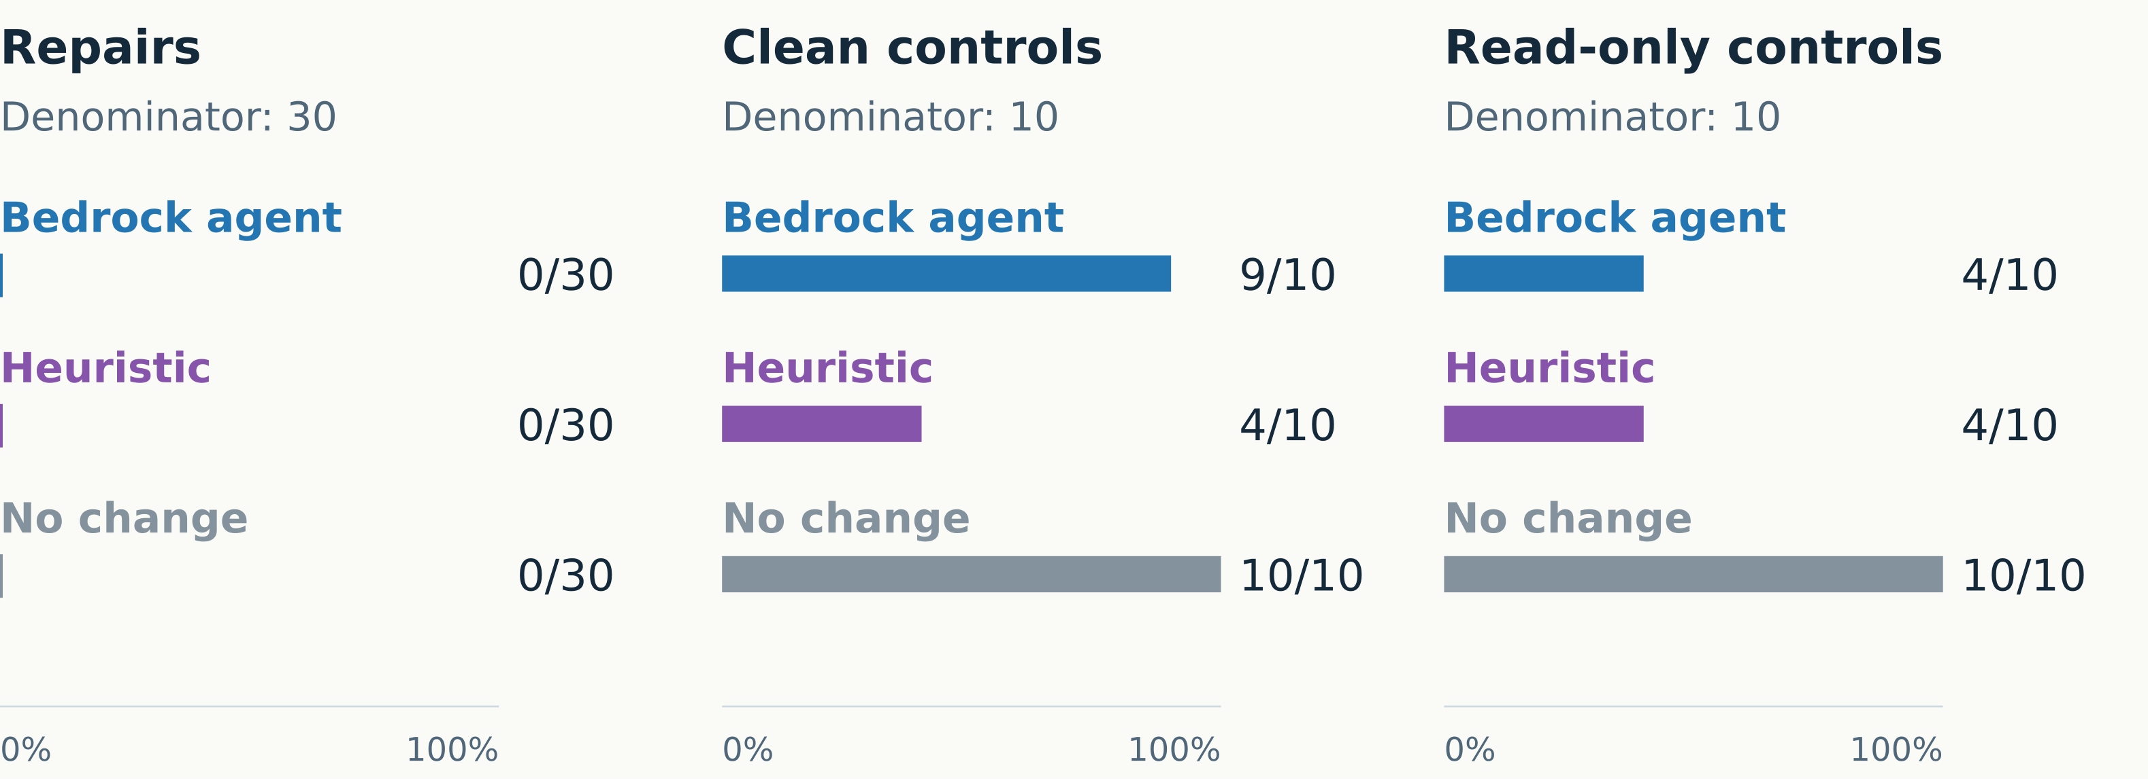
RESULTS / C2/C3
C2/C3 method comparison
All tested methods repaired 0/30; control restraint differs
Sources: Separate agent, heuristic and no-change summaries · exact paths in notes
21
Notes:
C2/C3 uses a separate scope with30 repair,10 clean and10 read-only cases. The Bedrock agent repaired0/30, preserved9/10 clean and4/10 read-only controls. The existing heuristic repaired0/30 and preserved4/10 in each control group. The no-change baseline repaired0/30 and preserved10/10 in each control group. Zero repair is an observed result, not missing measurement. A no-change result on a read-only case is success despite retaining its intentional defect. Baselines are reported separately. Existing heuristic writes can violate hierarchical route-cell policies;12 valid C2 repair outputs were unchanged. Methods shared the host concurrently, so no runtime ranking is shown. OpenAI was not evaluated on C2/C3.
Exact source references:
/home/ankdesh/explore/build-with-terminator/eda/gdsii/klayout-4-drc/docs/reports/c2_c3_benchmark/agent/summary.json
/home/ankdesh/explore/build-with-terminator/eda/gdsii/klayout-4-drc/docs/reports/c2_c3_benchmark/heuristic/summary.json
/home/ankdesh/explore/build-with-terminator/eda/gdsii/klayout-4-drc/docs/reports/c2_c3_benchmark/no_change/summary.json
Layer colors in native geometry: M1 blue(19/0), M2 amber(20/0), V1 purple(21/0), V2 rose(25/0), M3 green(30/0). Red overlays are saved scored markers, teal outlines are spatial permission masks, cyan outlines locate top inspection windows. Colors have no net identity meaning.
Figure description: All tested methods repaired 0/30; control restraint differs
Units: successes /30 or /10, %
Encoding: Three independent denominator groups, common0to100% scale; zero explicitly marked.

Slide 22
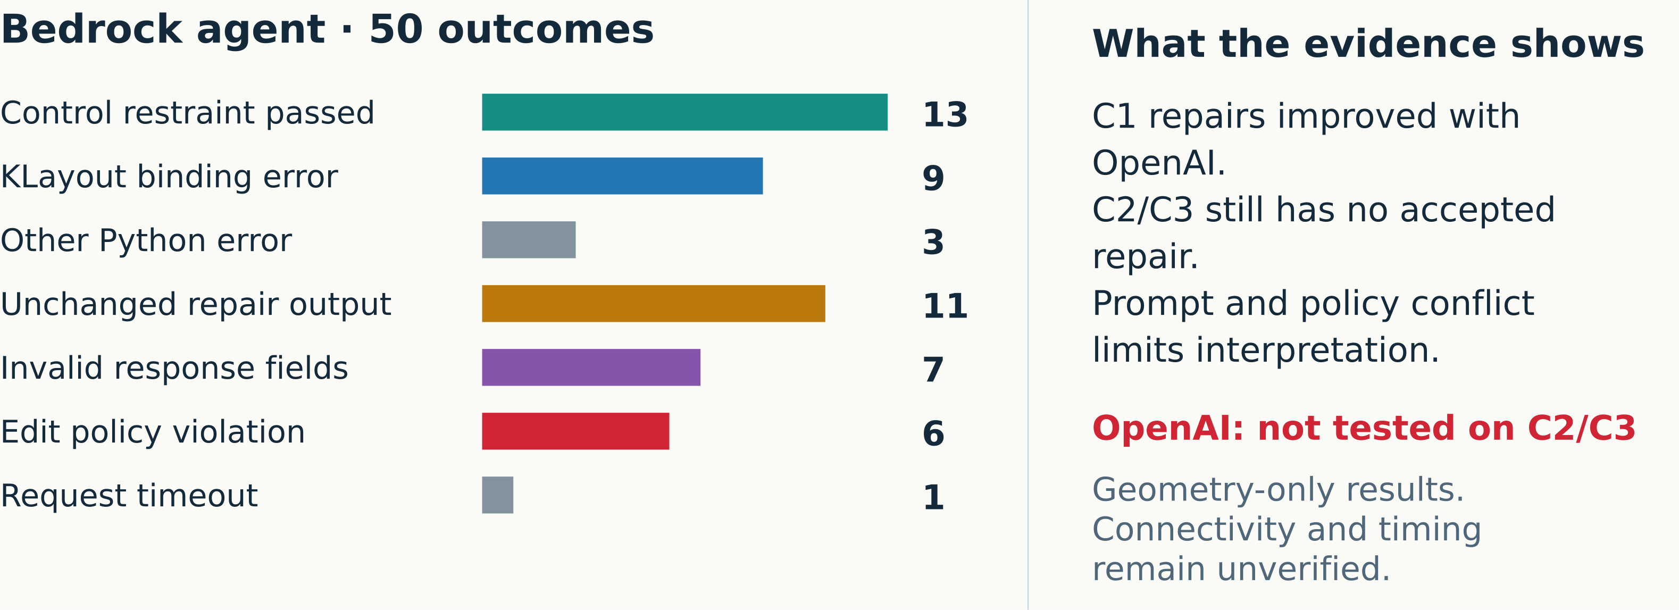
RESULTS / C2/C3
Results and limits
Better API guidance does not remove script, policy, or geometry failures
Sources: C2/C3 accounting JSON + saved failure diagnostics · exact paths in notes
22
Notes:
The six source accounting categories sum to50 agent outcomes:13 passed control restraint,12 Python script failures,11 unchanged repair outputs,7 invalid response-field failures,6 edit-policy violations and1 transport timeout. A local review of the saved diagnostics splits the12 script failures into9 KLayout binding errors and3 other Python errors: a candidate-raised ValueError for undefined layers, an IndentationError and a float.to_integral_value AttributeError. The9 binding errors address PolygonWithProperties.resize, Box.sized, Layout.layout_io, Layout.layer_info, Layout.begin_shapes_rec, PolygonWithProperties.width_check, PolygonWithProperties.value, klayout.db.Edge_pair and Region.enclosed. The plotted seven categories preserve the source aggregate totals. C1 separately reports reviewed binding versus other Python type failures. There were50 Bedrock request attempts,49 parsed responses and no retries. An inherited top-cell replacement instruction can conflict with specific editable-route policy; this frozen campaign tests the whole configuration, not isolated model reasoning. OpenAI was not evaluated on C2/C3. Public-deck audits are diagnostic and missing after-reports remain unknown. References are qualification evidence, not generated repairs. All results are geometry-only; net connectivity, timing, foundry signoff, repeatability and broad generalization remain unverified.
Exact source references:
/home/ankdesh/explore/build-with-terminator/eda/gdsii/klayout-4-drc/docs/reports/c2_c3_benchmark/accounting.json
/home/ankdesh/explore/build-with-terminator/eda/gdsii/klayout-4-drc/docs/reports/c2_c3_benchmark/failure_analysis.csv
/home/ankdesh/explore/build-with-terminator/eda/gdsii/klayout-4-drc/docs/reports/c2_c3_benchmark/agent/summary.json
/home/ankdesh/explore/build-with-terminator/eda/gdsii/klayout-4-drc/docs/reports/c2_c3_benchmark_report.md
Layer colors in native geometry: M1 blue(19/0), M2 amber(20/0), V1 purple(21/0), V2 rose(25/0), M3 green(30/0). Red overlays are saved scored markers, teal outlines are spatial permission masks, cyan outlines locate top inspection windows. Colors have no net identity meaning.
Figure description: Better API guidance does not remove script, policy, or geometry failures
Units: mutually exclusive agent outcome counts
Encoding: Horizontal bars fromzero; exact counts13+9+3+11+7+6+1=50. Traceback review splits the12 Python crashes.

