Slide 1
Smart Building automation using Microcontroller
Guidance by
Mrs. Ankita Mishra
Summited by
Ravi Chaudhary(1505631037)
Ankesh Tiwari(1505631006)

Slide 2
Content
What is Smart building
Component use
Block diagram
How it’s Work
Application
Conclusion

Slide 3
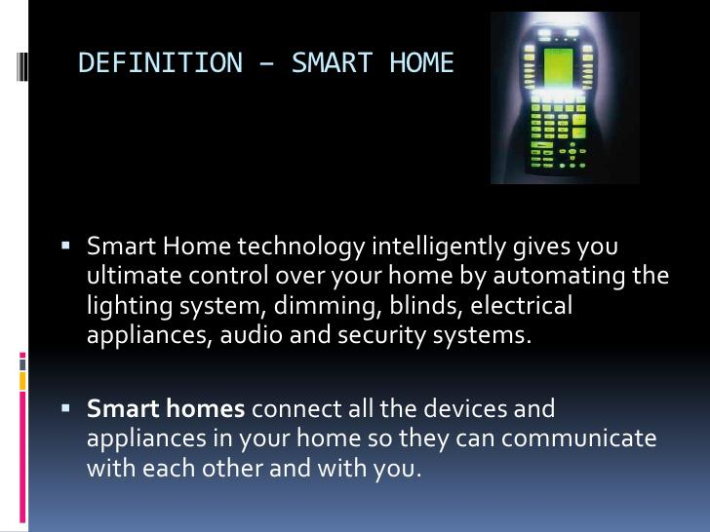

Slide 4
Components
Atmega328 microcontroller
Bluetooth module HC-05
GSM module
LM 358 Ic
IR sensors
PIR sensors
LDR
Ultrasonic sensor
Smoke detector

Slide 5
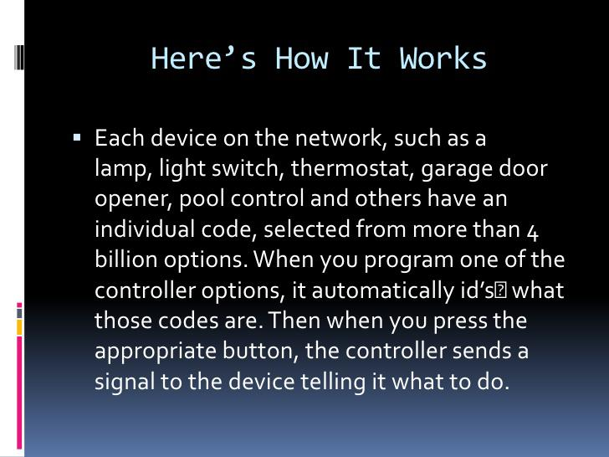

Slide 6
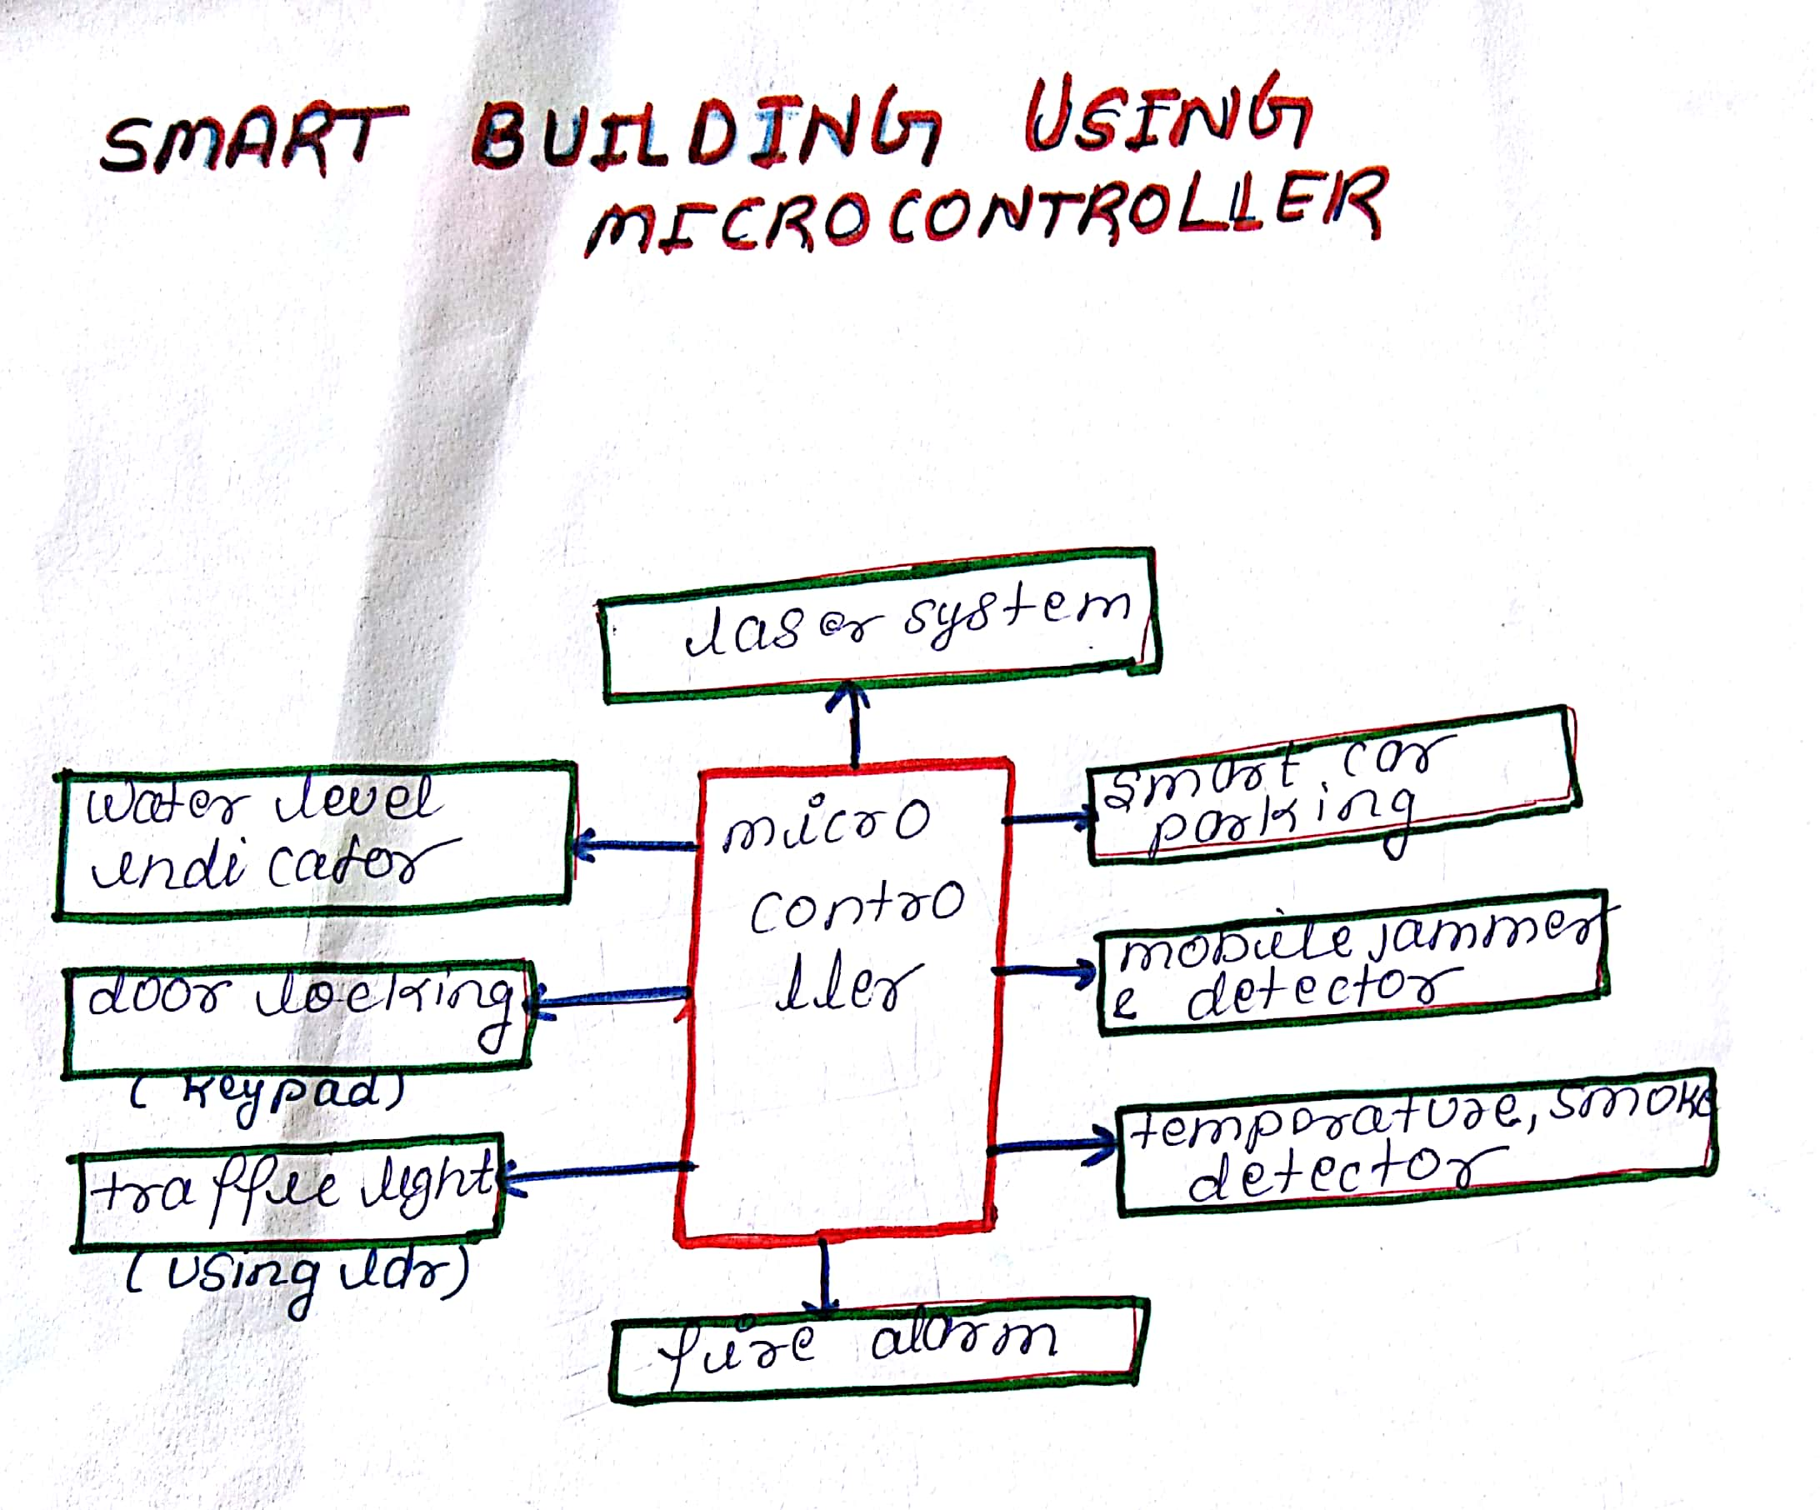
WORKING

Slide 7
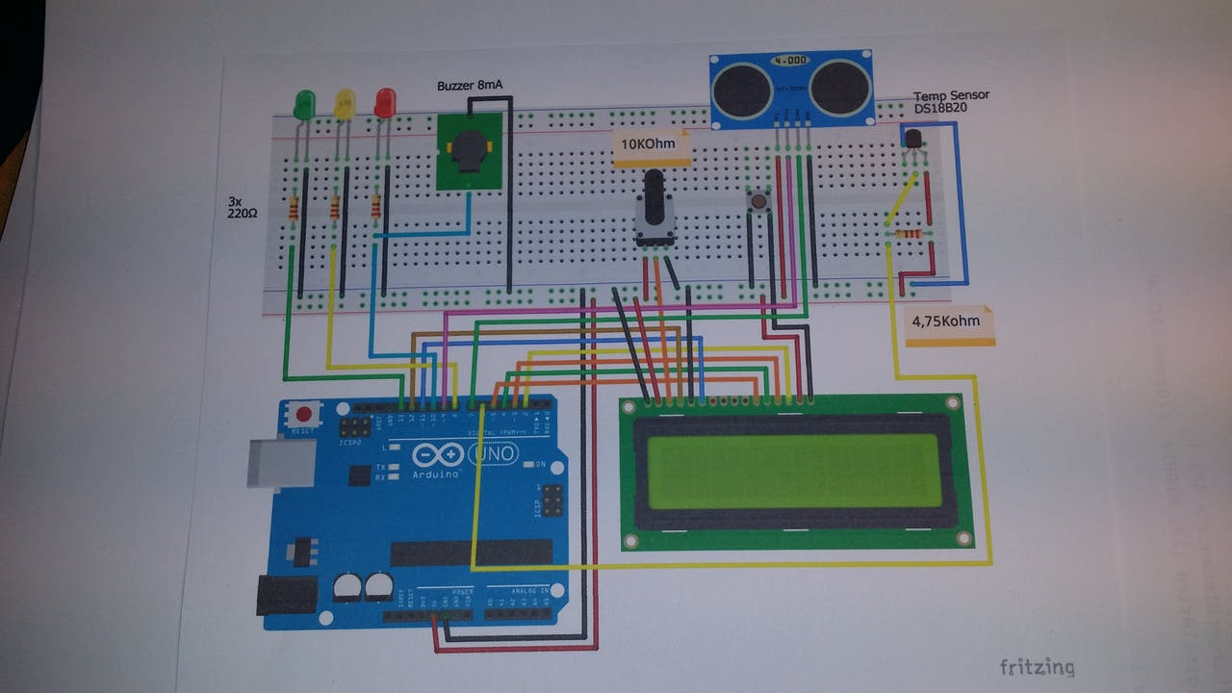
WATER LEVEL INDICATOR

Slide 8
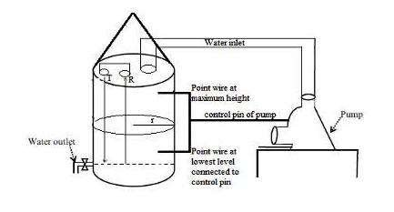

Slide 9
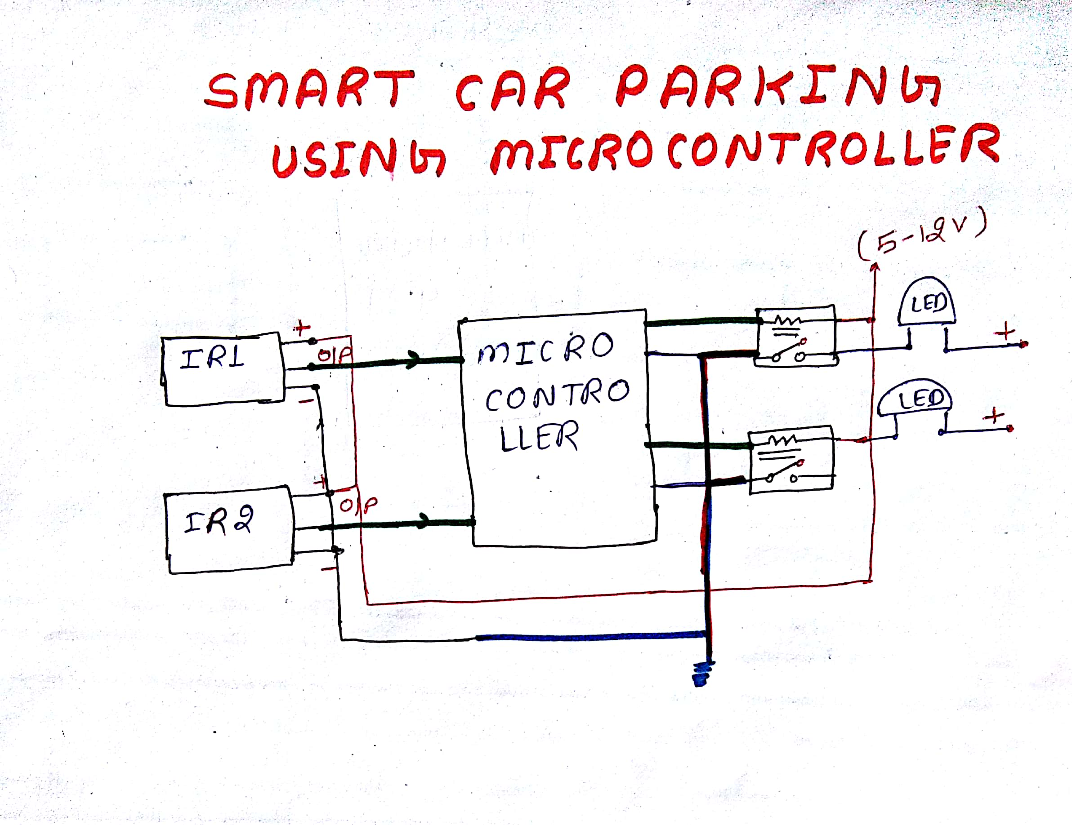
CAR PARKING

Slide 10
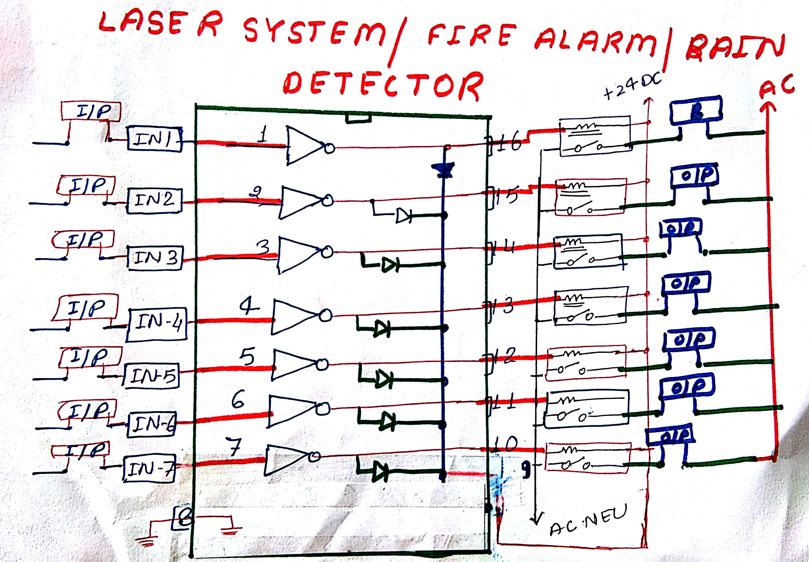
LASER SYSTEM

Slide 11
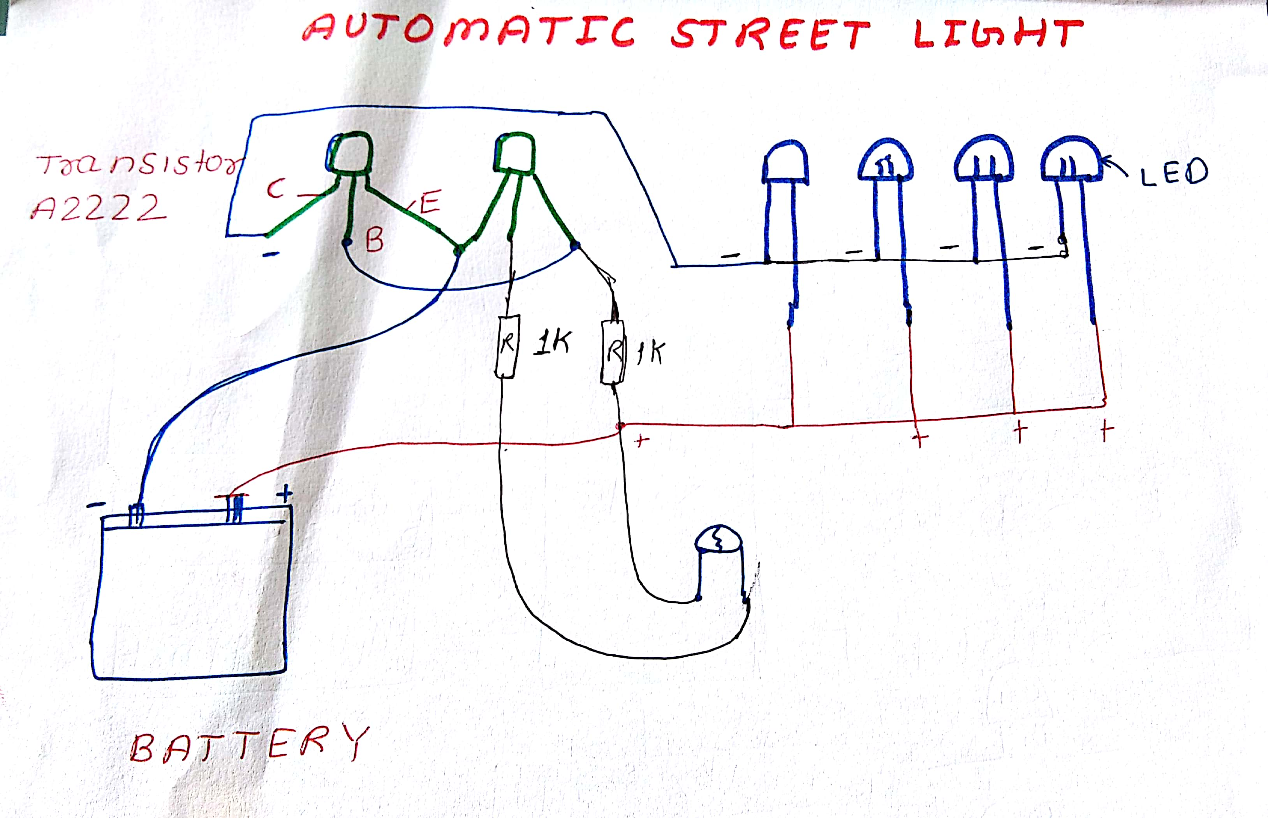
STREET LIGHT

Slide 12
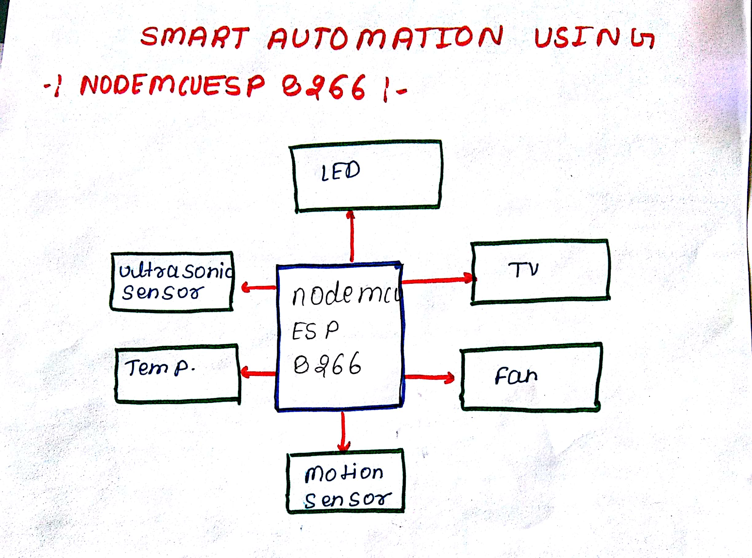
WI FI MODULE

Slide 13
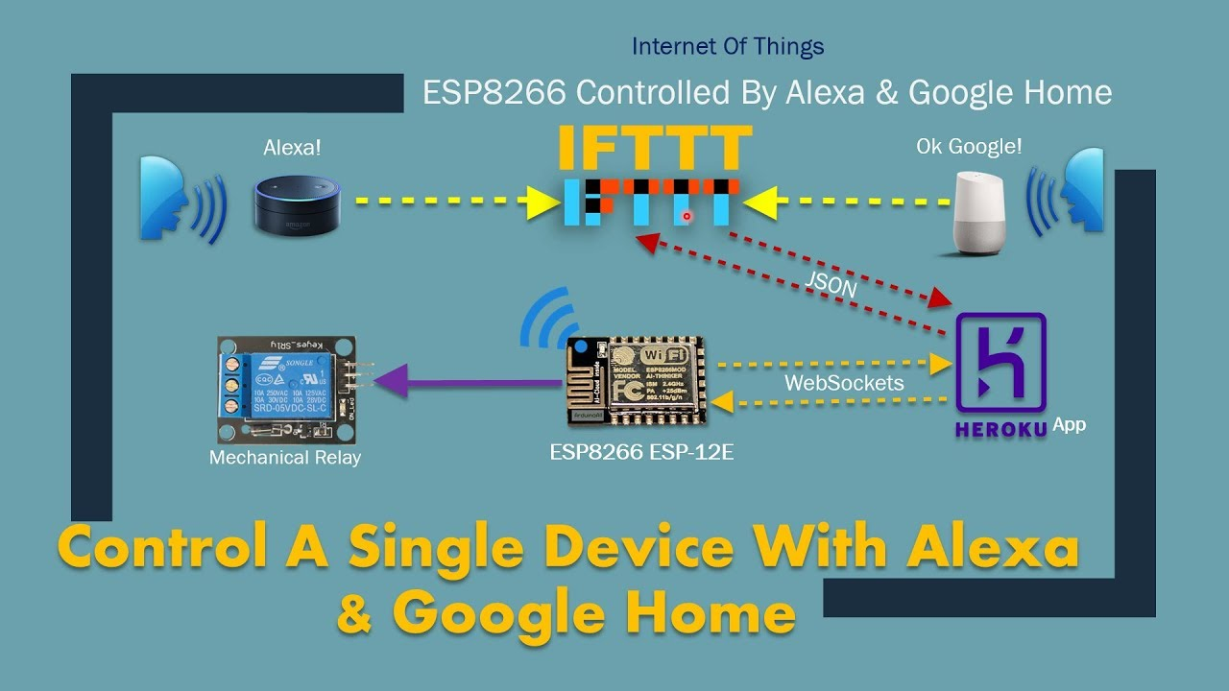
WORKING

Slide 14
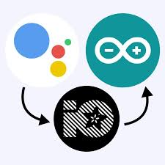
WORKING WITH IO

Slide 15
Application
To control indoor and outdoor lights ,heat, ventilation, electronics and electrical appliances.
It is also used to lock or open the doors and gates.
It is also used for outdoor lawn irrigation,kitchen appliances and security system.

Slide 16
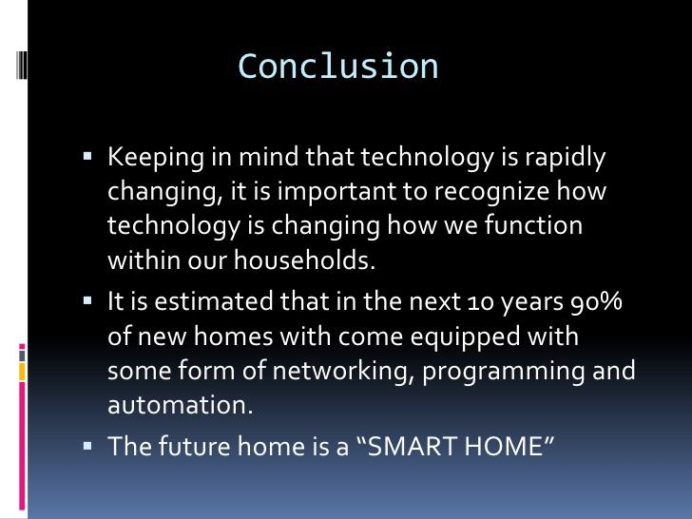

Slide 17
Thank you

