Slide 1

Presented BY
Ankesh
Aamir
Sanjana
GROUP - 14

Slide 2
Project Topic Selection
Project Title :
An ML–powered platform for intelligent resume evaluation and data driven hiring
Domain :
Machine Learning + NLP + Intelligent Recruitment Systems .
Focus :
Semantic resume job matching. Explainable ATS scoring , skill gap detection and intelligent candidate ranking .

Slide 3
Problem Definition
Modern companies use ATS systems for automated resume screening and ranking
Most ATS rely heavily on keyword-based filtering
Limited semantic understanding of skills, projects, and experience
Black-box scoring with no clear explanation for rejection
Lack of skill-gap feedback for candidates
Static ranking models without adaptive learning from recruiter decisions

Slide 4
OBJECTIVES
Develop an Explainable AI-based resume evaluation system
Implement semantic resume-job matching using NLP embeddings
Provide explainable ATS scoring with section-wise analysis
Integrate NER, classification, and semantic matching in a unified ML pipeline
Enable intelligent and transparent candidate ranking

Slide 5
PLATFORM LAYOUT
PUBLIC LAYOUT CANDIDAE LAYOUT RECRUITER LAYOUT
Platform overview System Introduction Role based access (Candidate & Recruiter) Secure Authentication
Resume Builder ML Based Evaluation Section-wise Feedback Skill Gap Detection Job Search
Job Posting ML based Candidate Shortlisting Intelligent Candidate Ranking Resume Analysis Reports Interview Management

Slide 6
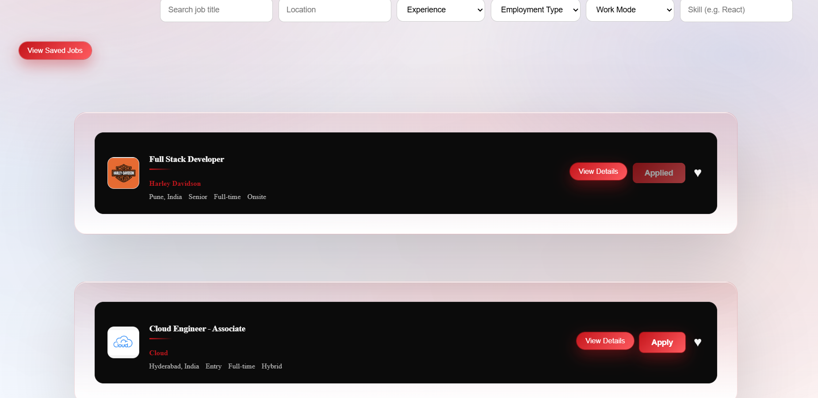
APPLY JOBS

Slide 7
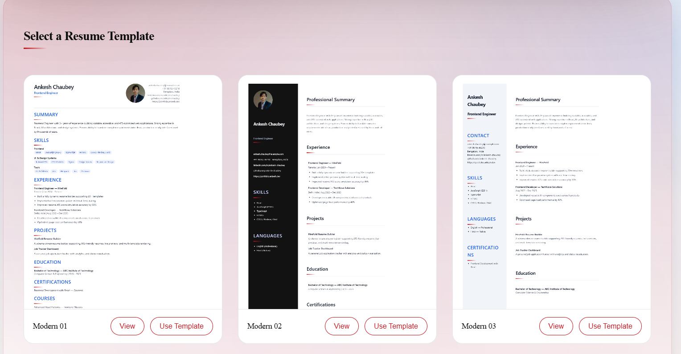
RESUME TEMPLATES

Slide 8
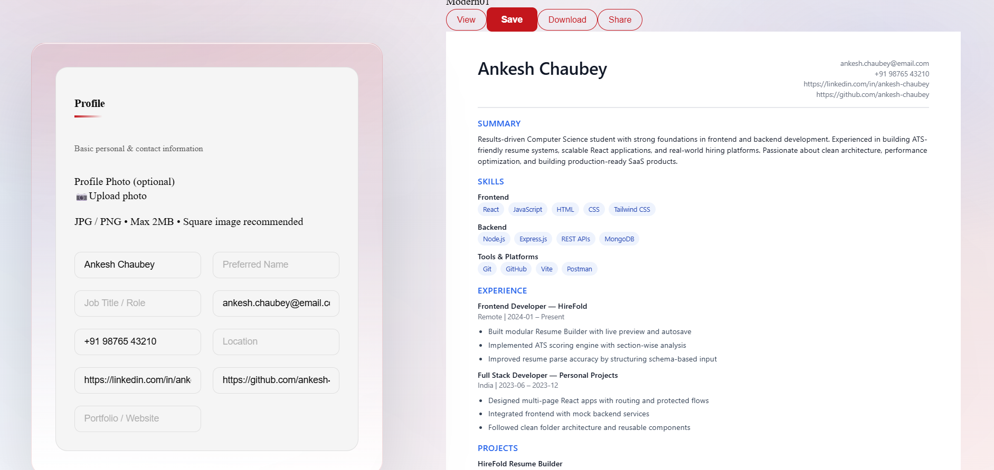
RESUME BUILDER

Slide 9
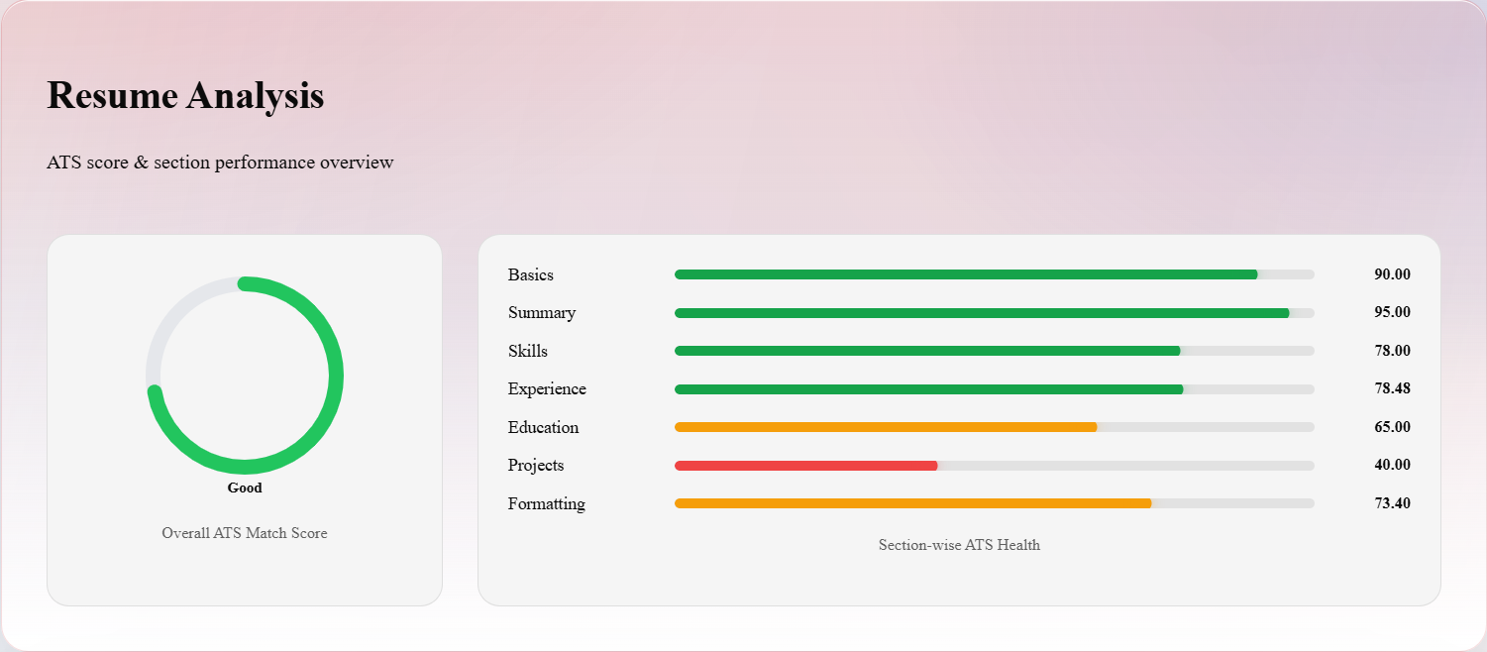
RESUME EVALUATION

Slide 10
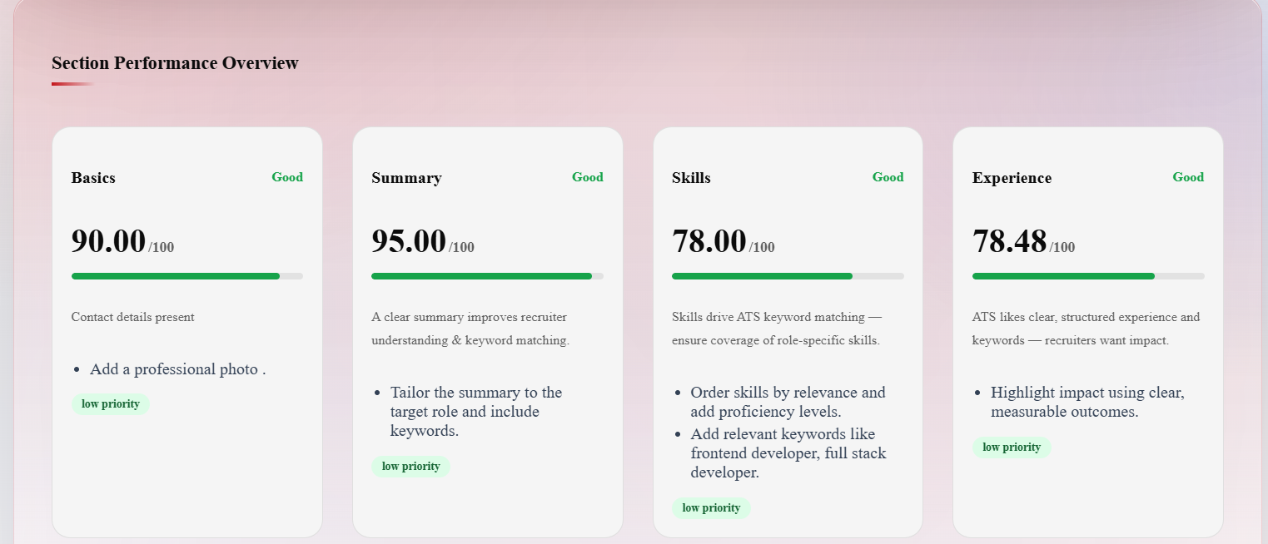
SECTION WISE FEEDBACK

Slide 11
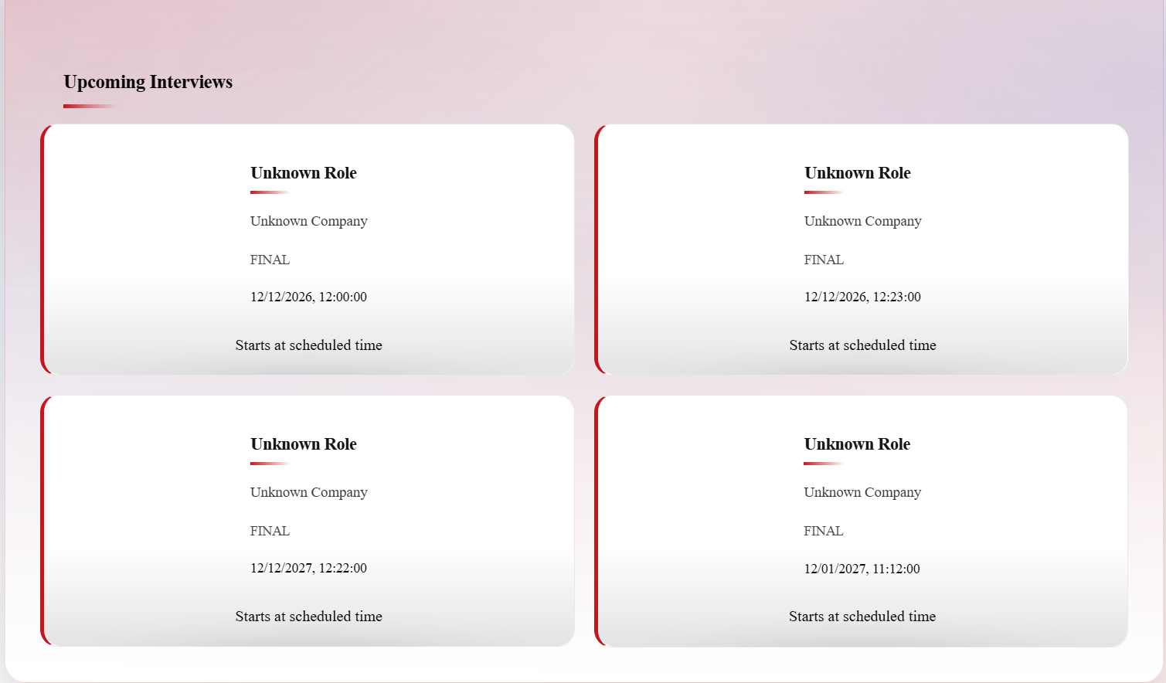
SCHEDULED INTERVIEW

Slide 12
PLATFORM LAYOUT
PUBLIC LAYOUT CANDIDAE LAYOUT RECRUITER LAYOUT
Platform overview System Introduction Role based access (Candidate & Recruiter) Secure Authentication
Resume Builder ML Based Evaluation Section-wise Feedback Skill Gap Detection Job Search
Job Posting ML based Candidate Shortlisting Intelligent Candidate Ranking Resume Analysis Reports Interview Management

Slide 13
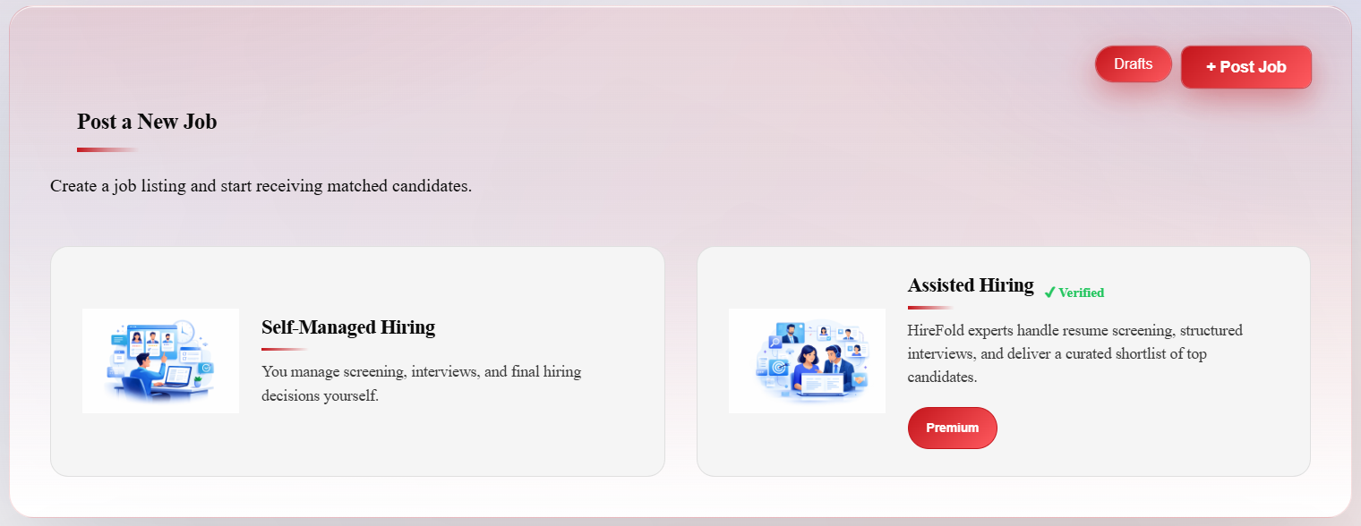
JOB POSTING

Slide 14
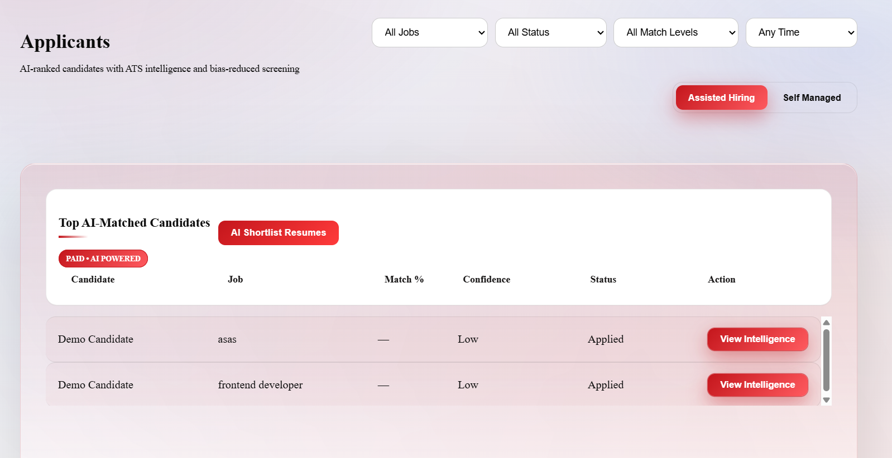
APPLICANTS TRACKING

Slide 15
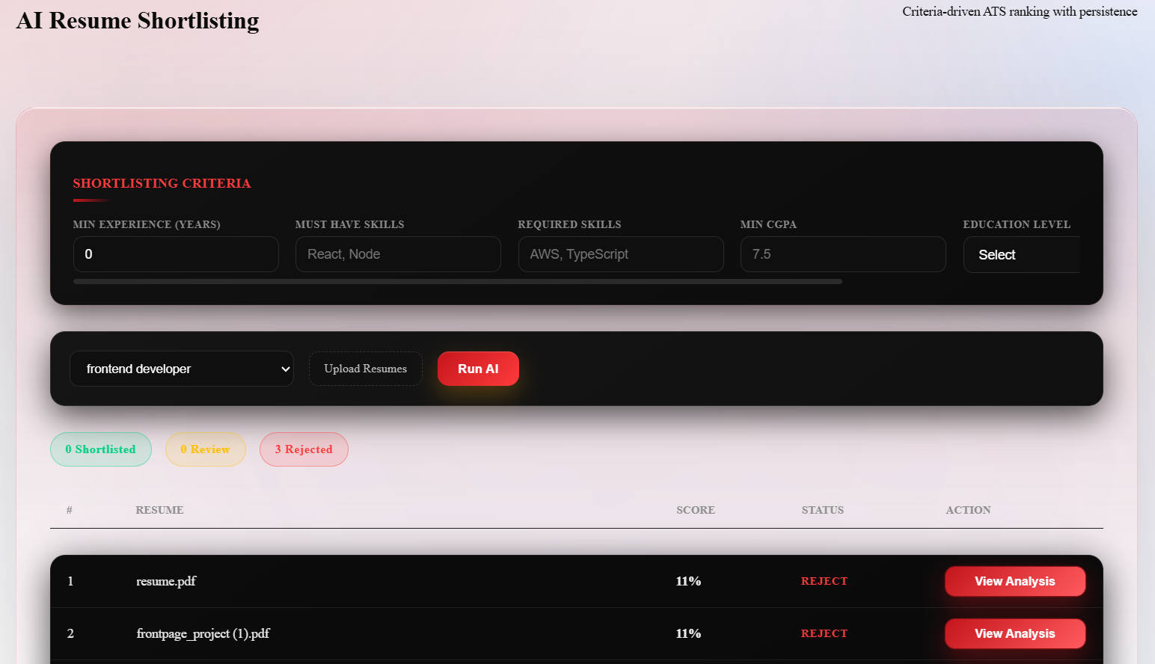
CANDIDATES SHORTLISTING

Slide 16
MACHINE LEARNING APPROACH
Type of ML
Supervised NLP based Deep Learning
Multi Task Transformer Pipeline
(resume + analysis + matching + scoring)

Slide 17
CORE MODELS USED
DistilBert ( Fine Tuned NER Model)
MiniLM/Sentence-BERT ( Semantic Matching Model)
XGBoost/Regression Scoring Model

Slide 18
DATASETS USED FOR TRAINING
Resume Classification Dataset(13000+ resumes )
Resume Corpus Dataset ( Annotated NER entries )
Resume NER Training Dataset (22000+ labelled samples )
Combined Resumes Dataset (Synthetic resumes for robustness )
Resume –ATS Score Dataset (Job description pairs )
Vacancy – Resume Matching Dataset ( Human ranked data )
Resume Score Details Dataset ( Macro / Micro scoring criteria for evaluation )

Slide 19
THANK YOU !

