Slide 1
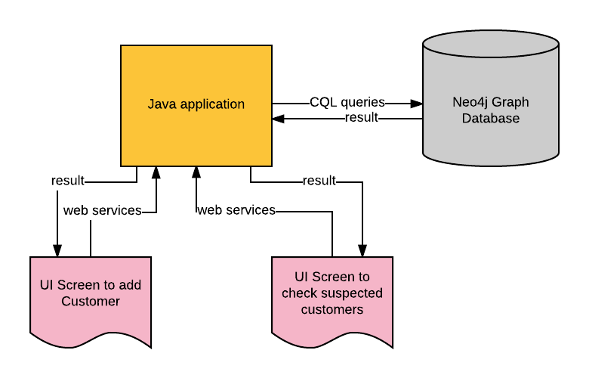

TECHNICAL DESIGN
Mastek Proprietary and Confidential

