Slide 1

Maharishi International University
CS523 BIG DATA TECHNOLOGY
Final project
Ankhtuya Ochirbat

Slide 2
Installs
Data Source
Hadoop 2.2.0
Spark 1.6.2
Kafka_2.10-0.9.0
Hive 1.2.1
Python 2.6.6
bookID
title
authors
average_rating
isbn
isbn13
language_code
# num_pages
ratings_count
text_reviews_count
[https://www.kaggle.com/jealousleopard/goodreadsbooks]

Slide 3
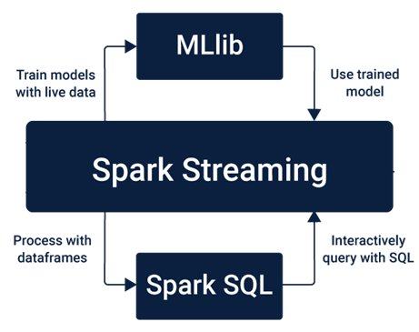
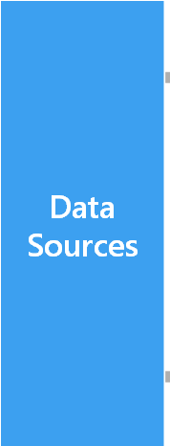




Architecture

Slide 4
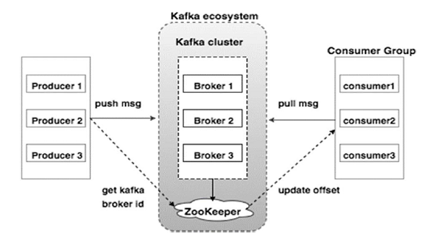
Apache Kafka Architecture
[https://www.tutorialspoint.com/apache_kafka/apache_kafka_cluster_architecture.htm]

Slide 5
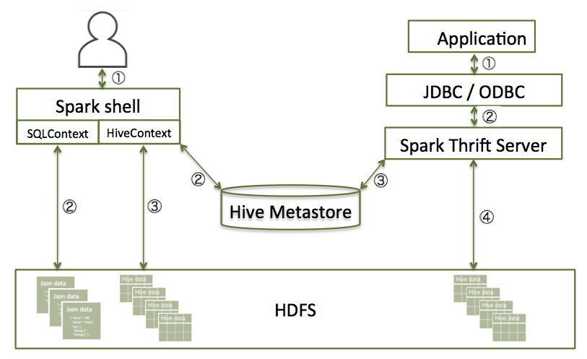
Spark Hive Interaction
[https://docs.cloudera.com/HDPDocuments/HDP3/HDP-3.1.5/developing-spark-applications/content/using_spark_sql.html]

Slide 6
DEMO

Slide 7
Thank you ☺

