Slide 1
Exercise 3

Slide 2

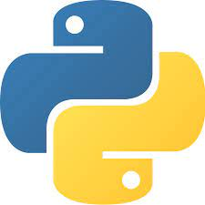
Description of the exercise
Welcome to the third exercise of Data Science Survival Skills. With this activity you will learn:
What is GitHub.
How to create an account and your first repository.
How to set packages in your repo.
Use the packages and a virtual environment.
&

Slide 3


GitHub: Overview
GitHub is a tool that helps us track our codes. You can commit and push changes to keep a record of what you are doing, work without affecting the original program, work simultaneously with different people on the same project, and even deploy your codes or websites.

Slide 4

GitHub: Overview
We can decide if we want to use Git with either a GUI or the command line.
Some of the main commands of GitHub are: clone, status, branch, checkout, add, commit, push and pull.
Notes:
GitHub Desktop, integrations with text editors, directly Git GUIs, etc. .

Slide 5



Anaconda
It is a Python distribution platform that allows us to install and manage Python libraries together with several Virtual Environments. Its installation comes with various packages and elements such as Jupyter Notebook, Spyder, Pycharm, and its GUI: Anaconda Navigator.
Notes:
Using the conda package manager

Slide 6

Prerequisites
To carry out the tasks of this exercise, you need to install two essential components, namely Git and Anaconda. Their installation is straightforward, so you only have to follow the instructions.
Link to Git
Link to Anaconda

Slide 7
1. Create your first repository

Slide 8
1. Task: Create your first repository
The first step is to set an account on GitHub. After following the instructions, the subsequent procedure is to create your first repo!
To do it, you can press the green button 'New' on the feed or follow:
Profile → Repositories →

Slide 9
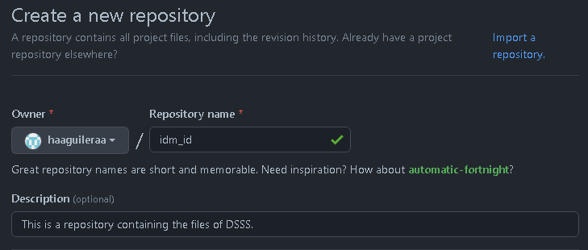
1. Task: Create your first repository
As a repository name, use your IdM-ID (this will help us later). We recommend always writing a short description; it helps everyone who checks your work (and yourself) to identify the contents of your repo.

Slide 10
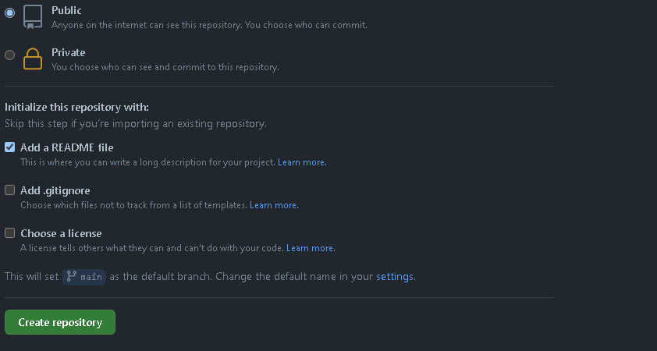
1. Task: Create your first repository
For this example, it is necessary to create a public repository. You can check the 'Add a README file' cell and leave 'Add .gitignore' and 'Choose a license' without a checkmark.
CHOOSE A LICENSE! E.g. APACHE and gitignore for Python

Slide 11
2. Virtual Environment

Slide 12
Virtualenv
It allows us to have isolated the packages needed to work in a specific project; i.e., these packages don't affect the base Python installation. Using a virtual environment, you can use different versions of the same package for several programs without affecting each other.
Project 1
package== 1.0
2.7
Project 2
package== 3.2
3.7

Slide 13
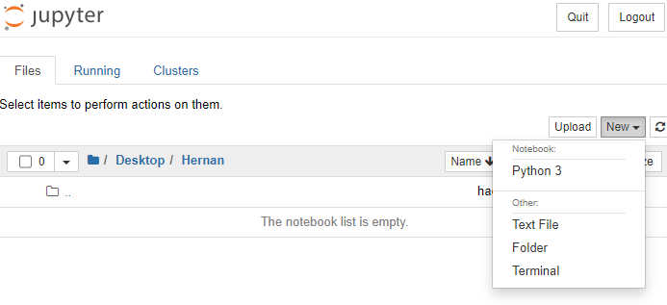
Jupyter Notebooks and venv
At this point, you should open Jupyter Notebook using Anaconda Navigator and select a web browser to run the notebooks. Subsequently, you will choose under "New" the option "Terminal."

Slide 14
Activating Venv
To create and activate your virtual environment we need to write the following on the command prompt:
conda create -n myvenv python=3.7
You will see the request “Proceed ([y]/n)?” from the command prompt. Press ‘y’ and then enter. This will create the virtual environment under the name “myvenv”. Finally, you can activate the venv by writing
conda activate myvenv
After the activation of the venv, you will see its name in front of the command line.
You can deactivate it using: conda deactivate

Slide 15
Using venv
Now we want to use this virtual environment within Jupyter Notebook. To do it, we can install and specify the kernel using the commands:
pip install --user ipykernel
ipython kernel install --user --name=myvenv

Slide 16
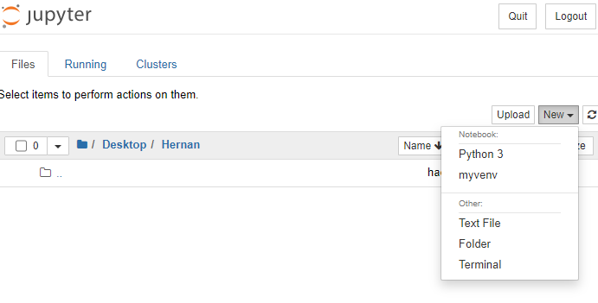
Using venv
If there are no errors, you can refresh the tab of the notebook and find the venv like:
This new file will be running using the virtual environment that we just created, and you can install the packages inside the notebook as we did in Google Colab.

Slide 17
3. Working with GitHub

Slide 18
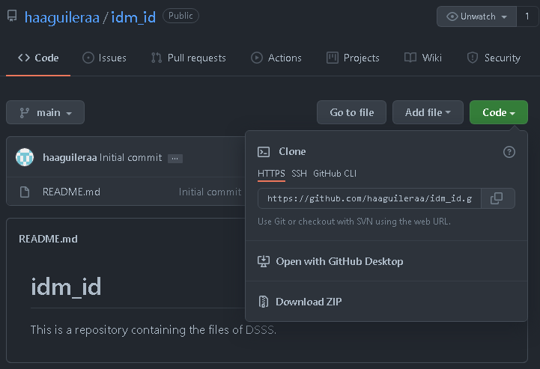
Cloning your repo
To clone the repository that you created before, you need its link to download. GitHub gives you three options to do it: HTTPS, SSH or GitHub CLI. In this case we will copy the HTTPS.

Slide 19
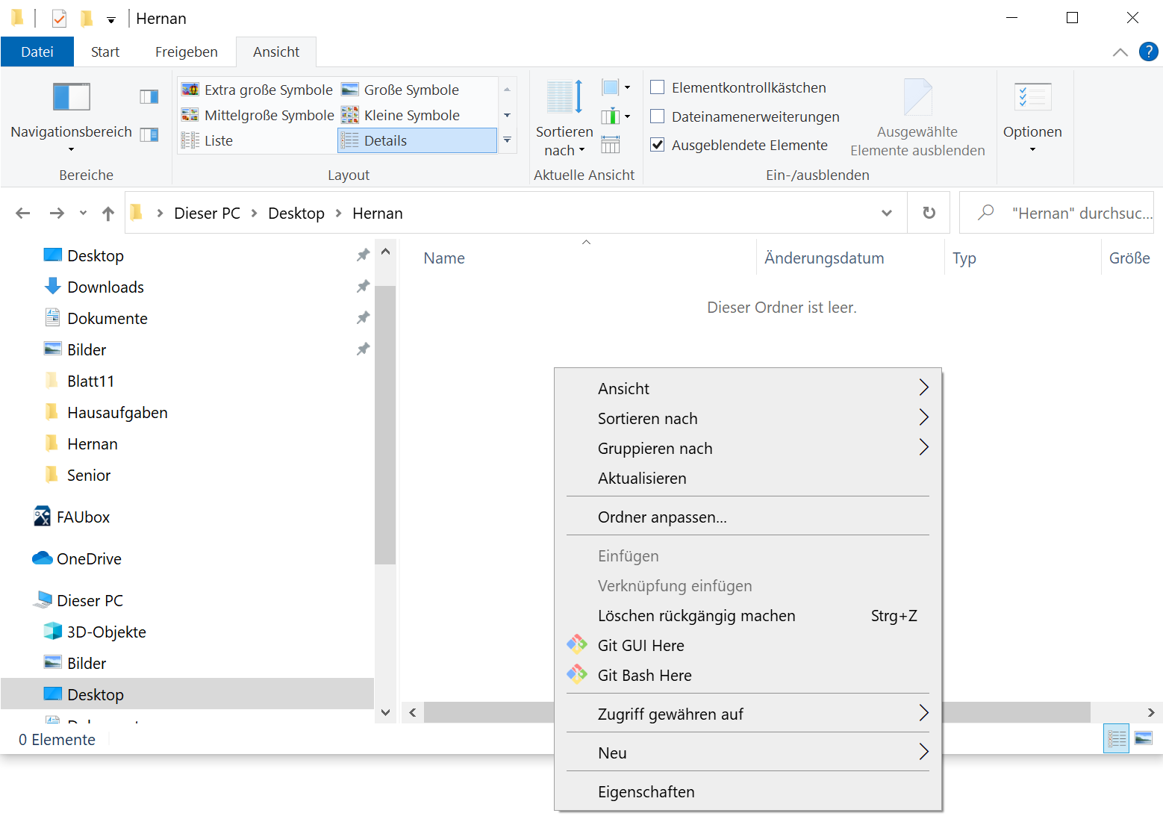
Cloning your repo
Go to a desired folder and open a git bash there
On Windows: right click -> Git Bash Here
You will find afterwards a folder containing the files from your repo. Open this folder and create a new Jupyter Notebook file named “git_config”

Slide 20
Cloning your repo
Write there the link that we copy before as:
git clone HTTPS_link
You will find afterwards a folder containing the files from your repo. To access it via command line, write:
cd name_folder/
and leave this Bash open.

Slide 21
Add, commit, push, pull...
Let us now create our first file! The first step is to use Jupyter's file explorer and move inside our just downloaded folder. There, you will create a new Notebook using our virtual env and name it as "mypackage."
Task: Copy the code of the next chapter and follow the instructions of slide 29.
In order to grade this task, we will install it and check it directly in our virtual environment.
We will now push this file to your repo!

Slide 22
Add, commit, push...
Go back to the Git Bash and write
git add -A
This line will add all our files to the queue and prepares them to commit. Then
git commit -m “comments: committing my first package”
This command will prepare all your files to be pushed. Finally,
git push
In this case, you will push the files committed in your repository. You need then to follow the instructions for adding your credentials to access GitHub.

Slide 23
Problem with credentials
If your computer has already an account you can solve it going to:
Control Panel\ All Control Panel Items\Credential Manager
or
Systemsteuerung\Alle Systemsteuerungselemente\Anmeldeinformationsverwaltung
There, you can edit the credentials used to access GitHub.

Slide 24
Git pull, status
Another necessary feature is the command git status. It assists us to check some information about our working branch, i.e., the state of the working directory.
Now, using the command git pull, you will retrieve the information from remote changes in your current working repository; thus, it will update your files.

Slide 25

Working with branches
Branching and merging is a helpful feature of Git, and we will need it in our projects. This Video on youtube explains how branching works; you can also follow the full tutorial to learn more about Git.
You can find more information about Git here.

Slide 26
4. Creating your own installable package

Slide 27
Structure of the repository
To create a pip-installable package, we need to follow the next structure:
.
├── idm_id # Folder containing our set of functions
│ ├── __init__.py
│ └── function.py
├── setup.py
├── requirements.txt
├── README.md
└── .gitignore

Slide 28
__init__.py
File used to indicate that this folder contains a Python package.
from .function import *

Slide 29
function.py
HERNAN make nice pls
File containing our functions (this is your task):
import numpy as np
from PIL import Image
def imshow(X, resize=None):
"""
The purpose of this function is to show an image either in Python or in a Jupyter notebook . Remember the plotting functions shown earlier (e.g. plt.imshow).
Next, the resize variable should be optional. If given, the image should be resized to the new shape. For example, image is (512, 512), resize=(256,256) the image shape of X should be (256, 256) after resizing.
"""
pass

Slide 30
setup.py
You have to generate a set-up to ensure the functioning of your package:
from distutils.core import setup
from setuptools import find_packages
setup(name='idm_id',
version='0.1',
author='DSSS',
author_email='name@fau.de',
packages=find_packages(),
install_requires=['numpy', 'Pillow', 'ipywidgets'])

Slide 31
requirements.txt
You can also install packages using this file and the command line: pip install -r requirements.txt
Other options to specify the version of a package are:
###### You can write here which packages are necessary to run your code ######
##You can specify the version using '=='. For example: numpy==1.21.2
numpy
Pillow
ipywidgets
Numpy >=1.0 , <1.21.2 # For 1.0 or greater but not 1.21.2 or higher Numpy ~= 1.21.2 #For a compatible release
Among others (Documentation).

Slide 32
.gitignore
Git is a helpful file that specifies which folders and scripts Git shouldn't push into your repository but, instead, you are using locally.
More info: https://git-scm.com/docs/gitignore

Slide 33
Evaluation of results
We should be able to run ! pip install git+link_of_your_repo on Google Colab or Jupyter Notebook and use the function that you created previously.

Slide 34
And we are done!
Thank you

