Slide 1
Exercise 7

Slide 2

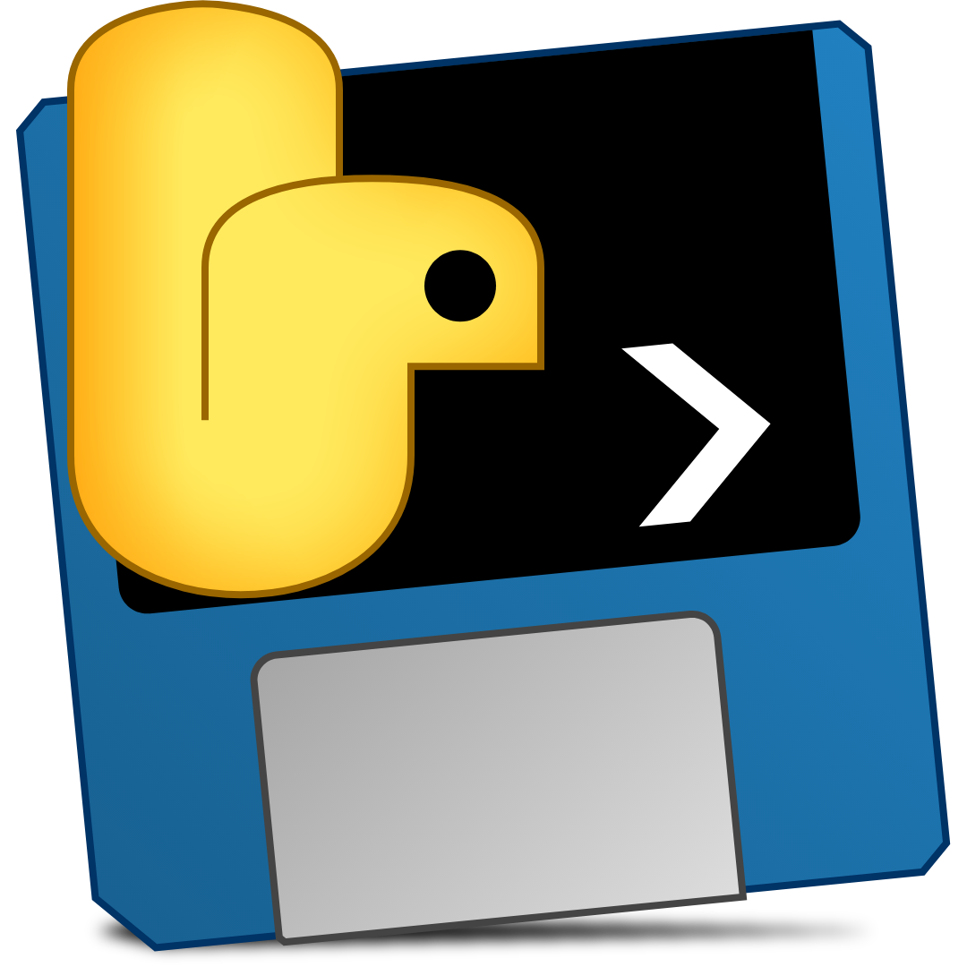

Exercise 7
Hello everyone!
The purpose of this exercise is to create your own .EXE file from a Python code and make it installable!
Your task:
Adjust main.py such that the program has your full name in the window title. Without your name, the exercise will not be passed.
Get PyInstaller
Create from our provided main.py an executable with (1) no command line/shell window shown and use (2) our dsss.icon as icon file
Use NSIS to create an installer.
Upload the final installer of your executable to StudOn.
Tipps: https://pyinstaller.readthedocs.io/en/stable/usage.html
At some point you have to zip something...

Slide 3
And we are done!

