Slide 1
HOUSING
NAME: NITIN SINGH TATRARI
BATCH No. : 1825

Slide 2
Problem Statement
Houses are one of the necessary needs of each and every person around the globe and therefore housing and real estate market is one of the markets which are one of the major contributors in the world’s economy. Data science helps to predict the actual value of the prospective properties and decide whether to invest in them or not.
The company uses data analytics to purchase houses at a price below their actual values and flip them at a higher price. It helps the companies to increase their overall revenue, profits, improving their marketing strategies and focusing on changing trends in house sales and purchases.
House prices depends on many factors like location and its proximity to different utilities, house size and usable space, Age and condition of property and upgrades like garage, swimming pool, etc added to the properties.

Slide 3
THANK YOU!!!

Slide 4
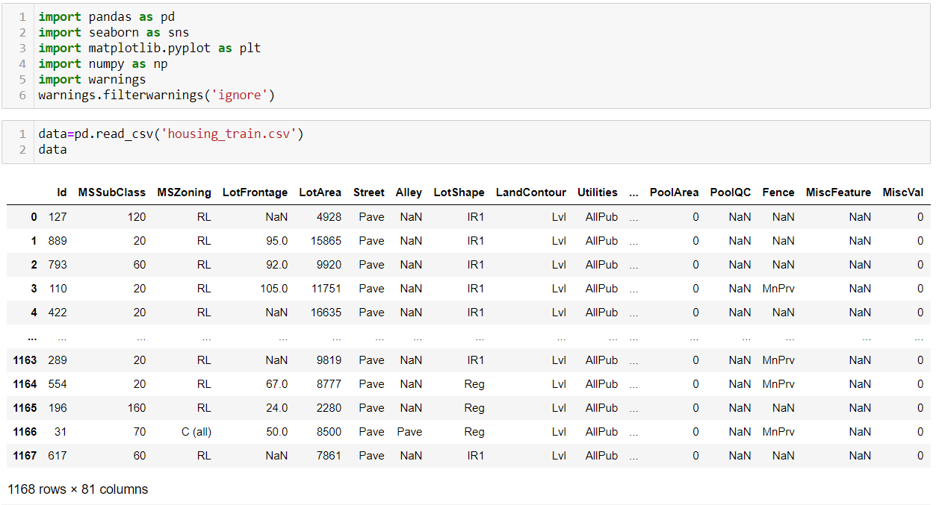
Steps followed: (1) Loading the data
We load the data set by pandas library

Slide 5
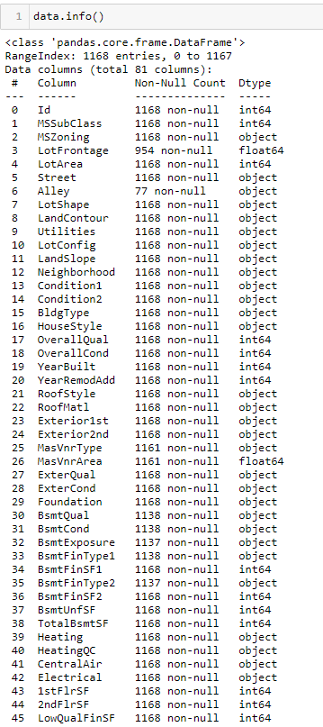
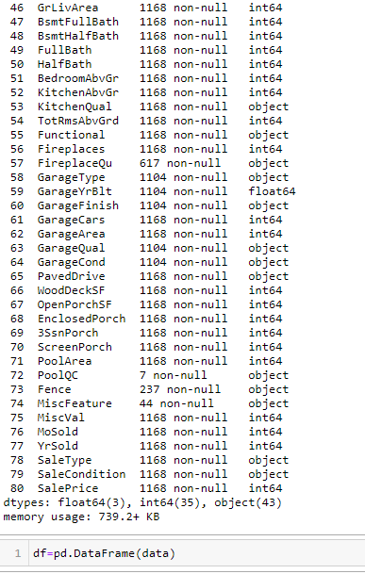
(2) Understanding the data
There are 1168 entries and 81 columns in the dataset.
The data type comprises of 35 integer type columns, 3 float type columns and 43 string type columns.
Columns- LotFrontage, Alley, MasVnrType, MasVnrArea, BsmtQual, BsmtCond, BsmtExposure, BsmtFinType1, BsmtFinType2 have Nan values.

Slide 6
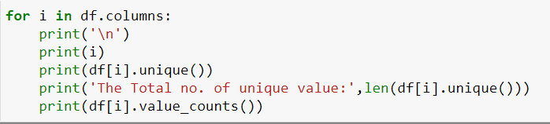
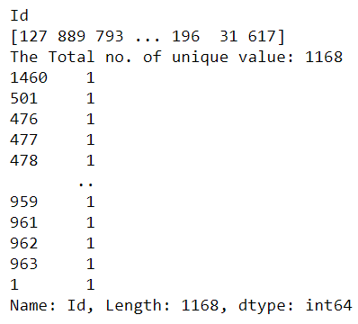
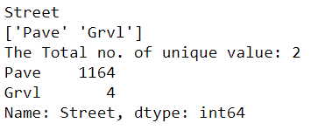
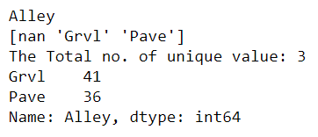
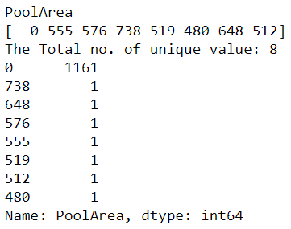
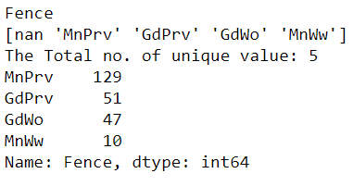
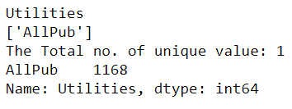
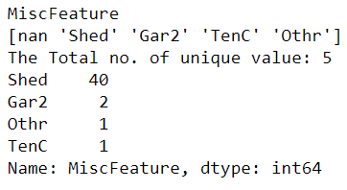
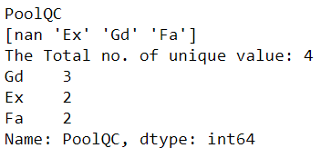
(3) Cleaning the data

Slide 7
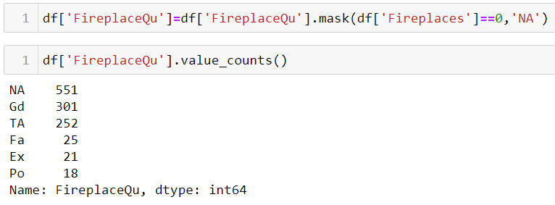
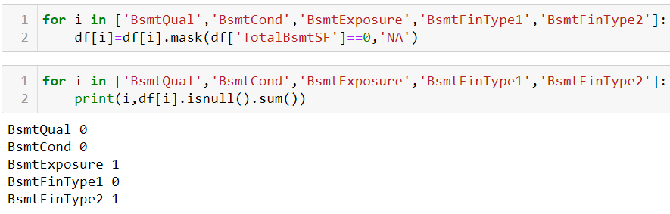
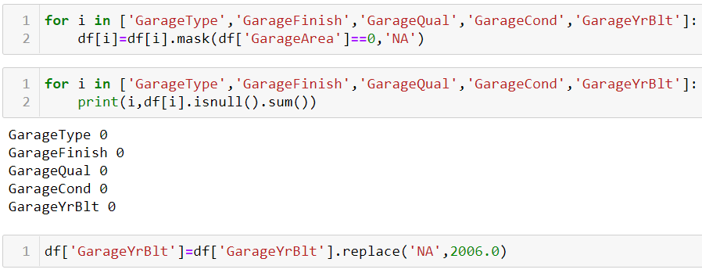
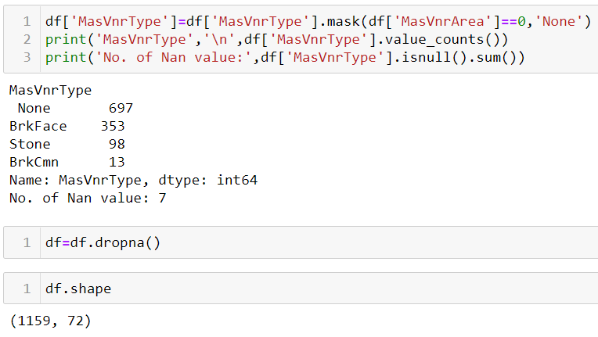
All rows in column- ID have different values, thus it show no relevance to house price.
Since only 4 houses have gravel road to access out of 1168, we will only consider paved road.
Since column- Alley has 1091 missing data out of 1168, it provides no help in house price prediction.
All rows in column- Utilities have same value ‘AllPub’. Thus we consider all houses having all public utilities.
Since column – Fence has 931 missing value out of 1168, thus can not to develop any relation with target.
Since column – MiscFeature has 1124 missing value out of 1168, thus can not to develop any relation with target.
Only 7 houses out of 1168 have swimming pool, we should avoid making relation with the target variable
Since no swimming is considered, PoolQC (pool quality) can be ignored too.

Slide 8
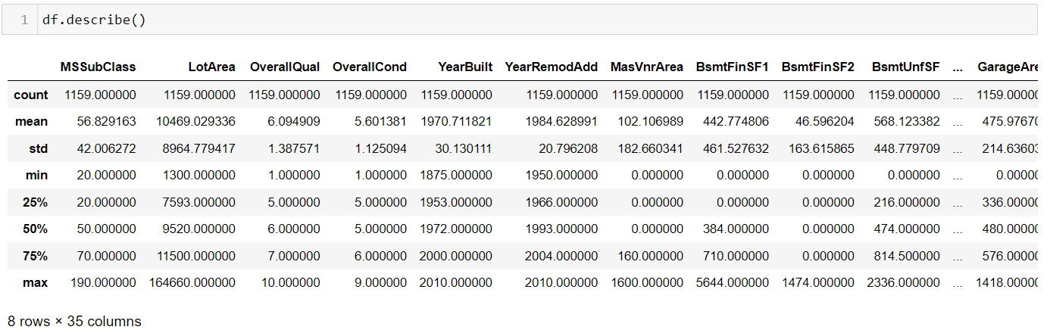
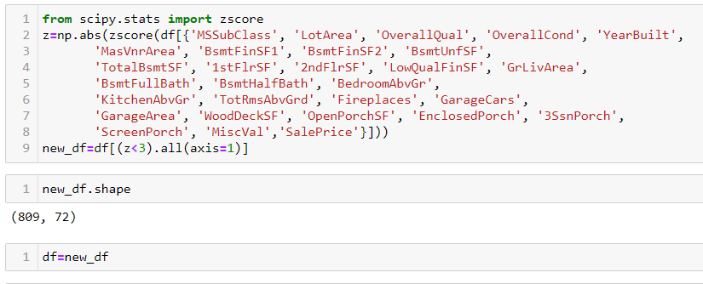
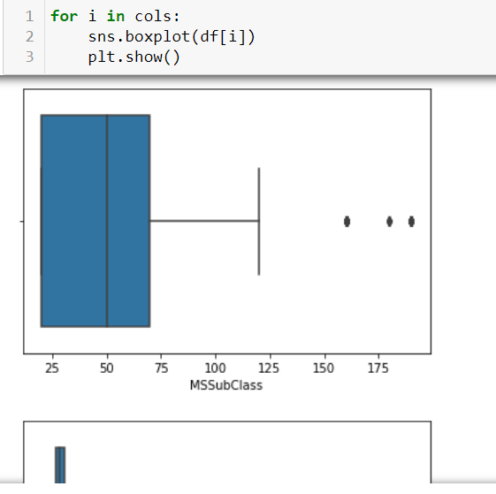
(4) Treating Outliers
Variables have outliers in it. So we apply Z-score on all continuous variables to keep the data between -3 standard deviation to +3 standard deviation of the curve.

Slide 9
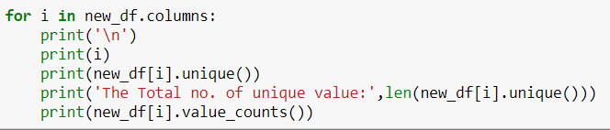
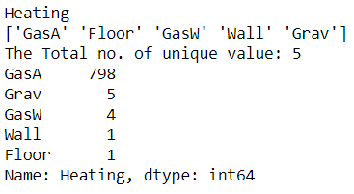
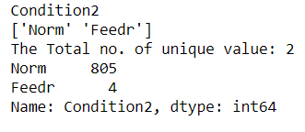
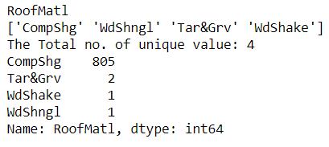
Out of 809 entries column- Condition2 has 805 entries of norm(Normal proximity to various condition). Thus, we can consider all houses to have normal proximity.
Out of 809 entries column-RoofMat1 has 805 entries of CompShg(Standard (Composite) Shingle). Thus, we can consider all houses to Standard (Composite) Shingle.
Out of 809 entries column- Heating has 798 of GasA (Gas forced warm air furnace). Thus, we can consider all houses to have GasA heating system.
Thus, we drop all above three columns.

Slide 10
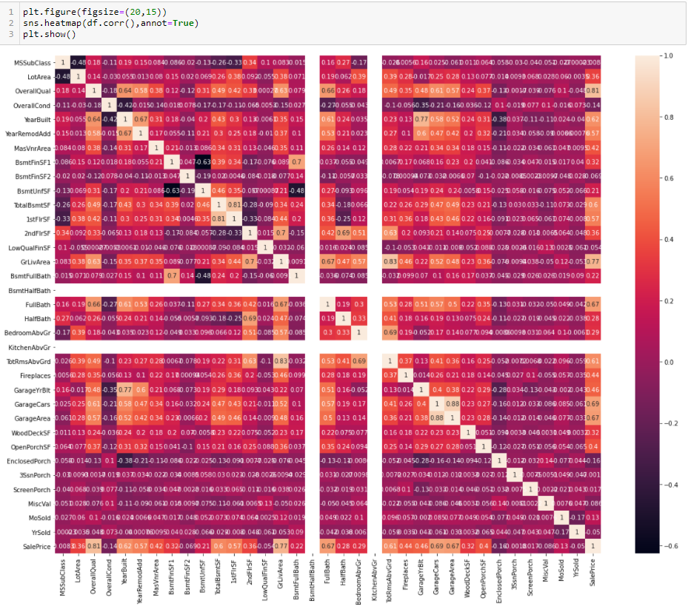
(5)Finding correlation with continuous variables
We drop all variables having correlation less than 15%.
The variables to be drop are:- 'MSSubClass', 'OverallCond', 'BsmtFinSF2', 'LowQualFinSF', 'BsmtHalfBath', 'KitchenAbvGr', 'EnclosedPorch', '3SsnPorch', 'ScreenPorch', 'MiscVal', 'MoSold', 'YrSold', 'GarageCars'

Slide 11
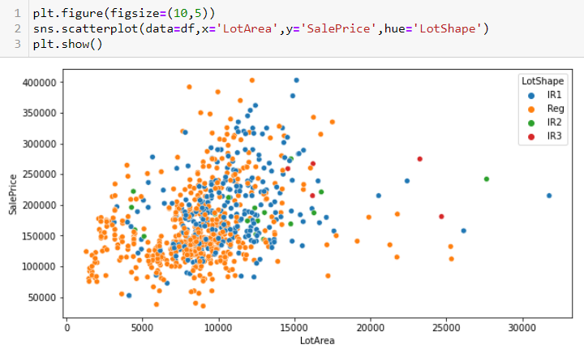
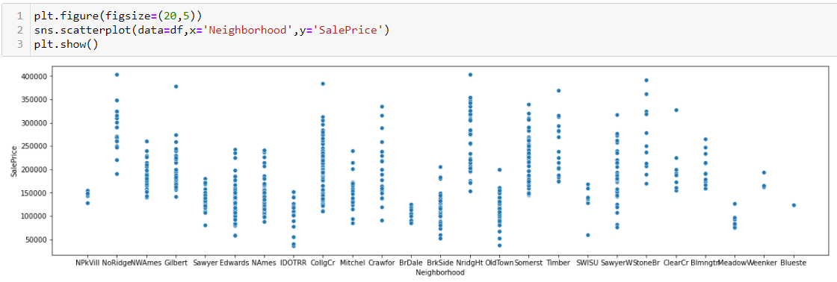
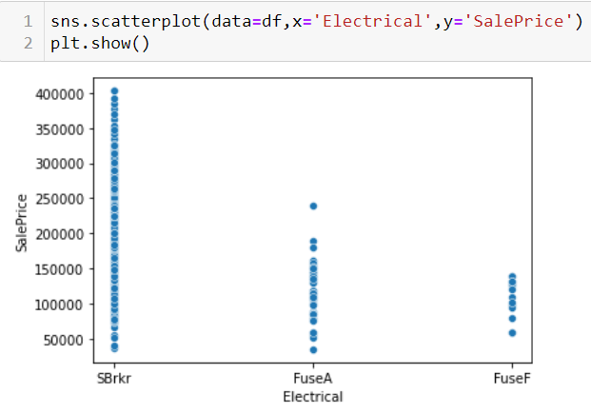
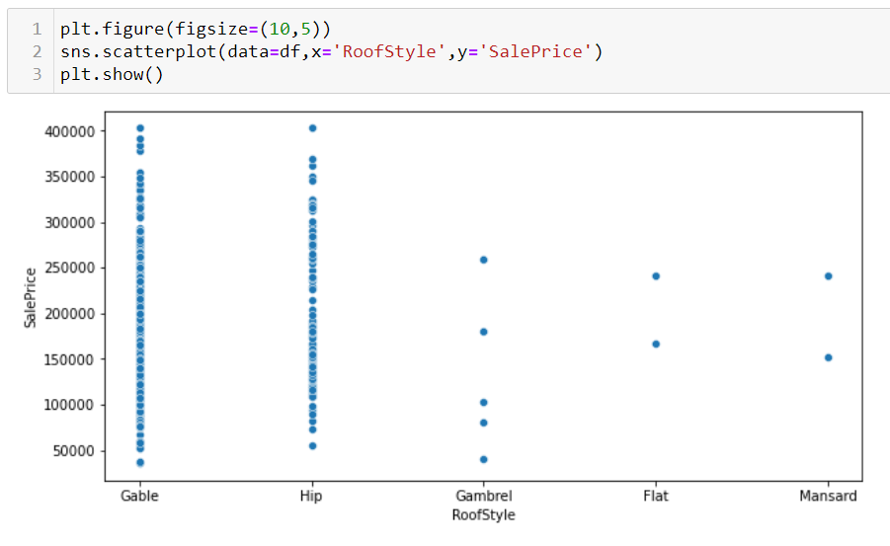
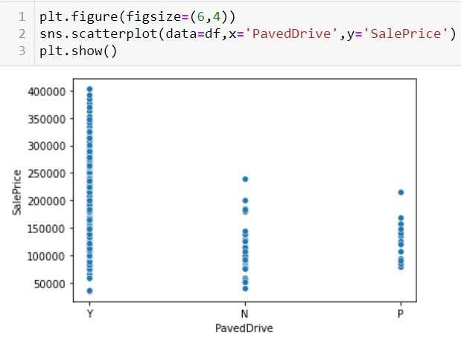
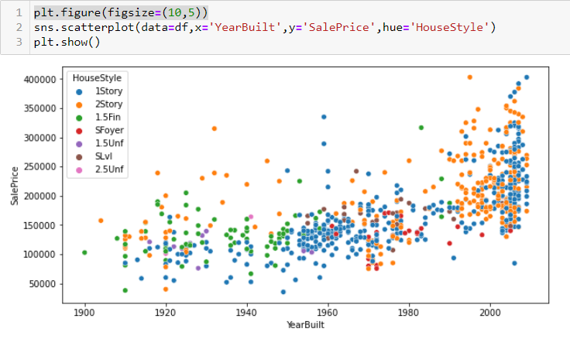
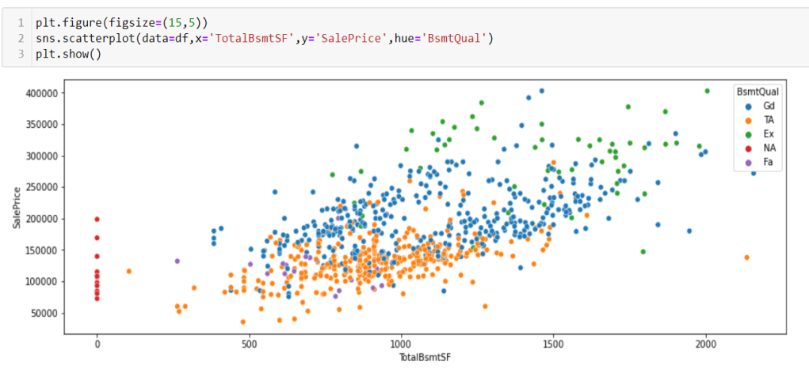
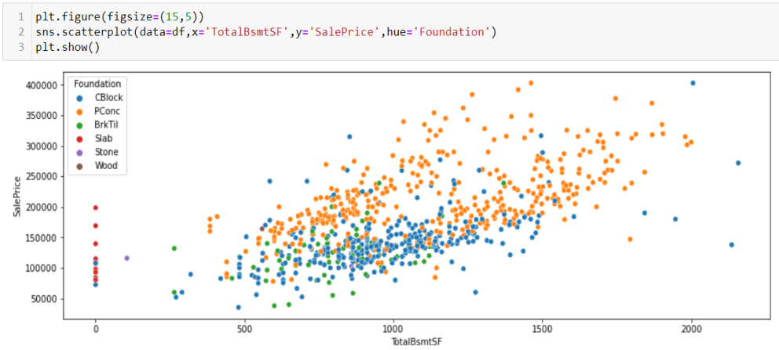
(6) Graphical analysis

Slide 12
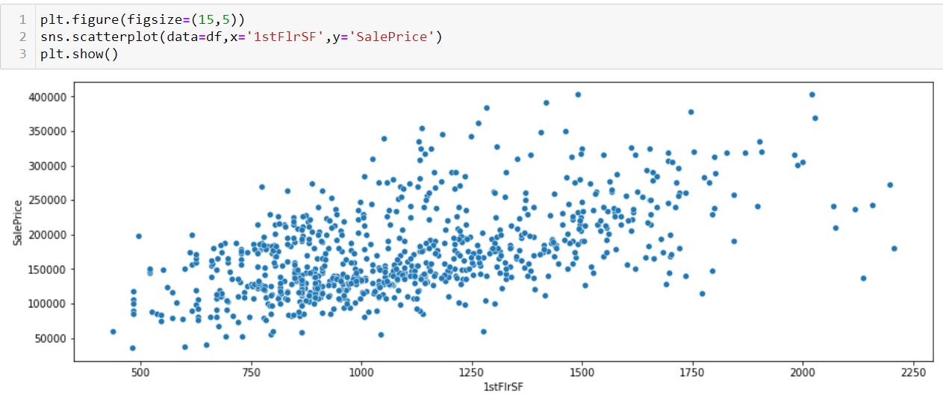
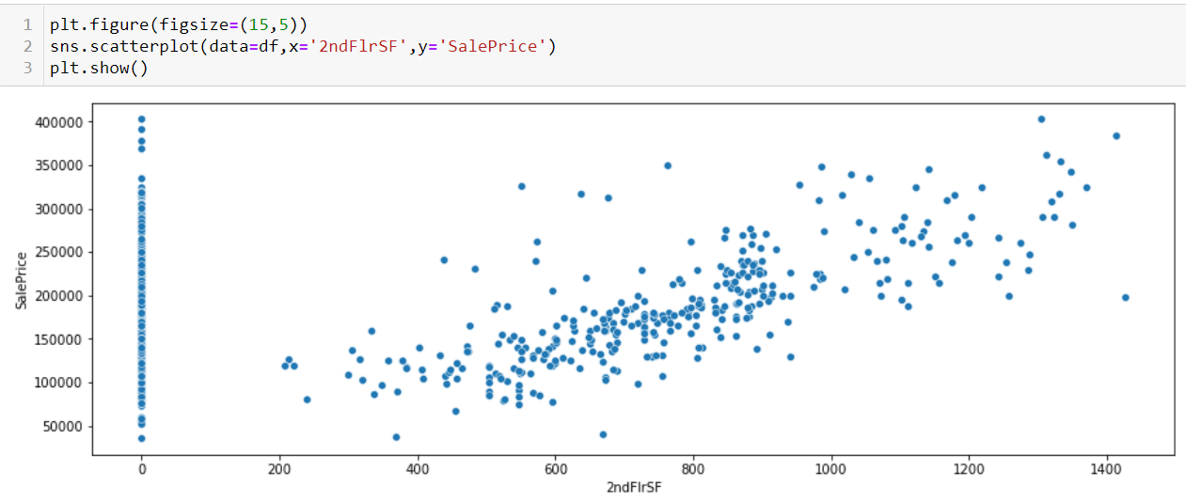
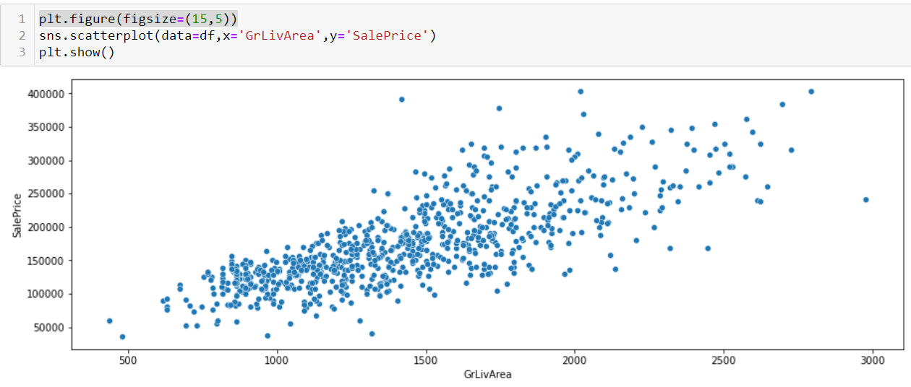
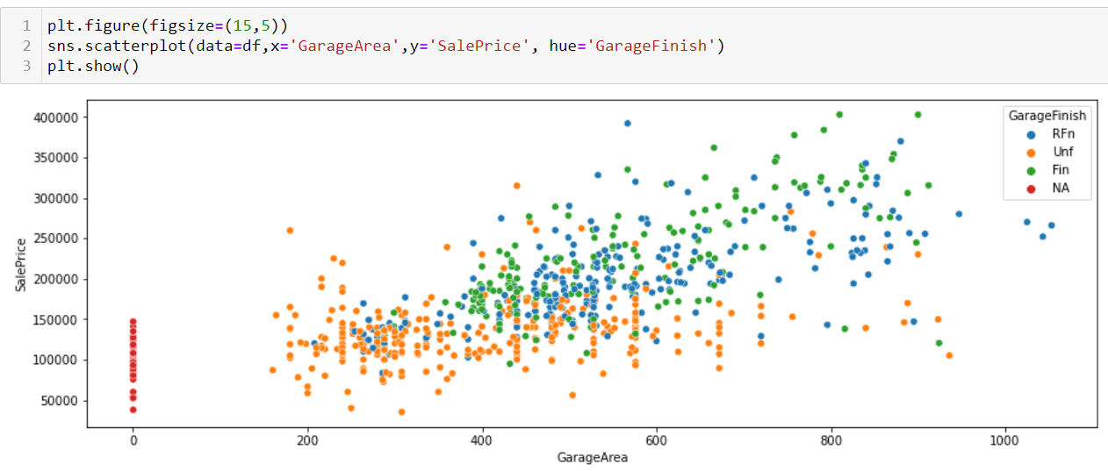
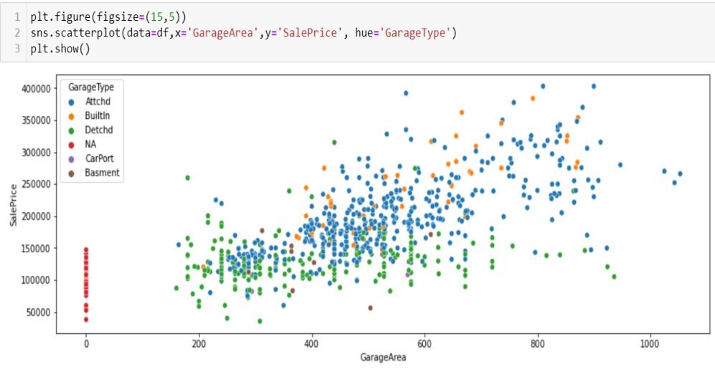
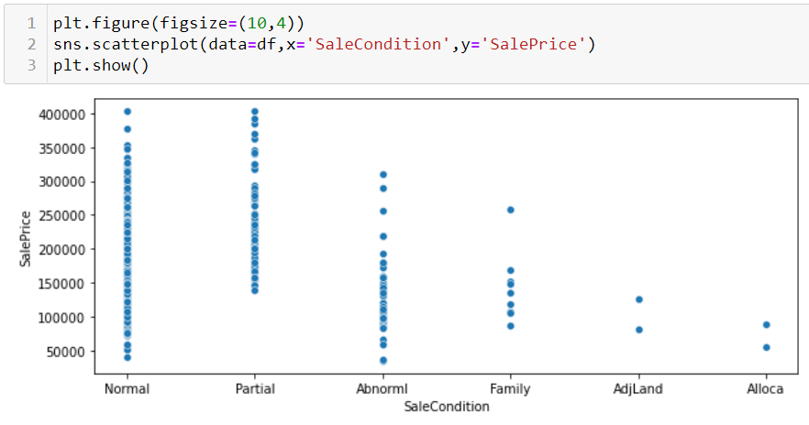

Slide 13
The observation from the graphs are as follows:-
Sale price show a positive linear relationship with Lot area.
Regular lot shape is seen more in less than 7000sqtmr Lot area.
Slightly irregular lot is seen more in above 7000sqmtr Lot area.
Sale price varies with Neighbourhoods.
Newer constructions are costlier than older construction.
Newer constructions are mainly of one storey and two storey
Gable & Hip type of roof is found in houses of all price range, but houses which are sold for more than 300000, only have either Gable or Hip type of roof.
Sale price of house is proportional to total basement area.
Sale price of house is proportional to elevated height of basement.
Basement Foundation made with poured concrete are found in costlier house, followed by basement foundation made with cinder block.
Sale price of house is proportional to first floor area.
Sale price of house is proportional to second floor area.
Sale price of house is proportional to Above grade (ground) living area
Houses with FuseF (60 AMP Fuse Box and mostly Romex wiring) electrical system have selling prices sell than 160000.
Houses with FuseA (60 AMP Fuse Box and all Romex wiring) electrical system have selling prices sell than 250000.
Sale price is proportional to Garage area.
Sale price of houses depends on Garage finish. (Finished> Rough Finished > Unfinished)
Sale price of Houses is more with Attached and build-in garage than detached garage to the house.
All Houses sold above 250000, have paved drive way.

Slide 14

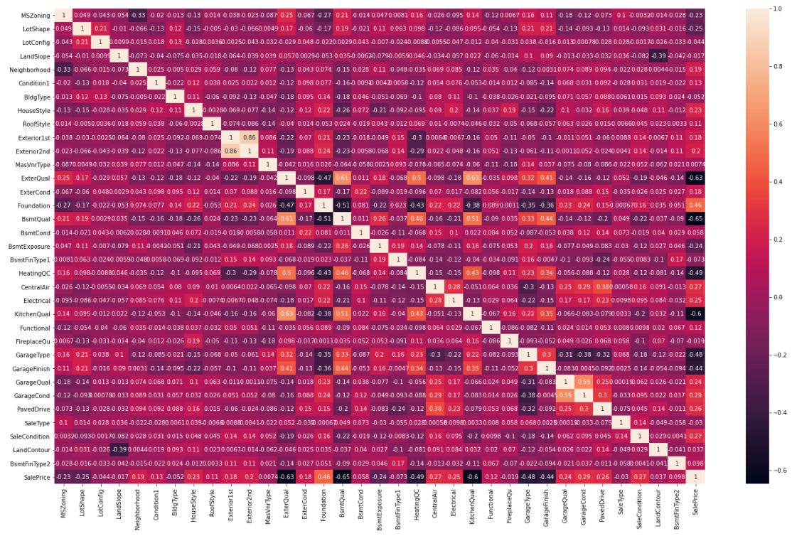
(7) Finding correlation with categorical variable
We convert all categorical data into numbers by Label encoder function.

Slide 15
We drop all the variables having correlation less than 15%

Slide 16
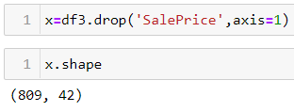
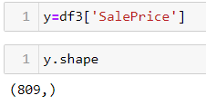
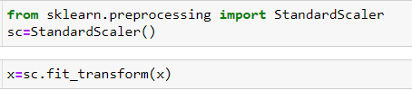
(8)Standardization of data
We separate the target variable from data frame and store the remaining in x.
We store the target variable in y.
We use Standard Scaler function on x, to standardized all its value.

Slide 17
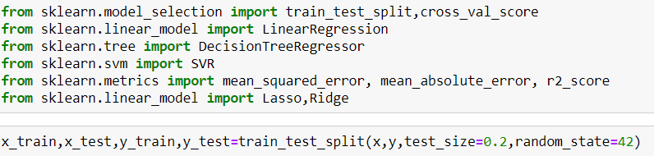
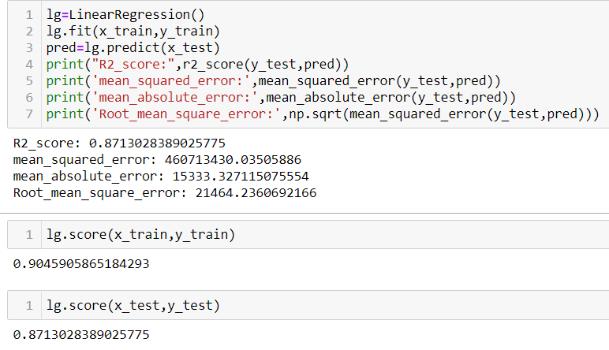
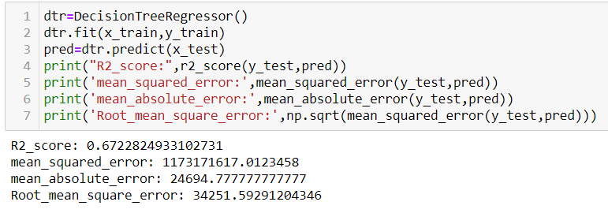
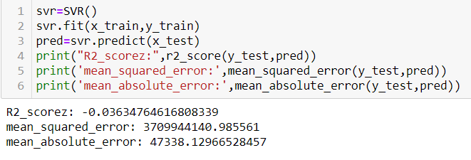
(9) Model Selection

Slide 18
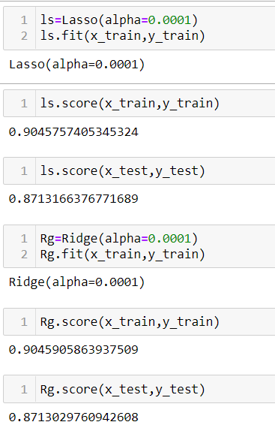
The best score is shown by Linear Regression, Lasso regression & ridge regression algorithm
Since all three have same score, thus, there is no over fitting .

Slide 19
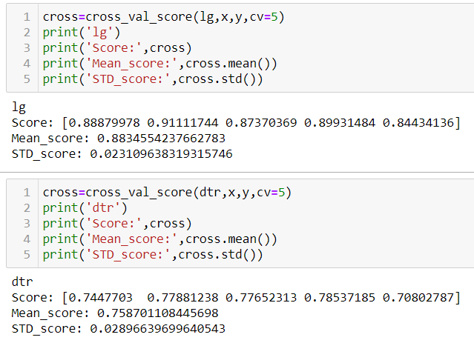
(10)Cross Validation
Variance is in limit

Slide 20
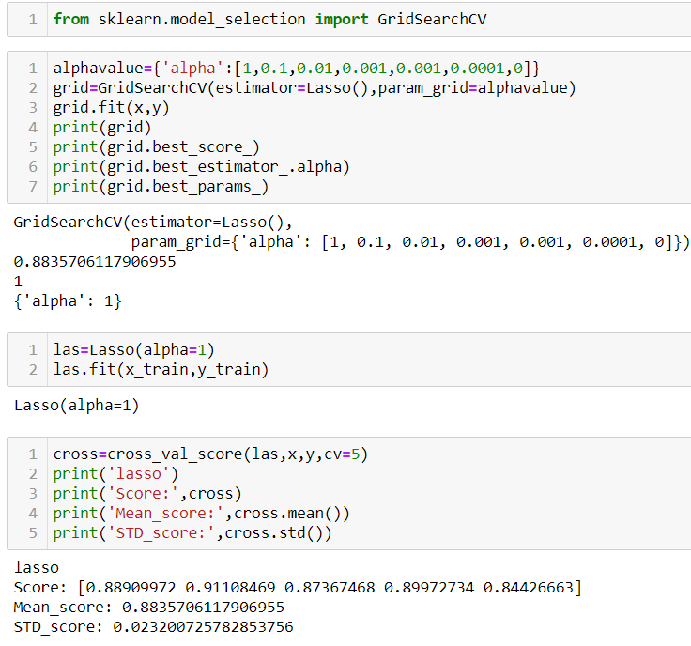
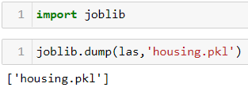
(11)Hyper parameter & Saving the best model
Best alpha value =1 for Lasso regression.
We use it and create new algorithm as Las.
We dump the best algorithm

Slide 21
(12) Conclusion
The Sale price depends on following parameters:-
The zone and the neighbourhood of the lot
The size and shape of lot.
The original construction date and remodelling date of house.
Area of masonry veneer, its quality, its present condition and whether there are two type of masonry veneer used.
Type of foundation of basement, its height, its total area, its unfinished area, its overall quality and exposure of basement.
Quality and condition of Heating system
Central air conditioning facility
Area of 1st floor, 2nd floor and above ground living area.
No. of full Bathroom in basement and above ground. No. of half bathroom above ground
Quality of Kitchen
Total no. of room above ground
Functionality of House
No. of Fire places in the house.
Garage area and its location, years on which it was build, garage quality and its present condition, and the interior finish of garage.
Whether driveway is paved.
Wood deck and open porch area.
Condition of Sale
Overall material and finish quality of House.

