Slide 1
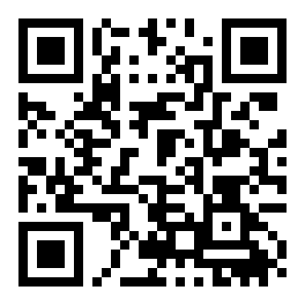
SETU 2026 Forge Realm
PS-02 NOTICE DECODER
FORGE REALM PS-02
Notice Decoder
Paste a messy college notice. Get clear events, catch clashes, add them to your calendar.
Team Nova Nexus
3 of 3
events right on the PS-02 example
145 of 152
checks right on 20 new messy notices
Ankit Kumar (Team Leader), Ankit, Ashwani Tanwar
Rules that show their reasons. Every date, time and place points to the exact words it came from.
Runs in the browser: works offline, the notice never leaves the phone, ₹0 per notice.
Live demo
Scan, or open:
anki1kr.me/NoticeDecoder/app
Team Nova Nexus | SETU 2026 Forge Realm | PS-02 Notice Decoder
1

Slide 2
SETU 2026 Forge Realm
PS-02 NOTICE DECODER
01 The problem
Dates, times and rooms hide inside long paragraphs, so students miss them or find clashes too late.
NOTICE
Students miss notices
APSIT Mumbai stopped posting notices in WhatsApp groups because "many students miss important notices" (Sep 2025).
All III-year CSE students: Internal Test 2 will be held on 13 Nov 2026 from 10:00 AM to 11:30 AM in Room 204. Lab records must be submitted to the department office by 12:00 noon on 13 Nov. A guest lecture on "AI in Healthcare" is scheduled on 13 Nov, 11:00 AM to 12:30 PM, Seminar Hall.
The class rep carries them
Jamia now keeps academic notices in official class groups run by the class representative (Sep 2026).
Clashes reach the news
St Agnes College, Mangaluru set semester exams in the Dasara holidays; students protested (PTI, Oct 2026).
Who it is for
Students first. Then the class rep who forwards every notice by hand.
The PS-02 example: three things on one day. Two of them clash, and nothing in the text says so.
Team Nova Nexus | SETU 2026 Forge Realm | PS-02 Notice Decoder
2

Slide 3
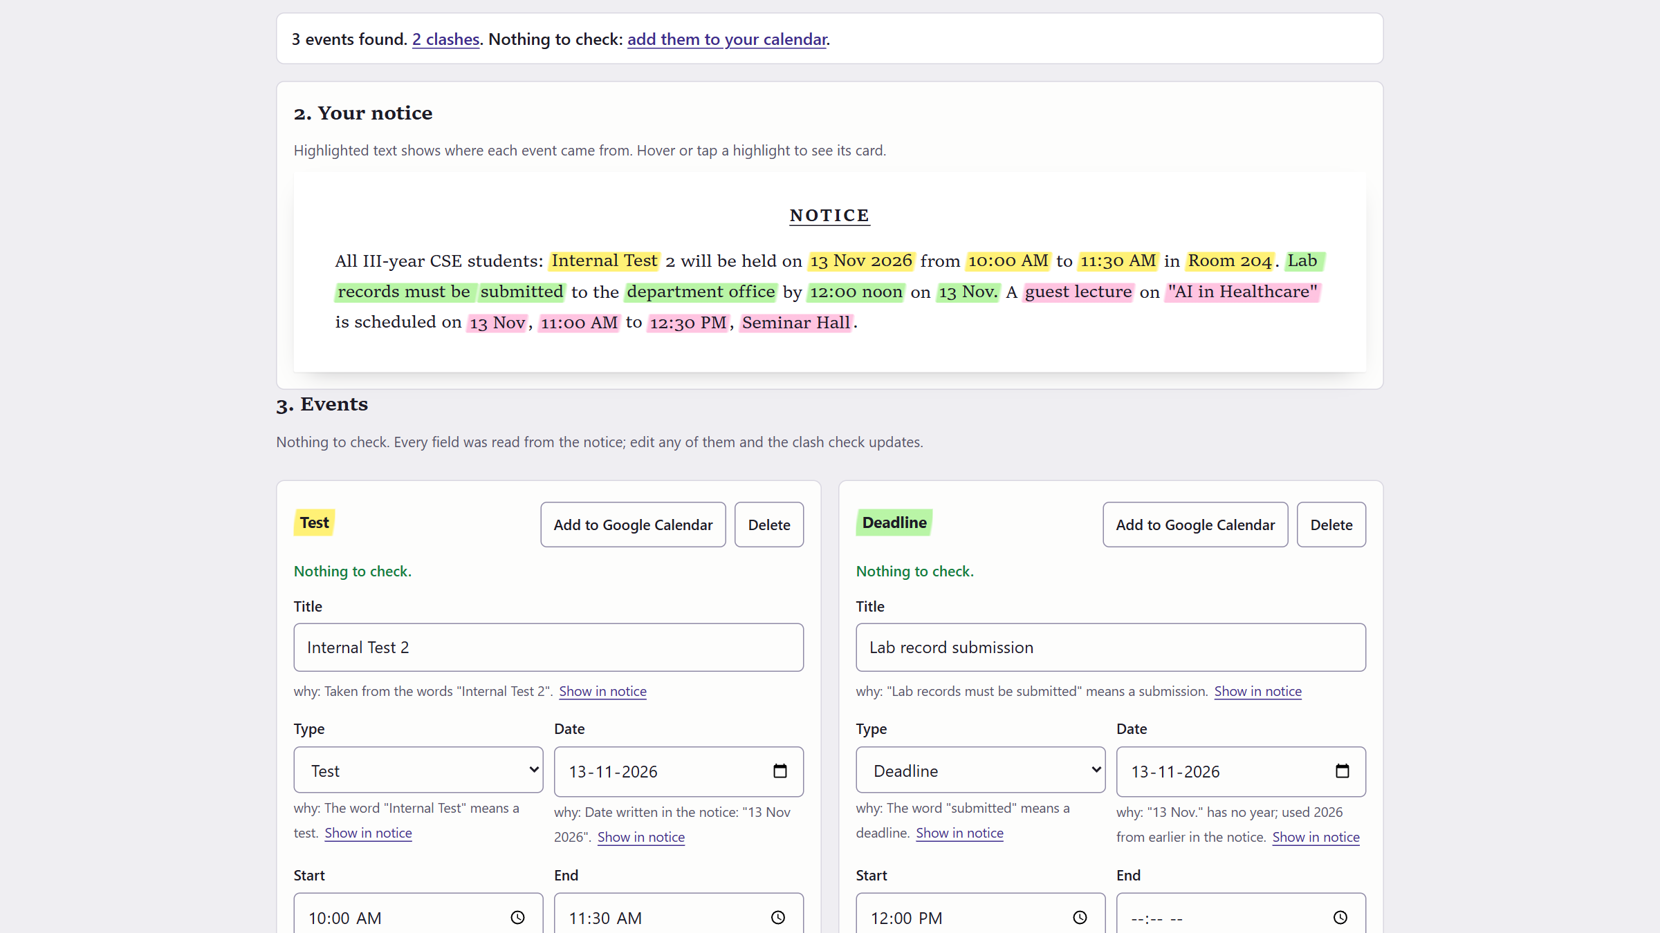
SETU 2026 Forge Realm
PS-02 NOTICE DECODER
02 Our solution
The real app on the PS-02 example. One paste, three events, every field explained.
1
1
One-line answer first
3 events found. 2 clashes. Nothing to check.
2
Highlighter colours
Each event's words in the notice, in its own colour.
2
3
A reason for every field
"why" line + Show in notice lights up the words.
5
4
4
Only doubts ask
Sure fields say "Nothing to check"; unsure ones turn amber.
3
5
One tap to the calendar
Google Calendar per event, or one .ics file for all.
Team Nova Nexus | SETU 2026 Forge Realm | PS-02 Notice Decoder
3

Slide 4
SETU 2026 Forge Realm
PS-02 NOTICE DECODER
03 How it works
Plain rules, in order. Each step leaves a reason the student can read.
Paste the notice
WhatsApp text, a PDF copy, the board
Split it
Sentences, and "Date:" / "Time:" lines kept together
Find dates, times, places
13 Nov, 13/11/2026, 2 PM, 14:00, 12 noon, kal 5 baje
Notice rules
"today" = the notice's date, postponed, windows, TBD
Events with reasons
Each field shows its words in the notice
Student checks
Only amber fields; export stays locked until then
Clash check
Overlap = each starts before the other ends; a deadline is a point
Add to calendar
One .ics file, or Google Calendar in one tap
Runs in the browser. No server and no API key: it works offline, the notice never leaves the phone, and a notice costs ₹0 to decode.
Team Nova Nexus | SETU 2026 Forge Realm | PS-02 Notice Decoder
4

Slide 5
SETU 2026 Forge Realm
PS-02 NOTICE DECODER
04 PS-02, point by point
Every "must have" in the problem statement, and how we checked it.
PS-02 asks | What Notice Decoder does | Checked on
Title, type, date, start, end, venue | Reads each field and shows the words it came from | PS example: all 3 events, every field
"13 Nov", "13/11/2026", "2 PM", "14:00" | All four, plus "12 noon", "1:30pm-5pm", "FN", "kal 5 baje" | Engine tests
Review and fix every field before export | Every field editable; export locked until amber fields are fixed or marked "Looks right" | Browser test at phone width
Overlap: each starts before the other ends | "Clash. They overlap from 11:00 to 11:30 AM (30 minutes)." | PS example
A deadline is a point; it clashes inside an event | "The 12:00 PM deadline falls during the guest lecture" | PS example
A valid .ics for common calendar apps | India time zone, reminders by event type, repeats for multi-day events | Read back by Python's icalendar parser
Suggest an action | "Finish Lab record submission before 10:00 AM" | PS example
Team Nova Nexus | SETU 2026 Forge Realm | PS-02 Notice Decoder
5

Slide 6
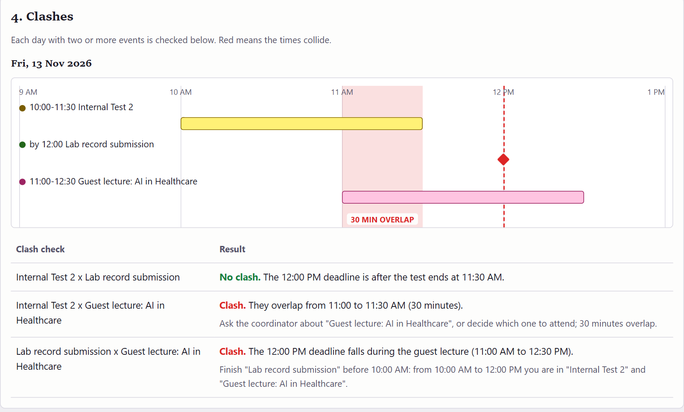
SETU 2026 Forge Realm
PS-02 NOTICE DECODER
05 The PS-02 example, end to end
Same three answers as the problem statement, from the real app.
No clash
Test ends 11:30 AM, before the 12:00 PM deadline.
Clash: 30 minutes
Test and guest lecture overlap 11:00 to 11:30 AM.
Clash: deadline inside
The 12:00 PM deadline falls during the lecture.
Suggested action
Finish the lab records before 10:00 AM: from 10:00 to 12:00 you are in the test and the lecture.
Team Nova Nexus | SETU 2026 Forge Realm | PS-02 Notice Decoder
6

Slide 7
SETU 2026 Forge Realm
PS-02 NOTICE DECODER
06 Beyond the obvious: real notices
Rules written for the way Indian college notices are really written.
"POSTPONED to 20 Nov"
Moves the event and shows the old date
"today's drive" + "Date: 05 Oct"
"today" means the notice's date, not the day you paste it
"available 1:30pm-5pm, 60 min"
A window: "take it 1:30 to 2:30 PM", not a clash
"this week or next week"
Goes to Not scheduled yet, never a made-up date
"results today 9 pm" and "next day"
Both shown in amber until the student picks one
"04/05/2027"
Read day first (4 May) and asks if it means 5 April
"lecture cancel ho gayi"
Reported as cancelled, never added
"kal shaam 5 baje"
5 PM tomorrow, flagged: kal can also mean yesterday
Why rules, not AI: the same answer every time, a reason for every field, offline and ₹0. Rules missed 7 of 152 checks, mostly spelling mistakes: the only place an AI fallback would help.
Team Nova Nexus | SETU 2026 Forge Realm | PS-02 Notice Decoder
7

Slide 8
SETU 2026 Forge Realm
PS-02 NOTICE DECODER
07 Tested, and compared
Numbers from our own test runs and from reading other teams' public code.
19 of 19
engine tests pass
37 of 37
browser checks pass at phone width
Public project (Oct 2026) | Calendar file | Clash check
7 notice tools on GitHub, mostly AI summaries | 0 of 7 | 0 of 7
edt-tamis: university timetable files, not notices | Yes | Yes
Notice Decoder | Yes | Yes, with the reason
145 of 152
checks right on 20 new messy notices
3 of 3
.ics files read back by Python's icalendar parser
We read their code, not their README: no VCALENDAR, no clash or overlap check in any of the 7.
Closest on rules: one tool reads DD/MM dates offline, but has no clock times, calendar file or clash check.
Not done yet: photos of notices, Hindi script, spelling mistakes ("tset", "Nvo" leave the date empty and keep export locked).
Team Nova Nexus | SETU 2026 Forge Realm | PS-02 Notice Decoder
8

Slide 9
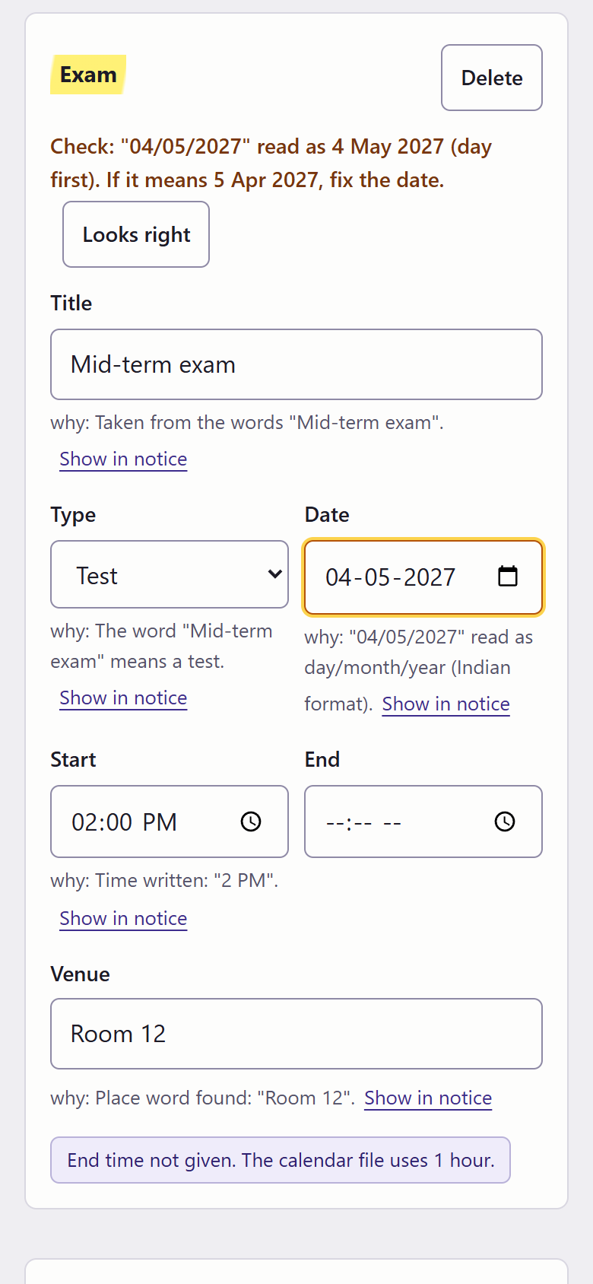
SETU 2026 Forge Realm
PS-02 NOTICE DECODER
08 Easy on a phone
A first-time user knows where to look: the answer first, then only what needs a check.
1
It says what to check
"04/05/2027" read as 4 May 2027. If it means 5 Apr, fix the date.
One-line answer at the top
"3 events found. 2 clashes. Nothing to check."
1
3
2
The doubtful field is outlined
Amber, on the field itself; the sure fields stay plain.
Colour links card and notice
Same highlighter colour on both
2
3
"Looks right" or fix it
Export and Google Calendar unlock only after this.
Fits a 360 px phone
No sideways scroll; the timeline fits the screen
Plain words: "Clash. They overlap from 11:00 to 11:30 AM (30 minutes)." No codes, no jargon.
Errors say what to do
"Too short to be a notice. Paste the whole message, with its date and time."
Team Nova Nexus | SETU 2026 Forge Realm | PS-02 Notice Decoder
9

Slide 10
SETU 2026 Forge Realm
PS-02 NOTICE DECODER
09 Who pays
Free for every student. The department pays for the part that saves the class rep's time.
Plan | Who uses it | Who pays | What they get | Our cost
Free | Every student | Nobody | Paste, check, clashes, calendar file, Google Calendar | About ₹0: runs on the phone
Department plan (planned) | Class rep or teacher | Department; HOD signs off | Decode once, publish; the class subscribes to one calendar link that updates itself | A small server and storage
₹2,999
per department per year (proposed), first term free
Why pay when WhatsApp is free?
The plan does the typing, catches clashes before publishing, and moves an event for everyone when a notice is revised.
Pilot: one department, one term
Count notices published and clashes caught. It works if the HOD pays for the next term.
For scale: Fedena, a full college ERP, lists $999 to $1,699 a year for a whole college, so one feature for one department must cost far less.
Honest status: no college has paid yet; the price is our estimate for the pilot to test.
Team Nova Nexus | SETU 2026 Forge Realm | PS-02 Notice Decoder
10

