Slide 1
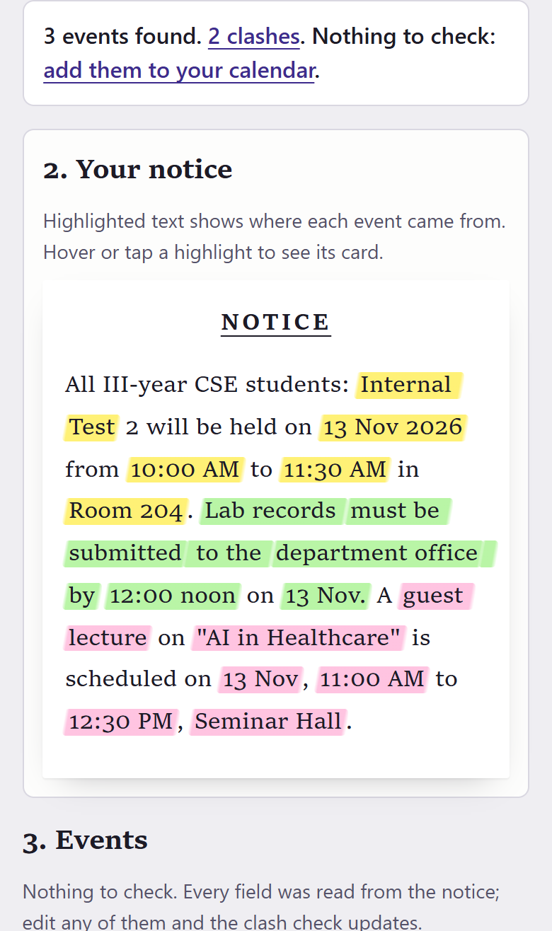


IIC ACEM | Smart Campus Innovation Challenge | 28 October 2026, Room 208
Notice Decoder
Paste a college notice. Its dates go into your calendar, with clashes marked.
Scan: live app
Team Nova Nexus
Ankit, Ankit Kumar (Leader), Apoorv
Demo video
Notes:
Member 1. Open with the line under the title, then point at the QR: the judges can try the live app while we talk.

Slide 2



Notice Decoder
IIC ACEM | Smart Campus Innovation Challenge
Find the clash in this notice. You have 10 seconds.
Buried
NOTICE
Date, time and room sit inside one long paragraph.
All III-year CSE students: Internal Test 2 will be held on 13 Nov 2026 from 10:00 AM to 11:30 AM in Room 204. Lab records must be submitted to the department office by 12:00 noon on 13 Nov. A guest lecture on "AI in Healthcare" is scheduled on 13 Nov, 11:00 AM to 12:30 PM, Seminar Hall.
Missed
Students miss dates.
Clashing
Two things at the same hour, found too late.
APSIT Mumbai stopped sharing notices in WhatsApp groups because "many students miss important notices" (e-notice board post, 23 Sep 2025).
Notes:
Member 1 asks the room to find the clash. Count down from 10. Then: "Did anyone get both?" Next slide shows what the app found.

Slide 3
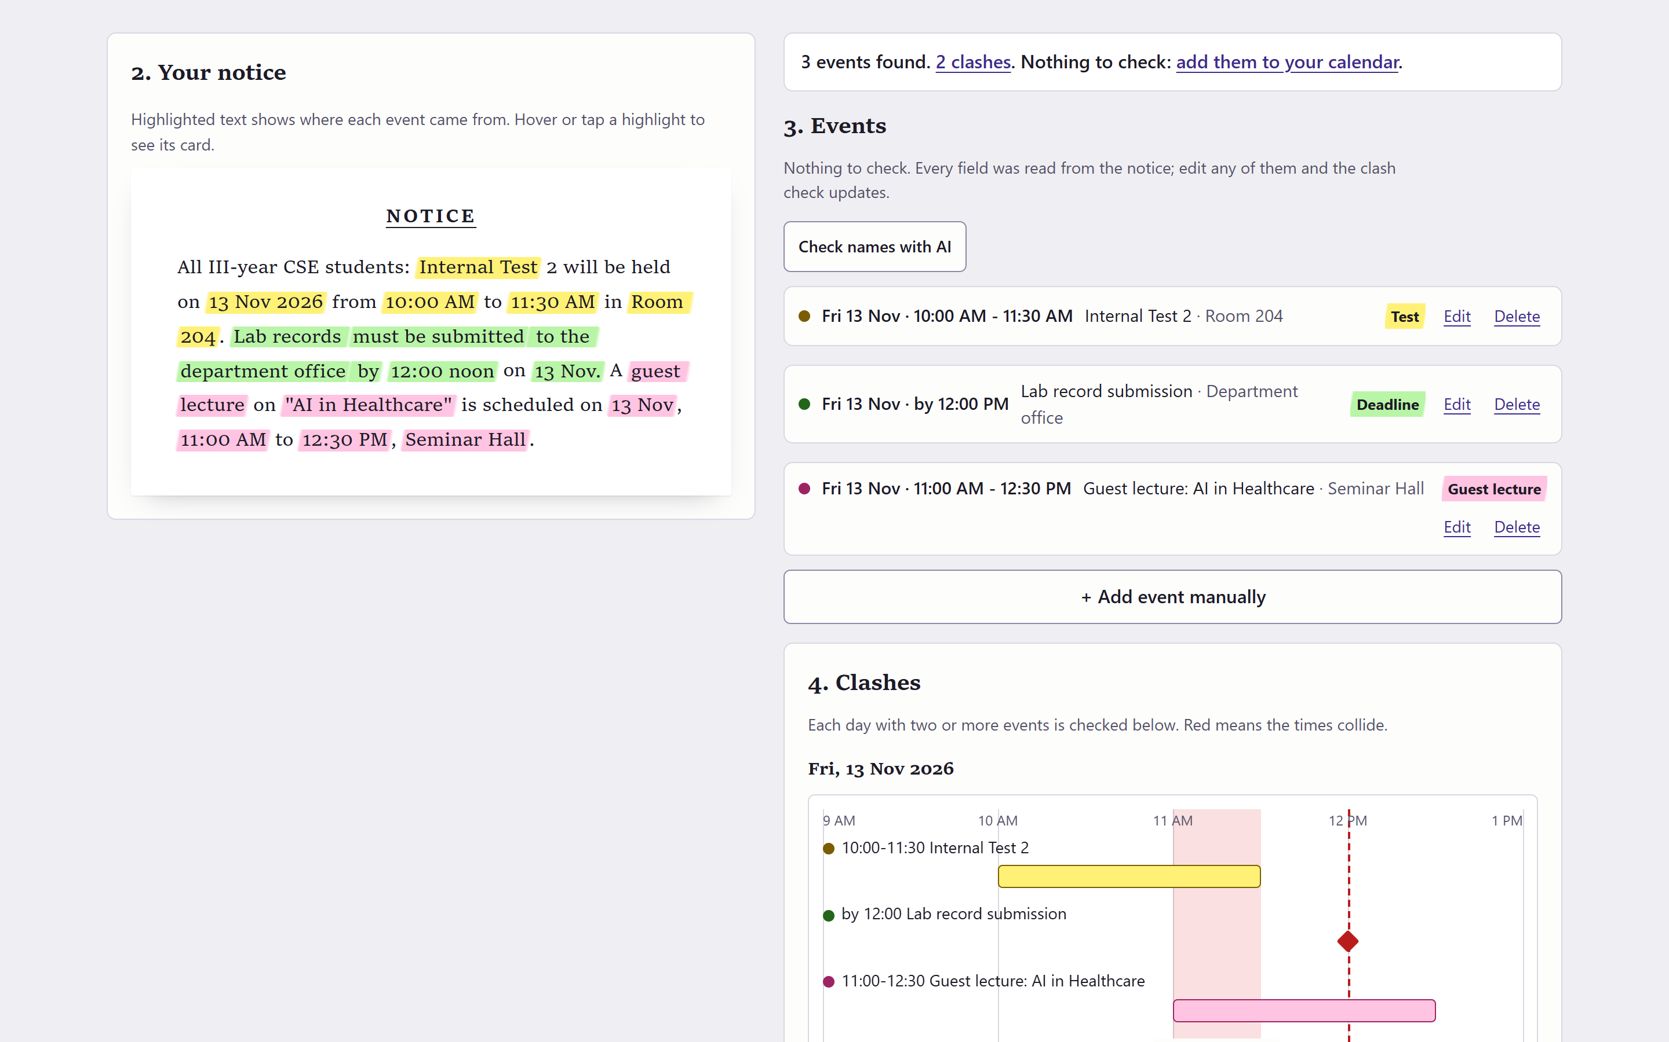
Notice Decoder
IIC ACEM | Smart Campus Innovation Challenge
The app found 3 events and 2 clashes.
1
1
The answer first
2
2
The words each date came from, in its event's colour
3
3
One line per event
4
Clashes on a timeline, with what to do
4
3 of 3 events right
nothing left to check
Notes:
Member 2. Point at each number on the screenshot. The clash the room just hunted for is pin 4.

Slide 4
Notice Decoder
IIC ACEM | Smart Campus Innovation Challenge
What is new here
0 of 7
Every date shows its source
Tap a date and the notice lights up the words it came from.
notice tools on GitHub export a calendar file or check clashes. We read their code in Oct 2026; most send the text to an AI model for a summary.
It catches a notice that disagrees with itself
Both dates shown in amber; you pick one.
The AI never sets a date
Rules read dates and times. The AI check only names things, and only when the rules are unsure.
One class calendar that moves
The rep publishes once. Students join once with Google; a postponed exam moves in their calendar, with a reminder.
Notes:
Member 2. Four things, each one shown on the last slide or in the demo. The AI line is our answer to the theme.

Slide 5
Notice Decoder
IIC ACEM | Smart Campus Innovation Challenge
Rules read the dates. AI only names things.
Paste or share
Sure
added, with Undo
30,000
random notices thrown at the rules
21
bugs found and fixed
45 + 89 + 89
rule tests, browser checks and break checks pass on every change
Photo, PDF, Word
Reading rules
dates, times, rooms, Hinglish; a reason for each
Not sure
the AI check suggests a name; you confirm
College email
WhatsApp group
Clash check
two events at once? a deadline inside a class?
Calendar
Google, phone, .ics or the class link
Dashed: a one-time install (Gmail script, Android app).
The rules run in the browser, so the app works offline and the notice is read on your phone.
Notes:
Member 2. Walk the arrows left to right. Land on "Not sure": that is the only place AI comes in.

Slide 6

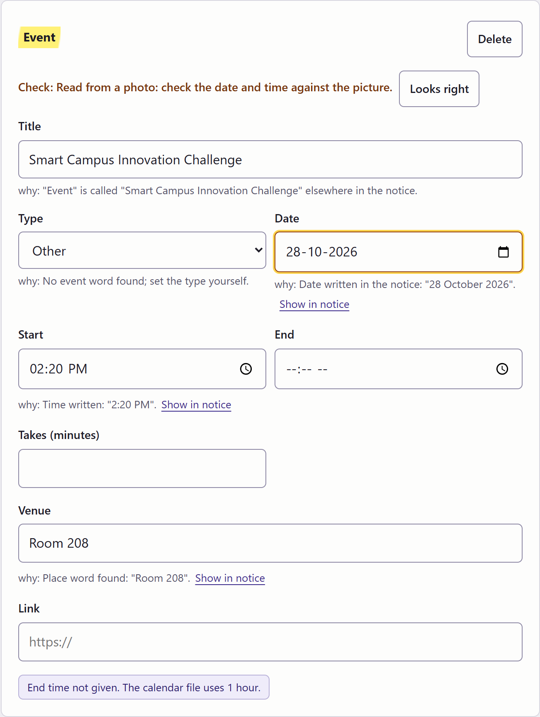
Notice Decoder
IIC ACEM | Smart Campus Innovation Challenge
This challenge's own poster, read on the phone.
One calendar for the whole class
Class rep
publishes the notice
Preview
"2 new, 1 moved" first
Every student
calendar + reminder
Change in the notice | What the class gets
A new event | In Google Calendar + reminder
"Postponed to 16 Nov" | Moves there + notification
"Cancelled" | Removed; the rep can bring it back
A notice from last week | Marked PAST and left out
28 Oct 2026, 2:20 PM, Room 208 photo never uploaded
Join once with Google, by link or QR. Term-wide clashes are checked on every publish.
Notes:
Member 3. Live demo here: upload the poster photo, show the card, press Looks right. Then the class calendar.

Slide 7
Notice Decoder
IIC ACEM | Smart Campus Innovation Challenge
One notice: 14 fields to type, now 0.
By hand today
With Notice Decoder
Who pays
Typing
14 fields for 3 events
0 fields
₹2,999
Clashes
Found on the day
2 found before the day
per department per year: our proposed price; the first term is free
Adding
One event at a time
1 tap for all 3
Students: free; the rules run on the phone.
The rep or a teacher publishes; the HOD pays.
Where we are: no college has paid yet.
A revised notice
Every student edits again
The rep publishes once; calendars move
Counted by the app itself on the sample notice (3 events, 14 fields, 0 to check).
Notes:
Member 3. Read the table row by row; the "after" column wipes in as you speak.

Slide 8
Notice Decoder
IIC ACEM | Smart Campus Innovation Challenge
Scan it. Paste any notice from your class group.
Why it is real
APSIT Mumbai stopped sharing notices in WhatsApp groups (e-notice board post, 23 Sep 2025). Jamia Millia Islamia keeps academic notices in class-rep groups (Careers360, 9 Sep 2026). St Agnes College, Mangaluru set exams in the Dasara holidays and students protested (PTI via Careers360, 12 Oct 2026).
noticedecoder.pages.dev/app
Team Nova Nexus: Ankit, Ankit Kumar, Apoorv. Thank you.
Demo video: youtu.be/joI75POVTr0
Notes:
Member 3. Leave this up during questions so the judges can scan it.

