Slide 1

A New Memory Scheduling Policy for Real Time Systems
7th International Symposium on Embedded Computing & System Design
18-19 Dec, 2017
Ankita Samaddar, Moumita Das and Ansuman Banerjee
Indian Statistical Institute
Kolkata 700108, India

Slide 2
Motivation and Objectives
7th International Symposium on Embedded Computing & System Design
18-19 Dec, 2017
Real Time tasks are ubiquitous in embedded systems context today
Executed on an embedded processor with tight interaction with the on-board DRAM memory
Real Time tasks are usually associated with hard / soft deadlines
Violation of hard deadlines can often have catastrophic consequences
Real time task scheduling policies adopted by the processor to minimize deadline violations
Earliest Deadline First, Rate Monotonic
Scheduling policy followed in DRAM is quite different
State-of-the art DRAMs use open page policy to schedule tasks at the memory
Many tasks fail to meet their deadlines while waiting for memory access at the DRAM
Objective of our work: Design a DRAM scheduling policy that can ensure less deadline violations

Slide 3
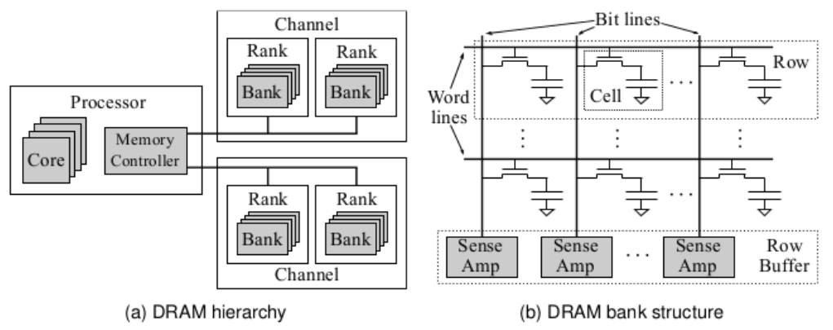
Basic Organisation of DRAM
7th International Symposium on Embedded Computing & System Design
18-19 Dec, 2017
Memory is hierarchically organized into
Rank, Bank, Array
Open Page Memory Scheduling Policy
Favors memory accesses to the same row of memory by keeping sense amplifiers open, holding data for ready access
Whenever a row of data is brought to the sense amplifier array in a DRAM cell, different columns of the same row can be accessed again and again having only column access latency
When a different row of the same bank needs to be accessed, the memory controller first precharges the DRAM array, activates the desired row and then allows for column access
Works best for sequential memory accesses
Performance increases by better exploiting spatial and temporal locality in memory

Slide 4
Open Page Policy in DRAM
7th International Symposium on Embedded Computing & System Design
18-19 Dec, 2017
ROW D E C O D E R
ROW BUFFER
COLUMN DECODER
DATA

Slide 5
Open Page Policy in DRAM
7th International Symposium on Embedded Computing & System Design
18-19 Dec, 2017
ROW D E C O D E R
Application 1
Row 0 Col 0
Row 0 Col 1
Row 2 Col 1
Application 2
Row 1 Col 1
Row 2 Col 2
Row 2 Col 1
Row 0 Col 0
ROW BUFFER
COLUMN DECODER
DATA

Slide 6
Open Page Policy in DRAM
7th International Symposium on Embedded Computing & System Design
18-19 Dec, 2017
ROW D E C O D E R
Application 1
Row 0 Col 0
Row 0 Col 1
Row 2 Col 1
Application 2
Row 1 Col 1
Row 2 Col 2
Row 2 Col 1
Row 0 Col 1
ROW BUFFER
COLUMN DECODER
DATA

Slide 7
Open Page Policy in DRAM
7th International Symposium on Embedded Computing & System Design
18-19 Dec, 2017
ROW D E C O D E R
Application 1
Row 0 Col 0
Row 0 Col 1
Row 2 Col 1
Application 2
Row 1 Col 1
Row 2 Col 2
Row 2 Col 1
Row 0 Col 1
ROW BUFFER
COLUMN DECODER
DATA

Slide 8
Problem Definition
7th International Symposium on Embedded Computing & System Design
18-19 Dec, 2017
Given a set of real time tasks to be executed in an embedded real time context
Embedded processor with some real-time scheduling policy
A DRAM bank with open page scheduling policy
Formally, i^{th} instant of a real time task Ƭ_{i} is represented as:
Ƭ_{i} = (A_{i}, E_{i}, D_{i}, P_{i})
A_{i} denotes the arrival time of i^{th} task instance,
E_{i} denotes worst case execution time of i^{th} task instance,
D_{i} denotes deadline of i^{th} task instance
P_{i} denotes the time interval after which the next task instance arrives
Objective: Design a DRAM scheduling policy that can ensure minimum deadline violations

Slide 9
Proposed Solution
7th International Symposium on Embedded Computing & System Design
18-19 Dec, 2017
A two-level scheduler
at the processor
at the memory
Scheduling at the processor:
schedule tasks on the basis of Earliest Deadline First (EDF)
Scheduling at the memory:
keep a set of extra memory banks which do not participate in address mapping
schedule tasks based on a cost function involving some known task parameters

Slide 10
The Cost Function
7th International Symposium on Embedded Computing & System Design
18-19 Dec, 2017
C_{ijk} - the remaining time after execution of i^{th} instruction of j^{th} task in the k^{th} bank (where it is actually mapped after address translation)
C_{ijk} = D_{j} − (t_{ik} + e_{iw} + e_{ik} + e_{rem})
D_{j} : the deadline of j^{th} task,
t_{ik} : the time to copy the i^{th} instruction in the k^{th} bank,
e_{iw} : the maximum waiting time of the i^{th} task in the memory buffer due to presence of other tasks in front of the i^{th} instruction in the memory buffer,
e_{ik} : the execution time of i^{th} instruction in the k^{th} bank if there is a row miss / hit,
e_{rem} : the worst case execution time required by the remaining instructions of the j^{th} task
C_{ijk'} - the remaining time after execution of the i^{th} instruction of the j^{th} task in one of the extra memory banks or the reserved banks, say k’

Slide 11
Choosing a bank based on the cost function
7th International Symposium on Embedded Computing & System Design
18-19 Dec, 2017
Cost_{ij} - cost to execute the i^{th} instruction of the j^{th} task
Cost_{ij} = C_{ijk} − C_{ijk'}
If Cost_{ij} > 0, allow the task to schedule in its own bank
Otherwise, schedule the task in any of the reserved banks

Slide 12
Implementation and Results
7th International Symposium on Embedded Computing & System Design
18-19 Dec, 2017
Trace generation from benchmark programs of the Malardalen WCET benchmark
Generated real time tasks with random arrival time (A), execution time (E) as the sum of execution time of each instruction in the worst case, random period (P) with P > E and deadline (D) equal to the period (P)
Executed the benchmark programs on an X-86 architectural platform to generate X-86 instructions
End to end simulation
Uniprocessor system using EDF as scheduling policy
Memory controller operating on the basis of our proposed algorithm
Compared memory scheduler with open page policy vs our proposed scheduler varying number of banks and size of each row
Results generated on Malardalen WCET benchmark programs by varying the number of banks and rowsize
Plotted number of deadline miss of tasks over number of cycles in open-page policy vs our proposed DRAM policy

Slide 13
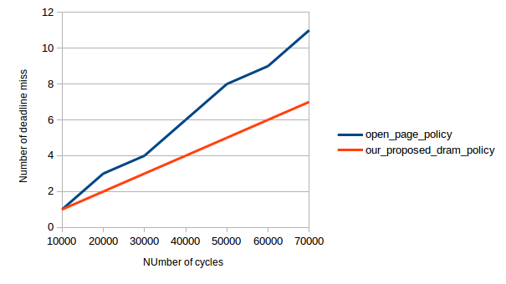
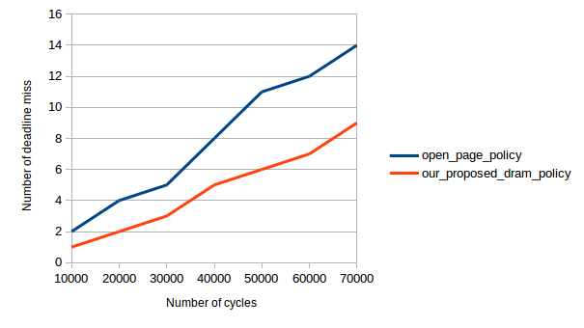
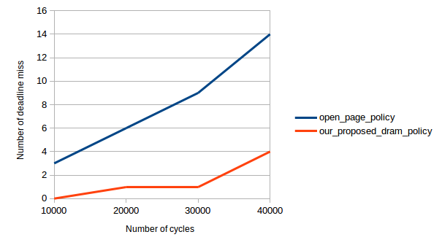
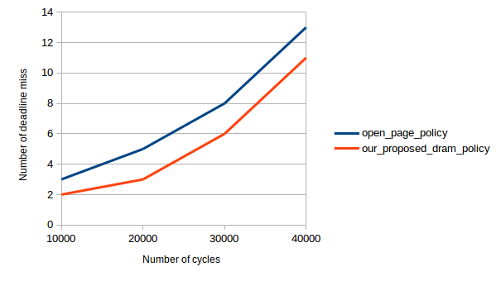
Implementation and Results
7th International Symposium on Embedded Computing & System Design
18-19 Dec, 2017
Number of banks = 10, Rowsize = 64B
Number of banks = 10, Rowsize = 32B
Number of banks = 19, Rowsize = 64B
Number of banks = 19, Rowsize = 32B

Slide 14
Conclusion
7th International Symposium on Embedded Computing & System Design
18-19 Dec, 2017
present the open page policy in the state－of－the－art DRAM controllers
present the problem os using these controllers in real time systems
proposed a scheduling algorithm at the DRAM which schedules tasks based on a cost function evaluated on the basis of some local task parameters
implemented an end－to－end simulator for the same
generated our results on the Malardalen WCET benchmark programs

Slide 15
THANK YOU
7th International Symposium on Embedded Computing & System Design
18-19 Dec, 2017

