Slide 1
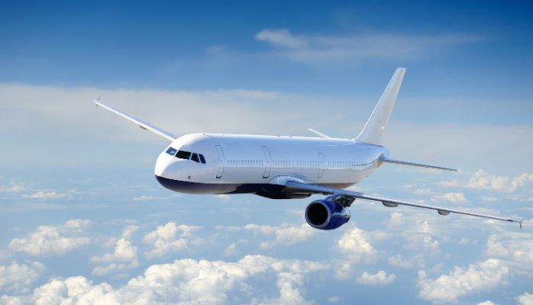
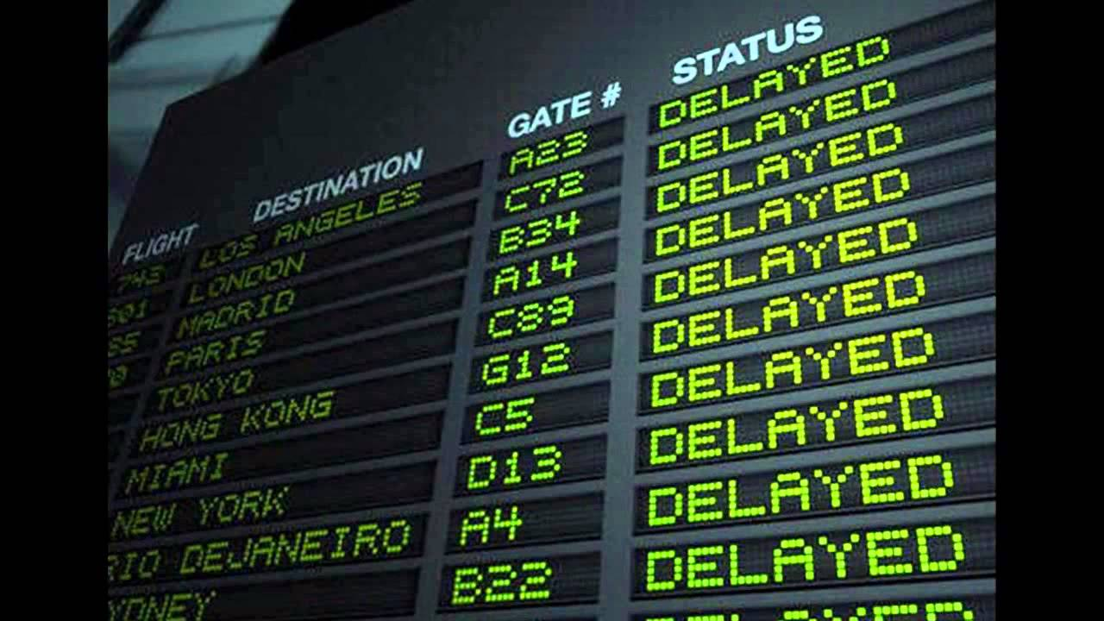
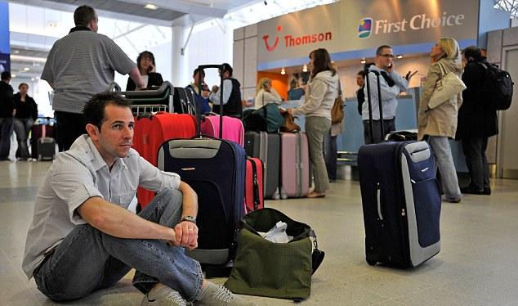
DATA MINING PROJECT
Predicting Flight Delay

Slide 2




Ankita Sawant
CS-513-A
(10412051)
Muskaan Mulchandani
CS-513-B
(10411601)
Pinkal Ganjawala
CS-513-B
(10411758)
Shradha Nayak
CS-513-B
(10411519)

Slide 3
Predicting flight delay
Like it or not, flight delays are a common plague of airline travel. That means major headaches for travelers, many of whom count on on-time arrivals for business, family or leisure purposes.
It’s probably little consolation to know that the airlines share your suffering when planes don’t depart on schedule.
Flight delays cost the industry billions of dollars each year. For travelers, the cost is both monetary and intangible. Delays can cause you to miss a connecting flight.
Subsequently, you may be late for an important meeting, lose a reservation, or miss a family event. You may find yourself calling friends or relatives for help, spending money on alternative forms of travel, or spending the night in an airport while waiting to snag a seat on another flight.

Slide 4
Objective
We will be focusing on causes of flight delays , which is the best time to travel.
We will be discussing about the factors which plays the most important role in delays.
We will be discussing prediction models , which is best suited for our dataset.
Common reasons for flight delays:
Natural disasters
Mechanical or maintenance problems
Air traffic congestion
Crew or pilot issues
Security problems or mandatory evacuations
Airline or airport errors
Limited runway space
Ripple effects due to other delayed flights

Slide 5
Project Flow
Understanding the data
Filtering data
Selecting Important Variables
Replacing Missing values
KNN
Categorizing Data
KKNN
Summary
CART
C5.O
Applying Model’s
Normalizing Data
ANN

Slide 6



Understanding Data
Dataset source: http://stat-computing.org/dataexpo/2009/the-data.html (year 2008)
There were 7009728 observations and 29 variables.
Statistics :

Slide 7
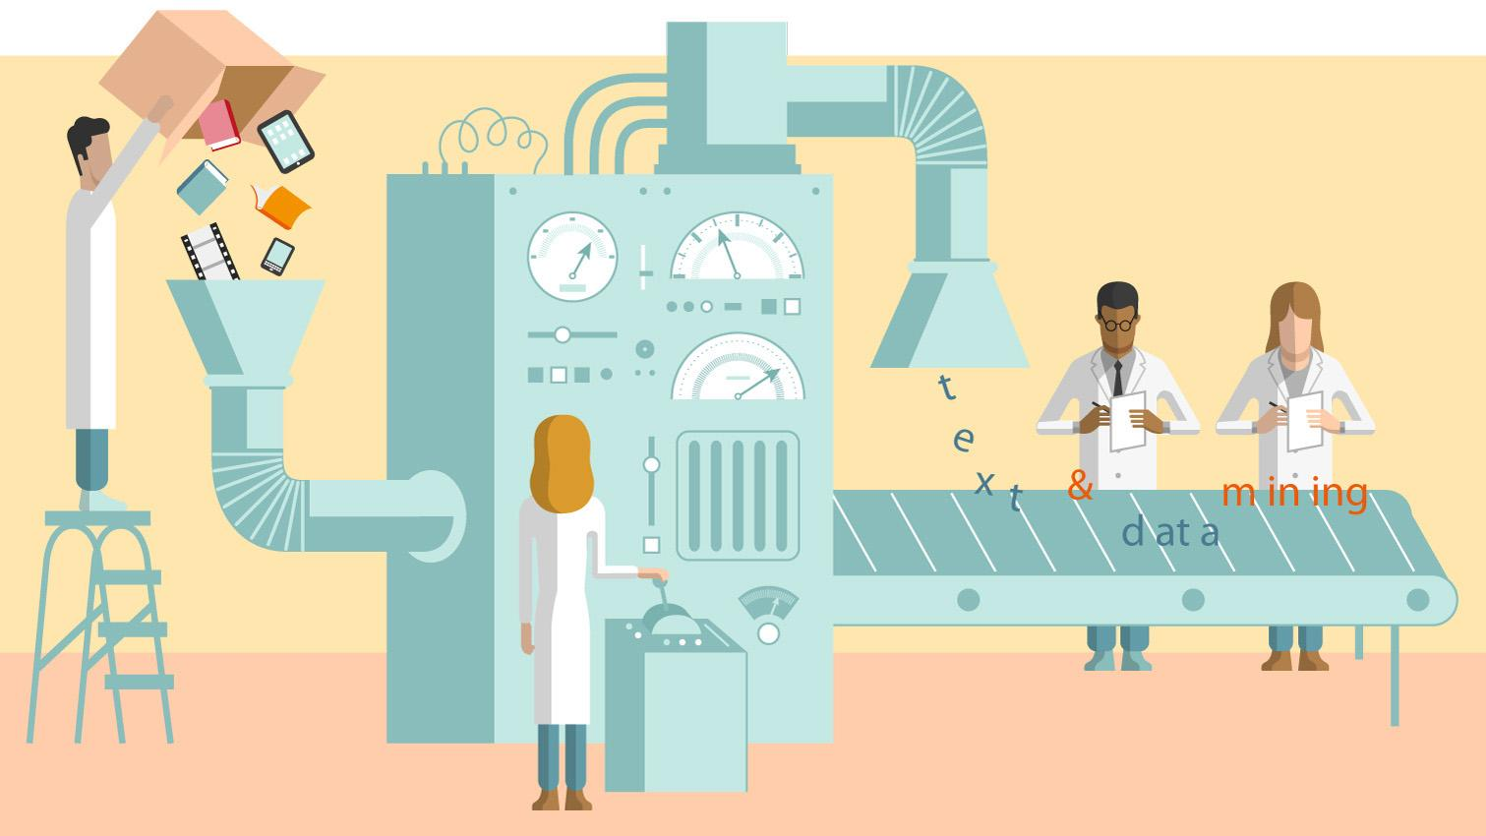
Filtering Data

Slide 8
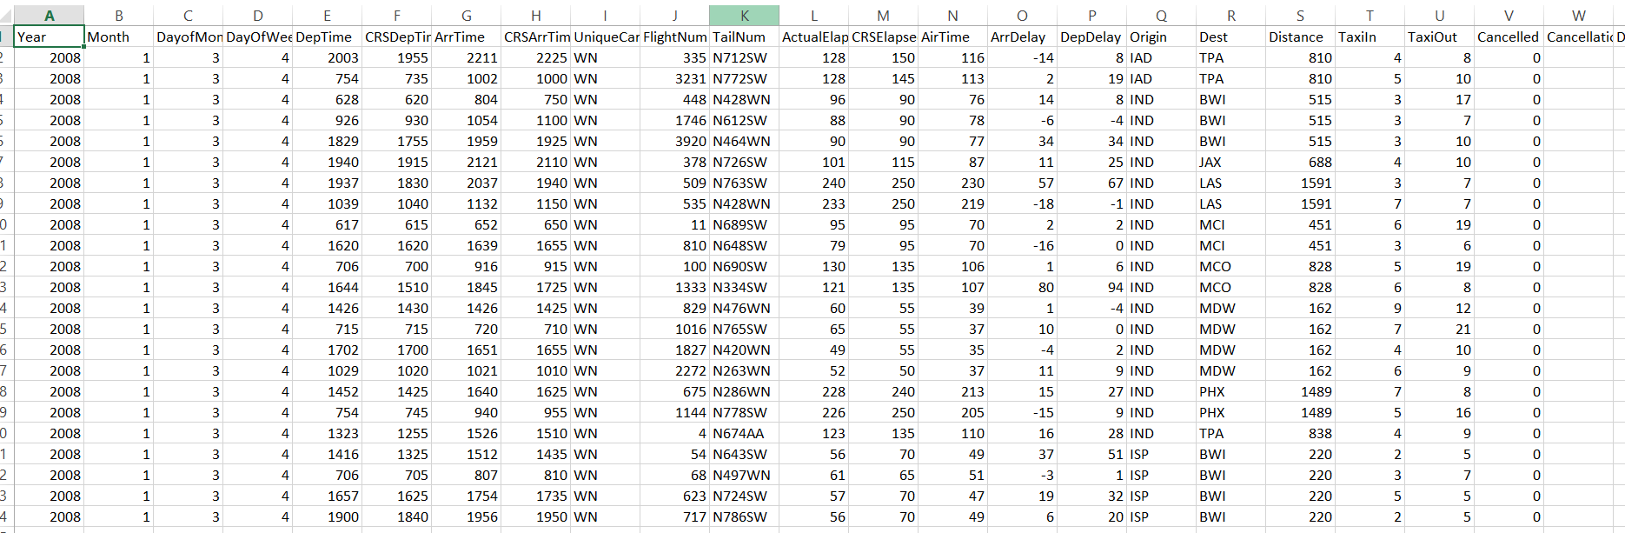
Actual dataset

Slide 9
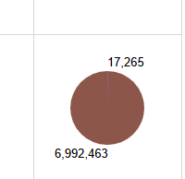
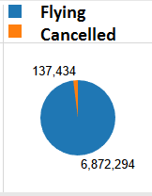
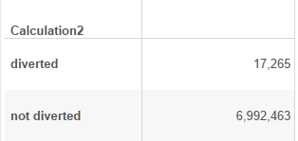
Cleaning Data
We removed the flights which were cancelled. (cancelled=1).
We removed the flights which were diverted. (diverted=1)
We removed the flights which departed late.

Slide 10
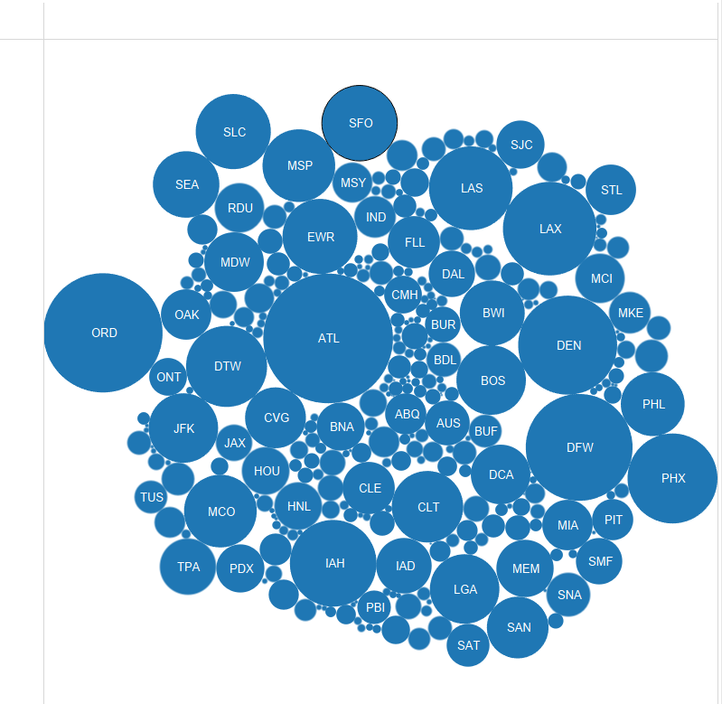
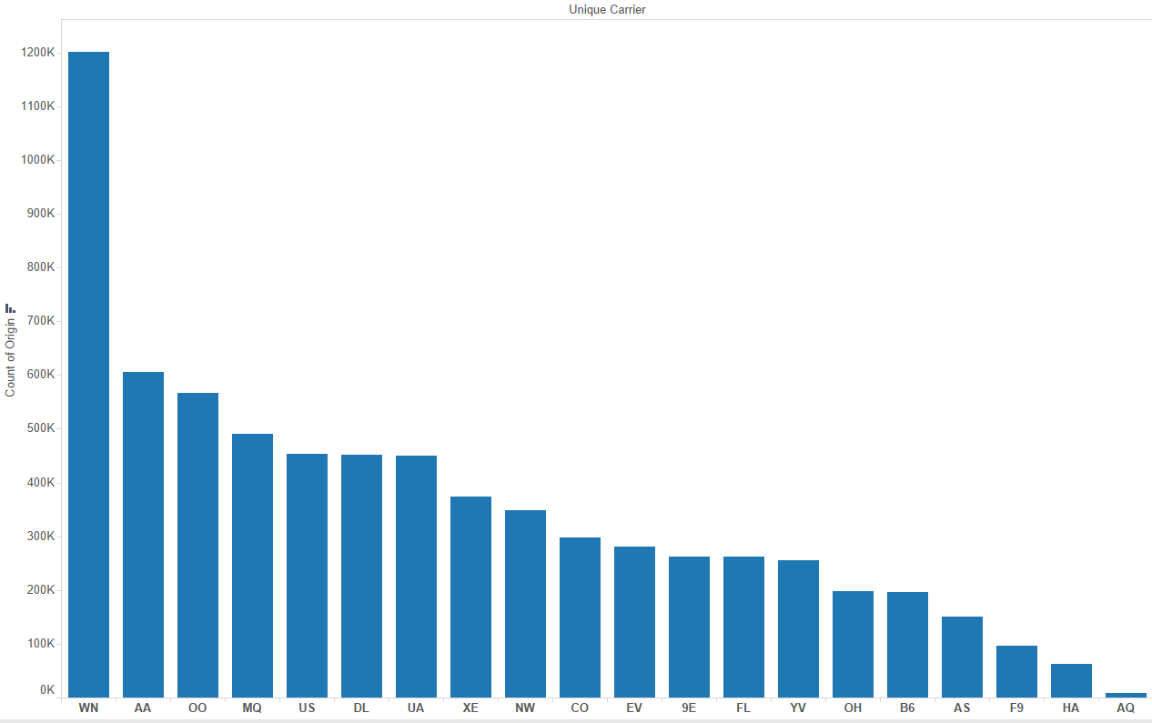
We selected top 3 carriers : WN ,AA,OO
We selected 3 Busiest Origin : ATL,ORD,LAX

Slide 11
Selecting Important variables
We selected the below mentioned variables for our prediction model:
1) day of month : 1-31
2) day of week : 1-7
3) crs dep time : scheduled departure time (local, hhmm)
4) crs arr time : scheduled arrival time (local, hhmm)
5) unique carrier : wn,aa,oo
6) origin
7) destination
8) distance : in miles
9) weather delay
10) nas delay
11) security delay
12) late aircraft delay
13) carrier delay
Target - arr delay

Slide 12

Replacing Missing Value:
Replacing na with zero’s in following column:
nas delay
security delay
late aircraft delay
weather delay
carrier delay
arr time

Slide 13
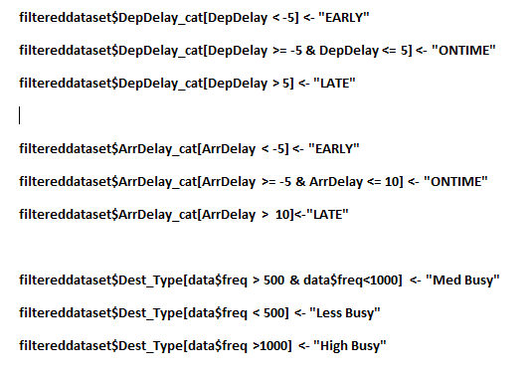
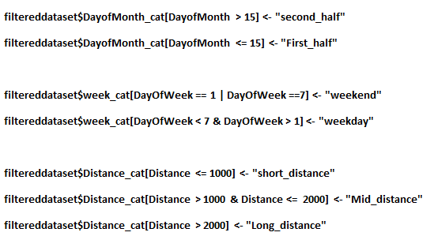
Categorizing Data

Slide 14
Normalizing Data
We have used Min-Max Normalization for normalizing Continuous data values

Slide 15
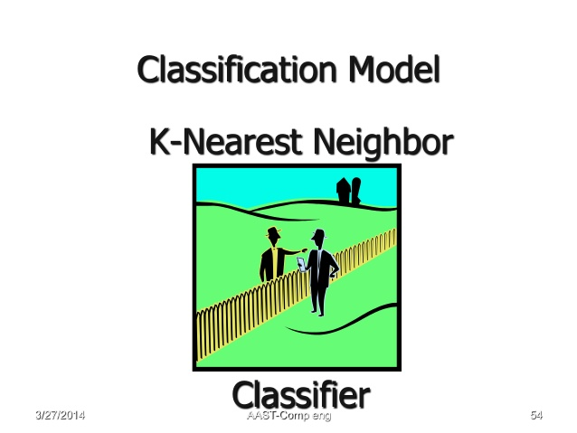

Slide 16
KNN
The KNN or k-nearest neighbors algorithm is one of the simplest machine learning algorithms and is an example of Supervised Methods.
Where a target variable is specified – The algorithm “learns” from the examples by determining which values of the predictor variables are associated with different values of the target variable.
We are also given a single number “K”. This number decides how many neighbors influence the classification.
k-nearest neighbour classification for test set from training set. For each row of the test set, the k nearest training set vectors are found, and the classification is decided by majority vote, with ties broken at random. If there are ties for the kth nearest vector, all candidates are included in the vote.

Slide 17
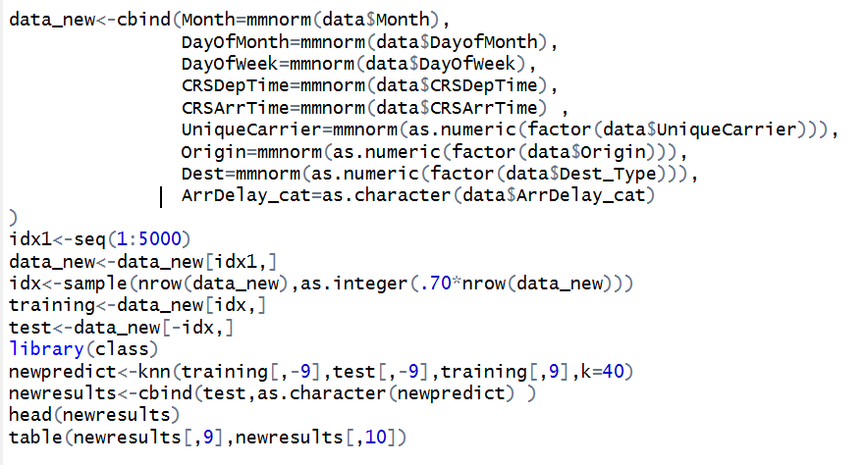
KNN

Slide 18
Choosing K
What value of k is optimal?
Smaller k – Choosing a small value for k may lead the algorithm to overfit the data.
Larger k – Larger values will tend to smooth out idiosyncratic or obscure data values in the training set.

Slide 19
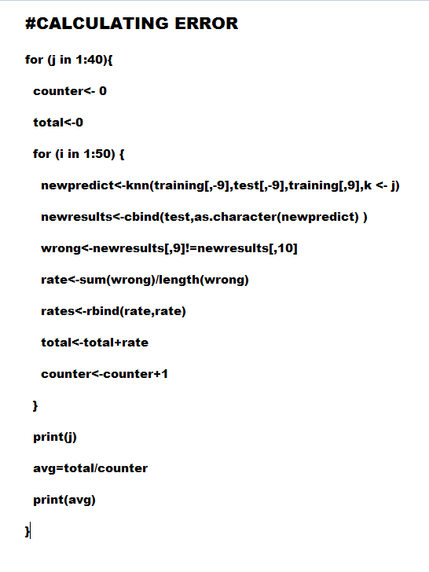
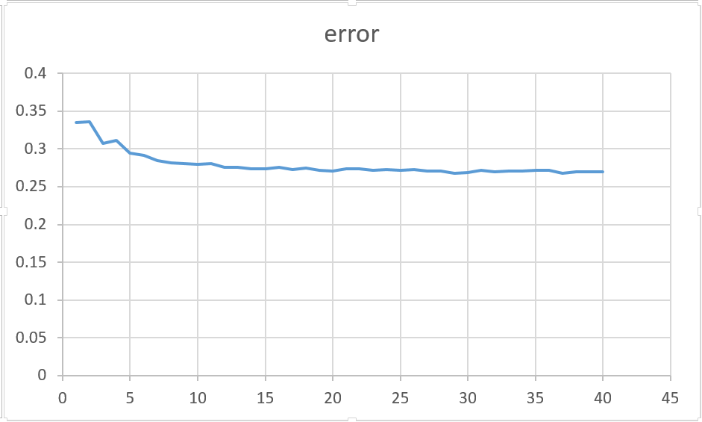
In for loop we get less error rate when k=36 ie. error rate=25.95%
Choosing k

Slide 20
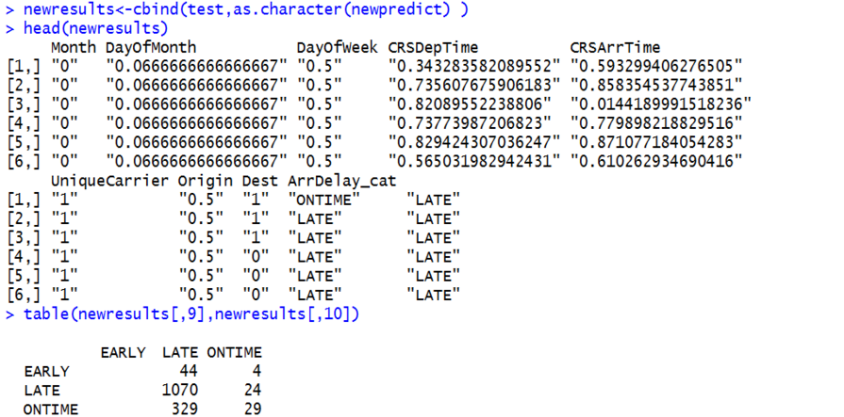
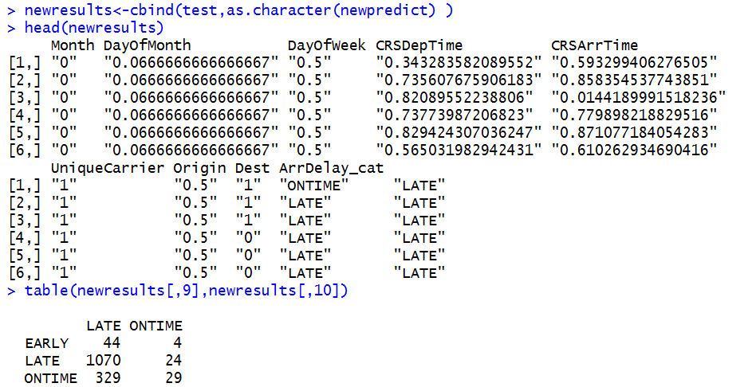
Output Of KNN:

Slide 21
KKNN
Associate weights with the attributes.
This nearest neighbor method expands knn in several directions. First it can be used not only for classification, but also for regression and ordinal classification. Second it uses kernel functions to weight the attributes according to their distances or relevance.
Assign random weights and calculate the classification error
Adjust the weights according to the error
Repeat till acceptable level of accuracy is reached

Slide 22
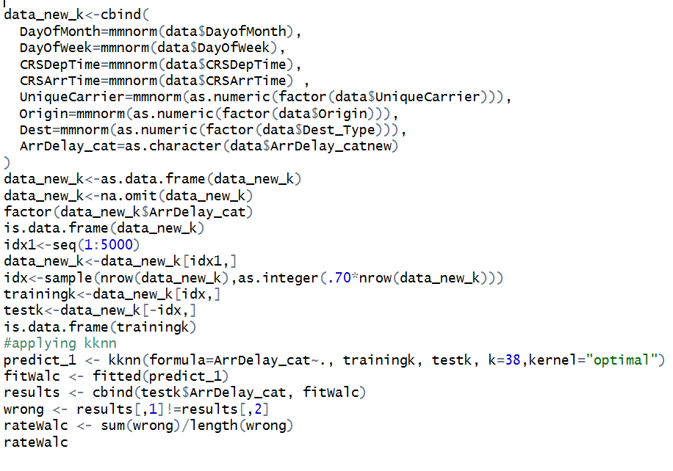
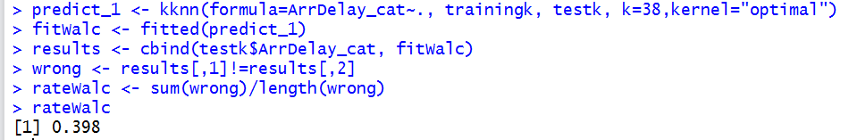
KKNN:

Slide 23

Artificial Neural Network (ANN)

Slide 24
An artificial neural network (ann) is an information processing paradigm that is inspired by the way biological nervous systems, such as the brain, process information.
The key element of this paradigm is the novel structure of the information processing system. It is composed of a large number of highly interconnected processing elements (neurons) working in unison to solve specific problems.
Neural networks, with their remarkable ability to derive meaning from complicated or imprecise data, can be used to extract patterns and detect trends that are too complex to be noticed by either humans or other computer techniques.
Other advantages include:
Adaptive learning: an ability to learn how to do tasks based on the data given for training or initial experience.
Self-organisation: an ann can create its own organisation or representation of the information it receives during learning time.
Real time operation: ann computations may be carried out in parallel, and special hardware devices are being designed and manufactured which take advantage of this capability.
Fault tolerance via redundant information coding: partial destruction of a network leads to the corresponding degradation of performance. However, some network capabilities may be retained even with major network damage.

Slide 25
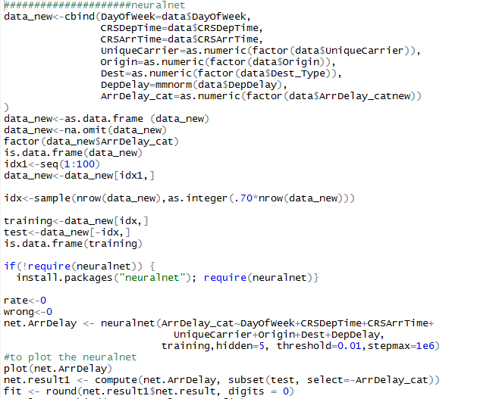
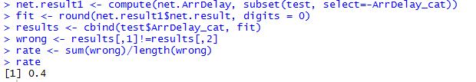
ANN

Slide 26
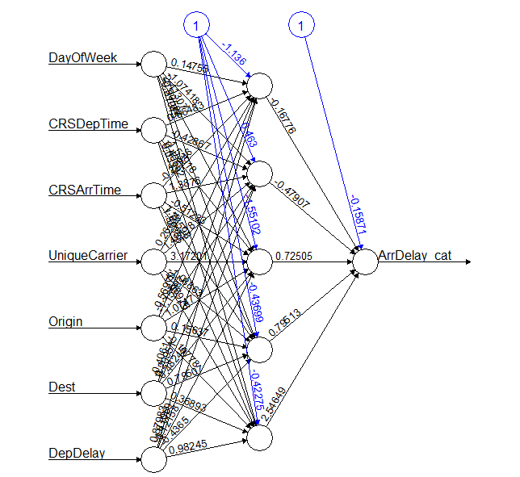
ANN Plot

Slide 27


Slide 28
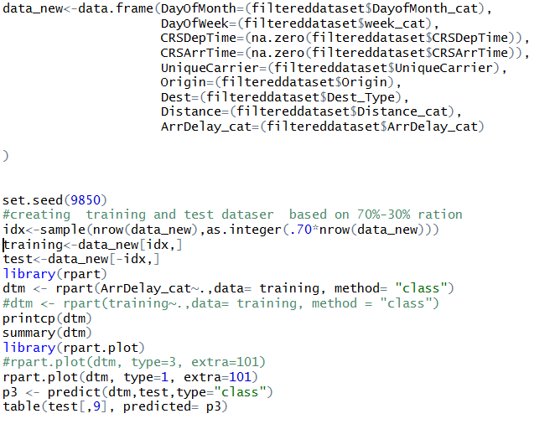
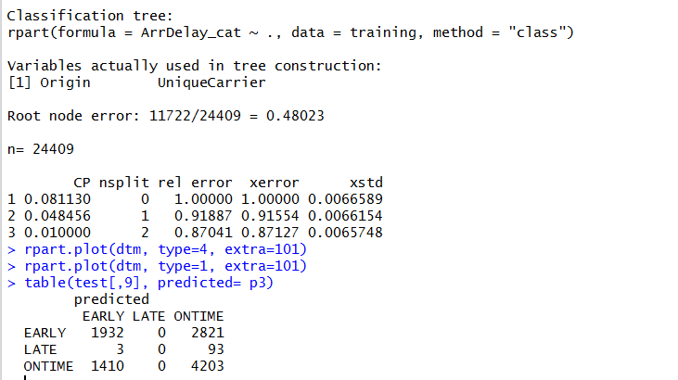
Decision Tree:

Slide 29
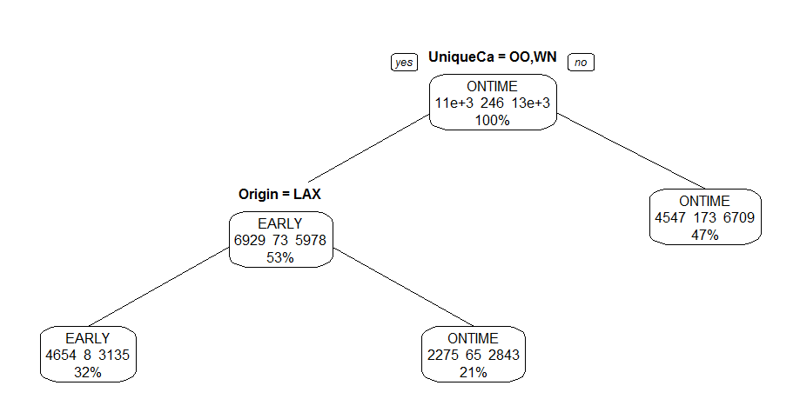
Output Of DTREE(CART):

Slide 30
C5.0
C5.0 decision trees and rule-based models for pattern recognition.
This is an extension of the C4.5 algorithm.

Slide 31
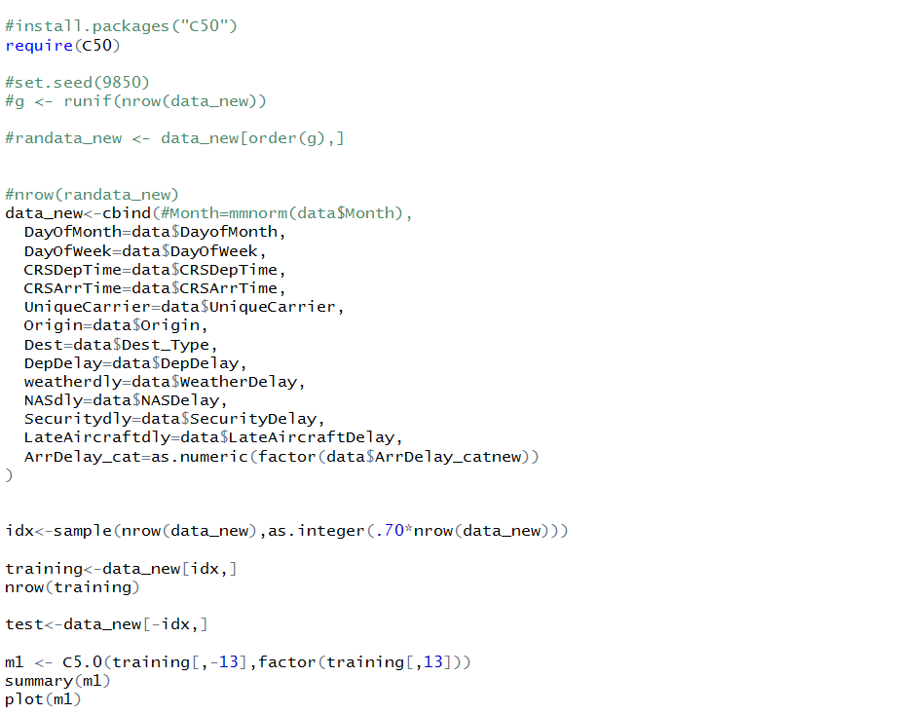
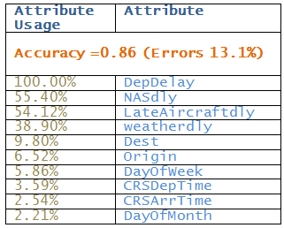
C5.0 (Before Pruning)

Slide 32
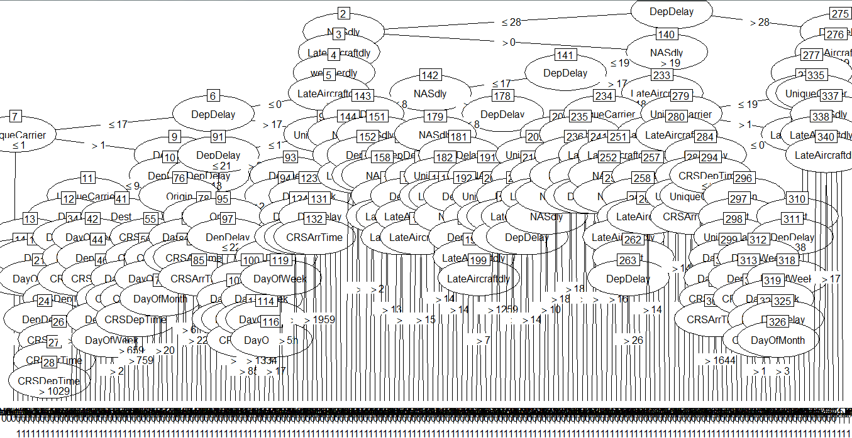
C5.0 Tree (Before Pruning)

Slide 33
Boosting
Boosting is the process of adding weak learners in such a way that newer learners pick up the slack of older learners. In this way we can (hopefully) incrementally increase the accuracy of the model. Using the C5.0() function, we can increase the number of boosting iterations by changing the trials parameter.
m1 <- C5.0(training[,-7], factor(training[,7]), trials=10)

Slide 34
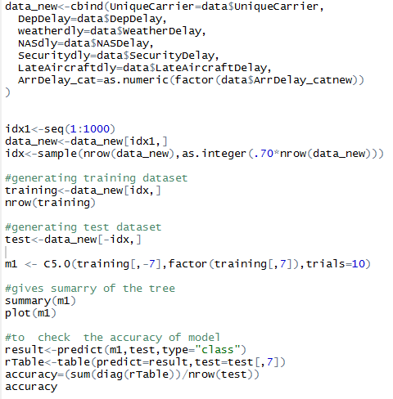
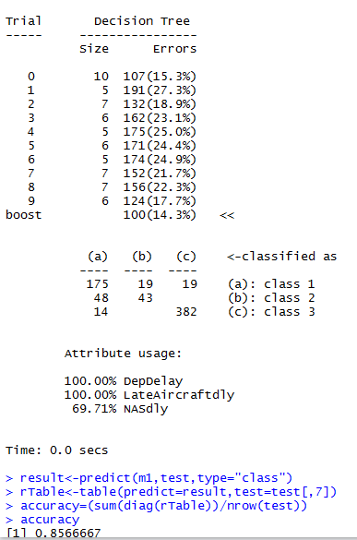
Code And Summary Of C5.0
(After Pruning)

Slide 35
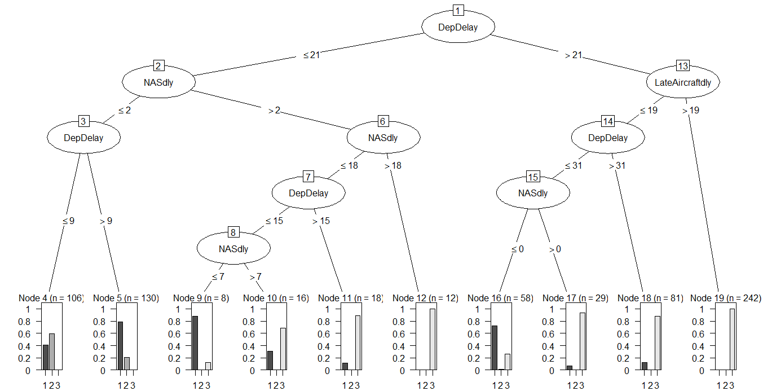
C5.0

Slide 36
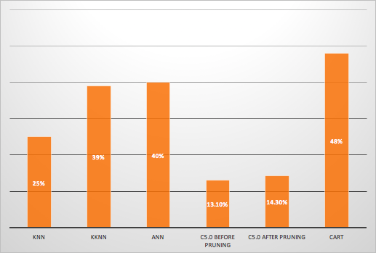
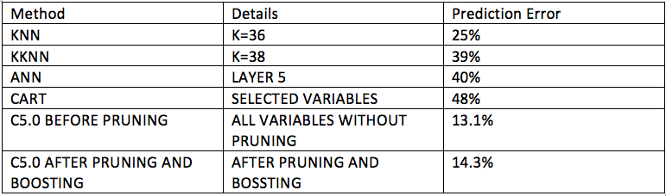
Comparison on basis of Error :

Slide 37
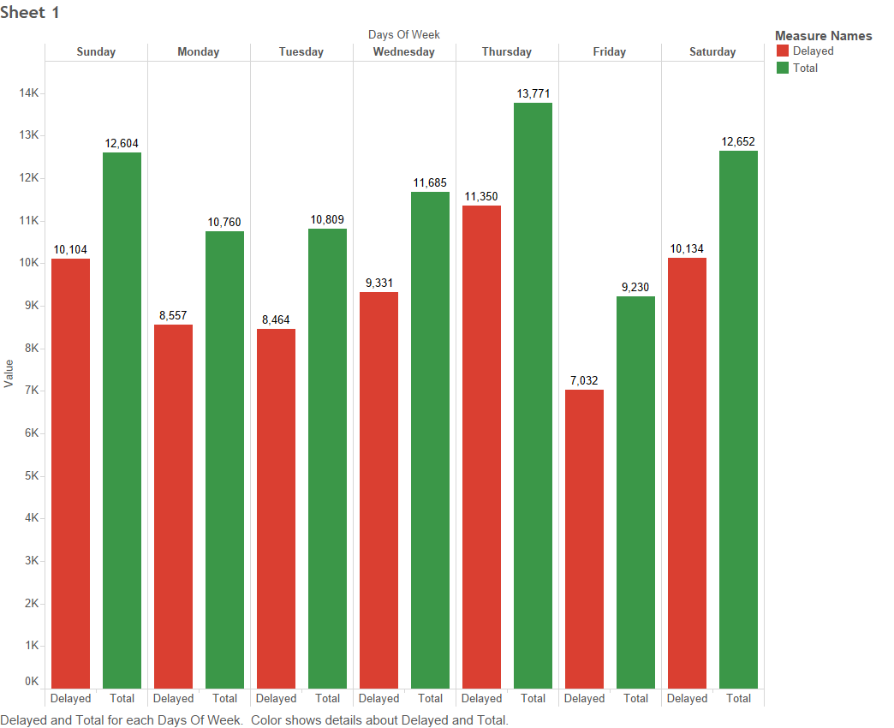
Data Analysis
Day-wise arrival delay statistics

Slide 38
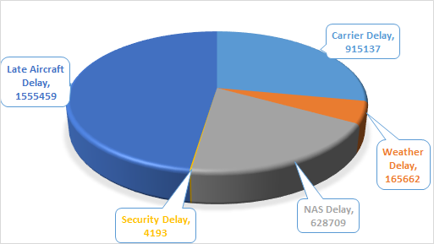
Breakdown of arrival delay

Slide 39
Conclusion
We have explored different prediction models. By measuring the performance of the models using real data, we have seen interesting results on the predictability of the delays.
The best delay prediction method appeared to be the most specific one, which takes into account all the combination of categorical parameters and a condition on the arrival hour.
The performances of the models were challenging to evaluate, due to the variety of measures used, and the different parameterizations adapted to them.
C5.0 before pruning came out to be best for our dataset.

Slide 40
Future Scopes
The models used , could be improved in several ways:
The models could also be refined, in order to give specific predictions for some period of time, like holidays and days off, during which a lot of people are travelling.
We can also imagine building an expert system, which will use a combination of the different models we have seen, to select the best one for different use cases.
We can for instance build separate models per time period, per type of aircraft, per airline, per region, and then grouping them into a general model. This way, we may be able to predict the delays of a new flight, without needing several months of data to build a prediction model.
Another step forward would be to generalize the model to flights of the entire world, or at least to exploit more data sources, to build more complete predictions.
Finally, the most interesting step would be to integrate such a model into a flight booking tool, to provide the delay prediction to future passengers, even if this would require a strong confidence in the information provided, considering the possible impact in terms of reservations.

Slide 41


