Slide 1


Cost Prediction on Acquiring Customers
Suruchi rani Ankita sharma INDRAJEET SUPATE
ABHISHEK KUMAR RAI CEFARAHEL.S ADITI GANDHI
M.PRAVIN NAIR

Slide 2
Introduction
Marketing's primary goal is gaining customers. Most funds are allocated to acquiring new customers. Customer Acquisition Cost (CAC) measures expenses for acquiring customers and helps evaluate marketing effectiveness. Predicting CAC is crucial for estimating expenses and optimizing resources.
ML in Marketing Data Science and Machine Learning are transforming marketing.
They analyze strategies, uncover data relationships, forecast variables, and categorize customers based on purchasing habits.
These technologies are rapidly expanding and solving a majority of marketing problems across various industries.

Slide 3
Literature Review
E-commerce companies aggressively pursue customer acquisition, known as a "land grab," with CAC ranging from $40 for Amazon.com to over $400 for online brokers.
Early investments aim to generate long-term profits from loyal customers.
Acquiring new customers is time-consuming, making it simpler to satisfy existing ones.
Identifying profitable new customers is crucial, though only a small percentage become profitable.
Cost prediction methods include qualitative and quantitative approaches, such as regression for traditional methods, time series analysis for modern methods, and Artificial Neural Networks (ANN) for quantitative methods, especially beneficial for longer-term forecasts.
Combining multiple prediction tools is common in the latest cost prediction models.

Slide 4
Data Set
This dataset obtained from Kaggle focuses on Food Mart X, a franchise operating convenience stores across the United States.
It provides information on customer acquisition costs through media campaigns, income, and store data.
The goal is to predict customer acquisition cost and analyze campaign strategies using the 'train' dataset, consisting of 36256 rows and 41 features related to customers, products, stores, promotions, and costs.
Models
Regression Algorithms:
Most popular techniques to build a prediction models. There are various regression algorithms available.
Simple Linear Regression, Multiple Linear Regression, Polynomial Regression, Ridge or Lasso Regression etc..,
Support Vector Machine algorithm, Decision Tree Regressor, Random Forest Regressor etc..,

Slide 5
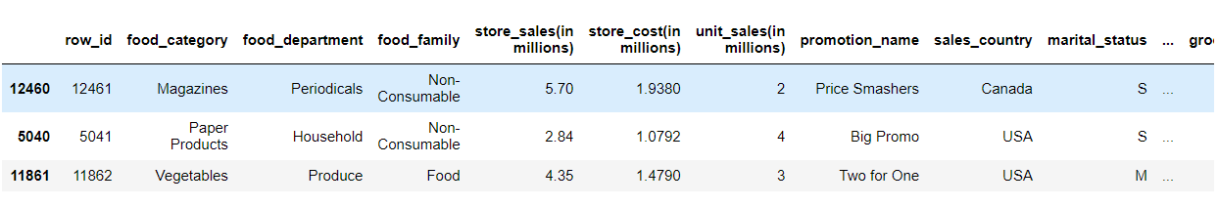
Exploratory Data Analysis (EDA)
EDA helps to process the data that suitable to machine learning model and help us to find out the hidden patterns and trends in the data. Also can summarize data through the statistical summary and graphical way.
Handling the Missing Values
Handling Outliers
Data Visualization: Visualisation of each categorical columns to check their variation with target variable cost .
Fig 1: Sample of data

Slide 6
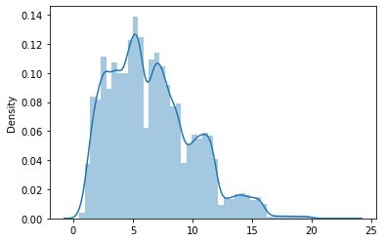
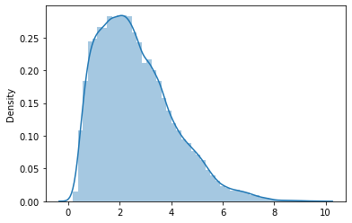
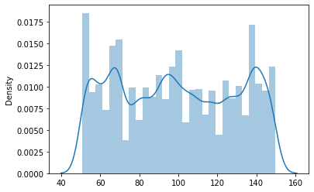
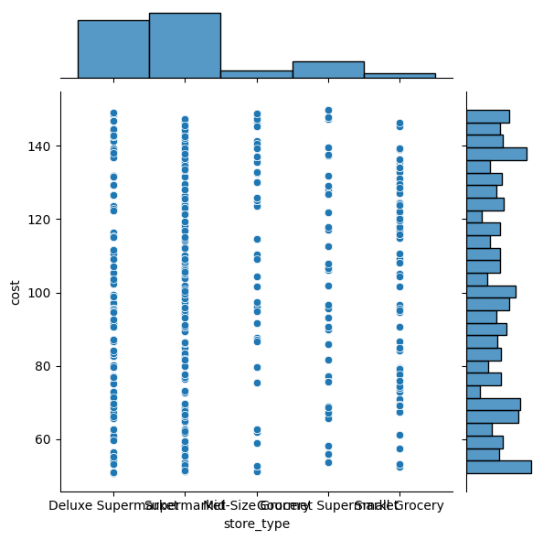
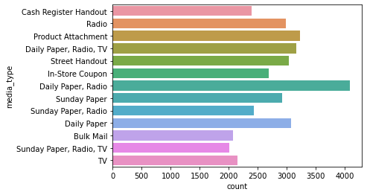
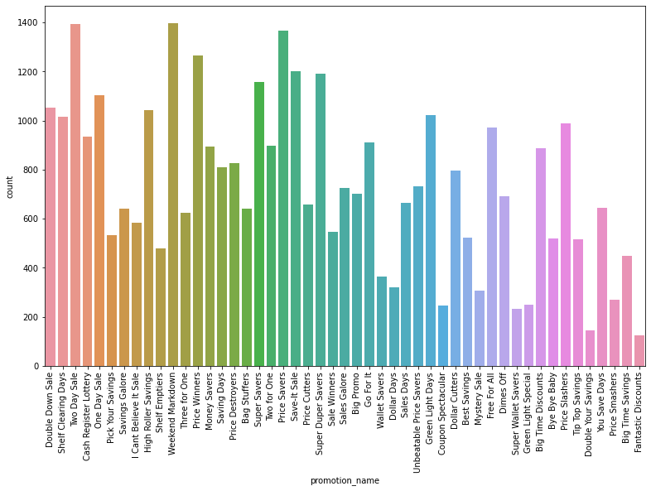
Fig 2: a)Store sales distribution (in millions)
b) Store cost distribution (in millions)
c) Distribution of the cost (dollars)
a) Count plot of media_type
b) Count plot of promotion_name
c) Variation of cost w.r.t. store type
Fig 3: EDA Analysis

Slide 7
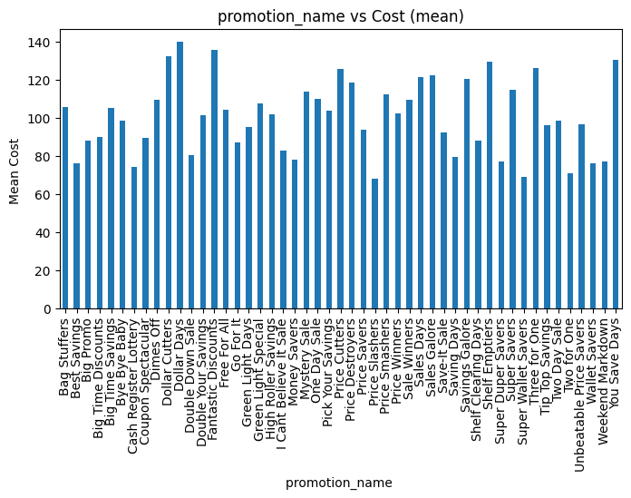
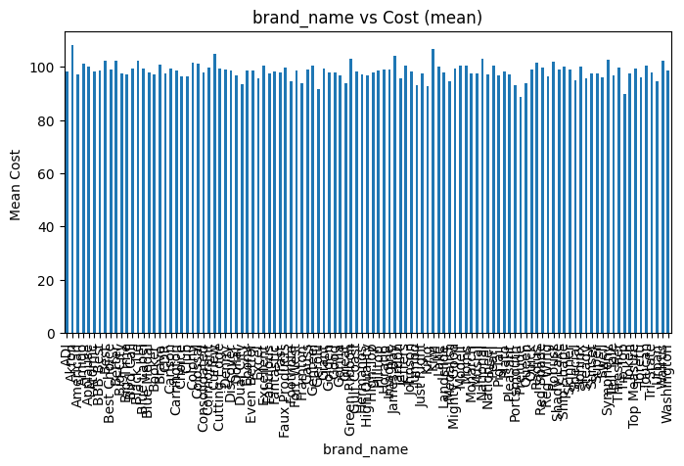
Visualization of categorical variables - Inferences from bargraph:
1. Product type such as food_category, food_department, food_family do not effect much on campaign cost. As the variation in cost is very small with variation in product type.
2. Visualiasing promotion vs cost graph we can see that promotions significantly affect the cost of campaigns. Some promotions have a much higher cost than others.
3. customer details: marital_status, gender,education, member_card,houseowner are almost evenly distributed to campaign cost.
4. store details: store sales, store type, city, state effects the variation in cost.

Slide 8
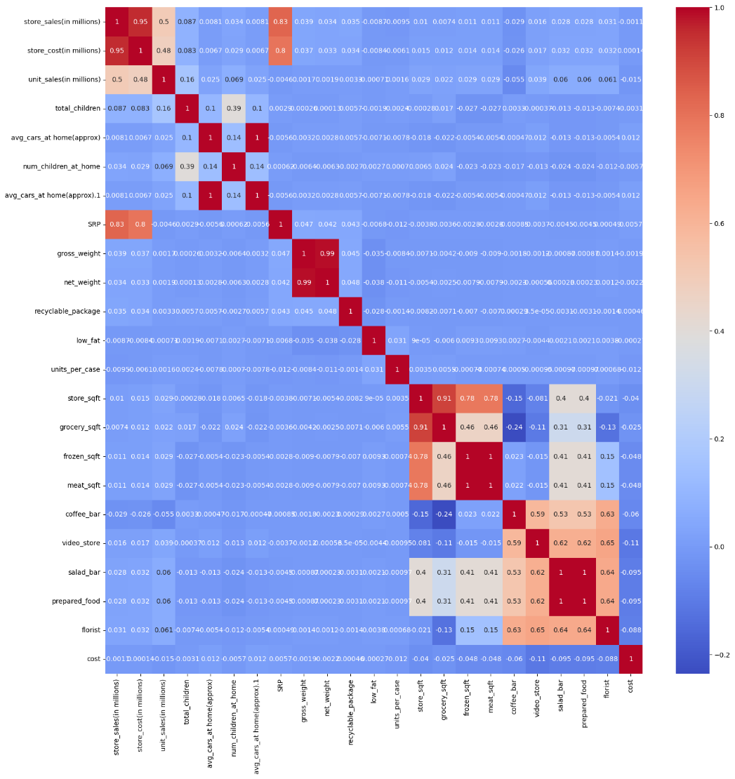
e) Heat Map
observations:
Features with correlation 1 a. prepared_food and salad bar b. meat sqft and frozen_sqft
correlation 0.99 - net_weight and gross_weight
correlation 0.95 - store_sales and store_cost
correlation 0.91 - grocery_sqft and store_sqft

Slide 9
Data Pre-Processing
Data preprocessing is the manipulation or removal of data before it is used to ensure or improve performance.
Through the EDA we identify that there is no much linearity between the data features and target column.
So, The redundant features are removed in data pre-processing.
Encoding: Encoding is a process of converting categorical features into numerical values.
We use label encoding to convert categorical features into continuous values.
Splitting the data: Split the data into train and test data.
X_train, X_test, y_train, y_test = train_test_split(X,y,train_size = 0.7, test_size = 0.3, random_state = 42)

Slide 10
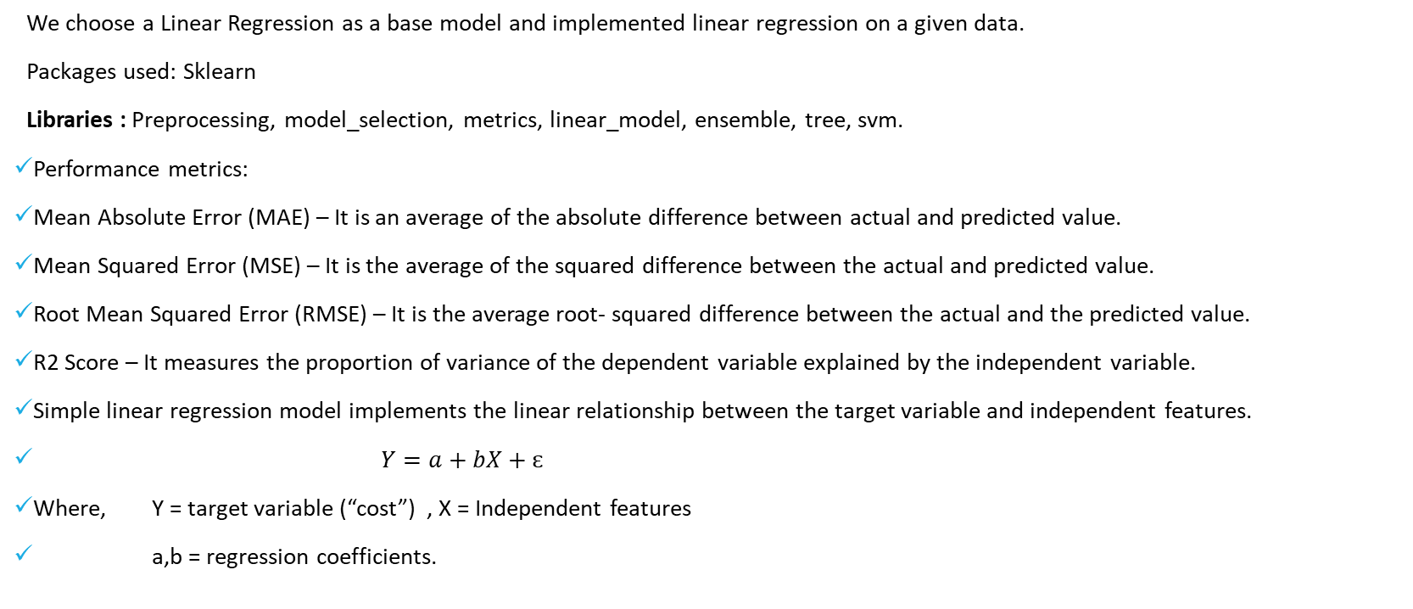
Base Model
We choose a Linear Regression as a base model and implemented linear regression on a given data.
Packages used: Sklearn
Libraries : Preprocessing, model_selection, metrics, linear_model, ensemble, tree, svm.
Performance metrics:
Mean Absolute Error (MAE) – It is an average of the absolute difference between actual and predicted value.
Mean Squared Error (MSE) – It is the average of the squared difference between the actual and predicted value.
Root Mean Squared Error (RMSE) – It is the average root- squared difference between the actual and the predicted value.
R2 Score – It measures the proportion of variance of the dependent variable explained by the independent variable.
Simple linear regression model implements the linear relationship between the target variable and independent features.
$Y=a+bX+ɛ$
Where, Y = target variable (“cost”) , X = Independent features
a,b = regression coefficients.

Slide 11
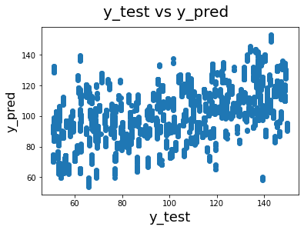
Linear model
Performance Metric | Value
Mean Absolute Error (MAE) | 25.04595659041828
Mean Squared Error (MSE) | 857.8914384093781
Root Mean Squared Error (RMSE) | 25.04595659041828
R² Score | 0.02594784923372706
Table 1: Performance metrics of Simple linear Regression
Fig 5: y_test Vs. y_pred
A. Multiple Linear Regression:
Multiple linear regression (MLR) is a statistical technique that uses several explanatory variables to predict the target variable. It is extension of the simple linear regression.
B. Polynomial Regression:
Polynomial Regression is regression model that analysis relationship between the independent variable and target variable is modelled as the nth degree polynomial.

Slide 12
Performance Metric | Value
Mean Absolute Error (MAE) | 25.35312
Mean Squared Error (MSE) | 870.1791
Root Mean Squared Error (RMSE) | 5.0351
R² Score | 0.01199
Performance Metric | Value
Mean Absolute Error (MAE) | 0.5867
Mean Squared Error (MSE) | 857.890
Root Mean Squared Error (RMSE) | 5.0046
R² Score | 0.025948
Table 2: Performance metrics of Lasso()
Table 3: Performance metrics Ridge Regression
C. Gradient Boosting Regression:
Gradient boosting is one of the model from ensemble methods where all weak models combined and get better performance.
D. Decision Tree Regressor:
Decision Tree is the most popular technique for both regression and classification problems. It is a non-parametric supervised learning algorithm.
Performance Metric | Value
Mean Absolute Error (MAE) | 14.3796
Mean Squared Error (MSE) | 320.5533
Root Mean Squared Error (RMSE) | 3.7920
R² Score | 0.63604
Performance Metric | Value
Mean Absolute Error (MAE) | 25.0461
Mean Squared Error (MSE) | 5.7470
Root Mean Squared Error (RMSE) | 0.40871
R² Score | 0.99347
Table 4: Performance metrics of Gradient Boosting Regression
Table 5: Performance metrics of Decision Tree Regression
Great Learning - PGDCSAI APR22

Slide 13
E. Random Forest Regressor:
Random Forest Regression is a supervised learning algorithm that uses ensemble techniques to solve both regression and classification problems.
F. KNeighborsRegressor :
Regression based on k-nearest neighbors.The target is predicted by local interpolation of the targets associated of the nearest neighbors in the training set.
Performance Metric | Value
Mean Absolute Error (MAE) | 0.169
Mean Squared Error (MSE) | 2.9668
Root Mean Squared Error (RMSE) | 0.4156
R² Score | 0.9966
Performance Metric | Value
Mean Absolute Error (MAE) | 11.33340
Mean Squared Error (MSE) | 334.54970
Root Mean Squared Error (RMSE) | 3.3665
R² Score | 0.62015
Table 6: Performance metrics of Random Forest Regression
Table 7: Performance metrics of KNeighborsRegressor
Great Learning - PGDCSAI APR22

Slide 14
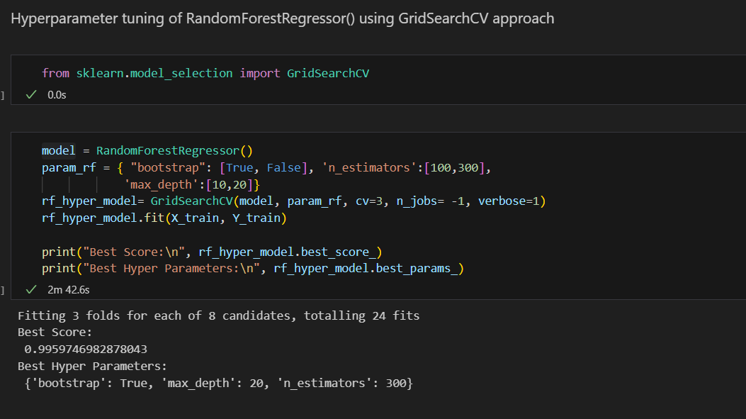
Assuming that RandomForestRegressor() is the best model, now we can look doing hyper parameter tuning on it. This approach saves time as compared going one by one and exploring each mode.
By comparing these results, we can infer that DecisionTreeRegressor(),RandomForestRegressor() and ExtraTreesRegressor are best models to explore further.

Slide 15
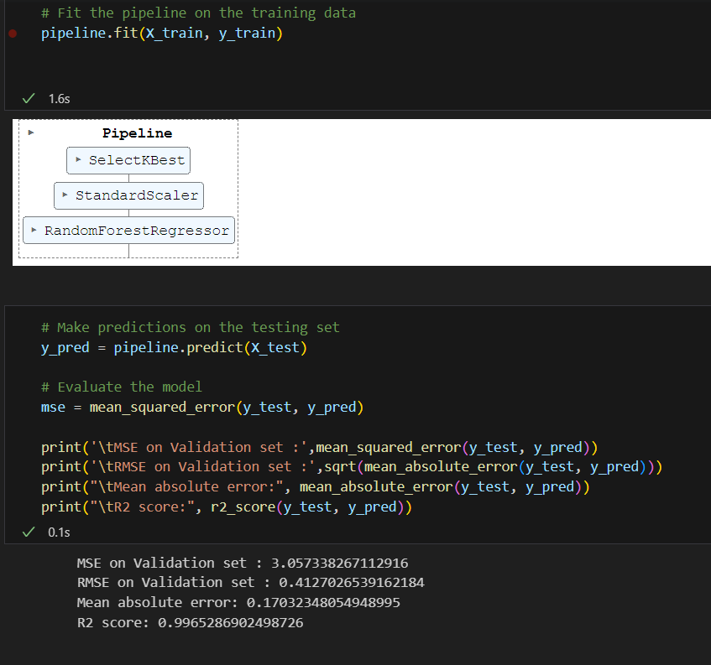

Slide 16
Conclusion
A random forest regressor that has been fine-tuned is performed well on the given data set.
With these parameters, the “random forest regressor ” model has an accuracy of 98.4%.
And the model is also tested on a unseen test data where the model get better performance with 99.5% accuracy.
Performance Metrics | Values on Training Data | Values on Validation set | Values on test data
MAE | 0.3016 | 0.432 | 0.1703
MSE | 20.4103 | 14.555 | 13.934
RMSE | 0.5492 | 0.4127 | 3.733
R² Score | 0.9774 | 0.9965 | 0.985
Table 11: Performance metrics of random forest regressor model on Seen and Unseen Data

Slide 17
Thank You…
Great Learning – PGDCSAI APR22

