Slide 1

Analyzing and Predicting Long Hospital Stays to Improve Healthcare Resource Planning
Presented By : Ankita Pingale

Slide 2
BACKGROUND
Hospitals face major operational challenges in managing patient length of stay (LOS).
Long hospital stays can lead to:
Higher treatment costs
Increased risk of hospital-acquired infections
Reduced bed availability
Strain on medical staff and resources
Very short stays may indicate premature discharge or poor care planning.
Therefore, accurately predicting length of stay at admission can help hospitals plan better and improve patient care.

Slide 3
PROJECT OBJECTIVE
The goal of this project is to build a predictive model that can identify patients likely to stay in the hospital more than 10 days at the time of admission.
This will help hospitals:
Plan staffing levels
Manage bed availability
Prioritize high-risk patients
Improve care coordination
Reduce operational inefficiencies

Slide 4
RESEARCH QUESTION
Primary Business Question:
Can hospital admission variables such as department, severity of illness, staff availability, health conditions, and type of admission accurately predict long hospital stays?
Key Variables Examined:
Severity of illness
Department
Type of admission
Health conditions
Staff availability
Admission deposit

Slide 5
DATA OVERVIEW
The dataset was obtained from a publicly available source on Hugging Face.
It contains approximately 500,000 hospital admission records and includes 15 variables describing both clinical and operational hospital information.
The dataset includes a mix of categorical variables, such as department, severity of illness, and type of admission, as well as numerical variables like admission deposit and staff availability.
Since the original dataset provided length of stay in days, a new binary target variable called long_stay was created, where 1 represents a hospital stay greater than 10 days and 0 represents a shorter stay.
The analysis was conducted using Python, with Pandas for data manipulation, Seaborn and Matplotlib for data visualization, and Scikit-learn for implementing the Logistic Regression model.

Slide 6
DATA CLEANING & PREPROCESSING
Converted “Stay (in days)” to numeric
Created binary variable: long_stay
Removed patient ID (no predictive value)
Encoded categorical variables
Checked missing values
Split data: 80% training / 20% testing

Slide 7
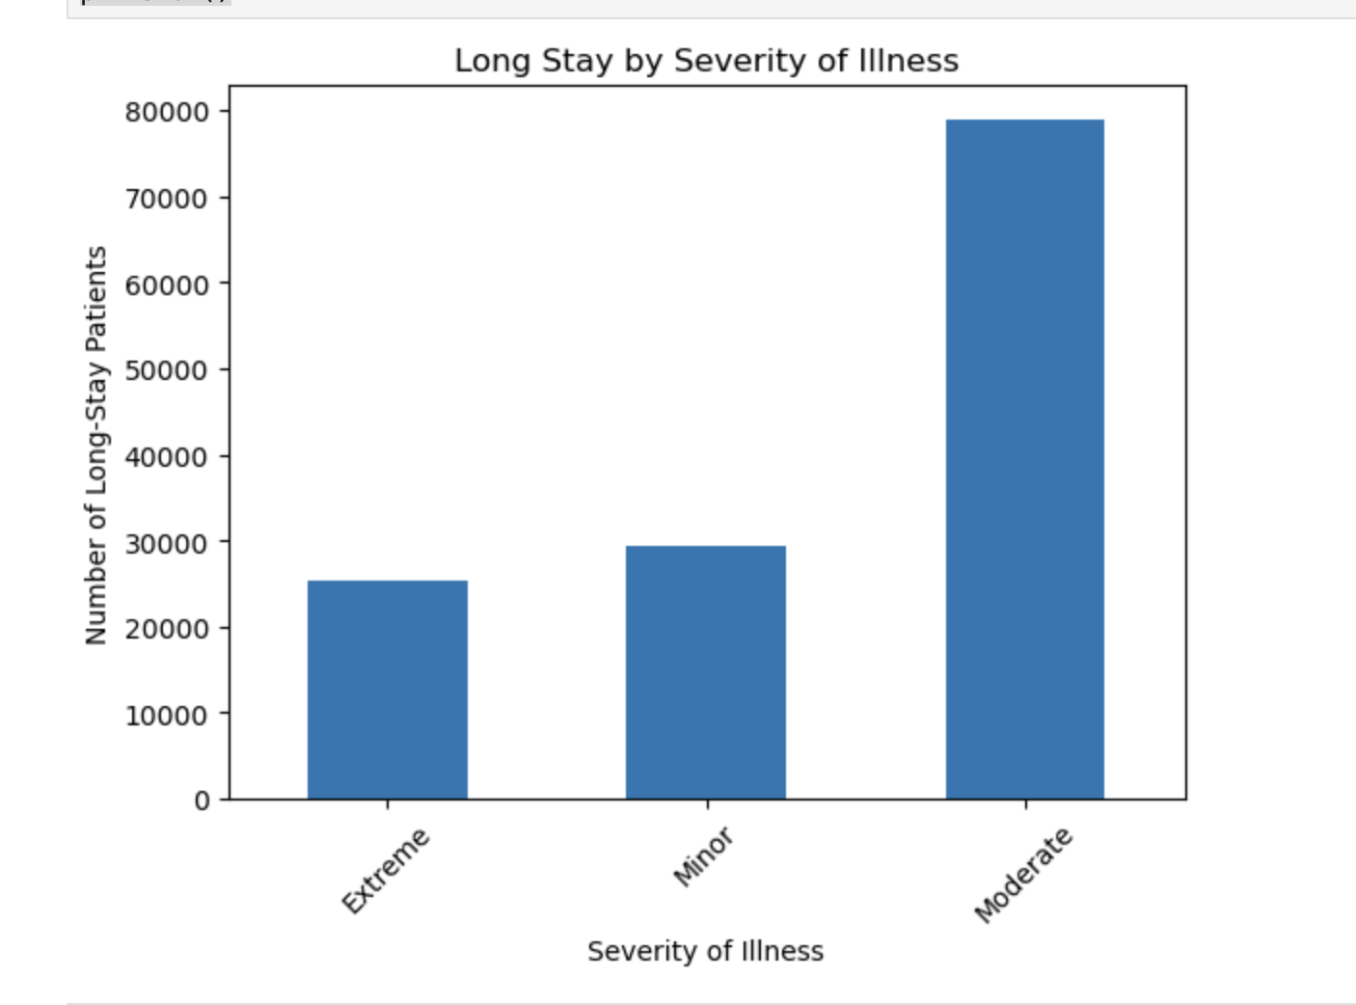
EXPLORATORY DATA ANALYSIS (EDA)
Long Stay by Severity of Illness
Patients with moderate severity show the highest number of long stays, indicating that illness severity is strongly associated with extended hospitalization.

Slide 8
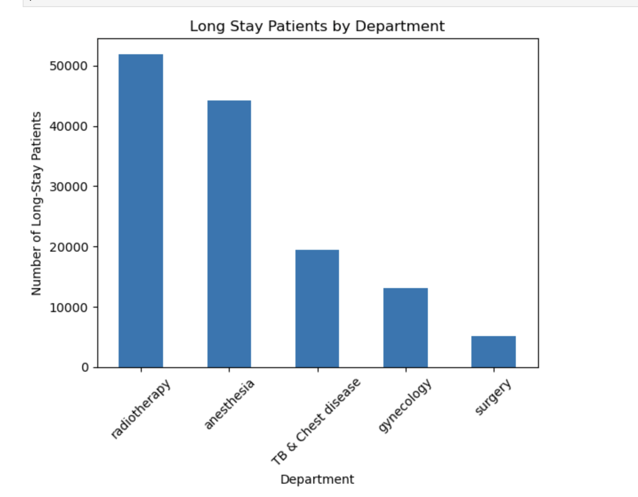
Long Stay Patients by Department
Radiotherapy and anesthesia departments have the highest proportion of long-stay patients, suggesting department type influences hospitalization duration.

Slide 9
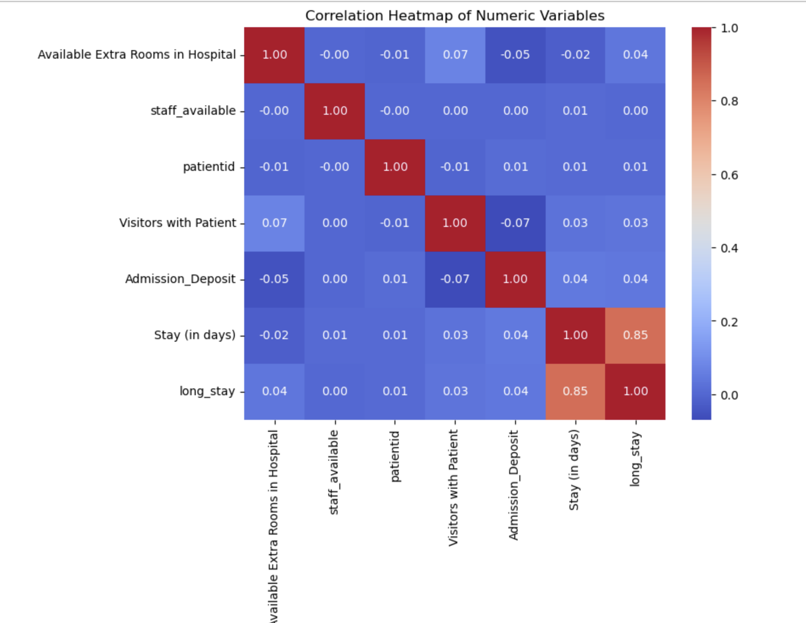
Correlation Heatmap of Numeric Variables
Length of stay shows a strong positive correlation with the long_stay variable (0.85), while other numeric variables demonstrate weak linear relationships.

Slide 10
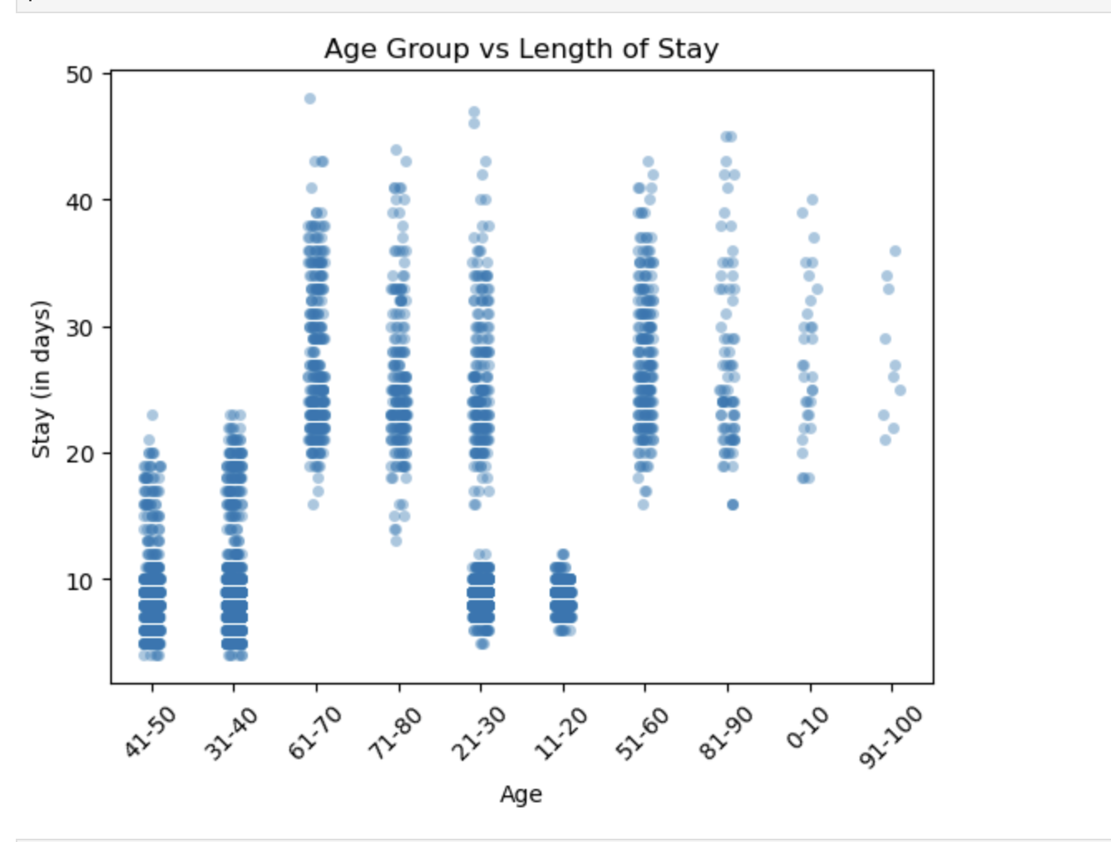
Age Group vs Length of Stay
Older age groups generally show longer hospital stays, suggesting age may be a contributing factor to prolonged hospitalization.

Slide 11
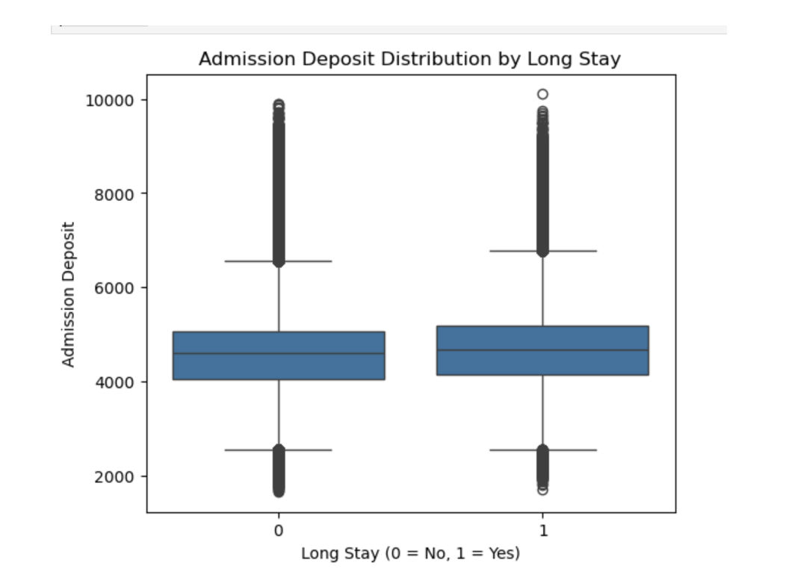
Admission Deposit Distribution by Long Stay
Patients with long stays tend to have slightly higher admission deposits, indicating a potential financial association with extended hospitalization.

Slide 12
Model Performance - Logistic Regression
Why Logistic Regression?
Suitable for binary classification
Interpretable coefficients
Efficient for large datasets
Provides probability estimates
Accuracy: 96.36%
Precision: 96.97%
Recall: 89.16%
ROC-AUC: 0.955
These results indicate the model is highly reliable in distinguishing between short and long stays.”

Slide 13
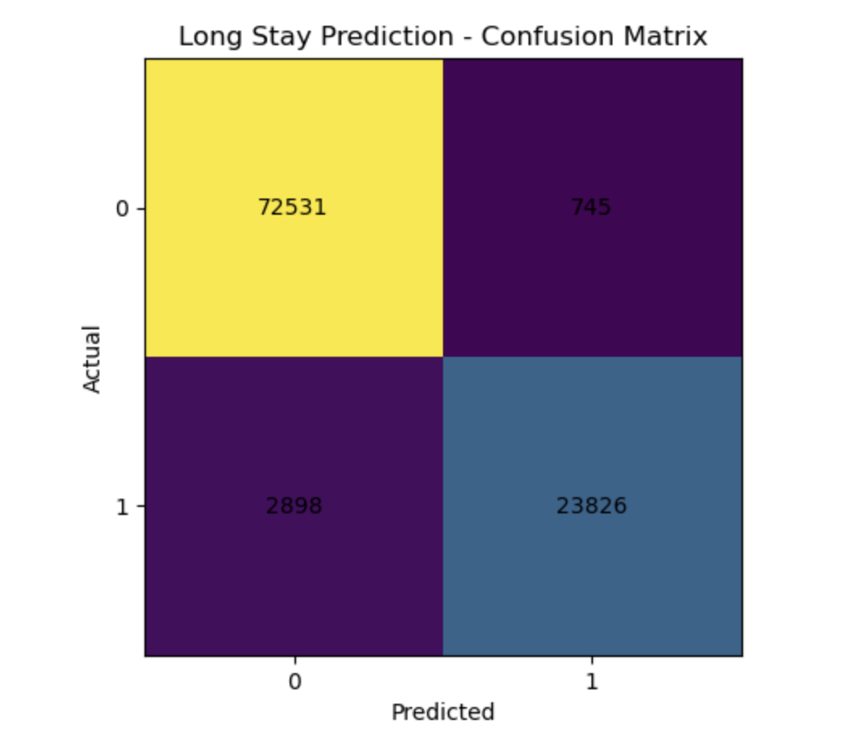
CONFUSION MATRIX
The model correctly classified most patients:
True Negatives (short stay correctly predicted): 72,531
False Positives: 745
False Negatives: 2,898
True Positives (long stay correctly predicted): 23,826

Slide 14
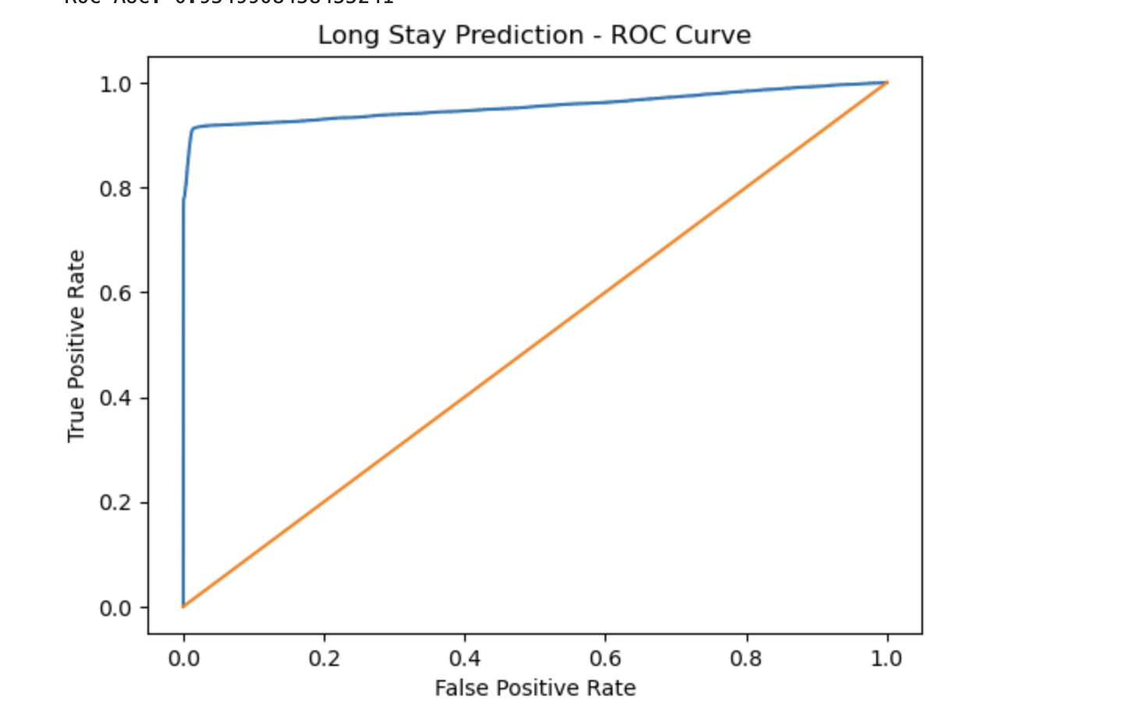
Model Performance - ROC Curve for Long Stay Prediction
What this graph shows:
The blue line = Logistic Regression model performance
The orange diagonal line = random guessing baseline
Key takeaway:
The curve is close to the top-left corner → strong predictive power
Metric to add below the graph:
ROC-AUC = 0.955
“The model is very good at distinguishing long-stay vs short-stay patients.”

Slide 15
CONCLUSION
This project successfully demonstrated that hospital admission characteristics can be used to predict long hospital stays with high accuracy.
Logistic Regression achieved strong performance, with an accuracy of over 96% and a ROC-AUC score of 0.955, indicating excellent predictive capability.
Severity of illness, department type, health conditions, and operational factors were identified as key contributors to extended hospitalization.
The findings directly answer the business question by confirming that admission data contains sufficient information to classify patients at risk for prolonged stays.
Hospitals can leverage this predictive approach to improve bed allocation, optimize staffing levels, and implement early intervention strategies for high-risk patients.

Slide 16
References
Nicolybgs. (n.d.). Healthcare data dataset. Hugging Face. https://huggingface.co/datasets/Nicolybgs/healthcare_data
Pedregosa, F., Varoquaux, G., Gramfort, A., Michel, V., Thirion, B., Grisel, O., … Duchesnay, É. (2011). Scikit-learn: Machine learning in Python. Journal of Machine Learning Research, 12, 2825–2830.
Hosmer, D. W., Lemeshow, S., & Sturdivant, R. X. (2013). Applied logistic regression (3rd ed.). Wiley.

Slide 17
Thank You !!

