Slide 1
FEDERATED LEARNING / PATHMNIST
FedAvg vs FedProx
Non-IID medical image classification with client label noise
5 clients • Dirichlet α = 0.3 • 40% noisy labels at client 0
Screening task project overview and experiment results

Slide 2
SCREENING TASK
Question and benchmark
•
Compare two standard federated optimization baselines under the same setup.
•
PathMNIST is a 9-class, 28×28 RGB histology image benchmark.
•
The experiment introduces client heterogeneity and a single noisy-label client.
•
This is a controlled research exercise, not a clinical model evaluation.
PathMNIST | 5 clients | Dirichlet alpha = 0.3 | seed 0

Slide 3
SCREENING TASK
Federated data setup
•
5 clients receive non-IID training examples via class-wise Dirichlet allocation.
•
Alpha 0.3 creates different label mixtures across clients.
•
Client 0 has 40% of its training labels changed to a uniformly sampled wrong class.
•
Global and client test sets keep their original labels; client test subsets are disjoint.
PathMNIST | 5 clients | Dirichlet alpha = 0.3 | seed 0

Slide 4
SCREENING TASK
The two baselines
FedAvg
FedProx
Each client trains locally; the server averages client models weighted by local sample count.
Adds μ/2 · ||w − w_global||² to the local objective to keep client models near the current global model.
FedProx μ = 0.01. Both methods use the same model, partition, seed, and training settings.
PathMNIST | 5 clients | Dirichlet alpha = 0.3 | seed 0

Slide 5
SCREENING TASK
What we track each round
•
Global test accuracy and loss on the full official test set.
•
Per-client test accuracy and loss on clean, client-specific test subsets.
•
Per-client training loss and local update L2 norm.
•
Cosine similarity between client updates, plus each client's mean similarity to peers.
•
W&B stores the run history; CSV and JSON summaries are also saved locally.
PathMNIST | 5 clients | Dirichlet alpha = 0.3 | seed 0

Slide 6
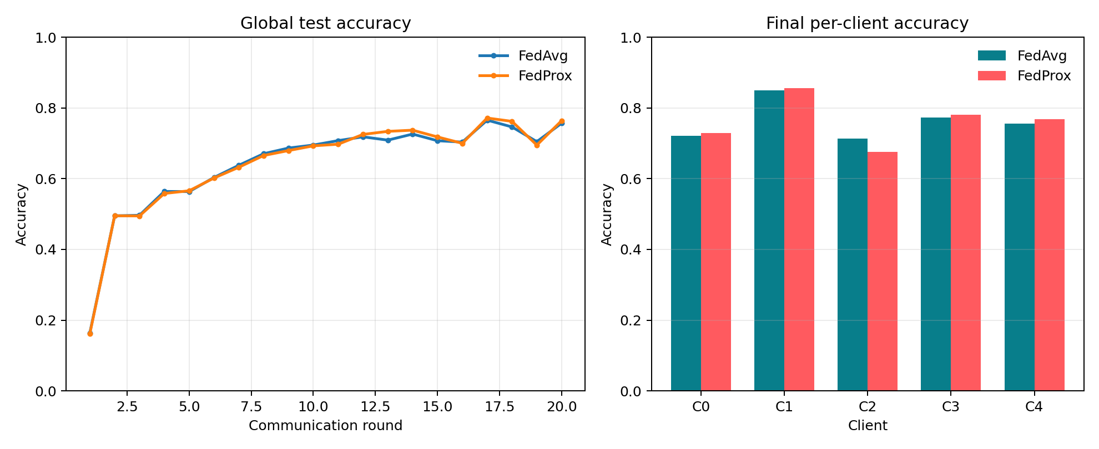
RESULTS
Global accuracy by round
PathMNIST | 5 clients | Dirichlet alpha = 0.3 | seed 0

Slide 7
RESULTS
Final accuracy summary
Evaluation group | FedAvg | FedProx (μ=0.01)
Global | 75.7% | 76.4%
Client 0 | 72.1% | 72.8%
Client 1 | 85.0% | 85.7%
Client 2 | 71.3% | 67.6%
Client 3 | 77.2% | 78.2%
Client 4 | 75.6% | 76.9%
Full per-client values are available in each run's results.json and metrics.csv.
PathMNIST | 5 clients | Dirichlet alpha = 0.3 | seed 0

Slide 8
READING
Reactive optimizers: reading connection
•
OPAL uses an AI agent to inspect training signals and rewrite optimizer logic during training.
•
The post shows adaptive schedules and responses to loss spikes and overfitting.
•
Limitation: agent-driven decisions may reduce reproducibility; most reported runs were single runs.
•
Federated idea: use round-level loss, update norms, and update disagreement to tune server steps.
•
Per-client signals can expose information, so any deployment must respect its privacy design.
PathMNIST | 5 clients | Dirichlet alpha = 0.3 | seed 0

Slide 9
TAKEAWAYS
Interpretation and limits
•
Read global and client-level scores together: non-IID data can hide weak client outcomes.
•
The noisy client makes robustness to mislabeled local data part of the comparison.
•
A single seed is an initial result; repeated seeds are needed to assess variability.
•
This single-process simulation does not model communication failures, secure aggregation, or deployment privacy.
PathMNIST | 5 clients | Dirichlet alpha = 0.3 | seed 0

