Slide 1
Coffee Shop Sales Summary
Audience: Business Stakeholders
Period Covered: Jan 2023 to Jun 2023
By – Ankit Gupta

Slide 2
Coffee Shop Sales Performance Snapshot
Overview of key business metrics for Jan to Jun 2023
Interactive slicers available: Month, Weekday
Focus areas: Total Sales, Footfall, Avg Bill, Top Products
Attached the snapshot of dashboard created using Power BI

Slide 3
Key Performance Indicators
Total Sales: ₹6,98,812
Total Footfall: 149,116
Avg Bill per Person: ₹4.69
Avg Orders per Person: 1.44
Insight: Strong average billing shows good revenue efficiency per customer.

Slide 4
Monthly Sales Trend
Sales steadily increased from Jan (₹81K) to Jun (₹1.66L)
Highest monthly growth: March (+29.8%) and May (+31.8%)
Observation: Growth consistent with seasonality or successful campaigns.

Slide 5
Month-over-Month Sales Change
Feb: ₹76,145 (-6.77%)
Mar: ₹98,834 (+29.8%)
Apr: ₹1,18,904 (+20.3%)
May: ₹1,56,727 (+31.8%)
Jun: ₹1,66,486 (+6.2%)
Insight: Strong recovery after February dip.

Slide 6
Product & Size Preferences
Top 5 Products:
- Barista Espresso (₹91K)
- Brewed Chai Tea, Hot Chocolate, etc.
Size Preference:
- Regular (32.7%) & Large (32.0%) dominate orders
Actionable: Focus on top-selling sizes and SKUs for combo offers.

Slide 7
Location and Weekday Trends
Best Location: Hell’s Kitchen (₹2.36L sales)
Best Weekdays (sales & quantity): Tuesday to Friday steady; Sunday drops in order volume
Insight: Consider weekend offers to boost Sunday performance.

Slide 8
Orders by Hour of Day
Peak ordering time: 9 AM to 12 PM
Steady drop post 4 PM
Actionable: Push breakfast/late morning specials and loyalty offers in non-peak hours.

Slide 9
Actionable Business Insights
Launch marketing campaigns around top 3 products.
Increase focus on morning and weekday customer base.
Offer loyalty rewards to increase Avg Orders per Person.
Monitor Feb-like dips and respond with time-sensitive promos.

Slide 10
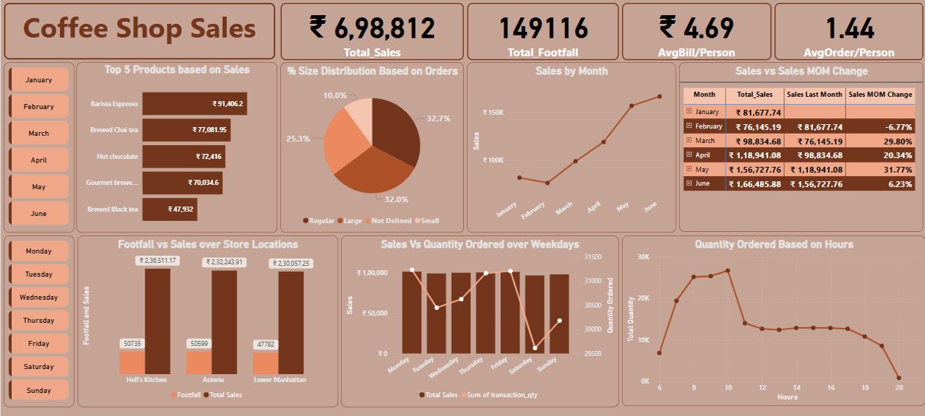
Snapshot of Dashboard

