Slide 1
Google Play Store Apps Rating Prediction
Presented by:
ankit khatavkar

Slide 2
Introduction of Mobile Applications
Mobile app development is the creation of computer programs
Mobile apps are developed for various OS such as Android, iOS, and Windows Mobile.
Since we live in a digitally smart world, more than 80 percent of people who owns mobile devices search for products and services online.
Of this 80 percent, 27 percent search for mobile apps that is connected to the products or services they want to acquire.
Nowadays, mobile app development has been used to develop mobile apps for virtually every possible reason.

Slide 3
Importance of Mobile Applications
Reasons why every business owner needs a mobile app for his/her business
Business Exposure
Customers Loyalty
A Viable Marketing Tool
Increases Sales
Excellent Customer Service
Creating Brand Awareness
Increases Accessibility to Customers
Source of Data and Information

Slide 4
Our Goal
App rating is most important part for app promotion
Generally 60 Percent users checks the rating of the app before they install the application
App ratings directly affect the number of downloads.
Predict the google play store market applications ratings in order to bring more business and profit for the android application building companies.

Slide 5
OVERVIEW OF DATASET USED
Project Data Source Name : googleplaystore.csv
10841 observations and 13 variables
The dataset gives the information about the Play Store apps to drive app-making businesses to success. Actionable insights can be drawn for developers to work on and capture the Android market.

Slide 6
EXPLORATORY DATA ANALYSIS

Slide 7
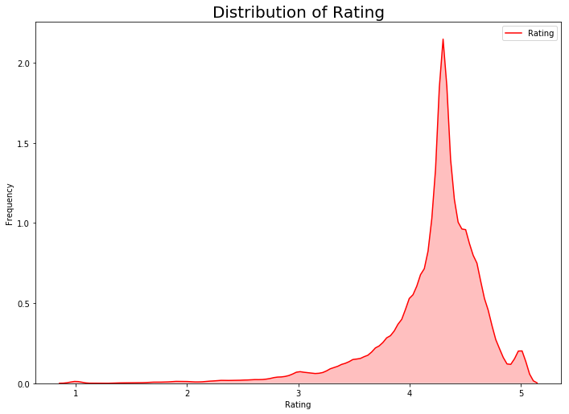
DISTRIBUTION OF APPs RATING

Slide 8
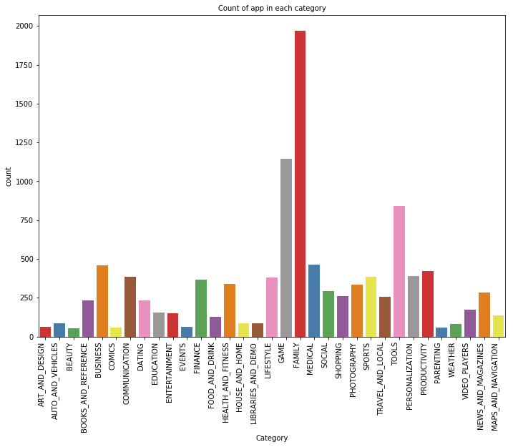
IMPACT OF DIFFERENT CATEGORY ON APPS

Slide 9
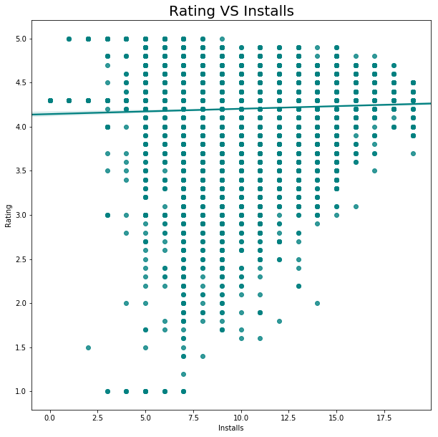
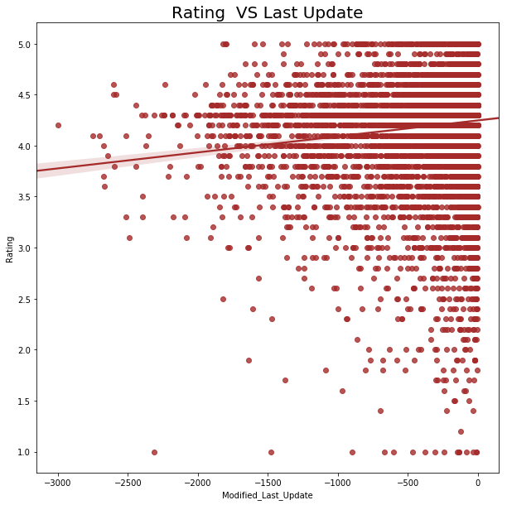
IMPACT OF APP INSTALL AND LAST UPDATE

Slide 10
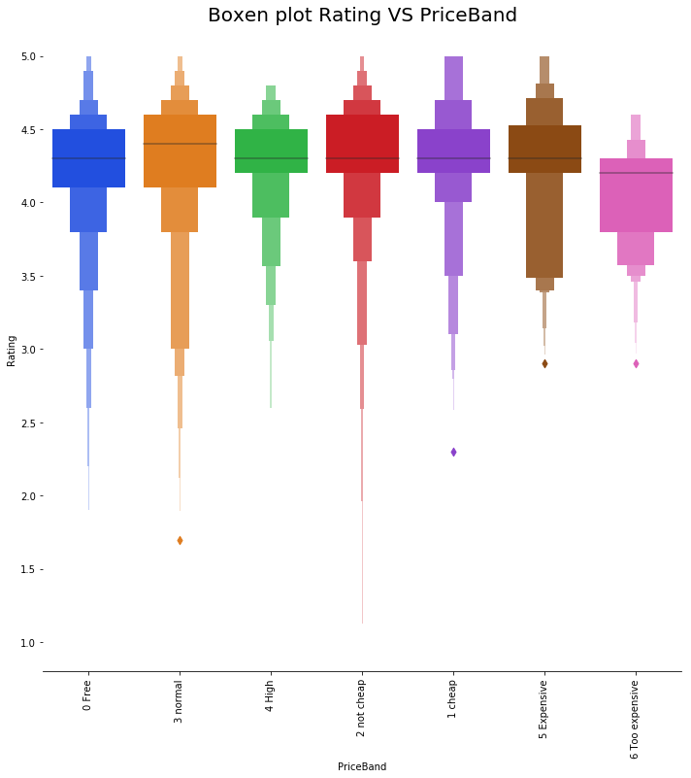
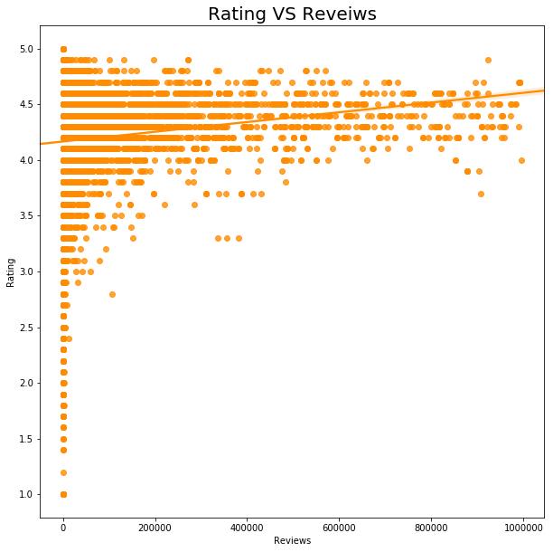
IMPACT OF APP price AND reviews

Slide 11
MACHINE LEARNING MODELS
Choosing different machine learning models:
Logistic Regression
Random Forest
Decision Tree Classifier

Slide 12
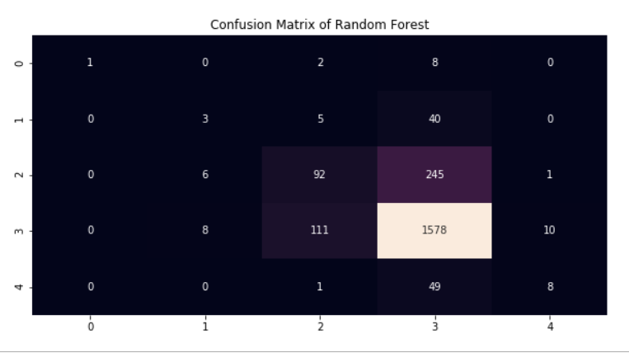
Why Random Forest
Accuracy | 0.78
Mean Absolute Error | 0.26
Mean Squared Error | 0.33
Root Mean Squared Error | 0.57
Random forest an ensemble learning method for classification, regression and other tasks that operates by constructing a multitude of decision trees at training time and outputting the class that is the mode of the classes or mean prediction of the individual trees.

Slide 13
Conclusion
Average rating of (active) apps on Google Play Store is 4.17.
Users tend to download a given app more if it has been reviewed by a large number of people.
Users prefer to pay for apps that are light-weighted. Thus, a paid app that is bulky may not perform well in the market.
Most of the top rated apps are optimally priced between ~0$ to ~30$
Medical and Family apps are the most expensive and even extend up to 80$.

Slide 14
Future outcome
For Innovation - Developers should focus in on apps with a category of Auto and Vehicles and Entertainment, as there are not many highly rated apps in these categories.
For Revenue - Marketers should advertise on the top most installed apps in order to reach the maximum viewing of their advertisements.
For Popularity - Everyone building apps should consider that the Category of an app may strongly dictate if an app will be popular or not. However, Content Rating, Reviews and Price features should all be used to most accurately determine if an app will gain maximum installs.

Slide 15
NEXT 3 MONTHS PLAN
There is a wealth of information out there hidden in individuals comments, emails, reviews and the challenge is wrangling all of this info and extracting value from it.
Review plays an important role to improve mobile applications rating.
Sentiment analysis would help to understand the reviews for the applications which can be positive, neutral or negative.
Rating indicates the overall evaluation of customer experiences using a numeric scale, but textual comments are capable of telling more insightful stories that the overall ratings cannot.

Slide 16
NEXT One year PLAN
To help target the most impactful improvements for any app, we can view top trends and issues that users mention in the app's reviews.
With the help of apps rating and sentiment analysis of reviews, we would be able to dig deeper to improve the overall experience of mobile applications in different category.

Slide 17
THANK YOU

