Slide 1
RegEx2DFA Converter

Slide 2
Regular Expression
Before diving into automata, it's important to familiarize ourselves with some fundamental terms:
Alphabet: A finite set of symbols, usually represented as Σ, used to construct strings. For example, Σ = {a, b}.
Language: A set of strings {aaba} formed from an alphabet. A language can be finite or infinite. For example, the language {a, ab, abb} consists of strings made from the alphabet {a, b}.
Regular Expression: A symbolic representation used to describe regular languages. Regular expressions can define patterns within strings, such as "a*b" meaning zero or more 'a's followed by a ‘b’.
- Concatenation (.) : This operator connects two expressions in sequence.
- Union (+) : The union operator indicates a choice among multiple options.
- Kleen Closure (*) : This operator represents zero or more repetitions of the preceding element.

Slide 3
Automata
Automata are mathematical models of computation that represent abstract machines capable of processing strings of symbols according to predefined rules. Finite Automata (FA) are a specific type of automaton with a finite number of states.
Nondeterministic Finite Automata (NFA)
An NFA can have multiple transitions for the same symbol from a single state, including transitions that don't consume any symbols epsilon transitions(ε).
An NFA accepts a string if there is at least one path from the initial state to a final state that corresponds to the string.
Deterministic Finite Automata (DFA)
A DFA has exactly one transition for each symbol from every state, leading to a unique path through the automaton for any given input string. It has a finite number of states, with one designated as the start state and some as accepting states.

Slide 4
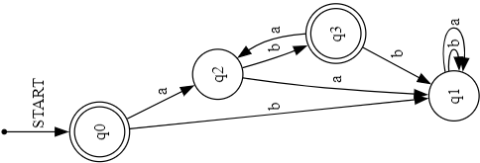
LET’S QUICKLY LOOK AT ONE EXAMPLE
Regular Expression: (ab)*
Language: { "", "ab", "abab", "ababab", ... }
Solution:

Slide 5
SO How Did we do this?

Slide 6
ROADMAP
Problem analysis and literature review
Implementing the Shunting Yard Algorithm
Implementing the Subset Construction Algorithm
1
3
5
2
4
6
Understanding different algorithms
Implementing Thompson's Algorithm
Integrating all components and generating output using Graphviz

Slide 7
So there are three Basic Algorithm.
Shunting-Yard Algorithm
Thompson's Construction Algorithm
Subset Construction Method

Slide 8
Shunting-Yard Algorithm
The Shunting Yard Algorithm is used to parse mathematical expressions written in infix notation and convert them to postfix notation (Reverse Polish Notation, RPN).
Key Concepts
Infix Notation: Operators are placed between operands (e.g., 3 + 4).
Postfix Notation: Operators follow their operands (e.g., 3 4 +).
Steps of the Algorithm
1. Initialize:
Output Queue: Stores the final postfix expression.
Operator Stack: Temporarily holds operators and parentheses.

Slide 9
2. Process the Input:
Operands: Push directly to the output queue.
Operators:
Pop operators from the stack to the output queue until an operator with lower precedence is found or the stack is empty.
Push the current operator onto the stack.
Parentheses:
Left Parenthesis (: Push onto the stack.
Right Parenthesis ): Pop from the stack to the output queue until a left parenthesis is encountered.
3. End of Expression:
Pop any remaining operators on the stack to the output queue.

Slide 10
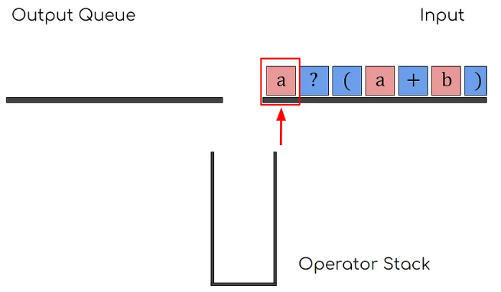
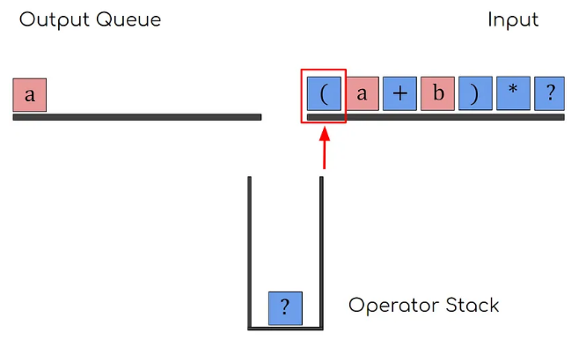
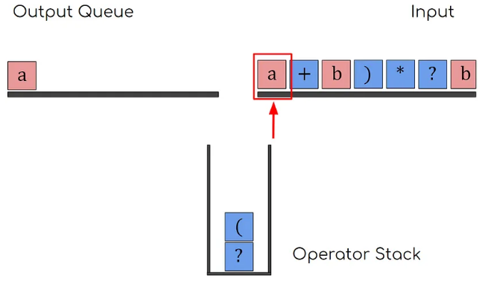
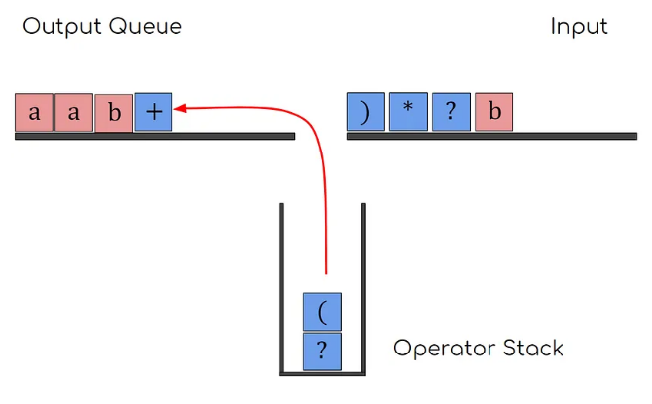
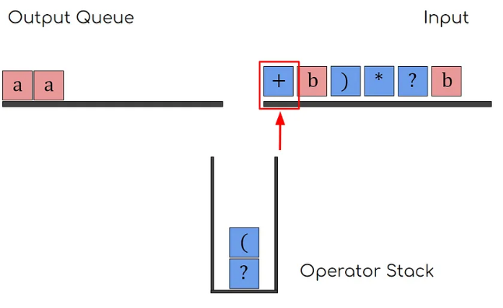
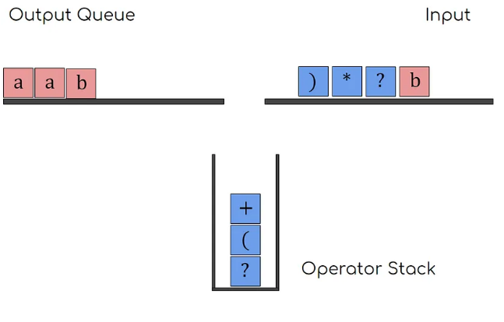
Shunting-Yard Algorithm Visualisation

Slide 11
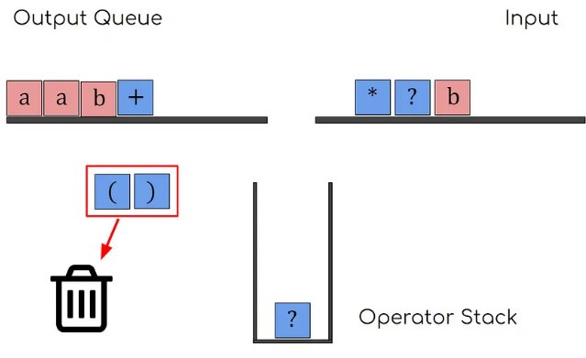
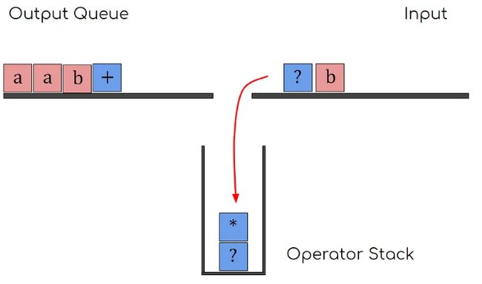
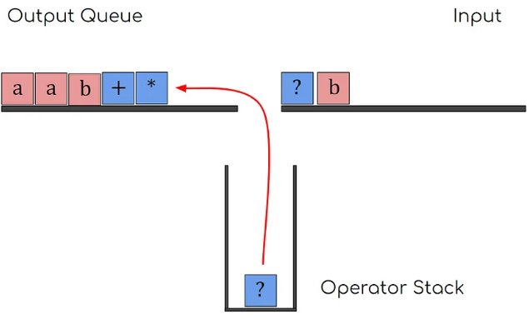
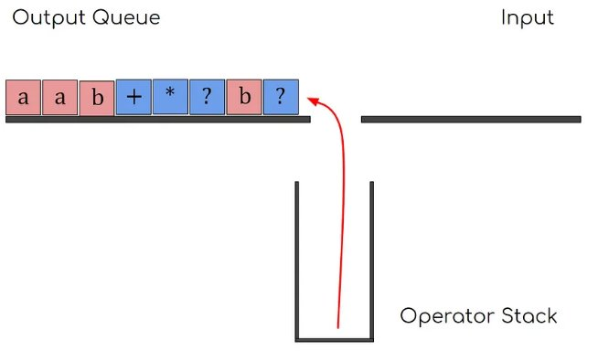
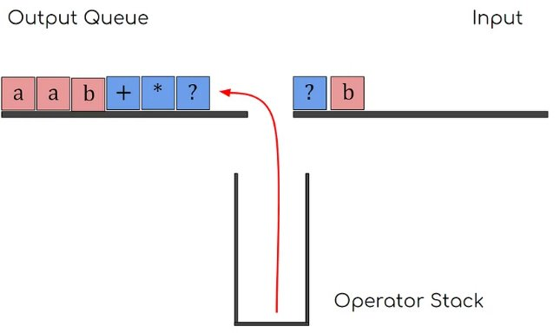
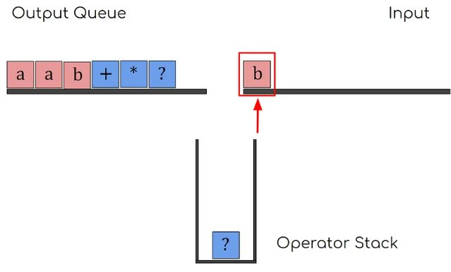

Slide 12
Thompson's Construction Algorithm
Thompson’s Construction Algorithm is a method for converting regular expressions to their respective NFA diagrams. It uses just five simple steps to convert any postfix notation to ε-NFA.
Steps of Algorithm:
Empty String (ε): Creates an NFA with a single transition from start to accept state labeled ε.
Single Character (a): Creates an NFA with a single transition from start to accept state labeled a.
Concatenation (AB): Connects the accept state of NFA for A to the start state of NFA for B.

Slide 13
Union (A | B):
-> Creates a new start state with ε-transitions to the start states of both NFA for A and NFA for B.
Kleene Star (A*):
-> Creates a new start state with ε-transitions to the start state of NFA for A and the new accept state.
-> Connects the accept state of NFA for A back to its start state and to the new accept state with ε-transitions.

Slide 14
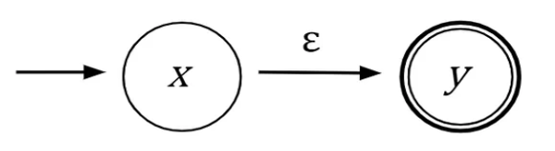
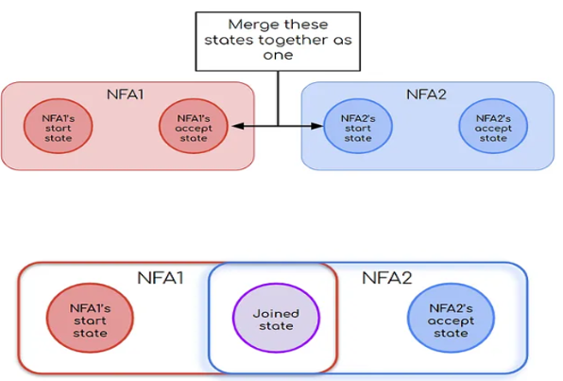
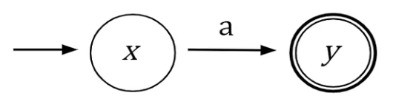
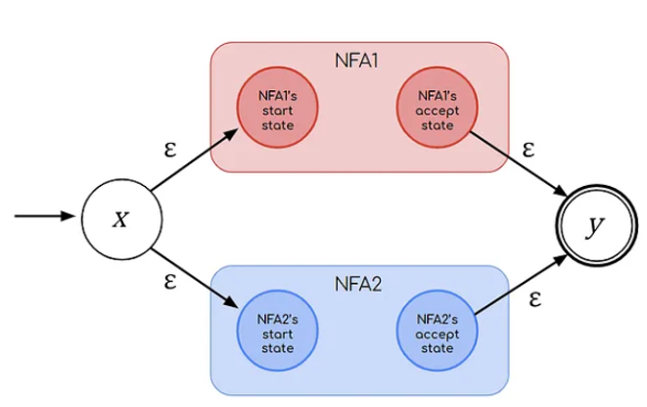
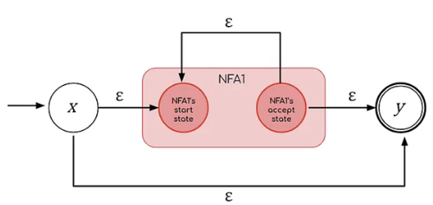

Slide 15
Subset Construction Method
The subset construction method, also known as the powerset construction, is used to convert a non-deterministic finite automaton (NFA) into a deterministic finite automaton (DFA). It systematically explores all possible states the NFA can be in for each input symbol, grouping them into subsets that represent single states in the DFA.

Slide 16
Steps of Algorithm:
Remove ε-transitions using ε-closure
Find the ε-closure of the start state
Determine transitions for each alphabet symbol
Find the ε-closure for new states
Define start and accepting states

Slide 17
Limitations
Poor Code Management:
The current codebase lacks a clear and organized structure, making it difficult to maintain and extend.
Limited Use of Object-Oriented Programming (OOP) Concepts:
The project does not fully leverage OOP principles, resulting in a less modular and flexible codebase.
There is a lack of inheritance and polymorphism, which could simplify the addition of new features and operators.

Slide 18
Future Enhancements
Algorithm Optimization:
Optimize the conversion algorithm to improve efficiency and reduce processing time.
Implement state minimization techniques to produce more compact NFAs.
Improved Code Structure:
Refactor code using object-oriented principles for better organization and readability.
Modularize the code to separate different components and functionalities.

Slide 19
Enhanced User Interface:
Develop a more intuitive and interactive graphical user interface.
Provide visual representation of the NFA, showing states and transitions.
Testing and Validation:
Implement comprehensive testing to ensure the accuracy and robustness of the converter.
Validate the output NFAs against expected results for a variety of regular expressions.
Documentation and Tutorials:
Create detailed documentation explaining the usage of the converter, its features, and limitations.
Provide tutorials and examples to help users understand how to use the converter effectively.

Slide 20
Conclusion
Our goal was to develop a program that assists students and teachers in solving problems related to DFA construction, and we successfully achieved this objective. We applied Object-Oriented Programming (OOP) concepts and C++ to implement various algorithms, utilized different data structures, and employed Graphviz for generating state diagrams. We effectively constructed both NFA and DFA from regular expressions.

Slide 21
LIMITATIONS & FUTURE ENHANCEMENTS
Limited Regular Expression Operators
Lack of Graphical User Interface
DFA Optimization

Slide 22
CONCLUSION
This Project was a Success!
We aimed to create a program to help students and teachers with DFA construction, which we successfully achieved. Using OOP principles and C++, we implemented algorithms, used various data structures, and generated state diagrams with Graphviz. We also constructed both NFA and DFA from regular expressions.

Slide 23
THANKS!
Any questions?

