Slide 1
School Of Information Technology and Engineering
Department of Computer Application
Fall Semester 2022-2023
SET CONFERENCE
Final Review ( 24 January 2022 )
Presented By :
Ankit Kumar (22MCA0391)
Shubham Kumar Gupta (22MCA0179)
Subhodip Ghosh (22MCA0009)
Guided By :
Prof. E Sreehari

Slide 2
TITLE
‘An Experiment on Multi Dissimilar Disease Prediction Using Machine Learning’

Slide 3
INTRODUCTION
People are facing various health issues because of their busy life style.
They don’t get enough time for assessment and diagnosis of their health.
Many people lacks in sufficient knowledge about the symptoms and diseases.
Doctors and medical staffs get burdened by a large number of patients resulting in inaccurate prediction of disease.
All of the above results in various diseases which is sometimes incurable.
Therefore early diagnosis of diseases is very crucial.
It increases the chance of the disease to be cured.

Slide 4
OBJECTIVE
We are developing a system for the prediction of diseases with the help of Machine Learning technology.
It will predict the disease as output on the basis of symptoms given by the user as input.
The Machine Learning model which predicts the disease implements the Random Forest and Naïve Bayes Classifier for better accuracy and reliability.
The ML model is integrated with a Web-Application based front-end in order to make it easily accessible.

Slide 5
LITERATURE SURVEY
TITLE | OBJECTIVE | REMARKS
Disease Prediction using Symptoms based on Machine Learning Algorithms ) | To build a model that takes variety symptoms as input and predict the disease as output. For building the machine learning model, it utilizes DT, NB and RF classifiers for more accurate results. | A disease prediction system is created that is concerned about input symptoms and respective outputs. The result shows a good accuracy of 95%. This system also prescribes doctor for the predicted disease
Disease Prediction using Machine Learning Algorithms | To study the results of RF classifier, NB classifier and DT classifier. Each classifier took data of 4920 patients records diagnosed with 41 diseases as training data. | By studying all three machine learning algorithms performance on disease data set each yielding precision up to 95 percent.

Slide 6
LITERATURE SURVEY(contd.)
TITLE | OBJECTIVE | REMARKS
Designing Disease Prediction Model Using Machine Learning Approach | To predict disease using two ML model CNN) and KNN on the disease data set. | By comparing results of both KNN and CNN in terms of accuracy and time, CNN was found better.
Utilization of Machine Learning Algorithms for Prediction of Disease | To implement three algorithms RF Classifier, DT Classifier and NB classifier to predict disease precisely. To know how to apply these data mining techniques in clinics. | By studying all three algorithms they came to a conclusion that Naïve Bayes is the most accurate one with the accuracy of 93.12 percent.
Disease Prediction: Smart Disease Prediction System Using Random Forest Algorithm | To implement Random Forest classifier for creating a prediction system that can detect the disease at an early stage. To integrate machine learning model with Tkinter GUI interface. | 41 records were taken for testing in which 39 records were found correct and only 2 were found wrong. Using the Random Forest classifier, the accuracy was found to be 94.6%, which is better than another algorithm

Slide 7
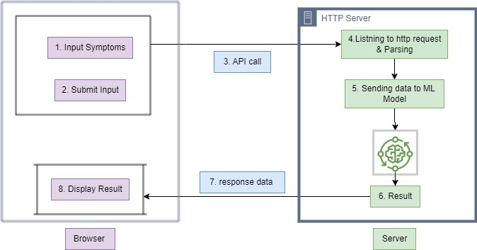
IMPLEMENTATION
Workflow Diagram

Slide 8
IMPLEMENTATION
Working Process
Step 1: Taking all the symptoms from the users as input.
Step 2: Click on submit button to send all the user’s symptoms to http server.
Step 3: Sending all the user’s symptoms from browser to backend http server via API call.
Step 4: Server listening to incoming http request and parsing the incoming data.
Step 5: Sending parsed data to machine learning model (including naïve byes and random forest classifiers) for the prediction of disease on the given symptoms.
Step 6: Getting predicted disease from machine learning model.
Step 7: Sending back predicted disease to user via http response.
Step 8: Display the predicted disease in the browser.

Slide 9
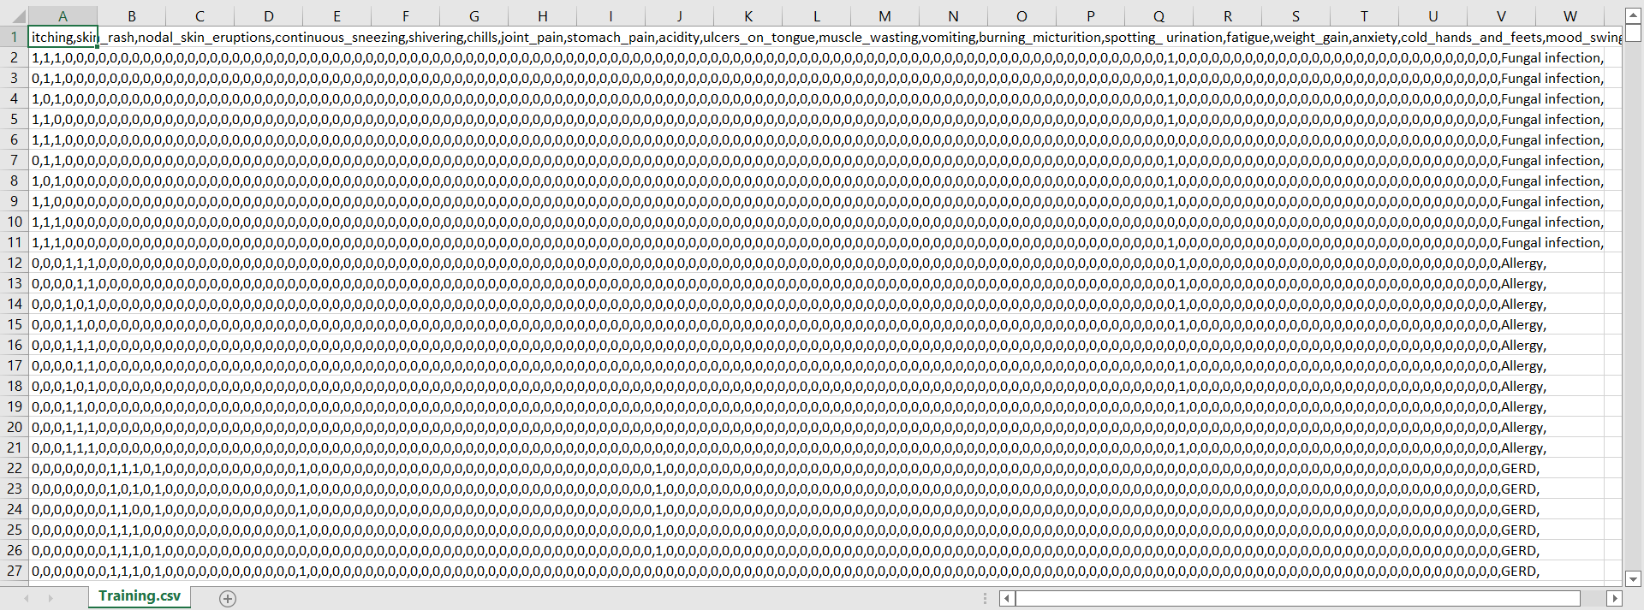
DATASET
*Datasets are taken from Kaggle.
Training.csv

Slide 10
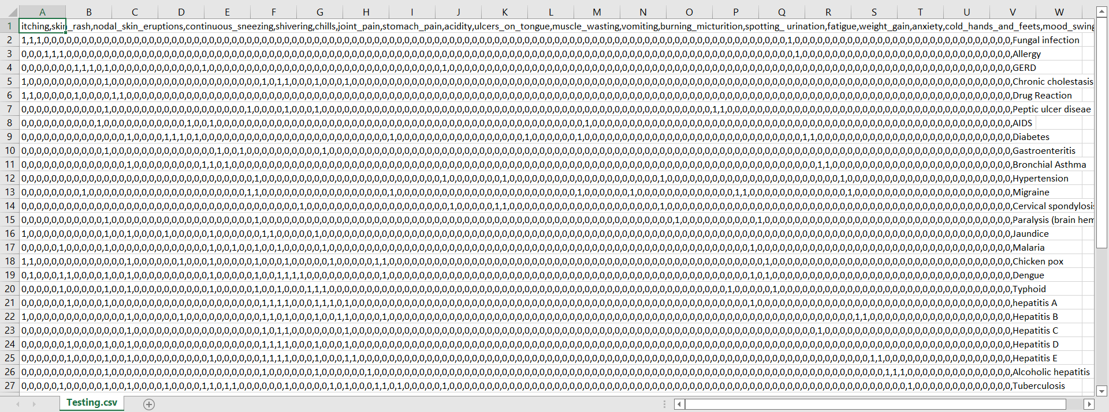
DATASET
Testing.csv

Slide 11
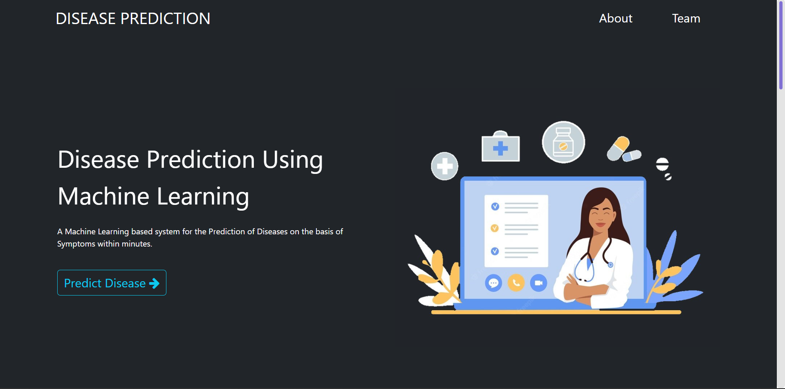
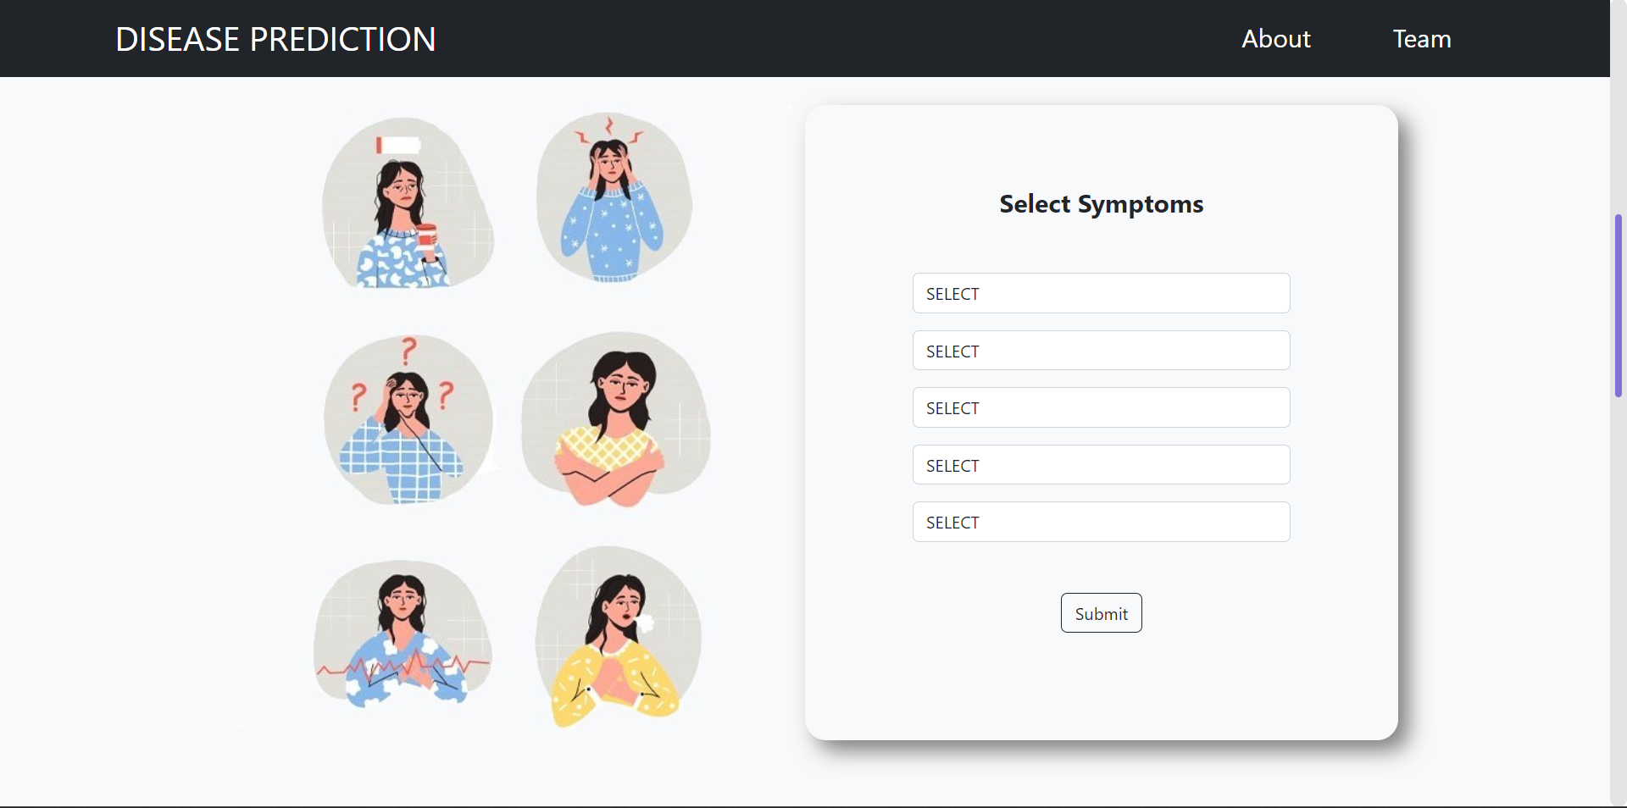
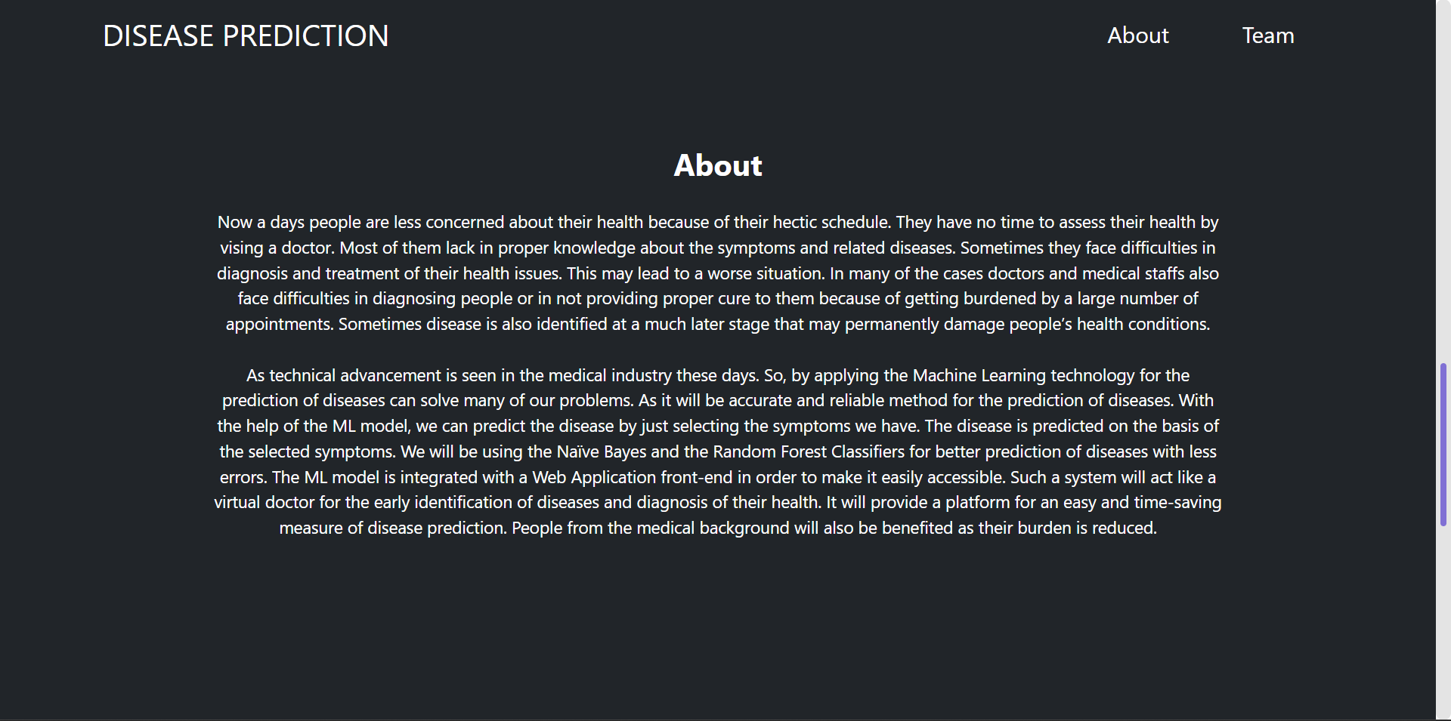
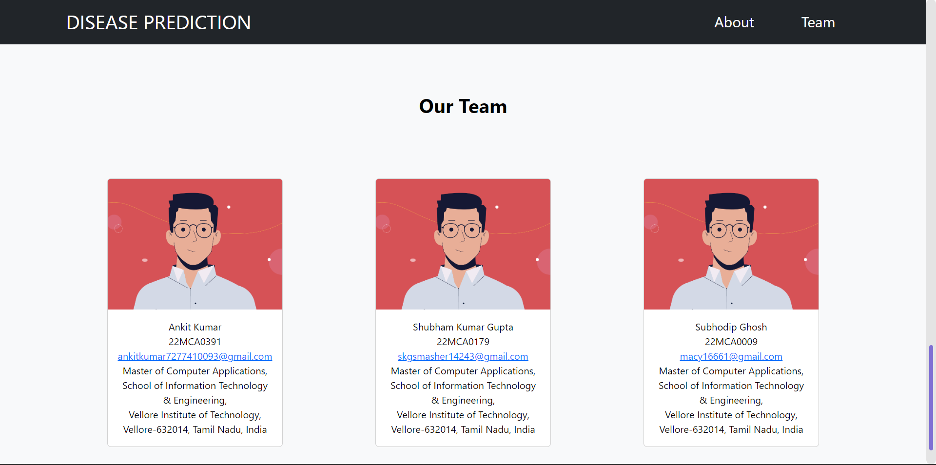
OUTPUT SCREENSHORTS
Homepage

Slide 12
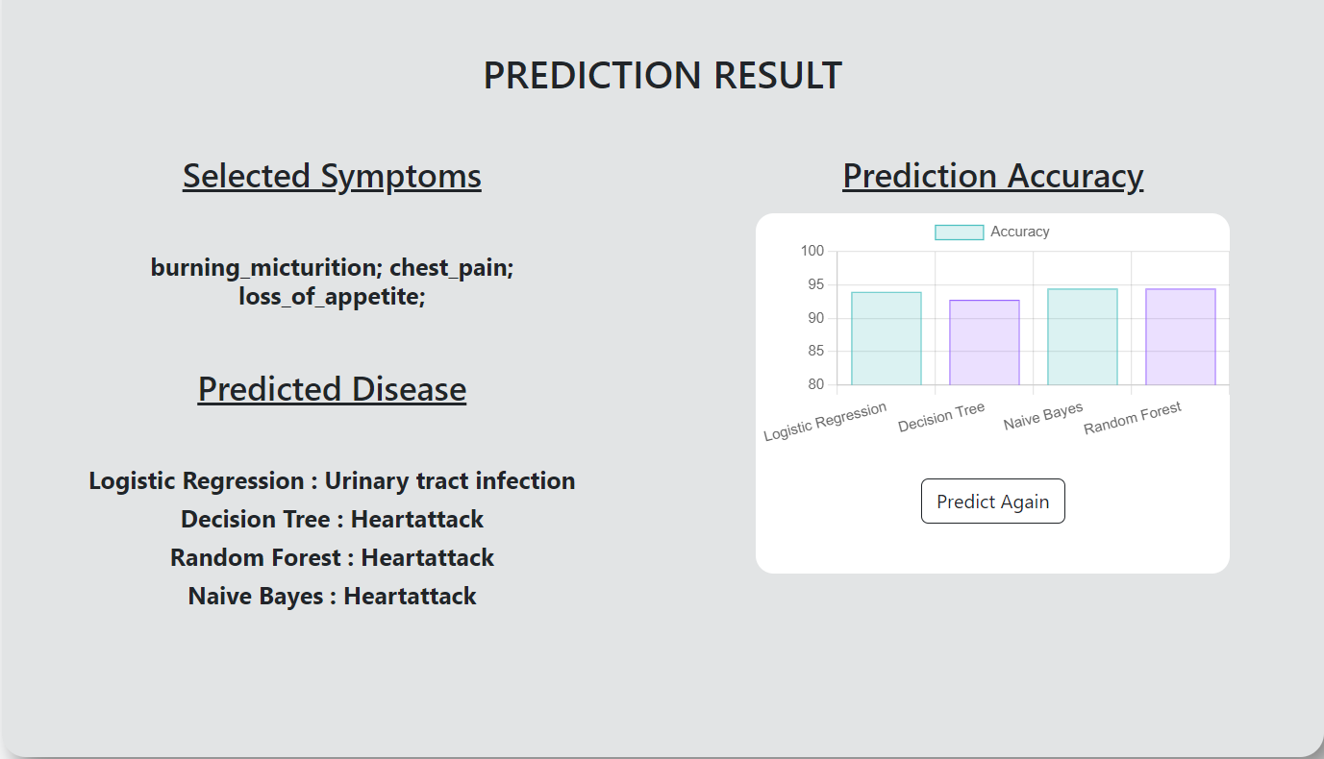
OUTPUT SCREENSORTS
Prediction Result

Slide 13
IMPLEMENTATION RESULT
We examine the analytical findings for all the mentioned classification models, Logistic Regression, Decision Tree , Random Forest and Naïve Bayes in terms of the accuracy of the results and the time complexity, or the time required predict.
Accuracy of Random Forest is 94.5% , Naïve Bayes 94.5%, Logistic regression 93% and Decision Tree 92.8% at predicting disease.
A comparison of the algorithms Logistic Regression , Decision Tree, Random Forest and Naïve Bayes is displayed along with a range of threshold values.
Axis-X depicts the algorithm, and axis-Y shows the algorithm's efficiency in percent.

Slide 14
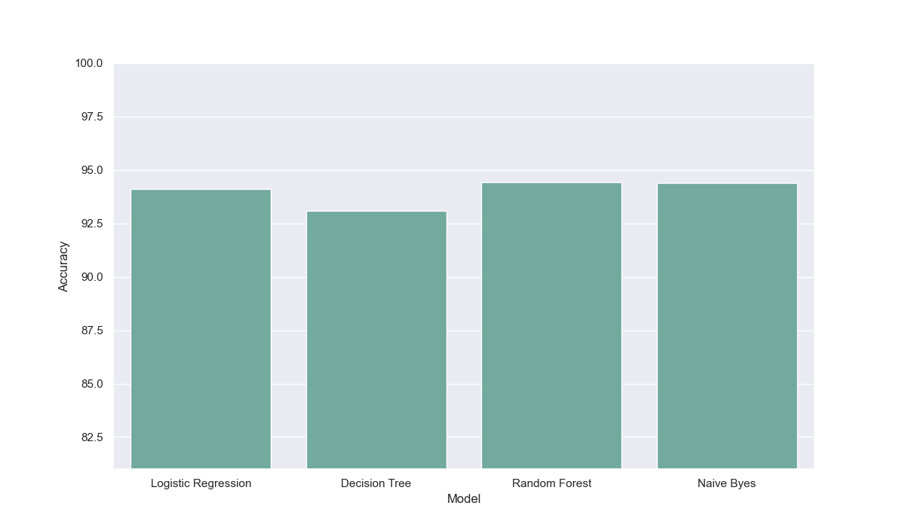
IMPLEMENTATION RESULT

Slide 15
CONCLUSION
We employed the Logistic Regression, Decision Tree , Random Forest and Naïve Bayes algorithms to classify patient disease.
So we can understand the level of risk from illness by using symptoms as an input and obtaining correct general disease as an output.
It is likely that this technique will lead to less time being spent as well
as fewer expenses when it comes to disease risk prediction.

Slide 16
CONCLUSION
Whole medical industry can benefit from these machine learning models.
Early disease identification of disease will be very beneficial to the patients.
This technology would aid in reducing the expense involved in treating the ailment and speed up the healing process.
Anyone can use this system at any moment.

Slide 17
Thank You!!!

