Slide 1
DEEPFAKE DETECTION
using Vision Transformer (ViT-B/16)
MCA Major Project | Transfer Learning for Real vs. Fake Image Classification
[Student Name] · [Institute Name] · [Month, Year]

Slide 2
Problem Statement
Generative models (GANs, diffusion, autoencoder face-swapping) can now produce highly convincing fake facial imagery, enabling misinformation, fraud and reputational harm.
Scale
Generalisation
Trust
Manual review cannot keep pace with the volume of synthetic media generated daily.
CNN-only detectors often overfit to artefacts of a specific manipulation method.
Detections need to be explainable, not just a black-box score.
Deepfake Detection using Vision Transformer (ViT)
2

Slide 3
Objectives
Fine-tune a pretrained ViT-B/16 for Real vs. Fake classification via transfer learning
Build a modular, reproducible, fully-configurable training & evaluation pipeline
Perform thorough EDA and apply targeted data augmentation
Evaluate using accuracy, precision, recall, F1 and ROC-AUC
Provide explainability via Grad-CAM and attention rollout
Deploy an interactive Streamlit web application
Deepfake Detection using Vision Transformer (ViT)
3

Slide 4
Dataset
Standard binary ImageFolder layout — compatible with FaceForensics++, Celeb-DF, DFDC, 140k Real & Fake Faces, etc.
Image size
224 x 224 (resized)
dataset/ ├── train/{real, fake} ├── validation/{real, fake} └── test/{real, fake}
Classes
Real, Fake
Recommended split: 70% train / 15% validation / 15% test, class-balanced.
Normalisation
Backbone-matched mean/std
Augmentation
Flip, rotate, crop, jitter, erasing
Deepfake Detection using Vision Transformer (ViT)
4

Slide 5
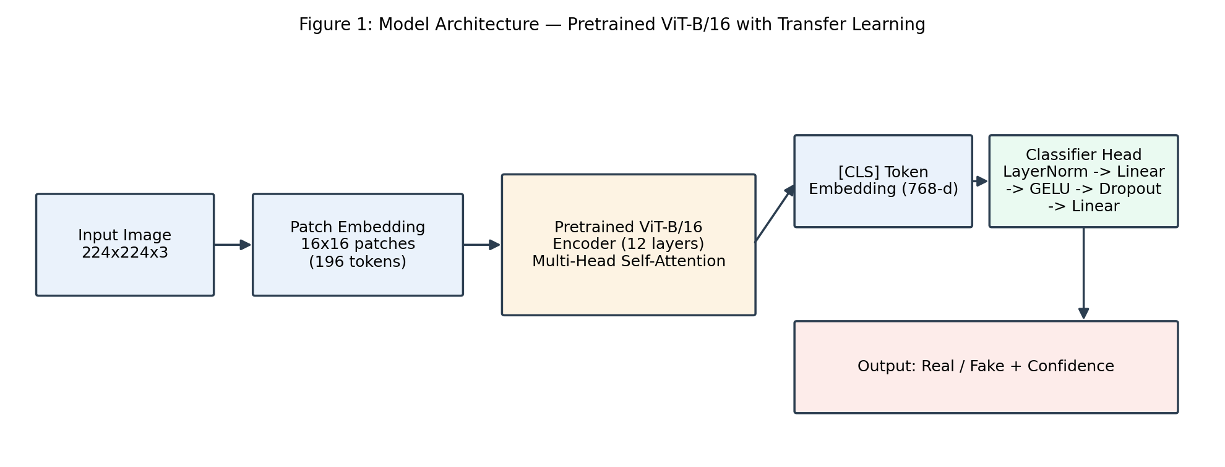
Model Architecture
Deepfake Detection using Vision Transformer (ViT)
5

Slide 6
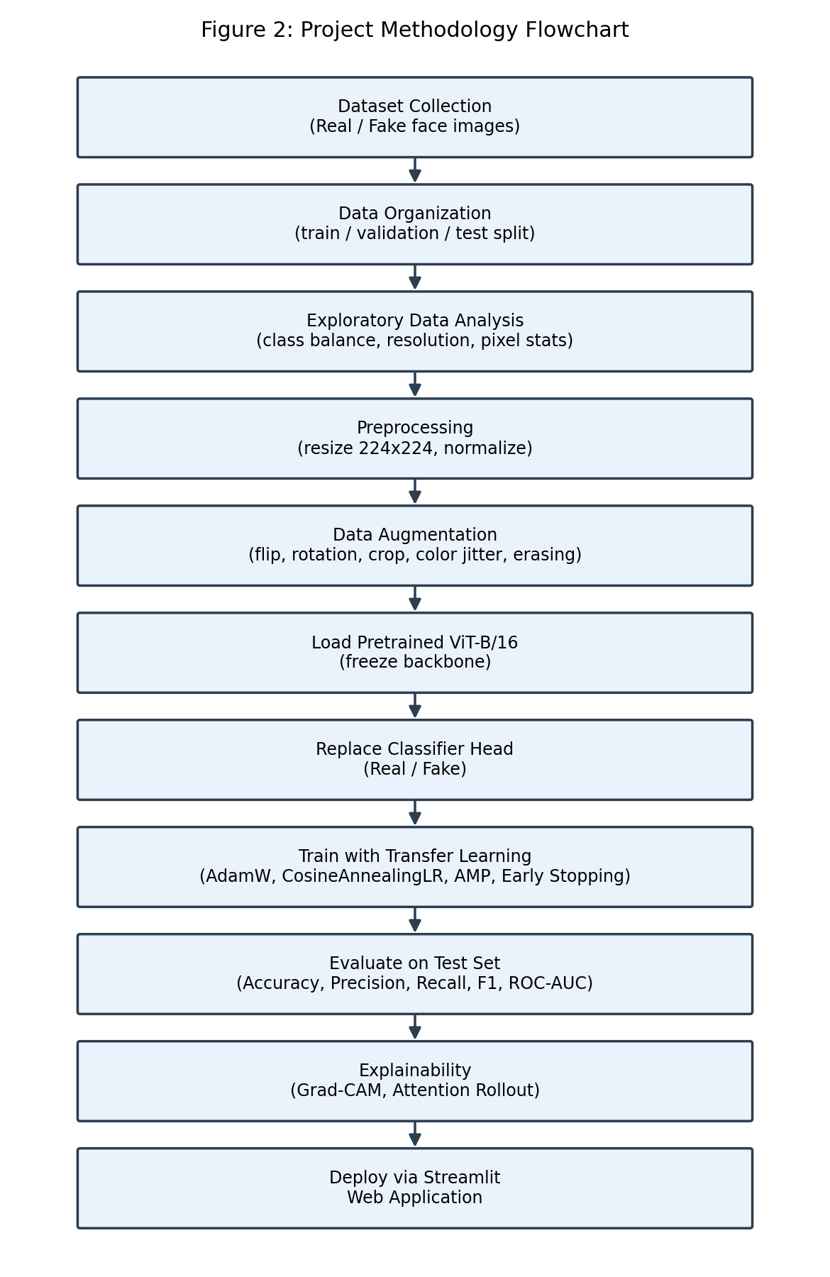
Project Methodology
Data collection & organisation
EDA & preprocessing
Augmentation pipeline
Transfer-learning fine-tuning
Evaluation & explainability
Streamlit deployment
Deepfake Detection using Vision Transformer (ViT)
6

Slide 7
Training Configuration
Component | Choice
Backbone | ViT-B/16, pretrained (ImageNet-21k), backbone frozen initially
Optimizer | AdamW, discriminative LR (head vs. backbone)
Loss | Cross-Entropy with label smoothing
Scheduler | Cosine Annealing LR
Precision | Automatic Mixed Precision (AMP) when CUDA available
Regularisation | Early stopping (patience-based) + best-checkpoint saving
Deepfake Detection using Vision Transformer (ViT)
7

Slide 8
Evaluation Metrics
Accuracy
Precision
Overall proportion of correct predictions
Trustworthiness of a 'real' prediction
Recall
F1 Score
Coverage of actually-real images correctly found
Harmonic mean of precision and recall
ROC-AUC
Confusion Matrix
Discrimination ability across all thresholds
Full breakdown of TP / FP / TN / FN
Deepfake Detection using Vision Transformer (ViT)
8

Slide 9
Explainable AI
Grad-CAM
Attention Rollout
Gradients of the predicted class w.r.t. the last encoder block's patch-token activations are reshaped into a 14x14 heatmap and upsampled onto the original image.
Multiplies [CLS]-token attention weights across every encoder layer to reveal which image patches most influenced the model's final decision.
Both overlays render live inside the Streamlit app for every uploaded image, so users can see exactly why a prediction was made.
Deepfake Detection using Vision Transformer (ViT)
9

Slide 10
Streamlit Web Application
Drag-and-drop image / video upload with preview
Real / Fake prediction with confidence score & probability chart
Grad-CAM and attention-rollout heatmap overlays
Loading spinners and graceful error handling
Optional frame-wise video analysis with overall verdict
Deepfake Detection using Vision Transformer (ViT)
10

Slide 11
Results
This project ships complete, runnable code without a bundled dataset. Populate the figures below with your own outputs/test_metrics.json after running train.py and test.py.
Metric | Value
Accuracy | [fill after training]
Precision | [fill after training]
Recall | [fill after training]
F1 Score | [fill after training]
ROC-AUC | [fill after training]
Deepfake Detection using Vision Transformer (ViT)
11

Slide 12
Future Scope
Native video deepfake detection (Video ViT / 3D-CNN)
Robustness evaluation against compression & adversarial noise
Ensembling ViT with CNN backbones (e.g., EfficientNet)
Automatic face detection & alignment for in-the-wild inference
REST API deployment (FastAPI) alongside the Streamlit demo
Active learning to continuously retrain on hard examples
Deepfake Detection using Vision Transformer (ViT)
12

Slide 13
Thank You
Questions & Discussion
Deepfake Detection using Vision Transformer (ViT-B/16) · MCA Major Project

