Slide 1
Medical Chatbot Design for Homeopathic Treatment Using LLaMA-2 Model

Slide 2
AGENDA:
Introduction
Problem Statement
Research Objectives
System Implementation
Sample Results
Challenges Faced
Conclusion

Slide 3
INTRODUCTION
Importance of Medical Services and Chatbots
Key role in enhancing public health access and convenience.
Assists people in finding specialized care.
Role of AI in Healthcare
AI-powered chatbots bridge the gap between patients and doctors.
Utilize NLP and ML to process and respond in natural language.

Slide 4
PROBLEM STATEMENT
Limited Medical Knowledge Scope in Existing Chatbots
Patients seeking homeopathy have minimal chatbot support.
Reliance on Online Databases
Potential issues:
Data privacy and accessibility concerns.
Increased response time.
Dependency on consistent internet speeds.

Slide 5
RESEARCH OBJECTIVES
Design a Homeopathic Medical Chatbot using LLaMA-2
Develop a curated, domain-specific knowledge base.
Implement a local RAG system using FAISS for retrieval.
Enable offline capabilities using CTransformers with LLaMA-2.
Evaluate performance on accuracy, relevance, and efficiency.
Integrate the medical chatbot with Disease diagnosis expert system.

Slide 6
System Implementations
Data Collection
Data Pre-Processing
Embeddings Creation
Query Matching with FAISS
LLaMA 2 Integration
User Interface Creation

Slide 7
Data Collection
Primary Source
"Practical Guide to Homeopathic Treatment" by Dr. Myron H. Adams
A trusted classical homeopathy reference book
Rich Symptom-Remedy Mapping
Contains detailed associations between symptoms and homeopathic remedies
Domain-Specific Knowledge Base
Focused exclusively on homeopathy
Avoids interference from general or unrelated medical information

Slide 8
Data Pre-processing:
Noise Removal
Removed irrelevant symbols, special characters, and typos
Eliminated duplicate lines and inconsistent entries
Text Normalization
Converted all text to lowercase
Standardized terminology and formatting for uniformity
Linguistic Cleaning
Applied lemmatization to reduce words to base forms
Improved consistency for better semantic understanding

Slide 9
Data Pre-processing:
Chunking and Segmentation
Divided text into manageable chunks
Ensured each chunk contains contextually complete information
Tokenization for Embedding
Converted text into tokens understandable by transformer models
Enabled accurate vector generation during embedding phase

Slide 10
Embedding Creation:
Embedding Model Used:
Sentence Transformer (all-MiniLM-L6-v2)
Lightweight and fast with strong semantic understanding
Embedding Process:
Convert disease and remedy texts into 384-dimensional vectors
Storage Mechanism:
FAISS (Facebook AI Similarity Search) used for indexing embeddings
Enables fast and scalable similarity search

Slide 11
Query Matching with FAISS
Query Embedding:
User query embedded using all-MiniLM-L6-v2
Ensures consistency with pre-computed document embeddings
Semantic Search with FAISS:
Query vector compared to indexed vectors using Euclidean distance
Retrieves top-k most relevant chunks instantly
Scalable and efficient, even with large datasets

Slide 12
LLaMA 2 Integration
Local LLM with Ctransformers
Integrated LLaMA-2-7B-Chat using the CTransformers library
Operates fully offline for privacy and autonomy
Custom Prompt Engineering
Structured prompts combine: Homeopathy context and User query
Promotes accurate, concise, and domain-specific answers
Efficient Document Retrieval
Uses FAISS vector store for fast, local semantic search
Embeddings via all-MiniLM-L6-v2
Retrieval configured with k=1 for minimal, focused context

Slide 13
User Interface with Chainlit
Frontend Implementation
Built interactive chat interface using Chainlit, a Python-based UI framework
Supports real-time communication with the backend LLM pipeline
Session Memory
Added chat history memory for each session
Enables smooth, context-aware multi-turn conversations

Slide 14
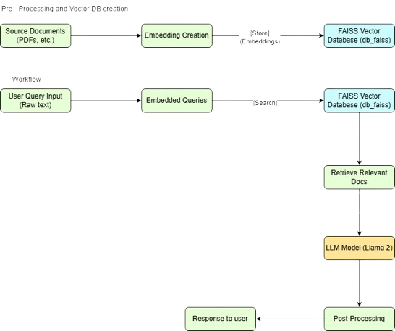
Flow Diagram:

Slide 15
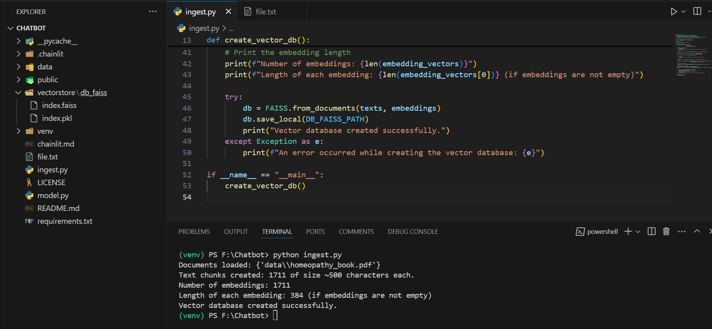
Vector Database creation:

Slide 16
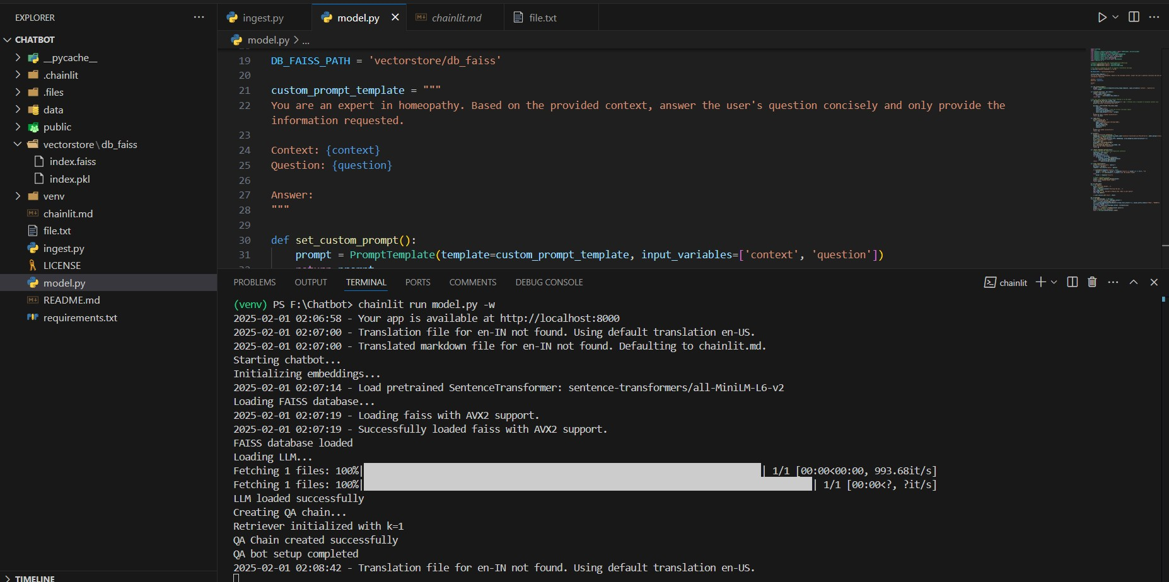
Starting the Chatbot

Slide 17
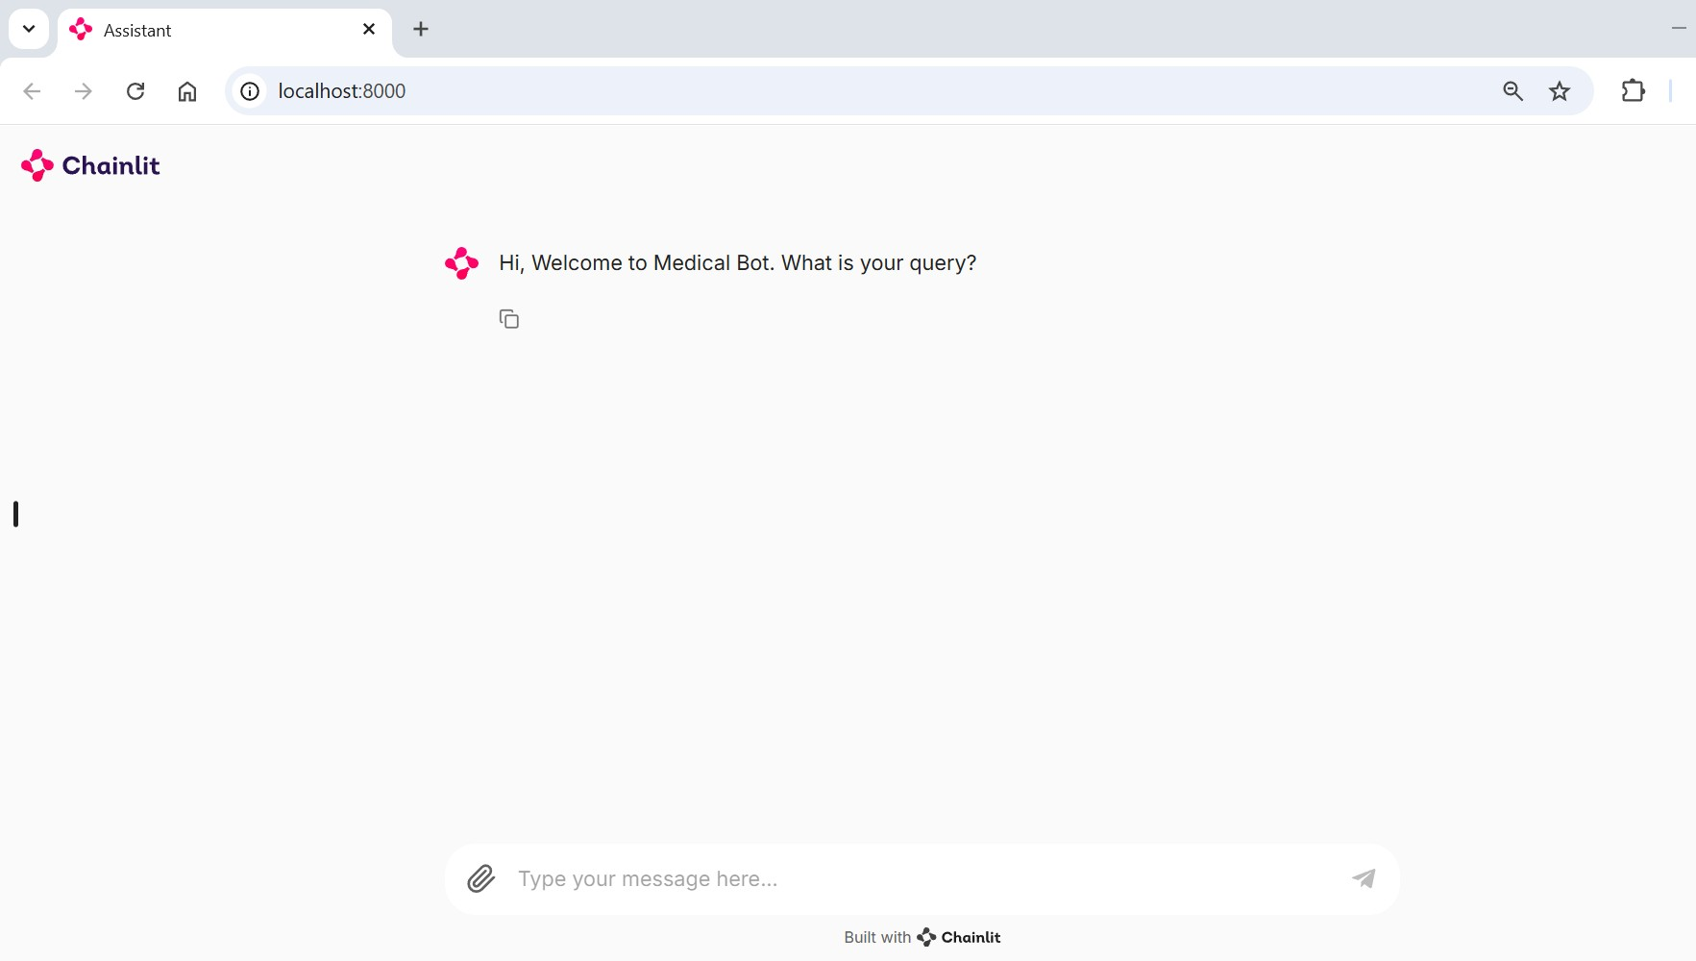
Home Page:

Slide 18
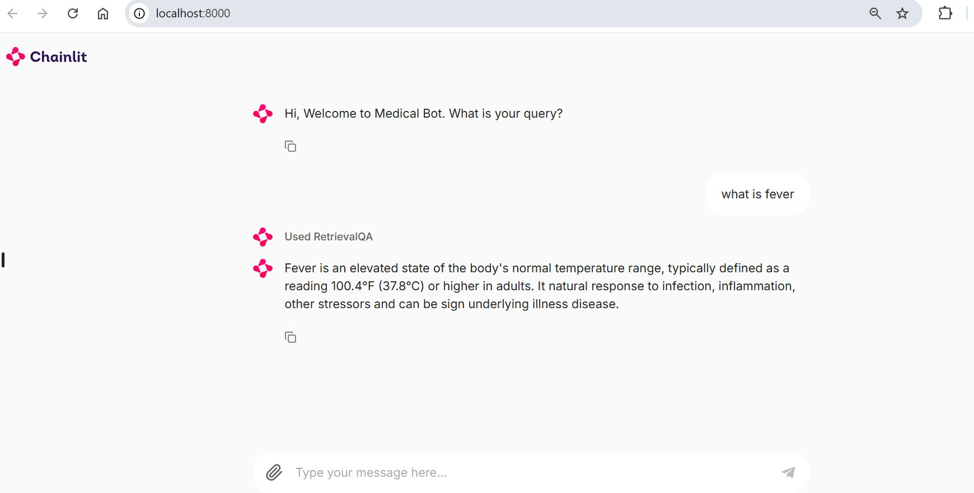
Chatbot Outputs:

Slide 19
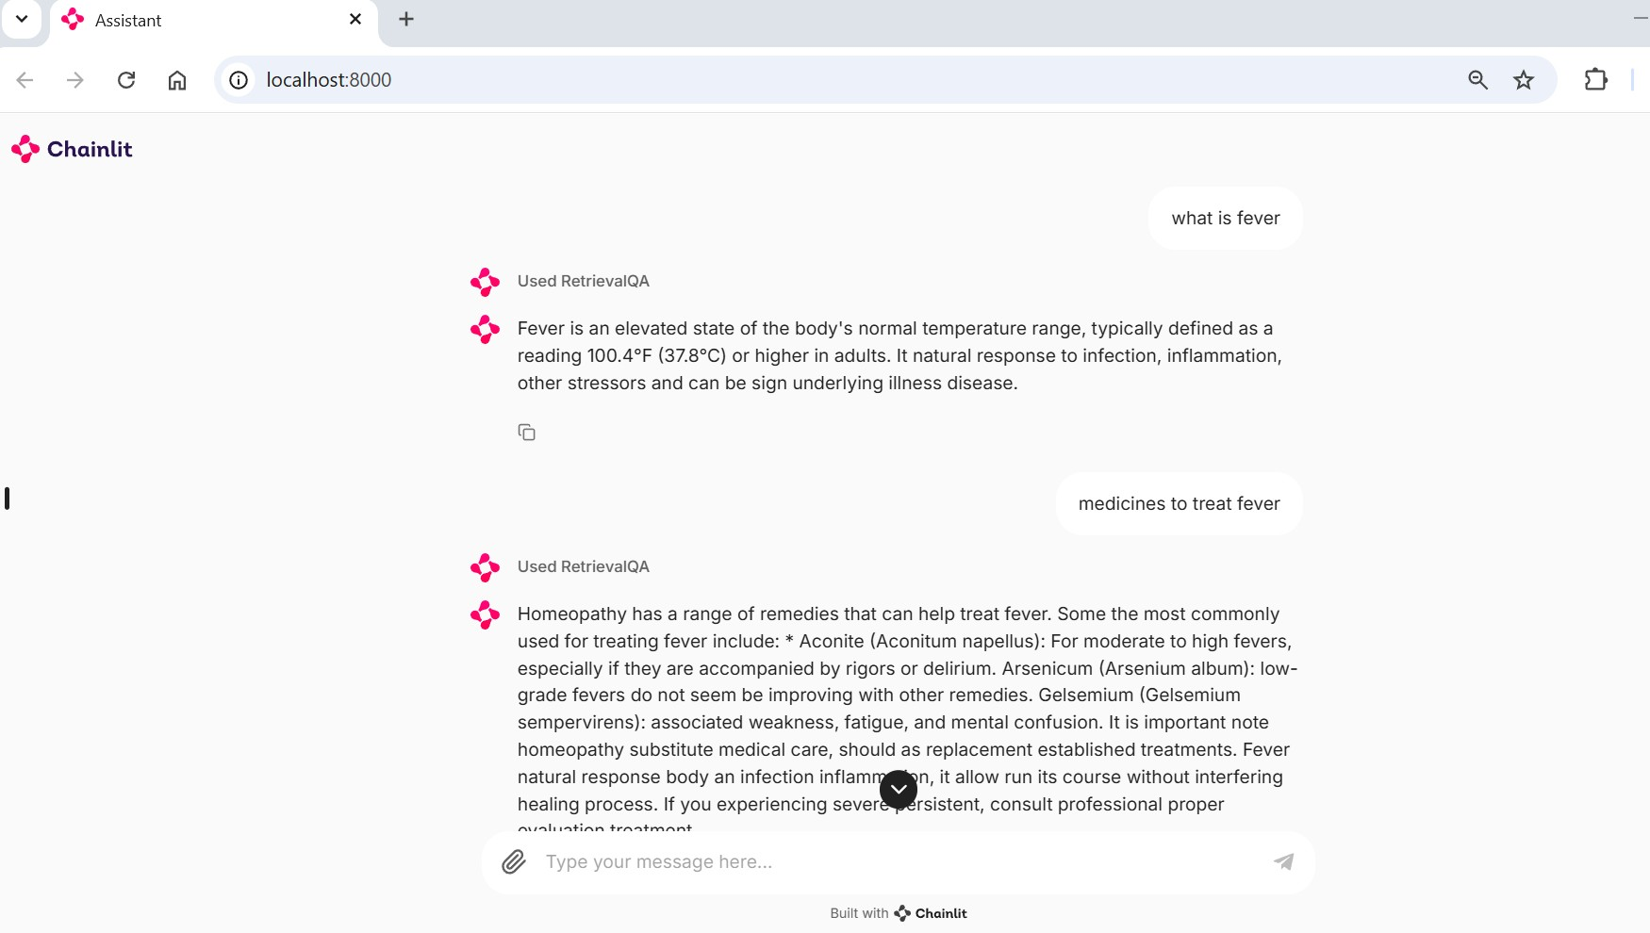
Chatbot Outputs:

Slide 20
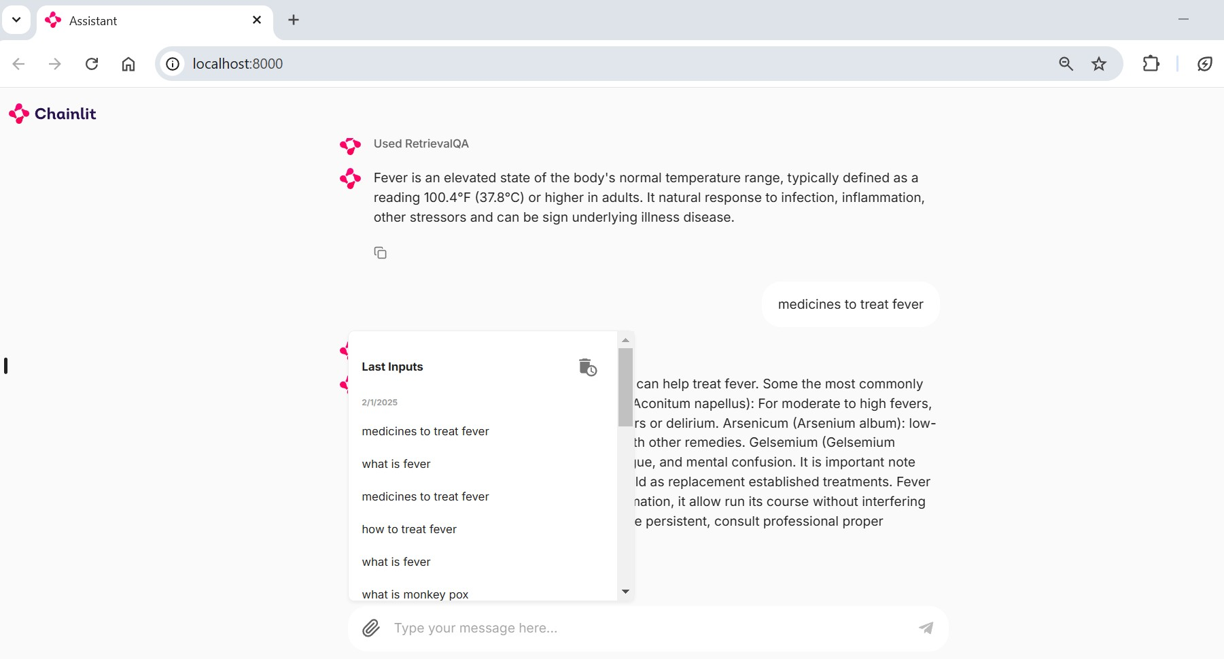
Local Cache for chatbot:

Slide 21
Challenges Faced
Dataset Availability
Limited sources with detailed disease descriptions and matching treatments.
Data Quality
Extensive data cleaning and standardization were required for embedding accuracy.
Computational Resources
Balancing system performance with available resources to optimize processing speed.

Slide 22
Future Work
Multi-Modality Integration:
Add voice and image input/output for better accessibility.
Multi-Language Support:
Extend chatbot to support regional and local languages.
Healthcare System Integration:
Link with EHRs and pharmacies for real-time data and medicine availability
Personalized Treatment Recommendations:
Use patient history and profiles for tailored advice.

Slide 23
Conclusions
Successfully developed a functional prototype.
Laid the foundation for an accurate homeopathy chatbot.
Addressed data availability and quality issues to enhance embedding accuracy.

Slide 24
THANK YOU

