Slide 1
Data Science
(Introductory Session)
Ankit Rathi

Slide 2

About me
A “passionate” data guy
Built multiple analytics platforms (end-to-end)
Somewhere between data architecture & data science
Started with SQL, PL/SQL
Worked on DB/DWH/ETL/BI
2

Slide 3
Setting the expectations
Delhi/NCR Vs Data Science
Breadth & depth of the field
Requires knowledge & skills (practice, practice, practice)
Scope: Overview & approach only
3

Slide 4
The Overview

Slide 5
What?
Why?
Data Science
How?
5

Slide 6
Why Data Science?

Slide 7
Improved Decisions
Intelligent Products
Why Data Science?
And so on…
Effective Customer Engagement
Efficient Operations
7

Slide 8
What is Data Science?

Slide 9
Data science is an interdisciplinary field of scientific methods, processes, algorithms and systems to extract knowledge or insights from data in various forms, either structured or unstructured, similar to data mining.
~ Wikipedia

Slide 10
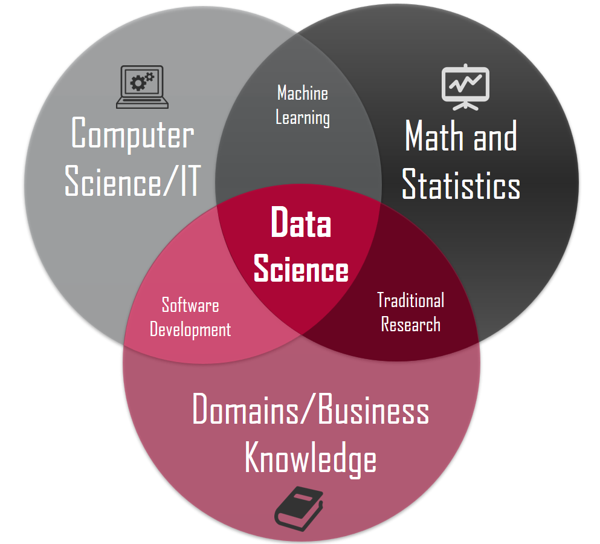

Slide 11
How to do Data Science?

Slide 12
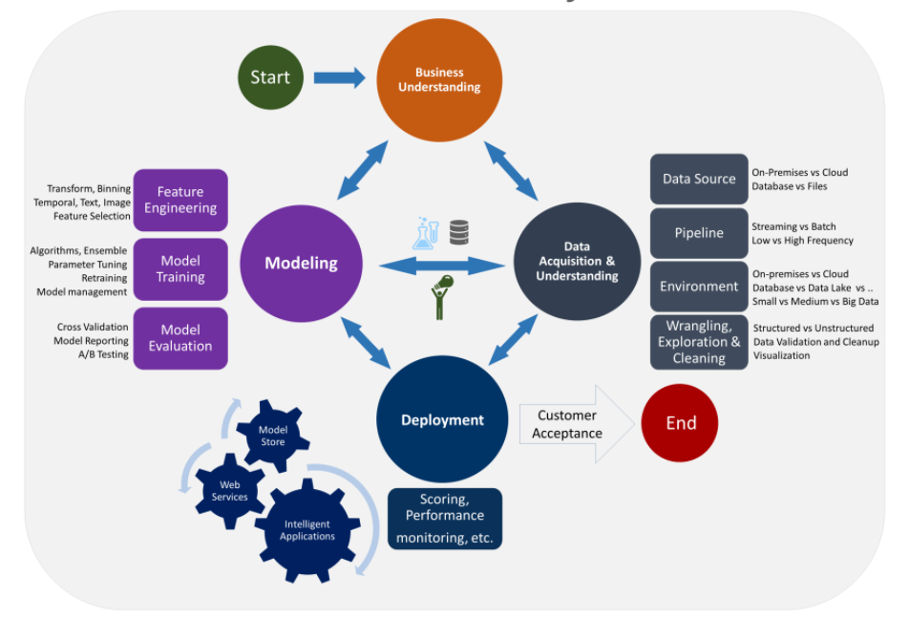

Slide 13
The Breadth
Data Literacy
Linear Algebra, Statistics & Probability
Algorithms
Programming (SQL/R/Python, KNIME/SPSS)
Domain Knowledge
13

Slide 14
The Challenges
Stakeholders Buy-in
Data Issues (Access, Quality)
Problem Statement
Maturity (Process, Analytics)
Wrong Expectations
14

Slide 15
The Approach…
Kaggle (learn, apply, compete)
Analytics Vidhya (learn, stay updated, compete)
KDNuggets (learn, stay updated)
Machine Learning Mastery (learn, apply)
Data Science Central (learn, stay updated)
Quora, Medium & StackOverflow (ask, learn, stay updated)
15

Slide 16
“If you want to learn to swim, jump into the water.”
~ Bruce Lee
“The secret of getting ahead is getting started.”
~ Mark Twain
16

Slide 17
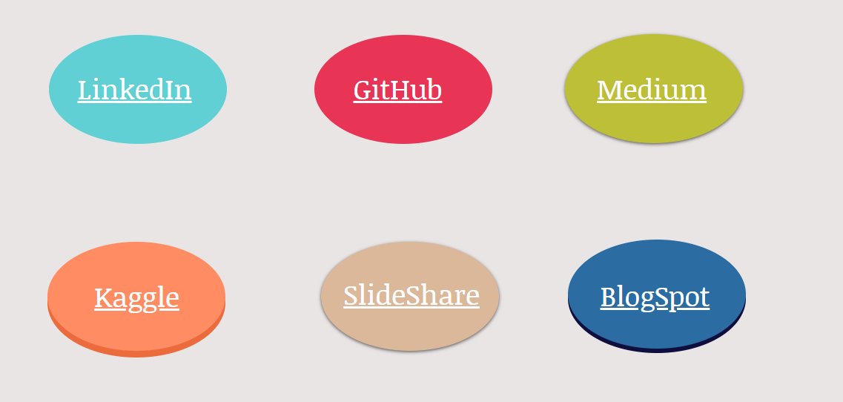
Connect with me
https://ankitrathi.wixsite.com/home/links
17

Slide 18
Questions?

