Slide 1
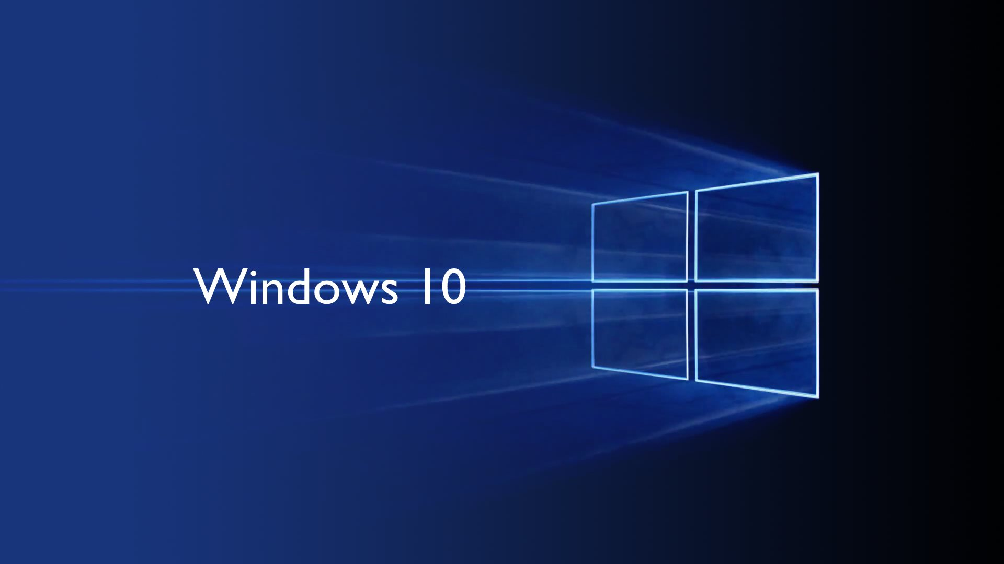
Top 5 Utilities
Aarsh Rathi
VI - A

Slide 2
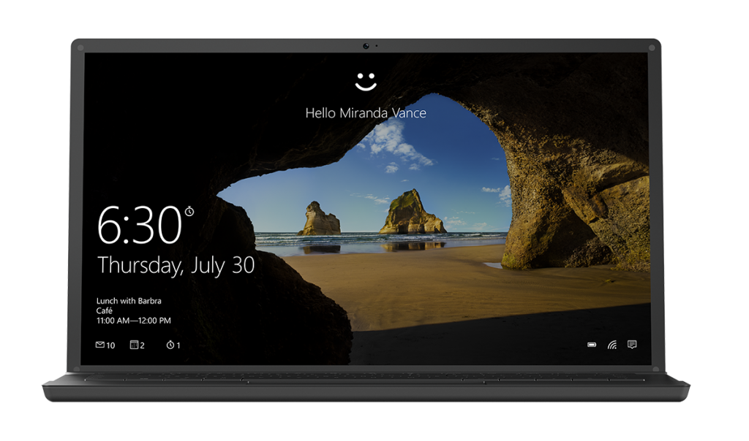
Windows Hello
Windows Hello is biometric authentication that provides you instant access to your Windows 10 devices. Simply show your face or use your fingerprint to login to your new devices running Windows 10 and be immediately recognized by a joyous look . Rest assured that the most secure authentication method is your presence.

Slide 3
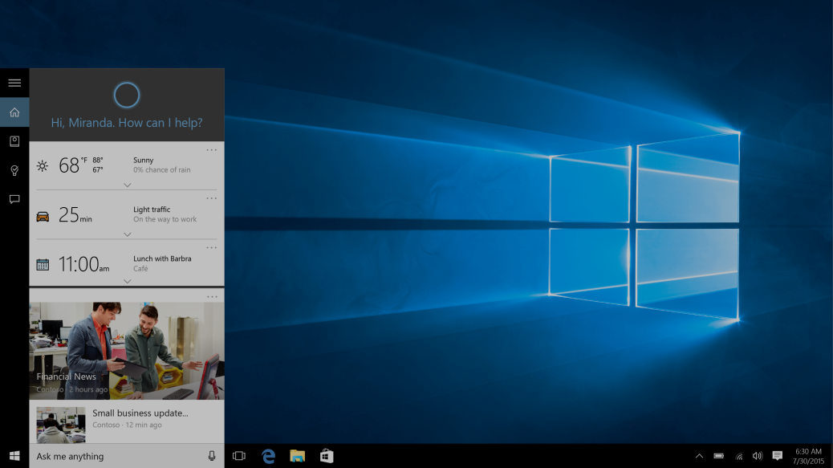
Cortana
The Cortana search box, in the bottom left of the Windows 10 taskbar, allows you to easily search across apps, documents, settings and the Web all with the help of your truly personal digital assistant.

Slide 4
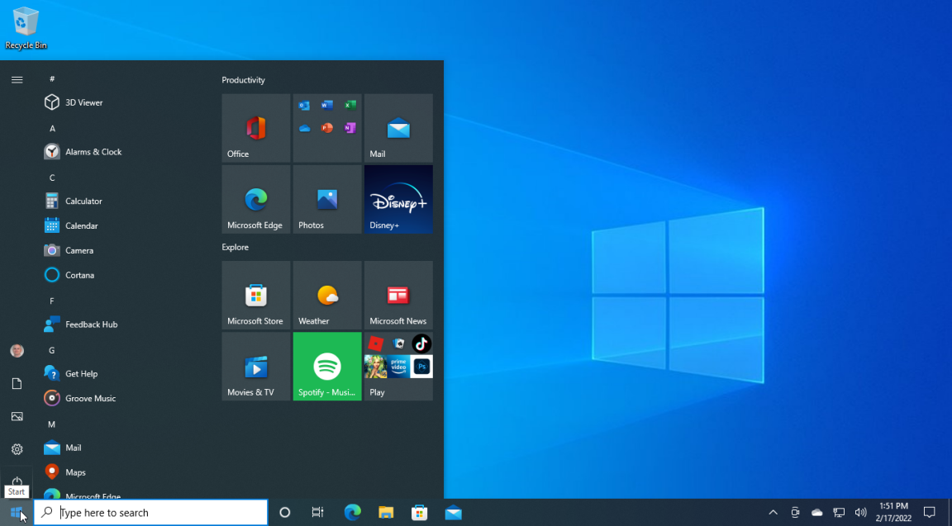
Start Menu
The Start button in Windows 10 is a small button that displays the Windows logo and is always displayed at the left end of the Taskbar. You can click the Start button in Windows 10 to display the Start menu or the Start screen.

Slide 5
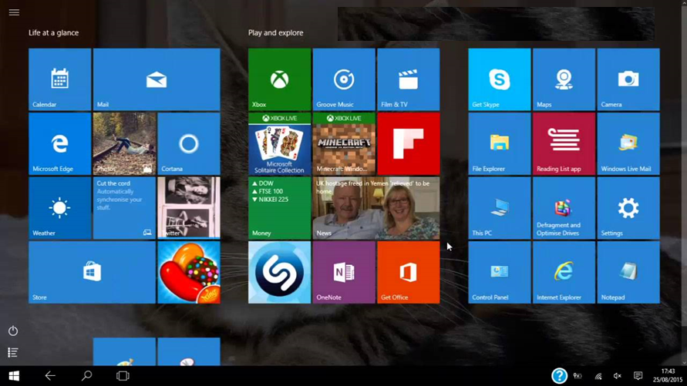
Tablet Mode
Tablet mode is an optional feature allowing Windows 10 users with touchscreen-enabled PCs to use their devices by touching the screen rather than using a mouse and keyboard. Tablet mode displays the Windows 10 user interface to maximize the PC's use as a tablet. Such soar usually includes large app icons, fewer icons shown, and an on-screen manual .

Slide 6
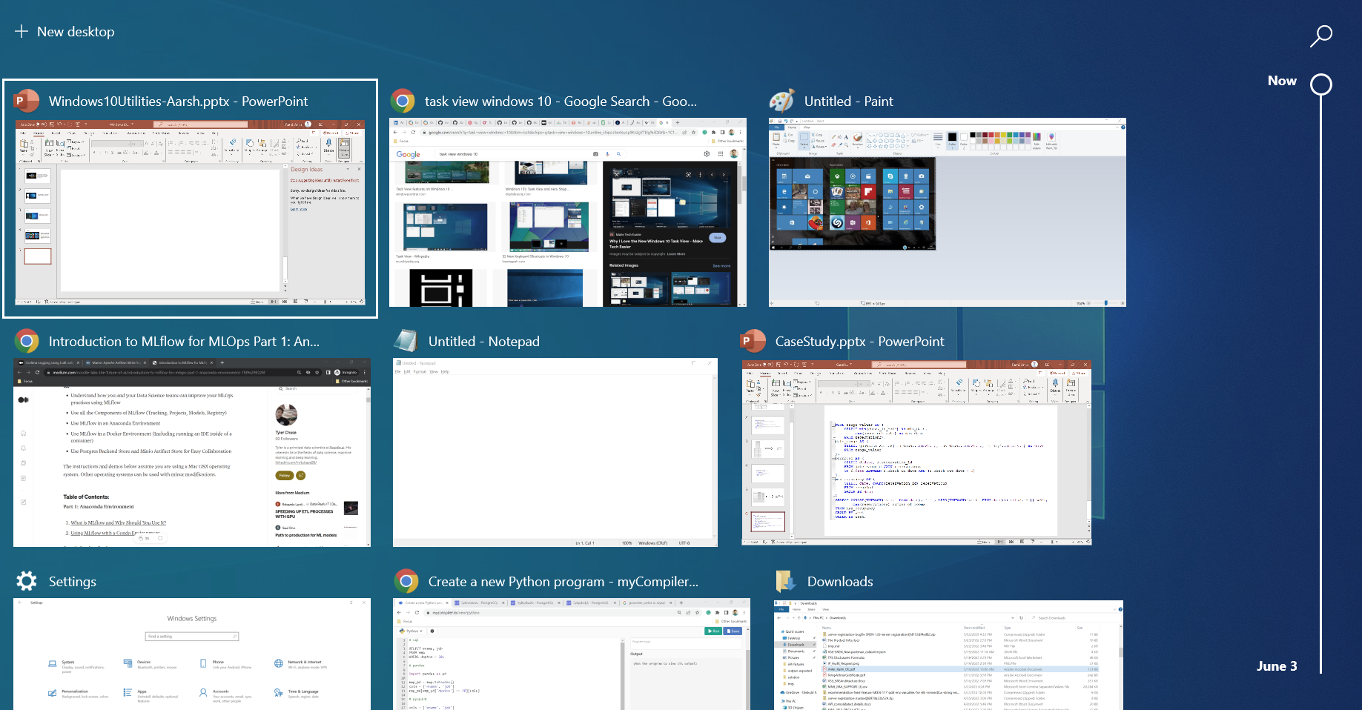
Task View
Task View is a task switcher and virtual desktop system introduced in Windows 10 and is among the first features new to Windows 10. Task View allows a user to quickly locate an open window, quickly hide all windows and show the desktop, and to manage windows across multiple monitors or virtual desktops.

Slide 7
Thank You

