Slide 1

RideShare
CSCI 4370/6370
Akshay Mendki
Ankit Vaghela
Omkar Mukund
Johnathan Kulovitz
Niraj Kadam

Slide 2
What is it?
Problem: “I need to get around Athens but I don’t have a car.” or “I wish someone would split gas with me on this trip to (X).”
RideShare connects those looking for rides with drivers who are already going to the same place.

Slide 3
Two Types of Accounts
Driver Account
Asked for more information on registration
Able to register a vehicle under their account
Registration includes Car capacity question (min 2)
Able to make a ride using a certain vehicle and publicly list it.
Able to delete any self-registered rides or vehicles and profile.
Rider Account
Only asked for basic information
Riders can look at available rides, and sign up for an available seat in the driver’s car.
Able to delete profile.

Slide 4
Post Trip Follow Up
Following a completed ride, a rider is allowed to review the driver. This includes an integer rating and comment.
The ratings per driver are averaged and their overall rating is displayed.

Slide 5
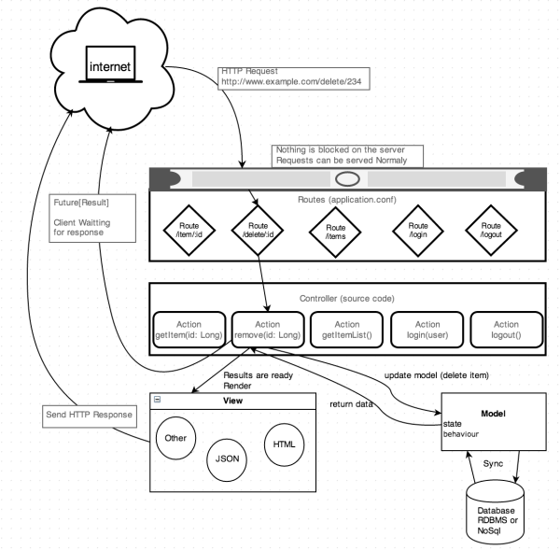
Software Architecture
source

Slide 6
Software Architecture
Play 2 framework
Netty for the web server
MySQL database
Ebean (Java) is included for database access
Twirl (Scala) as the html templating engine
Bcrypt for password protection
SBT for dependency management

Slide 7
DEMO

