Slide 1



Employee Attrition Analysis

Slide 2
Content
Problem statement
Key Metrics
Dashboarding(using Tableau) Analysis
Inferences Or Insights
RCA(Problem behind the cause)
Recommendations
Conclusion

Slide 3
Problem statement
Company which was established a few years back is facing around a 15% attrition rate for a couple of years. And it's majorly affecting the company in many aspects.
In order to understand why employees are leaving the company and reduce the attrition rate Company has approached an HR analytics consultancy for analyzing the data they have.
Building a dashboard which can help the organization in making data-driven decisions.

Slide 4
Key Metrics
Total Employees: 2511
Top Reasons for Leaving
Employees Who Left: 375
The primary factors driving employees to leave include:
Attrition Rate: 15%
Better job opportunities elsewhere
Average Employee Age: 37
Work-life balance challenges
Lack of career development opportunities
Active Employees: 2136

Slide 5
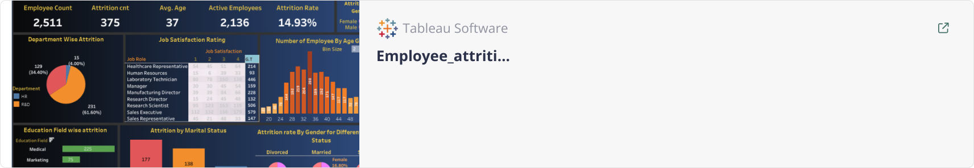
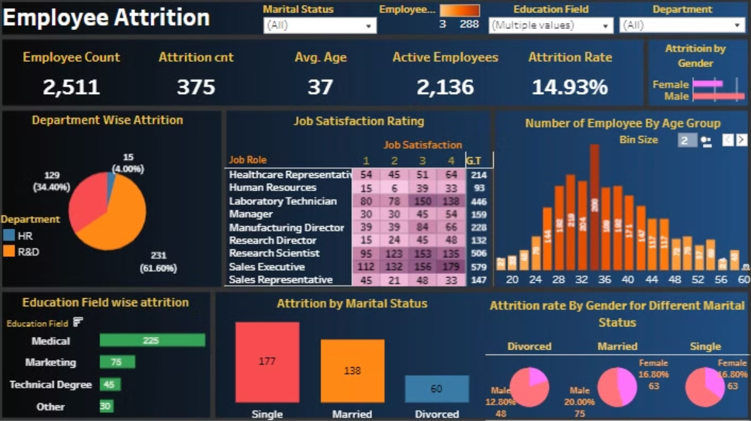
Dashboard:

Slide 6
Insight:
Most of the Attrition occured from male side.
61% highest attrition rate from the R&D department.Followed by S with 34% rate. Least from the HR department i.e. 4%.
Most of the employee come from the age group of 34 and as a Sales Executive and Research scientist job role.
Highest attrition count is from the Medical Education background followed by Marketing and Technical Degree.
After analysing the marital stauts, high Attrition count amongst all three category is from male and mostly are single.

Slide 7


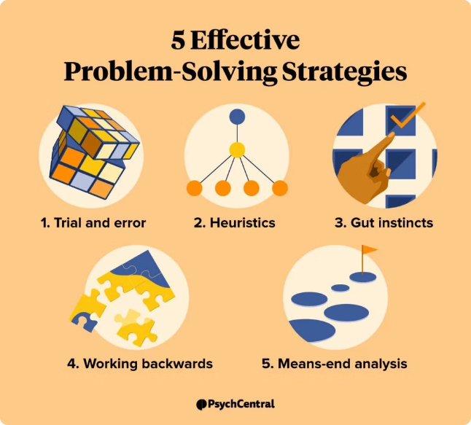


Root Cause Analysis
Compensation and Benefits
Assess whether the organization's compensation and benefits package is competitive and aligned with industry standards.
Management and Leadership
Evaluate the effectiveness of managerial practices, communication, and support provided to employees.
Career Growth Opportunities
Identify the gaps in professional development, training, and advancement opportunities within the organization.

Slide 8



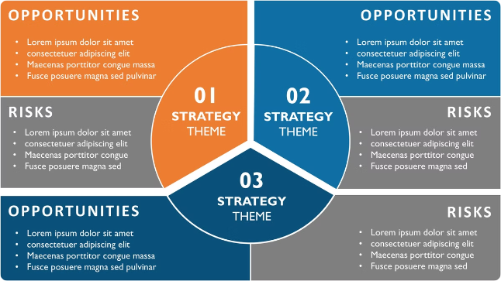

Recommendations
Targeted Recruitment
Talent Development
Enhance the recruitment process to attract and retain top talent with the right skills and cultural fit.
Invest in comprehensive training, mentorship, and career progression opportunities to upskill and retain employees.
Employee Engagement
Compensation Review
Implement initiatives to foster a positive work environment, boost morale, and increase job satisfaction.
Evaluate and adjust the organization's compensation and benefits package to remain competitive in the market.

Slide 9


Conclusion
By addressing the root causes of employee attrition, implementing targeted retention strategies, and fostering a positive work culture, the organization can effectively reduce turnover, retain top talent, and drive long-term success.

