Slide 1





MEDICAL
Healthcare
Analysis Dashboard

Slide 2

Acknowledgement
I would like to express my deepest gratitude to DK sir, for the invaluable guidance, feedback, and constant encouragement throughout the duration of this project.

Slide 3

Content Overview
Data Understanding
Data Cleaning and model creation
Data Analysis
Insights and Recommendations

Slide 4

Tools used for the Analysis:
  Microsoft Excel
  Power BI
  Microsoft PowerPoint

Slide 5


What all things did I do?
Data Import
Data Modeling
Downloaded and imported the data into Power BI
Created multiple relationships between different tables.
Data cleaning
Dashboard
Used Power Query and DAX to create new columns, measures, and calculated columns,
changed data type etc
Pie chart, Donut chart, Pie chart, column charts, line and area charts, filters, etc

Slide 6

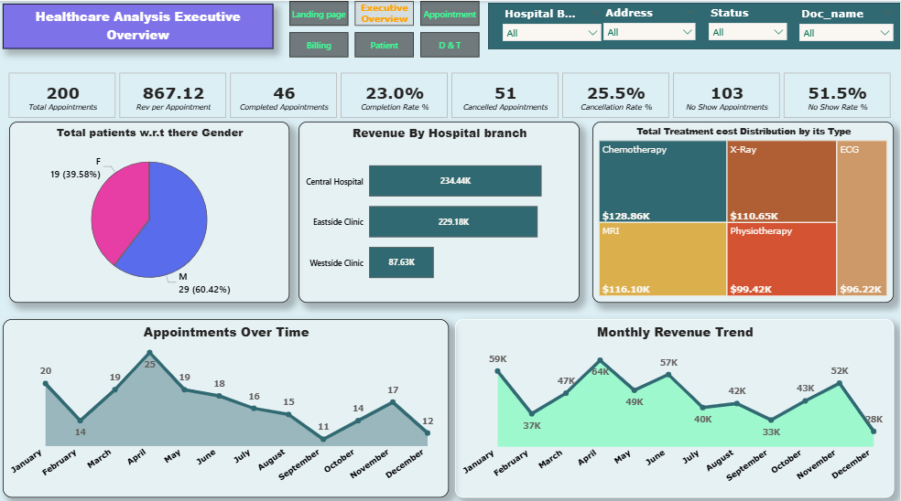
Healthcare Analysis Executive Overview

Slide 7
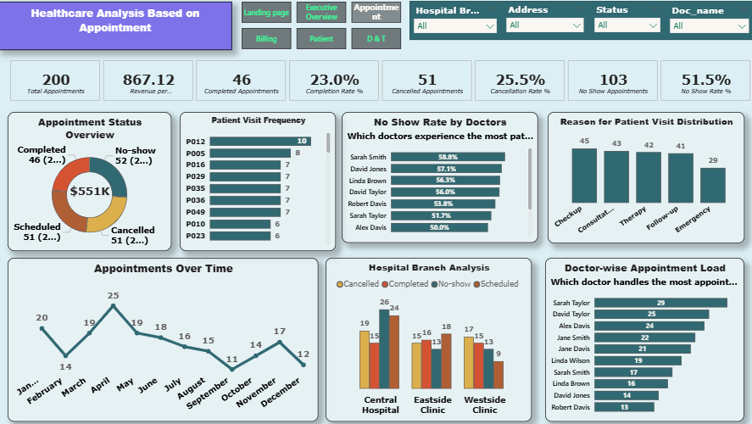

Healthcare Analysis Based on Appointment

Slide 8
Recommendations for appointments
  Improve Appointment Completion Rate - By implementing sms/emails as a medium to remind them.
  Enforce a nominal no-show penalty or flexible rescheduling policy.
  Investigate reasons behind High cancellations- appointment availability, staff allocation.
  Launch awareness campaigns or health packages specifically targeting women's health to balance gender representation.
  Optimize High-Cost Treatments.
  Capitalize on Peak Months (April, May)
  Boost Low-Performing Months (e.g., September)
  Patient P012 has 10 visits; others show 7–9 repeat visits
Leverage frequent visitors for loyalty programs or personalised care plans.
  Audit doctors'(Dr Sarah Smith, Dr David Jones) appointment workflows, communication styles, and time slots. Train or support them with care coordinators to follow up with patients and reduce no-show likelihood.
  Launch seasonal marketing campaigns or preventive health drives in slower months like September & December.

Slide 9
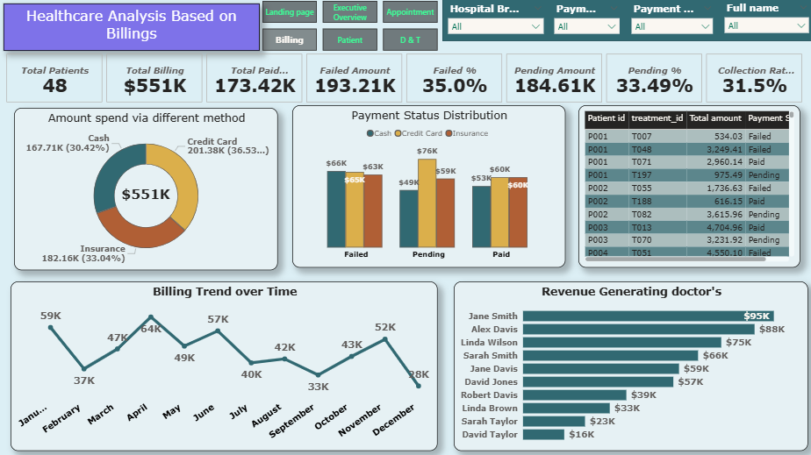

Healthcare Analysis Based on Billings

Slide 10
Recommendations for Billings dashboard
  Optimise the Use of Payment Methods: While credit cards account for the highest billing volume, they also exhibit high pending/failure rates. Promote more reliable payment channels.
  Act on Seasonal Billing Trends: Months like April, June, and December show spikes in billing — these periods can be leveraged for revenue pushes, bulk scheduling, or prepaid packages.

Slide 11
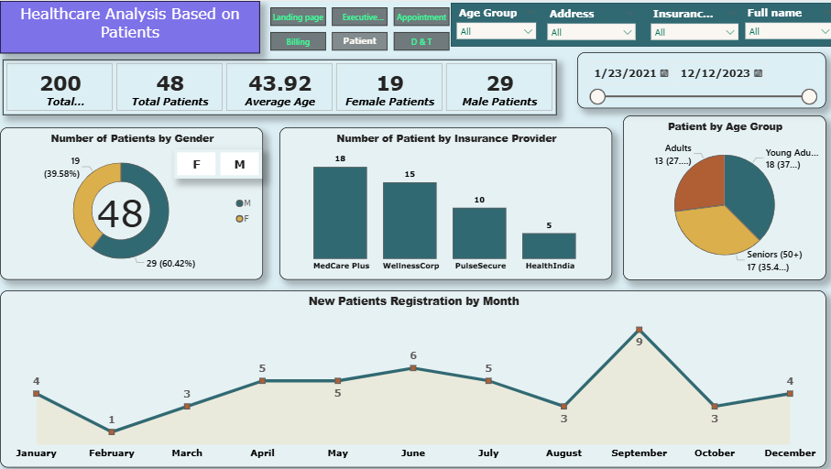
Healthcare Analysis Based on Patients

Slide 12
Recommendations for Patients Dashboard
  Smooth Seasonal Slumps:
February and October are slow. Run awareness campaigns, free screening events, or discounts during these months to maintain volume.
  Capitalize on Peak Months:
September shows peak patient registrations. Use it for seasonal checkups, promotional offers, or annual health packages.
  Evaluate Low-Performing Insurers:
Investigate why HealthIndia has a low patient count — maybe due to poor plan acceptance or coverage issues. Also, strengthen collaboration with MedCare Plus and WellnessCorp, offering exclusive plans or faster claim processes.
  Gender-Specific Outreach (female patients are less):
Offer women-focused health packages, affordable checkups, or awareness.

Slide 13
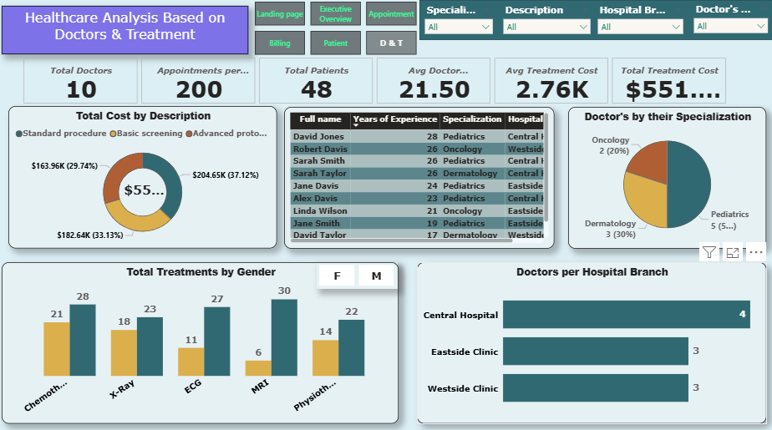

Healthcare Analysis Based on Doctors & Treatment

Slide 14
Recommendations for doctors and treatments dashboard
  Leverage Doctor Experience:
Market the hospital’s highly experienced medical staff as a differentiator for trust and quality
  Increase Patient Outreach:
48 patients over 200 appointments indicate a small pool; run community health campaigns to attract new patients.
  Promote High-Cost Services:
Focus marketing on Advanced Protocols, MRI, and Chemotherapy — these yield higher revenue
  Expand Staff at Central Hospital
  Service Diversification Needed:
Only a few services dominate. Introduce new treatments or wellness programs

Slide 15
Insights:
Facility 1
  Specialization Distribution:
Paediatrics (50%) and Dermatology (30%) dominate.
Oncology is underserved with only 2 doctors.
  Top Treatment Types:
Chemotherapy (28) and MRI (27) are the most frequent treatments

Slide 16

THANK
YOU

