Slide 1

Time Series Analysis and Forecasting
Presented by
Ankit Pandey
Roll No: 22223018
MCA-V Semester
Faculty Name
Dr. Tanmoy Kanti Das

Slide 2

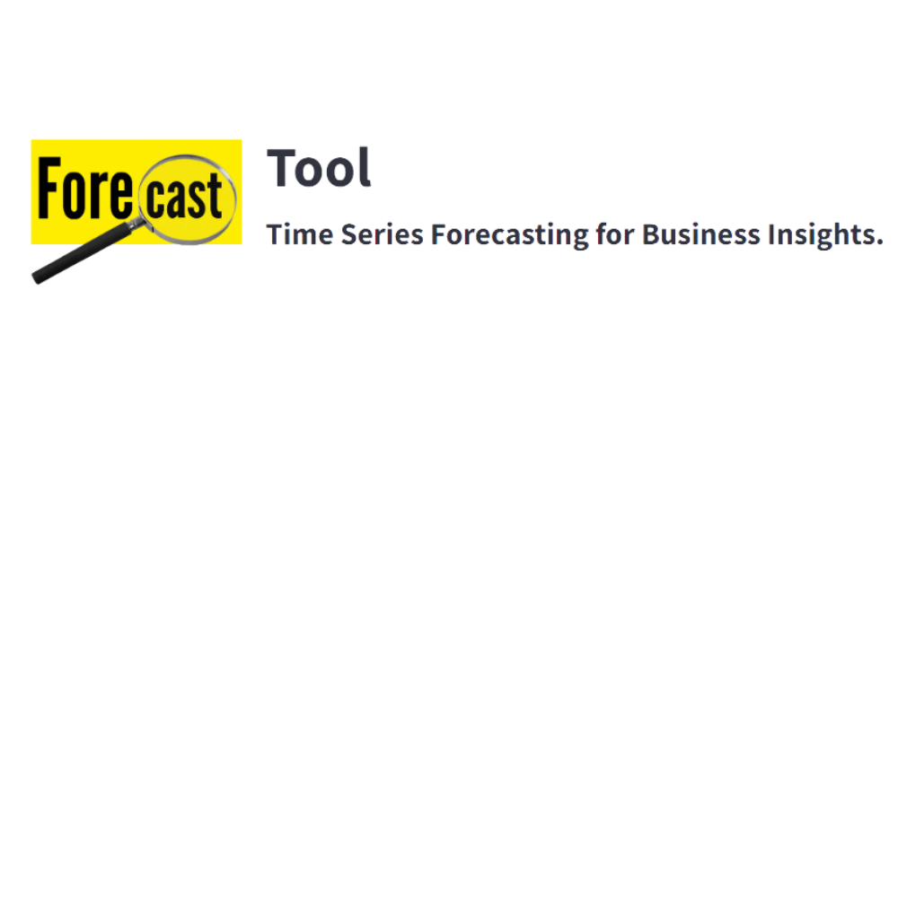

Data Preprocessing
Exploratory data analysis
Comparative study
+

Slide 3
Problem Statement
Based on past power consumption, what will the power usage be for the next Upcoming days?
Let's explore different time series forecasting techniques to predict power usage for the coming year

Slide 4
Data Preprocessing
We’re using the PJME Hourly dataset, which provides hourly power consumption data in megawatts (MW) across regions in the Eastern U.S. This data helps us analyze and predict electricity usage patterns over time.
We need to first check a few things:
1. Duplicate and missing data, as well as spread
2. How autocorrelated is this data and its seasonal decomposition

Slide 5
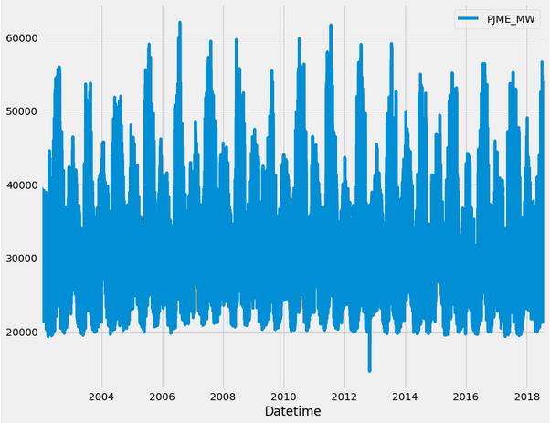
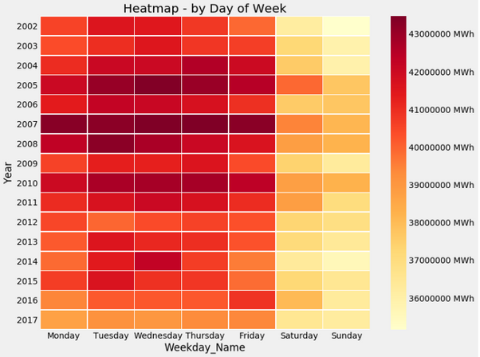
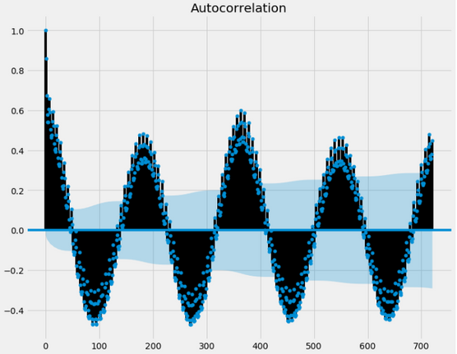
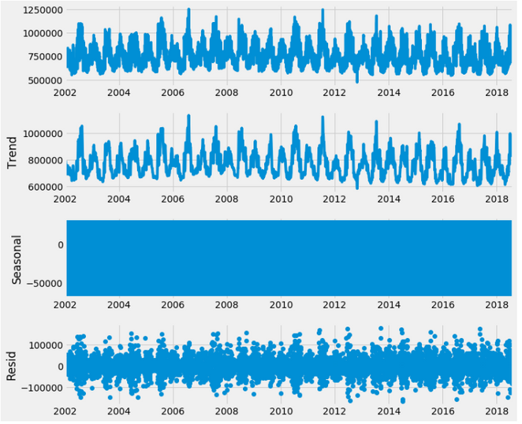
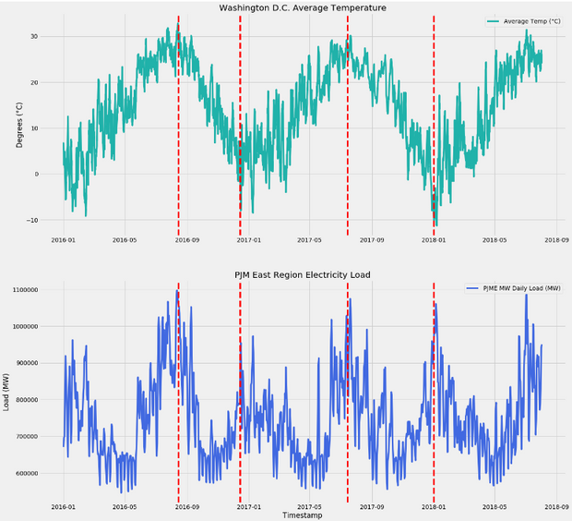
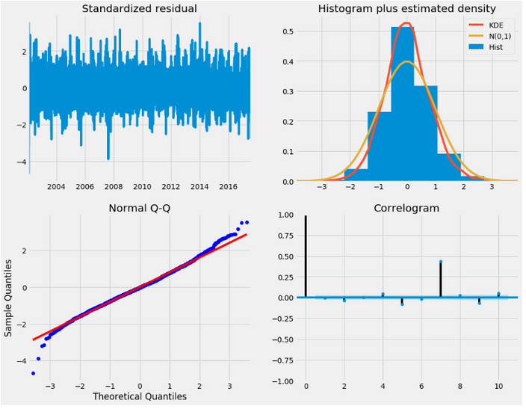
EDA(Exploratory Data Analysis)

Slide 6
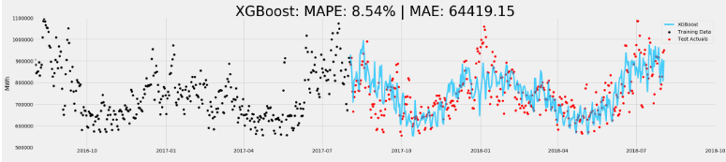
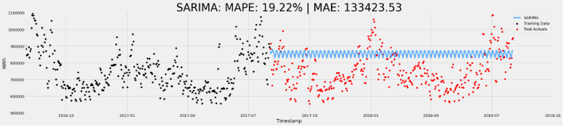

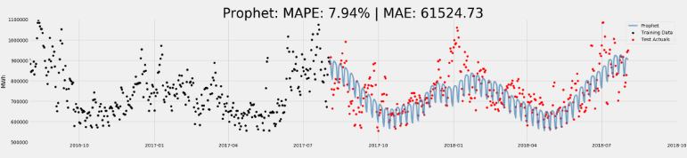
Comparative study

Slide 7
So We've used Facebook Prophet to create an intuitive UI using Streamlit, that allows easy forecasting for general time series data.

Slide 8
link to website:forecastify.streamlit.app

Slide 9


Objective
We already seen that FB Prophet gave the most accurate results among the forecasting methods we tried.
So, we built a simple and user-friendly tool with Streamlit to make time series forecasting easier. This tool allows anyone, even without technical knowledge, to predict future trends using different datasets.
Laptop
Smartphone

Slide 10

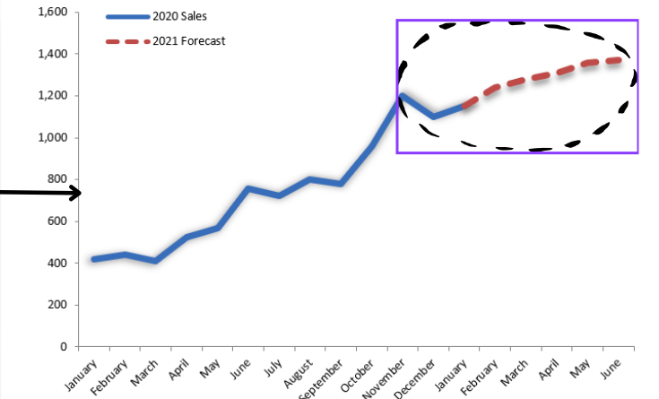


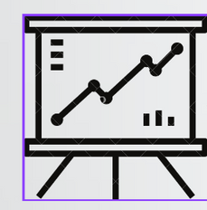
Proposed Methodology
Sales Dataset
Stock Market Dataset
Forecast
Any TIme series Dataset

Slide 11
How It Works?
Forecasting: In this actual forecasting is done using the Facebook Prophet model in 4 steps
1.Data loading and visulization
2.Parameter configuration
3.Forecasting (model fitting)
4.Cross validation and metrics

Slide 12
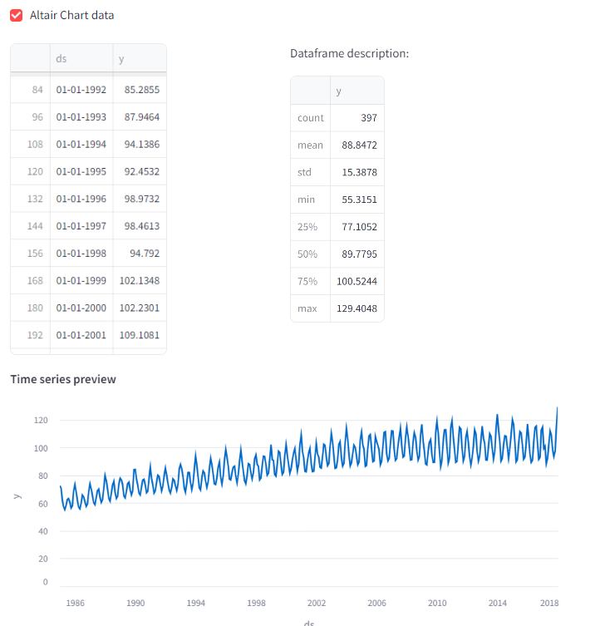
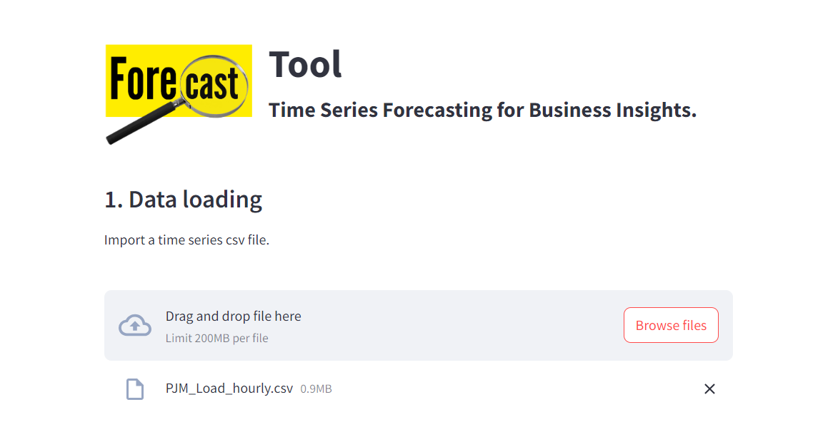
1.Data Loading
Upload any time series dataset, like sales figures, stock prices, or other data over time, and Visualize it using an interactive chart.

Slide 13
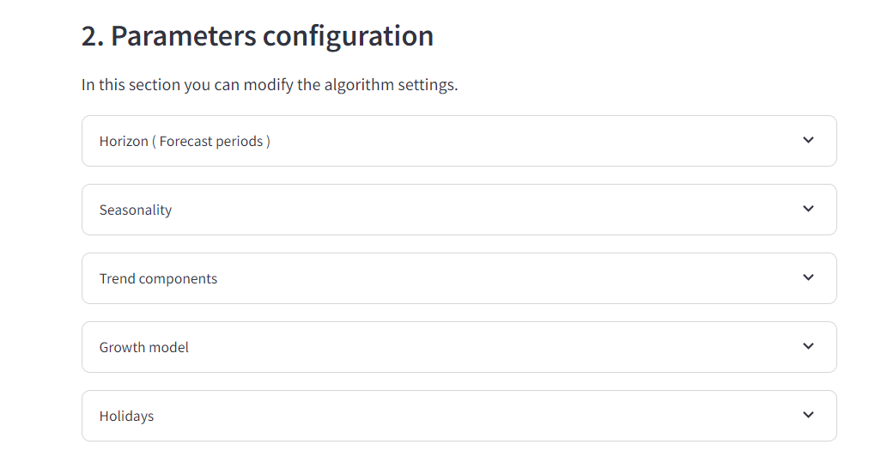
2.Parameter Configuration:
Configure parameters such as horizon, seasonality, trend component, growth model, and holidays.

Slide 14
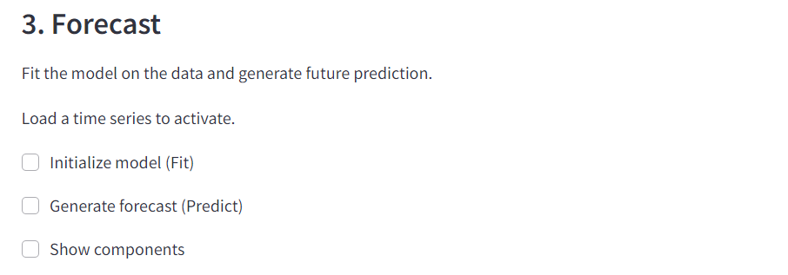
3.Forecasting:
Forecast involves fitting a model to historical data and using it to generate future predictions.

Slide 15
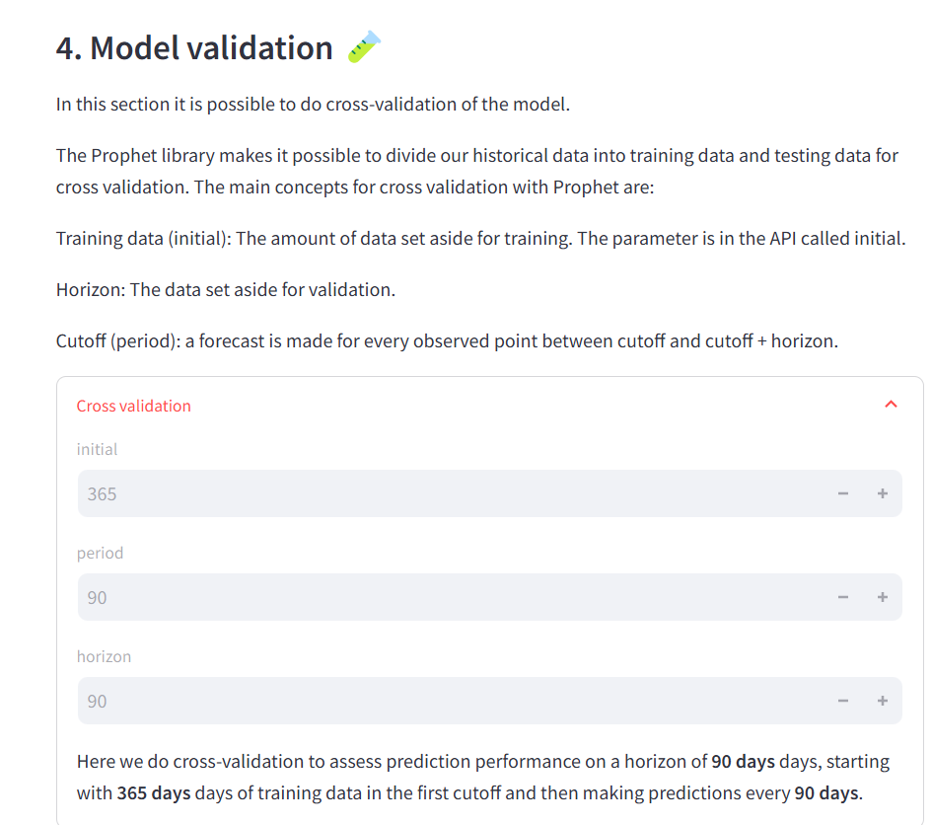
4.Model Validation
Assesses the model's accuracy by dividing historical data into training and testing sets, making forecasts, and comparing them to actual values.

Slide 16
Conclusion
In this project, we looked at different ways to forecast time series data, including XGBoost, SARIMA, and FB Prophet.
After comparing their results, we found that FB Prophet gave the most accurate predictions for our dataset. Using this knowledge, we created an easy-to-use tool with Streamlit. This tool makes forecasting simple, allowing anyone to predict future trends with just a few clicks.

Slide 17
Thank You!
Q & A

