Slide 1
SPARK
THE LIFE COACH

Slide 2
CONTENTS
STATS
INTRODUCTION
HOW IT WORKS
DESIGN
EMOTIONS BEING HANDLED
TECH STACK
DEMO
PRODUCT BACKLOG
QUESTIONS

Slide 3
STATS
The National Mental Health Survey 2015-16 conducted by National Institute of Mental Health and Neuro-Sciences (NIMHANS), reported mental morbidity of 10.6% among those who are aged 18 and above.
WHO’s new global health estimates on depression said while over 5 crore Indians suffered from depression, over 3 crore others suffered from anxiety disorders.
The total estimated number of people living with depression increased by 18.4% between 2005 and 2015.

Slide 4
INTRODUCTION
Depression is a very common mental illness that can become dangerous, if left untreated.
The only challenge in treating cases of depression is that people are afraid to talk about it openly.
To solve this we have come with an idea of making a chat bot which can make reliable and private conversations with the user.
This will help the user to overcome anxiety, stress and helps to move on.

Slide 5
HOW IT WORKS ?
The bot works using Cognitive Behavioural Therapy (CBT) principles.
It uses insights and empathy of a real therapist to help people in dealing with anxiety and depression issues.
It is possible to automate CBT as bot follows steps to identify and address the problem.

Slide 6
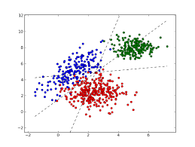
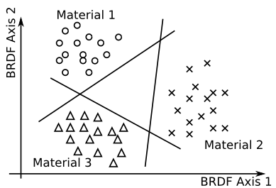
DESIGN
Multi class classification
C
O
U
N
T
LABEL

Slide 7
EMOTIONS BEING HANDLED
Anger, Boredom, Enthusiasm, Fun, Happiness, Hate, Love, Neutral, Relief, Sadness, Surprise, Depressed, Worry

Slide 8
TECH STACK
Programming language - Python
Technique – Machine Learning
Front end – Angular - Ionic Framework
Backend – Flask Restful API

Slide 9
DEMO
Time to show our demonstration of the IDEA.

Slide 10
PRODUCT BACKLOG
Indent Classification
Third party API support
Voice Input - Output Support
Micro Animations
Native Support

Slide 11
QUESTIONS ?
Feel free to ask queries about our project…

Slide 12
THANK YOU - TEAM ZOMBIES
ANKIT AGGARWAL
DEEPAK SHETTY
PRABHSIMRAN SINGH
HARI PRASAD
SAI CHARAN

