Slide 1
Bank Loan status prediction using machine learning
By Ankit Kumar (2028018), Arbaaz Khan (2018023) and Mayank Gupta (2018157)
Group 22

Slide 2

Introduction
The financial area has advanced a ton, with numerous individuals applying for loans. Approval for a loan is a vital cycle for banking associations, as advance reimbursement is a significant contributing variable in the bank's budget or financial statement.
That's why we are making a Machine learning model to predict who can provide a loan or not based on property or attributes related to the finance of that particular person or user.

Slide 3
Data Set and Evaluation Metric
The used dataset is obtained from the Kaggle. The following dataset has 1,00,000 samples with 18 features initially.
After preprocessing and data analysis for the training set, we used 80% of the dataset for training and the other 20% is used for testing purpose. The training set is further divided into validation using 10% of the training dataset.
We came across some of the main features in the dataset: Credit Score, annual income, current credit balance.
Evaluation metric that we will use: Accuracy, AUC Score, Precision, Recall
and F1 Score

Slide 4
Approaches
We have used Neural networks , Decision Tree , SGD and Gradient boosting approaches.
Doing Hyperparameter tuning for Every Model for finding the best parameter so that we can get better results as possible.
Using Gridsearch and Random Search For tuning.
Using Ensemble techniques like Bagging and Voting classifiers for getting better performance from our model.
Checking Overfitting and underfitting by making plots of error and iteration or by checking error using Kfold on test and training sets.

Slide 5

Error Analysis and Progress
We started with the pre-processing of the dataset. First, we have to deal with null values for every attributes one by one.
Then we are Plotting a pair-plot using seaborn for data analysis.
Checking Correlation between different attributes using seaborn heatmap.
We started dropping the column, which is highly correlated with each other.
Then we are using label encoding and One-Hotencoding for processing of string data type.
Then after normalization and splitting, we have tested the logistic regression model
for k-fold.

Slide 6
Error Analysis and Progress
Then we have checked the distribution of data using TSNE plot as it’s not linearly separable that’s why logistic regression give very poor result.
Initially there was no imbalanced in our data but after splitting it become imbalance that’s why we have used oversampling and stratify during splitting for maintaining the ratio of labels.
Then we have used grid search for hyperparameter tuning at every model by choosing a appropriate parameter grid according to model and dataset.
After it we have used some ensemble techniques to get more better results.

Slide 7
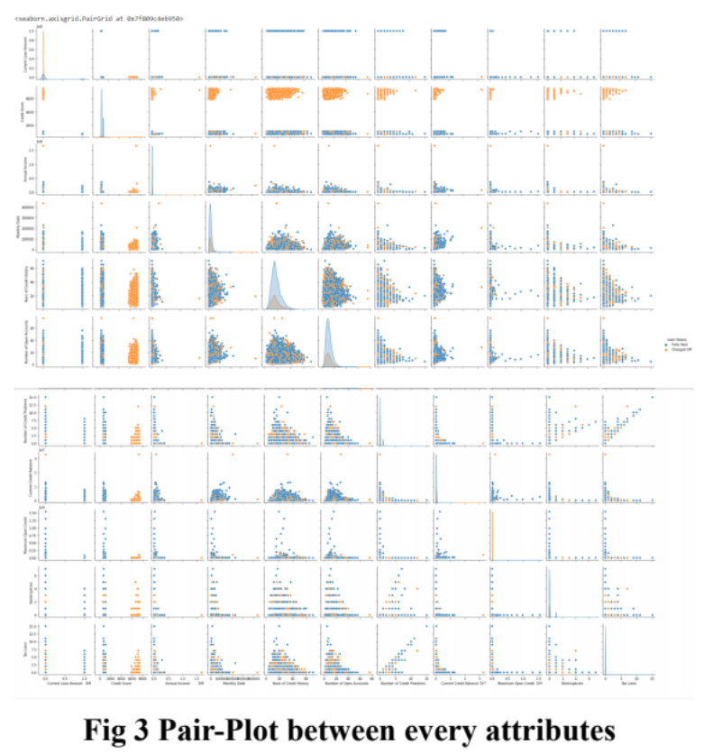
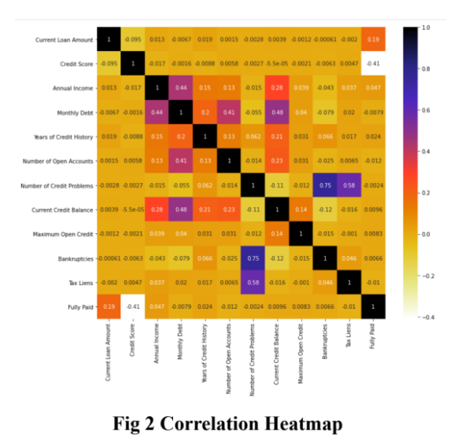
Plots

Slide 8
Checking Underfit and Overfit
For checking Underfitting and Overfitting We have plot some graph of Loss or accuracy vs epoch or iterations shown in next slide.
We have also used cross validation technique for test and train error analysis.
By comparing test and train accuracy on 5-fold of our data set.
If accuracy difference between any corresponding folds between train and test is very high than it’s not a good fit.
But we have got good results our test and train accuracy is nearly same for every model on 5-fold it means it’s not overfitting and underfitting.
Even in our graph of loss vs epoch , error vs iteration, error is decreasing smoothly it’s not increasing at any point significantly.

Slide 9
Checking Underfit and Overfit
For MLP classifiers: it’s good fit test accuracy [0.850383803923329, 0.8438748484984513, 0.8547380706558334, 0.8506980293576334, 0.8478182797629736]
train accuracy [0.8489456496122639, 0.8497985567912734, 0.8571717149045529, 0.8527276196033982, 0.8503164699016923]
For RF classifiers : its overfit as training accuracy is high enough in compare to test accuracy
test Accuracy [0.8839161466983885, 0.8770031871436909, 0.8827490236566863, 0.881806347353773, 0.8785688633506913]
train accuracy [1.0, 1.0, 1.0, 1.0, 1.0]
For XGB classifiers : it’s good fit
test accuracy [0.8783049782286664, 0.8749831664945908, 0.8781254208376352, 0.878170310185393, 0.8754713593104687]
train accuracy [0.8769569169649971, 0.8783821697509735, 0.8771701437597496, 0.8775629299606091, 0.8774071912735107]
Test and train accuracy on 5-fold for different model

Slide 10
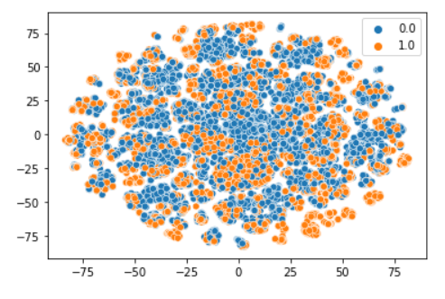
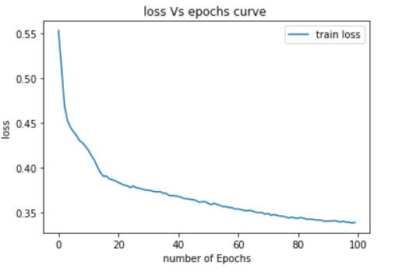
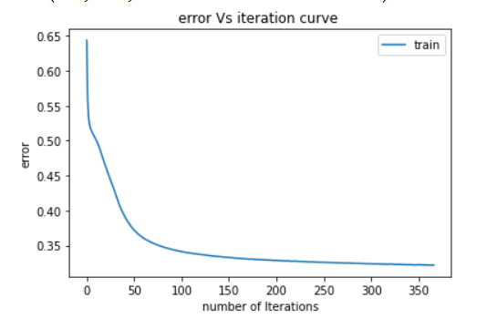
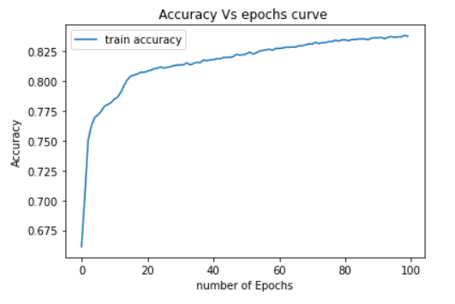
Plots
TSNE for 30000 datasets
For Sequential NN
For MLP classifier

Slide 11
Results for Different Models
Base model results and Best results that we have get after Hyperparameter tuning and error analysis.
Models | precision | recall | f1-score | AUC score | Accuracy
Logistic Regression | 0.67 | 0.76 | 0.71 | 0.6921537 | 0.6921560
MLP classifier | 0.79 | 0.98 | 0.87 | 0.85960002 | 0.8596037
Sequential NN | 0.77 | 0.97 | 0.86 | 0.8440862 | 0.8440903
Random Forest classifier | 0.82 | 0.99 | 0.90 | 0.885650 | 0.8856533
XBG classifier | 0.81 | 1.00 | 0.89 | 0.880704 | 0.8807084

Slide 12
Results after using bagging and voting classifiers
Models | precision | recall | f1-score | AUC score | Accuracy
MLP classifier | 0.80 | 0.98 | 0.88 | 0.863769 | 0.863772
Random Forest classifier | 0.82 | 0.99 | 0.90 | 0.8841954 | 0.8841989
XBG classifier | 0.81 | 1.00 | 0.89 | 0.8804784 | 0.8804822
Hard Voting | 0.81 | 0.99 | 0.89 | 0.880737 | 0.8807407
Soft Voting | 0.81 | 1.00 | 0.89 | 0.88096330 | 0.8809670

Slide 13
Result Analysis and conclusion
As we can see clearly in TSNE plot data is not linearly separable that’s why logistic regression give very bad result even after oversampling because before oversampling there is bit class imbalanced in our data.
Our data is more balanced towards label 1 that why at first the results from every model that we get is not so good our even AUC score was 0.679 for every model.
After preprocessing, oversampling tuning, bagging and using voting classifiers the best results that we have get is from model Random Forest and gradient Boosting maybe because both uses Decision Tree algorithms that’s why both shows the same results.

Slide 14
Result Analysis and conclusion
After bagging on MLP classifiers result has increased by a bit (1%) for every metric .
But in case of XBG and RF the result is still the same which is max that we have get maybe due to it’s already optimized enough after tuning.
And another reason maybe Both uses decision tree algo that’s why after bagging there is not a significant difference between their results.
Our best models are here is Random Forest and Gradient boating classifiers as they gives high precision: 0.82 , recall: 1, F1 score: 0.90, AUC SCORE: 0.8856 and Accuracy: 0.8856.

Slide 15
Thank you
Group 22

