Slide 1

THE Google File System
AND
Large-scale Incremental Processing
Using Distributed Transactions and Notifications
Sanjay Ghemawat, Howard Gobioff, Shun-Tak Leung
Frank Dabek, Daniel Peng
Presented By:-
Ankitkumar Biscuitwala
Mahesh N. Bhamre

Slide 2
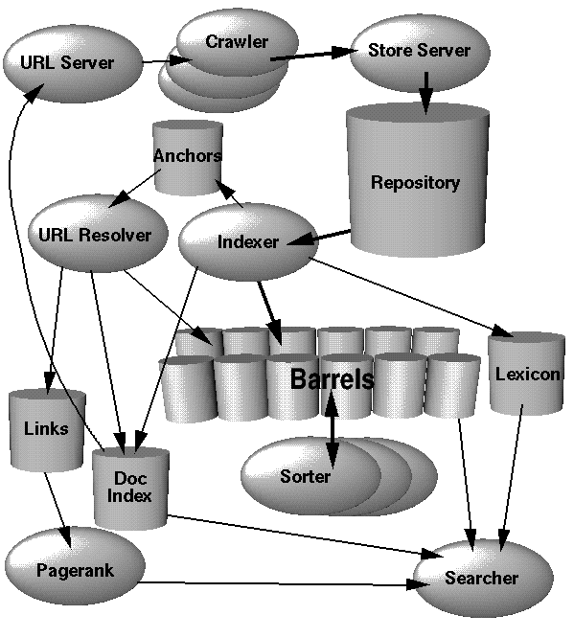
Contents
Introduction
GFS Design
Measurements
Problem: Index the Web
BigTable
Percolator
Conclusion

Slide 3
Introduction(1/2)
What is File System?
A method of storing and organizing computer files and their data.
Be used on data storage devices such as a hard disks or CD-ROMs to maintain the physical location of the files.
What is Distributed File System?
Makes it possible for multiple users on multiple machines to share files and storage resources via a computer network.
Transparency in Distributed Systems
Make distributed system as easy to use and manage as a centralized system
Give a Single-System Image
A kind of network software operating as client-server system

Slide 4
Introduction(2/2)
What is the Google File System?
A scalable distributed file system for large distributed data-intensive applications.
Shares many same goals as previous distributed file systems
performance, scalability, reliability, availability
Notes:
Storage for a LOT of REALLY large files
Across hundreds of thousands of machines
Need fast access, high availability
Soln: Google File System
Ability to run massively parallel computation jobs
SETI@home on serious steroids
Each “small” job takes thousands of CPUs at a time
Soln: MapReduce

Slide 5
Contents
Introduction
GFS Design
Measurements
Problem: Index the Web
BigTable
Percolator
Conclusion
1. Design Assumption
2. Architecture
3. Features
4. System Interactions
5. Master Operation
6. Fault Tolerance

Slide 6
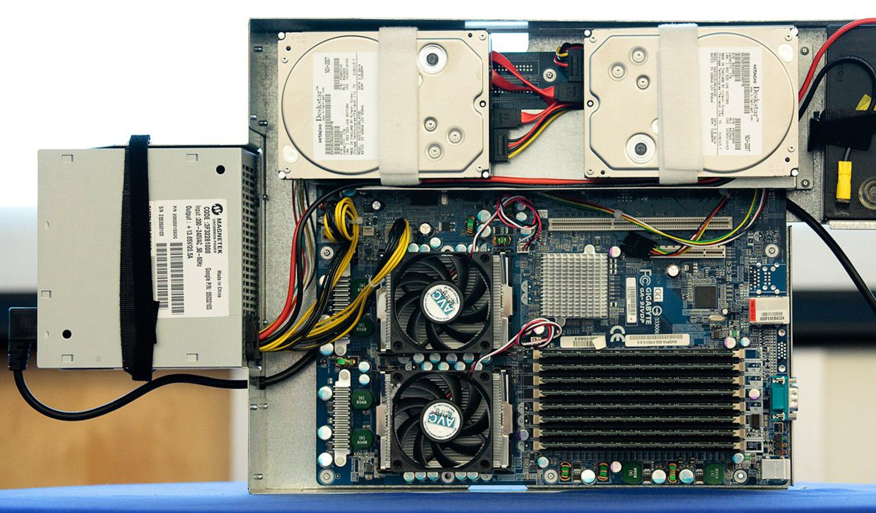
GFS Design 1. Design Assumption
Component failures are the norm
A number of cheap hardware but unreliable
Problems : application bugs, operating system bugs, human errors, and the failures of disks, memory, connectors, networking, and power supplies.
Solutions : constant monitoring,
error detection, fault tolerance,
and automatic recovery
Google Server Computer

Slide 7
GFS Design 1. Design Assumption
Files are HUGE
Multi-GB file sizes are the norm
Parameters for I/O operation and block sizes have to be revisited.
File access model: read / append only (not overwriting)
Most reads sequential
No random writes, only append to end
Data streams continuously generated by running application.
Appending becomes the focus of performance optimization and atomicity guarantees, while caching data blocks in the client loses its appeal.
Co-designing the applications and the file system API benefits the overall system
Increasing the flexibility.

Slide 8
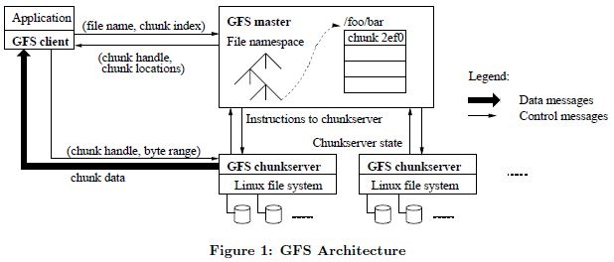
GFS Design 2. Architecture
GFS Cluster Component
1. GFS Master
2. GFS Chunkserver
3. GFS Client

Slide 9
GFS Design 2. Architecture
GFS Master
Maintains all file system metadata.
names space, access control info, file to chunk mappings, chunk (including replicas) location, etc.
Periodically communicates with chunkservers in HeartBeat messages to give instructions and check state
Helps make sophisticated chunk placement and replication decision, using global knowledge
For reading and writing, client contacts
Master to get chunk locations, then
deals directly with chunkservers
Master is not a bottleneck for reads/writes

Slide 10
GFS Design 2. Architecture
GFS Chunkserver
Files are broken into chunks.
Each chunk has a immutable globally unique 64-bit chunk-handle.
handle is assigned by the master at chunk creation
Chunk size is 64 MB (fixed-size chunk)
Each chunk is replicated on 3 (default) servers

Slide 11
GFS Design 2. Architecture
GFS Client
Linked to apps using the file system API.
Communicates with master and chunkservers for reading and writing
Master interactions only for metadata
Chunkserver interactions for data
Only caches metadata information
Data is too large to cache.

Slide 12
GFS Design 3. Features
Single Master
simplify the design
enables the master to make sophisticated chunk placement and replication decisions using global knowledge.
needs to minimize operations to prevent bottleneck
Chunk Size
block size : 64MB
Pros
reduce interactions between client and master
reduce network overhead between client and chunkserver
reduce the size of the metadata stored on the master
Cons
small file in one chunk -> hot spot

Slide 13
GFS Design 3. Features
Metadata
Type
the file and chunk namespaces
the mapping from files to chunks
the locations of each chunk’s replicas
All metadata is kept in the master’s memory (less 64bype per 64MB chunk)
For recovery, first two types are kept persistent by logging mutations to an operation log and replicated on remote machines
Periodically scan through metadata’s entire state in the background.
Chunk garbage collection, re-replication for fail, chunk migration for balancing

Slide 14
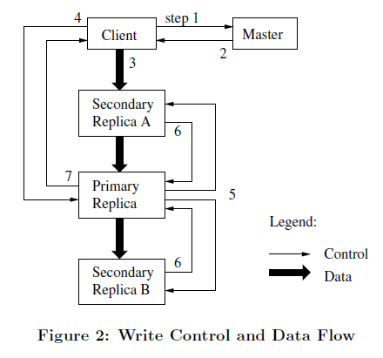
GFS Design 4. System Interactions
Client
Requests new file (1)
Master
Adds file to namespace
Selects 3 chunk servers
Designates chunk primary and grant lease
Replies to client (2)
Client
Sends data to all replicas (3)
Notifies primary when sent (4)
Primary
Writes data in order
Increment chunk version
Sequences secondary writes (5)
Secondary
Write data in sequence order
Increment chunk version
Notify primary write finished (6)
Primary
Notifies client when write finished (7)
Write Data

Slide 15
GFS Design 5. Master Operation
Replica Placement
Placement policy maximizes data reliability and network bandwidth
Spread replicas not only across machines, but also across racks
Guards against machine failures, and racks getting damaged or going offline
Reads for a chunk exploit aggregate bandwidth of multiple racks
Writes have to flow through multiple racks
tradeoff made willingly
Chunk creation
created and placed by master.
placed on chunkservers with below average disk utilization
limit number of recent “creations” on a chunkserver
with creations comes lots of writes

Slide 16
GFS Design 5. Master Operation
Garbage collection
When a client deletes a file, master logs it like other changes and changes filename to a hidden file.
Master removes files hidden for longer than 3 days when scanning file system name space
metadata is also erased
During HeartBeat messages, the chunkservers send the master a subset of its chunks, and the master tells it which files have no metadata.
Chunkserver removes these files on its own

Slide 17
GFS Design 6. Fault Tolerance
High Availability
Fast recovery
Master and chunkservers can restart in seconds
Chunk Replication
Master Replication
“shadow” masters provide read-only access when primary master is down
mutations not done until recorded on all master replicas
Data Integrity
Chunkservers use checksums to detect corrupt data
Since replicas are not bitwise identical, chunkservers maintain their own checksums
For reads, chunkserver verifies checksum before sending chunk
Update checksums during writes

Slide 18
GFS Design 6. Fault Tolerance
Master Failure
Operations Log
Persistent record of changes to master metadata
Used to replay events on failure
Replicated to multiple machines for recovery
Flushed to disk before responding to client
Checkpoint of master state at interval to keep ops log file small
Master recovery requires
Latest checkpoint file
Subsequent operations log file
Master recovery was initially a manual operation
Then automated outside of GFS to within 2 minutes
Now down to 10’s of seconds

Slide 19
GFS Design 6. Fault Tolerance
Chunk Server Failure
Heartbeats sent from chunk server to master
Master detects chunk server failure
If chunk server goes down:
Chunk replica count is decremented on master
Master re-replicates missing chunks as needed
3 chunk replicas is default (may vary)
Priority for chunks with lower replica counts
Priority for blocked clients
Throttling per cluster and chunk server
No difference in normal/abnormal termination
Chunk servers are routinely killed for maintenance

Slide 20
GFS Design 6. Fault Tolerance
Chunk Corruption
32-bit checksums
64MB chunks split into 64KB blocks
Each 64KB block has a 32-bit checksum
Chunk server maintains checksums
Checksums are optimized for appendRecord()
Verified for all reads and overwrites
Not verified during recordAppend() – only on next read
Chunk servers verify checksums when idle
If a corrupt chunk is detected:
Chunk server returns an error to the client
Master notified, replica count decremented
Master initiates new replica creation
Master tells chunk server to delete corrupted chunk

Slide 21
Contents
Introduction
GFS Design
Drawbacks
Problem: Index the Web
BigTable
Percolator
Conclusion

Slide 22
DRAWBACKS
Master can become a single point of failure.
If there exist a Hotspot then chunk server can get overloaded.
Performance of the Google File System on small reads and writes is not good enough.

Slide 23
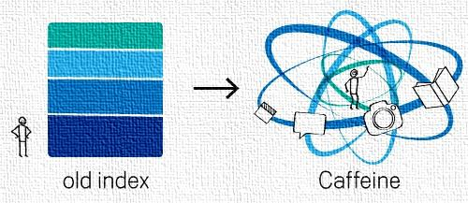
Contents
Introduction
GFS Design
Measurements
Problem: Index the Web
BigTable
Percolator
Conclusion

Slide 24
PRoBLeM: InDEX tHE WEB

Slide 25
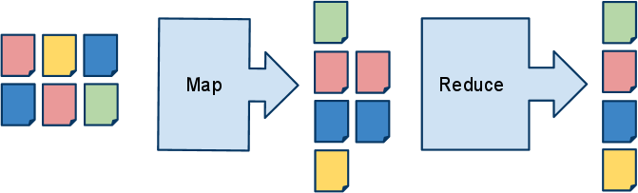

Duplicate Elimination with MapReduce
Indexing system is a chain of many MapReduces
Notes:
MapReduce makes this job easy. MapReduce is really good at the kind of clustering and aggregation operations that duplicate elimination, for example, involves.
To build an index using MR, we run the web through a series of mapreduces and the final result is a dupeliminated collection of documents ready for the final step of building the inverted index.

Slide 26
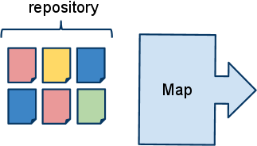

Index Refresh with MapReduce
Should we index the new document?
New doc could be a dup of any previously crawled
Requires that we map over entire repository
Notes:
Now imagine that we recrawl a small fraction of the web (something we do each day to keep our index fresh).
We need to decide if these documents should be in our index or not (dups)
It's not possible to process just the newly crawled documents (they might be dups of any document). We're forced to run the entire set of documents through our MR.
This is certainly possible: MapReduce is very scalable and we have lots of machines.
large batches make this reasonably efficient. However, it has some downsides:
- the time required to go from crawling a document to serving it is at least the time required to process the whole web.
- this means we're forced to trade off how much of the web we crawl against "freshness".

Slide 27
Indexing System Goals
What do we want from an ideal indexing system?
Large repository of documents
Upper bound on index size
Higher-quality index: e.g. more links
Small delay between crawl and index: "freshness"
MapReduce indexing system: Days from crawl to index

Slide 28
InCREMENTAL INDEXING
Maintain a random-access repository in Bigtable
Indices let us avoid a global scan
Incrementally mutate state as URLs are crawled

Slide 29
Incremental Indexing on Bigtable
URL Checksum PageRank IsCanonical?
no
nyt.com 0xabcdef01 6 yes
yes
nytimes.com 0xabcdef01 9
Checksum Canonical
0xabcdef01 nyt.com
nytimes.com
What happens if we process both URLs simultaneously?
Notes:
Here's an example of how clutering might work in an incremental system.
This example reveals a new challenge: we need to manage concurrency in t his system where it didn't exist in our mapreduce system.
Depending on the order of opeartions when a document is crawled we might fail to cluster it or even lose it entirely. We could even permanently damage our repository (lose an anchor forever, e.g.)

Slide 30
Percolator: Incremental Infrastructure
Adds distributed transactions to Bigtable
(0) Transaction t;
(1) string contents = t.Get(row, "raw", "doc");
(2) Hash h = Hash32(contents);
...
// Potential conflict with concurrent execution
(3) t.Set(h, "canonical", "dup_table", row);
...
(4) t.Commit(); // TODO: add retry logic
Simple API: Get(), Set(), Commit(), Iterate
Notes:
Percolator is the system we built to help us deal with the challenges of incremental indexing.
Percolator is built on top of bigtable which provides the random-access repository we need "for free"
To BT, Percolator adds cross-row cross-table transactions (BT only supports single-row transactios). These transactions help us maintain invariants despite concurrent updates.
Percolator also provides a way to help track which parts of the table need to be updated in response to changes. We let users register a bit of code that we call an observer. It will be called anytime a cell in a given column changes.

Slide 31
Contents
Introduction
GFS Design
Measurements
Problem: Index the Web
BigTable
Percolator
Conclusion

Slide 32
BIGTABLE BACKGROUND
Bigtable is a sorted (row, column, timestamp) store:
Data is partitioned into row ranges called tablets
Tablets spread across many machines

Slide 33
IMPLEMENTING DISTRIBUTED TRANSACTIONS
Provides snapshot isolation semantics
Multi-version protocol (mapped to Bigtable timestamps)
Two phase commit, coordinated by client
Locks stored in special Bigtable columns:

Slide 34
TRANSACTION COMMIT
Transaction t;
int a_bal = t.Get("Alice", "balance");
int b_bal = t.Get("Bob", "balance");
t.Set("Alice", "balance", a_bal + 5);
t.Set("Bob", "balance", b_bal - 5);
t.Commit();
 | Balance: data | Balance: commit | Balance: lock
Alice | 3: $10 | 4: data @3 3:
Ben | 3: $10 | 4: data @3 3:
5: $15
4:
6: data@5
5:
6:
5:lock
4:
3:
5: $5
4:
6: data@5
5:
6:
5:lock
4:
3:

Slide 35
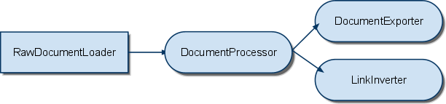
Notifications: tracking work
Users register "observers" on a column:
Executed when any row in that column is written
Each observer runs in a new transaction
Run at most once per write: "message collapsing"
Applications are structured as a series of Observers:

Slide 36
IMPLEMENTING NOTIFICATIONS
Dirty column: set if observers must be run in that row
Randomized distributed scan:
Finds pending work, runs observers in thread pool
Scan is efficient: only scans over bits themselves
No shards or work units: nothing to straggle

Slide 37
Contents
Introduction
GFS Design
Measurements
Problem: Index the Web
BigTable
Percolator
Conclusion

Slide 38
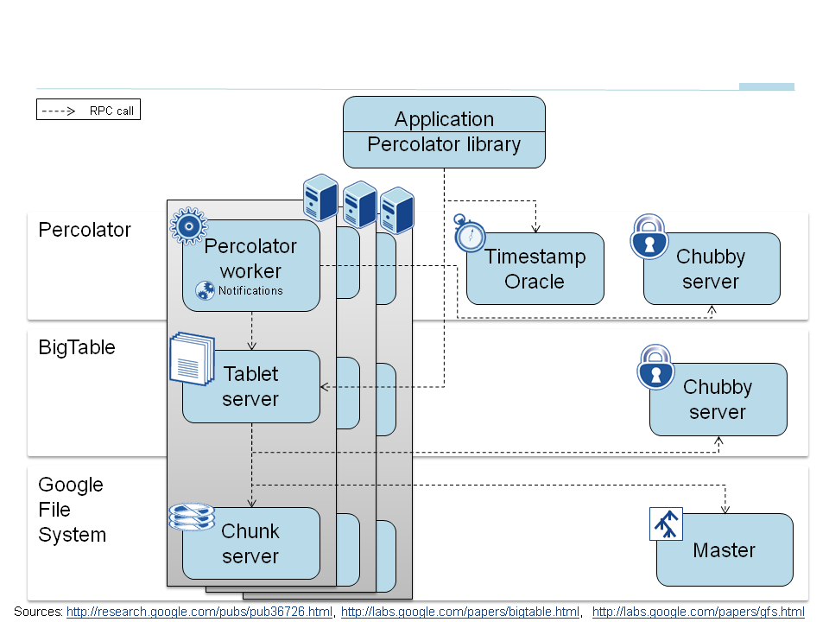
Running Percolator
Each machine runs:
Worker binary linked with observer code
Bigtable tablet server
GFS chunkserver
Notes:
Putting these features into practice, what does our system look like?
We run on each machine a TS and a worker. All of the user's code is linked into the worker binary. Percolator itself is a library.
Each _cell_ runs a timestamp oracle and a lightweight lock servcie that aids our scan for dirty notifications.

Slide 39
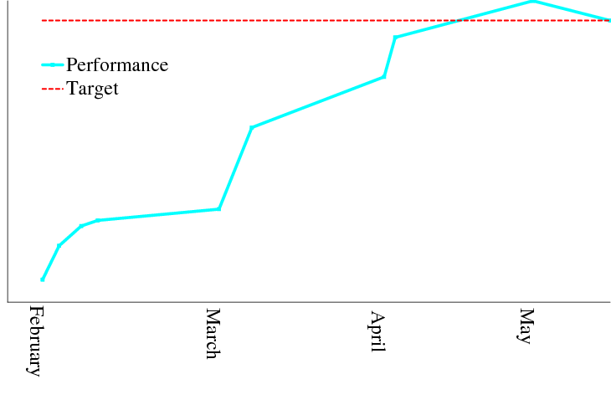
Optimizing an Incremental System
0
Notes:
You can see our paper for more details of how transactions and notifications are implemented. I thought I'd spend some time here discussion our experience with running a large, distributed system.

Slide 40
Very Different Access Patterns
Percolator:
small, random disk I/O
many RPCs per phase, per
document
MapReduce:
streaming I/O
Many documents per RPC,
per phase
Infrastructure is much better suited to the MR model.
Even though it does "extra" work, it does so very efficiently.
Notes:
Why did we struggle to make percolator work on newer, better hardware?
Access patterns are very different.

Slide 41
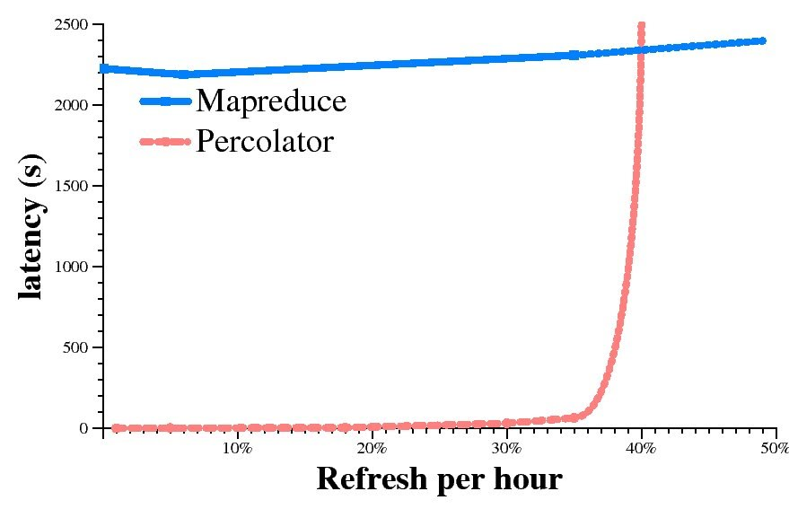

MR v. Percolator: Performance
Fraction of Repository refreshed / hour
Notes:
Here's a synhetic experiemtn designed to demonstrate h ow the different access patterns intract.
explain experiment.
left-most point
explosion of percolator

Slide 42
MAPREDUCE vS. Percolator
Google converted an MR-based pipeline to Percolator.
Pros:
Freshness: indexing delay dropped from days to minutes
Scalability:
More throughput: Just buy more CPUs
Bigger repository: Only limited by disk space
Utilization: immune to stragglers
Cons:
Need to reason about concurrency
More expensive per document processed (~2x)
Notes:
repository now 3x bigger

Slide 43
Running 1000 threads on Linux
Percolator uses a thread-per-request model:
Pros:
Application developers write "straight line" code
Meaningful stack traces: easy debugging / profiling
Easy scalability on many-core machines
Cons:
Kernel scalability: kernel locks were held while doing work on each of 1000 threads during process exit
Good detector for thread-local storage in libraries
Lock contention on, e.g., caches
Notes:
We chose a thread-per-request model. This is an old debate, but I thought I'd share our experiences.

Slide 44
Contents
Introduction
GFS Design
Measurements
Problem: Index the Web
BigTable
Percolator
Conclusion

Slide 45
Conclusion
GFS demonstrates how to support large-scale processing
workloads on commodity hardware
design to tolerate frequent component failures
optimize for huge files that are mostly appended and read
feel free to relax and extend FS interface as required
go for simple solutions (e.g., single master)
GFS2 as part of the new 2010 "Caffeine" infrastructure
1MB average file size
Distributed multi-master model
Designed to take full advantage of BigTable
Percolator now building the "Caffeine" websearch index
50% fresher results
3x larger repository
Existence proof for distributed transactions at web scale.

Slide 46
References
http://labs.google.com/papers/gfs.html
http://labs.google.com/papers/bigtable.html
http://labs.google.com/papers/mapreduce.html
http://videos.webpronews.com/2009/08/11/breaking-news-matt-cutts-explains-caffeine-update/
http://www.usenix.org/event/osdi10/tech/full_papers/Peng.pdf
http://www.usenix.org/events/osdi10/stream/peng/index.html
https://docs.google.com/present/view?id=dg2vfspf_17gx825cdd
http://googleblog.blogspot.com/2010/06/our-new-search-index-caffeine.html
http://webobserver.fr/google-percolator-caffeine-recherche-temps-reel/
http://www.searchcowboys.com/seo/1610
http://www.comparecaffeine.com/

Slide 47


Questions

