Slide 1
Sentiment Analysis with CNN
Ankit Shah
Shankar Venkataraman
14-Dec-2018
Notes:
Implementing a CNN for Text Classification in TensorFlow
In this project we have implemented a CNN model for Sentence Classification. The model presented here achieves good classification performance across a range of text classification tasks (like Sentiment Analysis) and has since become a standard baseline for new text classification architectures.

Slide 2
CNN Architecture
Data and Preprocessing The dataset we’ll use in this project is the Movie Review data from Rotten Tomatoes
The dataset contains 10,662 example review sentences, half positive and half negative. The dataset has a vocabulary of size around 20k. Note that since this data set is pretty small we’re likely to overfit with a powerful model. Also, the dataset doesn’t come with an official train/test split, so we simply use 10% of the data as a dev set.
Our code does the following:Load positive and negative sentences from the raw data files.
Clean the text data using the the code, Pad each sentence to the maximum sentence length, which turns out to be 59. We append special <PAD - 0> tokens to all other sentences to make them 59 words. Padding sentences to the same length is useful because it allows us to efficiently batch our data since each example in a batch must be of the same length. Build a vocabulary index and map each word to an integer between 0 and 18,765 (the vocabulary size). Each sentence becomes a vector of integers.

Slide 3
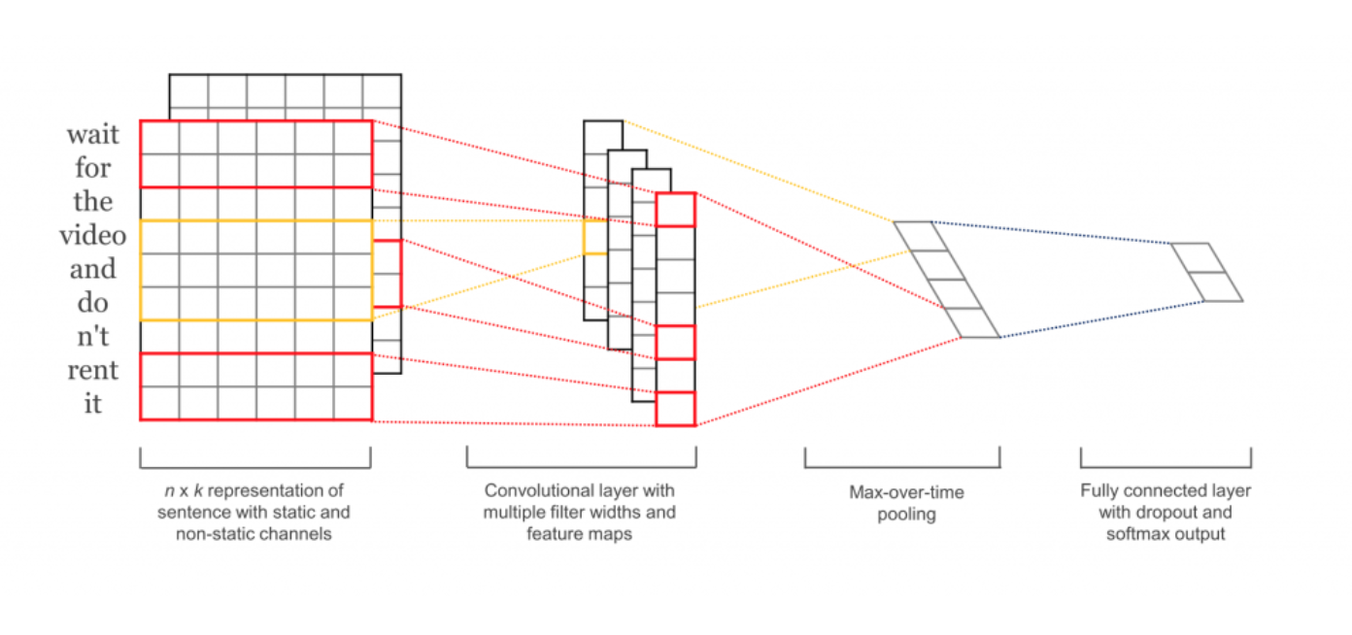
CNN Architecture
Notes:
The first layers embeds words into low-dimensional vectors.
The next layer performs convolutions over the embedded word vectors using multiple filter sizes. For example, sliding over 3, 4 or 5 words at a time.
Next, we max-pool the result of the convolutional layer into a long feature vector, add dropout regularization, and classify the result using a softmax layer.
We will not used pre-trained word2vec vectors for our word embeddings. Instead, we learn embeddings from scratch.
We will not enforce L2 norm constraints on the weight vectors. A Sensitivity Analysis of (and Practitioners’ Guide to) Convolutional Neural Networks for Sentence Classification found that the constraints had little effect on the end result.
The original paper experiments with two input data channels – static and non-static word vectors. We used both
Because each convolution produces tensors of different shapes we need to iterate through them, create a layer for each of them, and then merge the results into one big feature vector.

Slide 4
CNN Architecture
Word Embeddings | Word Embedding Width | Filters | Filter Span over Words
Randomly initialized | 128 | 64, 128 | 3, 4, 5
Word2vec built from dataset, Static | 128 | 64, 128 | 3, 4, 5
Word2vec built from dataset, Non-Static | 128 | 64, 128 | 3, 4, 5
GloVe, Wikipedia 400K vocabulary, Static | 100 | 64, 128 | 3, 4, 5
Input Layer with a Maximum of 56 words
Single Convolutional Layer, RelU, Max Pooling
Max pooling followed by Fully connected layer (64x3 or 128x3 nodes)
Dropout regularization with dropout rate 50%
Dataset: Movie reviews, 5331 positive and 5331 negative reviews, 18758 words Training/Test: 9596/1066 (90%/10%)
Notes:
embedding_size – The dimensionality of our embeddings.
num_filters – The number of filters per filter size (see above).
filter_sizes – The number of words we want our convolutional filters to cover. We will have num_filters for each size specified here. For example, [3, 4, 5] means that we will have filters that slide over 3, 4 and 5 words respectively, for a total of 3 * num_filters filters.

Slide 5
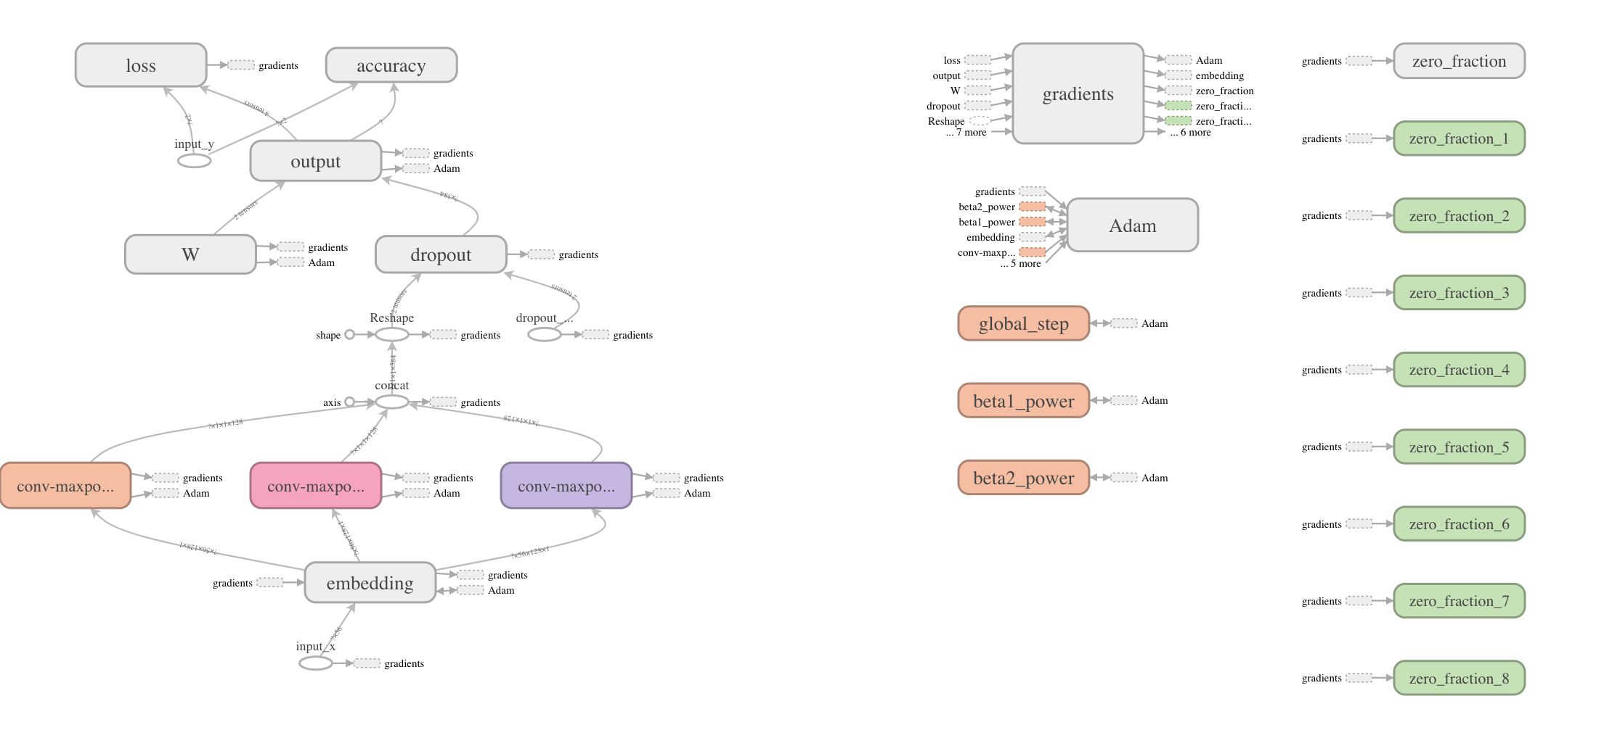
CNN Architecture Graph

Slide 6
Performance
Structure | Accuracy on Test Set | Run time
Random embedding, 64 filters | 0.725141 | 45 minutes
Random embedding, 128 filters | 0.733584 | 56 minutes
W2v embedding, non-static, 64 filters | 0.759850 | 50 minutes (includes w2v build)
W2v embedding, non-static, 128 filters | 0.761726 | 56 minutes (includes w2v build)
W2v embedding, static, 64 filters | 0.745779 | 20 minutes (includes w2v build)
W2v embedding, static, 128 filters | 0.738274 | 26 minutes (includes w2v build)
GloVE embedding, static, 64 filters | 0.737336 | 14 minutes
GloVE embedding, static, 128 filters | 0.740150 | 19 minutes
Not showing accuracy on training set. They all are between 0.98 and 1.0 (overfitting?)
Vectors corresponding to 1151 missing words in GloVE were set to 0
GloVE, static, 64 filters Amazon+IMDB+Yelp | 0.853333 | 05 minutes
GloVE, static, 128 filters Amazon+IMDB+Yelp | 0.865000 | 07 minutes
Notes:
Word 2 vec matrix is constructed using different algorightm for Glove – implemented by standford

Slide 7
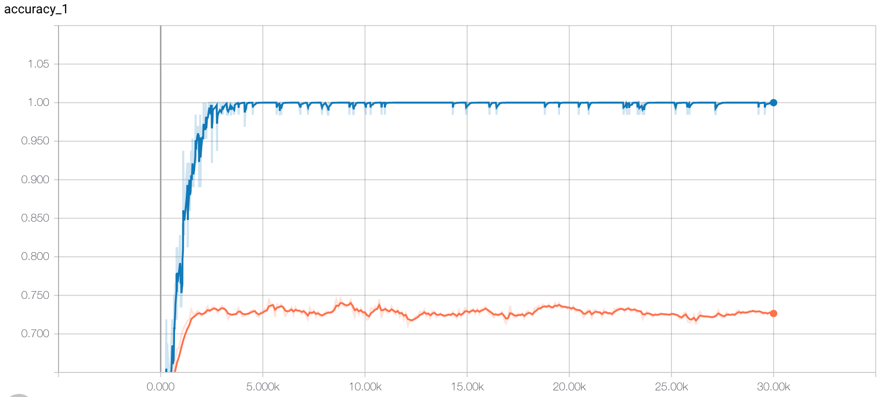
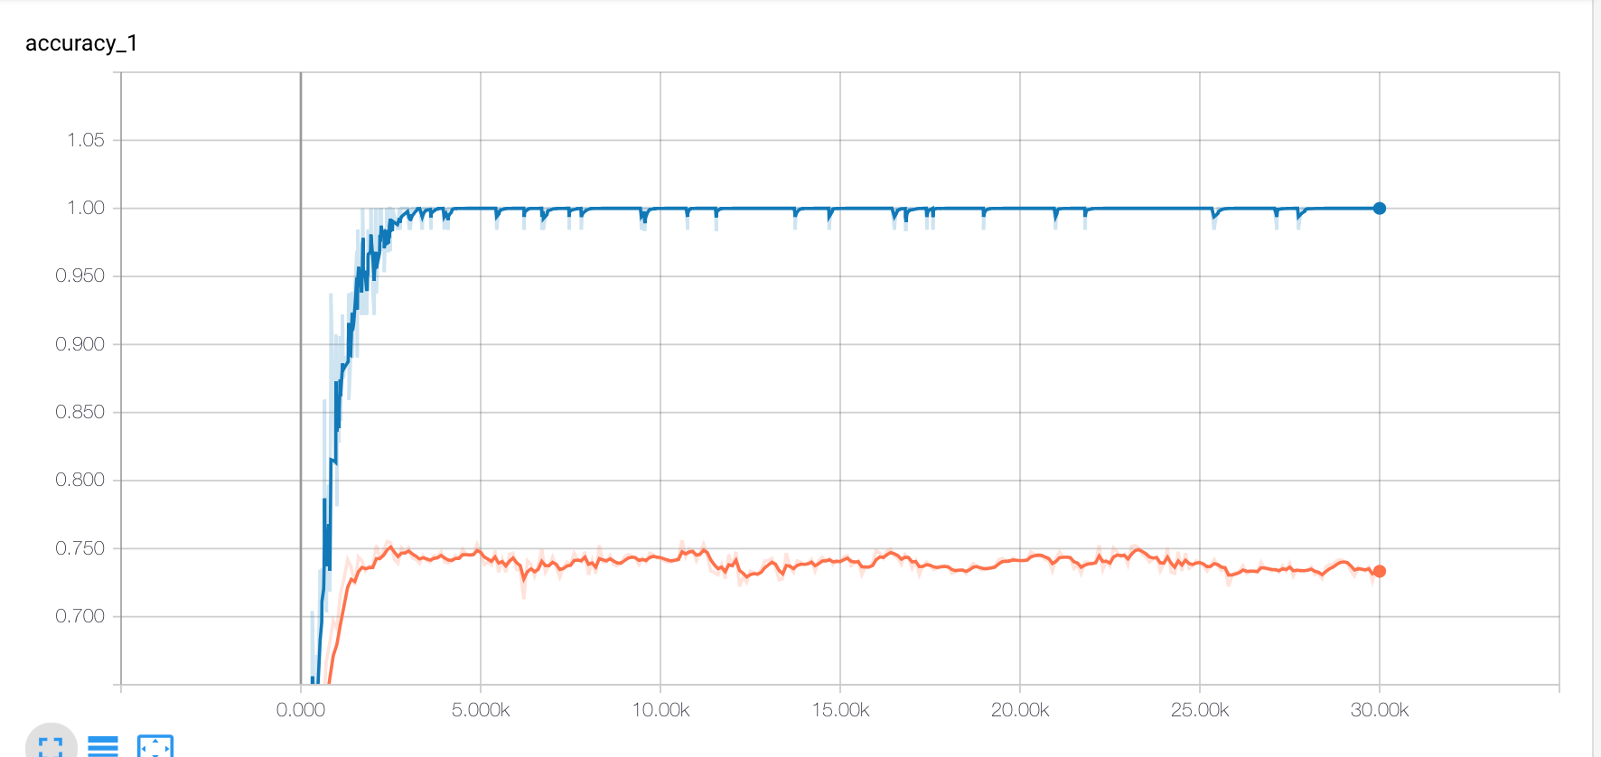
Embedding, Random Initialization: 64, 128

Slide 8
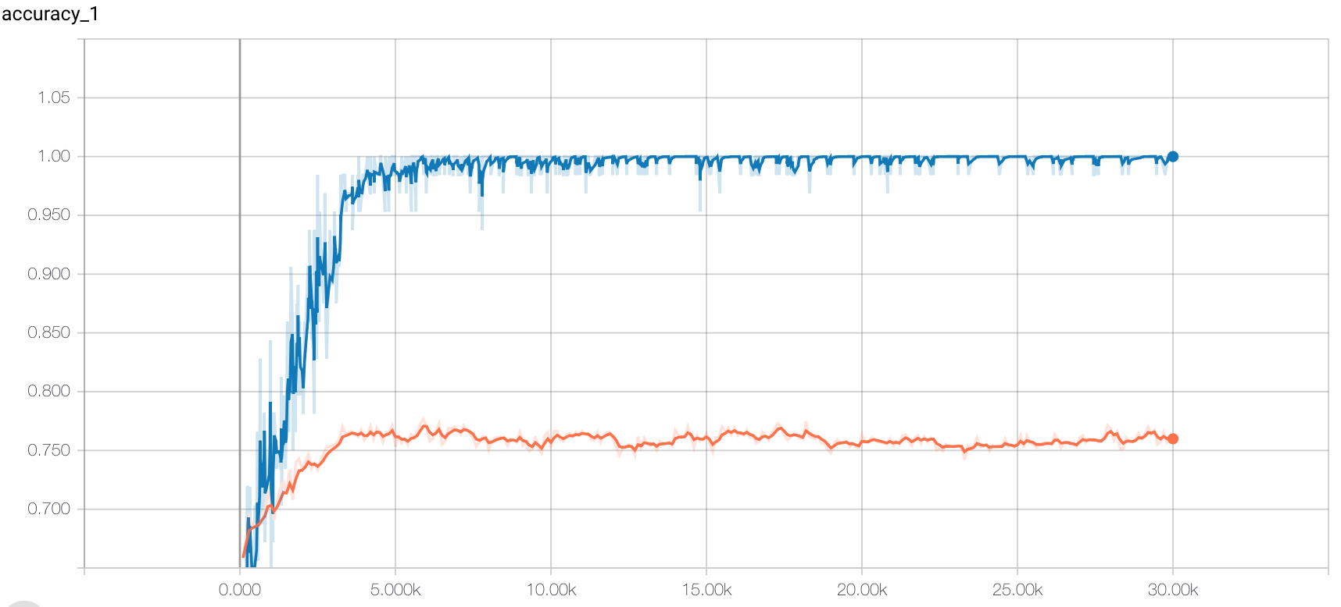
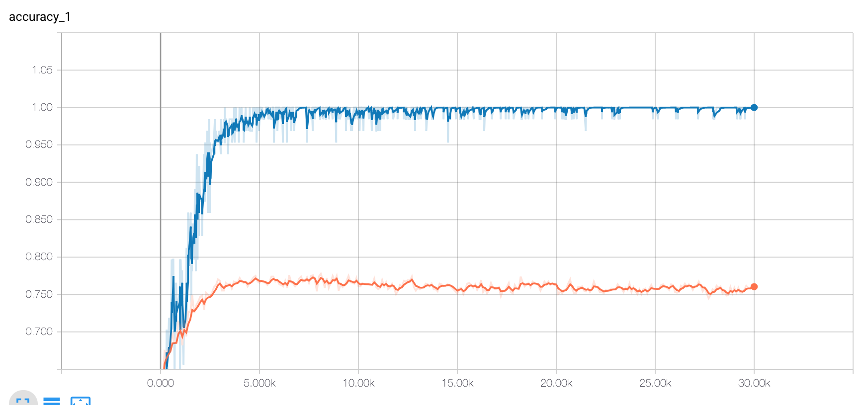
Word2vec Non-Static Embedding (Fine tuned): 64, 128

Slide 9
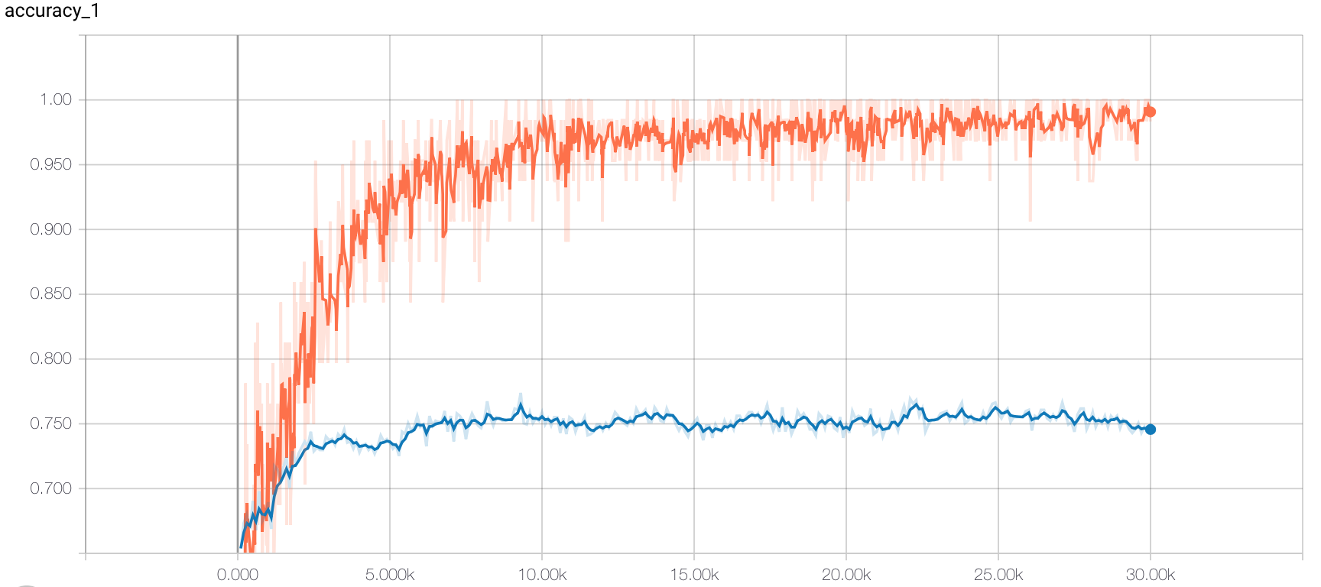
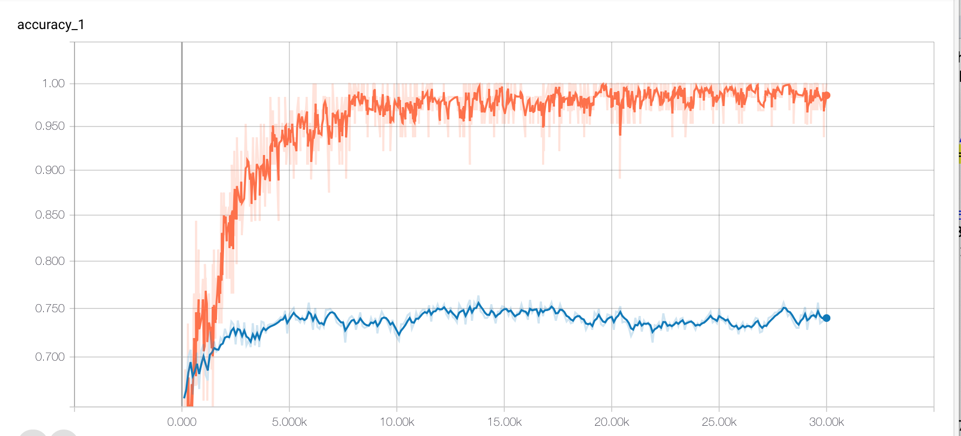
Word2vec Static Embedding: 64, 128

Slide 10
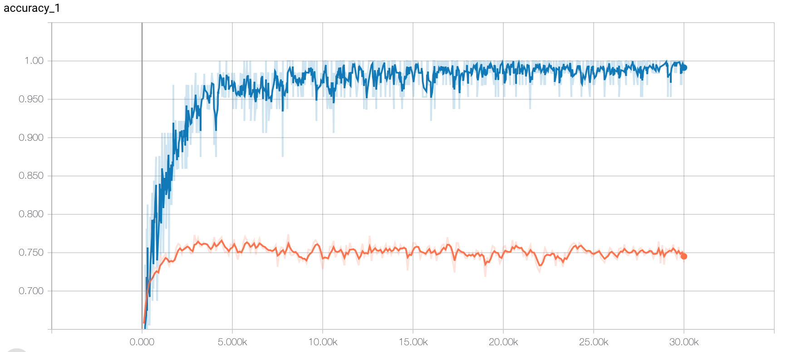
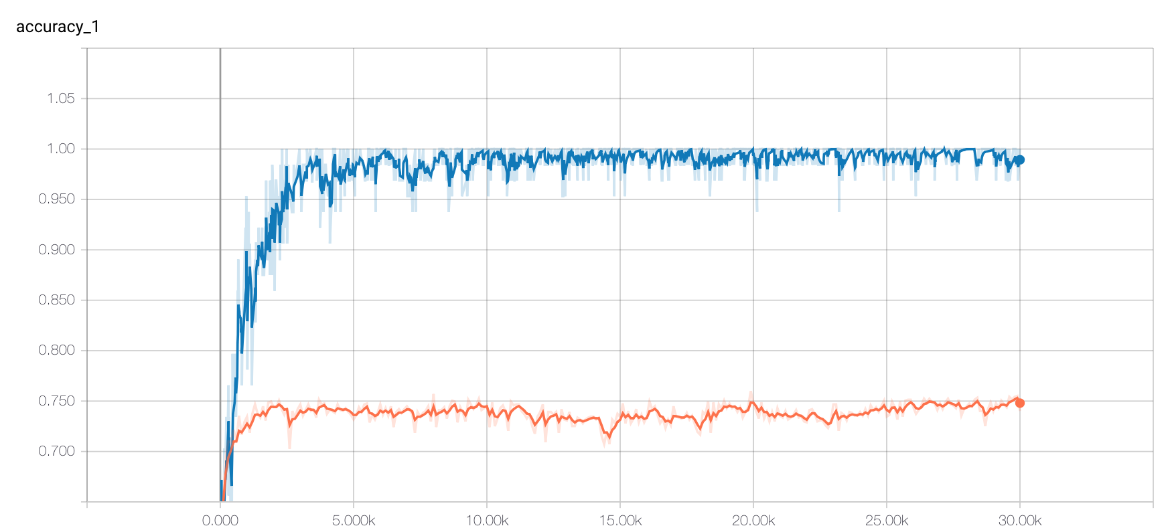
GloVE Static Embedding: 64,128

Slide 11
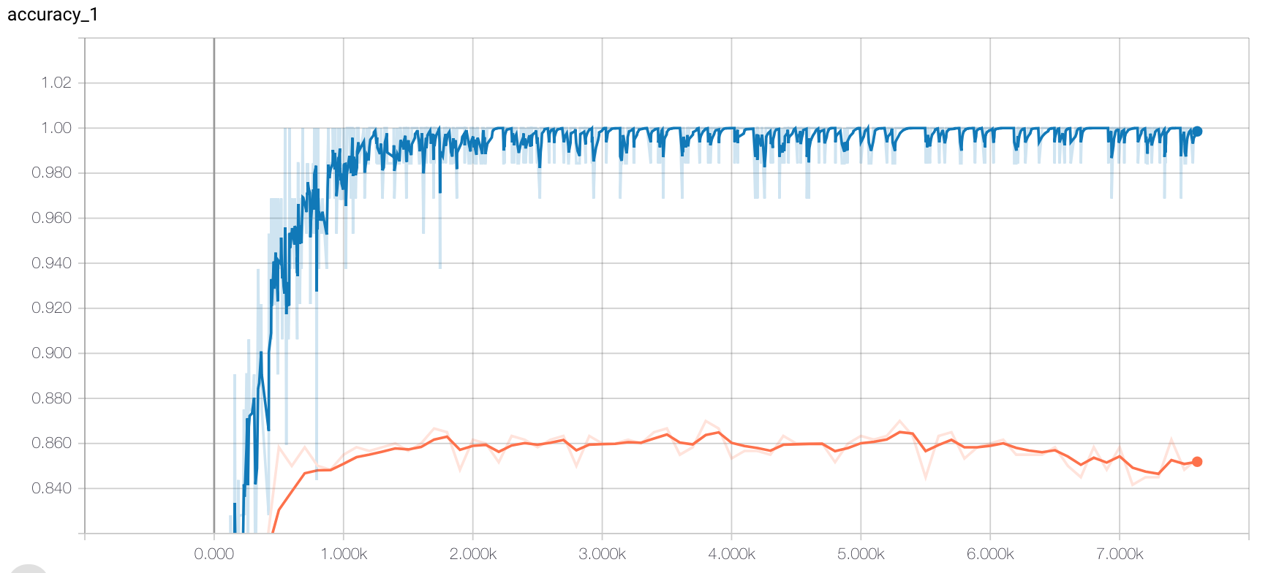
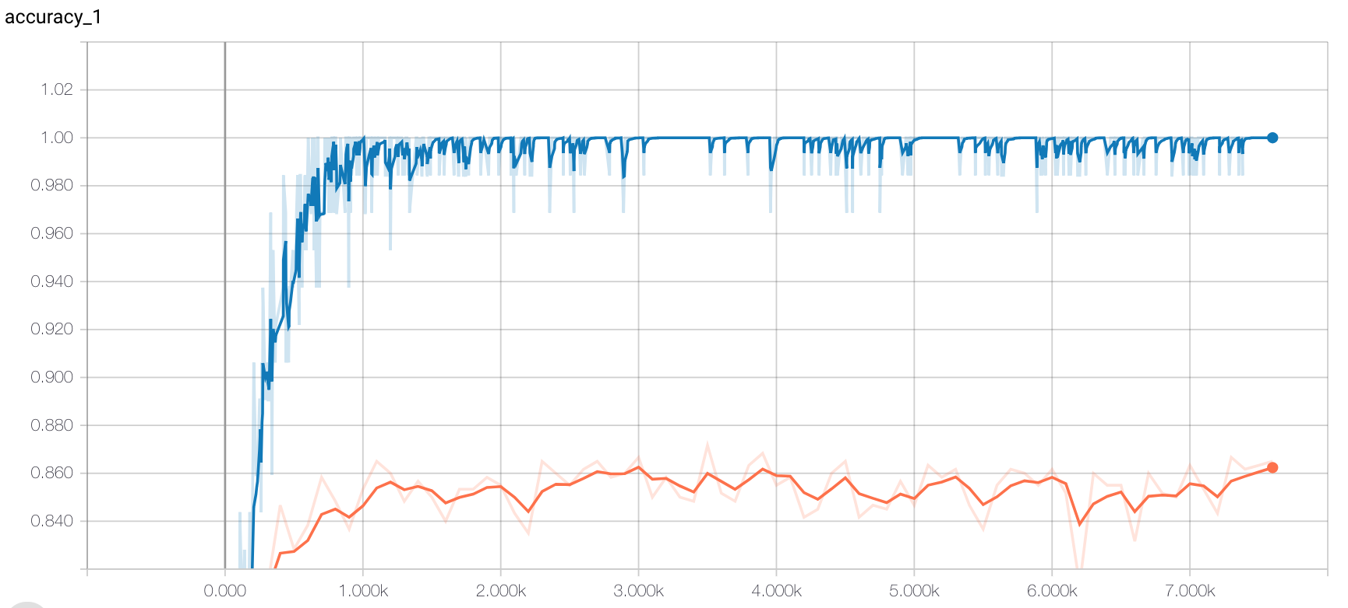
GloVE Static Embedding: 64,128 Amzn+IMDB+Yelp
3000 reviews, 1500 positive, 1500 negative. Sentence length 81 words, 100 dimensional embedding
5188 words in Vocabulary, of which 4995 present in GloVE. Missing 193 words set to 0 vectors.

Slide 12
Performance
Structure | Accuracy on Test Set | Run time
Random embedding, 64 filters | 0.725141 | 45 minutes
Random embedding, 128 filters | 0.733584 | 56 minutes
W2v embedding, non-static, 64 filters | 0.759850 | 50 minutes (includes w2v build)
W2v embedding, non-static, 128 filters | 0.761726 | 56 minutes (includes w2v build)
W2v embedding, static, 64 filters | 0.745779 | 20 minutes (includes w2v build)
W2v embedding, static, 128 filters | 0.738274 | 26 minutes (includes w2v build)
GloVE embedding, static, 64 filters | 0.737336 | 14 minutes
GloVE embedding, static, 128 filters | 0.740150 | 19 minutes
Not showing accuracy on training set. They all are between 0.98 and 1.0 (overfitting?)
Vectors corresponding to 1151 missing words in GloVE were set to 0
GloVE, static, 64 filters Amazon+IMDB+Yelp | 0.853333 | 05 minutes
GloVE, static, 128 filters Amazon+IMDB+Yelp | 0.865000 | 07 minutes

Slide 13
References
Word2vec: Tomas Mikolov et al: Efficient Estimation of Word Representations in Vector Space, Tomas Mikolov et al: Distributed Representations of Words and Phrases and their Compositionality.
Gensim: Topic modeling for Humans (https://radimrehurek.com/gensim/index.html)
Blog: Denny Britz, Implementing a CNN for Text Classification in Tensorflow (http://www.wildml.com/2015/12/implementing-a-cnn-for-text-classification-in-tensorflow)
Conference Paper: Kim Yoon, Convolutional Neural Networks for Sentence Classification, Sep 2014.
Conference Paper: Y. Zhang and B. C. Wallace, A Sensitivity Analysis of (and Practitioners’ Guide to) Convolutional Neural Networks for Sentence Classification, Sep 2016
GloVE: Global Vectors for Word Representation, pre-trained word vectors (http://nlp.stanford.edu/data/glove.6B.zip)

