Slide 1
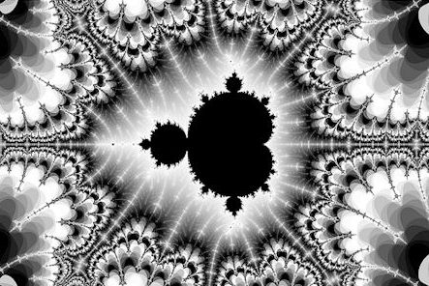
Pattern Discovery in Financial Markets using Fractals
Ankit Gupta
MIAF 2016

Slide 2
Agenda
GBM - Limitations
Current limitations under Geometric Brownian Motion
Fractals
A brief primer on Fractals introducing certain key properties
MMAR
Introduction to Trading Time and Multifractal Model of Asset returns (MMAR)
Pattern Discovery
Search for Multifractality in S&P500 and forecast the series
Image Source (Title page): Black and White Fractals that capture Creativity, Smashing Magazine

Slide 3
Agenda
GBM - Limitations
Current limitations under Geometric Brownian Motion
Fractals
A brief primer on Fractals introducing certain key properties
MMAR
Introduction to Trading Time and Multifractal Model of Asset returns (MMAR)
Pattern Discovery
Search for Multifractality in S&P500 and forecast the series

Slide 4
Brownian Motion and Limitations
A Normal distribution?
‘87 Crash: 23 sigma event
‘08 Financial crisis: 9 sigma event
June ‘16 Brexit: 18 sigma event (USDGBP pair)
Certain characteristics have been frequently displayed by market behavior, however Normal distribution is unable to justify those features.
fat tails (‘acts of God’)
Long range dependency
2008 Financial crisis
Data Source: Bloomberg.

Slide 5
Agenda
GBM - Limitations
Current limitations under Geometric Brownian Motion
Fractals
A brief primer on Fractals introducing certain key properties
MMAR
Introduction to Trading Time and Multifractal Model of Asset returns (MMAR)
Pattern Discovery
Search for Multifractality in S&P500 and forecast the series

Slide 6
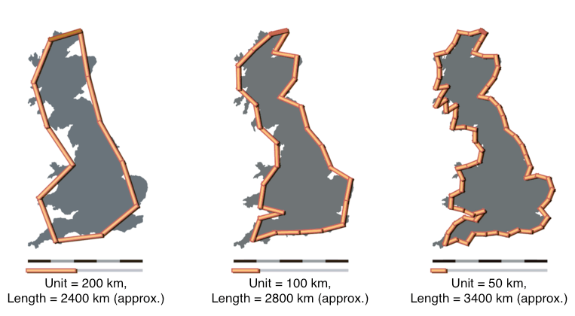

Fractals?
Scaling Law
Fractal Dimensions
Coastline Paradox…
What is the length of the coastline of Britain?
Can this be answered accurately using Euclidean space?
Change the scale of measurement, the length changes…
Leads to the concept of Scaling and Fractal dimension.
where, D → Fractal Dimension
N → number of sticks required (of a particular scale)
ε → the measure of the scale
Image Source: Wikipedia (’Fractal Dimensions’)
Notes:
A repetitive pattern that is displayed at every scale. These Patterns exhibit:
Self similarity (or self affinity)
Scale consistency
Fractal Dimensions
Long range dependencies

Slide 7


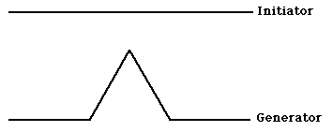

Fractals?
Scaling Law
Fractal Dimensions
Fractal & Dimension
Initiator/ Generator
Final Fractal
Cantor Dust
D_{f} = 0.63
Koch Curve
D_{f} = 1.26
Image Source: Fractal and Fractal Dimensions, Vanderbilt

Slide 8
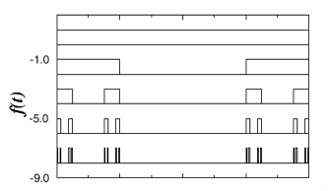
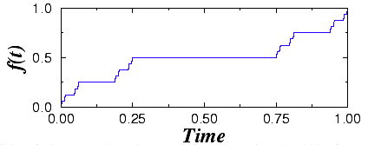
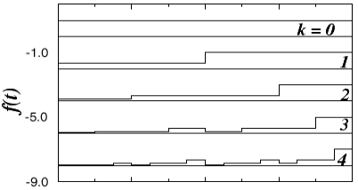
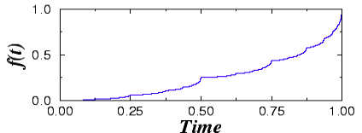
Unifractals Vs Multifractals
Unifractals
Multifractals
Fractal dimension remains constant throughout the structure
Fails to address the issue of fat tails
A random and stochastic fractal dimension
Addresses Fat tails properly
Lets consider a Cantor set with D_{f}= 0.5 (constant)
Lets consider a Binomial cascade (increments with binomial distribution at every stage)
Singularities of same magnitude (D_{f}=0.5), appearing at regular interval
Complexities of varying magnitude as defined by a Binomial distribution, giving rise to fat and long tails
Source: https://www.physionet.org/tutorials/multifractal/behavior.htm

Slide 9
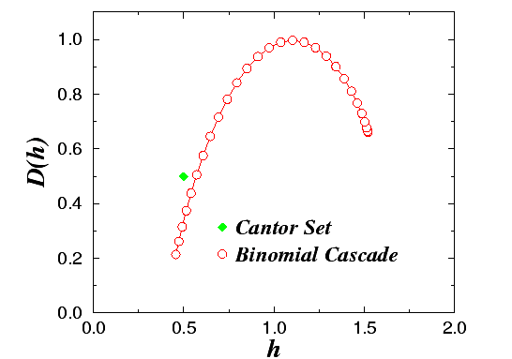
Multifractal Spectrum (Singularity Spectrum)
Unifractals
Multifractals
Constant Fractal Dimension (D_{f}).
Only a point on the Spectrum
Multitudes of Singularities (Complexities) in time series
Leading to a curve on the spectrum
Image Source: https://www.physionet.org/tutorials/multifractal/behavior.htm

Slide 10
Agenda
GBM - Limitations
Current limitations under Geometric Brownian Motion
Fractals
A Brief primer on Fractals introducing certain key properties
MMAR
Introduction to the Trading Time and Multifractal Model of Asset returns (MMAR)
Pattern Discovery
Search for Multifractality in S&P500 and forecast the series

Slide 11
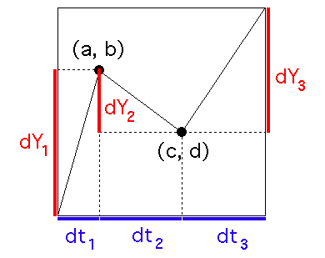
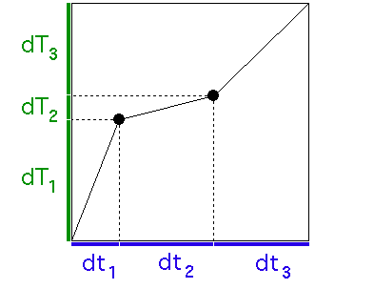
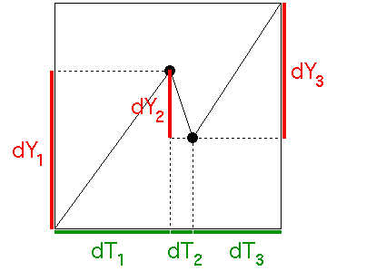
Trading Time – same as Clock Time?
The idea is to fast forward the bearish times, and slow down the bullish market
1
2
3
Price (Y) vs Clock Time (t)
Trading Time (T) vs Clock Time (t)
Price (Y) vs Trading Time (T)
1
Plot usual Price Graph
2
Convert Clock Time to Trading Time
(using Scaling Law)
3
Plot Price Graph against Trading Time. Times of Bullish market slowed down, and Bearish markets fast forwarded
Image Source: Fractal Geometry, Yale University http://users.math.yale.edu/public_html/People/frame/Fractals/

Slide 12
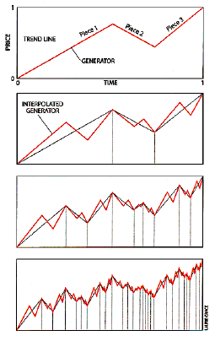
Random MultiFractal Walk down the Wall Street
Can we construct a Financial Time series using Fractals?
Start with trend line and a generator with 3 pieces (upwards and downwards) In 2nd iteration, the individual pieces represent the trend line. Interpolate the generator onto them Repeat this process over and over again, and it ends up similar to a Financial Time series, albeit Unifractality in characteristics since generator remains same at every iteration.
1
2
3
Is this what we see in the markets? Or is there something more to it?
Generation of Time series using Fractals
Image Source: “A Multifractal Walk Down Wall Street”, Benoit B. Mandelbrot

Slide 13
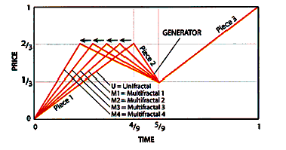
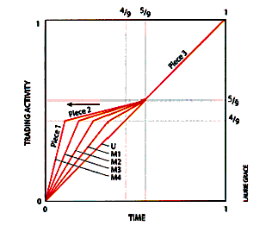
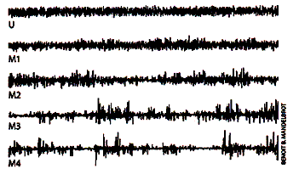
Random MultiFractal Walk down the Wall Street
Introducing the essence of Volatility, which leads to MultiFractals
1
2
3
1
Shorten the time period for first piece, denoting high market activity during that time.
2
Shifts in the generator causes market activity to become highly volatile.
3
Simulated Time series for different levels of ‘Volatility’
Image Source: “A Multifractal Walk Down Wall Street”, Benoit B. Mandelbrot

Slide 14
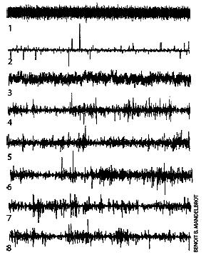
Pop Quiz Time!
On the left are some graphs of price changes.
Some are real data, some are artificially made time series
Label the graphs accordingly.
Various Processes included:
Real market Data: IBM Price return & USD-Deutschmark price return
Multifractal generated Data: 3 plots generated
Geometric Brownian Motion: (Random walk)
Levy Stable Motion (main characteristic: Fat tails)
Fractional Brownian Motion (main characteristic: Long range dependence)
Image and Quiz Source: “A Multifractal Walk Down Wall Street”, Benoit B. Mandelbrot Answer in the Appendix

Slide 15


Multifractal Model of Asset Returns (MMAR)
Development
Simulation
Concept of Scaling Law , Multifractality, Trading Time, Singularity Spectrum leads to the developments of MMAR
Let P(t)define daily Price levels and X(t) define the cumulative daily log returns
X(t) can be expressed as a Compound process of fractional Brownian Motion and a Multifractal process
B_{H}(t) → Fractional Brownian Motion (a stochastic process) with self affinity Index H ϴ(t) → Trading Time (a stochastic process) which exhibits Multifractality t → Clock time
Price return vs Clock Time
Price return vs Trading Time
Source: “Large Deviations and the Distribution of Price Changes”, CFM Image Source: Fractal Geometry, Yale University, Mathematics department

Slide 16
Multifractal Model of Asset Returns (MMAR)
Development
Simulation
Discovery
Forecasting
Discover Fractality: Check for Scaling Law
Unifractals or Multifractals: Identify Singularity Spectrum
Extract Multifractal Components
Construct Trading Time
Generate fractional Brownian Motion Time series
Compound the fBM series with Trading time
Component | Description | How to obtain?
H | Self – affinity Index required for the fBM series | Using Scaling function
α₀ | Signifies the most common Fractal dimension for the singularity | Multifractal spectrum
λ | Mean for the lognormal cascade (required for the Trading time) | Formula based
σ² | Variance for the lognormal cascade | Formula based
Notes:
Need to add how the components are extracted

Slide 17
Agenda
GBM - Limitations
Current limitations under Geometric Brownian Motion
Fractals
A Brief primer on Fractals introducing certain key properties
MMAR
Introduction to Trading Time and Multifractal Model of Asset returns (MMAR)
Pattern Discovery
Search for Multifractality in S&P500 and forecast the series

Slide 18
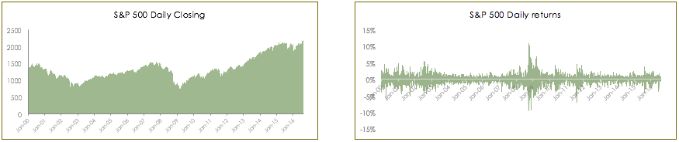
S&P500 – Dataset
Label | Date | Level |  | Label | Value | Sigma (σ)
Start | 3 Jan 2000 | 1455.22 |  | Avg daily return | 0.01% | -
End | 19 Aug 2016 | 2183.87 |  | Avg daily volatility | 1.25% | -
Maximum | 15 Aug 2016 | 2190.15 |  | Max return | 10.96% | 8.72
Minimum | 9 Mar 2009 | 676.53 |  | Min return | -9.47% | -7.55
Data Source: Bloomberg

Slide 19
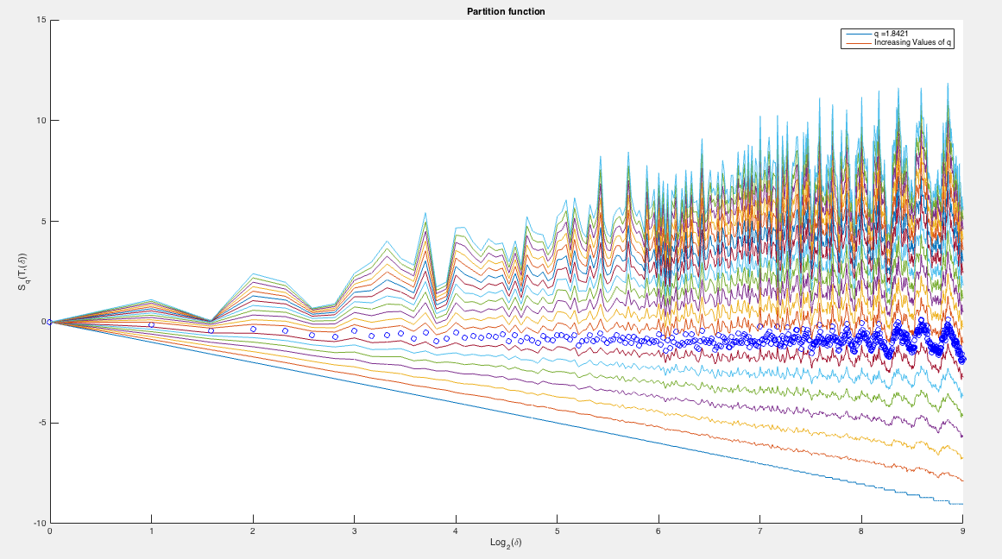
Discovery?
Discover Fracatlity
Unifractals vs Multifractals
Multifractal Components
Increasing values of q
(moments)
Plotted using Matlab Toolbox – Proprietary model

Slide 20
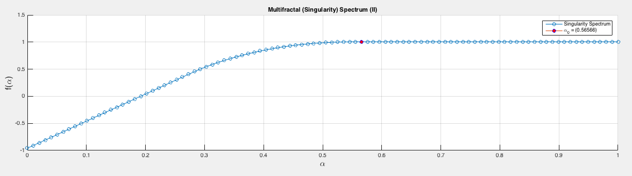
Discovery?
Discover Fracatlity
Unifractals or Multifractals
Multifractal Components
α₀ = 0.5657
Plotted using Matlab Toolbox – Proprietary model

Slide 21
Discovery?
Discover Fracatlity
Unifractals vs Multifractals
Multifractal Components
Component | Value | Description
H | 0.4717 | Self – affinity Index required for the fBM series
α₀ | 0.5657 | Signifies the most common Fractal dimension for the singularity
λ | 1.1993 | Mean for the lognormal cascade (required for the Trading time)
σ² | 0.3628 | Variance for the lognormal cascade
Calculated using Matlab Toolbox – Proprietary model

Slide 22
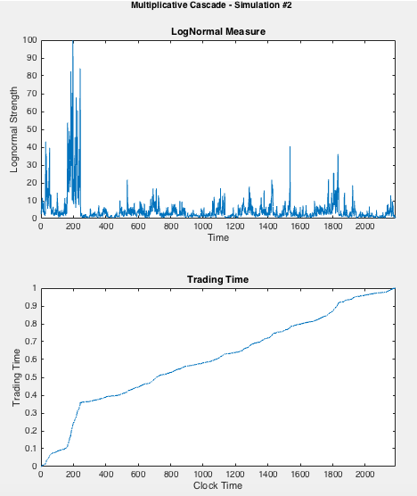
Forecasting Time Series
Trading Time
Compounded Return series
Comparison
Trading time generated using Multiplicative Cascades exhibiting lognormal characteristics
As can be seen in the 2nd plot, Trading time slows down the volatile times, and fast forwards the bearish moments
Multiple simulations performed using Monte Carlo
Plotted using Matlab Toolbox, Proprietary Model

Slide 23
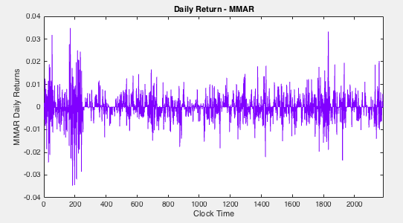
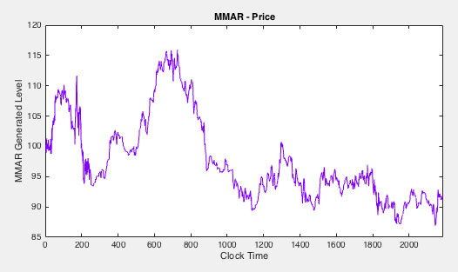
Forecasting Time Series
Trading Time
Compounded Return series
Comparison
Plotted using Matlab Toolbox, Proprietary Model

Slide 24
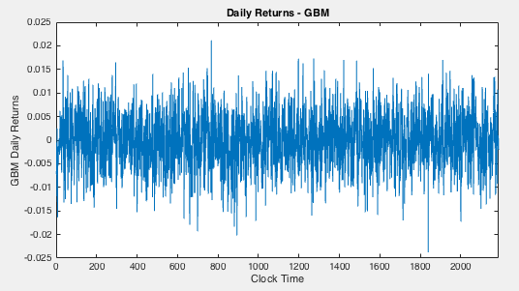
Forecasting Time Series
Trading Time
Compounded Return series
Comparison
Plotted using Matlab Toolbox, Proprietary Model
Notes:
A remarkable difference between 2 models’ price returns. A high volatility and spikes in MMAR is clearly visible

Slide 25
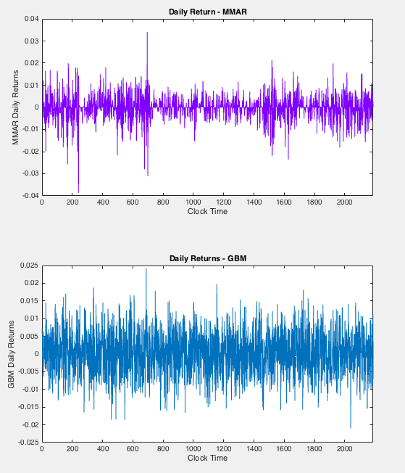
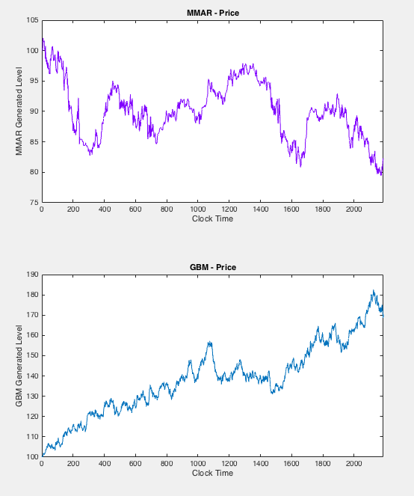
More Simulations…
Simulation 2
Simulation 3
Plotted using Matlab Toolbox, Proprietary Model

Slide 26
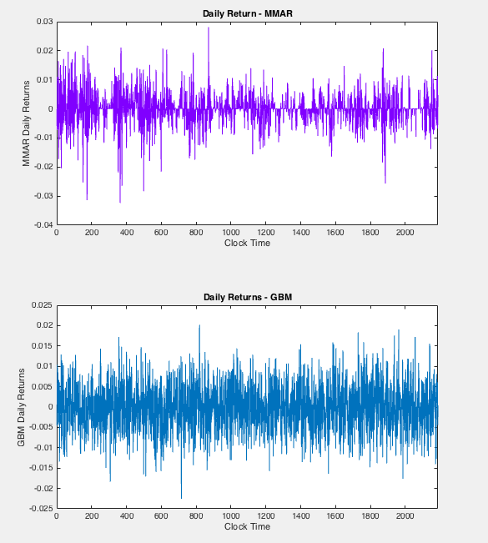
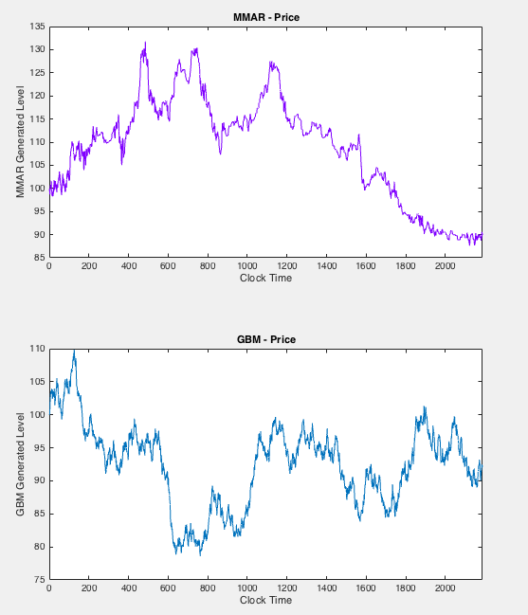
More Simulations…
Simulation 2
Simulation 3
Plotted using Matlab Toolbox, Proprietary Model

Slide 27

So…Multifractality?

Slide 28
Concluding remarks
In the observed period, SP500 had fatty tails, which are far from a Normal behavior
✓
However, the time series is a clear example of Multifractal, and exhibits Multifractal characterisics
✓
Simulated MMAR price series present more similarities to the financial market returns than Geometric Brownian Motion
✓
Potential for improved Pricing models, new Trading strategies (cross asset or factor based models)
✓

Slide 29
?

Slide 30
Appendix

Slide 31
1. Answers to Pop Quiz
Random Walk (Geometric Brownian Motion)
Levy Stable Motion (Fatty Tails)
Fractional Brownian Motion (Long range dependency)
Multifractal Model generated Returns
Market Data (IBM Stock)
Market Data (USD-Deutschmark)
Multifractal Model generated Returns
Multifractal Model generated Returns

