Slide 1
Artificial Neural Networks
Threshold units
Gradient descent
Multilayer networks
Backpropagation
Hidden layer representations
Example: Face recognition
Advanced topics

Slide 2
Connectionist Models
Consider humans
Neuron switching time ~.001 second
Number of neurons ~10¹⁰
Connections per neuron ~10⁴⁻⁵
Scene recognition time ~.1 second
100 inference step does not seem like enough
must use lots of parallel computation!
Properties of artificial neural nets (ANNs):
Many neuron-like threshold switching units
Many weighted interconnections among units
Highly parallel, distributed process
Emphasis on tuning weights automatically

Slide 3
When to Consider Neural Networks
Input is high-dimensional discrete or real-valued (e.g., raw sensor input)
Output is discrete or real valued
Output is a vector of values
Possibly noisy data
Form of target function is unknown
Human readability of result is unimportant
Examples:
Speech phoneme recognition [Waibel]
Image classification [Kanade, Baluja, Rowley]
Financial prediction

Slide 4
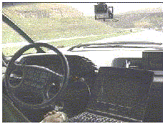
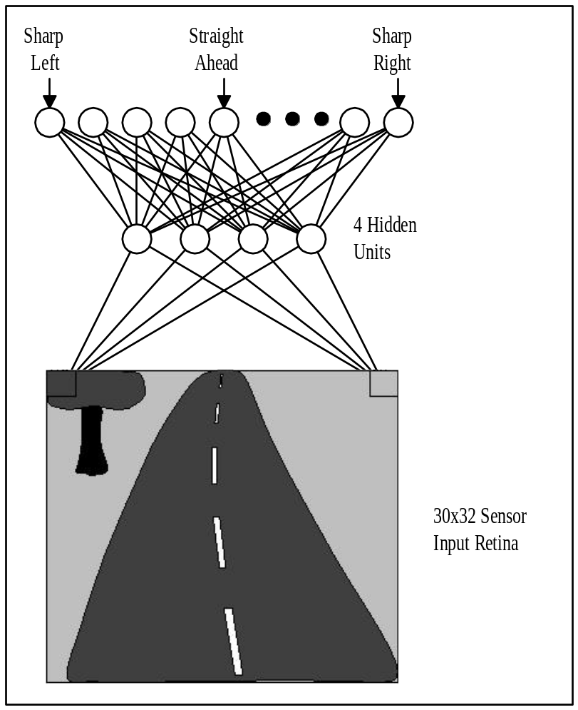
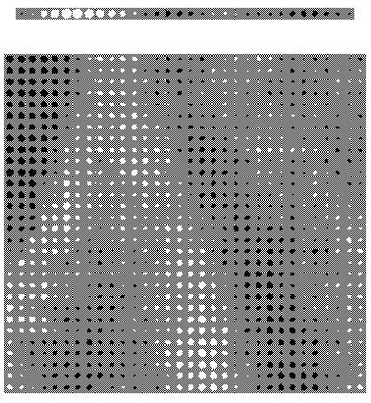
ALVINN drives 70 mph on highways

Slide 5
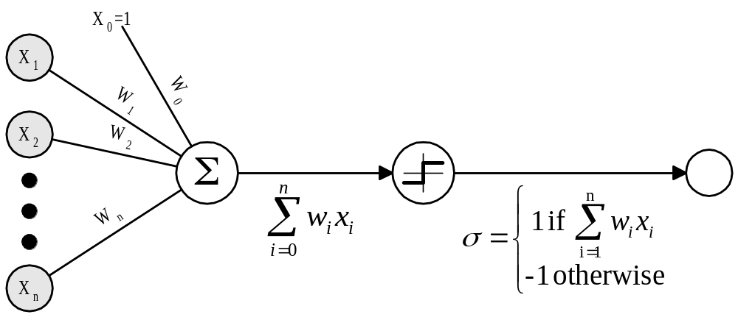
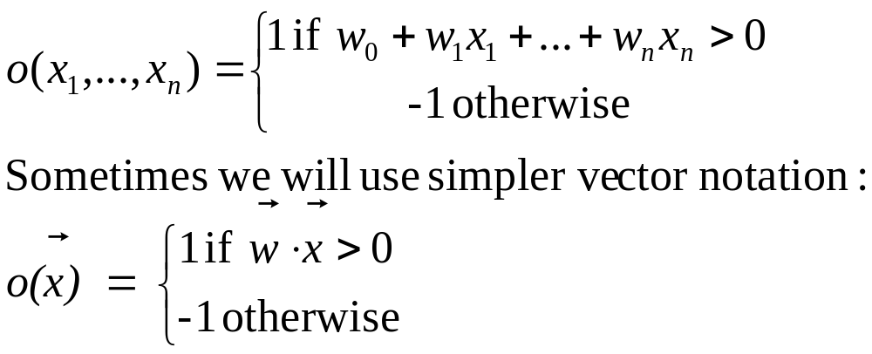
Perceptron

Slide 6
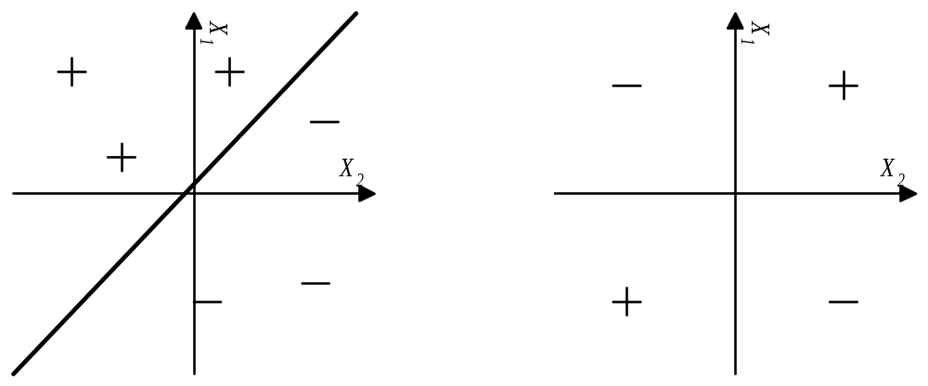
Decision Surface of Perceptron
Represents some useful functions
What weights represent g(x₁,x₂) = AND(x₁,x₂)?
But some functions not representable
e.g., not linearly separable
therefore, we will want networks of these ...

Slide 7
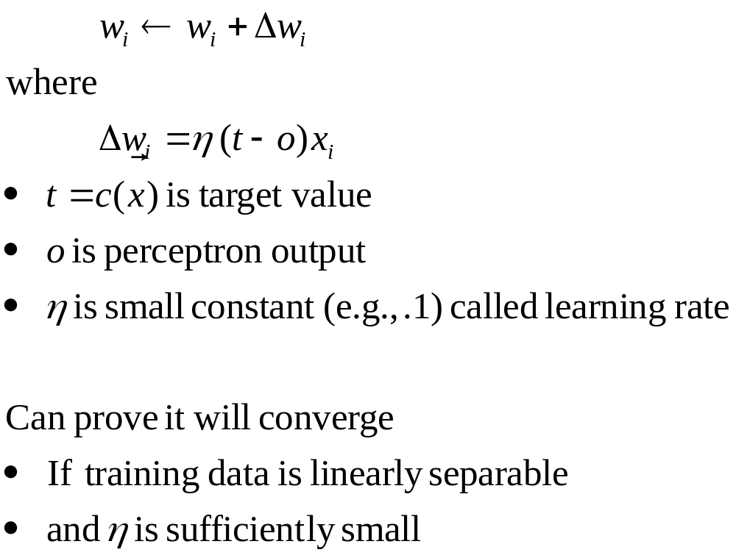
Perceptron Training Rule

Slide 8
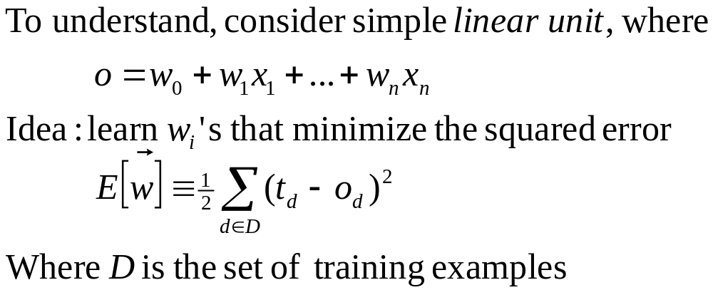
Gradient Descent

Slide 9
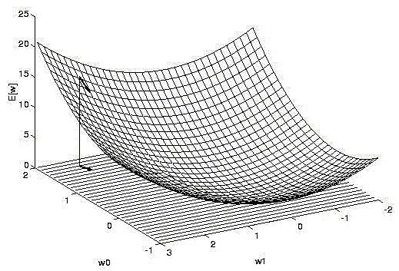
Gradient Descent

Slide 10
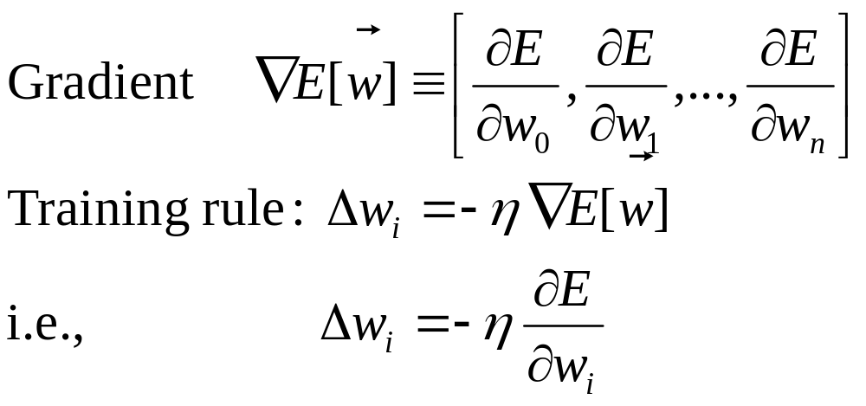
Gradient Descent

Slide 11
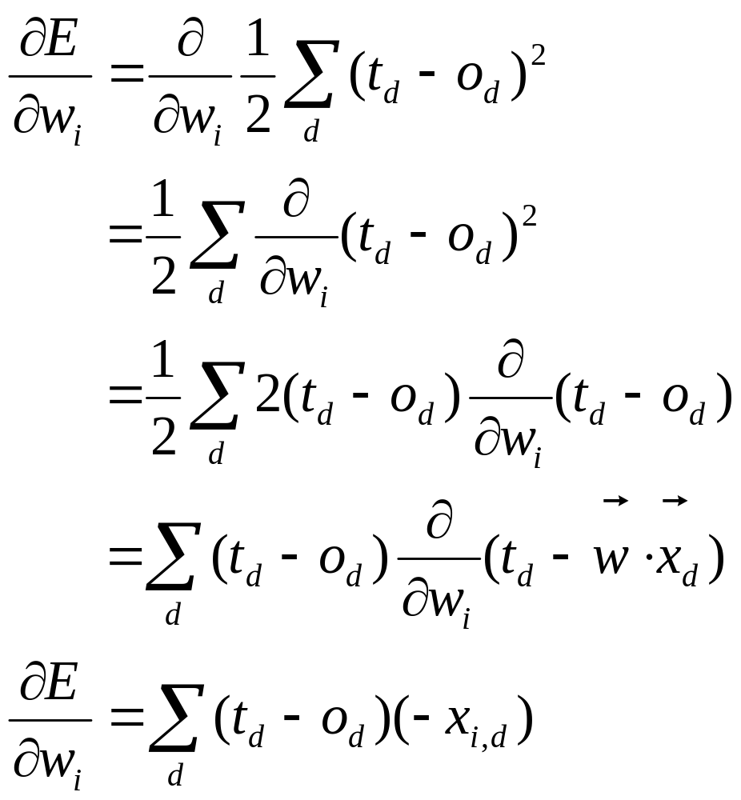
Gradient Descent

Slide 12
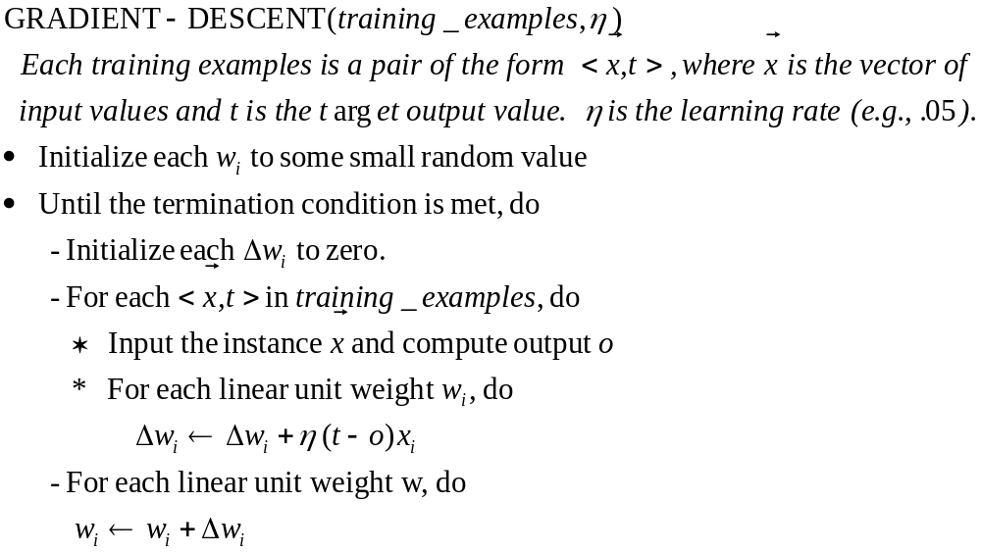
Gradient Descent

Slide 13
Summary
Perceptron training rule guaranteed to succeed if
Training examples are linearly separable
Sufficiently small learning rate η
Linear unit training rule uses gradient descent
Guaranteed to converge to hypothesis with minimum squared error
Given sufficiently small learning rate η
Even when training data contains noise
Even when training data not separable by H

Slide 14
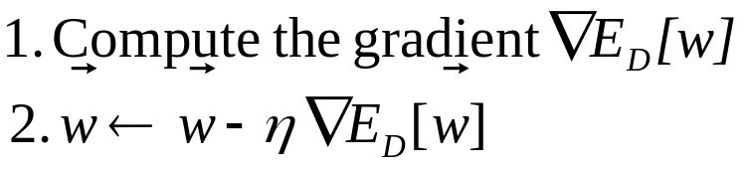
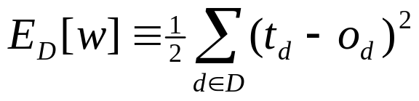
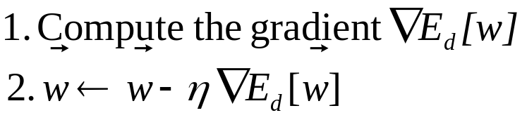

Incremental (Stochastic) Gradient Descent
Batch mode Gradient Descent:
Do until satisfied:
Incremental mode Gradient Descent:
Do until satisfied:
- For each training example d in D
Incremental Gradient Descent can approximate Batch Gradient
Descent arbitrarily closely if η made small enough

Slide 15
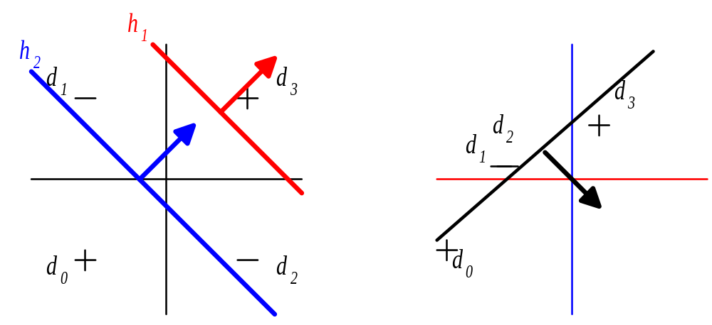
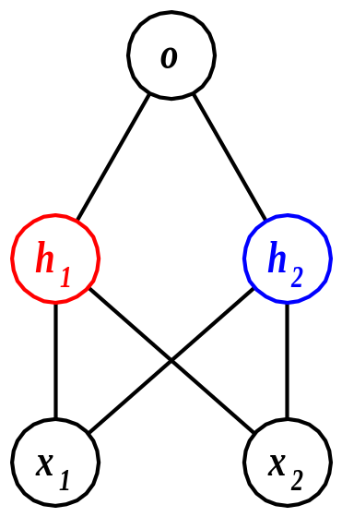
Multilayer Networks of Sigmoid Units

Slide 16
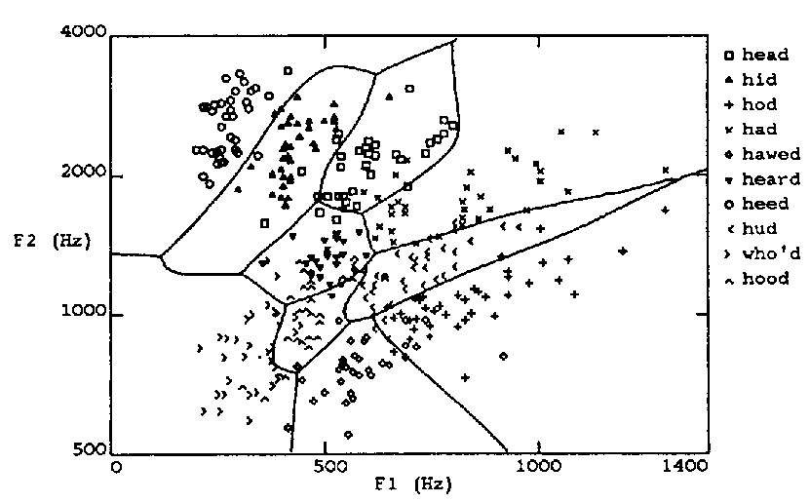
Multilayer Decision Space

Slide 17
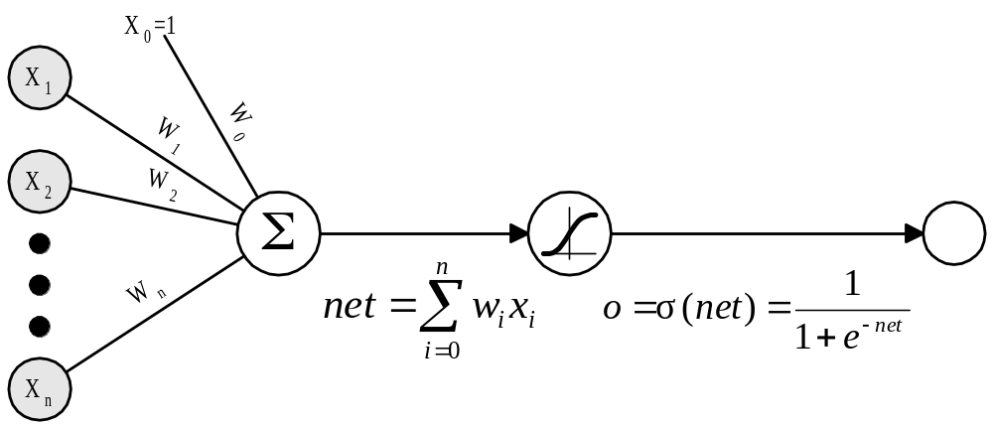
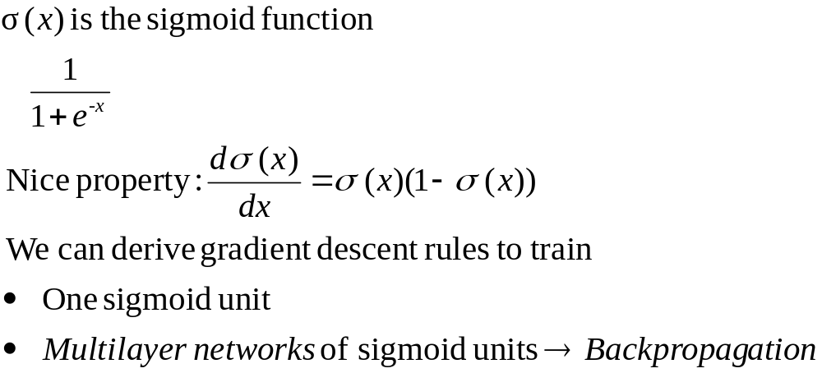
Sigmoid Unit

Slide 18
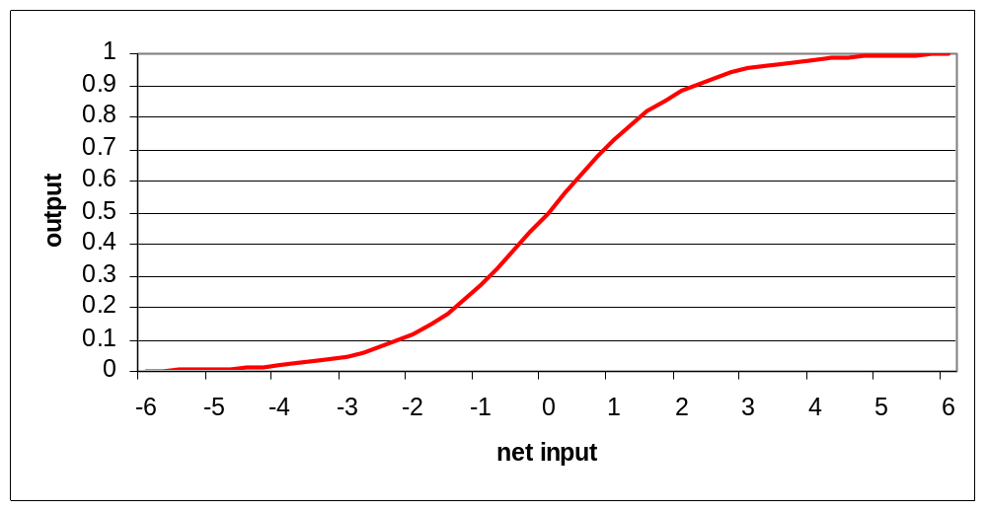
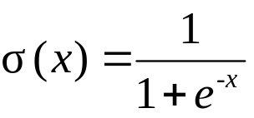
The Sigmoid Function
Sort of a rounded step function
Unlike step function, can take derivative (makes learning
possible)

Slide 19
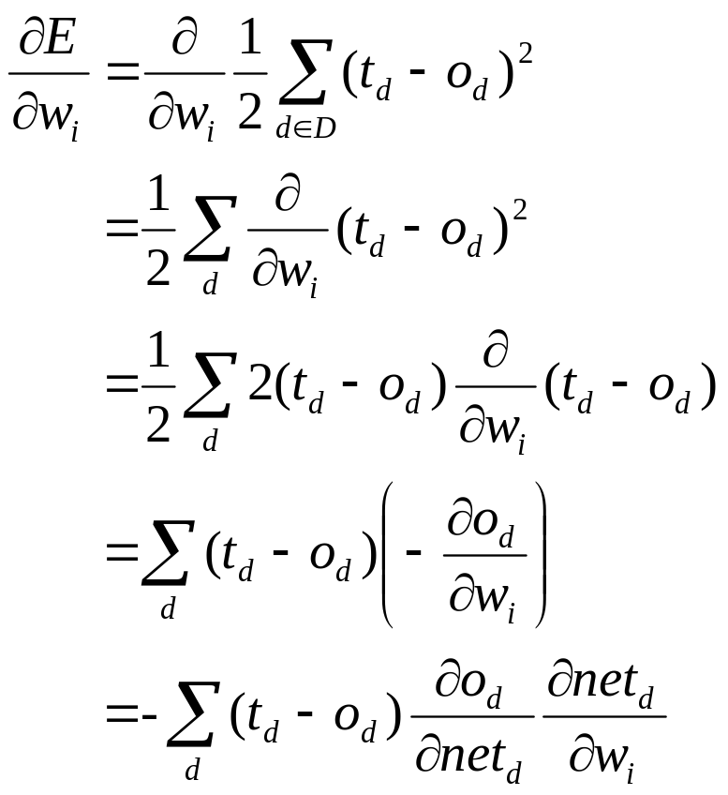
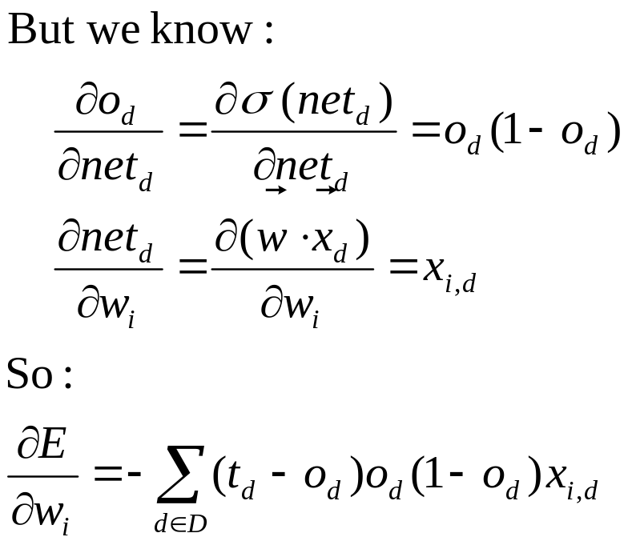
Error Gradient for a Sigmoid Unit

Slide 20
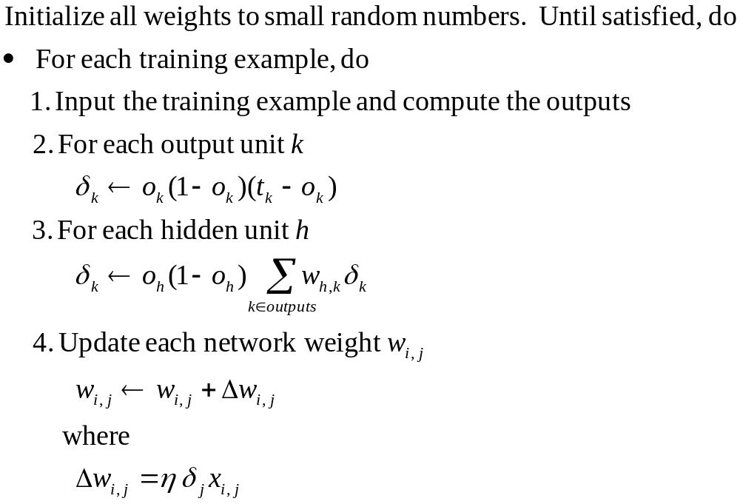
Backpropagation Algorithm

Slide 21
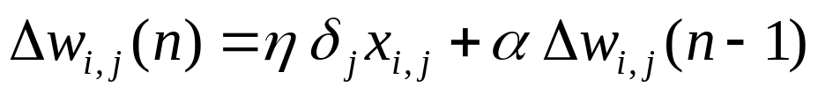
More on Backpropagation
Gradient descent over entire network weight vector
Easily generalized to arbitrary directed graphs
Will find a local, not necessarily global error minimum
  In practice, often works well (can run multiple times)
Often include weight momentum α
Minimizes error over training examples
Will it generalize well to subsequent examples?
Training can take thousands of iterations -- slow!
  Using network after training is fast

Slide 22
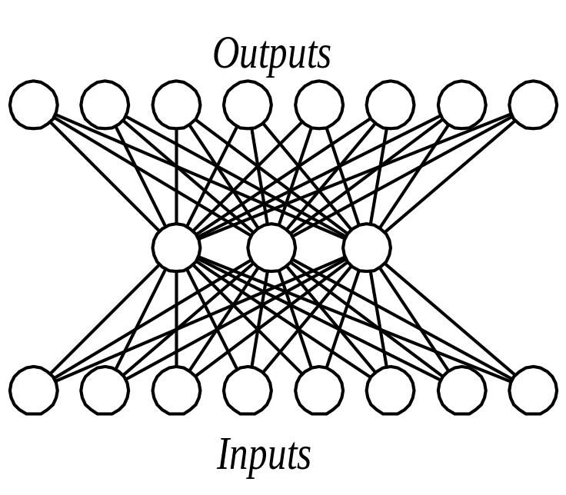
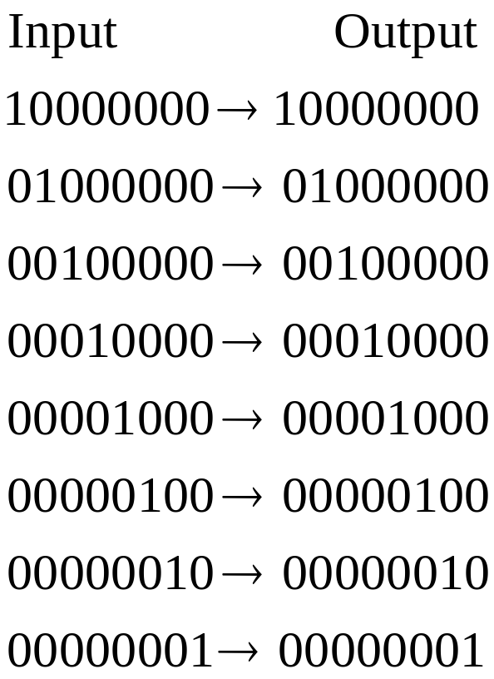
Learning Hidden Layer Representations

Slide 23
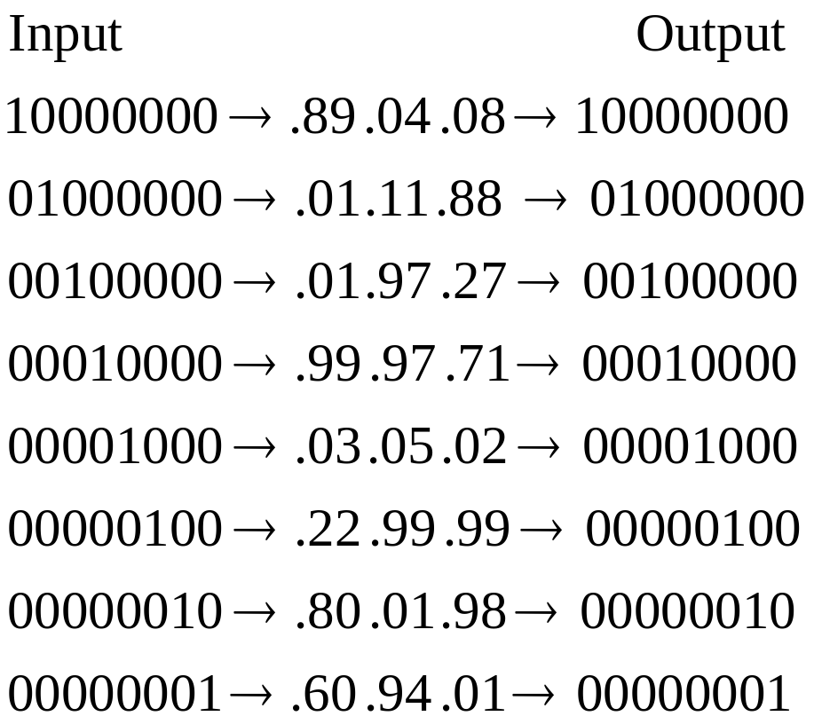
Learning Hidden Layer Representations

Slide 24
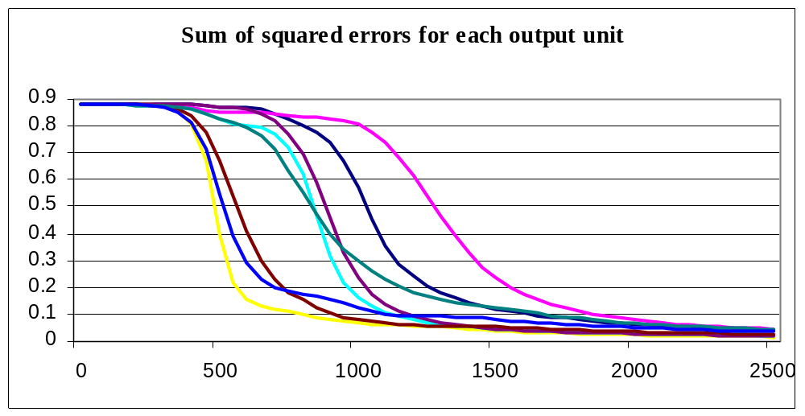
Output Unit Error during Training

Slide 25
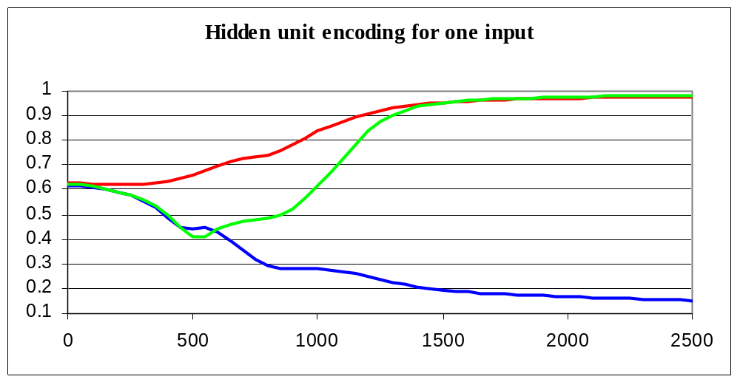
Hidden Unit Encoding

Slide 26
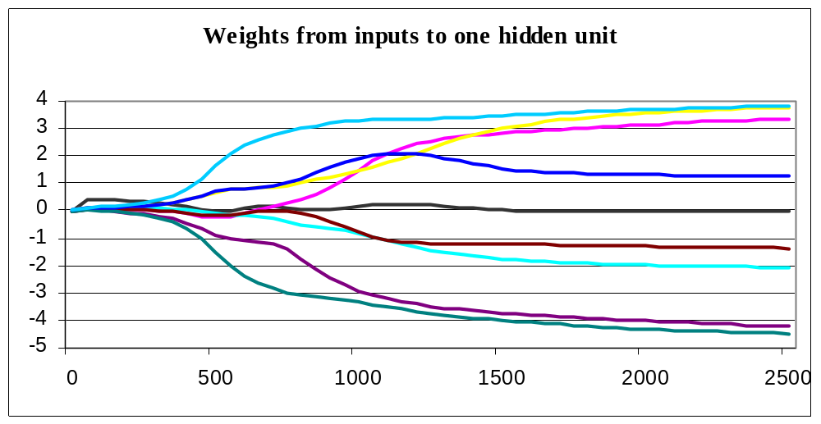
Input to Hidden Weights

Slide 27
Convergence of Backpropagation
Gradient descent to some local minimum
Perhaps not global minimum
Momentum can cause quicker convergence
Stochastic gradient descent also results in faster convergence
Can train multiple networks and get different results (using different initial weights)
Nature of convergence
Initialize weights near zero
Therefore, initial networks near-linear
Increasingly non-linear functions as training progresses

Slide 28
Expressive Capabilities of ANNs
Boolean functions:
Every Boolean function can be represented by network with a single hidden layer
But that might require an exponential (in the number of inputs) hidden units
Continuous functions:
Every bounded continuous function can be approximated with arbitrarily small error by a network with one hidden layer [Cybenko 1989; Hornik et al. 1989]
Any function can be approximated to arbitrary accuracy by a network with two hidden layers [Cybenko 1988]

Slide 29
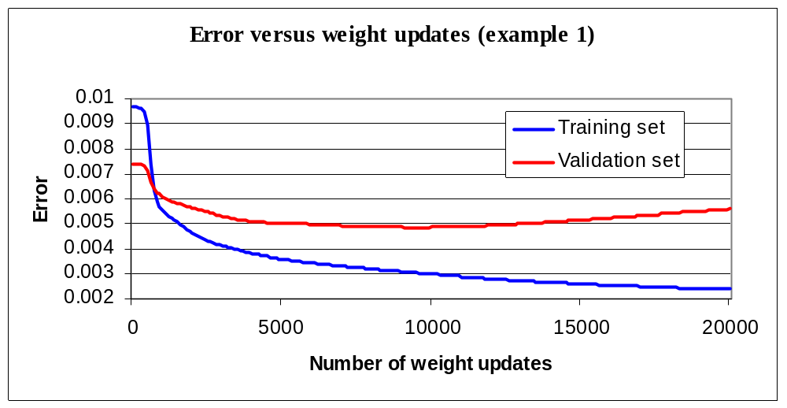
Overfitting in ANNs

Slide 30
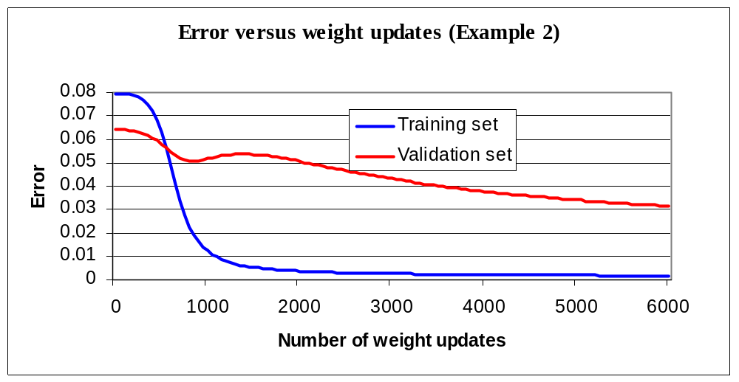
Overfitting in ANNs

Slide 31
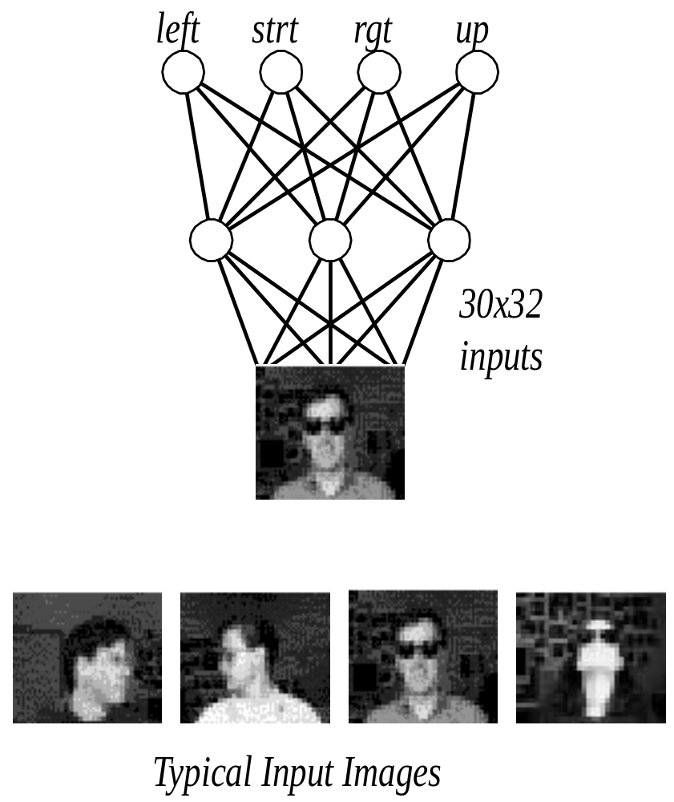
Neural Nets for Face Recognition
90% accurate learning
head pose, and recognizing
1-of-20 faces

Slide 32
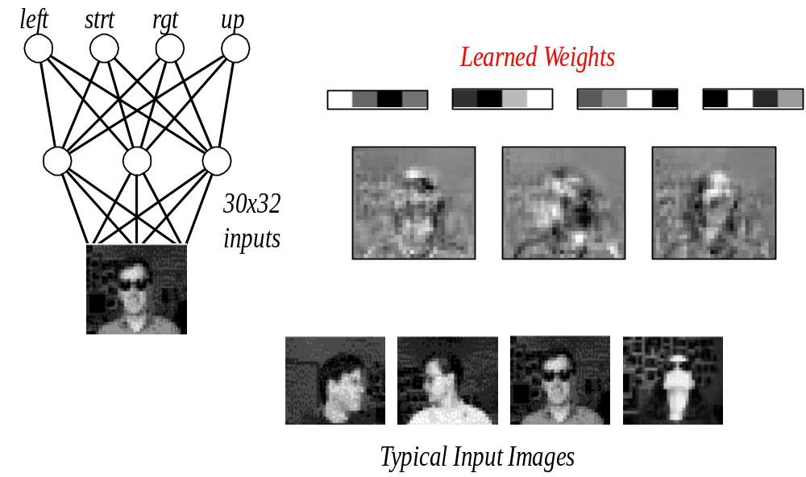
Learned Network Weights

Slide 33
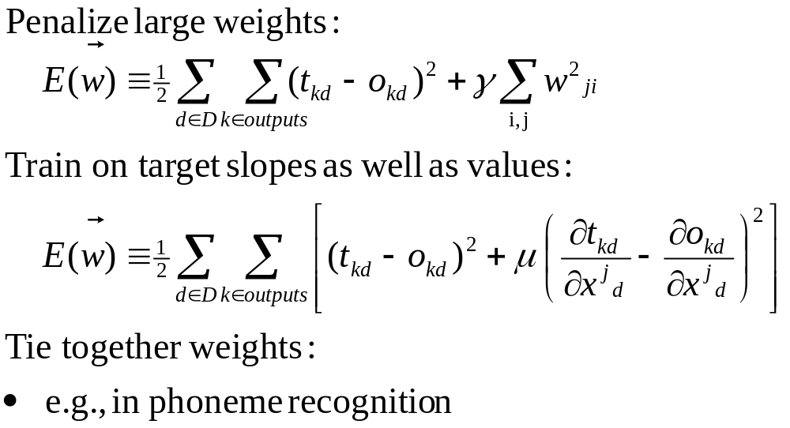
Alternative Error Functions

Slide 34
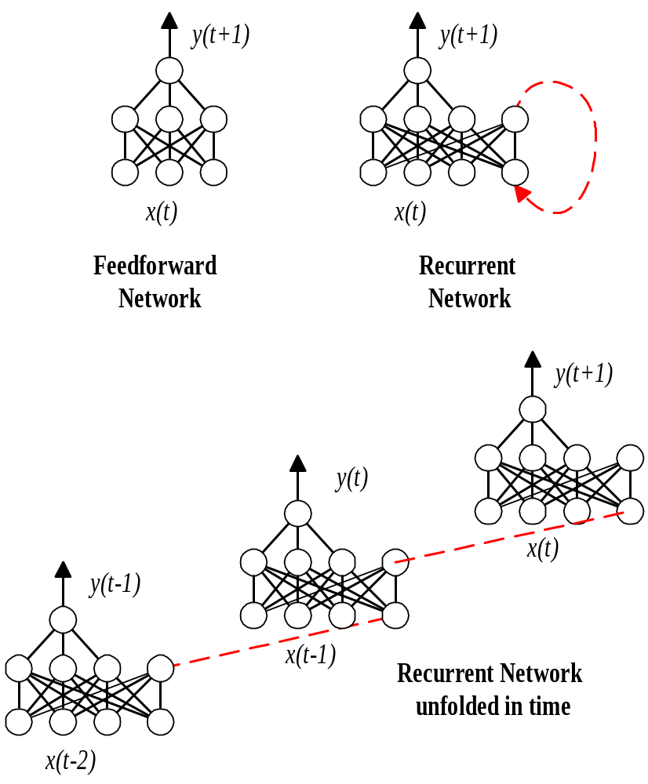
Recurrent Networks

Slide 35
Neural Network Summary
physiologically (neurons) inspired model
powerful (accurate), slow, opaque (hard to understand resulting model)
bias: preferential
  based on gradient descent
  finds local minimum
  effect by initial conditions, parameters
neural units
  linear
  linear threshold
  sigmoid

Slide 36
Neural Network Summary (cont)
gradient descent
  convergence
linear units
  limitation: hyperplane decision surface
  learning rule
multilayer network
  advantage: can have non-linear decision surface
  backpropagation to learn
    backprop learning rule
learning issues
  units used

Slide 37
Neural Network Summary (cont)
learning issues (cont)
  batch versus incremental (stochastic)
  parameters
    initial weights
    learning rate
    momentum
  cost (error) function
    sum of squared errors
    can include penalty terms
recurrent networks
  simple
  backpropagation through time

