Slide 1
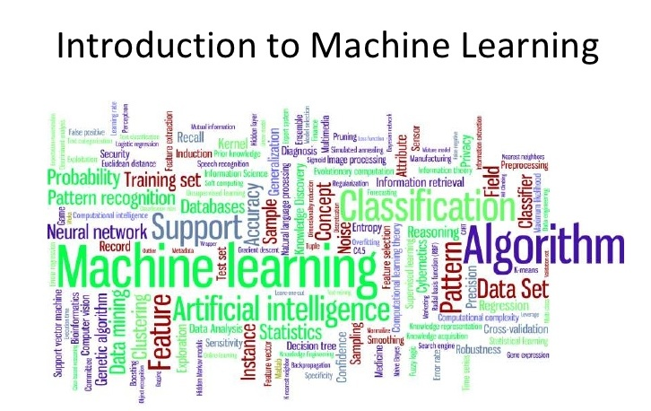
Presented by : Ankit Grover

Slide 2
What is Machine Learning ?
Field of Study that gives computers the ability to learn without being explicitly programmed.
Ability of a machine to improve its own performance through the use of a software that employs artificial intelligence techniques to mimic the ways by which humans seem to learn, such as repetition and experience.

Slide 3
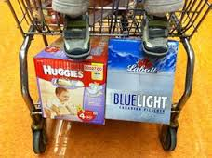
Why Machine Learning ?
Develop systems that can automatically adapt and customize themselves to individual users.
Personalized news or mail filter.
Discover new knowledge from large databases (data mining).
Market based analysis.
For ex : some supermarket placed beer next to diapers and got more business because they mined their sales data and found that men often bought those two items together.

Slide 4
Applications
Amazon customer reviews system.
Facebook’s personalized “News Feed” is being created
IBM Watson could learn how to identify cancer and heart disease from MRI scans and X-Rays.
How does Goolge’s self driving car work?
How do people’s faces on images get detected?
How are spam mails identified?
Google Translate (Optical Character Recognition).

Slide 5
TYPES OF Learning
Supervised learning:
the output is known
Training data is labelled with their output
It learns a function from the inputs to the outputs which can be used to generate an output for a new instance
Unsupervised learning
The output is unknown
Training data is unlabelled
It aims at discovering information from data

Slide 6
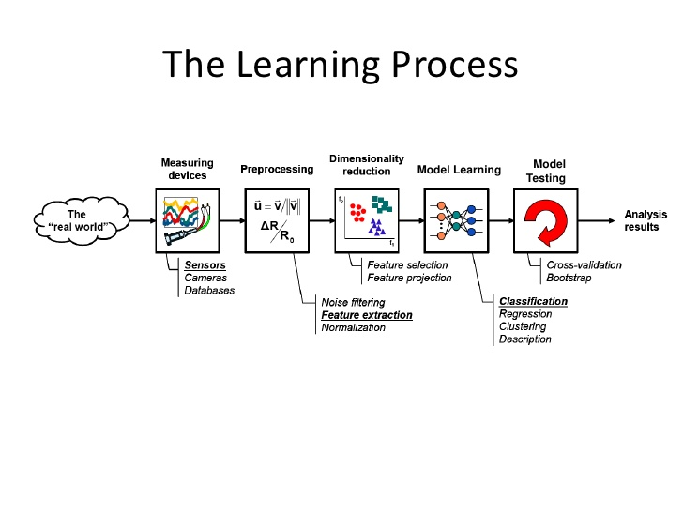

Slide 7
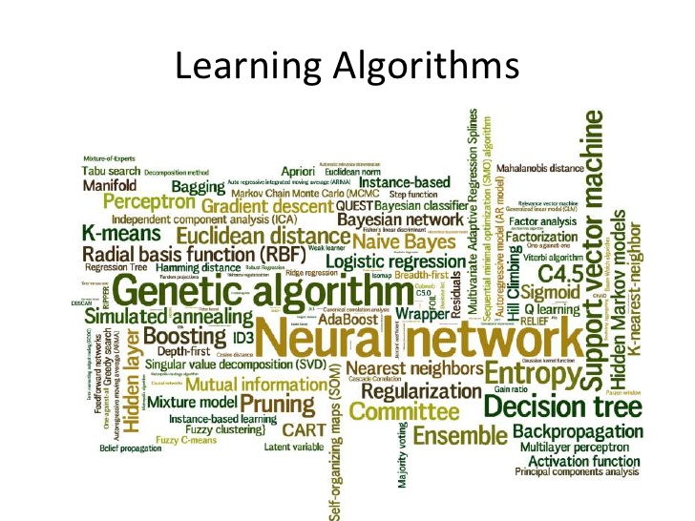

Slide 8
Types of SUPERVISED Learning ALGORITHMS
LINEAR REGRESSION
LOGISTIC REGRESSION
DECISION TREES
RANDOM FOREST

Slide 9
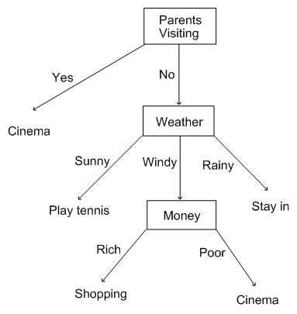
Decision TREE LEARNING
It is commonly used in data mining.
The goal is to create a model that predicts the value of target variable based on several input variables.
Example : You are making your weekend plans and find out that your parents might come to town.
In this case it is your parents coming to town. Out of that box, you have a branch for each possible outcome. In our example, it's easy: yes or no - either your parents come or they don't

Slide 10
UNSUPERVISED LEARNING ALGORITHMS
ASSOCIATION RULE LEARNING
CLUSTER ANALYSIS
OUTLINE DETECTION

Slide 11
What is Clustering?
Organizing data into classes such that there is
high intra-class similarity
low inter-class similarity
Finding the class labels and the number of classes directly from the data (in contrast to classification).
More informally, finding natural groupings among objects.

Slide 12
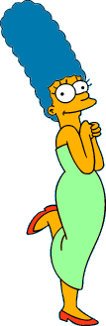



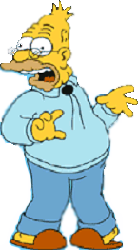
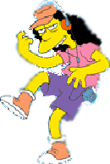


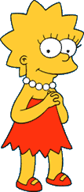
What is a natural grouping among these objects?

Slide 13


What is a natural grouping among these objects?
Clustering is subjective
Simpson's Family
School Employees
Females
Males

Slide 14
Algorithm k-means
1. Randomly choose K data items from X as initial centroids.
2. Repeat
Assign each data point to the cluster which has the closest centroid.
Calculate new cluster centroids.
Until the convergence criteria is met.

Slide 15
Applications of Clustering
Optical Character Recognition
Biometrics
Diagnostic Systems
Military Applications

Slide 16
IMPLEMENTATION TECHNIQUES
ARTIFICIAL NEURAL NETWORKS
SUPPORT VECTOR MACHINE
NAÏVE BAYES CLASSIFIER

Slide 17
Neural Networks
Artificial Neuron Networks are a family of models inspired by biological neural networks and are used to estimate or approximate functions that can depend on a large number of inputs and are generally unknown.
Artificial neural networks are generally presented as systems of interconnected neurons which exchange messages between each other.
The connections have numeric weights that can be tuned based on experience, making neural nets adaptive to inputs and capable of learning

Slide 18
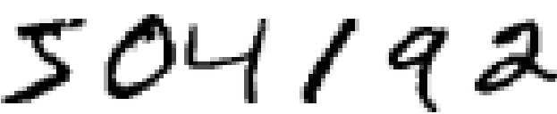
Example
Most people effortlessly recognize these digits as 504192.
In each hemisphere of our brain, humans have a primary visual cortex, also known as V1, containing 140 million neurons, with tens of billions of connections between them.
We carry in our heads a supercomputer, tuned by evolution over hundreds of millions of years, and superbly adapted to understand the visual world
Simple intuitions about how we recognize shapes - "a 9 has a loop at the top, and a vertical stroke in the bottom right"

Slide 19
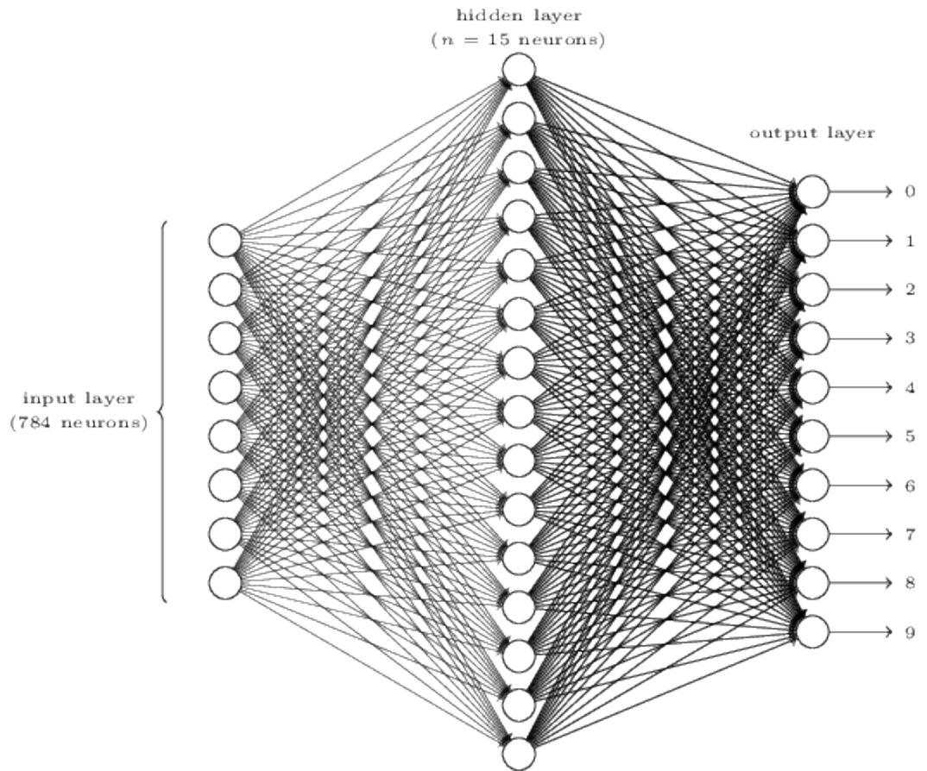
IDEA
The idea is to take a large number of handwritten digits, known as training examples, and then develop a system which can learn from those training examples.
By increasing the number of training examples and neurons, the network can learn more about handwriting, and so improve its accuracy

Slide 20
Any Questions ?

