Slide 1
2010 Winter School on Machine Learning and Vision
Sponsored by
Canadian Institute for Advanced Research and Microsoft Research India
With additional support from
Indian Institute of Science, Bangalore and The University of Toronto, Canada

Slide 2
Agenda
Saturday Jan 9 – Sunday Jan 10: Preperatory Lectures
Monday Jan 11 – Saturday Jan 16: Tutorials and Research Lectures
Sunday Jan 17: Discussion and closing

Slide 3
Speakers
William Freeman, MIT
Brendan Frey, University of Toronto
Yann LeCun, New York University
Jitendra Malik, UC Berkeley
Bruno Olshaussen, UC Berkeley
B Ravindran, IIT Madras
Sunita Sarawagi, IIT Bombay
Manik Varma, MSR India
Martin Wainwright, UC Berkeley
Yair Weiss, Hebrew University
Richard Zemel, University of Toronto

Slide 4
Winter School Organization
Co-Chairs: Brendan Frey, University of Toronto
Manik Varma, Microsoft Research India
Local Organzation: KR Ramakrishnan, IISc, Bangalore
B Ravindran, IIT, Madras
Sunita Sarawagi, IIT, Bombay
CIFAR and MSRI: Dr P Anandan, Managing Director, MSRI
Michael Hunter, Research Officer, CIFAR
Vidya Natampally, Director Strategy, MSRI
Dr Sue Schenk, Programs Director, CIFAR
Ashwani Sharma, Manager Research, MSRI
Dr Mel Silverman, VP Research, CIFAR

Slide 5
The Canadian Institute for Advanced Research (CIFAR)
Objective: To fund networks of internationally leading researchers, and their students and postdoctoral fellows
Programs
  Neural computation and perception (vision)
  Genetic networks
  Cosmology and gravitation
  Nanotechnology
  Successful societies
  …
Track record: 13 Nobel prizes (8 current)

Slide 6
Neural Computation and Perception (Vision)
Goal: Develop computational models for human-spectrum vision
Members
  Geoff Hinton, Director, Toronto
  Yoshua Bengio, Montreal
  Michael Black, Brown
  David Fleet, Toronto
  Nando De Freitas, UBC
  Bill Freeman*, MIT
  Brendan Frey*, Toronto
  Yann LeCun*, NYU
  David Lowe, UBC
  David MacKay, U Cambridge
  Bruno Olshaussen*, Berkeley
  Sam Roweis, NYU
  Nikolaus Troje, Queens
  Martin Wainwright*, Berkeley
  Yair Weiss*, Hebrew Univ
  Hugh Wilson, York Univ
  Rich Zemel*, Toronto
  …

Slide 7
Introduction to Machine Learning
Brendan Frey
University of Toronto
Brendan J. Frey
University of Toronto

Slide 8
Textbook
Christopher M. Bishop
Pattern Recognition and Machine Learning
Springer 2006
To avoid cluttering slides with citations, I’ll cite sources
only when the material is not presented in the textbook

Slide 9
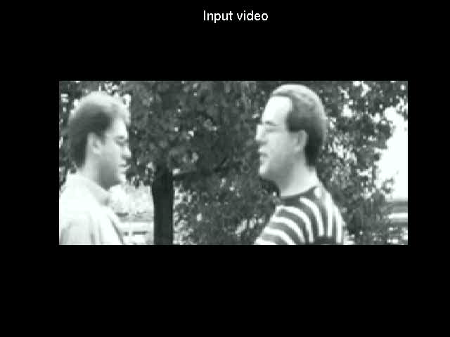
Analyzing video
How can we develop algorithms that will
Track objects?
Recognize objects?
Segment objects?
Denoise the video?
Determine the state (eg, gait) of each object?
…and do all this in 24 hours?

Slide 10
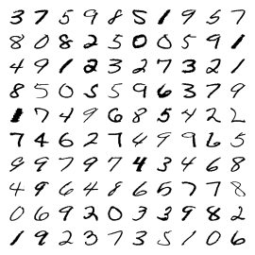
Handwritten digit clustering and recognition
How can we develop algorithms that will
Automatically cluster these images?
Use a training set of labeled images to learn to classify new images?
Discover how to account for variability in writing style?

Slide 11
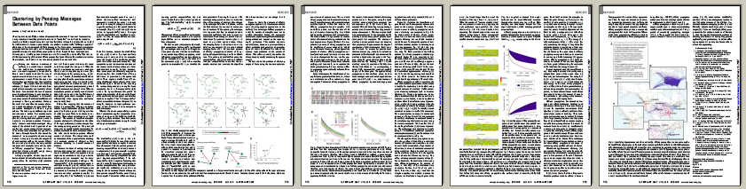
Document analysis
How can we develop algorithms that will
Produce a summary of the document?
Find similar documents?
Predict document layouts that are suitable for different readers?

Slide 12
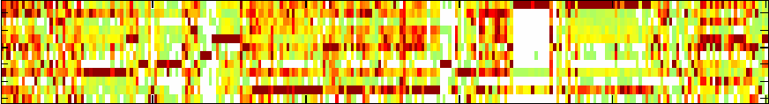
Bioinformatics
DNA activity
Mouse
tissues
Low
High
…
Position in DNA
How can we develop algorithms that will
Identify regions of DNA that have high levels of transcriptional activity in specific tissues?
Find start sites and stop sites of genes, by looking for common patterns of activity?
Find “out of place” activity patterns and label their DNA regions as being non-functional?

Slide 13
The machine learning algorithm development pipeline
Problem statement
Given training vectors x₁,…,x_{N} and targets t₁,…,t_{N}, find…
Mathematical description of a cost function
E(w)
L(θ )
p(x|w)
Mathematical description of how to minimize the cost function
∂ E/∂ w_{i}
∂L /∂θ = 0
Implementation
r(i,k) = s(i,k) – max_{j}{s(i,j)+a(i,j)}
…

Slide 14
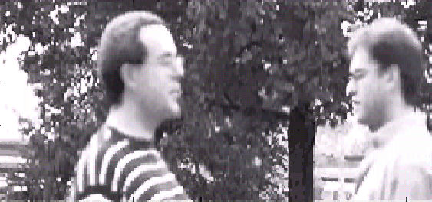
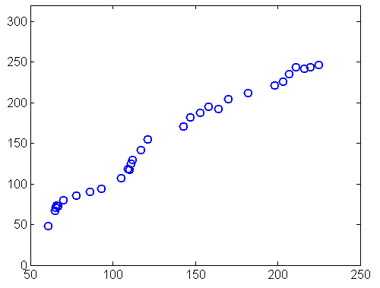
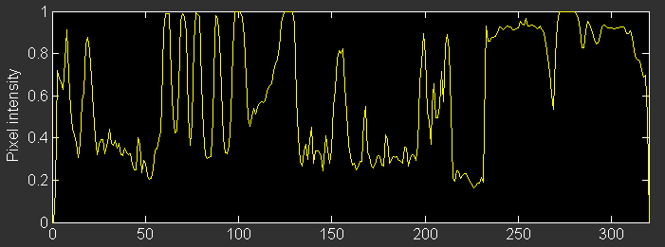
Tracking using hand-labeled coordinates
To track the man in the striped shirt, we could
  Hand-label his horizontal position in some frames
  Extract a feature, such as the location of a sinusoidal (stripe) pattern in a horizontal scan line
  Relate the real-valued feature to the true labeled position
t = 75
0
Hand-labeled horizontal coordinate, t
320
Pixel intensity
x = 100
Feature, x
Horizontal location of pixel

Slide 15
Tracking using hand-labeled coordinates
How do we develop an algorithm that relates our input feature x to the hand-labeled target t?
Hand-labeled horizontal coordinate, t
Hand-labeled horizontal coordinate, t
Feature, x
Feature, x

Slide 16
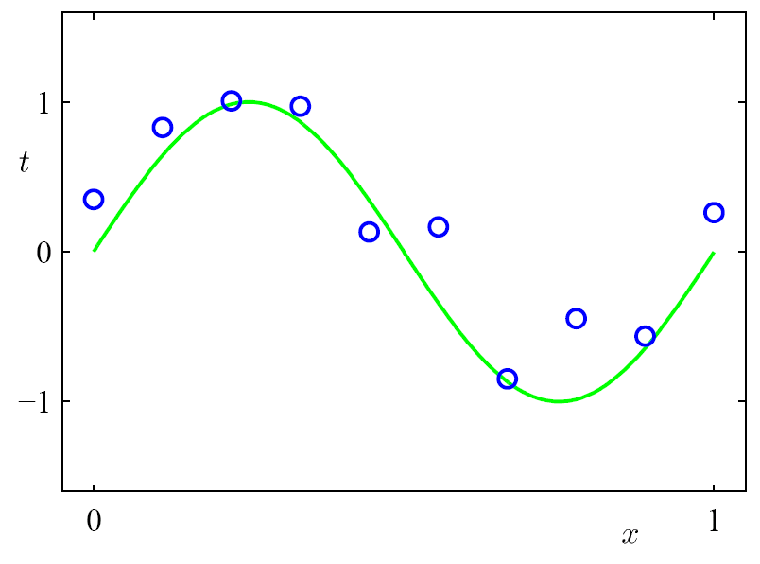
Regression: Problem set-up
Input: x, Target: t, Training data: (x₁,t₁)…(x_{N},t_{N})
t is assumed to be a noisy measurement of an unknown function applied to x
Horizontal position of object
“Ground truth” function
Feature extracted from video frame

Slide 17
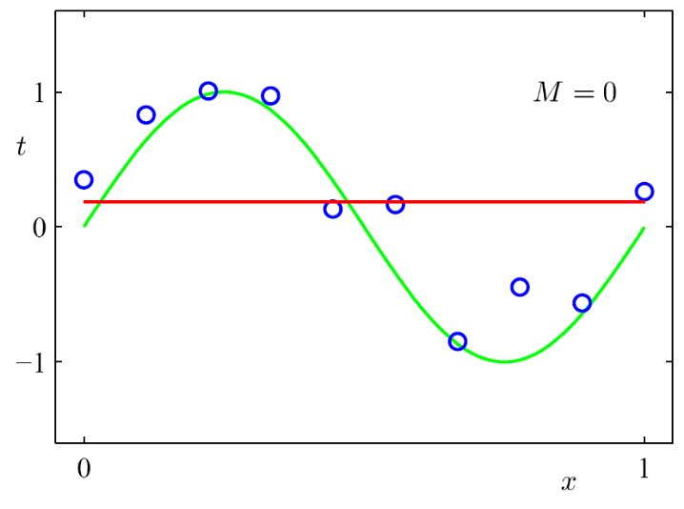
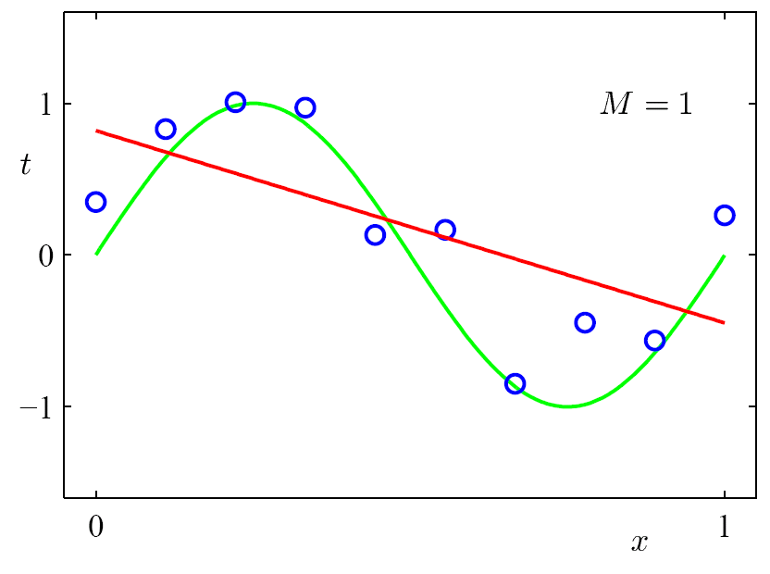
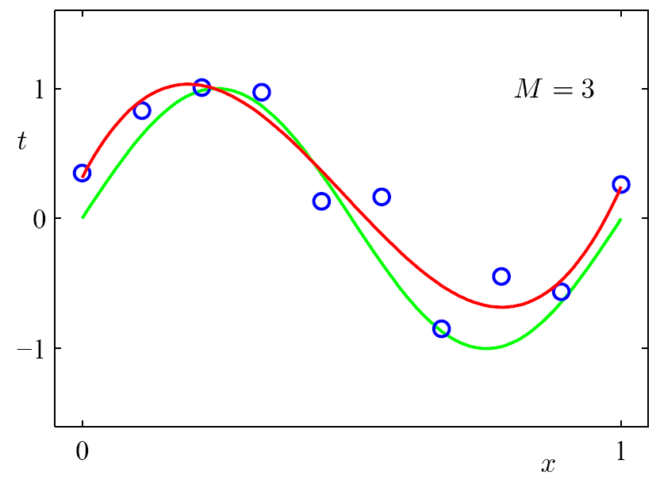
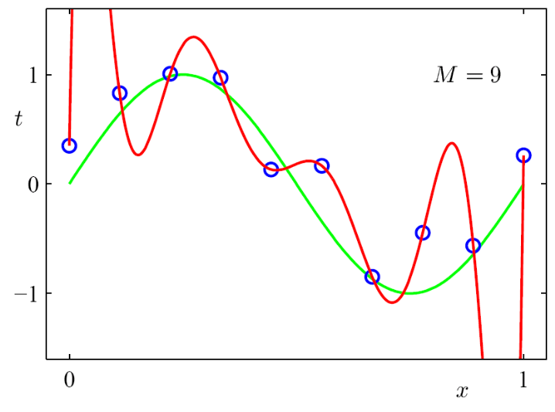
Example: Polynomial curve fitting y(x,w) = w₀ + w₁x + w₂x² + … + w_{M}x^{M}
Regression: Learn parameters w = (w₁,…,w_{M})

Slide 18
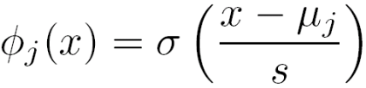
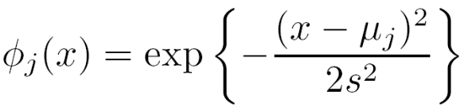
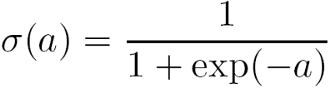

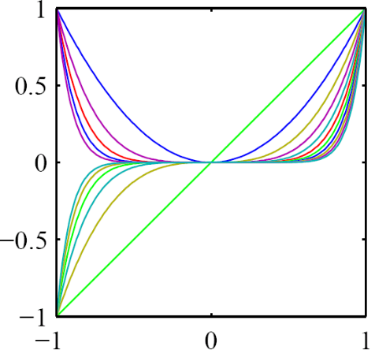
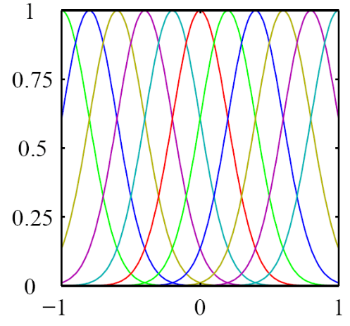
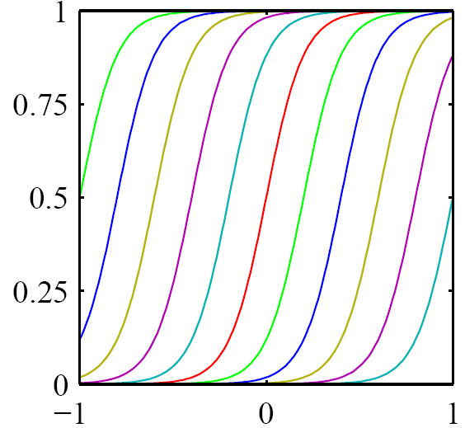
Linear regression
The form y(x,w) = w₀ + w₁x + w₂x² + … + w_{M}x^{M} is linear in the w’s
Instead of x, x², …, x^{M}, we can generally use basis functions:
y(x,w) = w₀ + w₁ φ₁(x) + w₂ φ₂(x) + … + w_{M} φ_{M}(x)

Slide 19
Multi-input linear regression
y(x,w) = w₀ + w₁ φ₁(x) + w₂ φ₂(x) + … + w_{M} φ_{M}(x)
x and φ₁(),…,φ_{M}() are known, so the task of learning w doesn’t change if x is replaced with a vector of inputs x:
y(x,w) = w₀ + w₁ φ₁(x) + w₂ φ₂(x) + … + w_{M} φ_{M}(x)
Example:
Now, each φ_{m}(x) maps a vector to a real number
A special case is linear regression for a linear model: φ_{m}(x) = x_{m}
x = entire scan line

Slide 20
Multi-input linear regression
If we like, we can create a set of basis functions and lay them out in the D-dimensional space:
1-D 2-D
Problem: Curse of dimensionality

Slide 21
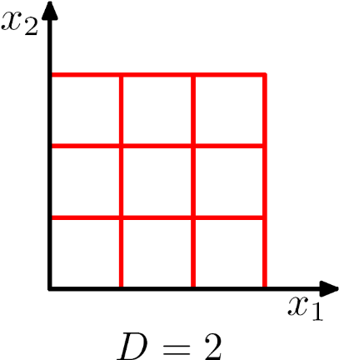
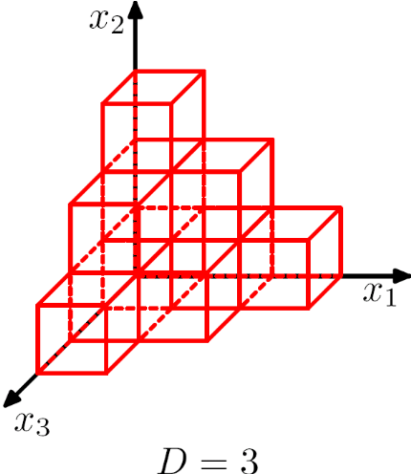
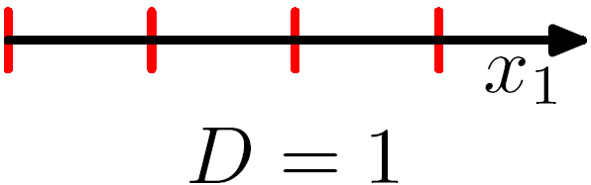
The curse of dimensionality
Distributing bins or basis functions uniformly in the input space may work in 1 dimension, but will become exponentially useless in higher dimensions

Slide 22
Objective of regression: Minimize error
E(w) = ½ Σ_{n} ( t_{n} - y(x_{n},w) )²
This is called Sum of Squared Error, or SSE
Other forms
Mean Squared Error, MSE =
(1/N) Σ_{n} ( t_{n} - y(x_{n},w) )²
Root Mean Squared Error, RMSE, E_{RMS} =
(1/N) Σ_{n} ( t_{n} - y(x_{n},w) )²

Slide 23
How the observed error propagates back to the parameters
y(x_{n},w)
E(w) = ½ Σ_{n} ( t_{n} - Σ_{m}w_{m}φ_{m}(x_{n}) )²
The rate of change of E w.r.t. w_{m} is
∂E(w)/∂w_{m} = - Σ_{n} ( t_{n} - y(x_{n},w) ) φ_{m}(x_{n})
The influence of input φ_{m}(x_{n}) on E(w) is given by weighting the error for each training case by φ_{m}(x_{n})

Slide 24
Gradient-based algorithms
Gradient descent
  Initially, set w to small random values
  Repeat until it’s time to stop:
    For m = 0…M
    Δ_{m} ← - Σ_{n} ( t_{n} - y(x_{n},w) ) φ_{m}(x_{n})
    or Δ_{m} ← (E(w₁..w_{m}+ε..w_{M})-E(w₁..w_{m}..w_{M})) / ε,
    where ε is tiny
    For m = 0…M
    w_{m} ← w_{m} - η Δ_{m}, where η is the learning rate
“Off-the-shelf” conjugate gradients optimizer: You provide a function that, given w, returns E(w) and Δ₀E,…,Δ_{M} E (total of M+2 numbers)
This is a finite-element approximation to ∂E(w)/∂w_{m}

Slide 25
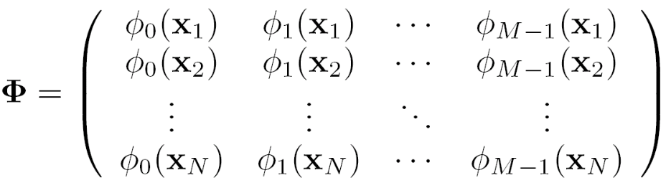


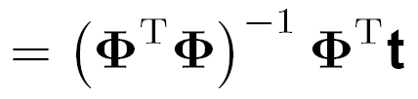
An exact algorithm for linear regression
y(x,w) = w₀ + w₁ φ₁(x) + w₂ φ₂(x) + … + w_{M} φ_{M}(x)
Evaluate the basis functions for the training cases x₁,…,x_{N} and put them in a “design matrix”:
where we define φ₀(x) = 1 (to account for w₀)
Now, the vector of predictions is y = and the error is E = (t- )^{T}(t- ) = t^{T}t - 2t^{T} + ^{T T}
Setting ∂E/∂w = 0 gives -2 ^{T}t + 2 ^{T} = 0
Solution: w
MATLAB

Slide 26
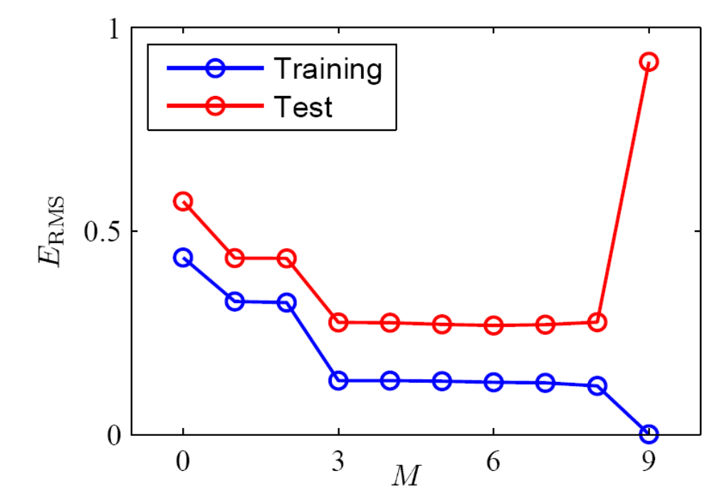
Over-fitting
After learning, collect “test data” and measure it’s error
Over-fitting the training data leads to large test error

Slide 27
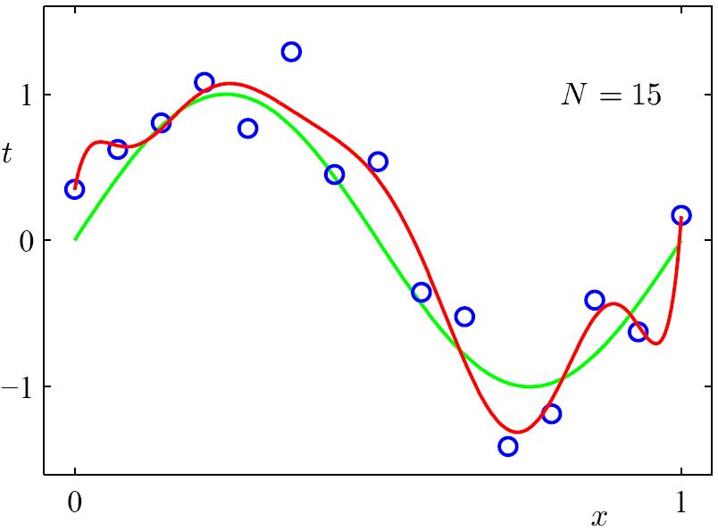
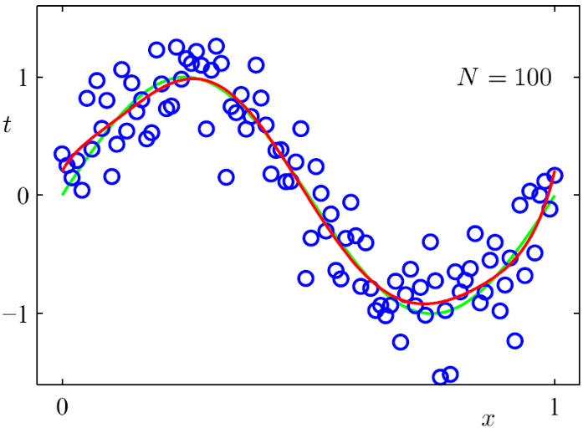
If M is fixed, say at M = 9, collecting more training data helps…
N = 10

Slide 28
Model selection using validation data
Collect additional “validation data” (or set aside some training data for this purpose)
Perform regression with a range of values of M and use validation data to pick M
Here, we could choose M = 7
Validation

Slide 29
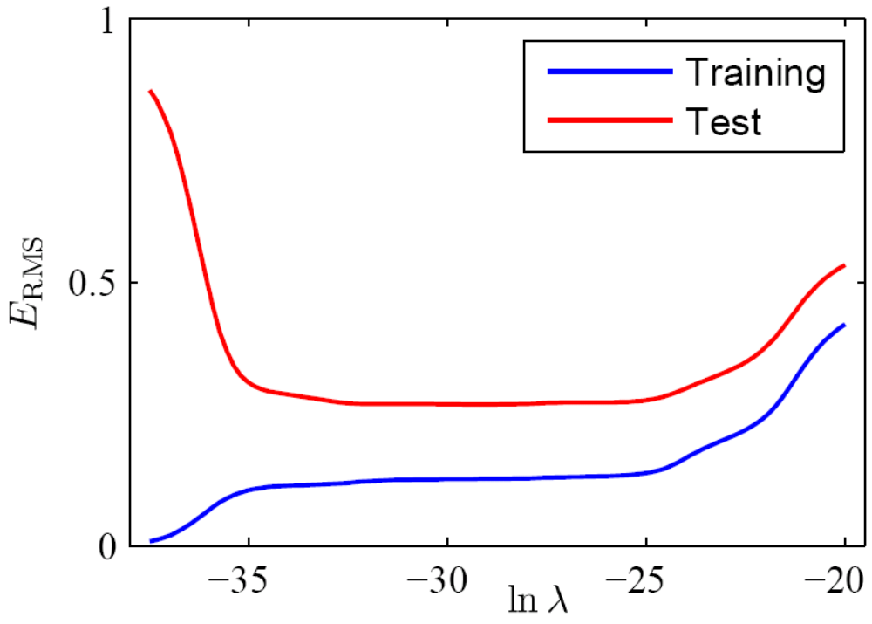
Regularization using weight penalties
(aka shrinkage, ridge regression, weight decay)
To prevent over-fitting, we can penalize large weights:
E(w) = ½ Σ_{n} ( t_{n} - y(x_{n},w) )² + λ/2 Σ_{m} w_{m}²
Now, over-fitting depends on the value of λ

Slide 30
Comparison of model selection and ridge regression/weight decay

Slide 31
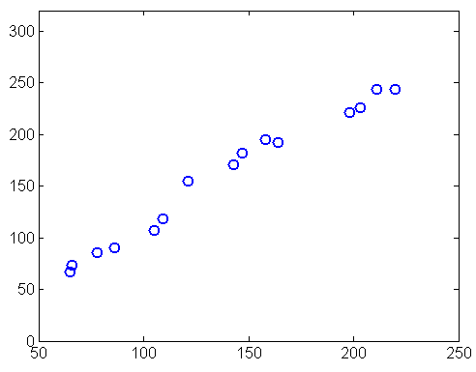
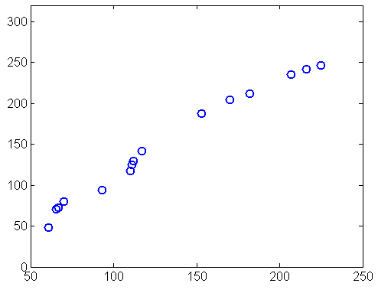
Using validation data to regularize tracking
Entire data set
Hand-labeled horizontal coordinate, t
Feature, x
Training data
Validation data
Hand-labeled horizontal coordinate, t
Hand-labeled horizontal coordinate, t
M = 5
Feature, x
Feature, x

Slide 32
Validation when data is limited
S-fold cross validation
  Partition the data into S sets
  For M=1,2,…:
    For s=1…S:
      Train on all data except the s^{th} set
      Measure error on s^{th} set
    Add errors to get cross-validation error for M
  Pick M with lowest cross-validation error
Leave-one-out cross validation
  Use when data is sparse
  Same as S-fold cross validation, with S = N

Slide 33
Questions?

Slide 34
How are we doing on the pass sequence?
This fit is pretty good, but…
Choosing a particular M and w seems wrong – we should hedge our bets
Cross validation reduced the training data, so the red line isn’t as accurate as it should be
The red line doesn’t reveal different levels of uncertainty in predictions
Hand-labeled horizontal coordinate, t

Slide 35


