Slide 1
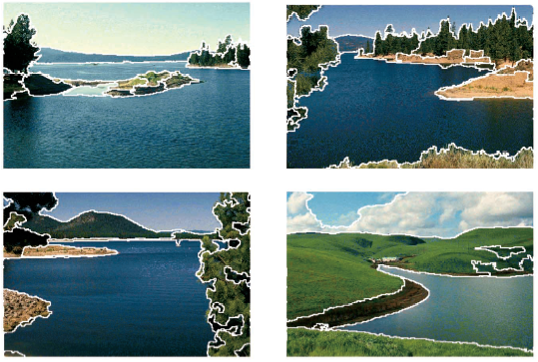
K-means clustering algorithm
Kasun Ranga Wijeweera
(krw19870829@gmail.com)

Slide 2
What is Clustering?
Organizing data into classes such that there is
  high intra-class similarity
  low inter-class similarity
Finding the class labels and the number of classes directly from the data (in contrast to classification).
More informally, finding natural groupings among objects.

Slide 3
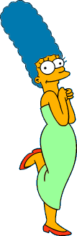



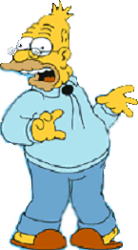
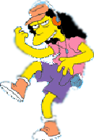



What is a natural grouping among these objects?

Slide 4


What is a natural grouping among these objects?
Clustering is subjective
Simpson's Family
School Employees
Females
Males

Slide 5
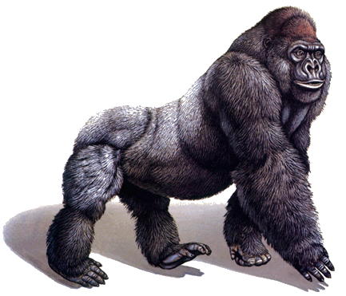
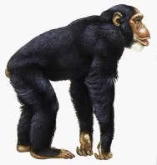
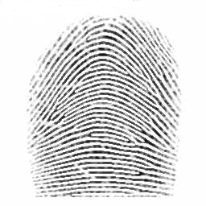
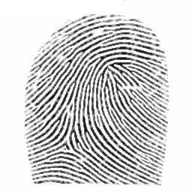
Defining Distance Measures
Definition: Let O₁ and O₂ be two objects from the universe of possible objects. The distance (dissimilarity) between O₁ and O₂ is a real number denoted by D(O₁,O₂)
Kasun
Kiosn
0.23
3
342.7

Slide 6
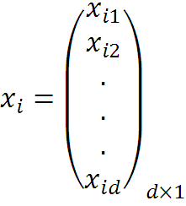


Consider a Set of Data Points,
And a Set of Clusters,

Slide 7


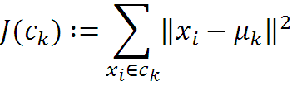

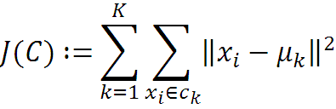
The Goal,

Slide 8
Algorithm k-means
1. Randomly choose K data items from X as initial centroids.
2. Repeat
  Assign each data point to the cluster which has the closest centroid.
  Calculate new cluster centroids.
  Until the convergence criteria is met.

Slide 9
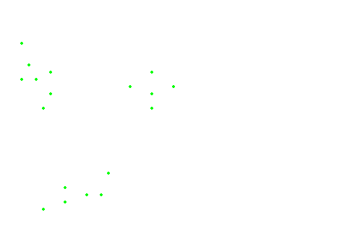
The data points

Slide 10
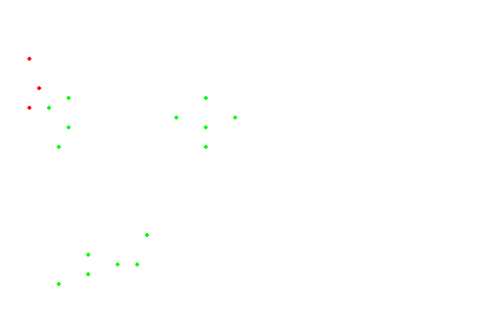
Initialization

Slide 11
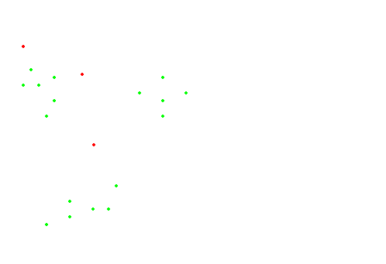
#Runs = 1

Slide 12
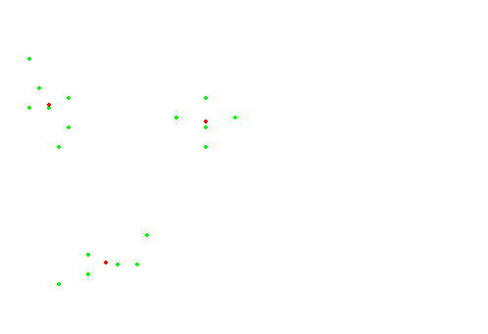
#Runs = 2

Slide 13
#Runs = 3

Slide 14
K-means gets stuck in a local optima

Slide 15
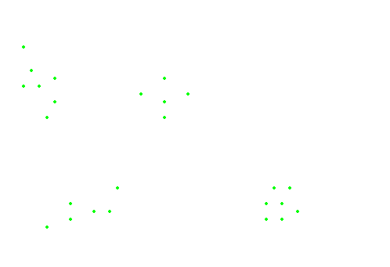
The data points

Slide 16
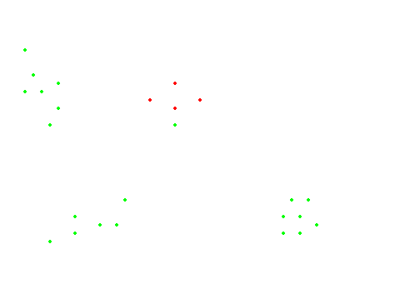
Initialization

Slide 17
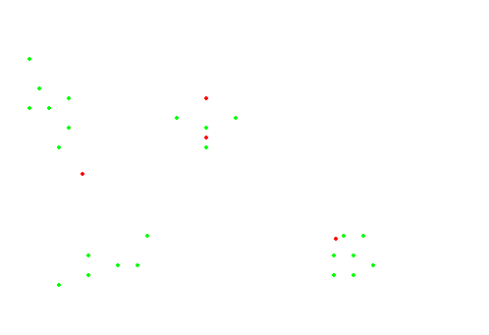
#Runs = 1

Slide 18
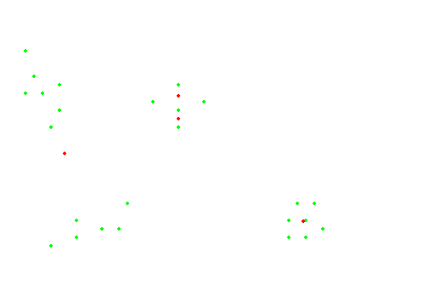
#Runs = 2

Slide 19
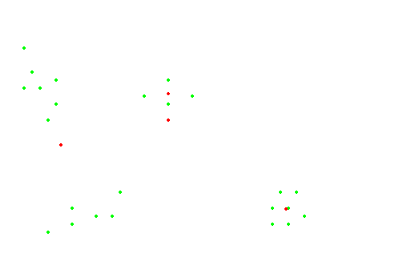
#Runs = 3

Slide 20
#Runs = 4

Slide 21
Applications of K-means Method
Optical Character Recognition
Biometrics
Diagnostic Systems
Military Applications

Slide 22
Comments on the K-Means Method
Strength
  Relatively efficient: O(tkn), where n is # objects, k is # clusters, and t is # iterations. Normally, k, t << n.
  Often terminates at a local optimum. The global optimum may be found using techniques such as: deterministic annealing and genetic algorithms
Weakness
  Applicable only when mean is defined, then what about categorical data?
  Need to specify k, the number of clusters, in advance
  Unable to handle noisy data and outliers
  Not suitable to discover clusters with non-convex shapes

Slide 23
Any Questions ?

Slide 24
Thanks for your attention !

