Slide 1
A basic introduction to Machine Learning
Catalina Hallett
SwiftKey

Slide 2
Machine learning
Machine learning deals with the construction of computer systems that act upon information learned from data, rather than on a set of specific instructions
The aim of a machine learning system is to generalize from experience, i.e. to perform accurately on new, unseen examples/tasks after having experienced a learning data set
All-pervasive: web search, marketing, financial predictions, voice and image recognition, self-driving cars

Slide 3
Supervised vs unsupervised learning
Supervised learning:
the output is known
Training data is labelled with their output
It learns a function from the inputs to the outputs which can be used to generate an output for a new instance
Unsupervised learning
The output is unknown
Training data is unlabelled
It aims at discovering information from data

Slide 4
Supervised learning for classification
Marketing:
which promotions are more likely to be effective
which customers are more likely to need a certain product
Identifying positive/negative feedback
Machine vision: Image (face) recognition, handwriting identification, fingerprint identification
Spam/plagiarism detection
Natural language processing: text categorisation (e.g., for indexing), parsing, word sense disambiguation, speech identification

Slide 5
Supervised learning for classification
Step 1: Learning
Given a target concept:
Collect a set of training examples that are representative of the concept
Identify features that are relevant in describing the concept
Learn a model that “explains” the concept (select an algorithm & fine tune it)
Step 2: Classification
Use the model learnt in the previous step to classify an unseen instance

Slide 6

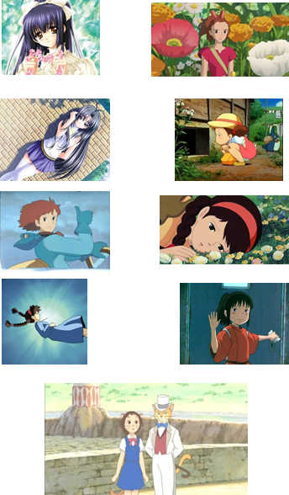
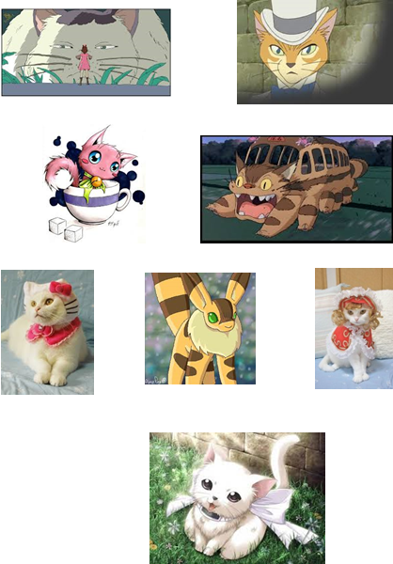
What is Kitty?
Class: Girl
Labelled training examples
Class: Cat
Labelled training examples
A girl?
A cat?
Features
Has a bow
Wears clothes
Is <5 apples tall
Has whiskers
Has round face
Has cat ears
Walks on 2 feet

Slide 7
Decision trees
Has bow
yes
Has bow
no
4 Girl
4 Cat
5 Girl
4 Cat
Round face
5 apples tall
Round face
yes
no
yes
no
3 Girl
4 Cat
1 Girl
4 Cat
0 Girl
2 Cat
5 Girl
2 Cat
Has whiskers
Has whiskers
…
Has whiskers
Cat
yes
no
yes
no
0 Girl
4 Cat
3 Girl
0 Cat
0 Girl
4 Cat
3 Girl
0 Cat
Cat
Girl
Cat
Girl
Cat

Slide 8
K-nearest neighbour
Compare the classification target with the set of training examples using a distance function
Chose as output the class that the majority of the k closest neighbours belong to
girl
cat
K=1
K=3
K=5

Slide 9
Many, many algorithms
Neural networks
Support vector machines (SVM)
Boosting
Naïve Bayes
Fisher linear discriminant
… each of them with a large number of possible tuning parameters
… each of them with advantages and disadvantages according to size of training data, speed, accuracy, overfitting risk, etc

Slide 10
How do you select the right one?
“No free lunch” – there is no one ML algorithm that outperforms all others on any give task
Some algorithms are known to work better for certain classes of problems, given certain circumstances
[Which estimator]
Trial and error

Slide 11
Unsupervised learning
Deals with identifying patterns
It works with observed patterns (assumed to be independent samples from some probability distribution)
Has some explicit or implicit knowledge of what is important
Has no knowledge or expectations of target outputs

Slide 12
Main approaches
Clustering – trying to group object in such a way that objects in the same cluster are more similar to each other than to objects in a different cluster
Feature extraction – tries to identify statistical regularities or irregularities in data

Slide 13
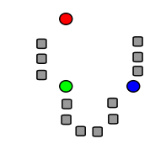
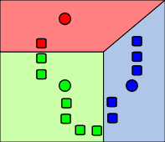
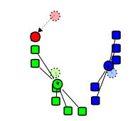
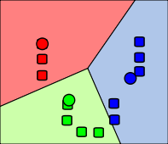
Clustering techniques
K-means clustering - partitions n instances into k clusters in which each instance belongs to the cluster with the nearest mean
Initialise k means – randomly or using some rules
Partition the data according to the initial means
Calculate the centroid of each cluster and use it as the new mean
Repeat until convergence is reached (assignments to clusters no longer change
* Images courtesy of Wikipedia

Slide 14
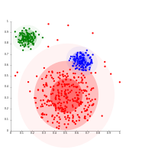
More models …
Distribution models: clusters are modelled using statistical distributions
Expectation-maximization algorithm: use a fixed number of Gaussian distributions, initialised randomly. Optimise their parameters to fit the data set better

Slide 15
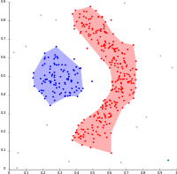
Density-based clustering: “a cluster is a set of data objects spread in the data space over a contiguous region of high density of objects. Density‐based clusters are separated from each other by contiguous regions of low density of objects” (Kriegel et al, 2011)
Objects in low density areas are considered outliers

