Slide 1
Water Crisis
Presented by:-
Team : FireFolks
Raunak Sarada
Ankit Gupta
Ankit Gokhroo
Arpit Khandelwal

Slide 2
Problem Statement
The 2019 Chennai water crisis is an ongoing water crisis occurring in India, most notably in the city of Chennai in Tamil Nadu. On 19 June 2019, Chennai city officials declared that "Day Zero", or the day when almost no water is left, had been reached, as all the four main reservoirs supplying water to the city had run dry.
These four main reservoirs are:
1.Poondi
2.Cholavaram
3.Redhills
4.Chembarambakkam

Slide 3
Dataset
The data that we are using for predicting the possibility of water crisis downloaded from Kaggle.com
The data is available on a daily basis and the unit is million cubic feet.
This dataset has details about the water availability in the four main reservoirs over the last 15 years
We are using two datasets that are responsible for proper water fulfillment:-
Chennai reservoirs level.
Chennai rainfall level.

Slide 4
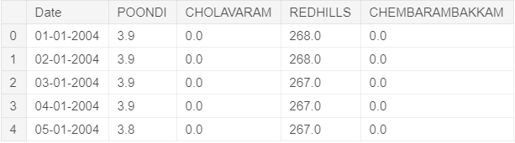
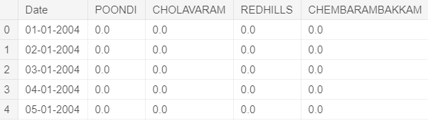
Dataset
Sample dataset for Chennai reservoirs level is :
Sample dataset for Chennai rainfall level is :

Slide 5


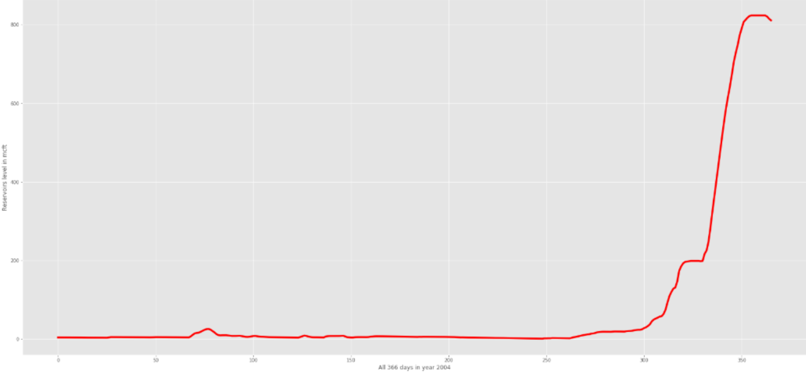
Rainfall Visualisation graph

Slide 6
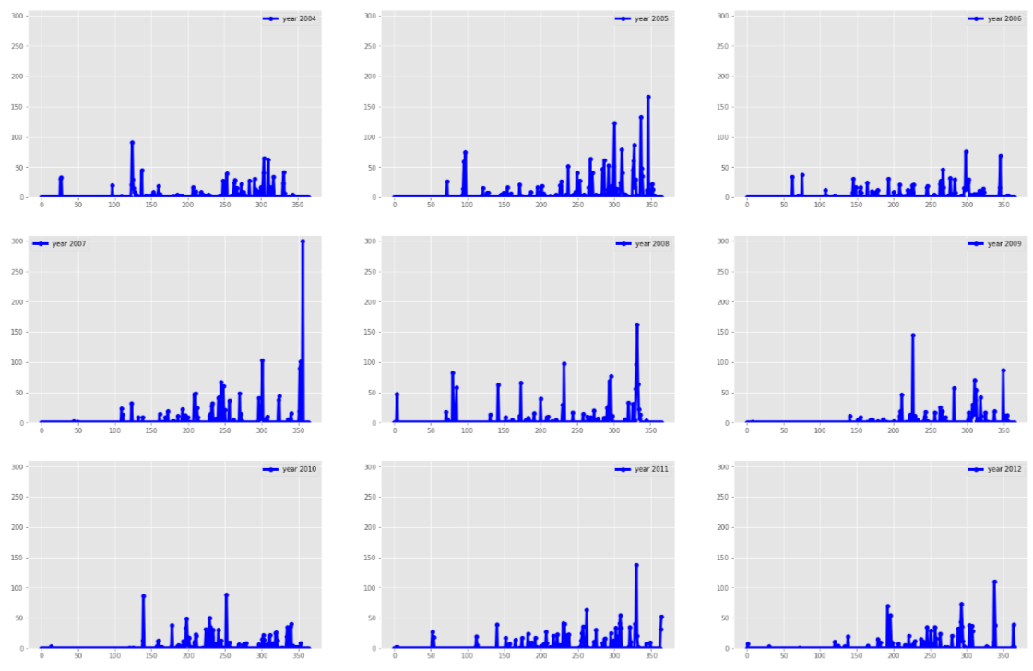
Rainfall level in Chennai before 2012 :

Slide 7
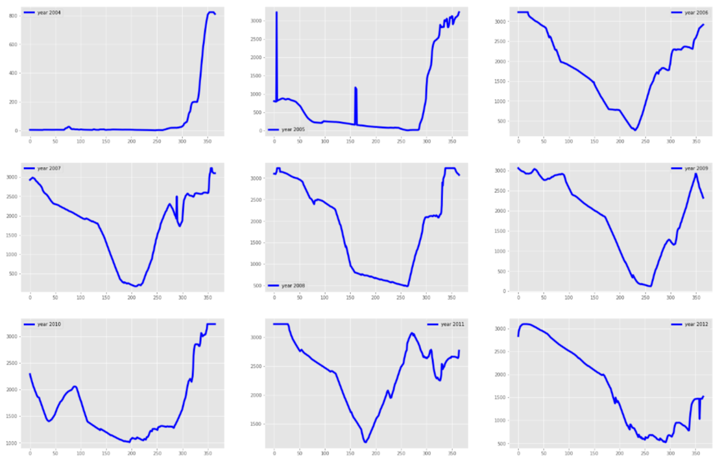
Reservoir level in Chennai before 2012 :

Slide 8
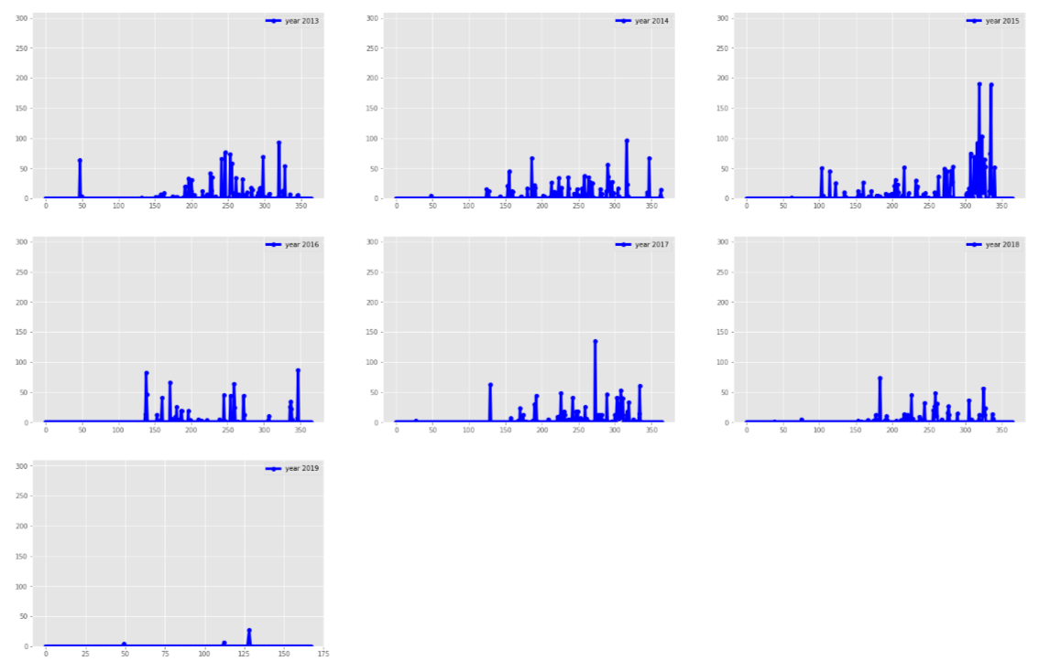
Rainfall level in Chennai after 2012 :

Slide 9
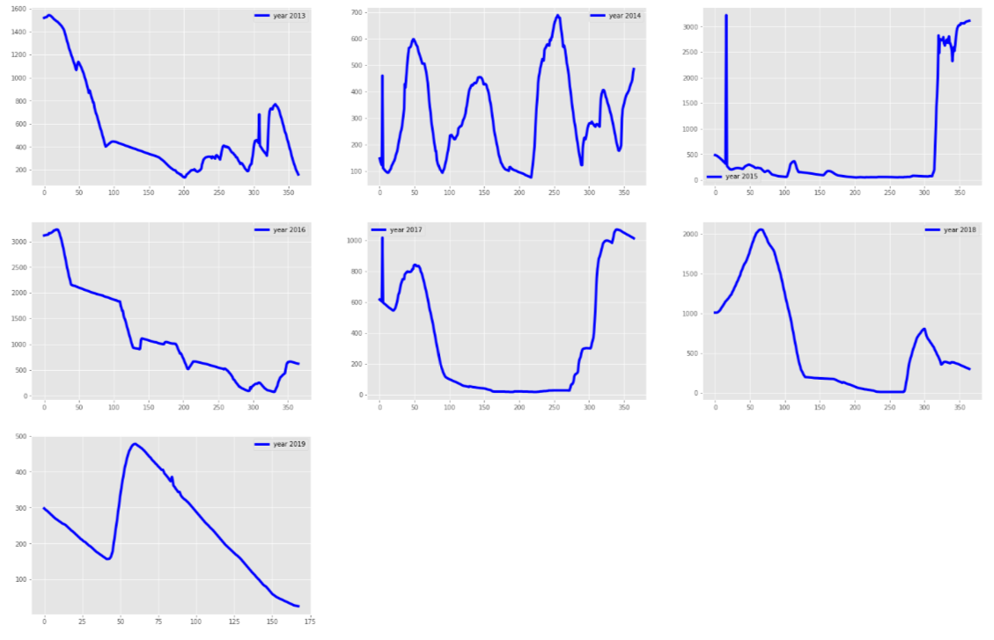
Reservoir level in Chennai after 2012 :

Slide 10
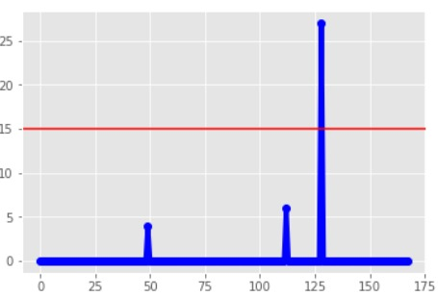
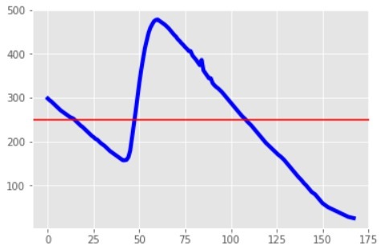
Water Crisis Situation in 2019
In 2019 , Rainfall level is lower than the average level due to which Reservoir level is also low that indicates water crises situation.

Slide 11
Feasible Solutions
At the time of the water crisis, we should make sure that large water-consuming companies should be bounded for an upper limit of consumption of water. also if shutting down them temporarily helps to reduce some water consumption one may do that .
We will make aware people based on our prediction data so that people can start to reduce the consumption of water .
We will provide a limited supply of water to household area.

Slide 12
How We Can earn from this ??
By Providing notification to the industries for water scarcity earlier so they have maximum production.
we can charge a fair amount of money for giving people weekly updates to avoid a water crisis.

