Slide 1

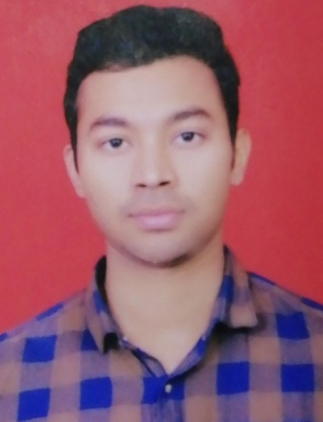
Ankit Raj
Education and certificates
Bachelor of Technology in Computer Science and Engineering(2015-2019)
Analyst/Software Engineer
Agile Software Development
TibcoBW6 Integration Essentials.
Base Location : Kolkata
Email ID : ankit.g.raj@capgemini.com
Mobile No: 8700798454/9546372235
Grade: A4
Skills
Strengths
A self driven learner with knowledge on implementation of TibcoBw6
Ready to learn new technologies/Frameworks and
implement them to further improve my knowledge.
A team player with good communication skill always ready to work for the enrichment of knowledge.
Integration Experience
Ability to comprehend the Business Requirement, Design and proficient in using Tibco business studio to build Tibco solutions
Knowledge on exposing REST/SOAP services and worked with different Tibco palettes like file, database, EMS, HTTP, SOAP,REST XML,JSON.
Knowledge on creating Tibco solutions to handle JSON/XML structure and used XPath transformations
Knowledge on development of applications using TIBCO BW6, BWCE ,EMS.
Tibco BW6
C
JAVA
HTML
MYSQL
Languages
English
Hindi
Presentation Title | Author | Date © Capgemini 2017. All rights reserved |
1

