Slide 1
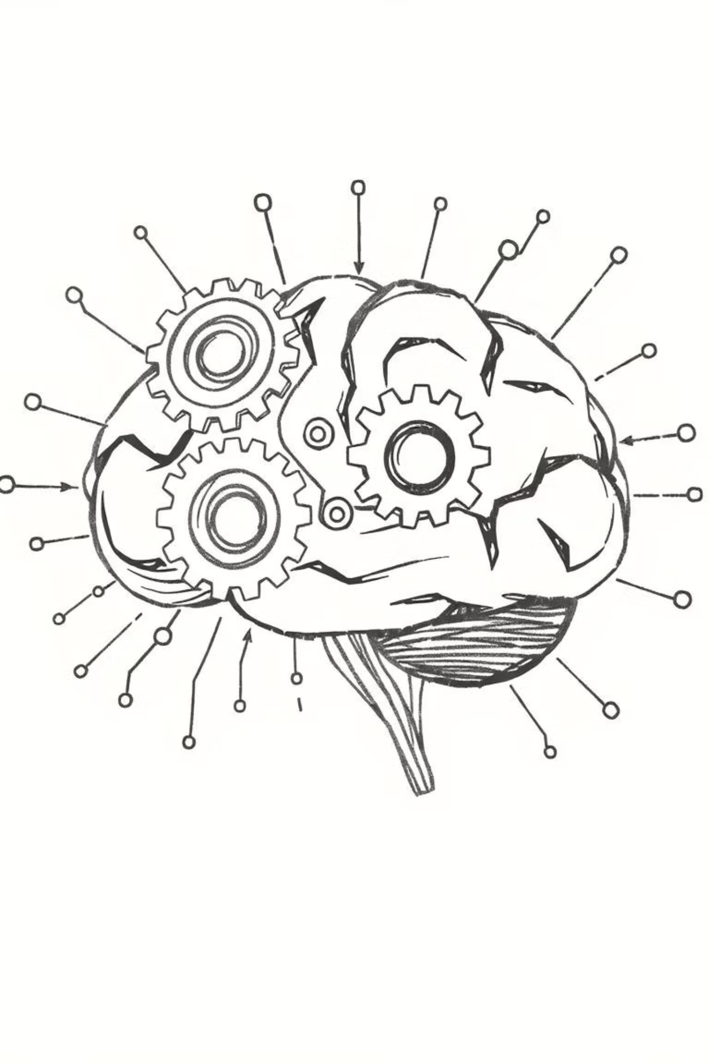
Project ARCHIMEDES
Advanced Responsive Consumer & Holistic Intelligence for Market Enhancement & Demand Efficiency System

Slide 2
Executive Summary: Seizing a ₹1,200 Cr Advantage
Project ARCHIMEDES aims to solve a ₹1,200 Cr annual supply chain demand-waste problem at HUL using AI-augmented analytics. This initiative transforms the supply chain into a predictive, proactive system, sensing market signals and automating responses.
16
₹150 Cr
₹20 Cr
Months Payback
Annual Gain
Pilot Investment

Slide 3
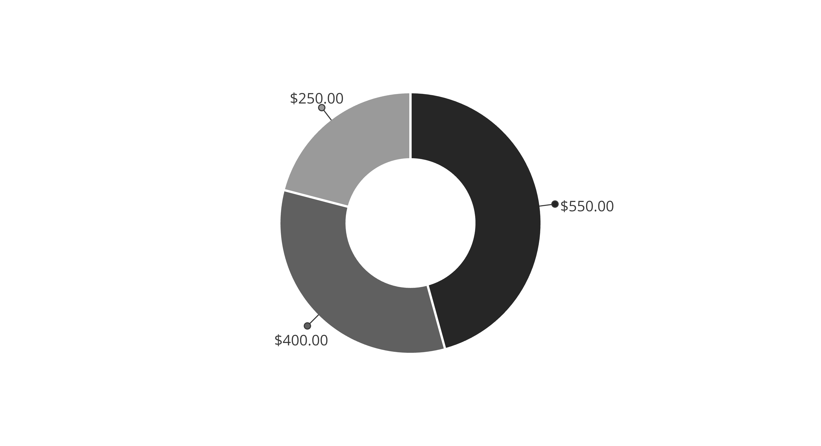
The ₹1,200 Cr Demand Waste Gap
Our analysis reveals a significant financial leakage driven by limitations in current forecasting. This "Demand Waste Gap" is quantified across three primary components:
Lost Sales (Stockouts)
Excess Inventory Costs
Inefficient Spend

Slide 4




Stakeholder Pain Points & Solutions
ARCHIMEDES addresses critical operational pain points for HUL's functional leaders, ensuring tangible value across the organization.
Supply Chain Head
Category Head
Optimize inventory, improve service fill rates, reduce stockouts.
Clarify promotion effectiveness and ROI.
IT/Data Head
Finance
Unify fragmented data ecosystems for analysis.
Optimize Working Capital by reducing inventory carrying costs.

Slide 5
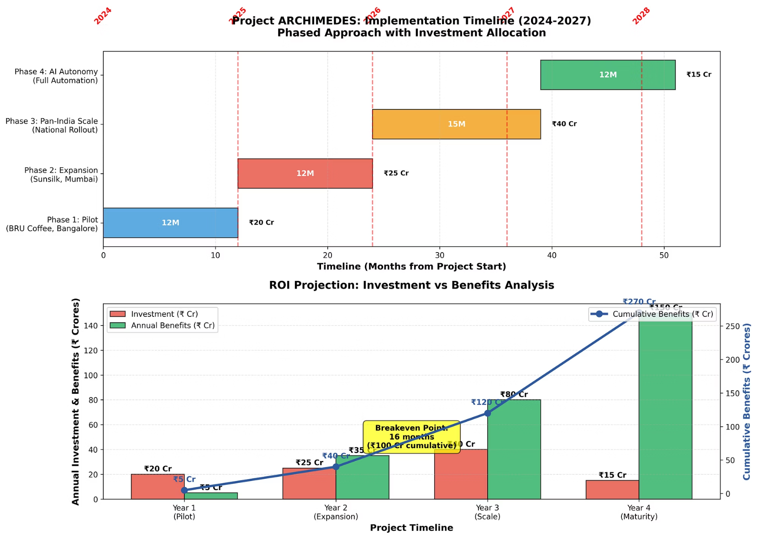
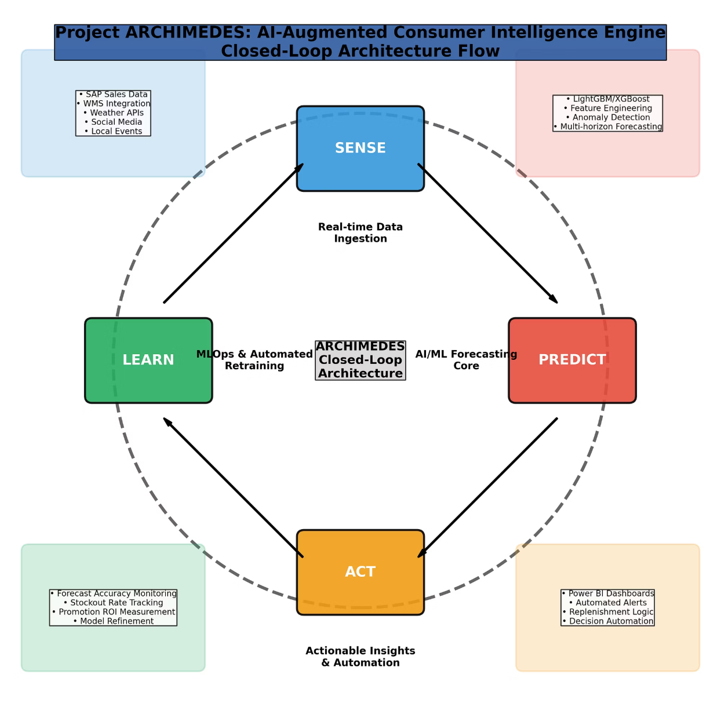
Process Transformation: AS-IS vs. TO-BE
ARCHIMEDES shifts HUL from a reactive, batch-processing mindset to a continuous, self-learning, real-time driven process powered by AI.
AS-IS Process: Manual & Reactive
TO-BE Process: AI-Driven & Proactive
Relying on manual data handling and complex spreadsheets is prone to errors and reactive.
Proactive, AI-powered intelligence for optimized decision-making.

Slide 6








The ARCHIMEDES Intelligence Loop
ARCHIMEDES is a closed-loop system that continuously collects data, generates predictions, translates them into actionable insights, and learns from outcomes to improve over time.
SENSE
PREDICT
Real-time data ingestion from internal and external sources.
AI/ML forecasting core for probabilistic, multi-horizon demand.
LEARN
ACT
Automated monitoring and model retraining for continuous improvement.
Actionable insights and automation for operational responses.

Slide 7
Solving the ₹1,200 Cr Problem
Lost Sales (₹550 Cr)
Excess Inventory (₹400 Cr)
Inefficient Spend (₹250 Cr)
ARCHIMEDES provides early warnings and hyper-accurate forecasts, reducing stockouts by 35% (from 8% to 5.2%).
Precise demand forecasts and intelligent safety stock reduce excess inventory by 20% (from 15% to 12%), freeing up ₹20 Cr in working capital.
Causal analytics and granular demand signals improve promo ROI by 44% (from 1.8x to 2.6x) and reduce logistics costs by 11%.

Slide 8
Strategic Roadmap & Change Management
A phased approach ensures successful implementation and adoption of ARCHIMEDES, building capability across the organization.
Phase 2: Expansion & Enrichment
Phase 1: Pilot (MVP)
2nd Category/City, Causal Engine (12 months).
BRU / Bangalore Pilot Dev & Deploy (12 months).
Phase 4: AI Autonomy & Advanced Capability
Phase 3: Pan-India Scale & Integration
Transition to Prescriptive-to-Automated Flow (12 months).
ERP, Production (15 months).

Slide 9
Conclusion: Enabling the Self-Learning Supply Chain
Project ARCHIMEDES is a strategic imperative for HUL, transforming its supply chain into an intelligent, responsive, and continuously improving competitive advantage.
"Project ARCHIMEDES isn't just a forecasting system — it's a competitive advantage architecture, empowering HUL to lead with intelligence in the era of hyper-personalized demand."
We urge the Executive Committee to approve the pilot phase, launching this critical initiative to build HUL's self-learning supply chain of the future.

