Slide 1
DATA SCIENCE PROJECT
Traffic Pattern
Forecasting
Cleaning, exploring, and forecasting one year of hourly intersection traffic volume using classical time-series methods.
Ankit | BCA, MDU University
Modules 2 – 4, 7

Slide 2
PROJECT OVERVIEW
From raw sensor data to a 30-day forecast
The project simulates a full applied data-science workflow on synthetic hourly traffic-volume data for one intersection, spanning 12 months.
1
2
3
4
Module 2
Module 3
Module 4
Module 7
Data Generation & Cleaning
Visualization & EDA
Descriptive Statistics
Decomposition & Forecasting
Simulate realistic traffic with gaps and outliers, then correct them.
Explore hourly, daily, and weekly patterns visually.
Summarize the cleaned distribution of vehicle counts.
Decompose the series and compare three forecasting models.
02

Slide 3
THE DATASET
One year of synthetic hourly traffic volume
1
Daily seasonality
8,760
Morning (~8am) and evening (~6pm) rush-hour peaks on weekdays; one broad midday peak on weekends.
2
Weekly seasonality
hourly readings
(365 days × 24 hours)
Weekday volumes consistently outrun weekend volumes.
3
Yearly drift
Built to mimic real traffic behaviour — not scraped from a live sensor feed — so ground truth is known at every stage.
Slow seasonal sinusoid plus a gentle upward trend, simulating city growth over the year.
4
Injected noise
Random Gaussian noise, 60 missing hourly readings, and 25 outlier spikes/drops (accidents, closures).
03

Slide 4
MODULE 2 · DATA CLEANING
Fixing gaps and outliers before analysis
Outliers were flagged with the IQR method, treated as missing, then imputed — together with the original gaps — via time-based interpolation, appropriate for a smooth hourly flow series.
60
12
72
0
Missing values
found (raw)
Outliers found
(IQR method)
Total points
corrected
Remaining NaNs
after cleaning
Method note
IQR bounds used a wider 3× multiplier (rather than the usual 1.5×) so genuine rush-hour peaks weren't mistaken for outliers — only extreme accident/closure-style spikes and drops were flagged.
04

Slide 5
MODULE 4 · DESCRIPTIVE STATISTICS
The shape of the cleaned traffic distribution
404.2
76.0
32.7
755.6
Mean vehicles / hr
Std. deviation
Minimum
Maximum
25th pct
352.8
75th pct
460.6
Interquartile spread (25th – 75th percentile)
Min
32.7
Median 405.2
Max
755.6
The distribution is fairly tight around its mean (std ≈ 76), with the long right tail driven mainly by weekday evening rush-hour peaks rather than data errors.
05

Slide 6
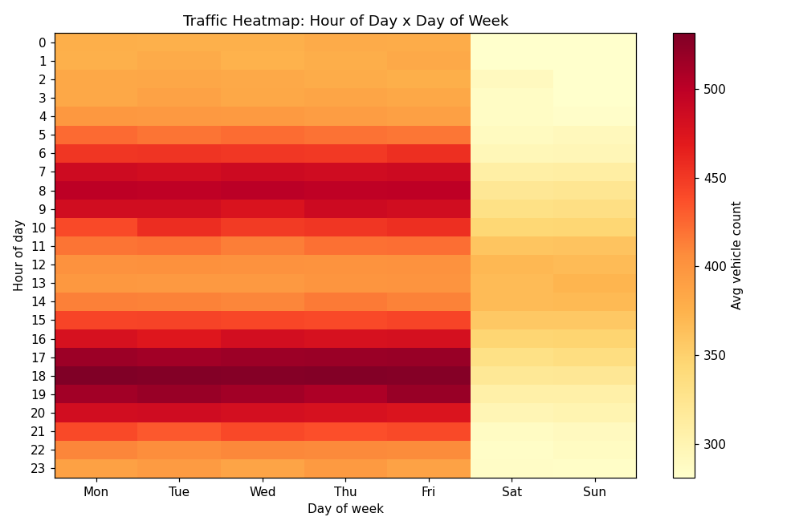
MODULE 3 · EXPLORATORY ANALYSIS
Rush hour, mapped
Twin weekday peaks
Darkest cells cluster at 7–9am and 5–7pm, Monday through Friday — classic commute behaviour.
Weekend flattens out
Saturday and Sunday stay uniformly light — no sharp rush-hour spikes, just a mild midday lift.
Evening beats morning
The 5–7pm band runs slightly hotter than the morning band across all five weekdays.
06

Slide 7
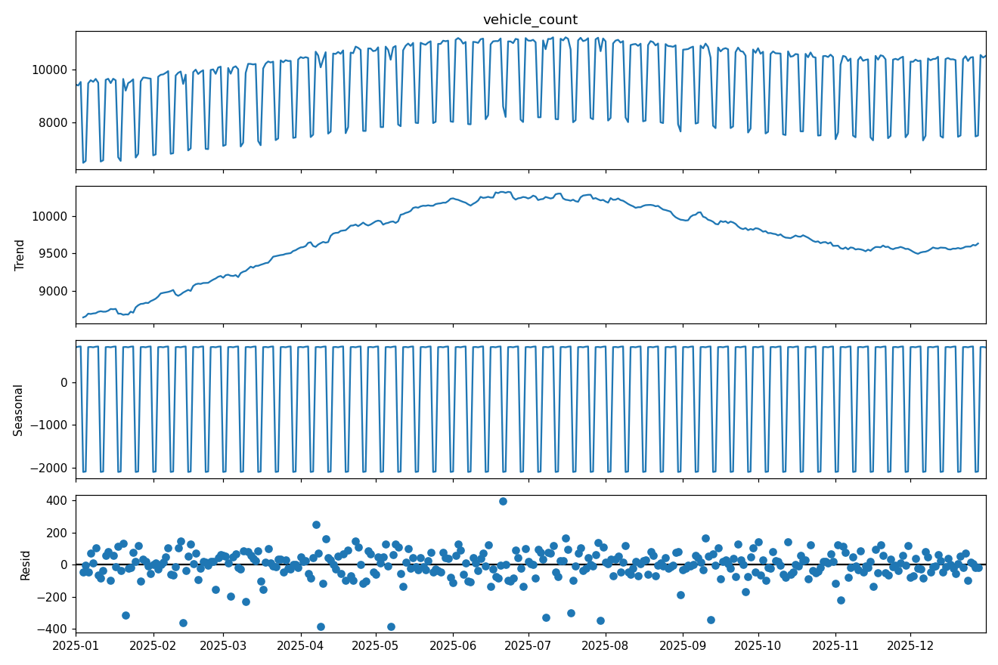
MODULE 7 · TIME-SERIES DECOMPOSITION
Separating trend, seasonality, and noise
An additive decomposition (period = 7 days) on daily totals splits the series into three interpretable layers.
Trend
Rises steadily through the first half of the year, peaks around June, then eases back — the injected growth + seasonal drift.
Seasonal
A crisp repeating weekly square wave: high on weekdays, a sharp drop every weekend.
Residual
Noise scattered tightly around zero, with a few larger spikes matching injected outlier days.
07

Slide 8
MODULE 7 · FORECASTING
Three models, one 30-day holdout
Daily totals were split into a training set and a final 30-day test window. Each model forecasts that window blind, then is scored against actuals.
1
2
3
Moving Average (7d)
Exponential Smoothing
SARIMA(1,1,1)(1,1,1,7)
Naive baseline: forecasts every day as the mean of the last 7 training days. No trend or seasonality awareness.
Holt-Winters with additive trend and additive weekly seasonality (period = 7). Adapts to both the trend and the weekday/weekend cycle.
Seasonal ARIMA capturing autocorrelation plus a 7-day seasonal component through differencing.
08

Slide 9
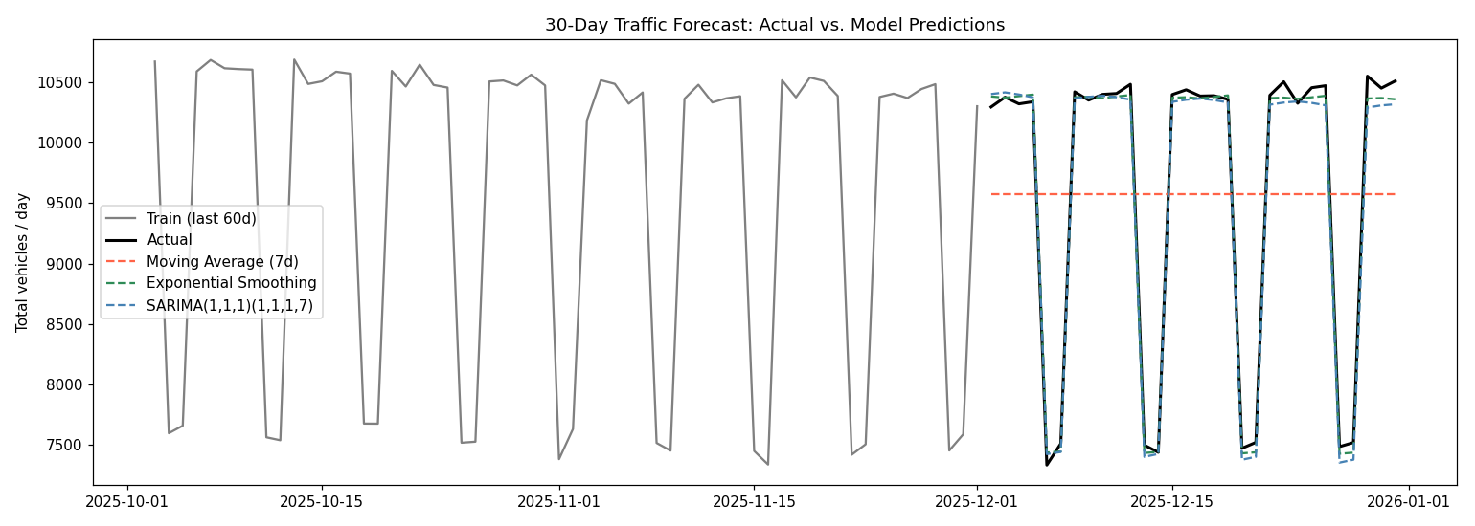
RESULTS
Exponential Smoothing wins on both metrics
Model
MAE
RMSE
Moving Avg (7d)
1171.2
1300.9
Exp. Smoothing
61.9
74.7
SARIMA(1,1,1)(1,1,1,7)
88.0
106.5
BEST MODEL
Exponential Smoothing
Lowest RMSE (74.7) and MAE (61.9) — the weekly-seasonal baseline the moving average lacks, without SARIMA's extra complexity.
09

Slide 10
KEY TAKEAWAYS
What the project shows
Structure over volume
Simplicity can win
Traffic is highly structured — dominated by predictable daily and weekly cycles — so models that capture seasonality dramatically outperform naive ones.
Holt-Winters Exponential Smoothing beat a full SARIMA model here, showing added complexity doesn't guarantee better forecasts.
Clean data matters
Weekly seasonality dominates
Interpolating just 72 flagged points (0.8% of readings) was enough to unlock reliable downstream statistics and forecasts.
Both winning approaches lean on the 7-day cycle — the single strongest signal in the data, stronger than yearly drift.
10

Slide 11
Thank You
Questions & discussion welcome.
Ankit
ankityadavv975@gmail.com

