Slide 1

“NEURAL NETWORK – BASED PREDICTIVE MODELLING FOR STOCK MARKET FORCASTING & ANALYSIS: A COMPARATIVE STUDY”
Research Internship, May – July, 2024
Ankit Kumar
Student at IIT Patna
Department of Computer Science & Engineering
Indian Institute of Technology, Patna (IITP), Bihar, India - 801106
Supervisor:
Dr Hari K Chaudhary
Associate Professor (Economics)
Department of Humanities and Social Sciences (Economics)
Indian Institute of Information Technology, Guwahati (IIITG), Assam, India -781015
Indian Institute of Information Technology, Guwahati

Slide 2
Outline
Introduction to AI, ML, DL, and Neural Networks
Machine Learning and its fundaments
Supervised Learning: Linear Regression, Non-Linear Regression (Polynomial, Decision, Random Forest, SVR, Logistic Regression)
Unsupervised Learning: Clustering, Dimensionality Reduction (PCA)
Semi-supervised
Reinforcement Learning
3. Deep Learning and Neural Network
Artificial Neural Networks (ANN) and Gradient Descent --- Feed Forward NN
Convolutional Neural Networks (CNN) – Feed Forward NN
Recurrent Neural Networks (RNN): Sentiment Analysis, GRU Model -- Feed Backward NN
Advanced NN: LSTM, Bi-Directional, and Stacked LSTM
3. Limitations & Future Enhancements
4. Conclusion and Key Takeaways
Indian Institute of Information Technology, Guwahati

Slide 3
Discover the Power of AI, ML, and Deep Learning
Dive into the world of Artificial Intelligence (AI), Machine Learning (ML), Deep Learning (DL), and Neural Networks. Unlock the potential of these transformative technologies to tackle complex challenges and drive innovation.
Why Now ??
Start in
1950
Alan Turing (Can machine think: The Turning Test)
Hints & Reasons:
Created Huge Data (Internet Bum around ’10th & ’12th , Cell phone, social media, V3 concepts)
Frameworks
Hardware (Moore’s Law in electronics, GPU)
Architecture (Transfer learning)
Community
Convert Unlabelled date into labelled
Available Public (GitHub, Kaggle, MS Coco, etc)
helps
In RESEARCH
(e.g. Facebook direct upload pics without name)
TensorFlow (+ KERASE) by google for Industry, PyTorch by Facebook for Researcher.
V3 = Volume, Velocity, Variety, Value & Veracity
Indian Institute of Information Technology, Guwahati

Slide 4
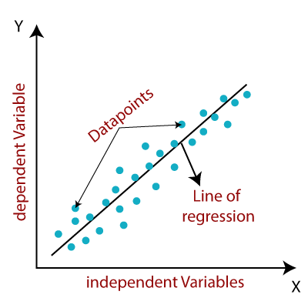
Supervised Learning: Unlocking Insights
Linear Regression
Predicting a continuous target variable using a linear relationship between input features.
Non - Linear Regression
Modeling complex, non-linear relationships between input features and target variables using techniques like polynomial, decision, and random forest regression, as well as support vector regression.
Decision Tree & Random Forest
Predicting powerful tool for classifier and predication, flowchart like Tree .
Indian Institute of Information Technology, Guwahati
Notes:
This is my Chapter 02 of documentation (Research at IIIT Guwahati)

Slide 5
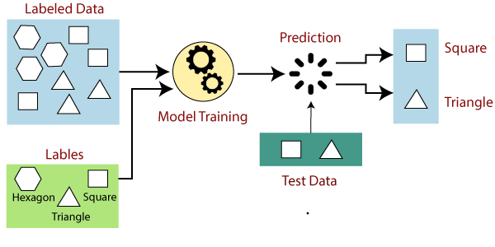
Supervised Learning: Unlocking Insights
Logistic Regression
Classify data into distinct categories and make binary decisions.
Application:
(labelled)
From real-life e.g.
SVR (Support Vector):
uses linear and non-linear KERNEL for predication Linear Kernel means simple dot product of two input, whereas Non-linear uses more complex function to capture to more advance pattern in data.
Indian Institute of Information Technology, Guwahati
Notes:
This is my Chapter 02 of documentation (Research at IIIT Guwahati)

Slide 6
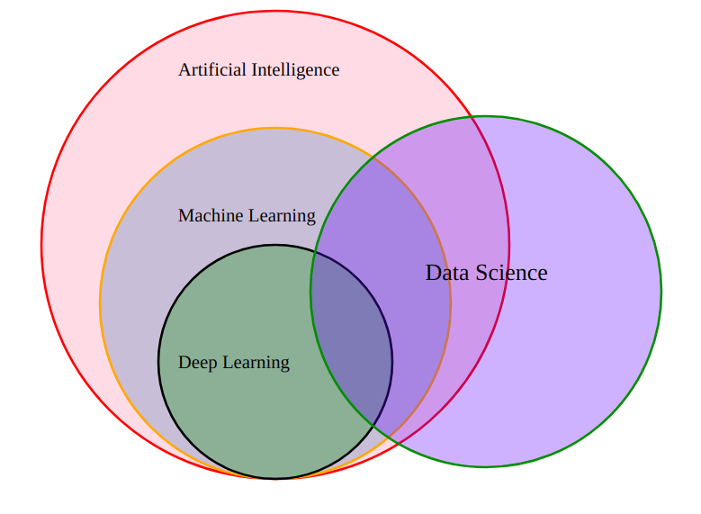
“Venn Diagram” !!!
Q. Diff b/w DeepNN & ML is a Big Ques ???
Hints:
Data size (D = more, M = less)
Hardware (D – GPU + TPU, M = CPU)
Training Time (D = more even month, M = less max hours)
Feature Selection (e.g. Resume building, Breed classifier can’t say WHY in D, but apply M = yes) this is major problem with deepNN
Interpretation (e.g. Command banned, Decision Tree in ML give why 0 and 1 )
In Deep NN, Matrix multiplication happen which give Predication value more optimum.
Why not use D (powerful & good) use in every project ?? D never replace ML !!! Slogan in society SWORD v/s sewing
D is Data Hungry person but ML at least 1000 it’s enough
Indian Institute of Information Technology, Guwahati
Notes:
Venn Diagram of ML, DL, DS and Neural Network (IMAGE used) : https://user-images.githubusercontent.com/7995307/64065525-153d9580-cbfe-11e9-9236-d9ffc3f34a43.png

Slide 7
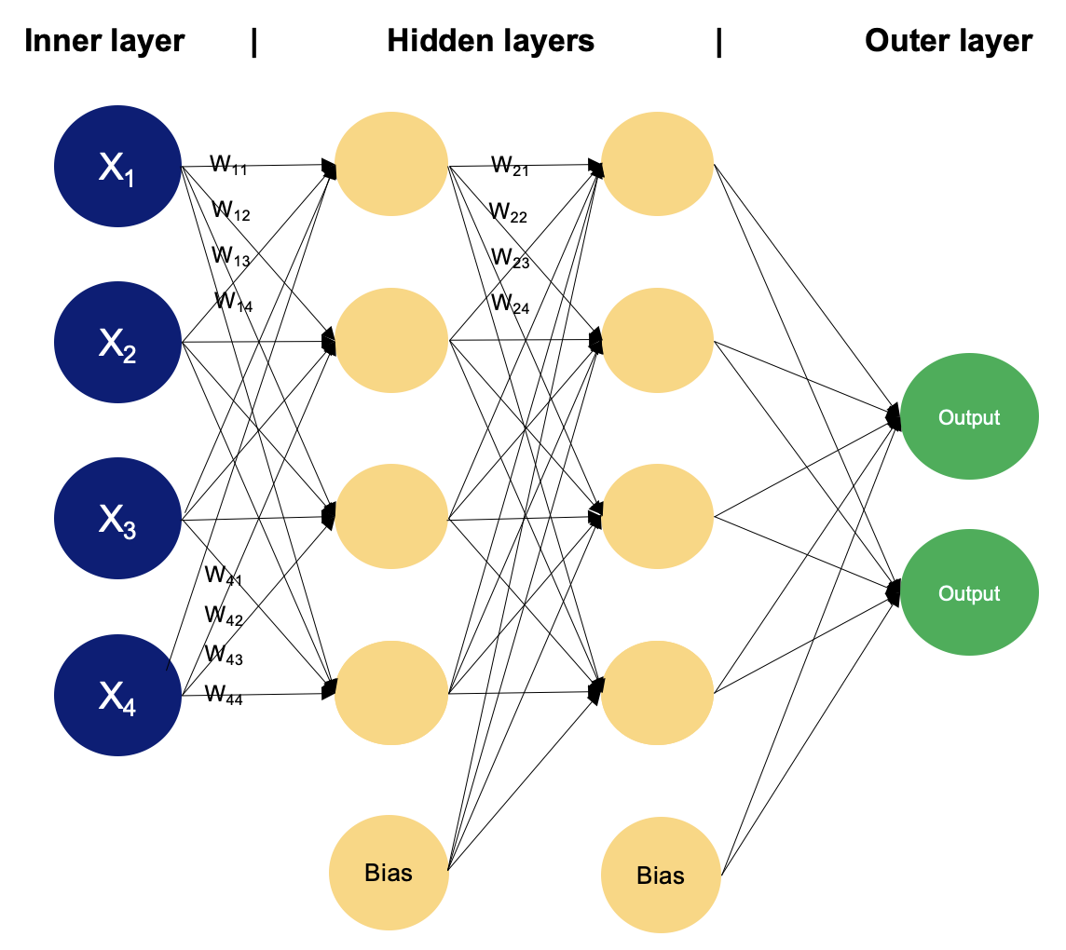
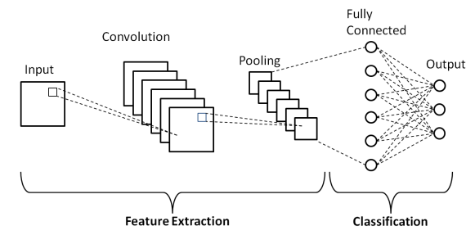
Overview:
Types of Neural Network
Application:
Supervised L Classification & Regression problems
Feed Forward NN
(signal moves first to last
Linearly )
Application:
Img & video detection (dataset)
Multi-Layer Perceptron
(MLP)
Convolutional Neural Network
(CNN)
Indian Institute of Information Technology, Guwahati
Notes:
MLP img src: https://images.datacamp.com/image/upload/v1707332922/image2_fb47b41f2f.png
CNN img link: https://d14b9ctw0m6fid.cloudfront.net/ugblog/wp-content/uploads/2020/12/1-4.png
https://www.upgrad.com/blog/basic-cnn-architecture/

Slide 8
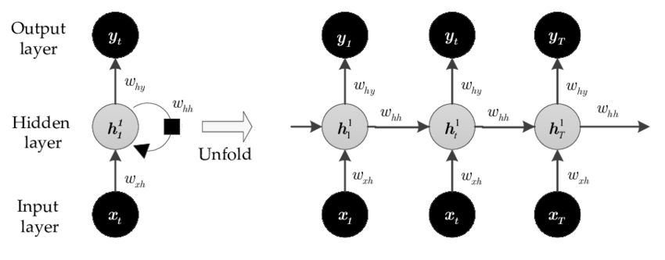
Overview:
Types of Neural Network
Feed Back NN
(Loop form which help in achieve optimum)
Recurrent (RNN) & Long Short Term Memory (LSTM)
Note: In this circuit diag, cycle symbol represent Back propagation & hidden layer.
Application of RNN: in NLP & chatbot device e.g. Alex. Siri
Indian Institute of Information Technology, Guwahati
Notes:
Img src: https://www.researchgate.net/publication/333119454/figure/fig2/AS:758994134134784@1557969711626/Recurrent-neural-network-RNN-The-circles-represent-network-layers-and-the-solid-lines.png

Slide 9
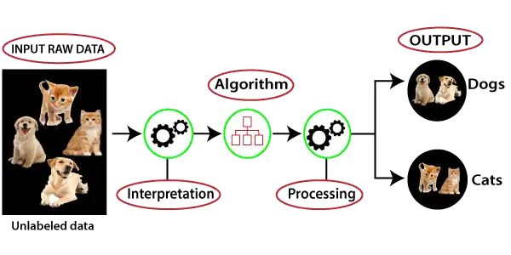
Unsupervised Learning: Uncovering Hidden Patterns
1. Clustering
Grouping similar data points together without any predefined labels.
2. Dimensionality Reduction
Reducing the number of input features while preserving the most important information.
3. PCA
Principal Component Analysis, a popular technique for dimensionality reduction.
Application:
(unlabelled)
From real-life e.g.
Indian Institute of Information Technology, Guwahati
Notes:
Img src of supervised L: https://static.javatpoint.com/tutorial/machine-learning/images/supervised-machine-learning.png
Img src of unsupervised L: https://static.javatpoint.com/tutorial/machine-learning/images/unsupervised-machine-learning-1.png

Slide 10
Reinforcement Learning: Adaptive Problem- Solving
Explore how intelligent agents can learn and make decisions by interacting with their environment, optimizing their actions to achieve specific goals.
Note: RL uses trial-error method or Reward based learning (feedback in the form of reward and penalties for wrong action is famous called Markov Decision Problem)
Indian Institute of Information Technology, Guwahati

Slide 11
Perceptron v/s Neuron and Perceptron Geometric Intuition
Perceptron: is the simplest ANN, consist of and type of feed forward NN, consisting of a single layer of input nodes.
can learn the linearly separable patterns. it uses slightly different types of artificial neurons known as threshold logic units (TLU).
Types: Single & Multi layered (MLP = ANN)
Working: create a region by divided into two part through line (same like my math's Sem2 IITP Graph Theory, Network & LPP chapter) so called Binary Classifier.
Perceptron acts like: In 2D = Line, 3D = plane (assume sheet), 4D = Hyperbola
Limitation of perceptron: only linear & sort of linear to classify applicable in 2D, 3D, 4D in class cases. Be careful about this in non linear dataset!
Neuron: is complex structure, biological electrochemical reaction, very Processing, Neuroplasticity
Same structure part are Inspired to perceptron, totally copy isn’t true at all.
Neuron have very internal operation but perceptron have two (summation & step function)
Smallest unit of human body is cell, similarly smallest unit (or fundamental) of NN or deep learning is Perceptron.
SKLEARN library support perceptron so no need to write code from scratch
https://scikit-learn.org/stable/modules/generated/sklearn.linear_model.Perceptron.html
Can Perceptron be train & predicate like other NN and ML algo ?
Indian Institute of Information Technology, Guwahati
Notes:
SKLEARN library documentation to be refer
https://scikit-learn.org/stable/modules/generated/sklearn.linear_model.Perceptron.html

Slide 12
Multi Layers Perceptron (MLP) become popular & Limitation of SLP
2. The limitation of Single Layer Perceptron (SLP) networks is that they can only learn linearly separable patterns, meaning they are not capable of solving some complex classification problems. This is because SLPs can only produce linear decision boundaries, making them limited in their capability to model and learn non-linear relationships in data.
1. MLP networks have become popular is due to their ability to effectively learn complex patterns and relationships in data through the use of multiple layers of neurons (perceptron). This allows MLPs to model more intricate and non-linear relationships compared to Single Layer Perceptron (SLP) networks.
Note:
you can solve any problem Non linear data by giving (enough or increase Hidden Layer + Training time) known for UFA (Universal Function Approximator) of neural network [NN = UFA]
Super - Impose of 2 graph + Decision boundaries and Smoothing are the method to solve SLP problems and this ways is used in MLP
For any networks: working visualize by GUI tool https://playground.tensorflow.org
From Back – propagation NN learn, (Predication – maths behind is matrix dot product on Linear Algebra).
Indian Institute of Information Technology, Guwahati
Notes:
for NN playground + GUI tool + free + open source + publically available just enjoy this https://playground.tensorflow.org
UFA resource ref: https://www.researchgate.net/publication/266656890_Neural_network-based_accelerators_for_transcendental_function_approximation

Slide 13
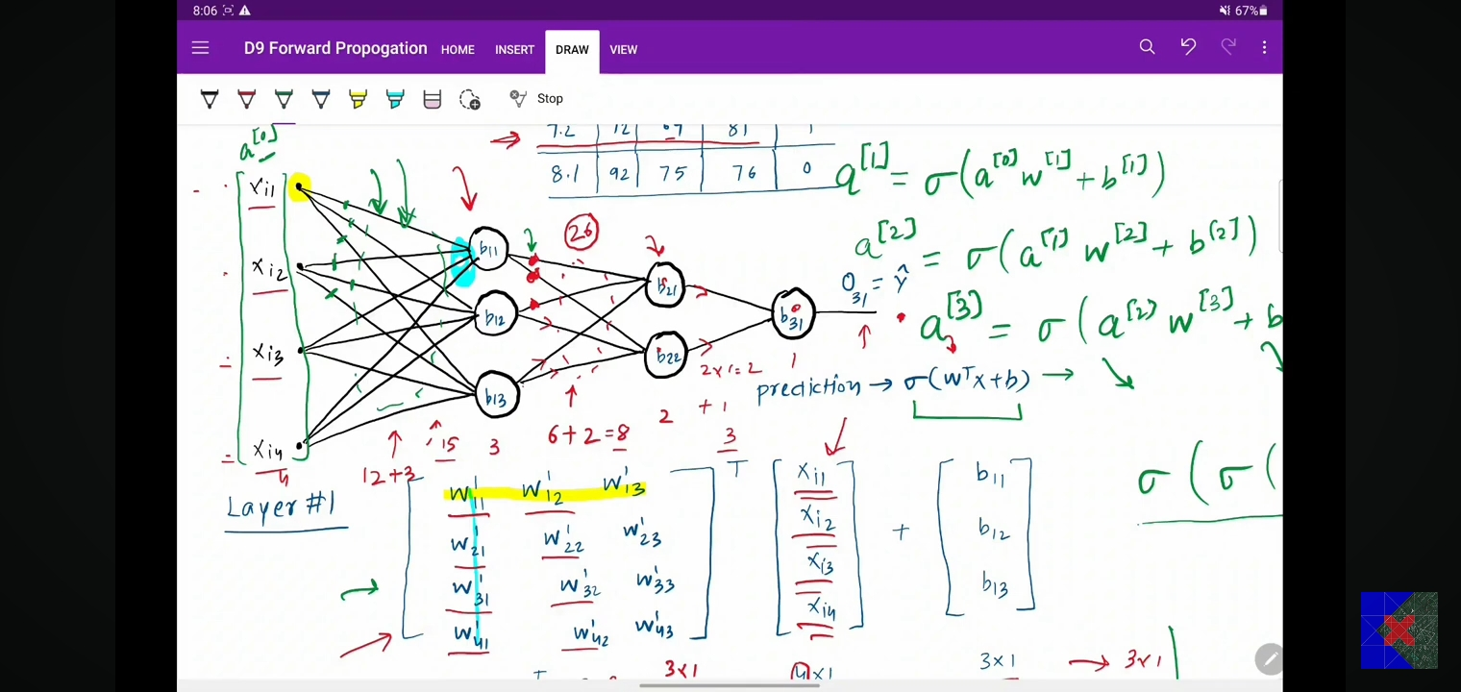
Maths behind the PREDICATION + Training of model (ANN: MLP)
Concept is very simple Matrix Dot Multiplication (scalar product)
Before moving ahead see 2 propagation terms:
Observe the difference: In Forward: data input moves toward forward direction, but in case of Backward (helps in predication): the update weights in backward direction that’s how training occurs.
Indian Institute of Information Technology, Guwahati
Notes:
This screenshot of predication maths behind is from CAMPUSX YouTube channel only for learning purposes.
Video link: https://youtu.be/7MuiScUkboE?si=KF_t3BMZczd_Pm0e
Behind the scene PREDICATION: how NN work – Linear Algebra (dot product of matrix multiplication) [Ankit have learnt in Sem2 IITP maths very easy also by MatLab]

Slide 14
Backward propagation
MLP Memorization concept in NN:
Is a technique to reduce time complexity by storing value .i.e. in DSA use fib(), recursive method – exponential.
Sol: DP (dynamic programming)
Loss function: is a function of all trainable parameters.
Concept of Gradient: is a fancy word of derivatives or gradient descent.
Rate of Learning Rate (denotes the minimum), concept of Gradient, vectorization
Backpropagation: chain of differentiate rule + memorization
No of batch size in even no (2, 4, 6. …)
WHY ??
Gradient Descent (Batch GD+ Stochastic GD + Mini GD): is a optimization algo,
NN = function of weight + bias
Indian Institute of Information Technology, Guwahati
Notes:
https://developers.google.com/machine-learning/crash-course/fitter/graph
Resource to see https://developers-dot-devsite-v2-prod.appspot.com/machine-learning/crash-course/backprop-scroll

Slide 15
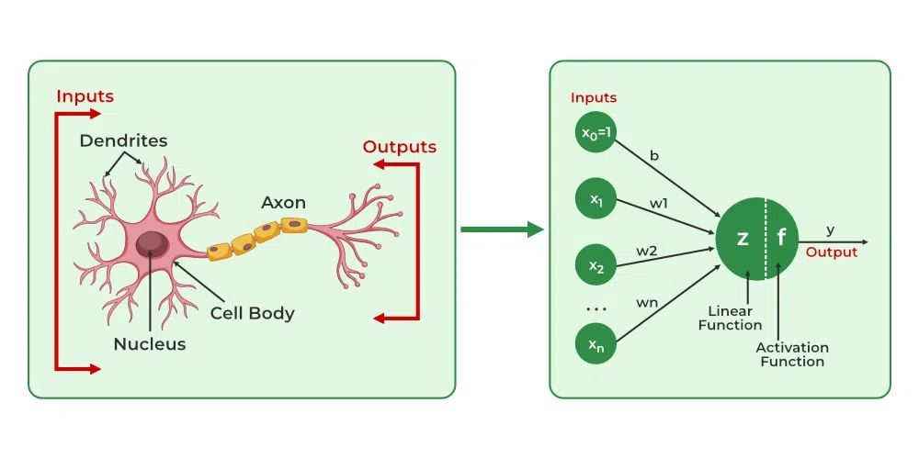
Neural Networks and Deep Learning
assffg
Observers this animation carefully which give clearcut ideas, BNN: Biological Neural Network (Human being) and ANN: Artificial Neural Network !!!
Model of Neuron
Note: Backpropagation (algo) is used to train neural networks by adjusting the weights and “Gradient Descent”: An optimization technique used to find the optimal weights and biases.
Indian Institute of Information Technology, Guwahati
Notes:
Now, My chapter 03 is started of Research documentation at IIIT Guwahati.
For ANN & BNN representation (ANIMATION used):
https://www.geeksforgeeks.org/artificial-neural-networks-and-its-applications/

Slide 16
Convolutional Neural Network (CNN)
Also known as Convnet, are a special kind of neutral network for processing data that has known gride-like topology like time series data (1D) or images (2D)
How differ from ANN? By convolution layer i.e., which works is convolutional operation use but in ANN (we use matrix-multiplication)
CNN have 3 layers: Convolutional, pooling, FC layer (fully connected, like used in ANN)
CNN > ANN more perform on image data because of efficiency and widely or mostly used in real life e.g., bank cheque, OCR, handwritten, face lock / finger lock on phone.
Image = pixels of 2D grid
(I) High computation cost, (ii) overfitting, (iii) Loss of imp. Info. Like spatial arrangements of pixels if you can the dimes ion of img i.e., 3D to 2D try to image the image by closing your eyes. Features extract of primitive features
Why not ANN ?
Indian Institute of Information Technology, Guwahati

Slide 17
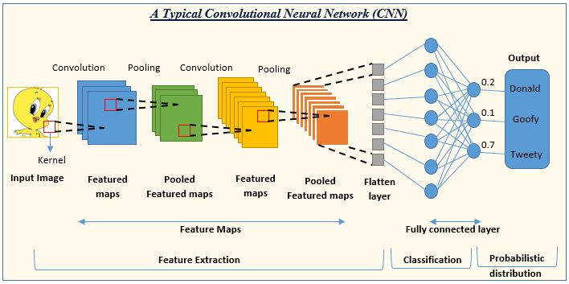
Architecture of CNN
Imp points:
Pooling operation: Animation enjoying https://deeplizard.com/resource/pavq7noze3
Concept of Generators in CNN: when the data set is given very big then it divides then generators is working i.e., the dataset into the Batches
Data Augmentation in deep NN: building powerful image classification using very little data.
ILSVRC – imageNET challenges where pretrained model needed for less error
Hyperparameters Tuner of NN: process of selecting the optimal values, Models can have many hyperparameters and finding the best combination of parameters can be treated as a search problem. The two best strategies for Hyperparameter tuning are:
GridSearchCV, RandomizedSearchCV, Bayesian Optimization
Indian Institute of Information Technology, Guwahati
Notes:
CNN str. Image link:
https://www.analyticsvidhya.com/blog/2022/01/convolutional-neural-network-an-overview/

Slide 18
Why Keras-Sequential model is failed and need Keras-Functional API
Consider two cases:
For predicting age (a regression problem) or classifying emotions (a classification problem), both can be effectively handled by the Sequential API with appropriate configurations (e.g., different output layers, loss functions).
If you need to combine multiple inputs (e.g., image and metadata) to predict age or emotion, then the Functional API might be more suitable to define the model architecture flexibly.
How to choose: between Sequential and Functional APIs:
Sequential API: It is straightforward and suitable for most feedforward neural networks where layers are stacked sequentially. It's ideal for simpler architectures.
Functional API: Offers more flexibility for creating complex models, including models with multiple inputs and outputs, shared layers, and non-linear connections between layers. It's particularly useful for advanced architectures like multi-output models, residual connections, etc.
Indian Institute of Information Technology, Guwahati
Notes:
Blog for functional API https://machinelearningmastery.com/keras-functional-api-deep-learning/

Slide 19
Recurrent Neural Network (RNN)
Data for RNN is in form of timesteps & input-features e.g. movies review
How differ? RNN is similar to ANN, but two difference in RNN on each time (t1, t2,.. ) one input is passed (X11, X12, X13) and second is back feed happen in RNN (this makes RNN) not in ANN
Taking weights + bias as same on each new input, which is called SHARING-Parameters occurs.
RNN can process the sequence of hidden occurs.
Sentiment Analysis
RNNs can understand and analyze the sentiment expressed in text data.
Why RNN is said recurrent
Indian Institute of Information Technology, Guwahati

Slide 20
Recurrent Neural Networks (RNNs): Sub-Parts
1. LSTM
a type of recurrent neural network (RNN) aimed at dealing with the vanishing gradient problem present in traditional RNNs.
2. GRU Model
Employ Gated Recurrent Units (GRUs) to improve the performance of RNNs on complex tasks, a type of RNN that can model long-term dependencies.
3. Bi-Directional LSTM (RNN or GRU) (Emotional detection)
BiLSTM is a term used for a sequence model which contains two LSTM layers, one for processing input in the forward direction and the other for processing in the backward direction.
4. Stacked LSTM (GRU or RNN) Model
consists of multiple LSTM layers stacked on top of each other. This architecture allows the model to learn complex representations of sequential data, making it suitable for tasks such as time series forecasting, natural language processing, and more.
Indian Institute of Information Technology, Guwahati

Slide 21
Limitations & Future Enhancements
Improve the model using Hyper-Parameter tuning (Grid Search CV, Random Search CV, Bayesian Search CV)
Transformer & Transfer Learning
Roll-Out window used to train model in equal no. of separation (suggest by Prof Nath)
KNN: K nearest neighbours
Indian Institute of Information Technology, Guwahati

Slide 22
Conclusion and Key Takeaways
AI, ML, DL, and Neural Networks are transforming industries and opening new possibilities. Mastering these technologies is crucial for staying competitive in the digital age.
Explore the boundless potential of these technologies to shape the future and drive innovation across diverse industries.
Indian Institute of Information Technology, Guwahati

Slide 23
References
Venn Diagram of ML, DL, DS and Neural Network (IMAGE used) : https://user-images.githubusercontent.com/7995307/64065525-153d9580-cbfe-11e9-9236-d9ffc3f34a43.png
For ANN & BNN representation (ANIMATION used):
https://www.geeksforgeeks.org/artificial-neural-networks-and-its-applications/
3. Tutorials and concepts clear by Krish Naik, CampusX & Five-Minute Engineering YouTube channels
https://www.youtube.com/channel/UCNU_lfiiWBdtULKOw6X0Dig
https://www.youtube.com/@5MinutesEngineering
https://www.youtube.com/@campusx-official
4. Source which we referred (THEORY) https://www.geeksforgeeks.org/machine-learning/
For NN and DL https://www.geeksforgeeks.org/deep-learning-tutorial/
Indian Institute of Information Technology, Guwahati

Slide 24
Thanks for your attention !!!

Slide 25
Q & A Session
Open floor for committee (audience) questions and discussions

Slide 26
Indian Institute of Information Technology, Guwahati

Slide 27
Indian Institute of Information Technology, Guwahati

Slide 28
Indian Institute of Information Technology, Guwahati

