Slide 1

“NEURAL NETWORK – BASED PREDICTIVE MODELLING FOR STOCK MARKET FORCASTING & ANALYSIS: A COMPARATIVE STUDY”
Supervisor:
Dr Hari K Chaudhary
Department of Humanities and Social Sciences
Indian Institute of Information Technology, Guwahati (IIITG), Assam, India -781015
E-mail: hari@iiitg.ac.in
Guided By:
Sanjib Singha
Research Scholar (PhD)
Department of Humanities and Social Sciences
Indian Institute of Information Technology, Guwahati (IIITG), Assam, India - 781015
E-mail: sanjib.singha@iiitg.ac.in
About Me:
Ankit Kumar
student at the Indian Institute of Technology, Patna (IITP), Bihar, India - 801106
Bachelor's degree in Computer Science and Data Analytics
Department of Computer Science & Engineering
E-mail: ankit_2312res127@iitp.ac.in
Indian Institute of Information Technology, Guwahati

Slide 2
Outline
Introduction to AI, ML, DL, and Neural Networks
Machine Learning and its fundaments
Supervised Learning: Linear Regression, Non-Linear Regression (Polynomial, Decision, Random Forest, SVR, Logistic Regression)
Unsupervised Learning: Clustering, Dimensionality Reduction (PCA)
Semi-supervised
Reinforcement Learning
3. Deep Learning and Neural Network
Artificial Neural Networks (ANN) and Gradient Descent
Recurrent Neural Networks (RNN): Sentiment Analysis, GRU Model
4. Conclusion and Key Takeaways
Indian Institute of Information Technology, Guwahati

Slide 3
Discover the Power of AI, ML, and Deep Learning
Dive into the world of Artificial Intelligence (AI), Machine Learning (ML), Deep Learning (DL), and Neural Networks. Unlock the potential of these transformative technologies to tackle complex challenges and drive innovation.
Indian Institute of Information Technology, Guwahati

Slide 4
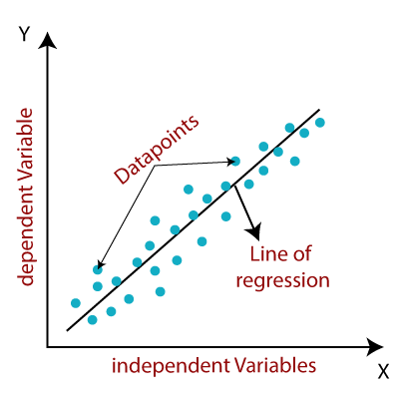
Supervised Learning: Unlocking Insights
Linear Regression
Predicting a continuous target variable using a linear relationship between input features.
Logistic Regression
Classify data into distinct categories and make binary decisions.
Non - Linear Regression
Modeling complex, non-linear relationships between input features and target variables using techniques like polynomial, decision, and random forest regression, as well as support vector regression.
SVR Regression:
uses linear and non-linear KERNEL for predication Linear Kernel means simple dot product of two input, whereas Non-linear uses more complex function to capture to more advance pattern in data.
Decision Tree & Random Forest
Predicting powerful tool for classifier and predication, flowchart like Tree .
Indian Institute of Information Technology, Guwahati
Notes:
This is my Chapter 02 of documentation (Research at IIIT Guwahati)

Slide 5
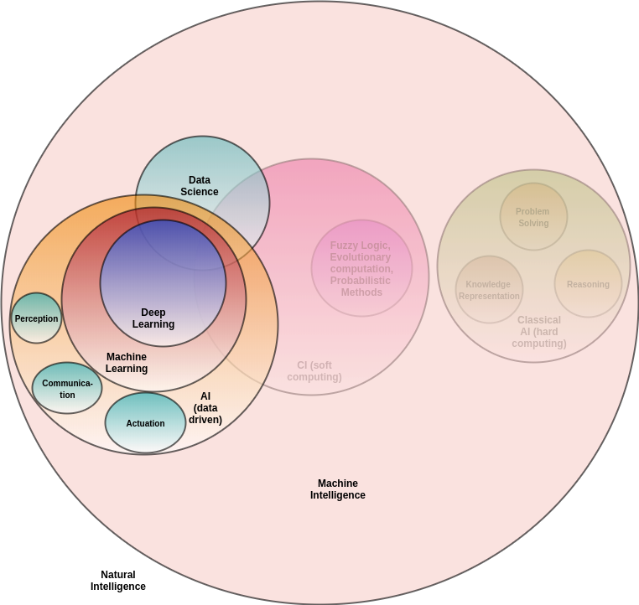
Have a look at this “Venn Diagram” !!!
Indian Institute of Information Technology, Guwahati

Slide 6
Unsupervised Learning: Uncovering Hidden Patterns
1. Clustering
Grouping similar data points together without any predefined labels.
2. Dimensionality Reduction
Reducing the number of input features while preserving the most important information.
3. PCA
Principal Component Analysis, a popular technique for dimensionality reduction.
Indian Institute of Information Technology, Guwahati

Slide 7
Reinforcement Learning: Adaptive Problem- Solving
Explore how intelligent agents can learn and make decisions by interacting with their environment, optimizing their actions to achieve specific goals.
Note: RL uses trial-error method or Reward based learning (feedback in the form of reward and penalties for wrong action is famous called Markov Decision Problem)
Indian Institute of Information Technology, Guwahati

Slide 8
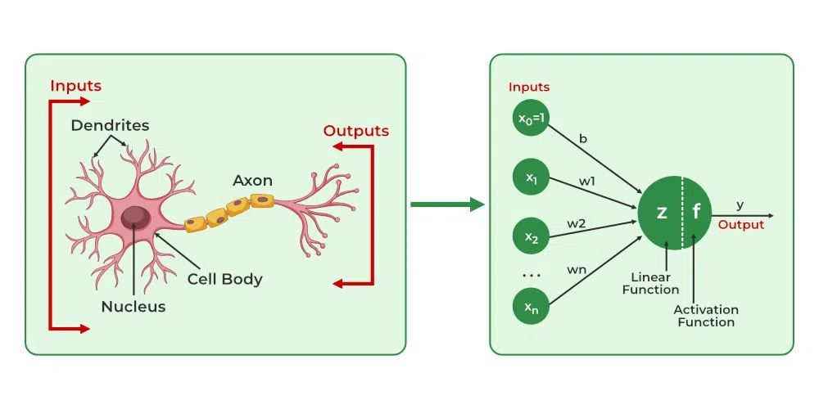
Neural Networks and Deep Learning
assffg
Observers this animation carefully which give clearcut ideas, BNN: Biological Neural Network (Human being) and ANN: Artificial Neural Network !!!
Model of Neuron
Note: Backpropagation (algo) is used to train neural networks by adjusting the weights and “Gradient Descent”: An optimization technique used to find the optimal weights and biases.
Indian Institute of Information Technology, Guwahati
Notes:
Now, My chapter 03 is started of Research documentation at IIIT Guwahati.

Slide 9
Recurrent Neural Networks (RNNs): Mastering Sequences
Sentiment Analysis
RNNs can understand and analyze the sentiment expressed in text data.
2. GRU Model
Employ Gated Recurrent Units (GRUs) to improve the performance of RNNs on complex tasks, a type of RNN that can model long-term dependencies.
3. LSTM
RNNs …………………………..
………………………………
4. Bi – directional LSTM (Emotional detection)
RNNs …………………………..
………………………………
Indian Institute of Information Technology, Guwahati

Slide 10
Conclusion and Key Takeaways
AI, ML, DL, and Neural Networks are transforming industries and opening new possibilities. Mastering these technologies is crucial for staying competitive in the digital age.
Explore the boundless potential of these technologies to shape the future and drive innovation across diverse industries.
Indian Institute of Information Technology, Guwahati

Slide 11
References
Venn Diagram of ML, DL, DS and Neural Network (IMAGE used) : https://pradeepney.medium.com/are-ml-dl-ds-the-unique-relations-of-ai-a52d7735c88
For ANN & BNN representation (ANIMATION used):
https://www.geeksforgeeks.org/artificial-neural-networks-and-its-applications/
3. Tutorials and concepts clear by Krish Naik & Five-Minute Engineering YouTube channels
https://www.youtube.com/channel/UCNU_lfiiWBdtULKOw6X0Dig
https://www.youtube.com/@5MinutesEngineering
4. Source which we referred (THEORY) https://www.geeksforgeeks.org/machine-learning/
Indian Institute of Information Technology, Guwahati

Slide 12
Thanks for your attention !!!
Indian Institute of Information Technology, Guwahati

Slide 13
Indian Institute of Information Technology, Guwahati

Slide 14
Indian Institute of Information Technology, Guwahati

Slide 15
Indian Institute of Information Technology, Guwahati

Slide 16
Indian Institute of Information Technology, Guwahati

