Slide 1

Swaminarayan BookStall
Project Guide: Developed By:
Mr. B.V.Patel Ankit Pandya - M10046

Slide 2
Introduction
Definition
Swaminarayan BookStall is a website for purchasing Books, CDs ,DVDs from website and also provides features for downloading E-Books.
Objective
The objective of the website is to provide the better way of displaying items, purchasing items. It also help the Administrator to perform such actions like inserting, editing, deleting of items and also managing orders and information of user’s.

Slide 3
Facilities
Less paper work required.
We able to advertise our latest products in less time and low cost.
A globally represented website will provide a large market to reach the maximum possible customers.
Search facility will help customer to speedily find out products.
Administrator can upload new products as well as can delete or edit existing product’s information.
Administrator can easily access account of the customer and also access different orders of customer.
Users/Customers can purchase different items from the website and also can download various E-Books.

Slide 4
Tools Used
Front End
Microsoft Visual Studio 2010 (ASP.NET with C#)
Back End
Microsoft SQL Server 2008

Slide 5
Resources Required
Hardware Requirement
Intel dual core, 1.8 GHz or above
512 MB RAM
40 GB Hard Disk (min)
32 bit Color Monitor with 1024 X 768 resolution
Mouse, Keyboard
Software Requirement
Operating System:
Windows XP or Above
Supporting Tool:
.NET Framework 4.0

Slide 6
Existing System
Existing System is based on the manual work and all the process are done manually, so they maintain registers and all files for recording all the details of the system. They maintain several registers for recording the entry of daily transaction such as sales, damaged items for return, given to administrator of the Swaminarayan BookStall of free of cost, etc. are listing in that book.
They maintain the record of the selling items so they keep each and every information regarding the books in the book master file. They keep bill book to maintain the record for each sale of the book or any transaction has been done in the book stall.
Thus every thing is performing on the book manually.

Slide 7
Drawbacks
For this bookstall there is only way to purchase books that is to visit the bookstall .
Every time visit to bookstall is time consuming for customer.
Customer faced problems like find out the book or item and it will become time consuming because of paper work or lack of rush
Administrator also maintain the clean up entire bookstall.
If some one is in hurry, customer or worker then may be mistake occurs.
The manual system does not provide fast access to information.

Slide 8
Data Dictionary
Item_Master
Primary Key: Book_id
Field Name | Type | Size
Book_id | Varchar | 5
Book_nm | Varchar | 50
Author | Varchar | 50
Price | Numeric | 8,0
Description | Varchar | 255
Photo | Varchar | 100
Stock | Numeric | 6,0

Slide 9
Data Dictionary
Login
Primary Key: email
Field Name | Type | Size
Email | Varchar | 50
Usrname | Varchar | 20
Password | Varchar | 20
Seque | Varchar | 40
Seans | Varchar | 30

Slide 10
Data Dictionary
Personal Info
Primary Key: email
Field Name | Type | Size
Email | Varchar | 50
Fname | Varchar | 30
Lname | Varchar | 40
Gender | Varchar | 1
Bdate | Date
Mno | Varchar | 15
Lno | Varchar | 15

Slide 11
Data Dictionary
Address Detail
Primary Key: email
Field Name | Type | Size
Email | Varchar | 50
Name | Varchar | 70
Stadd | Varchar | 200
City | Varchar | 40
Taluka | Varchar | 40
Dist | Varchar | 40
State | Varchar | 30
Country | Varchar | 30
Pin | Numeric | 6,0

Slide 12
Data Dictionary
Order Details
Field Name | Type | Size
Email | Varchar | 50
Order_id | Varchar | 10
Item_id | Varchar | 5
Item_name | Varchar | 50
Price | Numeric | 8,0
Quantity | Numeric | 5,0
Subtotal | Numeric | 10,0
Order date | Date
Order status | Varchar | 10

Slide 13
Data Dictionary
Order Shipping
Primary Key: email
Field Name | Type | Size
Email | Varchar | 50
Order id | Varchar | 10
Name | Varchar | 70
Address | Varchar | 200
City | Varchar | 40
Taluka | Varchar | 40
Dist | Varchar | 40
State | Varchar | 30
Country | Varchar | 30
Pin | Numeric | 6,0
Mono | Numeric | 15,0

Slide 14
Data Dictionary
Feedback
Primary Key: email
Field Name | Type | Size
Email | Varchar | 50
Book variety | Varchar | 1
Web rat | Varchar | 1
Remarks | Varchar | 255
Satis | Varchar | 10

Slide 15
Data Flow Diagaram
Context Level Diagram
Online
BOOKSTALL
Admin Id & Password
Request For Item
Administrator
Customer\User
Login/Error
Acknowledgment

Slide 16
Data Flow Diagaram
Zero Level DFD
Request For Item Info
1.0
Items
Request For Item Detail
Visitor/Admin
Item_mst
Item Detail
Acknowledgment
Insert Text
2.0
Search
Request For Items
Details of Items
Item Detail
Admin Id & Password
3.0
Admin
Check Id & Password
Admin_dtl
Login/Error
Acknowledgment
Visitor FeedBack Value
4.0
User
Feed
Back
Update FeedBack Detail
Feedback_dtl
Acknowledgment to Visitor
Acknowledgment

Slide 17
Data Flow Diagaram
First Level DFD for Process 1.0
Request For Item Info
1.1
Publication
Request For Item Detail
Visitor/Admin
Item_mst
Item Detail
Acknowledgment
Request For E-Book
1.2
E-Book
Request
E-Books
Download E-Book
E-Book
Id & Password
1.3
Registration
Check Id & Password
Login
Login/Error
Acknowledgment

Slide 18
Data Flow Diagaram
First Level DFD for Process 3.0
Id & Password
1.1
Registration
Check Id & Password
Admin
Login
Login/Error
Acknowledgment
Request For Item Update/Delete/Insert
Request For Item Detail
1.2
Publication
Item_mst
Updated Item
Acknowledgment
Accessing Orders
1.3
Orders
Request
Orders
Order Updated
Order Detail

Slide 19
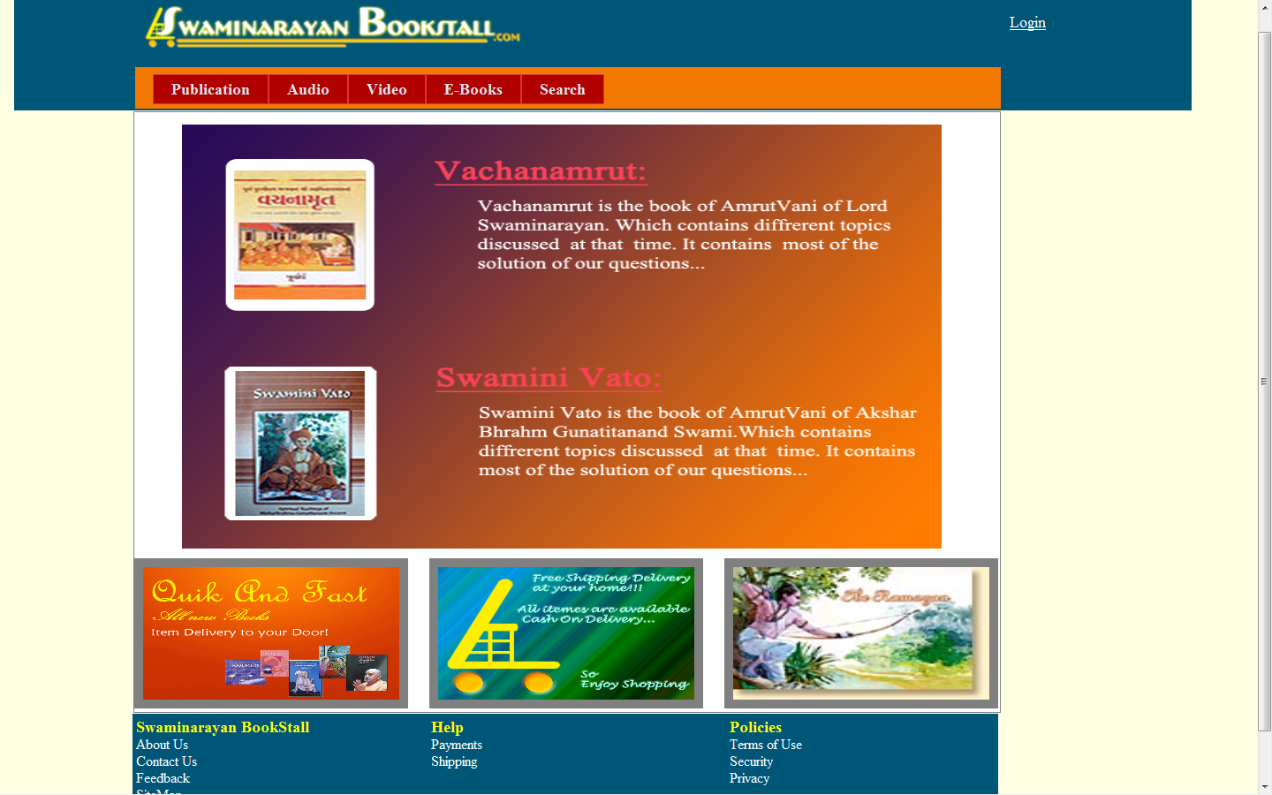
Screen Shots
Home Page

Slide 20
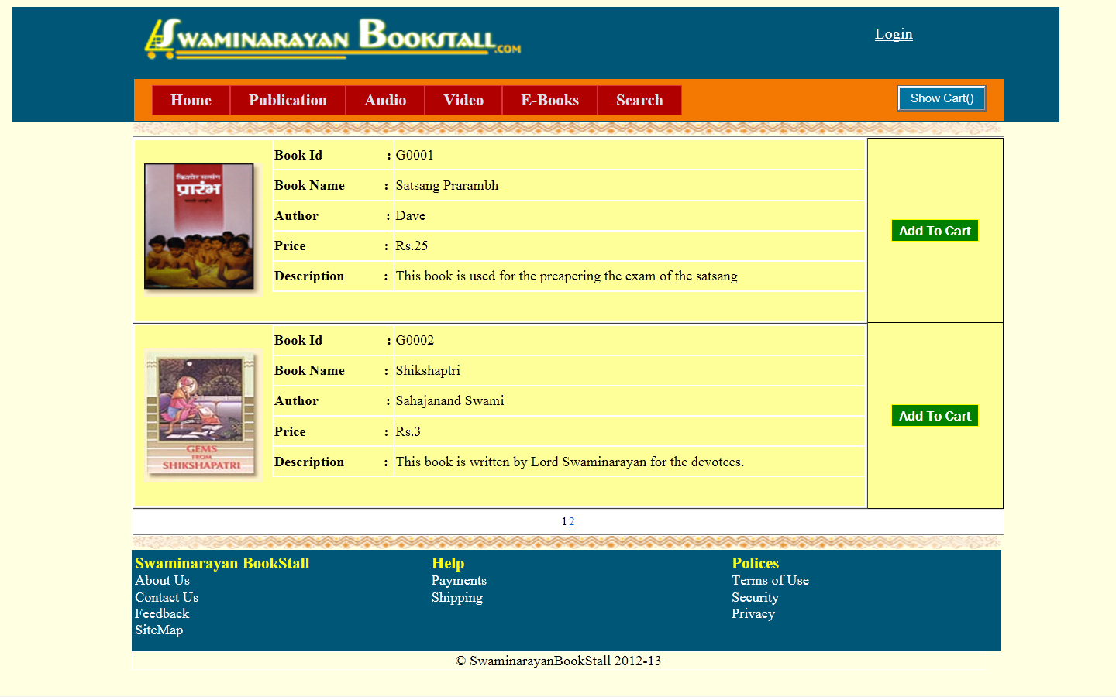
Screen Shots
Publication

Slide 21
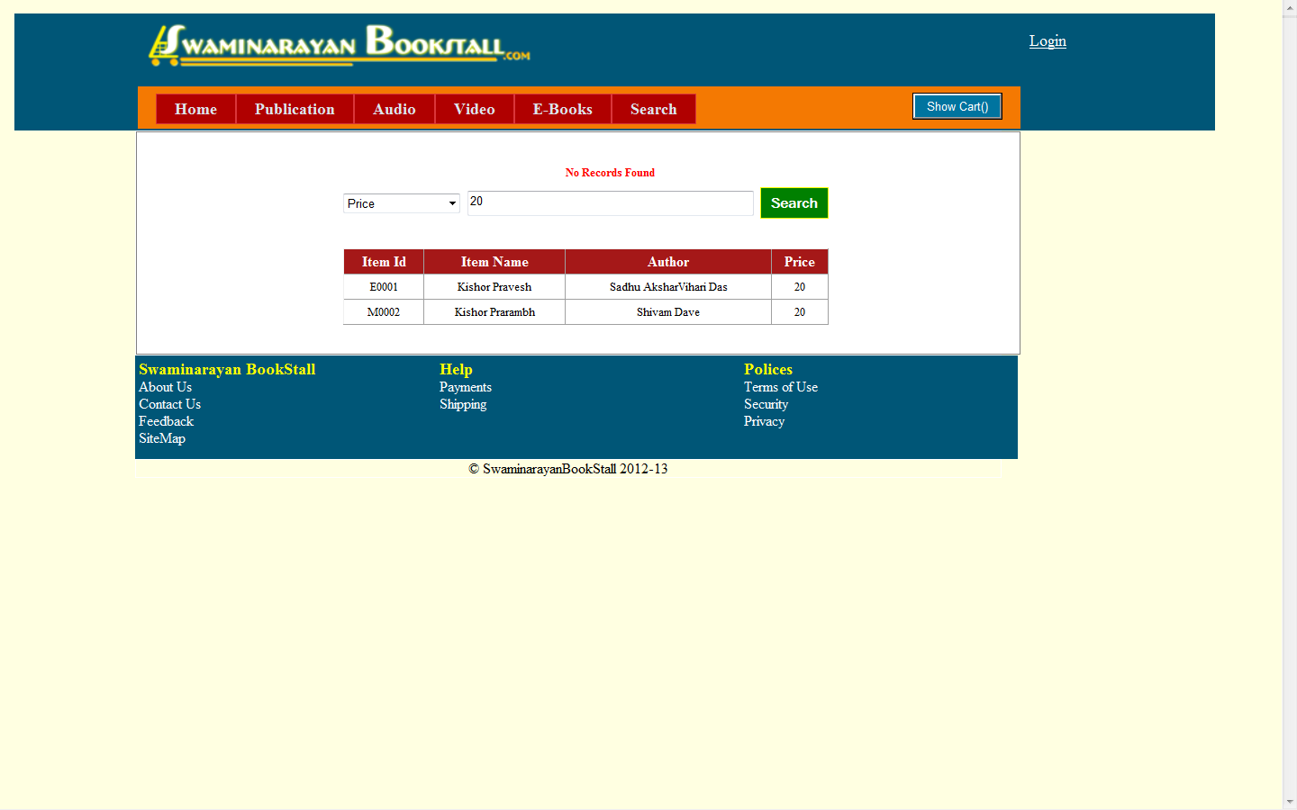
Screen Shots
Search

Slide 22
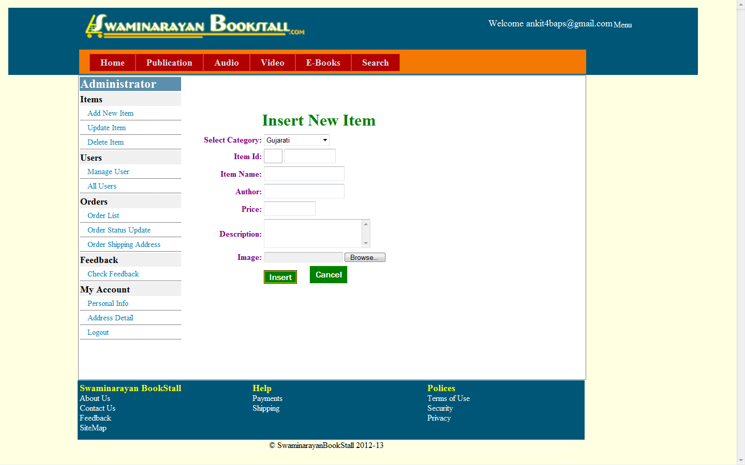
Screen Shots
Admin-Insert Item

Slide 23
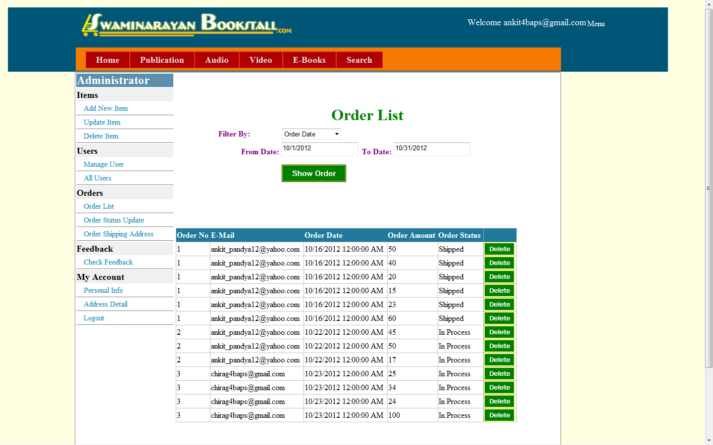
Screen Shots
Admin-Order List

Slide 24
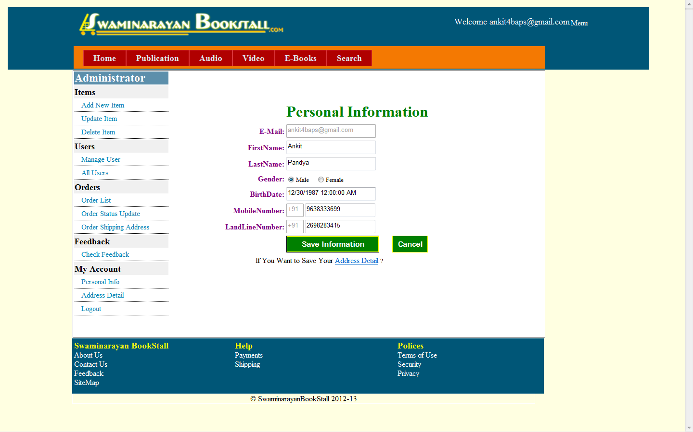
Screen Shots
Personal Information

Slide 25
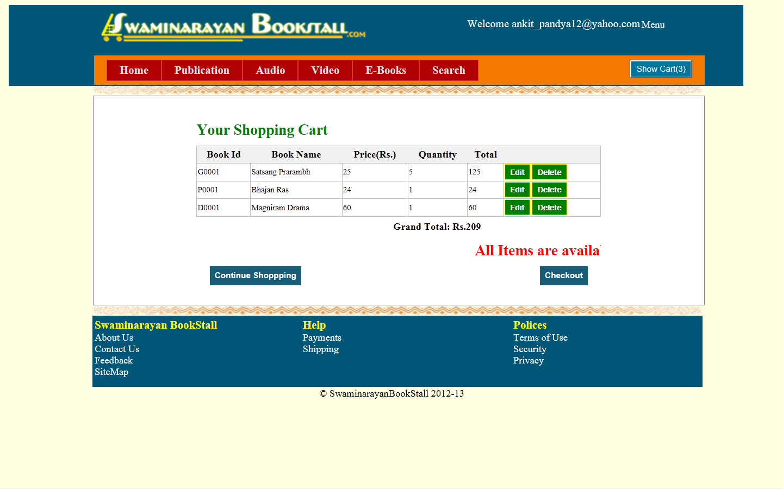
Screen Shots
Show Cart

Slide 26
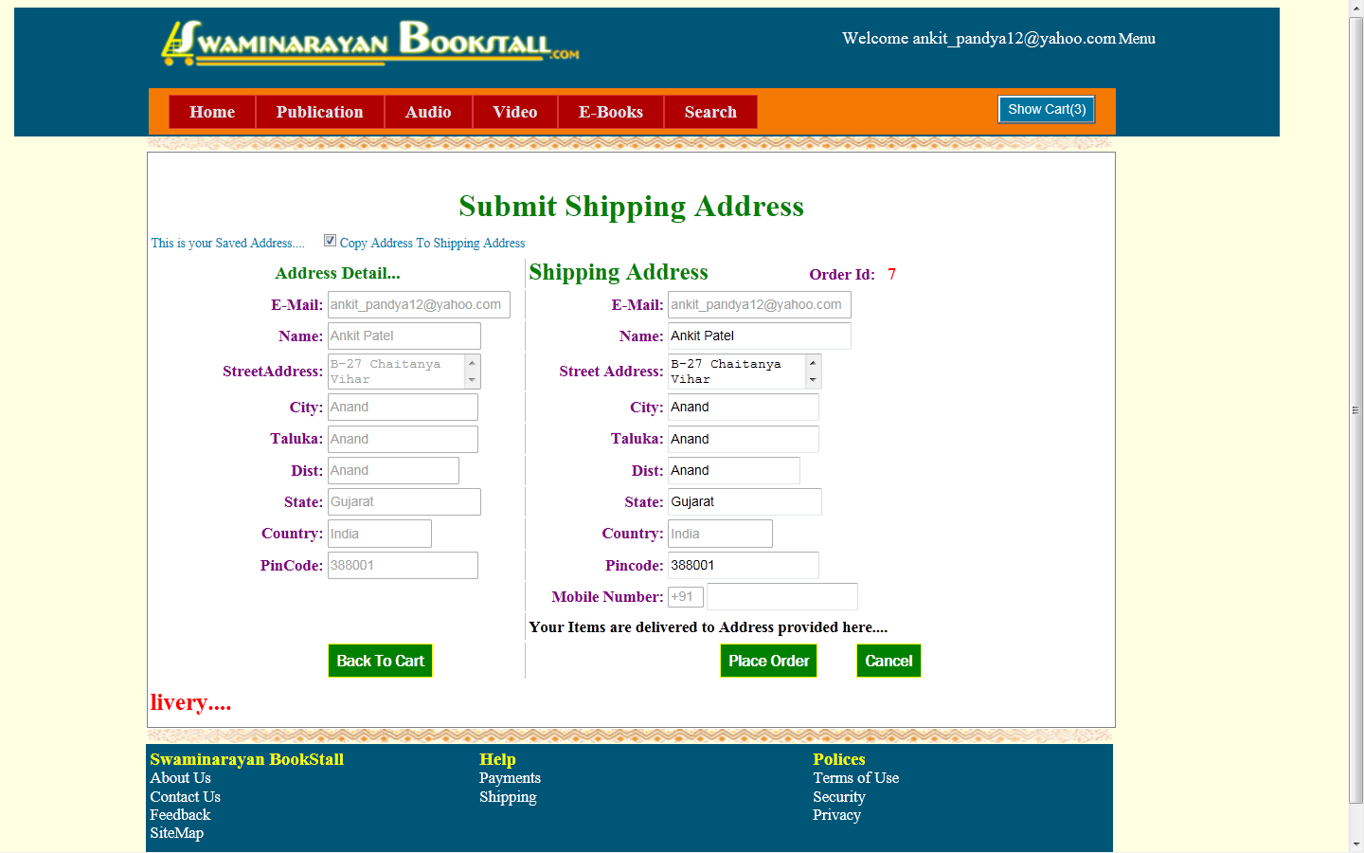
Screen Shots
Checkout

Slide 27
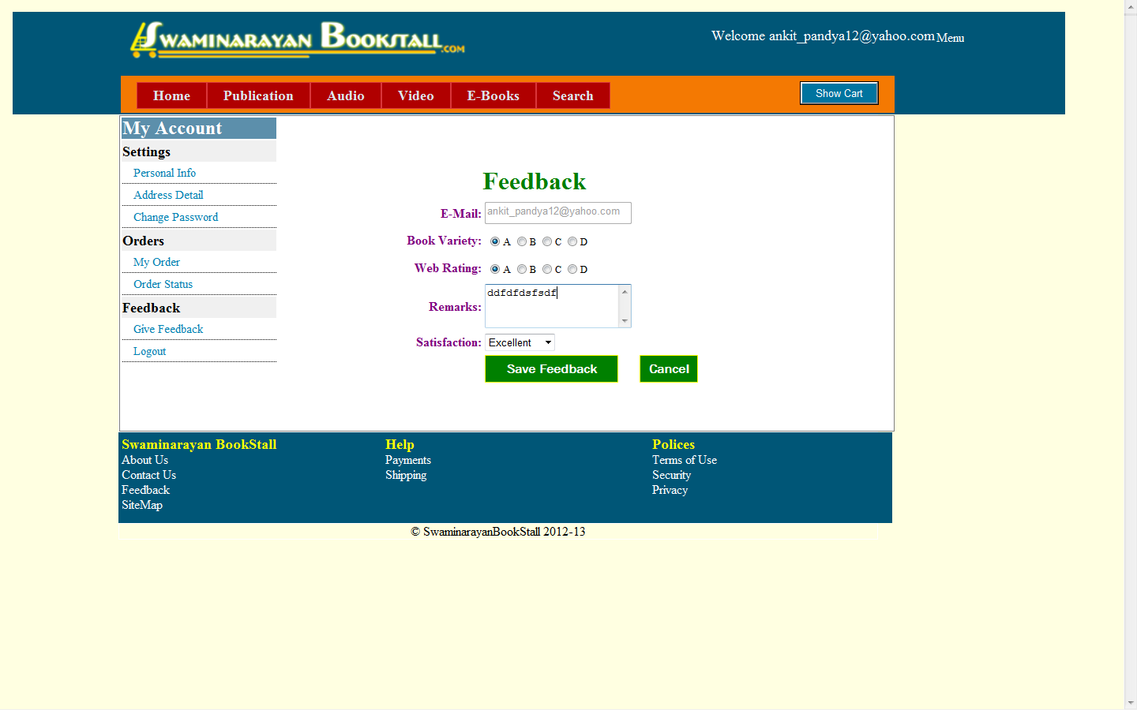
Screen Shots
Feedback

Slide 28
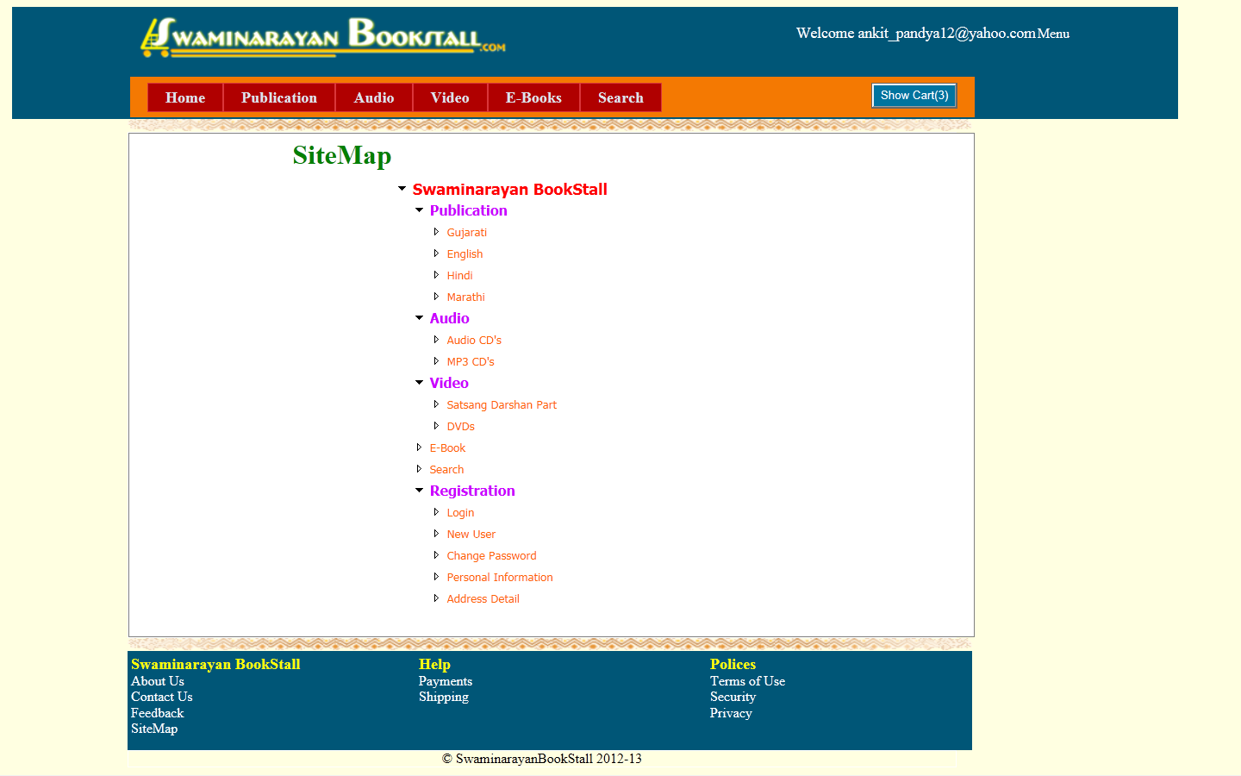
Screen Shots
Sitemap

Slide 29
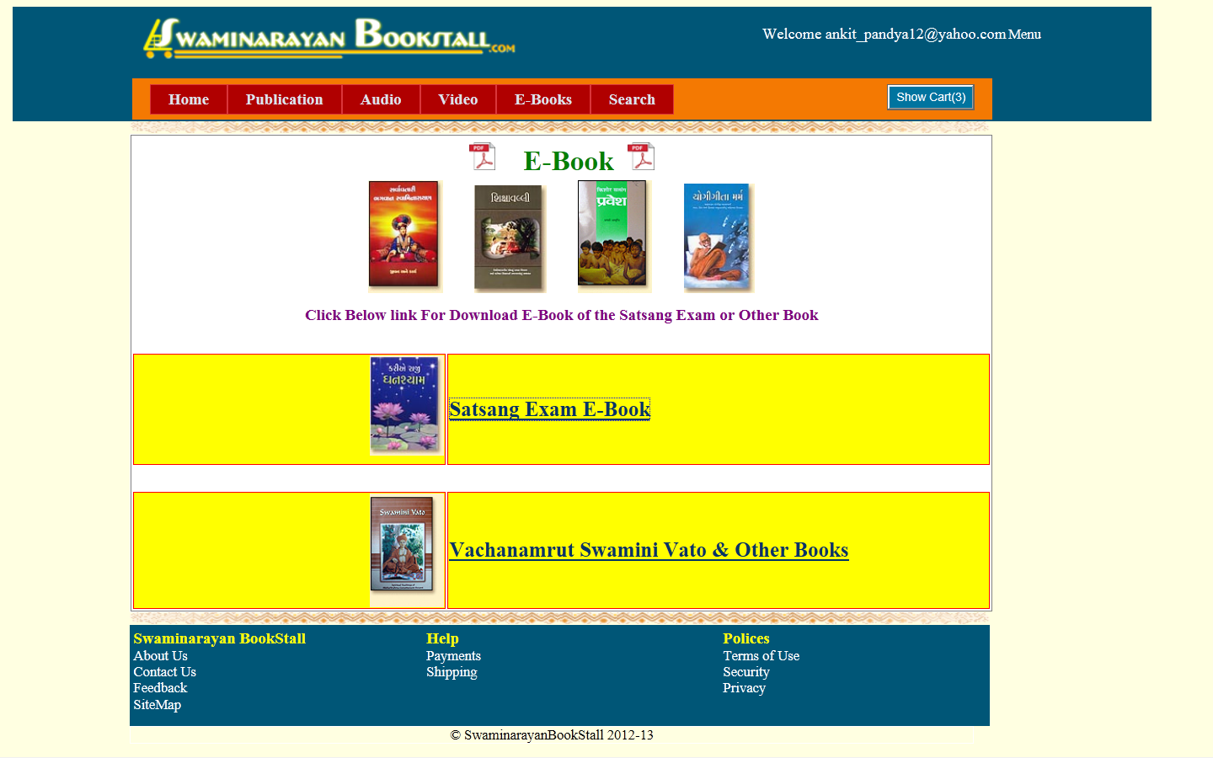
Screen Shots
E-book

Slide 30
Thank You

