Slide 1
API

Slide 2
Typical Data Science Cycle
Data Collection
Deployment
Data Understanding
Model Building & Evaluation
Data Pre-Processing

Slide 3
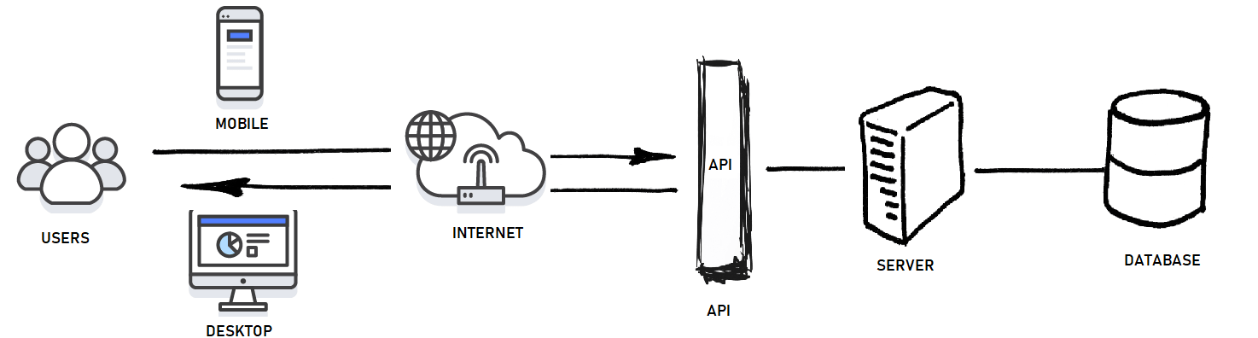
Introduction
API (Application Programming Interface) is a connection between two applications/services.
These are used to manipulate/fetch data to/from a online server using some requests by external script.
API requests act like a mediator between client and server.
Web APIs are different than Web-apps :
1. Web-apps are like websites where user can open it in browser and interact it but APIs return only data not views.
2. API has an endpoint set, which can be hit by other systems to get data which it provides. So APIs are meant for system to system interaction but web-apps are made for human interactions.
3. Web-apps can use APIs to retrieve information from external servers.
Notes:
https://programminghistorian.org/en/lessons/creating-apis-with-python-and-flask

Slide 4
Introduction
Need of API:
Users need to access data in real time, such as for display on another website or as part of an application.
Data changes or is updated frequently.
If data size is huge and users only need access to a part of the data at any one time, then APIs are used. But if we have small data size, then we can try other traditional methods to transfer complete data altogether.
Users will need to perform actions other than retrieve data, such as contributing, updating, or deleting data.
Providing data through API keeps database safe as users don’t directly access complete database.
Notes:
https://programminghistorian.org/en/lessons/creating-apis-with-python-and-flask

Slide 5
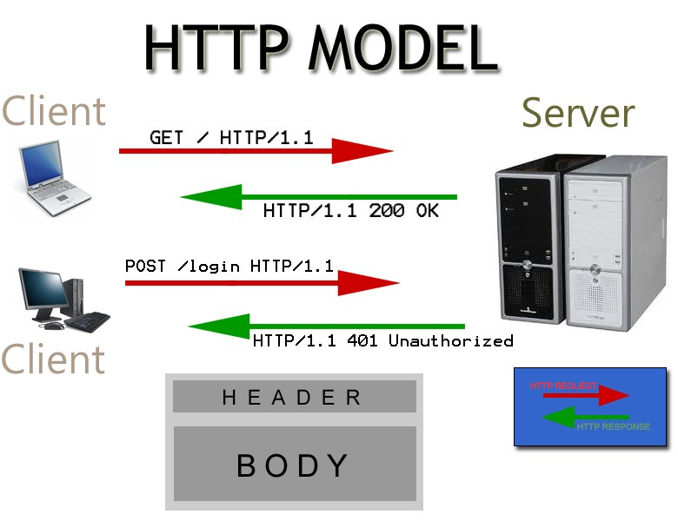
Components
HTTP:
HTTP (Hypertext Transfer Protocol) is the primary means of
communicating data on the web.
HTTP implements a number of “methods,” which tell which
direction data is moving and what should happen to it.
Following are the key http methods :
Purpose (CRUD) | Request | Details
Create | POST | Sent data to server (add a new detail)
Read | GET | Get data from server or retrieve information
Update | PUT | Update/modify an existing entity
Delete | DELETE | Remove file from server
Notes:
https://programminghistorian.org/en/lessons/creating-apis-with-python-and-flask

Slide 6
Components
URL :
URL (Uniform Resource Locator) - An address/reference for a resource on the web
A URL consists of a protocol, domain, and optional path.
Protocol (http:// or https://)
Domain (amazon.in)
Optional path (/home).
A URL describes the location/address of a specific resource such as a web page.
In context of APIs URL, request, URI, or endpoint are used interchangeable .
These url can be accessed either through browser or from tool such as python IDE
Notes:
https://programminghistorian.org/en/lessons/creating-apis-with-python-and-flask

Slide 7
Components
JSON:
JSON (JavaScript Object Notation) is a text-based data format that is designed to be easy to read for both humans and machines. Efficient to use.
JSON is generally the most common format for returning data through an API, XML (Extensible Markup Language) being the second most common.
REST:
REST (Representational State Transfer) are set of guidelines that describes some best practices for implementing APIs to provide some advantages such as low internet bandwidth, reuse responses by enabling cache responses.
A web API that obeys the REST guidelines is informally described as REST API.
Notes:
https://programminghistorian.org/en/lessons/creating-apis-with-python-and-flask
https://www.youtube.com/watch?v=-gUyWoe_SKI&t=839s

Slide 8
Components
Requests Status Code:
Requests status code are 3 digit code that tells us status of http requests.
Status Code | Description
1XX | Informational message such as request has been received and processing
2XX | Successful operations such as 200
3XX | Redirection means further actions requires
4XX | Client Error such as 404 tell that client is entering invalid URL, 401 tells unauthorized operations
5XX | Server side Error such as error in api output
Notes:
https://programminghistorian.org/en/lessons/creating-apis-with-python-and-flask
https://www.youtube.com/watch?v=-gUyWoe_SKI&t=839s

Slide 9
Some Public APIs
https://datausa.io/api/data?drilldowns=Nation&measures=Population : Population data
https://open.er-api.com/v6/latest/USD : USD exchange rate
https://v2.jokeapi.dev/joke/Any : Joke API
https://www.thecocktaildb.com/api/json/v1/1/search.php?s=margarita : Cocktail recipe
Test through Postman/RestMan extension and python
Notes:
https://mixedanalytics.com/blog/list-actually-free-open-no-auth-needed-apis/

Slide 10
API using Flask
Flask is a web framework for Python, meaning that it provides functionality for building
web applications, including managing HTTP requests and rendering templates.
Flask maps HTTPS requests (requests send by users using any
URL) to some associated functions also called routing and
return results based upon definition of function.
This returned output could be a data or it could be
a web page by rendering an html template.
Notes:
https://programminghistorian.org/en/lessons/creating-apis-with-python-and-flask
https://nearsoft.com/blog/how-to-create-an-api-and-web-applications-with-flask/

Slide 11
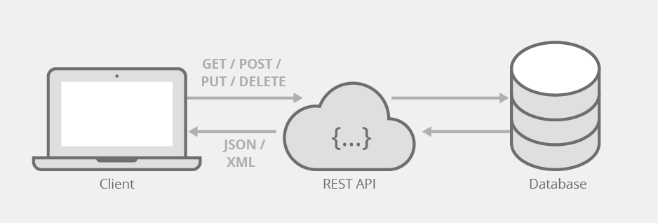
API using Flask
We can create flask web-apps that can contain APIs as well.
These APIs can be created similar way except in APIs we return a json data rather than rendering any html template.
API endpoints will be URL which is mentioned in @app.route.
Data is returned in json format.
DEMO : flask_basic_api.py
Data can be fetched from database as well
DEMO : flask_data_api.py
We can consume/use API using request module.
DEMO Flask API Consumption.py
We can test APIs using external platform such as Restman Chrome Extension
Notes:
https://programminghistorian.org/en/lessons/creating-apis-with-python-and-flask

Slide 12
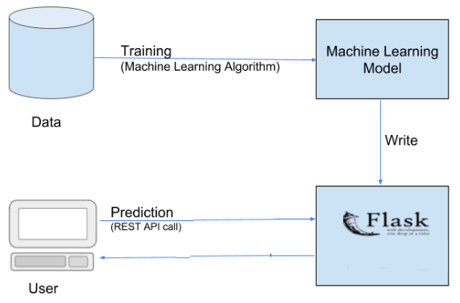
Machine Learning Model API
Deployment of machine learning models is simply putting
models into production that makes models available to other
systems within the organization or the web.
End user can utilize ML model in two ways :
Send data and retrieve Prediction on web-browser
Send data and retrieve Prediction using rest API in any tool
(e.g. python) through http request (POST method)
Let’s deploy ML model using flask .
Demo flask_ml_api.py

